Slide 1

Greg Kempe @longhotsummer
openbylaws.org.za @OpenByLawsZA
Notes:
Software engineer
Why:
curiosity: explore my city, what governs me in my city?
Busker, by-law
authoritative source: link to youtube, etc.

Slide 2
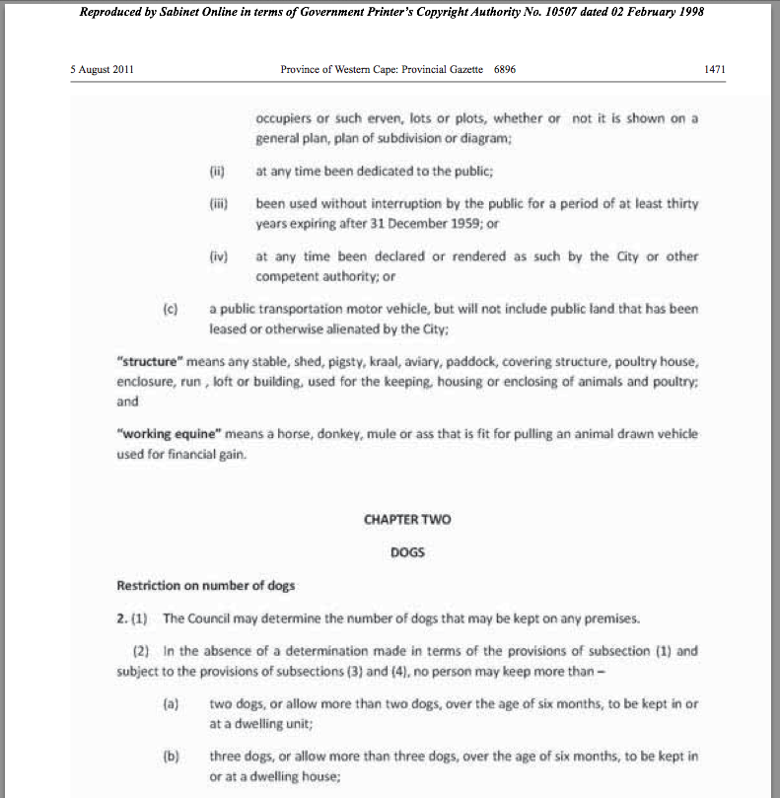
openbylaws.org.za
Notes:
- municipality reqd to post by-laws
- Animal by-law

Slide 3
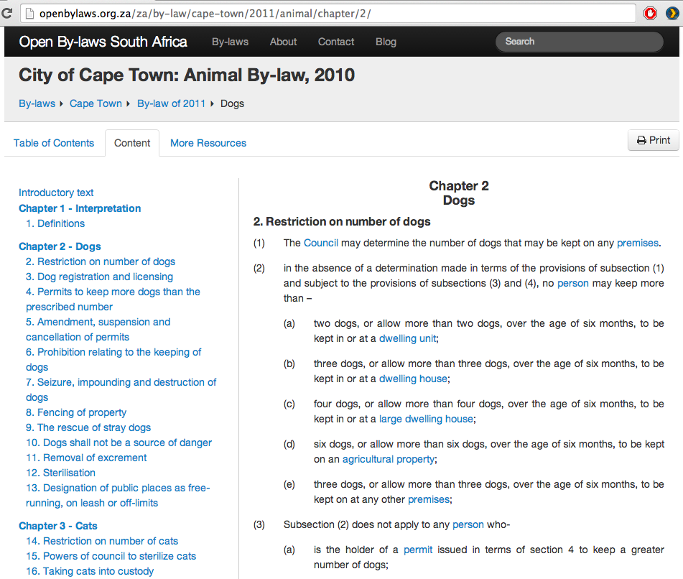
openbylaws.org.za
Notes:
easy to read
consistent formatting
Consolidated!
- Shareable URL: link to it!
Printable
Searchable
Inline definitions
Device friendly
- Can download original PDF, and XML

Slide 4
Why?
Understand your rights and obligations
Understand what your city does for you
A starting point for fighting for change
Reduce the gap between communities and local government
openbylaws.org.za
Notes:
Impacts small businesses
Impacts day-to-day lives: BOOZE! animals, parks and green areas, parking, fire safety

Slide 5
What you can do
Link to by-laws (and other legislation!)
Help us get other by-laws online: Joburg and surrounds
Partner with us
openbylaws.org.za
Notes:
If you have
Other MMA projects?

Slide 6



openbylaws.org.za

Slide 7
Questions!
openbylaws.org.za
@OpenByLawsZA
greg@kempe.net
@longhotsummer
openbylaws.org.za

