Slide 1
Big data
LONG HUYNH - 984850

Slide 2
Agenda
Overview
Basic word count approach
Pair approach
Stripe approach
Hybrid approach
Spark
Q & A

Slide 3
Overview

Slide 4
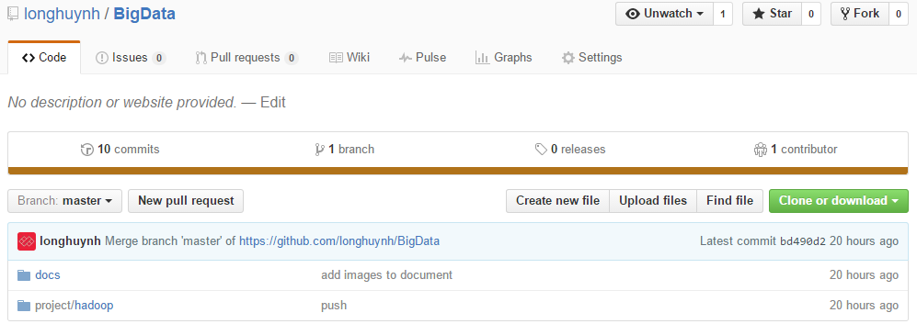
Overview
View more in Cloudera Hadoop - Single Node Setup.docx
Source code: https://github.com/longhuynh/BigData

Slide 5
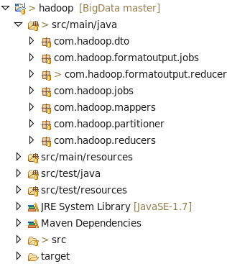
SETUP STEPS
Create Maven Project
Add dependency (see pom.xml)
Create package and project structure like below
Create Mapper, Reducer, Driver classes.

Slide 6
Package description
com.hadoop.dto: Entity classes
com.hadoop.mappers: Mapper classes.
com.hadoop.reducers: Double output.
com.hadoop.formatouput.reducers: Text output.
com.hadoop.jobs: Run mappers and reducers for double output.
com.hadoop. formatouput.jobs: Run mappers and reducers for text output.
com.Hadoop.partitioner: Partitioner classes

Slide 7
Create project steps
Using Maven to build project to jar file.
Create sh file to run in Terminal
cloudera\bash\mvn_package.sh : maven clean and install.
cloudera\bash\pre_run_hadoop_job: creat folder on hadoop
cloudera\bash\run_hadoop_job: run Hadoop tasks
cloudera\bash\run_optional_job.sh: run part 9.

Slide 8
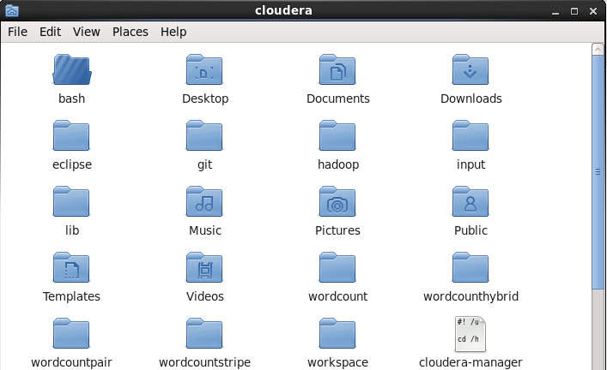
Create FOLDERs
Create folder input and create input files
Create folder like Hadoop jobName

Slide 9
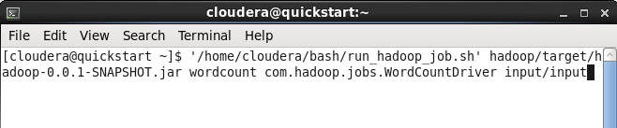
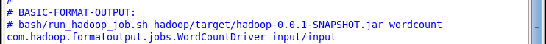
Run on terminal
Go to cloudera\bash\run_hadoop_job.sh to see command line
Open terminal then drag and drop this file to terminal
Copy to terminal and run

Slide 10
Part 1 Basic Word Count

Slide 11
Pseudo code
The word count basic to compute relative frequencies
class Mapper
method Map(docid a, doc d)
for all term w in doc d do
Emit(w, count 1)
class Reducer
method Reduce(term t, counts [c1, c2,..])
s = 0
for all count c in counts[c1, c2,...] do
s += c
Emit(term t, s)

Slide 12
Implement code
Implement Java code:
\project\hadoop\src\main\java\com\hadoop \jobs\WordCountDriver.java
\project\hadoop\src\main\java\com\hadoop \mappers\WordCountMapper.java
\project\hadoop\src\main\java\com\hadoop \ reducers\WordCountReducer.java

Slide 13
Input & Run on Terminal
Input: /project/input/*
Terminal
input0 | 18 34 56 29 12 34 56 92 29 34 12
input1 | 92 29 18 12 34 79 29 56 12 34 18

Slide 14
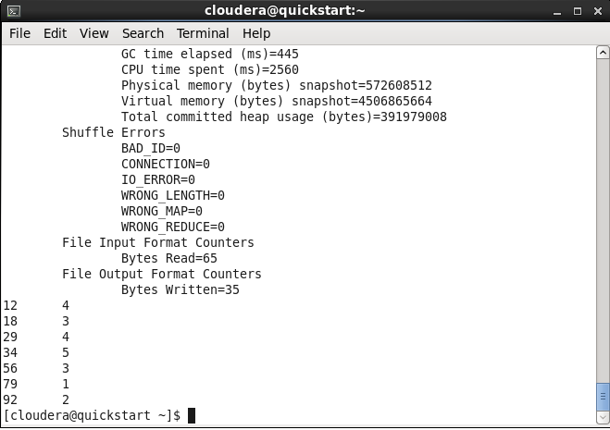
Terminal OUTPUT

Slide 15
Part 2 Pair Approach

Slide 16
Pseudo code
The Pairs approach to compute relative frequencies
class Mapper
method Map(docid a, doc d)
for all term w in doc d do
for all term u in Neighborhoods(w) do
Emit(pair (w, u), count 1)
Emit(pair (w, *), count 1)
class Reducer
method Initialize
marginal = 0
method Reduce(pair p, counts [c1, c2,..])
s = 0
for all count c in counts[c1, c2,...] do
s += c
if (p.u == "*") marginal = s
else Emit(pair p, double s/marginal)

Slide 17
Implement code
Implement Java code:
\project\hadoop\src\main\java\com\hadoop\jobs\PairDriver.java
\project\hadoop\src\main\java\com\hadoop\ mappers\PairMapper.java
\project\hadoop\src\main\java\com\hadoop\ reducers\PairReducer.java

Slide 18
Input & output
Input: /project/input/*
Output: /project/output/*
input0 | 18 34 56 29 12 34 56 92 29 34 12
input1 | 92 29 18 12 34 79 29 56 12 34 18
(12, 18) 1/11 | (18, 79) 1/17 | (34, 29) 3/12 | (79, 18) 1/5
(12, 29) 2/11 | (18, 92) 1/17 | (34, 56) 3/12 | (79, 29) 1/5
(12, 34) 4/11 | (29, 12) 4/14 | (34, 79) 1/12 | (79, 34) 1/5
(12, 56) 2/11 | (29, 18) 2/14 | (34, 92) 1/12 | (79, 56) 1/5
(12, 79) 1/11 | (29, 34) 4/14 | (56, 12) 3/10 | (92, 12) 3/13
(12, 92) 1/11 | (29, 56) 2/14 | (56, 18) 1/10 | (92, 18) 2/13
(18, 12) 4/17 | (29, 79) 1/14 | (56, 29) 2/10 | (92, 29) 3/13
(18, 29) 3/17 | (29, 92) 1/14 | (56, 34) 3/10 | (92, 34) 3/13
(18, 34) 5/17 | (34, 12) 3/12 | (56, 92) 1/10 | (92, 56) 1/13
(18, 56) 3/17 | (34, 18) 1/12 | (79, 12) 1/5 | (92, 79) 1/13

Slide 19
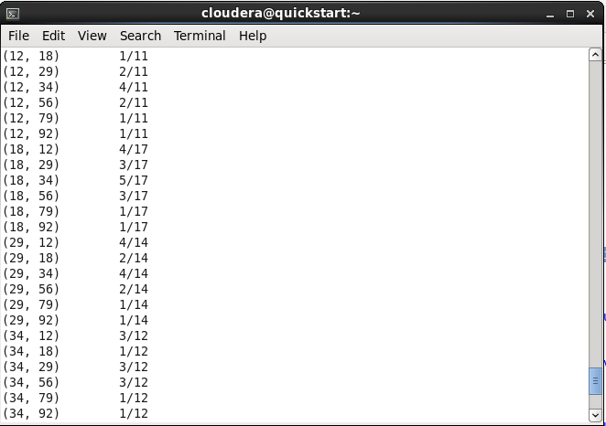
Terminal output

Slide 20
Part 3 Stripe Approach

Slide 21
Pseudo code
The Stripe approach to compute relative frequencies
class Mapper
method Map(docid a, doc d)
for all term w in doc d do
H = new AssociativeArray
for all term u in Neighborhoods(w) do
H{u} = H{u} + 1
Emit(term w, stripe H)
class Reducer
method Reduce(term w, stripes [H1, H2,...])
Hf = new AssociativeArray
marginal = 0
for all stripe H in stripes [H1, H2, ...] do
//Element-wise sum: Sum(Hf, H)
for all term t in stripe H do
Hf{t} += H{t}
total += H{t}
for all term t in stripe Hf do
Hf{t} = Hf{t}/ marginal
Emit(term w, stripe Hf)

Slide 22
Implement code
Implement Java code:
\project\hadoop\src\main\java\com\hadoop\jobs\StripeDriver.java
\project\hadoop\src\main\java\com\hadoop\mappers\StripeMapper.java
\project\hadoop\src\main\java\com\hadoop\reducers\StripeReducer.java

Slide 23
Input & output
Input: /project/input /*
Output: /project/output/*
input0 | 18 34 56 29 12 34 56 92 29 34 12
input1 | 92 29 18 12 34 79 29 56 12 34 18
12 [ (18, 1/11), (29, 2/11), (34, 4/11), (56, 2/11), (79, 1/11), (92, 1/11) ]
18 [ (12, 4/17), (29, 3/17), (34, 5/17), (56, 3/17), (79, 1/17), (92, 1/17) ]
29 [ (12, 4/14), (18, 2/14), (34, 4/14), (56, 2/14), (79, 1/14), (92, 1/14) ]
34 [ (12, 3/12), (18, 1/12), (29, 3/12), (56, 3/12), (79, 1/12), (92, 1/12) ]
56 [ (12, 3/10), (18, 1/10), (29, 2/10), (34, 3/10), (92, 1/10) ]
79 [ (12, 1/5), (18, 1/5), (29, 1/5), (34, 1/5), (56, 1/5) ]
92 [ (12, 3/13), (18, 2/13), (29, 3/13), (34, 3/13), (56, 1/13), (79, 1/13) ]

Slide 24
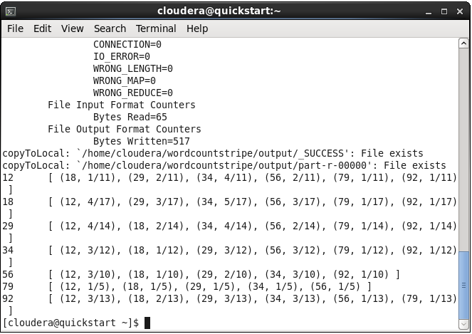
Terminal Output

Slide 25
Part 4 Hybrid Approach

Slide 26
Pseudo code
The Hybrid approach to compute relative frequencies
class Mapper
method Map(docid a, doc d)
for all term w in doc d do
for all term u in Neighborhoods(w) do
Emit(pair (w, u), count 1)
class Reducer
method Initialize
H = new AssociativeArray
method Reduce(pair p, counts [c1, c2,..])
s = 0
for all count c in counts[c1, c2,...] do
s += c
//Element-wise sum: Sum(H{p.w}, pair (p.u, s) )
(H{p.w}){p.u} += s
method Close
for all term w in H do
marginal= 0
for all term u in H{w} do
marginal += (H{w}){u}
for all term u in H{w} do
(H{w}){u} = (H{w}){u} / marginal
Emit(term w, stripe H{w})

Slide 27
Implement code
Implement Java code:
\project\hadoop\src\main\java\com\hadoop\jobs\HybridDriver.java
\project\hadoop\src\main\java\com\hadoop\mappers\HybridMapper.java
\project\hadoop\src\main\java\com\hadoop\reducers\HybridReducer.java

Slide 28
Input & output
Input: /project/input/*
Output: /project/output/*
input0 | 18 34 56 29 12 34 56 92 29 34 12
input1 | 92 29 18 12 34 79 29 56 12 34 18
12 [ (18, 1/11), (29, 2/11), (34, 4/11), (56, 2/11), (79, 1/11), (92, 1/11) ]
18 [ (12, 4/17), (29, 3/17), (34, 5/17), (56, 3/17), (79, 1/17), (92, 1/17) ]
29 [ (12, 4/14), (18, 2/14), (34, 4/14), (56, 2/14), (79, 1/14), (92, 1/14) ]
34 [ (12, 3/12), (18, 1/12), (29, 3/12), (56, 3/12), (79, 1/12), (92, 1/12) ]
56 [ (12, 3/10), (18, 1/10), (29, 2/10), (34, 3/10), (92, 1/10) ]
79 [ (12, 1/5), (18, 1/5), (29, 1/5), (34, 1/5), (56, 1/5) ]
92 [ (12, 3/13), (18, 2/13), (29, 3/13), (34, 3/13), (56, 1/13), (79, 1/13) ]

Slide 29
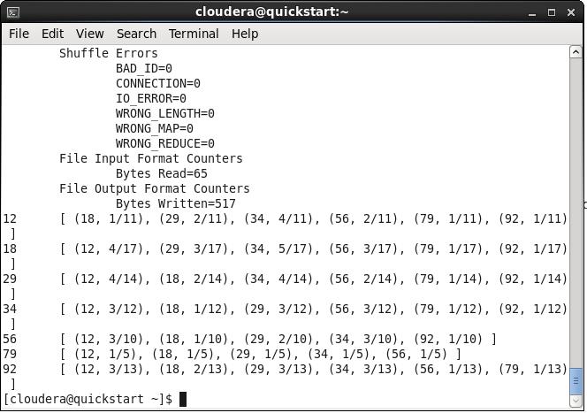
terminal output

Slide 30
Run with text example Question 4 in lab 7

Slide 31
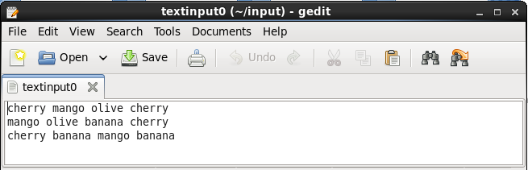
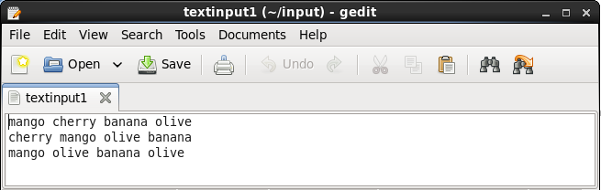
Input

Slide 32
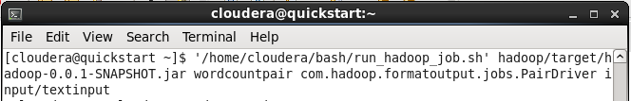
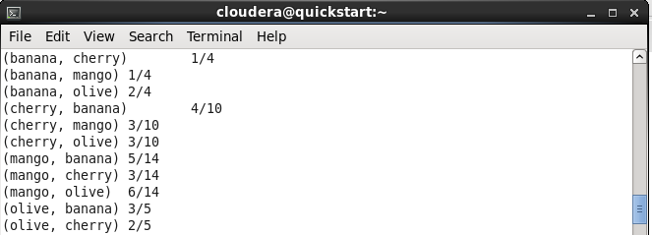
Output by using pair approach

Slide 33
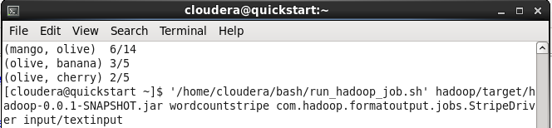
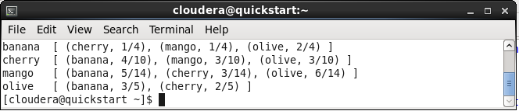
Output by using Stripe approach

Slide 34
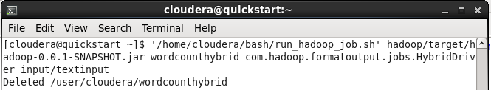
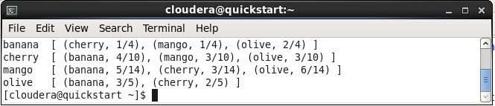
Output by using hybrid approach

Slide 35
Part 5 Spark

Slide 36
Word count
Purpose
Understands Spark as much as I can
Why Word Count?
Keeps everything simple to catch up
Implemented code:
Basic word count algorithm
In 2 ways: Hadoop & Spark
\project\spark\src\main\java\com\spark\wordcount\WordCount.java

Slide 37
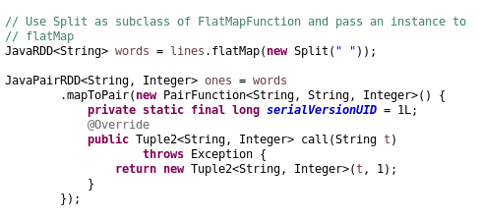
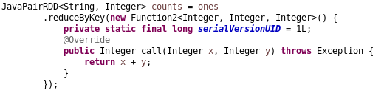
Code implement

Slide 38
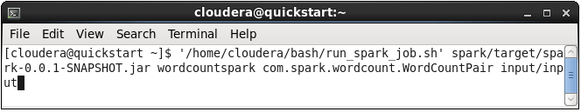
Input & Run on Terminal
Input: /project/input/*
Terminal
input0 | 18 34 56 29 12 34 56 92 29 34 12
input1 | 92 29 18 12 34 79 29 56 12 34 18

Slide 39
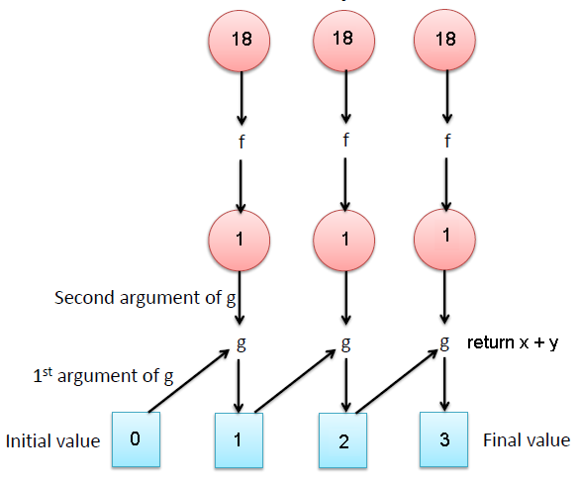
OUTPUT
mapToPair()
18, 1 | 92, 1
34, 1 | 29, 1
56, 1 | 18, 1
29, 1 | 12, 1
12, 1 | 34, 1
34, 1 | 79, 1
56, 1 | 29, 1
92, 1 | 56, 1
29, 1 | 12, 1
34, 1 | 34, 1
12, 1 | 18, 1
79, 1
18, 3
56, 3
92, 2
34, 5
12, 4
29, 4
reduceByKey()
reduceByKey()

Slide 40
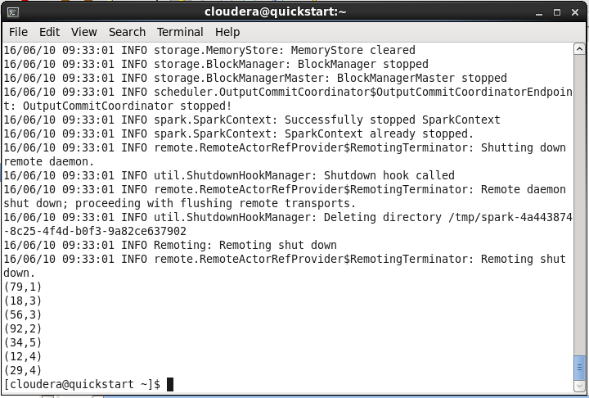
OUTPUT ON Terminal

Slide 41
Part 6 HBase

Slide 42
HBAse Table
Purpose
Understands more about HBase
Using HBase Java API
Feature:
Create table, delete table
Add record, delete record.
Get one/all record(s)
Implemented code
Basic HBase example

Slide 43

Project steps
Creat an HBase Maven Project
Edit file pom.xml config.
Implemented code
Basic HBase example
\project\hbase\src\main\java\com\hbase\table\HBaseTable.java

Slide 44
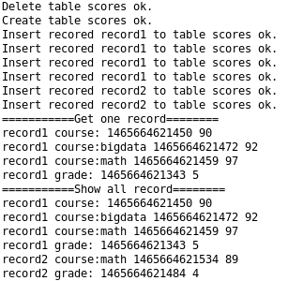
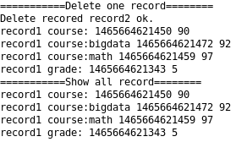
OUTPUT

Slide 45
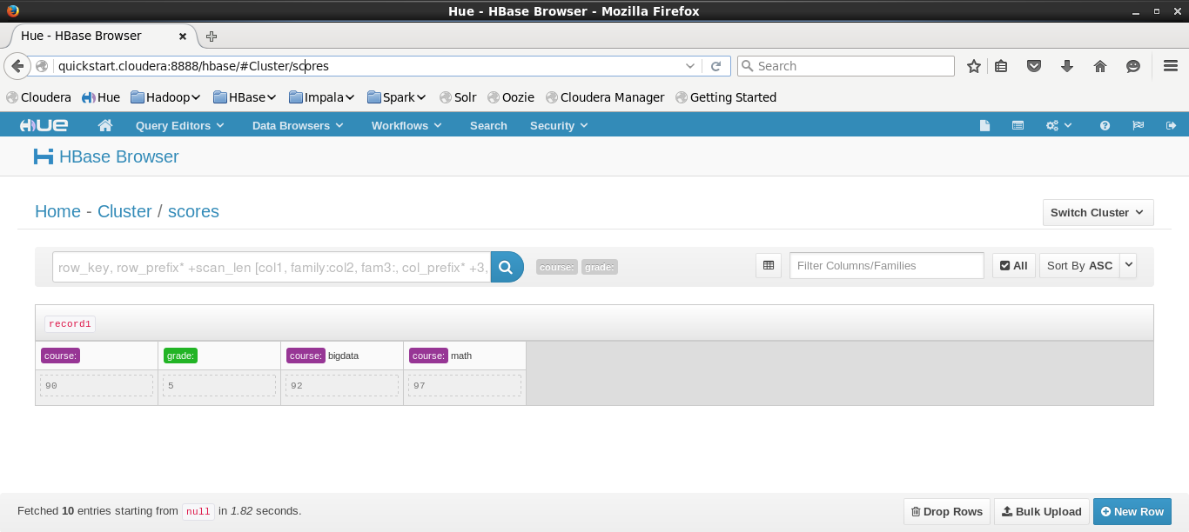
Using UI to Manage
Default username/password: cloudera/ cloudera

Slide 46
Part 9 Optional Project

Slide 47
Pseudo code
class Mapper
method Map(docid a, doc d)
for all row in doc d do
array = SPLIT(row)
firstName = array[0]
H = new AssociativeArray
for all term u in array[1] do
H{u} <-- 1 // Check exist
Emit(term w, stripe H)
class Reducer
method Reduce(term w, stripes [H1, H2,...])
Hf = new AssociativeArray
marginal = 0
for all stripe H in stripes [H1, H2, ...] do
Hf = INTERSECT(H, Hf)
Emit(term w, stripe Hf)

Slide 48
Implement code
Implement Java code:
\project\optional\src\main\java\com\hadoop\jobs CustomerDriver.java
\project\optional\src\main\java\com\hadoop\mappers\CustomerMapper.java
\project\optional\src\main\java\com\hadoop\reducers\CustomerReducer.java

Slide 49
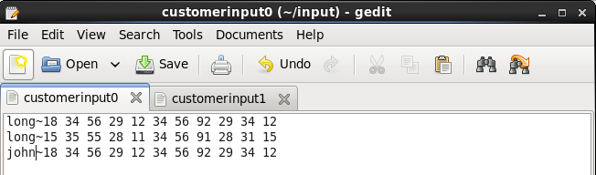
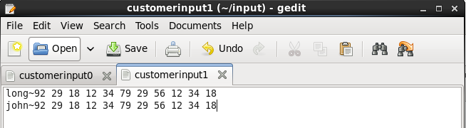
Input
Input: /project/input/customerinput*

Slide 50
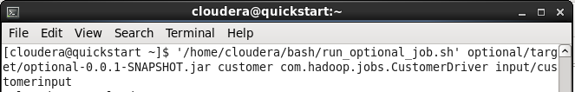
Command line
\bash\run_optional_job.sh

Slide 51
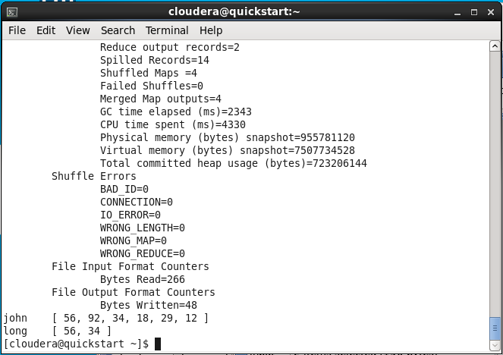
Terminal Output

Slide 52


Slide 53


