Slide 1
data analysis Bellabeat project
Presented by:
Ton Long Huy - 06/2022

Slide 2
Outline
Introduction
1.1 About Company
1.2 Project Summary
Methodology
Data sets and analysis
3.1 Data set brief
3.2 Visualization & chart
3.3 Findings and ideas
3.4 Dashboard
Conclusion

Slide 3
1.1. About company
Bellabeat is an US-based tech manufacturer of health-focused products for women founded in 2013.
The four pillars of their brand include: smart insights, women-centric, holistic approach and body positivity.
Collecting data on activity, sleep, stress, and reproductive health has allowed Bellabeat to empower women with knowledge about their own health and habits.
That “through tracking your body’s bio-responses and aligning that data with your hormonal cycle, you’ll always know why you feel how you do.”

Slide 4
1.2. PROJECT summary
Co-founder and Chief Creative Office of Bellabeat, believes that analyzing smart device fitness data could help unlock new growth opportunities for the company.
Key Task:
1. Analyze smart devices to gain insight into how to consumers are using their smart devices.
2. Use the gained insight to propose some recommendations for Bellabeat marketing strategy.
Answer the questions:
1. What are some trends in smart device usage?
2. How could these trends apply to Bellabeat customers?
3. How could these trends help influence Bellabeat marketing strategy?

Slide 5
1.2. PROJECT summary
87,88% of the users use their device 25 – 31 days, but only 50,85% of users wear device all day.
Continuing to promote Bellabeat’s product features for more daily use.
There is linear relationship between minutes of physical activity and the calories burnt.
Motivating users to be more active by pushing notification via mobile app.
Users take about an average of 7,500 steps /day and especially be active from 12-2 p.m and 5-7 p.m.
Allow users to set daily walking goals
Using the Rewards System based on amount of steps walked every day.
Users sleep between 6,5-7 hours /day and spend 30-50 mins on the bed before actually sleeping.
Pushing notifications via mobile app to alarms user to sleep.
Audio-generated content: Podcast with relaxing music, sleep techniques,…
1
2
3
4

Slide 6
2. methodology
Data used:
The data source used for this case is Fitbit Fitness Tracker Data, downloaded from Kaggle where it was updated by Mobius under the CCO, allowing for the dataset to be copies, modified, distributed and performs with out asking for permission.
The research method:
Excel: Each dataset was cleaned using Excel with the following steps:
Format date data into YYY-MM-DD hh:mm:ss.
Format all numerical data into Number format with either no decimals or up to 2 decimals.
Check for duplicate data using ‘Duplicate data’ tool in Excel.
T-SQL (Azure): After data is cleaned, using T-SQL to analyze the data.

Slide 7
3. DATA SET 01 | use of smart devices
Knowing how often do users use their device can help plan our marketing strategy and see what features would benefit the use of smart devices.
The users can be categorized into 3 main groups by time use in month:
High use – users who use their device between 25 and 31 days.
Moderate use – users who use their device between 15 and 24 days.
Low use – users who use their device between 1 and 14 days.
The next slide illustrates user’s device usage time of the day and month.

Slide 8
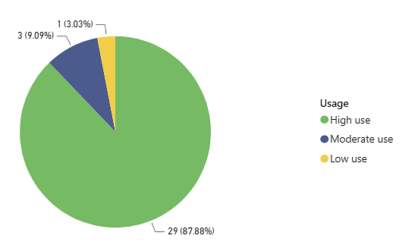
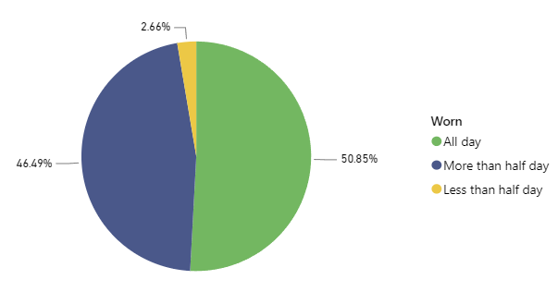
DATA VISUALIZATION | use of smart devices
Time used per month
Time worn per day
High use takes up 87.88%
49.15% do not wear all day

Slide 9
findings & Ideas | use of smart devices
Findings:
Time use in month: High use (25 – 31 days) takes up 87.88%
Time use in day: 49.15% do not wear all day
Ideas:
There are 87,88% of high-use users but 49.15% does not wear the devices all day.
This is the opportunities for Bellabeat to gain the more daily use by promoting its product features:
Water-resistant for swimming activities.
Fashion / elegant products for Outfit-of-the-day trend.
Long-lasting battery for outdoor activities.

Slide 10
Data set 02 | User TYPES & calories
The users are categorized into 4 groups (in decending order) using Active Minutes metric:
Very if (VeryActiveMinutes > Mean(VeryActiveMinutes))
Fairly if (FairlyActiveMinutes > Mean(VeryActiveMinutes))
Lightly if (LightlyActiveMinutes > Mean(LightlyActiveMinutes))
Sedentary if (SedentaryActiveMinutes > Mean(SedentaryActiveMinutes))

Slide 11
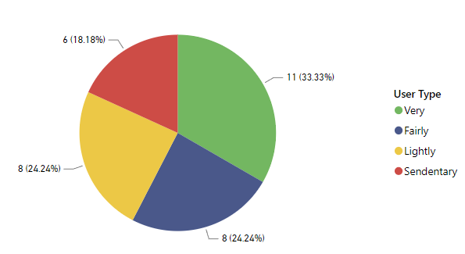
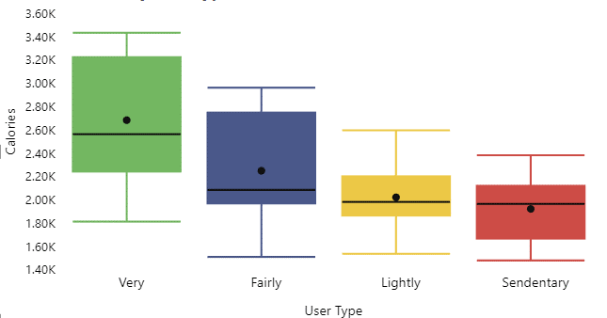
DATA VISUALIZATION | User TYPES & calories
User Type by Active Minutes
Calories burnt by User Type
~43% of lightly and sedentary active users
Very Active User have the most calories burnt

Slide 12
findings & Ideas | User TYPES & calories
Findings:
~43% of lightly and sedentary active users.
Unsurprisingly, there is a linear relationship between the activity level and calories burned, it’s important for losing weight. Very Active User have the most calories burnt, followed after by Fairly, Lightly and Sedentary.
Ideas:
Bellabeat can use this fact to motivate and educate its users (lightly and sedentary group) to be more active by pushing notifications or posts on the mobile app.

Slide 13
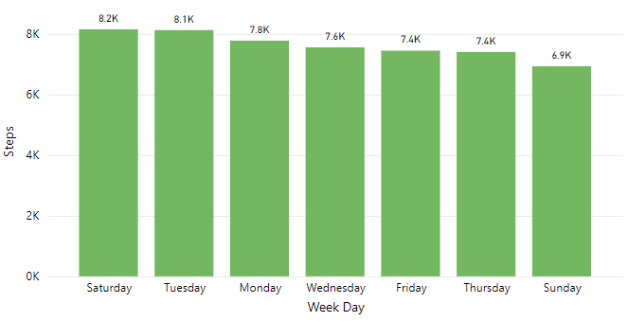
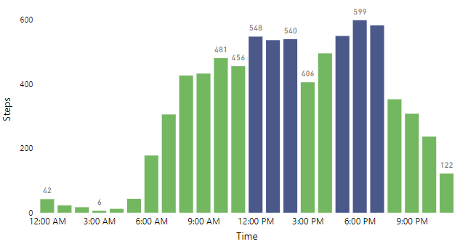
Data set 03 | Daily steps & steps IN day
Daily steps in week
Steps in day
Average of 7,500 steps per day
Mostly active between 12-2 p.m and 5-7 p.m

Slide 14
findings & Ideas | Daily steps & steps IN day
Findings:
Users take about an average of 7,500 steps per day. (According to CDC, taking 8,000 to 12,000 steps /day is associated with a 51-65% lower risk for all-cause mortality).
During the day, users are most active between 8 a.m to 7 p.m. Especially from 12-2 p.m (lunch break) and 5-7 p.m (after work).
Ideas:
Allow users to set daily goal (Ex: 8,000 – 12,000 steps).
Pushing notifications to remind in their active time of the day (Ex: 12-2 p.m and 5-7 p.m).
Gamification for reward system, consisting of different levels based amount of daily steps. For each level users have reached, users will unlock badges, receiving stars or discounts in exchange for other Bellabeat’s products.

Slide 15
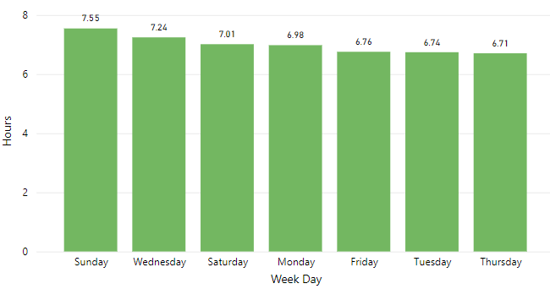
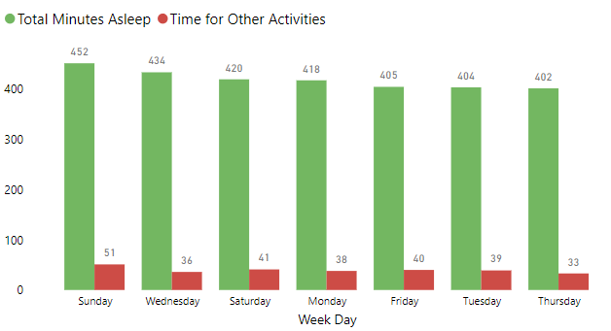
Data set 04 | user Sleep activity
Sleep hours in week
Minutes of daily sleep and other activities
Average of 6,5 and 7 hours per day
30-50 mins on the bed before actually sleeping

Slide 16
findings & Ideas | user Sleep activity
Findings:
On average, users sleep between 6,5 and 7 hours a day. According to CDC, we need 7 to 8 hours of sleep a day.
Users spend 30 to 50 minutes on the bed for other activities before actually sleeping. We can suppose that user is difficulty sleeping or spending time on the phone.
Ideas:
For users who spend time using their phone before sleep, they can set up a desired time to go to sleep and receive a reminding notification 15 mins in advance.
For users who may find difficulty in sleeping, Bellabeat can help users sleep better with audio-generated content (Ex: Podcast with relaxing music, sleep techniques,…)

Slide 17
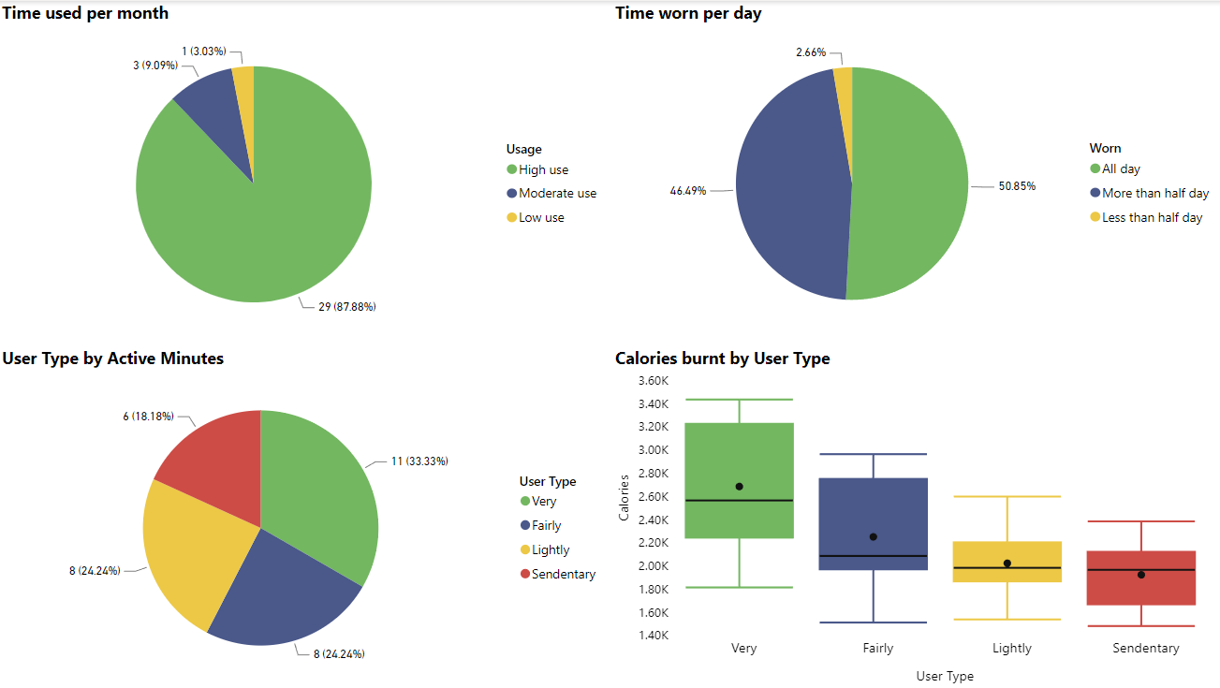
Dashboard tab 1

Slide 18
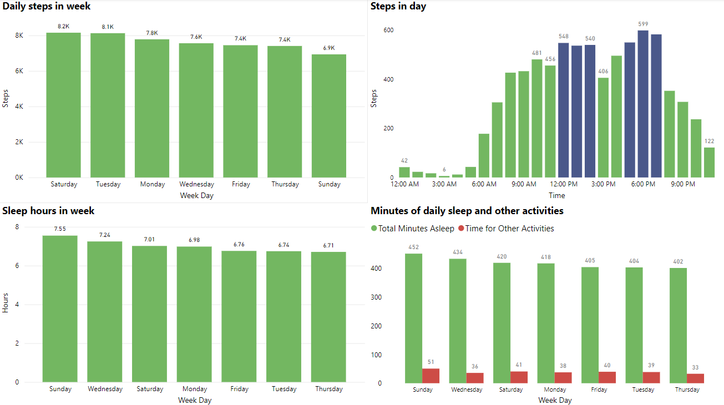
Dashboard tab 2

Slide 19
4. conclusion
After analyzing FitBit Tracker Data, we have the following findings:
87,88% of the users use their device 25 – 31 days, but 49.15% does not wear all day.
There is a linear relationship between the activity level and calories burnt.
Users are especially active at lunch break and after work.
Users take about an average of 7,500 steps per day and spend 30-50 mins on the bed before actually sleeping
I recommend some solutions that may help enhance the Bellabeat marketing strategy:
Continue promote its product features for more daily use: outdoor and swimming activities (long-lasting battery & water-resistant), fashion trend.
Allow user to set daily goals (walking) and set desired sleep hour.
Pushing notification to educate and remind its users in their daily activities (sleep hour, walking steps,...).
Gamification the reward system.
Develop audio-generated content.

Slide 20
Own your future by owning your data
Thank you for your time

