Slide 1
Email Spam Filtering
‘Simplicity is the ultimate sophistication.’ - Leonardo da Vinci

Slide 2
1
Introduction
2
Problem Solving
AGENDA
3
Result and Evaluation
4
Conclusion

Slide 3

INTRODUCTION
INTRODUCTION
Technology
Development
Digital Revolution

Slide 4

INTRODUCTION
INTRODUCTION
WHAT?
HOW?
WHY?

Slide 5

INTRODUCTION
INTRODUCTION
Problem
Problem
What is a SPAM EMAIL?
Unsolicited messages sent in bulk.
Usually contain fraud contents, advertisements, …

Slide 6
INTRODUCTION
INTRODUCTION
Problem
Problem
Why do we have to filter spam emails?
Contain fraud contents, advertisements, sales…
Used to steal information, leak user’s information…
Used to make profit for others.

Slide 7

INTRODUCTION
PROBLEM SOLVING
Apply the Machine Learning to the problem

Slide 8
Apply Machine Learning
INTRODUCTION
PROBLEM SOLVING
Overall
Pre-process Data
Test Model
Collect Data
Train Model
Improve

Slide 9
Apply Machine Learning
INTRODUCTION
PROBLEM SOLVING
Methodology
Dataset
Dataset is collected from Kaggle
Consists of 5572 samples
Has 3 properties: ID, label, text

Slide 10
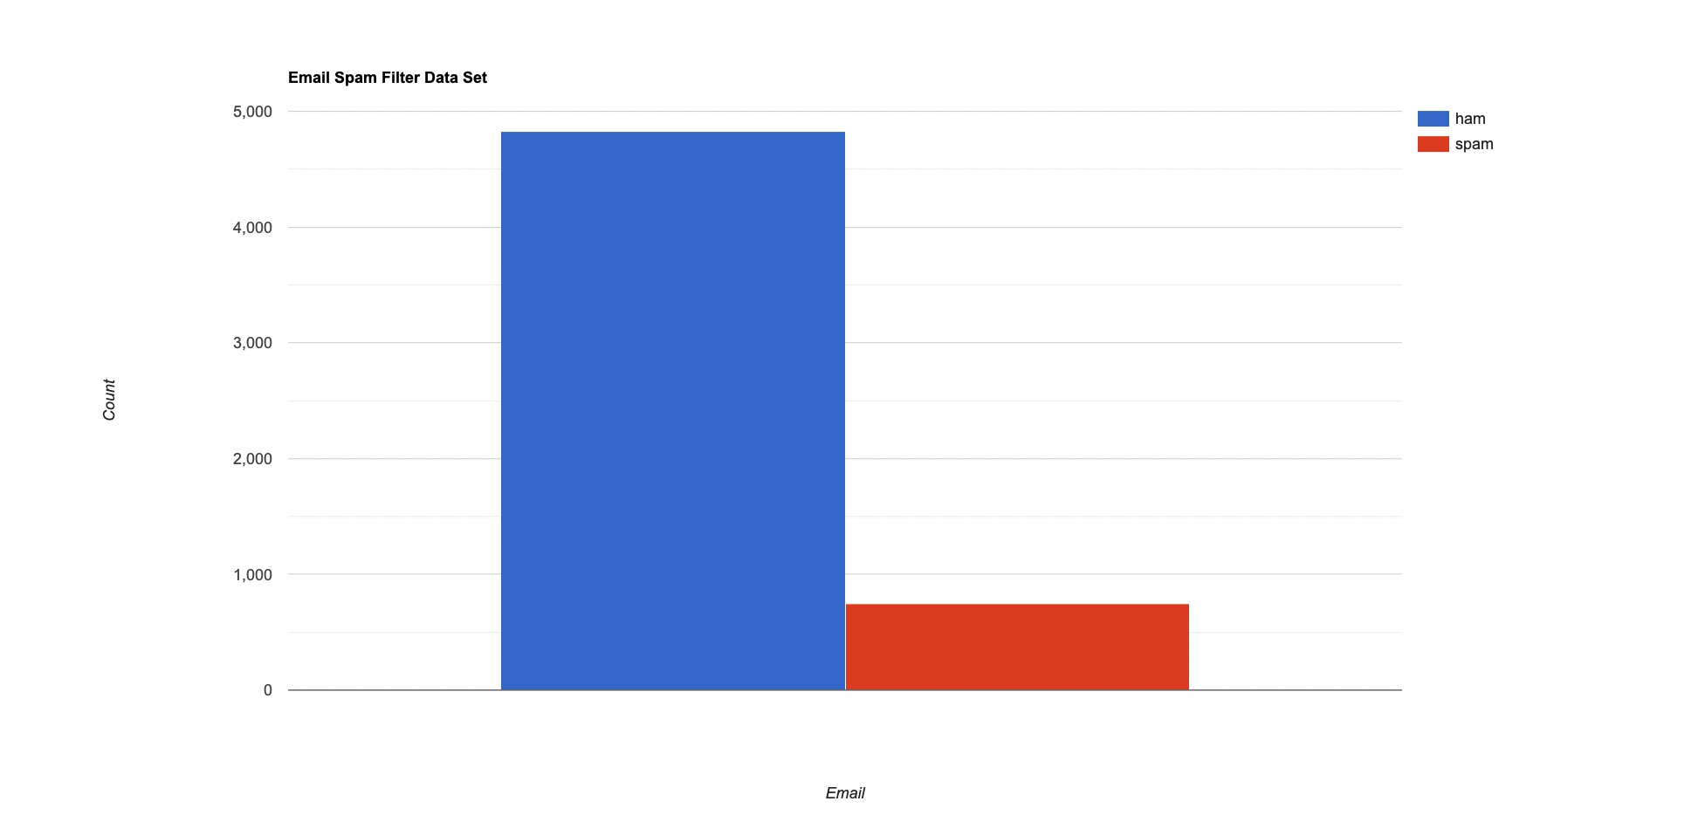
Apply Machine Learning
INTRODUCTION
PROBLEM SOLVING
Methodology
Overall the dataset

Slide 11
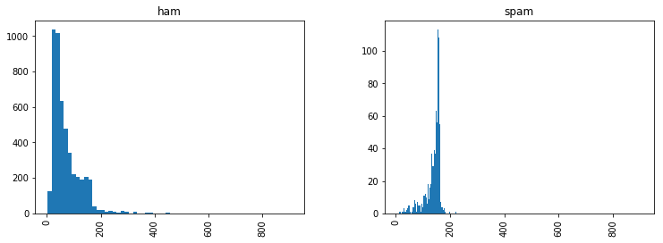
Apply Machine Learning
INTRODUCTION
PROBLEM SOLVING
Methodology
Email text length in ham and spam

Slide 12
Apply Machine Learning
INTRODUCTION
PROBLEM SOLVING
Methodology
Pre-processing
Convert label from text to number
Spam: 1; Ham: 0
Reduce noise
Stop word: “the”, “is”, “and”...
Punctuation: '!"#$%&\'()*+,-./:;<=>?@[\\]^_`{|}~'
Lemmatize
Remove emails with empty text
After-processed data contains 5560 samples

Slide 13
Apply Machine Learning
INTRODUCTION
PROBLEM SOLVING
Methodology
Pre-processing
Before | After
{ ID: '605', text: 'Go until jurong point, crazy.. Available only in bugis n great world la e buffet... Cine there got amore wat...', '': '', status: 0 } | { ID: '605', tokenization: [ 'jurong', 'point’, ‘crazy', 'avail’, ‘bugis’, ‘n', 'great’, ‘world’, ‘la', 'e’, 'buffet', 'cine', 'get’, 'amor', 'wat' ], status: 0 }
Data before and after pre-processed

Slide 14



Apply Machine Learning
INTRODUCTION
PROBLEM SOLVING
Methodology - Classifiers
Naive Bayes
K-nearest
Neighbors

Slide 15
Apply Machine Learning
INTRODUCTION
PROBLEM SOLVING
Methodology - Classifiers
K-nearest Neighbors
Theory:
A supervised machine learning algorithm for both regression and classification tasks.
Categorized as “lazy”
Label is decided based on the K closest data points in the training set (The weight of K neighbors is similar
Give weight to each neighbor. The weight is dependent on the distance between itself and the investigating point.
To aid the distance calculation:
Euclidean distance
Manhattan distance

Slide 16
Apply Machine Learning
INTRODUCTION
PROBLEM SOLVING
Methodology - Classifiers
K-nearest Neighbors
Implementation:
Apply Euclidean distance
Params: neighbors, weights

Slide 17
Apply Machine Learning
INTRODUCTION
PROBLEM SOLVING
Methodology - Classifiers
K-nearest Neighbors
Implementation:
Steps:
Step 1: Count the word frequency
Step 2: Compute the Euclidean
Step 2.1: A word appears in both training and dataset → calculate the distance between their frequency
Step 2.2: A word only appears in the training set → plus the distance with the square of frequency → Delete common words in the test data
Step 2.3: Looping through the rest test data → plus distance with the square of the frequency corresponding to each word
Step 3: Sort data and choose K nearest neighbors
Step 4: Evaluate the neighbors and label

Slide 18
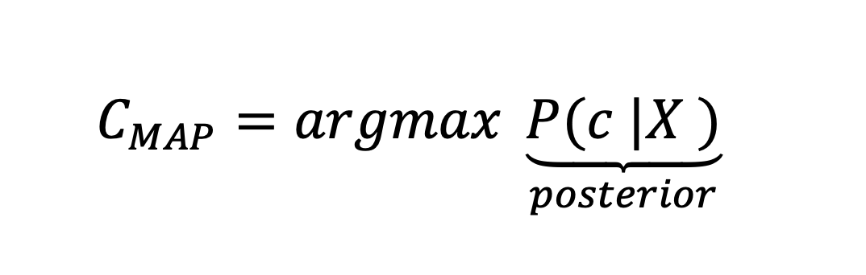
Apply Machine Learning
INTRODUCTION
PROBLEM SOLVING
Methodology - Classifiers
Naive Bayes
Theory:
Given the observed data X (x1, x2, x3,..., xn), estimations of a probabilistic model's parameter C by Maximum a Posteriori (MAP) is following:

Slide 19
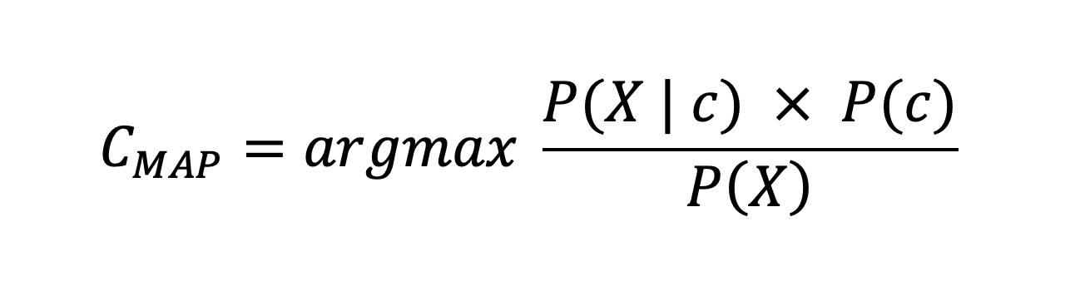
Apply Machine Learning
INTRODUCTION
PROBLEM SOLVING
Methodology - Classifiers
Naive Bayes
Theory:
Apply Bayes theorem with c belongs to C

Slide 20
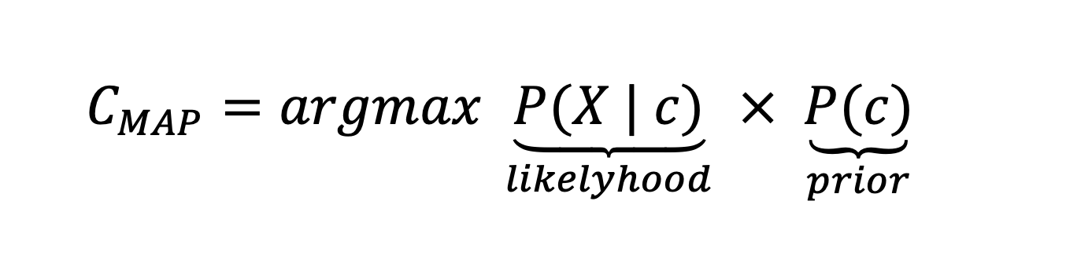
Apply Machine Learning
INTRODUCTION
PROBLEM SOLVING
Methodology - Classifiers
Naive Bayes
Theory:
P(X) is a constant and independent of C:

Slide 21
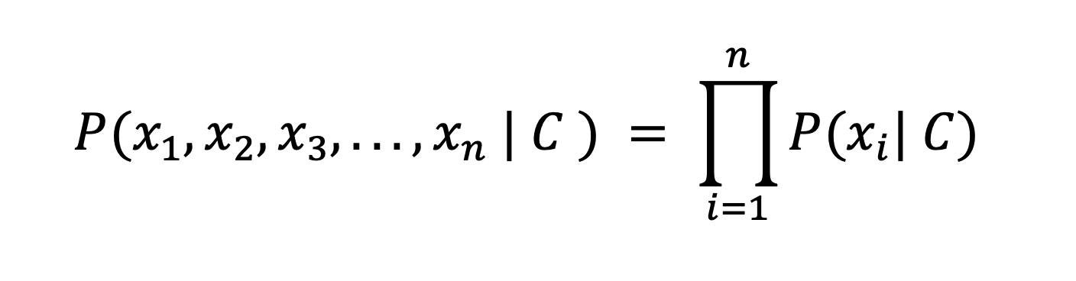
Apply Machine Learning
INTRODUCTION
PROBLEM SOLVING
Methodology - Classifiers
Naive Bayes
Theory:
The attributes are conditionally independent given the classification

Slide 22
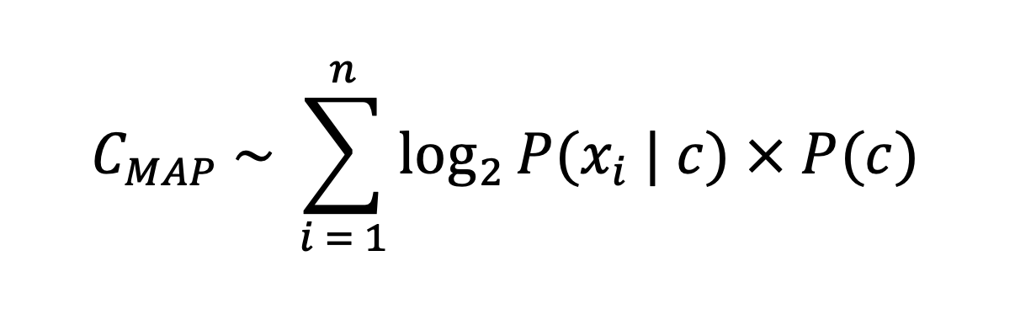
Apply Machine Learning
INTRODUCTION
PROBLEM SOLVING
Methodology - Classifiers
Naive Bayes
Theory:
Final formula:

Slide 23
Apply Machine Learning
INTRODUCTION
PROBLEM SOLVING
Methodology - Classifiers
Naive Bayes
Implementation:
Each training example is an object (id, text, label)
The proportion of the training set and the test set: 0.7 & 0.3
Steps:
Divide the training set into 2 arrays: rawSpamSet & rawHamSet and an array named a vocabulary.
Train the above arrays → get the probability for each word corresponding to the array vocabulary
Predict test email by applying the algorithm

Slide 24
RESULT AND EVALUATION
Evaluation Metrics
Term
TP: number of true positives (Ham emails are predicted as ham)
FP: number of false positives (Spam emails are predicted as ham)
TN: number of true negatives (Spam emails are predicted as spam)
FN: number of false negatives (Ham emails are predicted as spam)
Note: In these metrics, we choose ham class as positive and spam class as negative
 | Predicted as Positive | Predicted as Negative
Actual: Positive | TP | FN
Actual: Negative | FP | TN

Slide 25
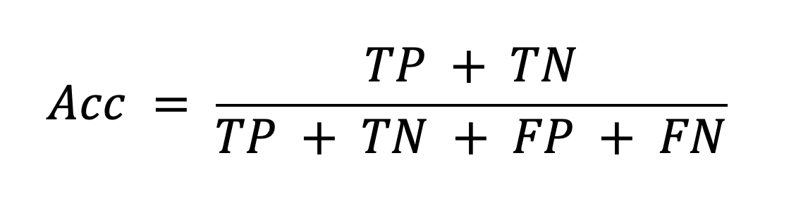
RESULT AND EVALUATION
Evaluation Metrics
Accuracy score
The simplest and most commonly used way is accuracy.
This evaluation simply calculates the ratio between the number of correctly predicted points and the total number of points in the test data set.

Slide 26
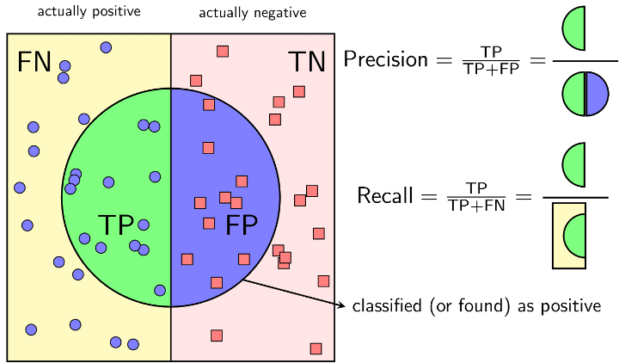
RESULT AND EVALUATION
Evaluation Metrics
F1 score
With the classification problem and the data set of the classes being very different from each other, there is an effective operation that is often used, which is Precision-Recall.
Notes:
Why

Slide 27
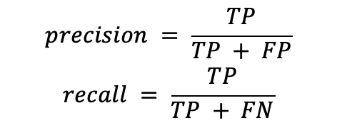
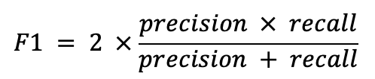
RESULT AND EVALUATION
Evaluation Metrics
F1 score
Notes:
Why

Slide 28
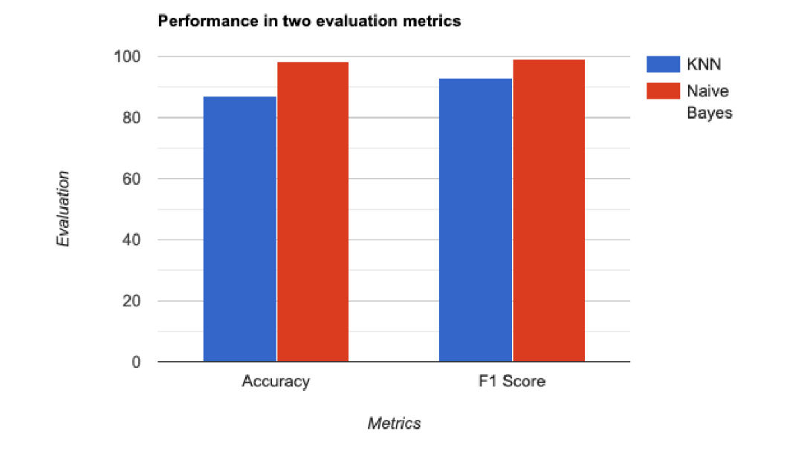
RESULT AND EVALUATION
Experimental Results
Performance illustration

Slide 29
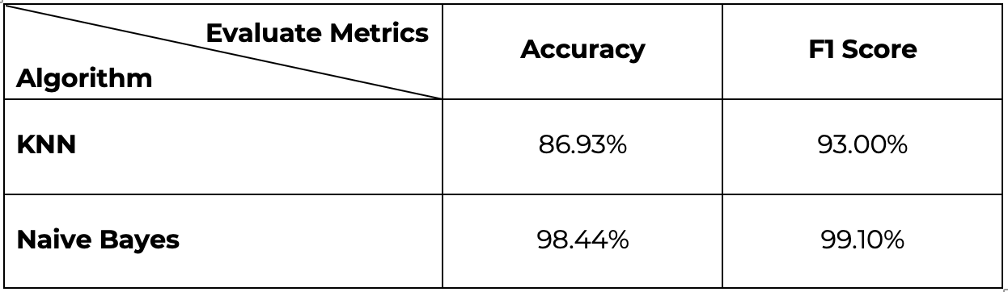
RESULT AND EVALUATION
Experimental Results
Result statistics

Slide 30
RESULT AND EVALUATION
Evaluation
The original dataset contains a lot of outliers → affect the performance
The accuracy of original data for training and testing is around 73% and F1 score is around 60%
Apply preprocessor → accuracy increases 8 - 13%, F1 score increases 20-22%
According to the result, Naive Bayes is better than KNN since KNN is poor with the problems that have many dimensions to calculate.
However, KNN without filling missing data has performed poor due to its sensitivities with outliers, with preprocessing and oversampling, it can improve the result because the data now is more balanced and cleaner.

Slide 31
CONCLUSION
Conclusion
The original dataset contains a lot of outliers → affect the performance
The dataset is quite imbalanced → need more experiments
The model targets only the content → build bigger model to handle more characteristics of object
Algorithms:
The Naive Bayes
The results are quite high
High recognition rate
Emails that have nearly the same probabilities → misclassified
The KNN:
Poor to multi-dimensional problems

Slide 32
CONTRIBUTION
Members:
Do Long Minh - 20184289 - minhdl.184289@sis.hust.edu.vn
Nguyen Tuan Minh - 20184294 - minh.nt184294@sis.hust.edu.vn
Hoang Minh Tri - 20184315 - tri.hm184315@sis.hust.edu.vn

Slide 33
THANK YOU
FOR LISTENING!
“A code that cannot be tested is flawed”
- Random internet quote-

