Slide 1
Network Programming Project Caro Chess
Team Members:
Đào Nguyễn Tùng Lâm
Thân Trọng Nghĩa
Đỗ Long Minh
Đặng Quốc Trung

Slide 2
Table of Contents
Introduction
Defined Protocol
Some Technical
Demo

Slide 3
Introduction
1
Giới Thiệu

Slide 4
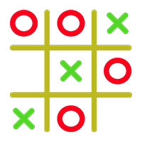
Introduction
1
The caro game is a 2-player game, where each player take turn placing X or O on the board.
Whoever get 5 in a row, column or diagonal first win.
Example of Caro Game

Slide 5
Introduction
1
The project off caro chess uses client-server TCP model:
Client:
login to server / start game / quit
handle some syntax validation
handle order of sending requests
Server:
manage list of players / pairing players
forward the player’s move to the opponent player
handle the logic of the game (and announce winner)

Slide 6
Defined Protocol
2
Giao Thức Tự Định Nghĩa

Slide 7
Command & Respone (text-based)
2.1
Request to server:
LOGIN <username>
FIND
MOVE <x> <y>
EXIT
Response from server:
200 Caro Game ready
110 This username is already in use
210 Login success
120 Cannot find any player
220 <opp username> - you play X
221 <opp username> - you play O
230 Move okay
330 <x> <y> Opponent move
342 You won
343 <x> <y> Opponent won
303 Opponent disconnected

Slide 8
Command & Respone (text-based)
2.1
Server return codes rule:
1xx: error x0x: connection
2xx: success x1x: login
3xx: game status x2x: find
x3x: move
x4x: game over

Slide 9
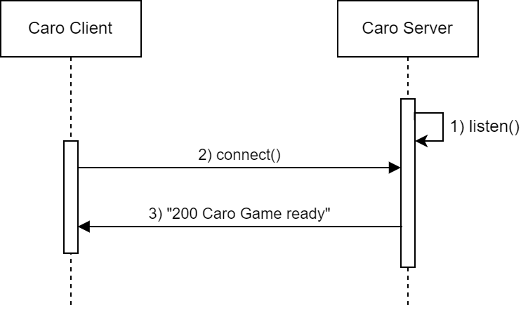
Data Flow
2.2
Connect To Server:

Slide 10
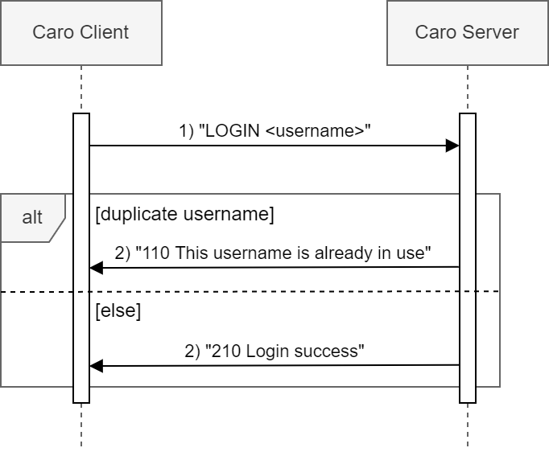
Data Flow
2.2
LOGIN:

Slide 11
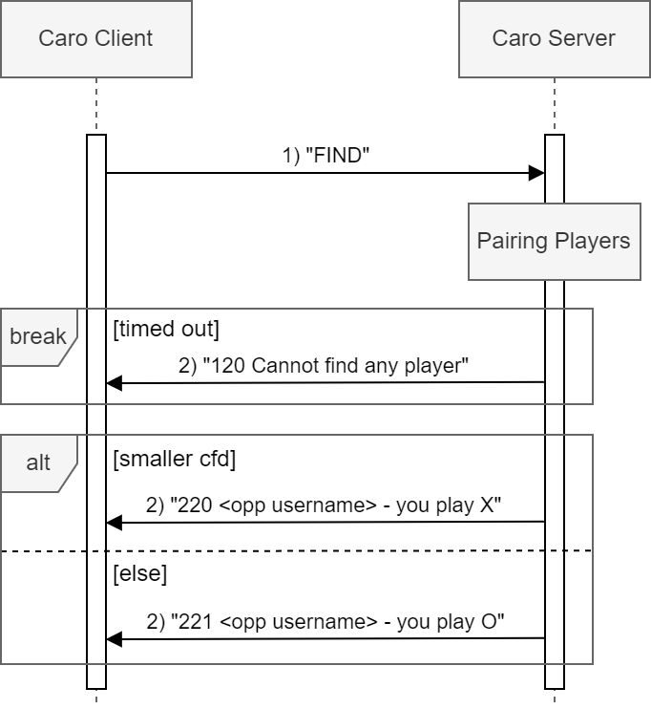
Data Flow
2.2
FIND:

Slide 12
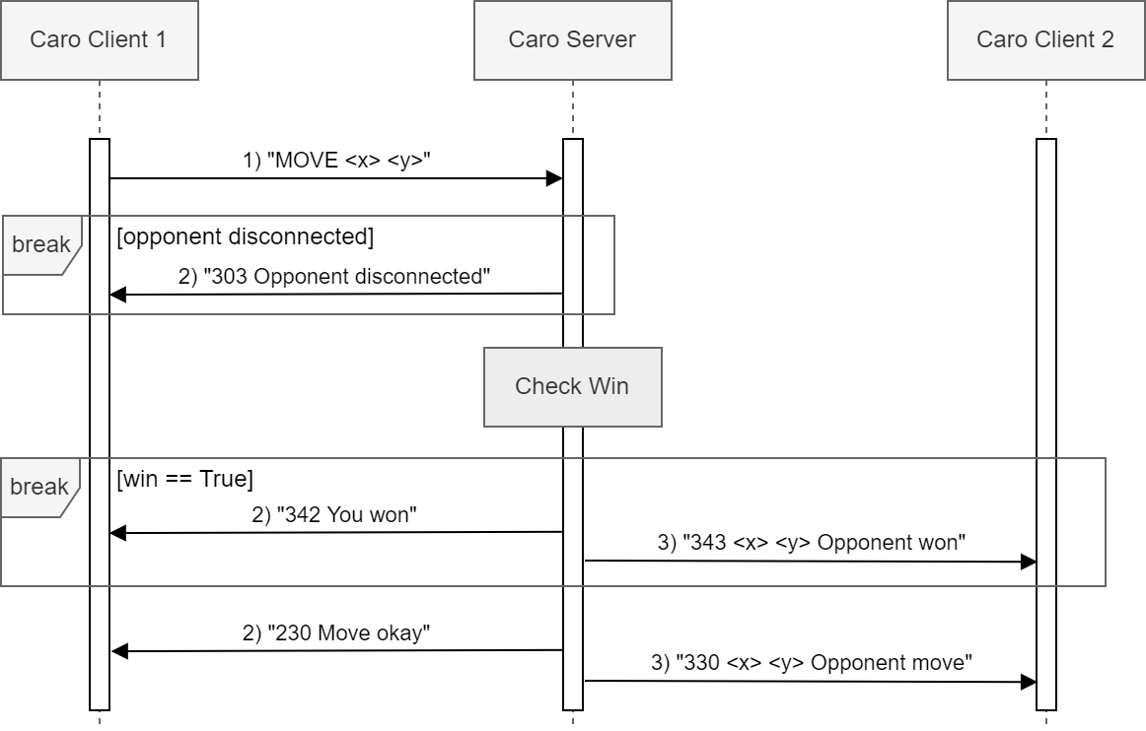
Data Flow
2.2
MOVE:

Slide 13
Some Technical
3

Slide 14
Some Technical
3
Caro Server: Multi-threading
Main thread: accept new client connection
A child thread to handle communication for each client

Slide 15
Some Technical
3
Pairing Players (Server)
Handle on one separate thread
Using a queue:
FIND → enqueue
dequeue and pair every two players on top of the queue
The queue is vulnerable to conflict (need synchronization)

Slide 16
Some Technical
3
Finding Player Animation (Client)
Using select (I/O multiplexing) with timeout:
Until the file descriptor is ready (receive some message), clear the screen and update the output after each timeout, to make an illusion of running animation

Slide 17
Demo
4

Slide 18
Thanks For Listening!

