Slide 1
Toxic Comments Classification
Kyeongho Min
Bhawana Mohta
Nicolette Sauramba

Slide 2
Table of contents
01
02
03
04
05
06
Problem Statement
Dataset Description
Implementation
Project Introduction and objectives
Data description and source
The model and technique we used
Model Application
Future work
Conclusion
Single Prediction from Twitter
Possible applications and improvements
Summary

Slide 3
01. Research Question
How can we classify the nature of toxic comments on online platforms?

Slide 4
tox⦁ic
very harmful or unpleasant in a pervasive or insidious way.

Slide 5
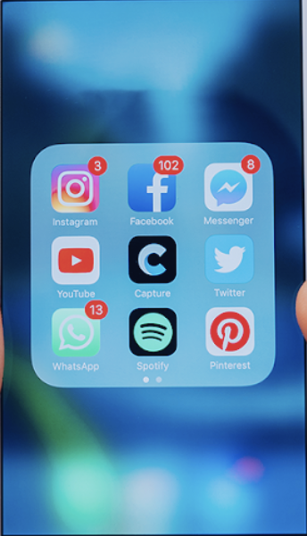
Significance
Research shows 40% of internet user have faced harassment and 73% have seen others get harrassed
7 in 10 internet users aged 18-24 have been harassed online
Online platforms are facing intense pressure to address toxicity online and protect their users
Twitter, for example, recently implemented features to fight toxic comments
There is a need for better algorithms to give control back to users

Slide 6
02. Dataset Description

Slide 7

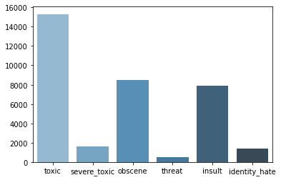
Data Description
Data Distribution
Wikipedia Data
Kaggle data
160K training
labeled with human ratings for toxic behavior
6 labels: ["toxic", "severe_toxic", "obscene", "threat", "insult", "identity_hate"]

Slide 8
03. Implementation
The technique and model used

Slide 9
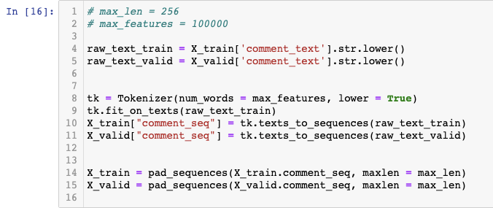
Procedures
Data Cleaning and preprocessing
- Tokenize the text (100K features)
- Convert to sequences
- Padding (256)

Slide 10
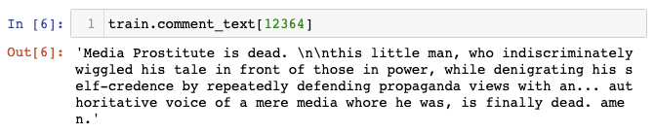
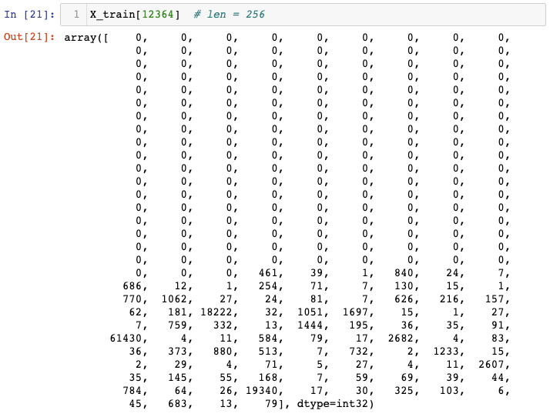
Procedures
Data Cleaning and preprocessing
- Tokenize the text (100K)
- Convert to sequences
- Padding (256)

Slide 11
Procedures
Unsupervised learning algorithms for obtaining vector presentations for words
GloVe vs. Word2Vec
GloVe embeddings are learnt based on matrix factorization while Word2Vec embeddings are based on training a shallow feedforward Neural network
GloVe focuses on words co-occurrences over the whole corpus, but Word2Vec is a predictive model that predicts context given word
Pre-trained word vectors (840B tokens, 2.2M vocabs, 300d vectors)
Word Embedding
- GloVe (Global Vectors)

Slide 12
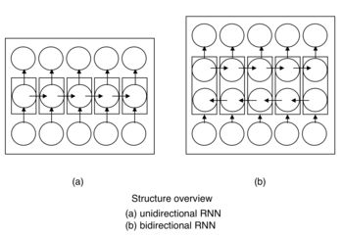
Procedures
Bidirectional RNN
One from right to left and the other in the reverse order
BiGRU (Gated Recurrent Unit)
Sequence processing model that consists of two GRUs
Comparing to LSTM, it has fewer parameters so it is used for smaller datasets
Modeling and evaluation
- BiGRU
- CNN
- Poolings

Slide 13
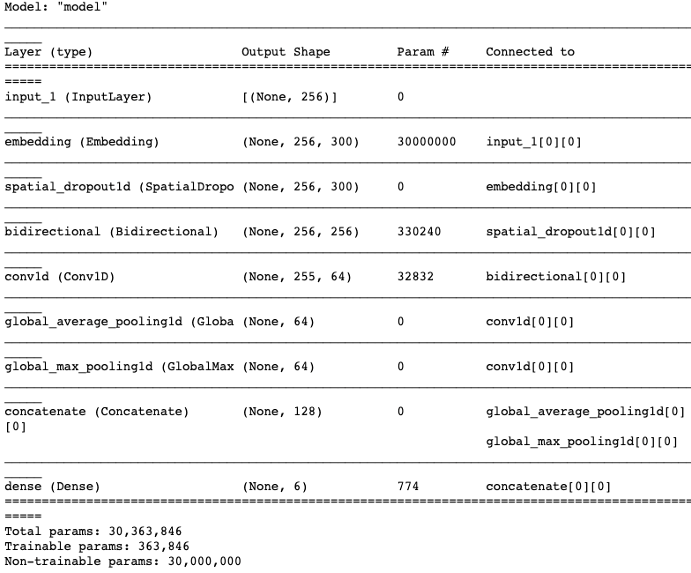

Procedures
Modeling and evaluation
- BiGRU
- CNN
- Poolings

Slide 14
04. Model Application
Single Prediction from Twitter

Slide 15
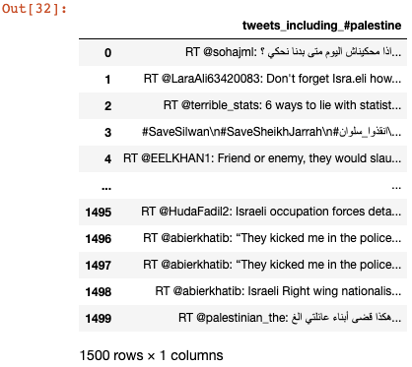

Model Application
Extract data from Twitter
- Hashtag: #palestine

Slide 16
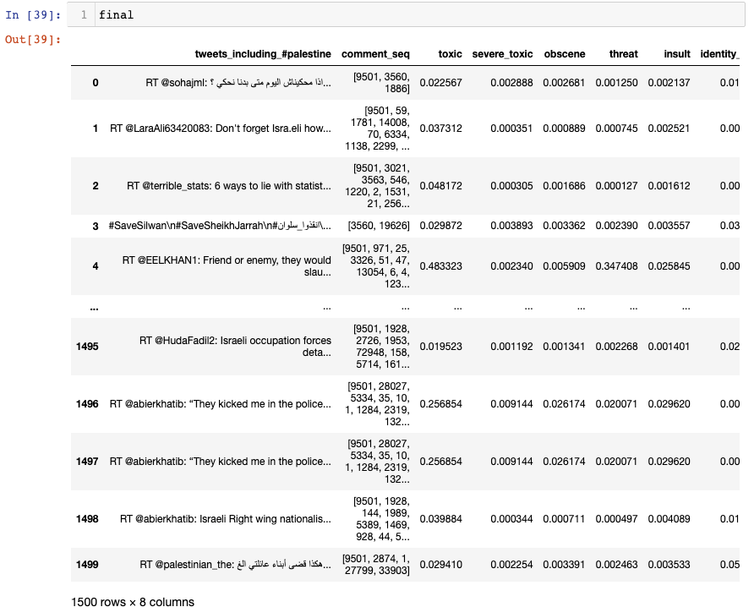
Model Application
Extract data from Twitter
- Hashtag: #palestine

Slide 17
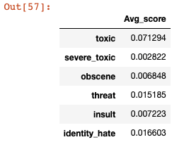
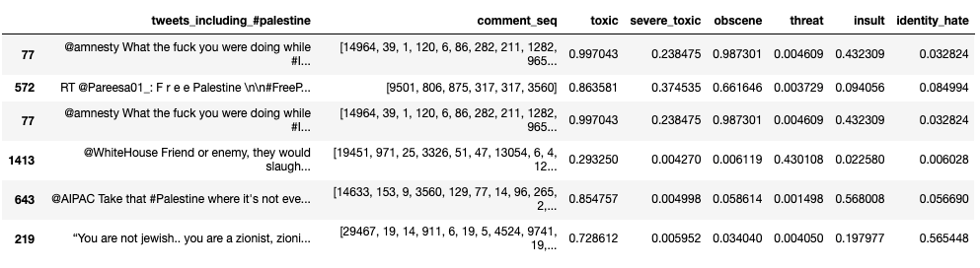
Model Application
Extract data from Twitter
- Hashtag: #palestine

Slide 18
05
Future Works

Slide 19
Possible applications and improvements
We suggest using SVM for text processing and text classification. It requires a grid search for hyper-parameter tuning to get the best results.
We suggest a plan to improve the NLP classifiers: by using algorithms such as Support Vector Clustering (SVC)
We also suggest finding solution for multilingual toxic comment classification problem.

Slide 20
Possible applications and improvements
Improve the prediction ability, in which the model can recognize the word context (sentiment analysis) so that it can evaluate the toxic content probability of sentences, not only by specific words.
Improve the training datasets,including more features with higher n-gram models.
Improve the prediction score across the 6 categories.
Notes:
Improve the training dataset, including more features with higher n-gram models

Slide 21
06
Conclusion

Slide 22
Summary
Our study has shown that harmful or toxic comments have many negative impacts to society. The ability to readily and accurately identify comments as toxic could provide many benefits while mitigating the harm. Our project has shown the capability of readily available algorithms to be employed in such a way to address this challenge. The research done in this project is intended to enhance fair online talk and views sharing in social media

