Slide 1
6.830/6.814 Introduction to Databases
6.830 Lecture 1
Sam Madden madden@csail.mit.edu
http://db.csail.mit.edu/6.830

Slide 2
Administrivia
http://db.csail.mit.edu/6.830
Email: 6.830-staff@mit.edu
Ask questions on Piazza!
Lecturers:
Sam Madden (madden@csail.mit.edu)
TAs:
Cheng Chen (chengch@mit.edu)
Yi Lu (yil@mit.edu)
Office hours: TBD – G9 Lounge

Slide 3
Textbooks
Readings in Database Systems
Available on Books24x7.com
Database Management Systems, 3rd ed. by Ramakrishnan and Gehrke

Slide 4
Zoo Data Model Entity Relationship Diagram
1
Animal
n
contains
1
Cage
1
entity
relationship
entity
name
n
feedTime
1
1
Name
Time
keeps
1
age
Building
1
bldg
Age
n
species
Keeper
1
name
1
entity
Species
1
Name
Animals have names, ages, species
Keepers have names
Cages have cleaning times, buildings
Animals are in 1 cage; cages have multiple animals
Keepers keep multiple cages, cages kept by multiple keepers

Slide 5
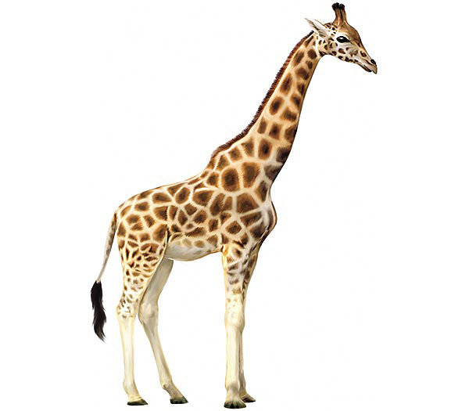
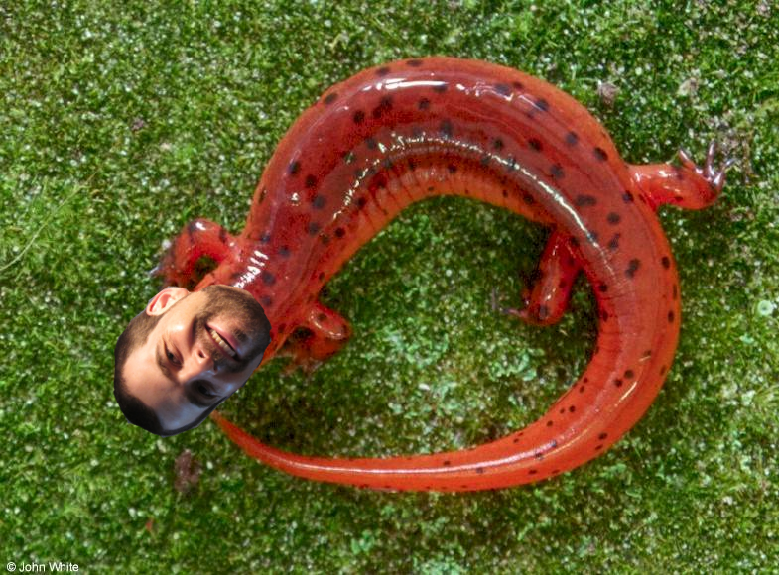
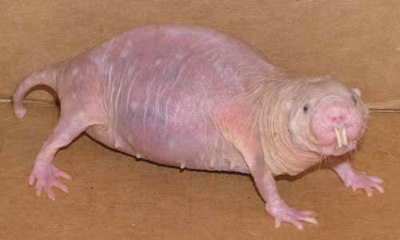
Our Zoo
Sam the Salamander
Cheng the Giraffe
Sally the Student
Slimy
Lanky

Slide 6
Break
Questions
Are there other ways to represent this zoo data than a collection of tables?
What are tradeoffs in different representations?

Slide 7
SQL – Structured Query Language
SELECT field1, …, fieldM
FROM table1, …
WHERE condition1, …
INSERT INTO table VALUES (field1, …)
UPDATE table SET field1 = X, …
WHERE condition1,…

Slide 8
Names of Giraffes
Imperative
for each row r in animals
if r.species = ‘giraffe’
output r.name
Declarative
SELECT r.name FROM animals
WHERE r.species = ‘giraffe’

Slide 9
Cages in Building 32
NESTED LOOPS
Imperative
for each row a in animals
for each row c in cages
if a.cageno = c.no and c.bldg = 32
output a
Declarative
SELECT a.name FROM animals AS a, cages AS c WHERE a.cageno = c.no AND c.bldg = 32
JOIN

Slide 10
Average Age of Bears
Declarative
SELECT AVG(age) FROM animals
WHERE species = ‘bear’

Slide 11
Complex Queries
Find pairs of animals of the same species and different genders older than 1 year:
SELECT a1.name,a2.name
FROM animals as a1, animals as a2
WHERE a1.gender = M and a2.gender = F
AND a1.species = a2.species
AND a1.age > 1 and a2.age > 1
“self join”
Find cages with salamanders fed later than the average feedtime of any cage:
SELECT cages.cageid FROM cages, animals
WHERE animals.species = ’salamander'
AND animals.cageid = cages.cageid
AND cages.feedtime >
(SELECT AVG(feedtime) FROM cages )
“nested queries”

Slide 12
Complex Queries 2
Find keepers who keep both students and salamanders:
SELECT keeper.name
FROM keeper, cages as c1, cages as c2,
keeps as k1, keeps as k2, animals as a1, animals as a2
WHERE c1.cageid = k1.cageid AND keeper.keeperid = k1.keeperid
AND c2.cageid = k2.cageid AND keeper.keeperid = k2.keeperid
AND a1.species = ’student' AND a2.species = ’salamander'
AND c1.cageid = a1.cageid AND c2.cageid = a2.cageid
keeper.keeperid = k1.keeperid
a1
c1
k1
species = ‘shrew’
keeper
a2
c2
k2
keeper.keeperid = k2.keeperid
species = ‘student’

