Slide 1
6.830 Lecture 10
Query Optimization
Postgres Planning and Histograms
10/11/2017

Slide 2
Database Internals Outline
Front End
Admission Control
Connection Management
Query System
(sql)
Parser
(parse tree)
Rewriter
(parse tree)
Planner & Optimizer
(query plan)
Executor
Last time
Storage System
Access Methods
Lock Manager
Buffer Manager
Log Manager

Slide 3
Selinger Optimizer Algorithm
algorithm: compute optimal way to generate every sub-join:
size 1, size 2, ... n (in that order)
e.g. {A}, {B}, {C}, {AB}, {AC}, {BC}, {ABC}
R ←set of relations to join
For i in {1...|R|}:
for S in {all length i subsets of R}:
optjoin(S) = a join (S-a), where a is the relation that minimizes:
cost(optjoin(S-a)) +
min. cost to join (S-a) to a +
min. access cost for a
Precomputed in previous iteration!

Slide 4
Selinger, as code
R ←set of relations to join
For i in {1...|R|}:
for S in {all length i subsets of R}:
optcost_{s} = ∞
optjoin_{S} = ø
for a in S: //a is a relation
c_{sa} = optcost_{s-a} +
min. cost to join (S-a) to a +
min. access cost for a
if c_{sa} < optcost_{s} :
optcost_{s} = c_{sa}
optjoin_{s} = optjoin(S-a) joined optimally w/ a
This is the same algorithm as previous one, written differently
Pre-computed in previous iteration!

Slide 5
Example
4 Relations: ABCD (only consider NL join)
Optjoin:
A = best way to access A (e.g., sequential scan, or predicate pushdown into index...)
B = " " " " B
C = " " " " C
D = " " " " D
{A,B} = AB or BA
{A,C} = AC or CA
{B,C} = BC or CB
{A,D}
{B,D}
{C,D}
Optjoin
R ←set of relations to join
For i in {1...|R|}:
for S in {all length i subsets of R}:
optjoin(S) = a join (S-a), where a is the relation that minimizes:
cost(optjoin(S-a)) +
min. cost to join (S-a) to a +
min. access cost for a

Slide 6
Example (con’t)
Optjoin
R ←set of relations to join
For i in {1...|R|}:
for S in {all length i subsets of R}:
optjoin(S) = a join (S-a), where a is the relation that minimizes:
cost(optjoin(S-a)) +
min. cost to join (S-a) to a +
min. access cost for a
Optjoin
{A,B,C} = remove A: compare A({B,C}) to ({B,C})A
remove B: compare ({A,C})B to B({A,C})
remove C: compare C({A,B}) to ({A,B})C
{A,C,D} = …
{A,B,D} = …
{B,C,D} = …
…
{A,B,C,D} = remove A: compare A({B,C,D}) to ({B,C,D})A
remove B: compare B({A,C,D}) to ({A,C,D})B
remove C: compare C({A,B,D}) to ({A,B,D})C
remove D: compare D({A,C,C}) to ({A,B,C})D

Slide 7
Complexity
Number of subsets of set of size n =
|power set of n| =
2^{n} (here, n is number of relations)
How much work per subset?
Have to iterate through each element of each subset, so this at most n
n2^{n} complexity (vs n!)
n=12 ➔ 49K vs 479M
Optjoin
R ←set of relations to join
For i in {1...|R|}:
for S in {all length i subsets of R}:
optjoin(S) = a join (S-a), where a is the relation that minimizes:
cost(optjoin(S-a)) +
min. cost to join (S-a) to a +
min. access cost for a
Notes:
(string of length n, 0 if element is in, 1 if it is out; clearly, 2^n such strings)

Slide 8
Materialized Views
sales : (saleid, date, time, register, product, price, ...)
CREATE MATERIALIZED VIEW sales_by_date AS
SELECT date, product, sum(price), count(*) AS quantity
FROM sales
GROUP BY date, product
Key properties:
Kept up to date as data is added
Selected for use automatically by optimizer when appropriate

Slide 9
6.830 Quiz 1 Review

Slide 10
Logistics
Exam is in class next Wednesday
75 minutes
Open notes; laptops allowed but no Internet

Slide 11
Topics on the Quiz
Database history: IMS, Codasyl
Schema design: BCNF, Entity-Relationship diagrams
Query optimization: Access methods, join algorithms, join ordering, cost analysis
Database internals: Buffer pool, iterator model for operators, index structures
Column stores: Database layout for analytic workloads
Physical database design: Choice of best indexes

Slide 12
Tips for Studying
Read through the lecture notes (your own and the ones posted on the website)
Do the practice exams and check your answers. Make sure you understand the solution.
Review the problem sets and solutions (PS2 solution to be posted soon!)
Review the high-level concepts of each lab
Review the readings
Ask questions on Piazza

Slide 13
Review: Access methods
Access Method | Key Features
Heap file | Records are unsorted Search for records by sequentially scanning the entire file Use if there are no available indexes on your search key or you expect to return a large number of records
Hash index | Typically points to an unsorted underlying heap file Constant time search for records Useful for finding a set of specific keys, not searching for ranges of keys May not be worth using if you have to perform random I/O to access a large number of records in the underlying heap file
B+ tree index | Typically points to an unsorted underlying heap file Logarithmic time search for records (log_{B}n) Useful for finding a set of specific keys or scanning a range of keys May not be worth using if you have to perform random I/O to access a large number of records in the underlying heap file
Clustered index | Records in underlying file are sorted, eliminating need for random I/O Constant or logarithmic search Useful for finding a set of specific keys or scanning a range of keys Could be used as input to sort-merge join, to avoid sort step Can have multiple indexes per table but only one clustered index!

Slide 14
Review: Join algorithms
Join algorithm | Key Features
Nested loops | O(nm), where n is tuples in outer, m inner Only useful if the inner relation is very small, and therefore the overhead of building a hash table is not worth it Block nested loops: Can operate on blocks of tuples of inner relation, to make more efficient; complexity is then (nB), where B is number of blocks
Index nested loops | Only possible if you have an index on the inner relation Efficient if the number of lookups you need to do on the index is small
In-memory hash | If one of the tables can fit in memory, can create an hash table on it on the fly Pipeline lookups from other table (which may not fit in memory) Good choice for equality joins when there is no index
Simple hash | Good choice if one of the tables almost fits in memory I/O cost is P(|R| + |S|), where P is the number of partitions you split each relation into. Each partition P must fit in memory |R| and |S| are the number of pages in relations R and S Always better to use Grace hash if P > 2
Grace hash | Usually the best choice if neither relation can fit in memory I/O cost is 3(|R| + |S|)
Sort-merge hash | Same I/O cost as Grace hash, but less efficient due to cost of sorting Could be a good choice if the relations are already sorted or you will need the output to be sorted on the join attribute later in the query plan (e.g., ORDER BY)

Slide 15
Join Algo Summary
Algo | I/O cost | CPU cost | In Mem?
Nested loops | |R|+|S| | O({R}x{S}) | R in mem
Nested loops | {S}|R| + |S| | O({R}x{S}) | No
Index nested loops (R index) | |S| + {S}c (c = 1 or 2) | O({S}log{R}) | No
Block nested loops | |S| + B|R| (B=|S|/M) | O({R}x{S}) | No
Sort-merge | |R|+|S| | O({S}log{S}) | Both
Hash (Hash R) | |R|+|S| | O({S} + {R}) | R in mem
Blocked hash (Hash S) | |S| + B|R| (B=|S|/M) | O({S} + B{R}) | No
External Sort-merge | 3(|R| + |S|) | O(P x {S}/P log {S}/P) | No
Simple hash | P(|R|+|S|) (P=|S|/M) | O({R} + {S}) | No
Grace hash | 3(|R| + |S|) | O({R} + {S}) | No
Grace hash is generally a safe bet, unless memory is close to size of tables, in which case simple can be preferable
Extra cost of sorting makes sort merge unattractive unless there is a way to access tables in sorted order (e.g., a clustered index), or a need to output data in sorted order (e.g., for a subsequent ORDER BY)

Slide 16
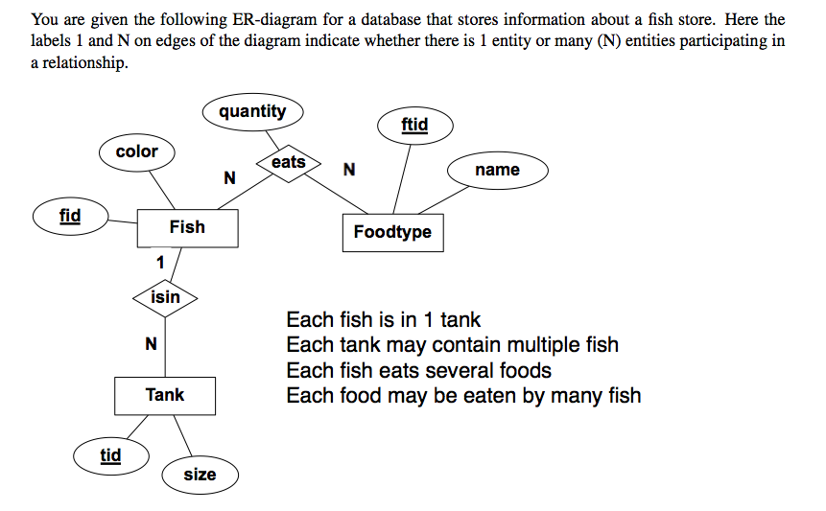
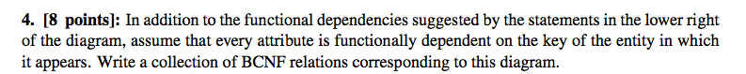
Example Problem 1

Slide 17
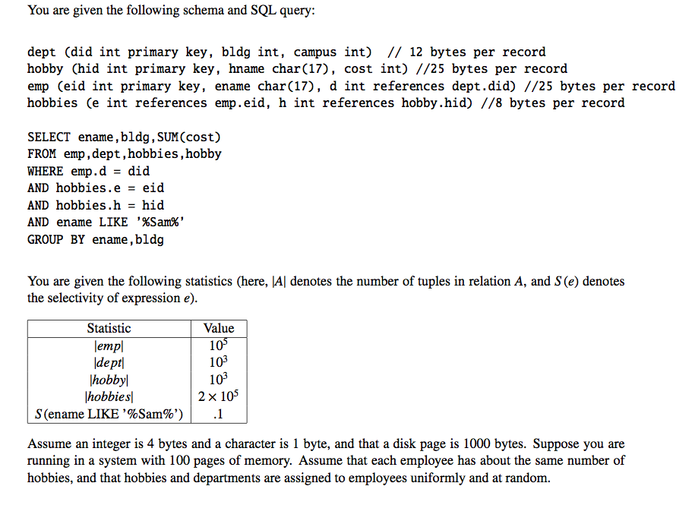
Example Problem 2

Slide 18
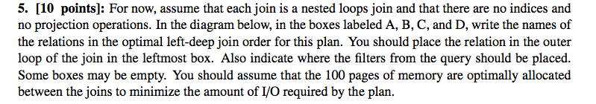
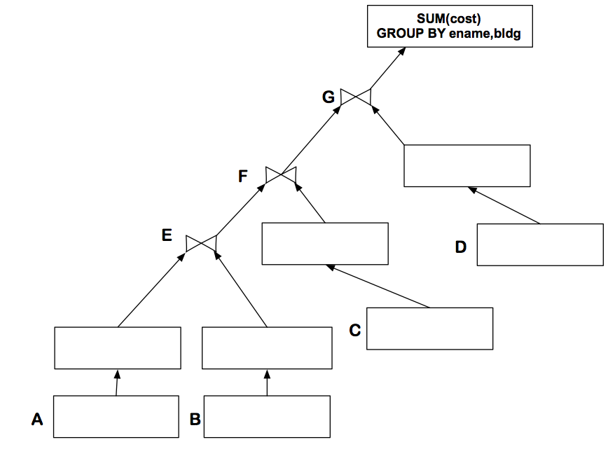
Example Problem 2 Cont

Slide 19
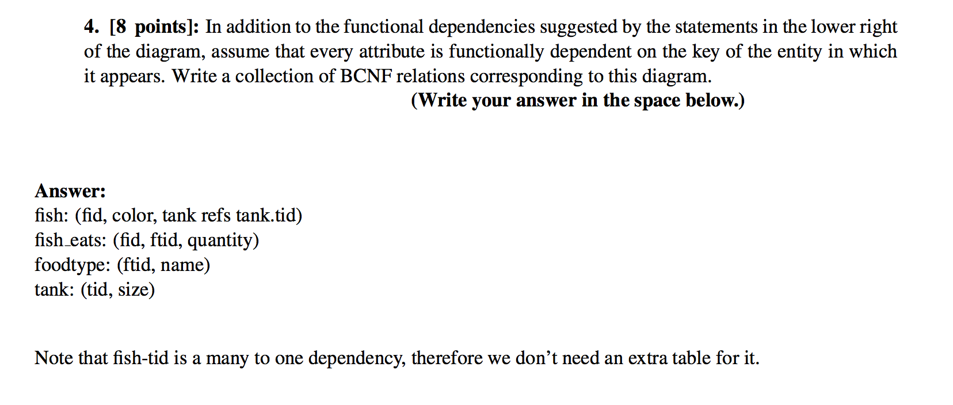
Example Problem 1 Answer

Slide 20
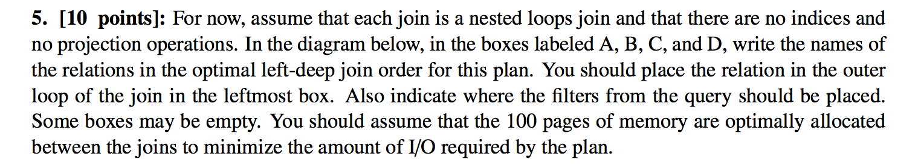
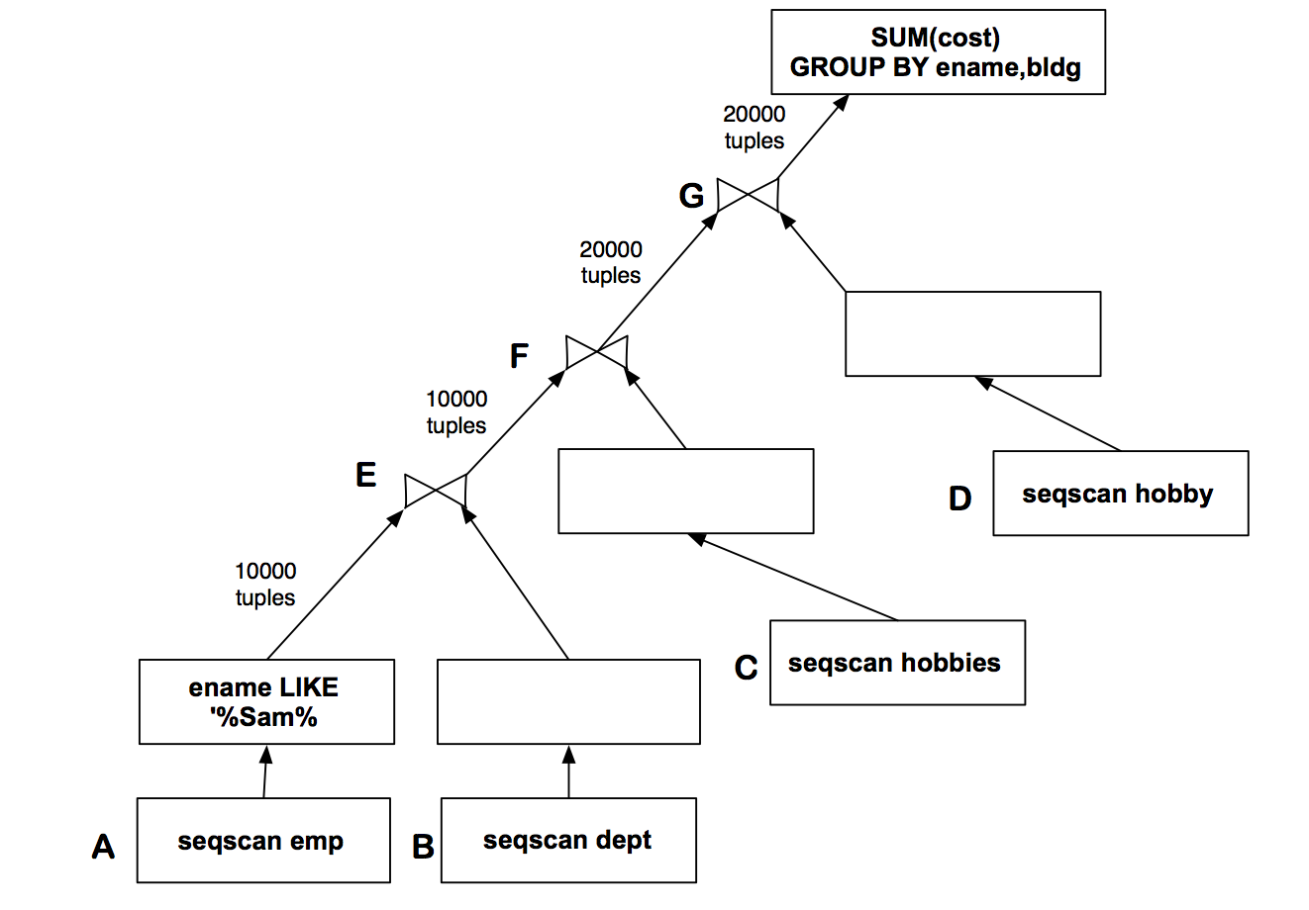
Example Problem 2 Answer

Slide 21
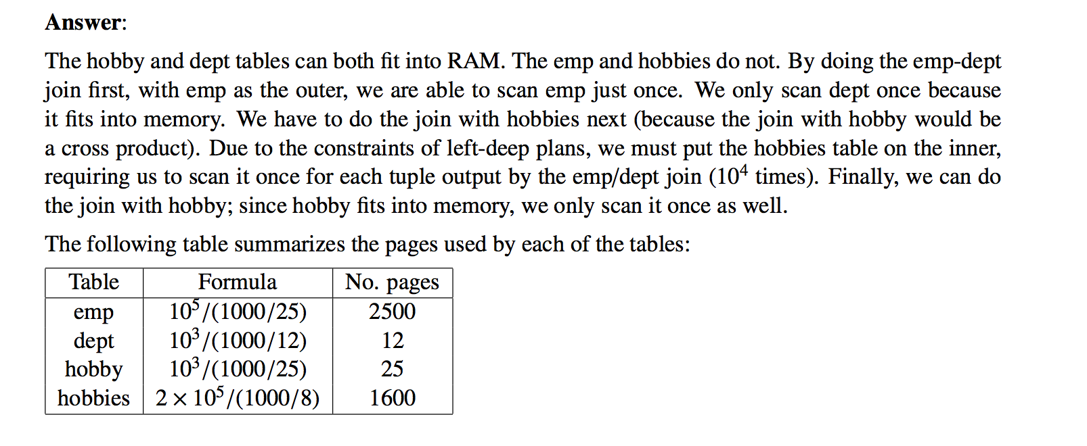
Example Problem 2 Answer Cont.

Slide 22
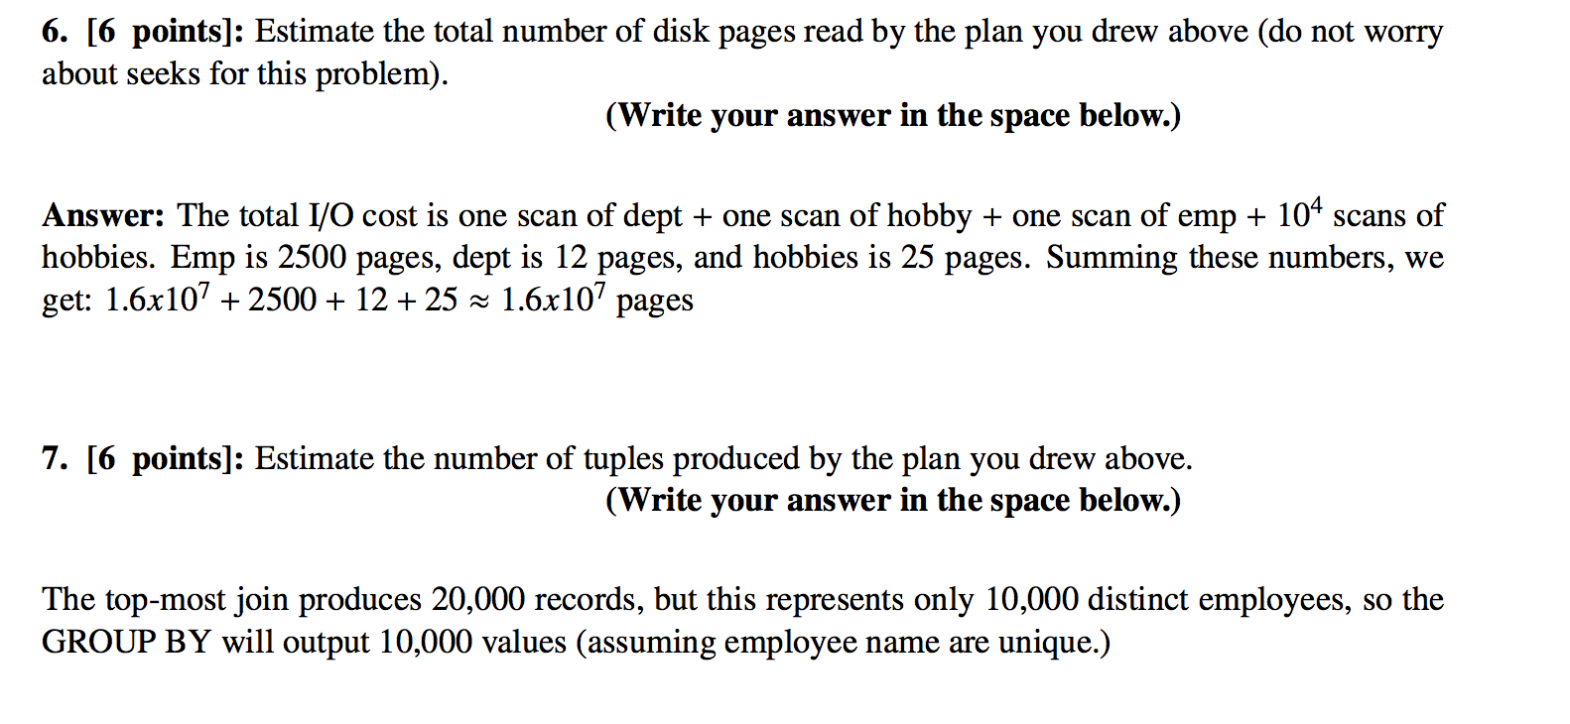
Example Problem 2 Answer Cont.

