Slide 1
Chapter 2
Pattern Representation
Assoc. Prof. Dr. Duong Tuan Anh
Faculty of Computer Science and Engineering,
HCMC Univ. of Technology
3/2015

Slide 2
Outline
  1. Data structures for pattern representation
  2. Proximity measures
  3. Size of patterns
  4. Abstractions of the data set
  5. Feature extraction
    Fisher’s linear discriminant
    Principal component analysis (PCA)
  6. Feature selection
  7. Evaluation of classifiers

Slide 3
Pattern representation
A pattern is a physical object or an abstraction notion.
Depending on the classification problem, distinguishing features of the patterns are used. These features are called attributes.
A pattern is the representation of an object by the values taken by the attributes.
The choice of attributes and representation of patterns is very important step in pattern classification.
A good representation is one which make use of discriminating attributes and also reduces the computational burden in pattern classification.

Slide 4
1. Data structures for pattern representation
Patterns as vectors
Each element of the vector can represent one attribute of the pattern.
Example: Spherical objects, (30, 1) represents a spherical object with 30 units of weight and 1 unit diameter.
A set of patterns.
1.0, 1.0, 1 1.0, 2.0, 1 2.0, 1.0, 1
2.0, 2.0, 1 4.0, 1.0, 2 5.0, 1.0, 2
4.0, 2.0, 2 5.0, 2.0, 2 1.0, 4.0, 2
1.0, 5.0, 2 2.0, 4.0, 2 2.0, 5.0, 2
4.0, 4.0, 1 5.0, 5.0, 1 4.0, 5.0, 1
5.0, 4.0, 1
The third element gives the class of the pattern.

Slide 5
Patterns as strings
The string may be view as a sentence in a language.
Example 1: a DNA sequence or protein sequence.
A gene can be defined as a region of the chromosomal DNA constructed with 4 nitrogenous bases: adeline, guanine, cytosine and thymine, which are referred to by A, G, C and T.
A gene data is arranged in a sequence, such as: GAAGTCCAG…

Slide 6
Pattern as sequence of real values
25.1750
25.2250
25.2500
25.2500
25.2750
25.3250
25.3500
25.3500
25.4000
25.4000
25.3250
25.2250
25.2000
25.1750
..
..
24.6250
24.6750
24.6750
24.6250
24.6250
24.6250
24.6750
24.7500
A time series is a sequence of real numbers measured at equal time intervals.
Examples: Financial time series, scientific time series
29
28
27
26
25
24
23
0
50
100
150
200
250
300
350
400
450
500
Figure 2.1 A time series about prices of a stock

Slide 7
Pattern as logical description
Patterns can be represented as a logical description of the form
(x₁ = a₁…a₂) ∧ (x₂ = b₁…b₂) ∧ …
where x₁ and x₂ are the attributes of the pattern and a_{i} and b_{i} are the values taken by the attribute.
This description consists of a conjunction of logical description.
Example:
(color = red ∨ white) ∧ (make = leather) ∧ (shape = sphere)
to represent a cricket ball.

Slide 8
Patterns as trees
Trees are popular data structures for representing patterns and patterns classes. Each node in the tree may represent one or more patterns.
The R-tree and k-d tree are example of this.
R1
R4
The R-tree represents patterns in a tree structure which splits space into hierarchically nested and possibly overlapping minimum bounding rectangles (MBRs).
We can further recursively group MBRs into larger MBRs….
R2
R5
R3
R6
R9
R7
R8
Figure 2.2 Minimum Bounding Regions

Slide 9
Each node of an R-tree has a number of entries. A non-leaf node stores a way of identifying the node and the MBR of all entries of nodes which are its descendants.
R10
R11
R10 R11 R12
R1 R2 R3
R4 R5 R6
R7 R8 R9
R12
Data nodes containing points
Figure 2.3 R-tree

Slide 10
R-tree (cont.)
Some of important operations on an R-tree are update (insertion, deletion) of the tree to reflect the necessary changes and searching of the tree to locate the nearest neighbors of a given pattern.
Insertion and deletion algorithms use the MBRs from the nodes to ensure that the nearby elements are placed in the same leaf node.
Search exploits the MBRs to decide whether or not to search inside a node. In this way, most of the nodes in the tree need not be searched.

Slide 11
2. Proximity measures
In order to classify patterns, they need to be compared against each other and against a standard.
When a new pattern is presented and we need to classify it, the proximity of this pattern to the patterns in the training set is to be found.
In unsupervised learning, it’s required to find some groups in the data so that patterns which are similar are put together.
A number of similarity and dissimilarity measures can be used.

Slide 12
Distance measure
A distance measure is used to find the dissimilarity between pattern representations. Patterns which are more similar should be closer.
A distance function could be a metric or a non-metric.
A metric is a measure for which the following properties hold:
1. Positive reflexivity: d(x,x) = 0
2. Symmetric: d(x, y) = d(y, x)
3. Triangular inequality: d(x, y) ≤ d(x, z) + d(z, y)

Slide 13
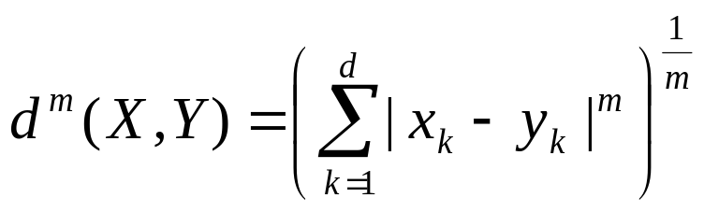
Distance measure (cont.)
The popular distance metric called the Minkowski metric is of the form
When m = 1 it is called the Manhattan distance or L₁ distance.
The most popular is the Euclidean distance or the L₂ distance when m = 2.

Slide 14
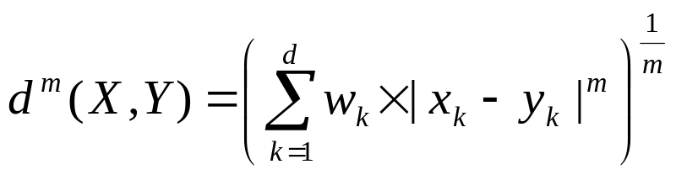
Distance measure (cont.)
Example: X = (4, 1, 3) and Y = (2, 5, 1), the Euclidean distance:
Weighted Distance Measure
The weighted distance metric is of the form
where w_{k} is the weight associated with the k-th attribute (feature)

Slide 15
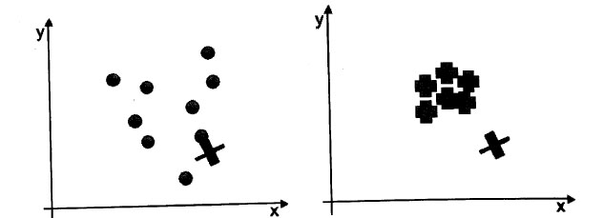
Mahalanobis distance
Suppose 2 datasets shown as in the figure and the test point (the large ‘X’). Let check if the X is part of the data. For the figure on the left, the answer is yes while for the (right), the answer is no.
We look at not only the mean of the dataset but also the spread of the actual data points.
If the data is tightly controlled then the test point has to be close the mean, while if the dataset is very spread out then the distance of the test point from the mean does not matter much.
The Mahalanobis distance is the distance that takes this into account.
Figure 2.4 Two different datasets and a test point

Slide 16
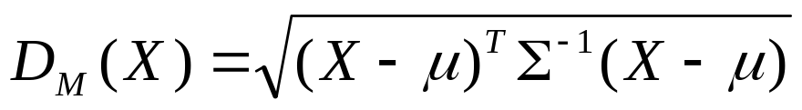
Mahalanobis distance
The Mahalanobis distance from data point X to the mean is given by
where X is the column vector of data point with mean vector μ and Σ⁻¹ is the inverse of the covariance matrix (of the dataset).
The Mahalanobis distance is a generalization of Euclidean distance. It is an approximate measure when attributes have different scales and are correlated, but still are Gausian distributed.
If we set the covariance matrix to identity matrix, the Mahalanobis distance reduces to the Euclidean distance.
Computing Mahalanobis distance incurs high computational cost.

Slide 17
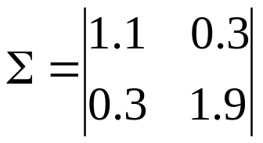
Example of Mahalanobis distance
In a two-class, two-attribute classification, the feature vectors are described by a covariance matrix:
And the mean vectors are μ₁ = [0, 0]^{T}, μ₂ = [3, 3]^{T}, respectively.
Classify the vector [1.0, 2.2]^{T}.
Compute the Mahalanobis distance from the test point to the two means
The vector is assigned to class 1, since it is closer to μ₁.

Slide 18
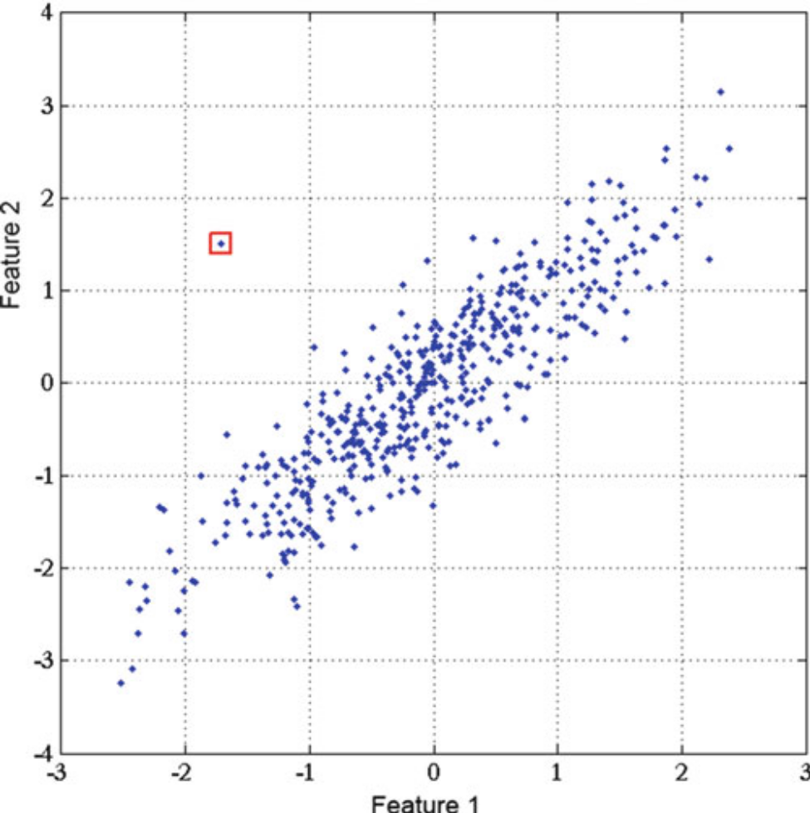
The Mahalanobis distance is widely used in supervised classification techniques and in clustering. A test point is classified as belonging to that class for which the Mahalanobis distance is minimal.
The Mahalanobis distance can also be used to detect outliers, as samples that have a significantly greater Mahalanobis distance from the mean than the rest of the samples.
Figure 2.5 Example of an outlier

Slide 19
Non-metric similarity function
Non-metric similarity function is the similarity function which does not obey either the triangular inequality or symmetry.
This kind of similarity functions are useful for images or string data.
Example: k-median distance
If X = (x₁, x₂,…,x_{d}) and Y = (y₁, y₂,…,y_{d}), then
d(X, Y) = k-median{|x₁ - y₁|,…|x_{d} - y_{d}|}
where the k-median operator returns the k-th value of the ordered difference vector.
Example: if X = (50, 3, 100, 29, 62, 140) and Y = (55, 15, 80, 50, 70, 170) then Difference vector = {5, 12, 20, 21, 8, 30).
d(X,Y) = k-median(5, 8, 12, 20, 21, 30).
If k = 3 then d(X, Y) = 12.

Slide 20
Edit distance (Levenshtein distance)
Edit distance measures the distance between two strings.
The edit distance between two strings s₁ and s₂ is defined as the minimum number of point mutations required to change s₁ to s₂.
A point mutations can be one of the following operations:
  Changing a letter
  Inserting a letter
  Deleting a letter
The following recurrence relation defines the edit distance between two strings.
  d(“ “, “ “) = 0
  d(s, “ “) = d(“ “, s) = ||s||
  d(s₁+ch₁, s₂+ch₂) = min(d(s₁, s₂)+ {if ch₁ = ch₂ then 0 else 1},
  d(s₁+ ch₁, s₂)+1, d(s₁, s₂ + ch₂)+1))

Slide 21
Edit distance (cont.)
Example:
  If s = “TRAIN” and t = “BRAIN”, then edit distance = 1 because this requires a change of just one letter.
  If s = “TRAIN” and t = “CRANE”, then edit distance = 3. We can write the edit distance from s to t to be the edit distance between “TRAI” and “CRAN” + 1 (since N and E are not the same). It would then be the edit distance between “TRA” and “CRA” + 2 (sine I and N are not the same). Proceeding in this way, we get the edit distance to be 3.
Application: Edit distance can be used in speech recognition
Dynamic Time Warping (DTW) is also a non-metric distance for time series data.

Slide 22
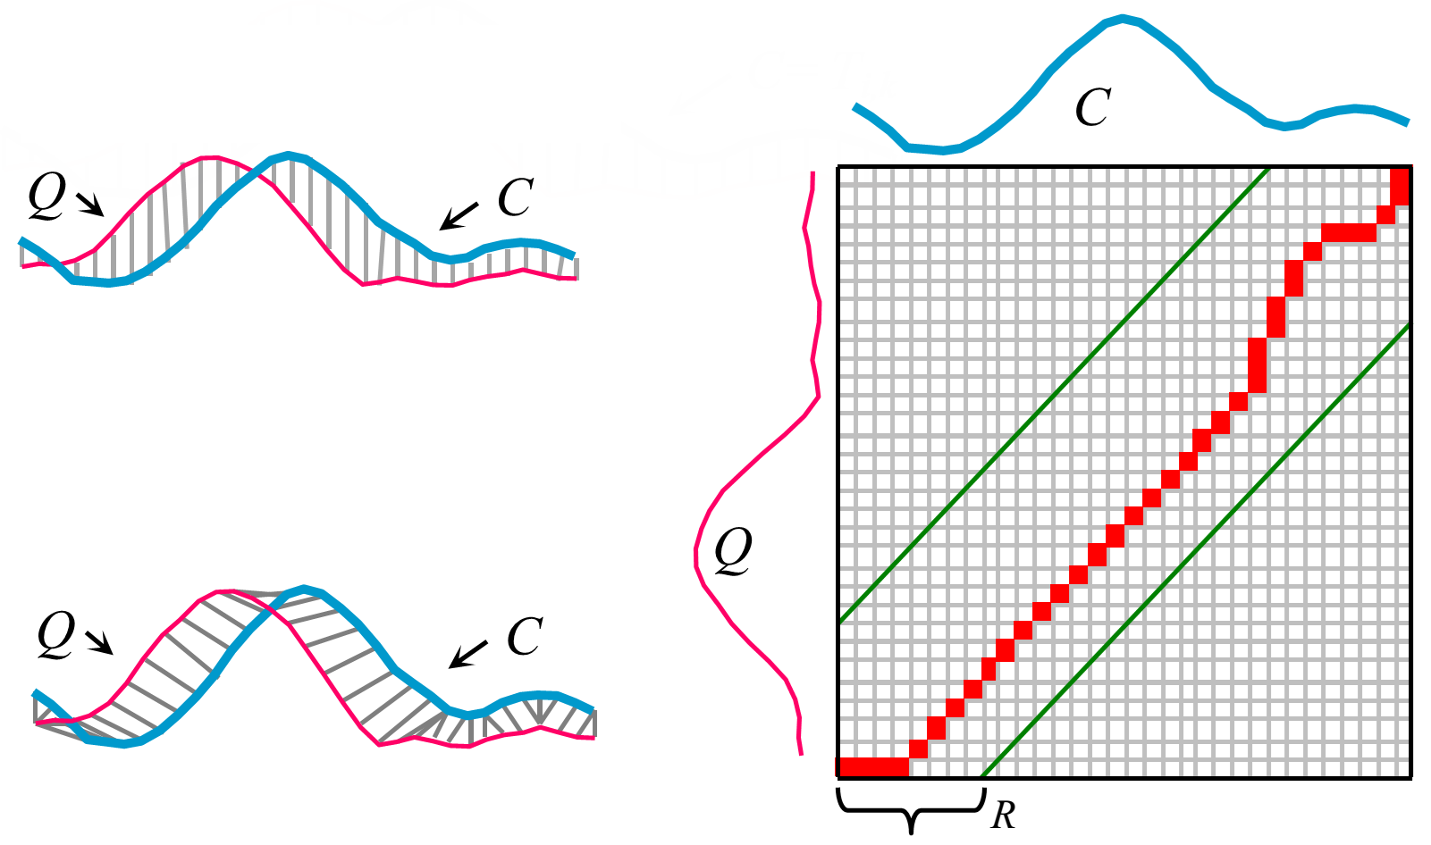
Dynamic Time Warping
(Left) Two time series Q and C which are similar but out of phase: using Euclidean distance (top left) and DTW distance (bottom left). Note that Sakoe-Chiba Band with width R is used to constrain the warping path (right).

Slide 23
3. Size of patterns
The size of a pattern depends on the attributes being considered. In some cases, the length of the patterns may be a variable.
Example: in document retrieval, documents may be of different lengths.
Example: in time series data mining, time series may be of different lengths.
This problem can be handled in different ways.
Normalization of data can make all the patterns have the same dimensionality (i.e. the same number of attributes)

Slide 24
Normalization of data
Normalization can also be done to given the same importance to every feature in a data set of patterns.
Ex: Consider a data set of patterns with two features:
X₁: (2, 120), X₂: (8, 533), X₃: (1, 987), X₄: (15, 1121),
X₅: (18, 1023)
Normalization givens equal importance to every feature. Dividing every value of the first feature by its maximum value (18) and dividing every value of the second feature (1121) by its maximum value.
X’₁= (0.11, 0.11), X’₂= (0.44, 0.48), X’₃ = (0.06, 0.88), X’₄= (0.83, 1.0), X’₅= (1.0, 0.91).
Note: Some similarity measures can deal with unequal lengths. One such similarity measure is the edit distance.

Slide 25
4. Abstractions of the data set
In supervised learning, a set of training patterns where the class label for each pattern is given, is used for classification. The large training set may not be used because the processing time may be too long but an abstraction of the training set can be used.
There are some ways of abstractions:
1. No abstraction of patterns.
2. Single representative per class.
  The mean of the class
  The medoid (the most centrally located pattern) of the class.
3. Multiple representatives per class
  Cluster representatives as abstractions. The patterns in the class are clustered and the cluster centers of each cluster is the representative of all the patterns in the class.
  Support vectors as representatives. Support vectors are determined for the class and used to represent the class.

Slide 26
5. Feature extraction
Feature extraction: detecting and isolating various desired features of patterns.
It is the operation of extracting features for identifying or interpreting meaningful information from the data.
This is especially relevant in the case of image data where feature extraction involves automatic recognition of various features.
Feature extraction is an essential preprocessing step in pattern recognition.
Two important methods of feature extraction:
  Fisher’s Linear Discriminant
  Principal Component Analysis (PCA)

Slide 27
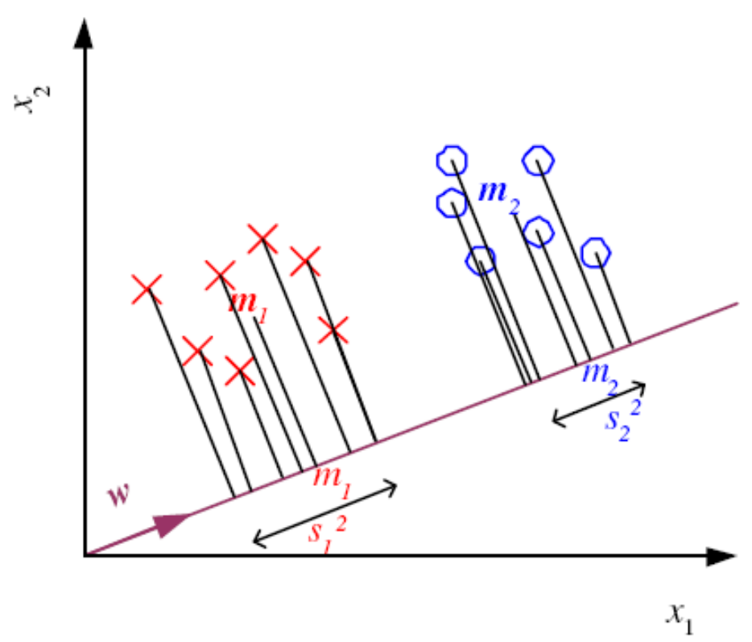
Fisher’s Linear Discriminant (LDA)
LDA projects high-dimensional data onto a line and performs classification in this space.
Give samples from two classes C₁ and C₂, we want to find the direction, as defined by a vector w, such that when the data are projected onto w, the examples from the two classes are as well separated as possible.
If there are two classes, the projection maximizes the distance between two means and minimizes the variance within each class. Fisher’s criterion which is maximized over all linear projection w can be defined as
Figure 2.6 Two-dimensional, two-class data projected on w

Slide 28
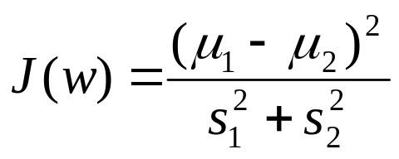
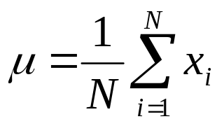
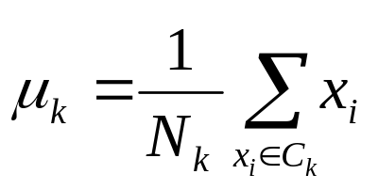
where μ₁ and μ₂ represent the mean of Class 1 patterns and Class 2 patterns and s² is proportional to the variance.
In general, if X ={x_{i}} is a set of N column vectors of dimension D, the mean of the dataset is:
In case of multi-dimensional data, the mean is a vector of length D, where D is the dimension of the data.
If there are K classes {C₁, C₂,…, C_{K}}, the mean of class C_{k} containing N_{k} members is

Slide 29
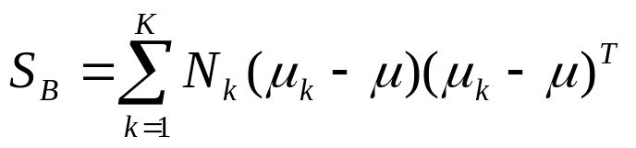
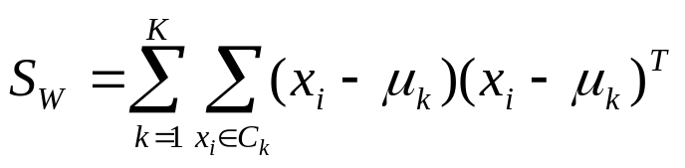
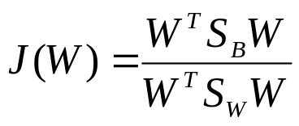
The between class scatter matrix is
The within class scatter matrix is
The transformation matrix W that repositions the data to be most separatable must maximize the criterion:
The vector W that maximizes J(W) can be shown to satisfy:
S_{B}W = λS_{W}W
Let {w₁, w₂,…,w_{D}} be the eigenvectors of S_{W}⁻¹S_{B.}
This gives the projection space of dimension D. A projection space of dimension d < D can be defined by using the eigenvectors with the largest d eigenvalues to give W_{d} = [w₁, w₂,…,w_{d}].
The projection of vector x into a sub-space of dimension d is y = W_{d}^{T} .x

Slide 30
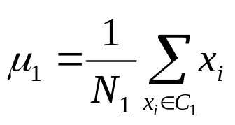
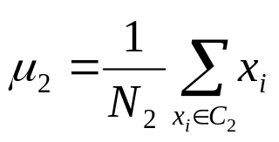
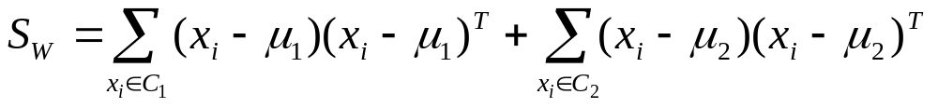
In the case of two-class problem,
S_{B} = N₁(μ₁ - μ)(μ₁ - μ)^{T} + N₂(μ₂ - μ)(μ₂ - μ)^{T}
S_{B}W= λS_{W}W
This means that
S_{W}⁻¹S_{B}W = λW
Since S_{B}W is always in the direction of μ₁ - μ₂, the solution for W is:
W = S_{W}⁻¹(μ₁ - μ₂)
The intention here is to convert a d-dimensional problem to a one-dimensional problem.

Slide 31
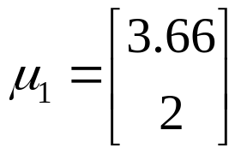
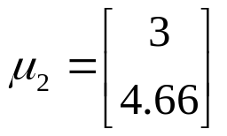
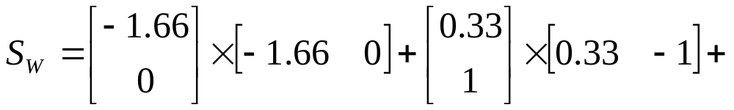
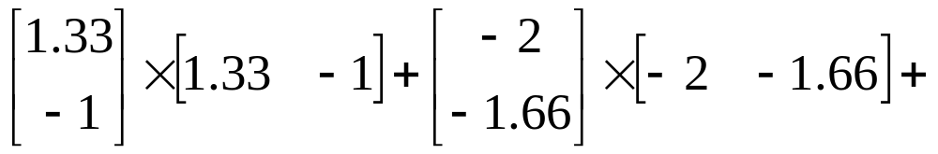
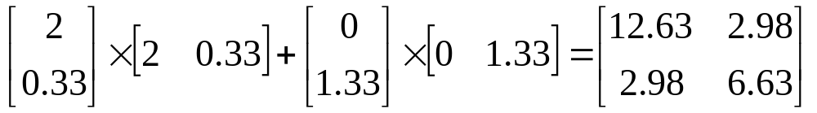
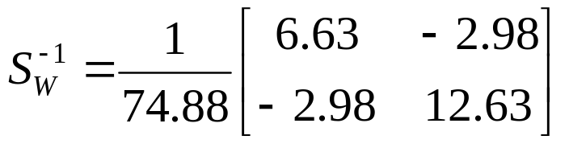
Example (LDA)
If there are 6 data points (2,2), (4,3) and (5,1) belonging to Class 1 and (1, 3), (5, 5) and (3, 6) belonging to Class 2, the means will be:
The within-class-scatter matrix will be:

Slide 32
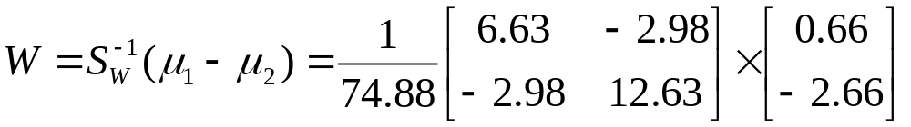
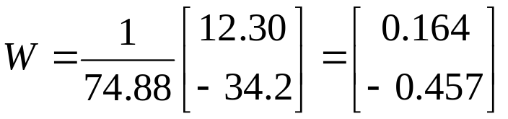
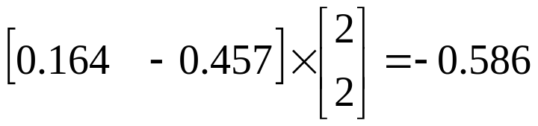
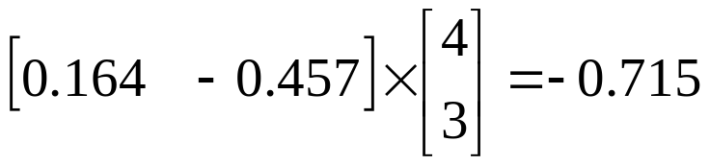
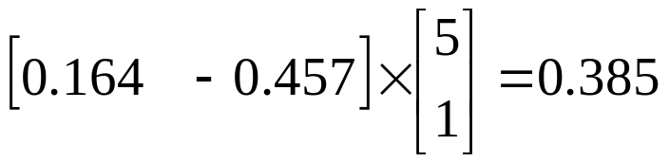
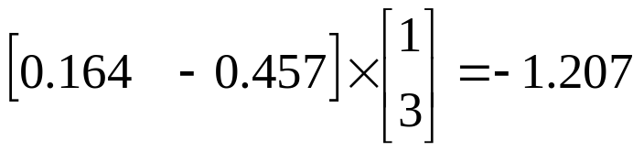
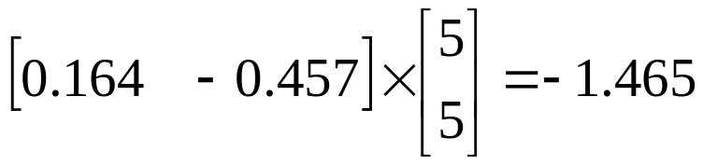
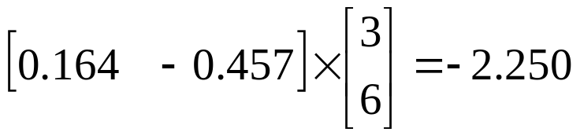
The projection of the data points in Class 1 are as follows:
The projection of the data points in Class 2 are as follows:
Note that w.x ≥ - 0.715 if x ∈ Class 1 and w.x ≤ - 1.207 if x ∈ Class 2.

Slide 33
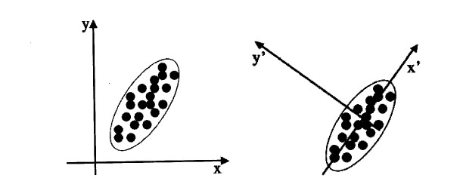
Principal Component Analysis (PCA)
PCA is a mathematical procedure that transform a number of correlated attributes into a smaller number of non-correlated attributes called principal components.
PCA is a method of dimensionality reduction
Figure 2.7: Two different sets of coordinate axes. The second consists of a rotation and translation of the first and was found by using PCA.
The goal of PCA is to identify the most meaningful basis to re-express a data set.

Slide 34
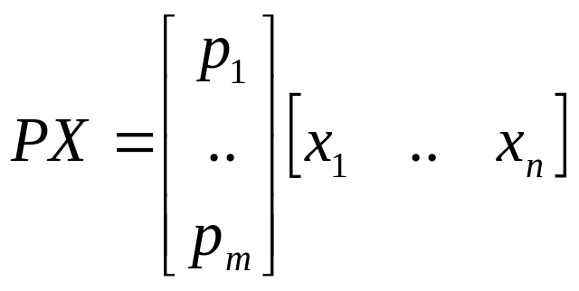
Change of basis
“Is there another basis which is a linear combination of the original basis, that best re-express our data set?
Let X be the original data set, where each column is a single sample of our data set. X is an m × n matrix. Let Y be another m × n matrix related by a linear transformation P. So X is the original recorded data and Y is a new representation of that data set.
PX = Y (1)
Equation (1) represent a change of basis.
  P is a matrix that transforms X into Y.
  Geometrically, P is a rotation and a translation.
  The rows of P, {p₁, …,p_{m}}, are set of new basis vectors for expressing the columns of X.

Slide 35
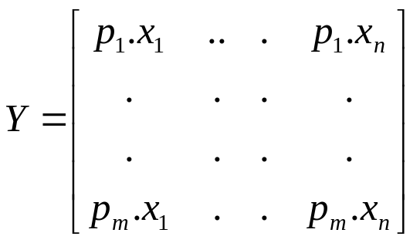
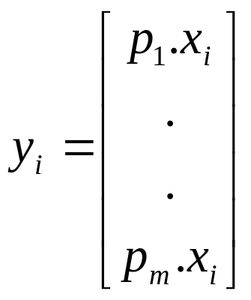
Each column of Y:
y_{i} is a projection of x_{i} on to the basis of {p₁, …,p_{m}}.
Now, several questions arise:
What is the best way to re-express X?
What is a good choice of basis P?

Slide 36
From the matrix X, let build the covariance matrix of X, called C_{X}.
  C_{X} is a square symmetric m × m matrix
  The diagonal terms of C_{X} are the variances of particular attributes.
  The off-diagonal terms of C_{X} are the covariance between two corresponding attributes.
C_{X} captures the noise and redundancy in our data set.
  In the diagonal terms, large values correspond to interesting structure.
  In the off-diagonal terms, large values correspond to high redundancy.
Now, the question is: What features do we want to have in C_{Y}?
What we want the optimized covariance matrix C_{Y} look like?

Slide 37
Principal component analysis
Unsupervised method for identifying the important directions in a dataset
We can then rotate the data into the (reduced) coordinate system that is given by those directions
PCA is a method for dimensionality reduction
Algorithm:
  Find direction (axis) of greatest variance
  Find direction of greatest variance that is perpendicular to previous direction and repeat
Implementation: find eigenvectors of the covariance matrix of the data
  Eigenvectors (sorted by eigenvalues) are the directions
  Mathematical details are covered in chapter on “Probabilistic methods”

Slide 38
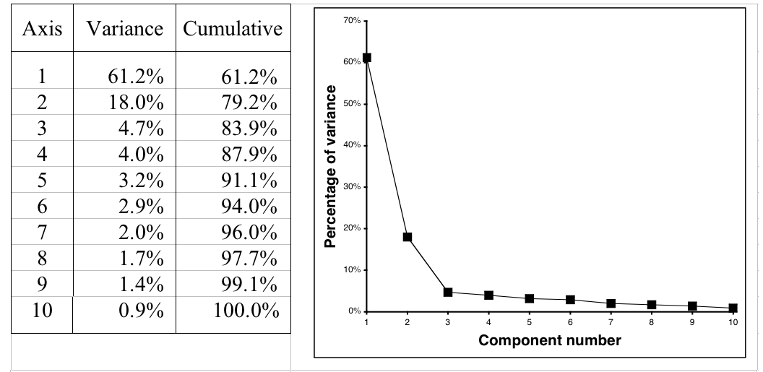
Example: 10-dimensional data
Data is normally standardized or mean-centered for PCA
Can also apply this recursively in a tree learner

Slide 39
Diagonalize the covariance matrix
What we want the optimized covariance matrix C_{Y} look like?
  All off-diagonal terms in C_{Y} should be zero. Thus, C_{Y} must be a diagonal matrix. Y is decorrelated.
  Each successive dimension in Y should be rank-ordered according to variance.
There are many methods for diagonalizing C_{Y}. PCA selects the easiest method: PCA assumes that P is an orthonormal matrix.
P acts as a generalized rotation to align a basis with the axis of maximum variance.
In multiple dimensions this could be performed by a simple algorithm:

Slide 40
PCA algorithm
1. Select a normalized direction in m-dimensional space along which the variance in X is maximized. Save this vector as p₁.
2. Find another direction along which variance is maximized, however, because of the orthonormality condition, restrict the search to all directions orthogonal to all previous selected directions. Save this vector as p_{i}.
3. Repeat this procedure until m vectors are selected.
The resulting ordered set of p’s are the principal components.
Summary of Assumptions in PCA
Linearity
Large variances have important structure
The principal components are orthogonal

Slide 41
Solving PCA using eigenvector decomposition
Given the data set X, an m × n matrix, where m is the number of attributes and n is the number of samples. The goal is as follows.
“Find some orthonormal matrix P in Y= PX such that C_{Y} = (1/n)YY^{T} is a diagonal matrix. The rows of P are the principal components of X.”
We begin by rewriting C_{Y} in terms of the unknown variable.
C_{Y} = (1/n)YY^{T}
= (1/n)(PX)(PX)^{T}
= (1/n)PXX^{T}P^{T}
= P(1/n)XX^{T}P^{T}
C_{Y} = PC_{X}P^{T}
Note that the covariance matrix C_{X} appears in the last line. C_{X} is a symmetric matrix.

Slide 42
Theorem: Let A be a square n × n symmetric matrix with associated eigenvectors {e₁, e₂,…,e_{n}}. Let E = [e₁ e₂ …e_{n}] where ith column of E is the eigen vector e_{i}. There exists a diagonal matrix D such that A = EDE^{T}.
Now come the trick. We select the matrix P to be the matrix where each row p_{i} is an eigenvector of C_{X}. By this selection, P = E^{T}. With this relation, we can finish evaluating C_{Y}.
C_{Y} = PC_{X}P^{T}
= P(EDE^{T})P^{T}
= P(P^{T}DP)P^{T}
= (PP^{T})D(PP^{T})
Since P^{T} = P⁻¹ (Theorem: the inverse of an orthogonal matrix is its transpose), we get
C_{Y} = (PP⁻¹)D(PP⁻¹)
= D
It is evident that the choice of P diagonalizes C_{Y}. This was the goal of PCA.

Slide 43
Computing PCA
We can summarize the results of PCA in the matrix P and C_{Y}.
  The principal components of X are the eigenvectors of C_{X}, the covariance matrix of X.
  The ith diagonal value of C_{Y} is the variance of X along p_{i}.
In practice computing PCA of a dataset X consists of:
  Subtracting off the mean of each attribute in X.
  Computing the covariance matrix C_{X}.
  Computing the eigenvalues and eigenvectors of C_{X}.
  Reject the eigenvalues less than some threshold, leaving l dimensions in the data.
  If P is the matrix consisting of eigenvectors of C_{X} as the row vectors, we get y_{i} = P(x_{i} - mean(X)) i = 1… n

Slide 44
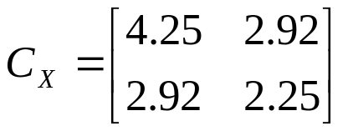
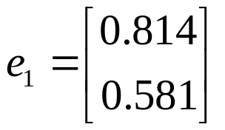
Example (PCA)
A data set contains four patterns in two dimension: (1,1), (1, 2), (4,4) and (5,4). With these four patterns, the mean vector is
[2.75 2.75].
With these four patterns, the covariance matrix is:
The eigenvalues of C_{X} are λ₁ = 6.336 and λ₂ = 0.1635.
Since the second eigenvalue is very small compared to the first eigenvalue, the second eigenvector can be left out. The eigenvector which is most significant is computed as

Slide 45
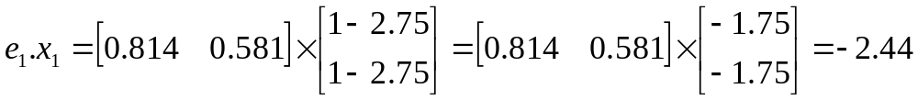
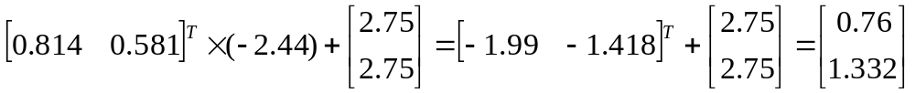
Example (PCA) (cont.)
To transform the patterns on to the eigenvector, the pattern (1, 1) gets transformed to
Similarly, the patterns (1, 2), (4, 4) and (5, 4) get transformed to -1.86, 1.74 and 2.56.
When we try to get the original data using the transformed data, some information is lost. For pattern (1, 1), using the transformed data, we get

Slide 46
PCA tool
PCA tool is available in:
  MATLAB
  The data mining software Weka (Attribute selection – “filters”)

Slide 47
6. Feature selection
Features used for classification may be always be meaningful. Removal of some of the features may give a better classification accuracy.
Features which are useless for classification are found and left out.
Feature selection can:
  Speed up the process of classification
  Ensure that the classification accuracy is optimal.
Feature selection algorithms involve searching through different feature subsets. Feature selection algorithms = search algorithms.

Slide 48
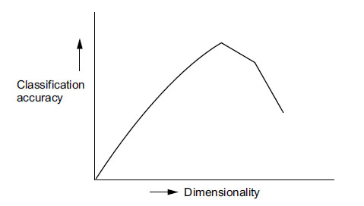
Feature selection can ensure improvement of classification accuracy, due to 2 reasons:
  1. The performance of a classifier depends on (i) sample size, (ii) number of features and (iii) classifier. The probability of misclassification does not increase as the number of features increases, as long as the number of training patterns is large. If the number of training patterns is small, adding features may degrade the accuracy of a classifier.
  ⇒ Peaking phenomenon or the curse of dimensionality
2. As dimensionality increases, the distance to the nearest data point approaches the distant of the furthest data point. This effects the results of the nearest neighbor problem.
Figure 2.8 The curse of dimensionality

Slide 49
Exhaustive search
The most straightforward approach to the problem of feature subset selection is exhaustive search.
Search through all the feature subsets and find the best subset.
If the patterns consist of d features and a subset of size m features is to be found with the smallest classification error, it entails searching all C(m,d) possible sub-sets of size m and selecting the subset with the highest criterion function J(.), where J = (1- P_{e}).
P_{e} : probability of classification error
This technique is impractical to use even for moderate value of d and m. Even when d is 24 and m is 12, approximately 2.7 million feature subsets must be checked.

Slide 50
Sequential selection
These methods operate either by evaluating growing feature sets or shrinking feature sets.
The method that starts with the empty set and add features one after the other is called sequential forward selection (SFS). This method is bottom-up.
The method that starts with the full set and delete features one after the other is called sequential backward selection (SBS). This method is top-down.
These methods are just heuristics. They do not guarantee the optimal result.
The stepwise forward selection and backward selection methods suffer the “nesting effect”.
In the case of top-down search the discarded features can not be re-selected while in the case of the “bottom-up” search the features once selected can not be later discarded.

Slide 51
Sequential selection (cont.)
The features are selected according to their significance. The most significant feature is selected to be added to the feature subset at every stage.
The most significant feature is the feature that give the highest increase in criterion function value as compared to that of the others before adding the feature.
If U₀ is the feature added to the set X_{k} consisting of k features then the significance of this is:
S_{k+1}(U₀) = J(X_{k} ∪ U₀) – J(X_{k})
i.e. J(X_{k}∪ U₀^{r}) = max J(X_{k} ∪ U₀^{i})
0≤ i ≤ ∅
where is ∅ the number of all the possible 0-features.

Slide 52
Sequential selection (cont.)
The least significant feature with respect to set X_{k} is
. J(X_{k}∪ U₀^{r}) = min J(X_{k} ∪ U₀^{i})
0≤ i ≤ ∅
Combination of forward selection and backward selection: The stepwise forward selection and backward selection methods can be combined so that, at each step, the procedure selects the best attribute and removes the worst from the remaining attributes.
This method is called sequential floating search.

Slide 53
Sequential floating forward search
The principle of SFFS is as follows:
Step 1: Let k = 0
Step 2: Add the most significant feature to the current subset of size k. Let k = k+1
Step 3: Conditionally remove the least significant feature from the current subset.
Step 4: If the current subset is the best subset of size k-1 found so far, let k = k-1 and go to step 3. Else return the conditionally removed feature and go to Step 2.
Note: The algorithm starts with no feature and then adds features one by one.

Slide 54
Sequential floating backward search
The method is similar to the SFFS except that the backward search is carried out first and then the forward search. The principle of SFFS is as follows:
Step 1: Let k = 0
Step 2: Remove the least significant feature to the current subset of size d - k. Let k = k +1
Step 3: Conditionally add the most significant feature not in the current subset.
Step 4: If the current subset is the best subset of size d – (k -1) found so far, let k = k -1 and go to step 3. Else remove the conditionally added feature and go to Step 2.
Note: The algorithm starts with all the features (size = d) and then removes them one by one.

Slide 55
Stochastic Search Techniques
Genetic algorithm is a stochastic search technique which is often used for feature selection.
The population in the GA consists of strings which is binary.
Each string (chromosome) is of length d, with each position i being zero or one depending on the absence or presence of feature i in the set.
Each feature subset is coded as a d-element bit string. Each string in the population is a feature selection vector α, where α = α₁,…, α_{d} and α_{i} assumes a value 0 if the ith feature is excluded and 1 if it is present in the subset.
To compute the fitness of a chromosome, it is evaluated by determine its performance on the training set.
Besides genetic algorithm, Tabu search and simulate annealing can be used in feature selection.

Slide 56
Filters and wrappers
There are a number of different approaches to feature selection. In general, they are divided into two kinds: filters and wrappers.
In filter model, the features are filtered independent of the classification algorithm.
  The criterion function used in the filter is not based on classification error. It is based on general characteristics of the data.
In wrapper model, the features subset selection algorithm conducts a search for a good subset using the classification algorithm itself as part of the evaluation function.

Slide 57

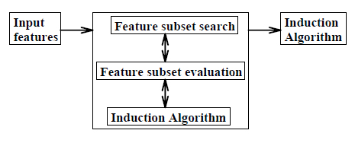
Filters and wrappers (cont.)
(a)
(b)
Figure 2.9: (a) Filter model, (b) Wrapper model

Slide 58
7. Classifier Accuracy Measures
Accuracy is better measured on a test set consisting of class-labeled tuples that were not used to train the model.
The accuracy of a classifier on a given test set is the percentage of test set tuples that are correctly classified by the classifier. It is also called the overall recognition rate of the classifier.
The error rate or misclassification rate of a classifier, M, is simply 1- Acc(M), where Acc(M) is the accuracy of M.
The confusion matrix is a useful tool for analyzing how well the classifier can recognize tuples of different classes. Give m class, a confusion matrix is a table of at least size m by m.
An entry, CM_{ij} indicates the number of tuples of class i that were labeled by the classifier as class j.
For a classifier to have good accuracy, most of the tuples would be represented along the diagonal of the confusion matrix, from entry CM₁₁ to CM_{mm}, with the rest of the entries being close to zero.

Slide 59
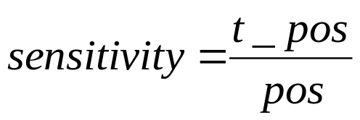
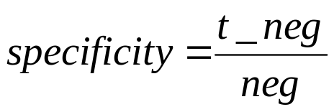
Predicted class
C₁ C₂
--------------------------------------------------------------------------
Actual class C₁ | true positives false negatives
C₂ | false positives true negatives
The sensitivity and specificity measures can be used.
Sensitivity is also referred to as the true positive (recognition) rate (that is, the proportion of positive tuples that are correctly identified), while specificity is the true negative (recognition) rate (that is, the proportion of negative tuples that are correctly identified).
where t_pos is the number of true positive tuples, pos is the number of positive tuples, t_neg is the number of true negative tuples and neg is the number of negative tuples.

Slide 60
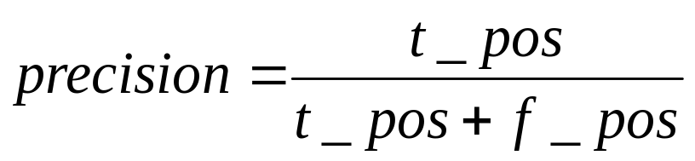
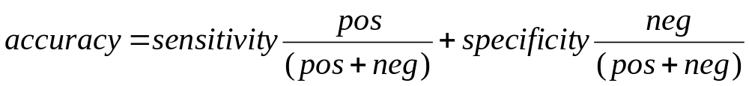
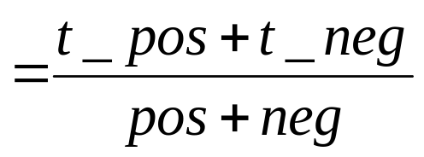
We may use precision to access the percentage of tuples labeled as “positive” that actually are positive tuples.
Accuracy is a function of sensitivity and specificity.

Slide 61
8. Evaluating the accuracy of a classifier
To estimate how good a classifier is, an estimate can be made using the training set. Assume that the training data is a good representative of the data.
Usually the training set is divided into smaller subsets. One of the subsets is used for training while the other is used for testing.
Different methods of testing are as follows.
Holdout method: The training set is divided into two subsets. Typically two-thirds of the data is used for training and one-third is used for testing. It could also be one-haft for training and one-haft for testing or any other proportion.
Random sub-sampling: In this method, the holdout method is repeated a number of times with different training and test data each time.

Slide 62
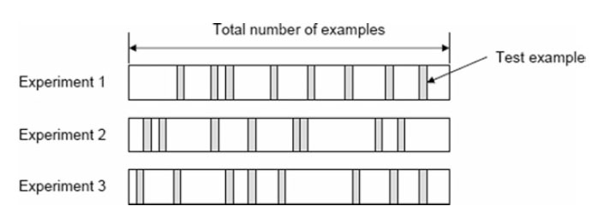
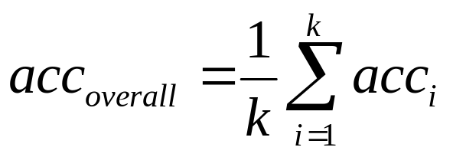
Random subsampling
Figure 2.10 Random subsampling
If the process is repeated k times, the overall accuracy will be

Slide 63
Cross validation
Cross-validation: In cross-validation, each pattern is used the same number of times for training and exactly once for testing. An example of cross-validation is the two-fold cross validation. Here the data set is divided into two equal subsets. First, one set is used for training and the other for testing. Then the roles of the subsets are swapped – the set for training becomes the set for validation and vice versa.
In k-fold cross-validation, the data is divided into k equal subsets. During each run, one subset is used for testing and the rest of the subsets are used for training. The procedure is carried out k times so that each subset is used for testing once.
  A special case of the k-fold cross-validation is when k = n, where n is the number of patterns in the data set. This is called the leave-one-out approach, where each test set contains only one pattern. The procedure is repeated n times.

Slide 64
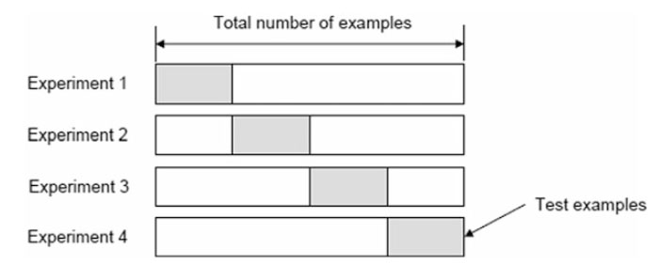

a) k-fold cross validation, with k = 4
b) Leave-one-out cross-validation
Figure 2.11 k-Fold cross-validation and Leave-one-out cross-validation

Slide 65
Bootstrap
The dataset is sampled with replacement, i.e., an instance already chosen for training is put back into the original dataset and can be chosen again so that there can be duplicate objects in the training set. The remaining instances not selected for training are used for testing.
The process is repeated for a specified number of folds, k.
In the bootstrap, we sample N instances from a dataset of size N with replacement. The original dataset is used as the test set. The probability that we pick an instance is 1/N; and the probability that it is not picked is 1-1/N. The probability that we do not pick it after N draws is
(1 – 1/N)^{N} ≈ e⁻¹ = 0.368
This means that the training data contain 63.2% of the instances and the test data contain 36.8%.

Slide 66

Boostrap (cont.)
Figure 2.12 The boostrap method

Slide 67
Appendix
Expectation
Variance
Covariance
The eigenvalue problem

Slide 68


Expectation
Expectation, expected value, or mean of a random variable X, denoted by E[X], is the average value of X in a large number of experiments.
It has the following properties (a, b ∈ℜ):
E[aX + b] = aE[X] + b
E[X + Y] = E[X] + E[Y]
Mean is the first moment and is denoted by μ.

Slide 69
Variance
Variance measures how much X varies around the expected value. If μ ≡ E[X], the variance is defined as
Var(X) = E[(X - μ)²] = E[X²] - μ²
Variance is the second moment minus the square of the first moment.
Variance, denoted by σ², satisfies the following properties (a, b ∈ℜ):
Var(aX + b) = a²Var(X)
Square root of Var(X) is called standard deviation and is denoted by σ.

Slide 70
Example:
Table: Probability distribution for Y
y p(y)
----------------------
0 1/8
1 1/4
2 3/8
3 1/4
μ = E(Y) = ∑ yp(y) = (0)(1/8) + (1)(1/4)+ (2)(3/8)+ (3)(1/4) = 1.75
σ² = E[(Y - μ)²] = ∑ (y - μ)²p(y)
= (0-1.75)²(1/8) + (1-1.75)²(1/4) + (2 -1.75)²(3/8) + (3-1.75)²(1/4) = 0.9375
σ = 0.97

Slide 71
Covariance
Covariance indicates the relationship between two random variables. If the occurrence of X makes Y more likely to occur, then the covariance is positive; it is negative if X’s occurrence make Y less likely to happen and is 0 if there is no dependence.
Cov(X, Y) = E[(X - μ_{X})(Y - μ_{Y})] = E[XY] - μ_{X}μ_{Y}
where μ_{X} ≡ E[X] and μ_{y} ≡ E[Y].
Some other properties:
Cov(X, Y) = Cov(Y, X)
Cov(X, X) = Var(X)
Cov(X + Z, Y) = Cov(X, Y) + Cov(Z, Y)

Slide 72

Covariance matrix
Covariance can be used to look at the relationship between all pair of variables within a set of data. We need to compute the covariance of each pair and these are put together into a covariance matrix.
where σ_{ij} is the covariance of two variables X_{i} and X_{j}, i.e.
σ_{ij} = Cov(X_{i}, X_{j}) = E(X_{i} - μ_{i})(X_{j} - μ_{j}) = E(X_{i}X_{j}) - μ_{i} μ_{j}
Covariance matrix is symmetric since σ_{ij} = σ_{ji} and σ_{ii} = σ_{i}²

Slide 73

Example of covariance matrix
Five measurements (observations) each are taken of 3 features, X₁, X₂ and X₃ so that the feature vector is
X₁ X₂ X₃
4.0 2.0 0.6
4.2 2.1 0.59
3.9 2.0 0.58
4.3 2.1 0.62
4.1 2.2 0.63
The mean values are given by μ = [4.1 2.08 0.604]. And the covariance matrix by:
where 0.025 is the variance of X₁, 0.0075 is the covariance between X₁ and X₂, 0.00175 is the covariance between X₁ and X₃, etc.

Slide 74
The eigenvalue problem
Let A be an n × n matrix, v an n × 1 column vector and λ a scalar. If
Av = λv
we say that v is an eigen vector of A and that λ is an eigenvalue of A.
The characteristic polynomial
The characteristic polynomial of a square n×n matrix A is
det |A - λI|
where λ is an unknown variable and I is the n×n identity matrix.

Slide 75
The eigenvalue problem (cont.)
The Cayley-Hamilton Theorem
In practical calculation, we set the characteristic polynomial equal to zero, given the characteristic equation:
det |A - λI| = 0
The zeros of the characteristic polynomial, which are solutions to this equation, are the eigenvalues of the matrix A.
The second step in solving the eigenvalue problem is to find the eigen vectors that correspond to each eigenvalue found in the solution of the characteristic equation.

Slide 76




Example
To find the eigenvalues, we solve
det |A - λI| = 0
where
The characteristic polynomial in this case is
= (5 - λ)(2 - λ) – 18 = λ² - 7λ -8 = (λ - 8)(λ+1) = 0
The solutions of this equation are the two eigenvalues: λ₁ = 8, λ₂ = -1

Slide 77




Now we consider each eigenvalue in turn. An eigen vector of a 2×2 matrix is going to be a column vector with 2 components. If we call these two unknowns x and y, then we can write the vector as
For the first eigenvalue (λ₁ = 8), the eigen vector equation is Av = λ₁v
We have two equations:
5x + 2y = 8x (1)
9x + 2y = 8y (2)
From (1) and (2), we get: y = 3x/2. The system has only one free variable. So we choose x = 2, then y = 3. Then the eigen vector corresponding to λ₁ = 8 is:

Slide 78


Now we check this result
So, the result satisfies: Av₁ = λ₁v₁
For the second eigenvalue: λ₂ = -1
We do the same procedure and obtain the second eigenvector:
Summarizing, we have found the eigenvectors of the matrix A to be

Slide 79
References
M. N. Murty and V. S. Devi, 2011, Pattern Recognition – An Algorithmic Approach, Springer.
G. Dougerty, 2013, Pattern Recognition and Classification – An Introduction, Springer
E. Alpaydin, 2004, Introduction to Machine Learning, The MIT Press.
J. Shlens, 2014, A Tutorial on Principal Component Analysis.
S. Theodoridis, K. Koutroumbas, 2009, Pattern Recognition – 4th Edition, Academic Press.

