Slide 1
SELECTION
SORT
ING

Slide 2
SELECTION
SORT
ING
S

Slide 3

GROUP 1

Slide 4
Hùng Anh
Ngô Long
Đinh Quân
Đức Thành

Slide 5
1. Introduce of selection sorts
2. Example of selection sorts
TABLE CONTENT
3. Selection sorts algorithm
4. Advantages and disadvantages
5. Q&A

Slide 6

1. Introduce of selection sorts
Define:
The selection sort algorithm sorts an array by repeatedly finding the minimum element (considering ascending order) from unsorted part and putting it at the beginning.

Slide 7
1. Introduce of selection sorts
1
j
k
n
Sorted
Unsorted
_Find the smallest element from the unsorted sublist and putting it at the beginning
_The imaginary wall: between two sublists.
_Repeat until the unsorted list is empty

Slide 8
2. Example
6
68
24
1
8
32

Slide 9
2. Example
6
68
24
1
8
32

Slide 10
2. Example
Swap
6
68
24
1
8
32

Slide 11
2. Example
6
68
24
1
8
32

Slide 12
2. Example
1
68
24
6
8
32

Slide 13
2. Example
1
68
24
6
8
32

Slide 14
2. Example
Swap
1
68
24
6
8
32

Slide 15
2. Example
1
68
24
6
8
32

Slide 16
2. Example
1
6
24
68
8
32

Slide 17
2. Example
Swap
1
6
24
68
8
32

Slide 18
2. Example
Swap
1
6
8
68
24
32

Slide 19
2. Example
Swap
1
6
8
24
68
32

Slide 20
2. Example
1
6
8
24
32
64

Slide 21
Selection sorts algorithm

Slide 22
Given list of integers. Ex: n = 3 5 8 1 4
Place the wall at the leftmost part of the bit(beginning with n0)
Compare
Each elements from the wall to find the smallest
[False]
Return for another loop
[True]
Swap the smallest element with first element of unsorted list
Returned: sorted list
Move the wall to the right exactly one element

Slide 23


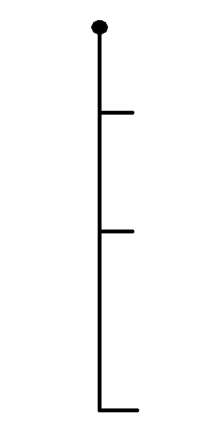






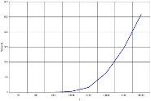
Selection Sort
Advantages
Disadvantages
That is performs well on
a small list
Its poor efficiency when dealing with a huge list of items
Because it is an in-place sorting algorithm, no additional temporary storage is required beyond what is needed to hold the original list.
The selection sort requires
n-squared number of steps for sorting n elements
No additional
Its performance is easily influenced by the initial ordering of the items before the sorting process
Quick sort is much more efficient than selection sort

Slide 24
Q&A

