Slide 1
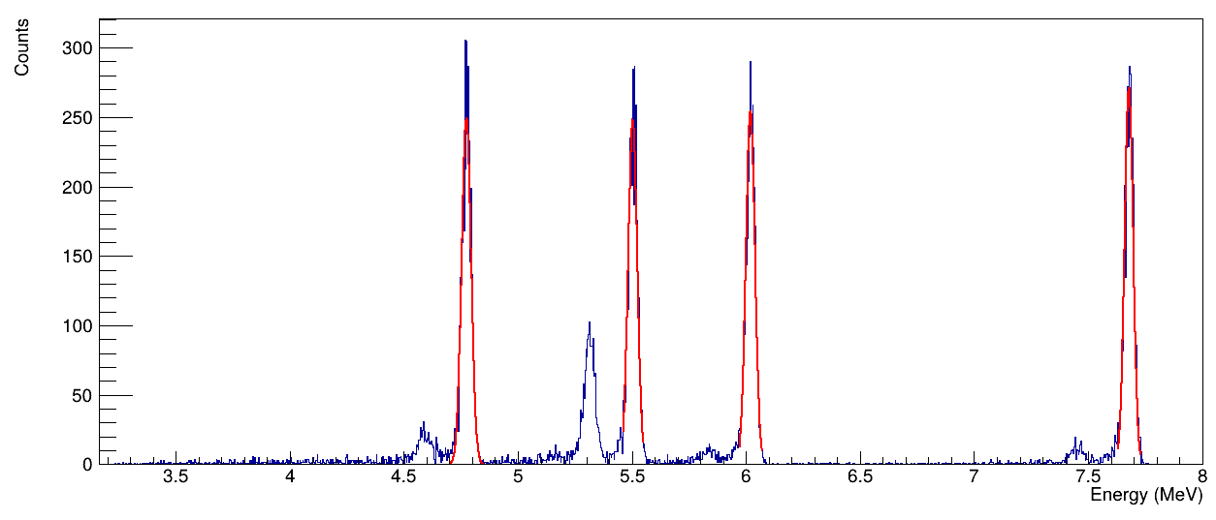
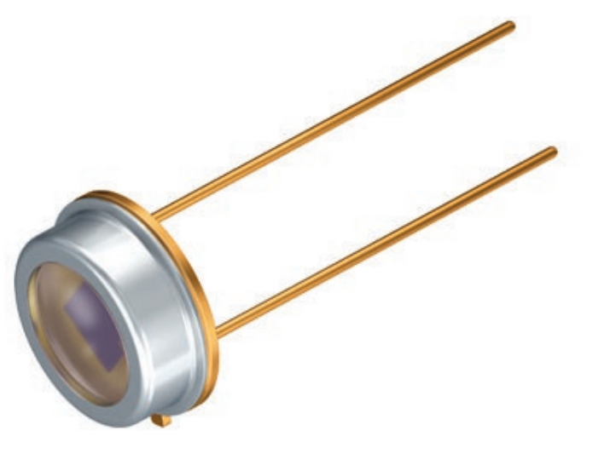
OSRAM BPX 61
Thickness: 100 um
Capacitance: 72 pF at 0 V, 20 pF at 7 V
Dark current: 2 nA at 10V
Silicon → Fano: 0.11, energy/pair: 3.62 eV
We use 6.7 V

Slide 2
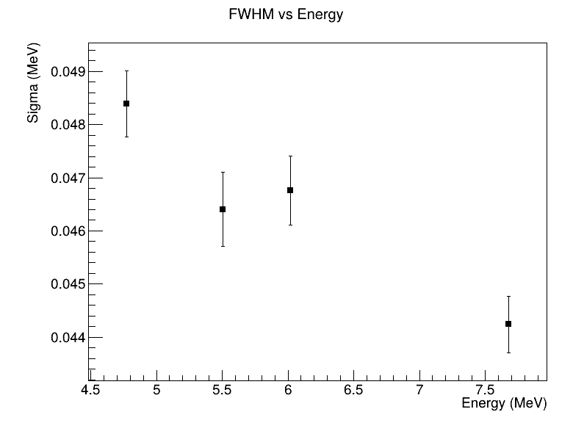
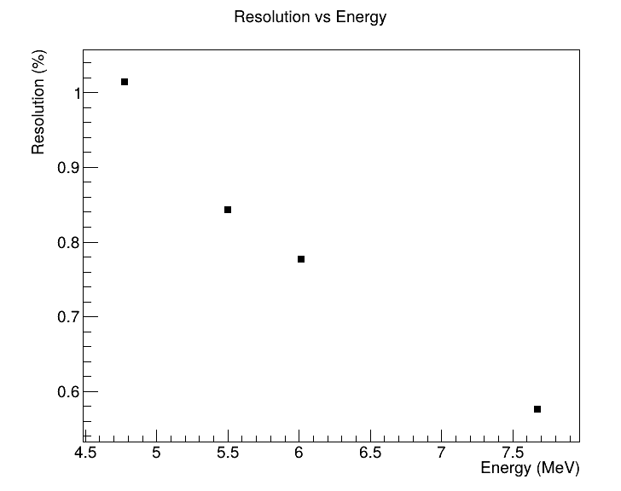
Relative FWHM = sqrt(F)/sqrt(ionizations) = sqrt(F*w)/sqrt(E)
So Relative FWHM is ~1/sqrt(E) (right figure)
Absolute FWHM = Relative FWHM*E = sqrt(F*w*E).
So Absolute FWHM should be ~sqrt(E) but it is not (left figure)

Slide 3
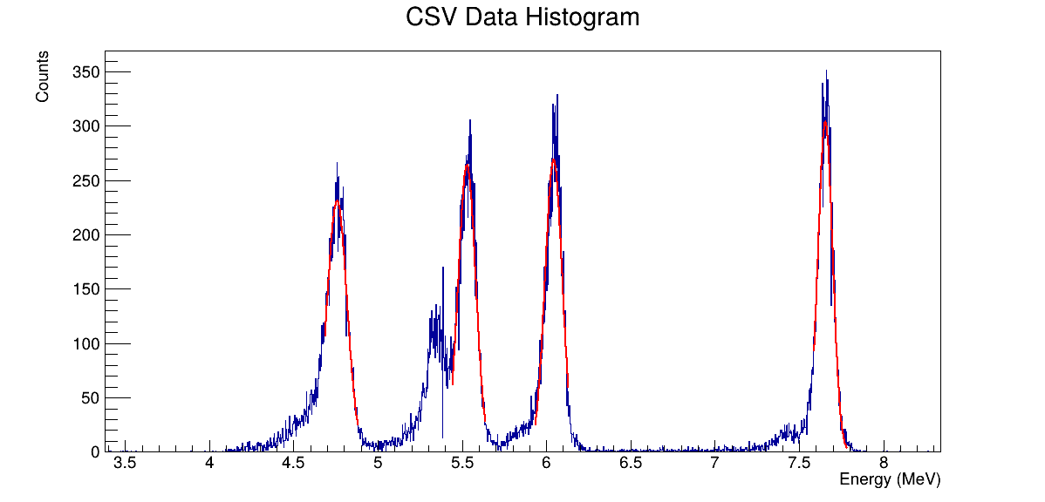

Slide 4
