Slide 1
IT 140 Design Presentation Template
Gary Hobson

Slide 2
Storyboard: Description
In a haunted pirate ship adrift on a ghostly sea, you’re a brave adventurer tasked with lifting a curse by collecting six sacred artifacts before confronting the spectral Pirate Captain. The ship’s creaky corridors and eerie cabins hide treasures and dangers, and you must navigate wisely to gather all artifacts and banish the captain’s spirit, freeing the ship.
Rooms:
Deck (start room, no item).
Captain’s Quarters (villain: Pirate Captain, no item).
Crew’s Quarters (item: Compass).
Galley (item: Spyglass).
Cargo Hold (item: Cutlass).
Crow’s Nest (item: Map).
Armory (item: Pistol).
Sick Bay (item: Amulet).
Items:
Compass, Spyglass, Cutlass, Map, Pistol, Amulet.
Villain:
Pirate Captain, a ghostly figure haunting the Captain’s Quarters.
In Ghost Ship Quest, you’re an adventurer aboard a cursed pirate ship, seeking to lift a supernatural blight by collecting six sacred artifacts before battling the spectral Pirate Captain. The game unfolds across eight eerie rooms: the Deck (start), Captain’s Quarters (villain), Crew’s Quarters (Compass), Galley (Spyglass), Cargo Hold (Cutlass), Crow’s Nest (Map), Armory (Pistol), and Sick Bay (Amulet). Navigate creaky corridors to gather the Compass, Spyglass, Cutlass, Map, Pistol, and Amulet, avoiding the Captain’s Quarters until all items are secured. The Pirate Captain, a ghostly menace, awaits in his quarters, ready to thwart your quest. Strategic movement ensures you collect all artifacts to win, freeing the ship from its curse.

Slide 3
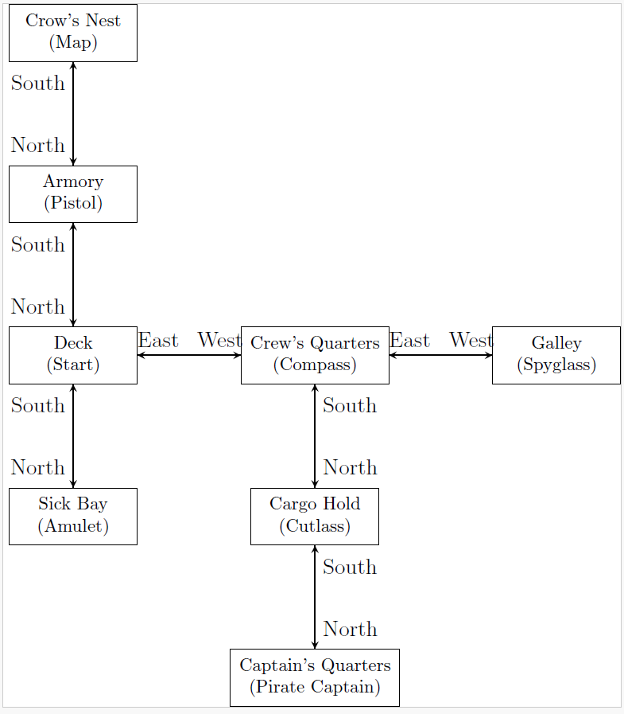
Storyboard: Map
Map of Ship Game

Slide 4
Pseudocode: Move Between Rooms
[SET currentRoom to "Deck"
SET inventory to empty list
WHILE game not over
PRINT "You are in the " + currentRoom
IF currentRoom has item THEN
PRINT "You see a " + item
ENDIF
PRINT "Inventory: " + inventory
READ move from user with prompt "Enter your move: "
IF move starts with "go" THEN
SET direction to move after "go" (e.g., "North")
IF direction is "North" AND currentRoom has North exit THEN
SET currentRoom to room North of currentRoom
ELSE IF direction is "South" AND currentRoom has South exit THEN
SET currentRoom to room South of currentRoom
ELSE IF direction is "East" AND currentRoom has East exit THEN
SET currentRoom to room East of currentRoom
ELSE IF direction is "West" AND currentRoom has West exit THEN
SET currentRoom to room West of currentRoom
ELSE
PRINT "You can't go that way!"
ENDIF
ELSE
PRINT "Invalid Input!"
ENDIF
ENDWHILE]

Slide 5
Pseudocode: Get an Item
IF currentRoom has item THEN
READ move from user with prompt "Enter your move: "
IF move starts with "get" THEN
SET item to move after "get" (e.g., "Compass")
IF item matches currentRoom’s item THEN
ADD item to inventory
REMOVE item from currentRoom
PRINT item + " retrieved!"
ELSE
PRINT "Can't get " + item + "!"
ENDIF
ELSE
PRINT "Invalid Input!"
ENDIF
ELSE
PRINT "No item to get!"
ENDIF

