Slide 1


Team Details
Team name: [add team name]
Team leader name: [add team leader name]
Problem Statement: Sustainability & Social Impact. Malaysian oil-palm smallholders must show where their fruit was grown (a plot boundary and no deforestation after 2020) for the EU Deforestation Regulation, yet keep their records on paper. KebunSah turns photos of their documents and a drawn boundary into a green / yellow / red check and a plain-language to-do list.
Project: KebunSah
Notes:
KebunSah - Google Cloud AI Builder Cup 2026, track: Sustainability & Social Impact.
Fill in the team name and the team leader's name (orange markers on this slide) before submitting.

Slide 2









Brief about the idea
KebunSah: a phone check that shows what is missing for EUDR
The problem
The idea
30 Dec 2026
EUDR starts for large and medium operators; micro and small operators follow on 30 Jun 2027.
Photograph the land title (several pages if needed), MPOB licence and MSPO certificate, from camera or gallery.
450,000+
oil-palm smallholders in Malaysia, most with paper records and no digital tools.
Draw the boundary on a satellite map, walk the corners with GPS, or mark one point for plots under 4 ha.
55–65%
of independent smallholder area projected to have compliance-ready data by early 2026.
Get a verdict in Malay or English, with a to-do list: what is missing, why, and where to get it.
Being on an official register is not proof. Registers hold names, not boundaries; a land title proves ownership, not forest history; and the documents often disagree with each other.
COMPLETE
NEEDS REVIEW
ACTION NEEDED
Smallholder
phone app
Field officer
adds land for members
Cooperative admin
desktop dashboard
Sources: EU Commission, PSQR, TraceX, GLOBOIL (see notes)
Notes:
Talk track: from 30 December 2026 palm fruit sold into the EU must come from land with no deforestation after 31 December 2020, and the producer must show where it grew (a plot boundary). Malaysia has 450,000+ smallholders, most with paper records.
Sources: [1] EUDR timetable: PSQR 'EU Deforestation Regulation (EUDR) 2026 Update: New Deadlines'; InvariTech 'EUDR Delay and Timeline: 2026-2027 Deadlines'; NST (2025-12). [2] Requirements: European Commission 'Deforestation-free products Regulation'; Coolset. [3] Smallholder data gap: TraceX 'EUDR Compliance for Palm Oil Exporters in Malaysia'; GLOBOIL (55-65% of independent smallholder area projected to have compliance-ready data by Q1 2026).
'Registers hold names, not boundaries' is the core insight: an official register or a land title does not prove forest history, and the documents often disagree with each other.

Slide 3



Opportunities
Built for the smallholder's phone, not the exporter's office
How different is it from any of the other existing ideas?
How will it be able to solve the problem?
USP of the proposed solution
Most EUDR tools are built for exporters, mills and large operators. KebunSah starts from the smallholder's phone, in Malay first.
It checks the documents against each other and against the drawn boundary: a title proves ownership, not forest history, and registers hold names, not boundaries.
It tells the farmer what to do next (what is missing, why, where to get it) instead of only reporting a score.
Photos of the land title, MPOB licence and MSPO certificate become structured data (Gemini), each field with a confidence score.
Rules compare area, expiry dates and names; Earth Engine screens the plot for forest loss after 31 Dec 2020.
The result is a green / yellow / red verdict and a to-do list. Cooperatives follow every member plot and export dossiers for buyers.
Gemini reads and explains; rules decide. Every verdict is reproducible and auditable.
Made for the field: large buttons, status as colour + icon + words, type or speak a question, and it keeps working with no signal.
Free for smallholders; cooperatives, mills and buyers pay, because they carry the due-diligence duty.
Notes:
Answers the three template questions. Differentiation: smallholder phone first, document cross-checking, plain-language next steps.
The positioning 'most EUDR tools target exporters, mills and large operators' comes from the team's market review; no specific competitor is named.

Slide 4






List of features offered by the solution
Nine features in one chain: capture, verdict, dossier
Photograph documents
Land title (up to 4 pages), MPOB licence and MSPO certificate, from camera or gallery.
Draw the boundary
On a satellite map, by walking the corners with GPS, or one point plus area under 4 ha.
AI document reading
Gemini reads each photo into fields with a confidence score; unsure ones go back to the user.
Rules check
Area (title vs drawing), expiry dates and names are compared across the documents.
Forest screening
Earth Engine looks for forest loss after 31 Dec 2020 inside the boundary. Marked preliminary.
Verdict and to-do list
Green, yellow or red, plus what is missing, why, and where to get it. A step log shows how.
Ask by typing or voice
In Malay or English; answers only about the plot, the EUDR and the documents needed.
Works with no signal
Drafts are kept on the phone and sent automatically when the signal returns.
Cooperative dashboard
Every member plot by status and issue, a CSV summary and a printable dossier per plot.
Three roles: smallholder · field officer (adds land on a member's behalf) · cooperative admin (read-only). Languages: Malay and English.
Notes:
Everything on this slide is built and running in the prototype (see the snapshot slides). Ask-by-typing/voice answers only about the plot, EUDR rules and documents needed; anything else gets a fixed refusal written by the server, not by the model.
Cooperative admin is read-only: the API returns 403 read_only_role for every write.

Slide 5
Process flow diagram or Use-case diagram
From a photo to a verdict in about two minutes
Smallholder or field officer
phone app
yellow or red: redraw, renew or add a document, then check again
Sign in
phone number and SMS code
Photograph documents
title · MPOB licence · MSPO certificate
Draw the boundary
map, GPS corners or one point
Start the check
no signal? saved on the phone, sent later
Verdict + to-do list
fix what is flagged, check again
result appears live
KebunSah check
automatic
30 s to 2 min
Read documents
Gemini: photo to fields + confidence
Rules check
area · expiry · names (Python)
Forest screening
Earth Engine, runs alongside reading
Explain
Gemini writes a plain-language note
Grade
green · yellow · red, plus the to-do list
the dashboard updates live
Cooperative admin
desktop
dashboard
Live dashboard
counts by status
Filter
status · issue · member
Open a plot
reasons, documents, boundary
Export
dossier (PDF) and CSV summary
Share with buyer
supporting material for the DDS
Notes:
Swimlane view: smallholder or field officer on the phone, the automatic check, and the cooperative admin on a computer.
Reading documents and forest screening run in parallel inside the pipeline. Any step that fails degrades to 'needs review' instead of failing the whole check.
Time to verdict: about 30 s in a local end-to-end run with real Gemini calls; up to about 2 minutes under free-tier rate limits (5 requests a minute per model, 4 Gemini calls per check).

Slide 6
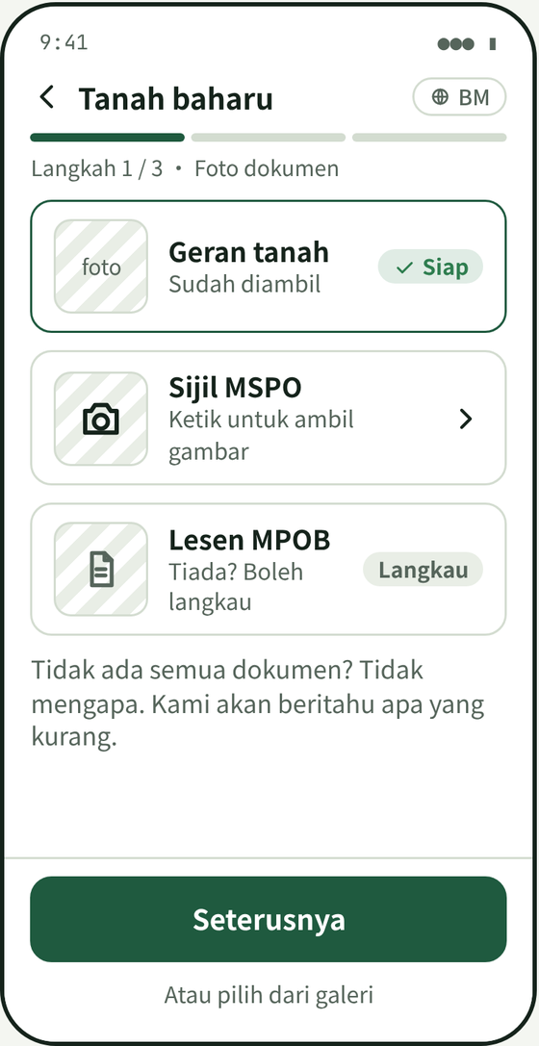
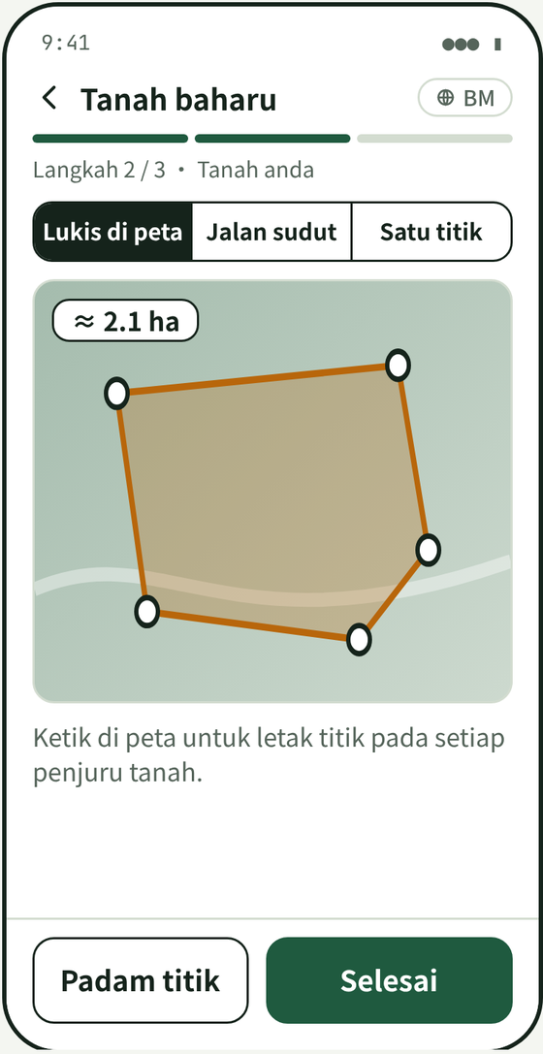
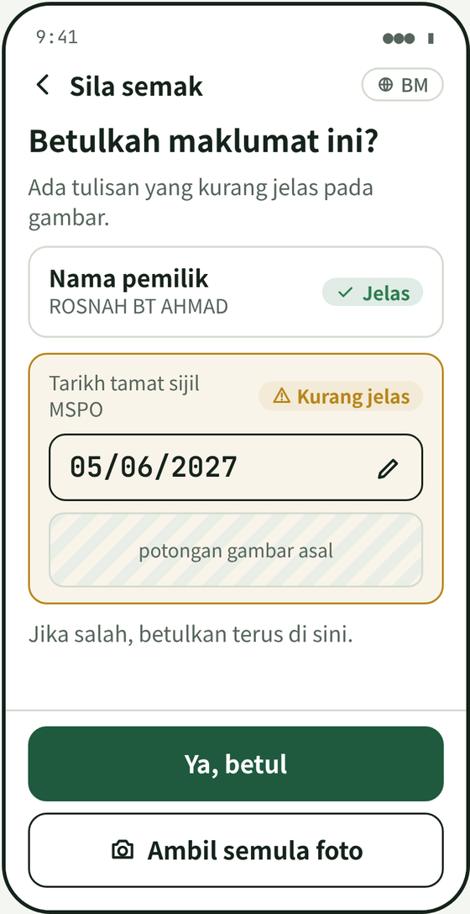
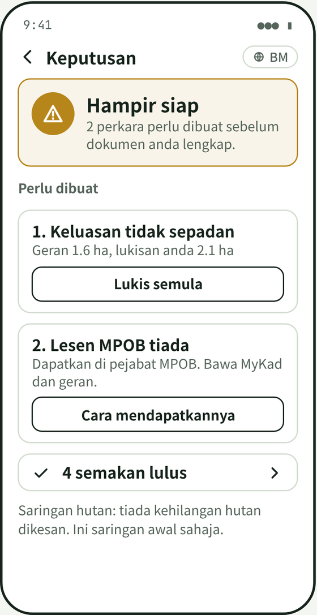
Wireframes/Mock diagrams of the proposed solution (optional)
Designed for low digital skill: one screen, one task
Design rules
One screen, one task. One main button and a progress bar (Step 1 / 3).
Big buttons in the thumb zone. Touch targets of at least 48 px.
Malay first. English one tap away; icons always with words.
Status is never colour alone. Colour, icon and words together.
Plain, kind words. "Take the picture again", not "Recognition failed".
Forgiving. Skip a document, retake a photo, fix what AI read, leave while it checks.
1 Photograph the documents
2 Draw the boundary
3 Confirm what AI could not read
4 Verdict and to-do list
Low-fidelity wireframes from the design phase (screen text in Malay). The built screens are on the snapshot slides.
Notes:
These are the low-fidelity wireframes from the design phase (screen text in Malay). The screens as built are on the snapshot slides.

Slide 7







Architecture diagram of the proposed solution
One Cloud Run service, with Gemini and Earth Engine as tools
Firebase Hosting
Angular 22 progressive web app
Cloud Run: kebunsah-api
one service, region asia-southeast1
Cloud Storage
photos, uploaded directly with 15-minute signed URLs
Phone screens and cooperative dashboard
Malay and English
FastAPI
checks the Firebase ID token and role, validates input, issues signed upload URLs
Smallholder or field officer
phone (installable PWA)
REST + ID token
Firestore
plots, documents, assessments; real-time to the app, read-only there
Offline queue
Service Worker + IndexedDB
Assessment pipeline
background task: read, check, screen forest, explain; writes every step to a log
Gemini API
reads documents, writes notes, answers questions
Google Maps JavaScript API
satellite map, boundary drawing
Earth Engine
JRC GFC2020 V4 + Hansen v1.13 (forest loss since 2020)
Cooperative admin
computer browser
Rules engine (core/)
pure Python, no cloud imports: area, expiry, name, grading
Firebase Authentication
phone code or email sign-in
Secret Manager holds the Gemini key
CI/CD GitHub → Cloud Build → Artifact Registry → Cloud Run and Firebase Hosting. Cloud Run keeps no idle instance (min 0, max 3).
Next Cloud Tasks + separate AI worker, Vertex AI quotas, cooperative-scoped Firestore rules.
Notes:
As built: one Cloud Run service (kebunsah-api) runs the FastAPI app and the assessment pipeline as a background task. Photos go from the phone straight to Cloud Storage on a 15-minute signed URL; the browser only reads Firestore (real-time) and never writes.
Planned (dashed box): Cloud Tasks with a separate AI worker for volume, Vertex AI for production quotas, and Firestore rules scoped to each cooperative (today any signed-in user can read).

Slide 8






Technologies to be used in the solution
Google Cloud AI at the core, standard open tools around it
Google AI
Google Cloud and Firebase
Front end
Gemini 3.5 Flash, with fallback to other Flash and Flash-Lite models
Photo reading: JSON schema output, temperature 0, confidence per field
Notes and typed or spoken Q&A
Earth Engine forest-loss datasets
Cloud Run (scales to zero), Cloud Build, Artifact Registry
Firebase Hosting and Authentication (phone code, email)
Firestore, Cloud Storage (signed URLs), Secret Manager
Maps JavaScript API for the satellite map
Angular 22, TypeScript, installable PWA
Service Worker and IndexedDB offline queue
Turf.js area preview; MediaRecorder voice input; browser speech output
Vitest: 993 tests
Back end
Reliability and safety
Delivery
Python 3.11, FastAPI, Pydantic (OpenAPI docs built in)
google-genai, earthengine-api, firebase-admin
Shapely + pyproj: area on the ellipsoid, server-side
RapidFuzz name similarity; pytest: 847 tests
Rules in pure Python: same input, same answer
Retry, back-off and model fallback on API errors
A failed step becomes "needs review"
Read-only browser; IDs stored only as a keyed hash
GitHub + Cloud Build: a push to main deploys API and app
200 synthetic demo plots, watermarked sample documents
Full journey driven in a real browser on the deployed service
Public repo, English README, judge access
Notes:
Gemini 3.5 Flash is the default model; the extraction list falls back to gemini-3.7-flash, gemini-3.8-flash and gemini-3.1-flash-lite when a model is out of quota or unavailable. Notes fall back to 3.1 Flash-Lite and 3.5 Flash-Lite, then to a template text.
Forest datasets: JRC Global Forest Cover 2020 V4 (JRC/GFC2020/V4) and Hansen Global Forest Change v1.13 (UMD/hansen/global_forest_change_2025_v1_13). JRC describes its map as a non-binding reference, so results are labelled preliminary.

Slide 9
Estimated implementation cost (optional)
Cents per check, and free tiers carry the prototype
Cost item | Prototype today | Pilot: one cooperative, ~1,000 plots
Gemini API | Free tier or pay-as-you-go; est. under US$10 for build, tests and judging | ≈ US$30–60 per full pass of checks (≈ 3–6 US cents per check: 3 photo reads + 1 note)
Cloud Run | Within free-tier limits at demo traffic; no idle instance (min 0, max 3) | Free tier to low tens of US$ per month
Firestore, Storage, Hosting, Auth | Free tier or cents | Low US$ per month; ~1.2 GB of photos per 1,000 plots
Google Maps JavaScript API | Free monthly allowance | Beyond the allowance ≈ US$7 per 1,000 map loads
Earth Engine | Non-commercial use | A commercial deployment needs a paid plan (from US$500 per month)
People | 2 builders, 10 days | Cooperative onboarding and support
Cost guardrails built in
Flash-class models only. Reading a photo does not need a Pro model.
Up to four Gemini calls per check, and documents already read are reused on a re-check.
Photos shrunk on the phone to 1,600 px JPEG before upload.
A hard ceiling: Cloud Run runs at most 3 instances and none when idle.
Fallback models and retries absorb quota errors instead of repeating paid calls.
Token usage is logged for each Gemini call, so spend can be watched.
Estimates from public list prices (Gemini 3.5 Flash US$1.50 / US$9.00 per 1M input / output tokens, third-party trackers, 18 Oct 2026) and token estimates. Not a quote; verify on Google's pricing pages.
Notes:
Cost estimate, not a quote. Gemini 3.5 Flash list price used: US$1.50 per 1M input tokens and US$9.00 per 1M output tokens (third-party trackers, 18 Oct 2026; Google's own pricing page was not reachable when this deck was written).
Assumption per check: 3 photo reads (about 1.5-3k input and 0.5-1.5k output tokens each) plus 1 note. That gives roughly 3-6 US cents per check. Maps JavaScript API: about US$7 per 1,000 map loads after the monthly free allowance (third-party listing). Earth Engine: commercial plans start at US$500 per month on Google's Earth Engine pricing page; non-commercial research use is free.
Verify all prices on Google's pricing pages before budgeting.

Slide 10
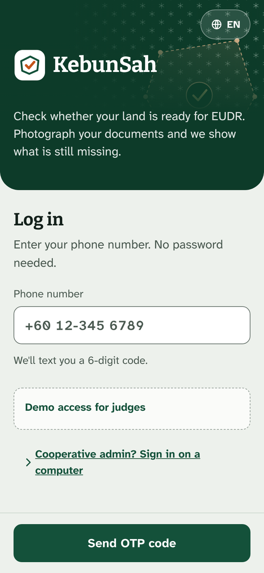
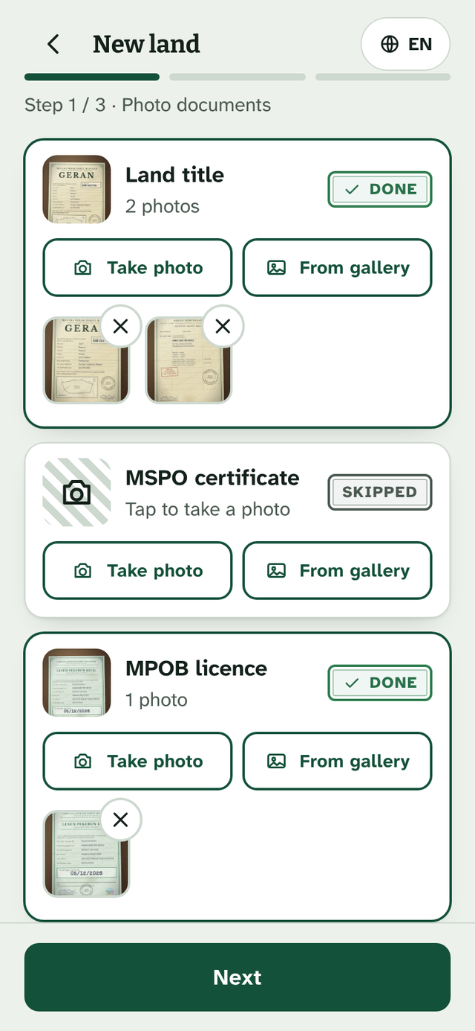
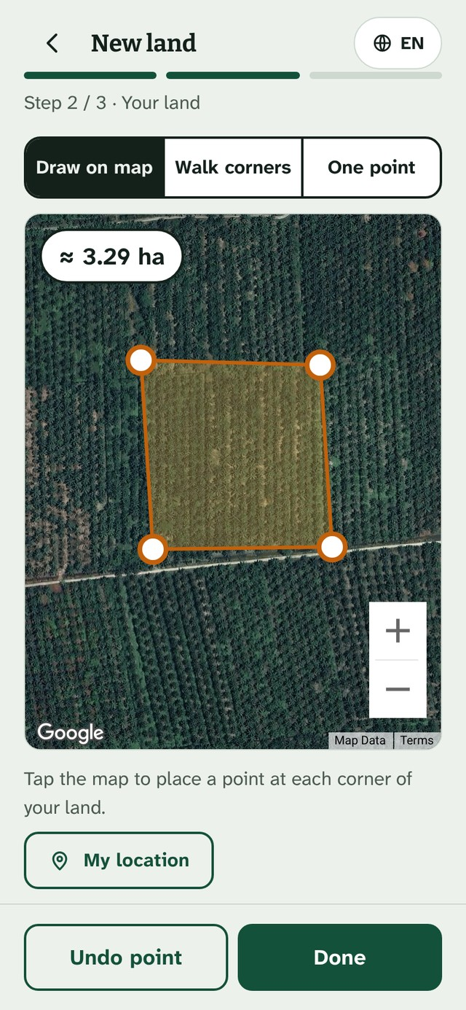
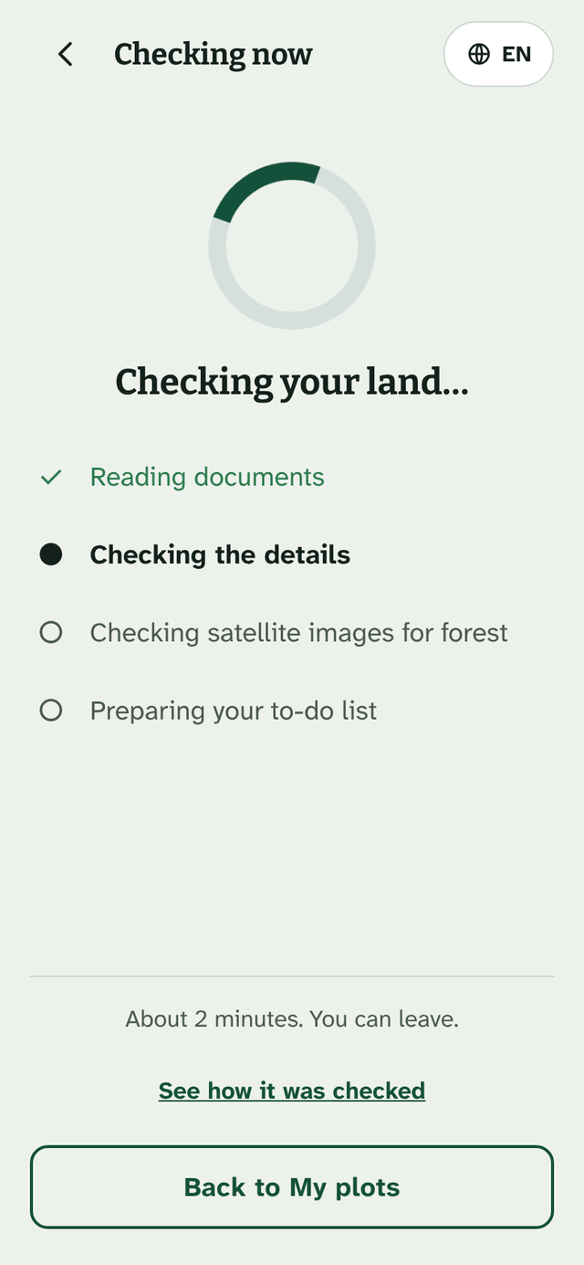
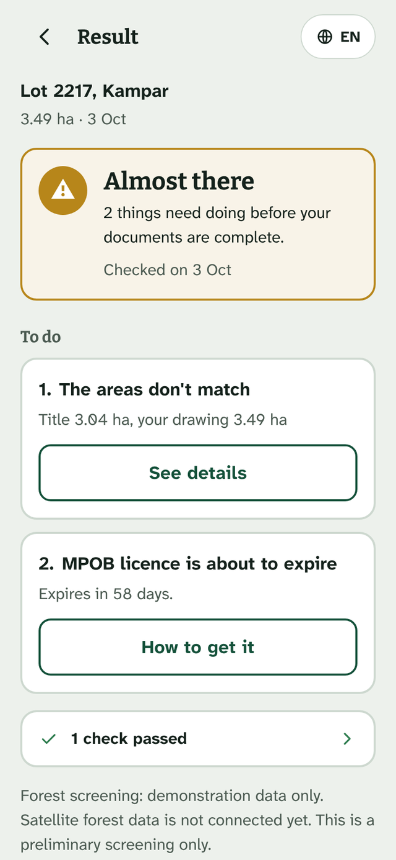
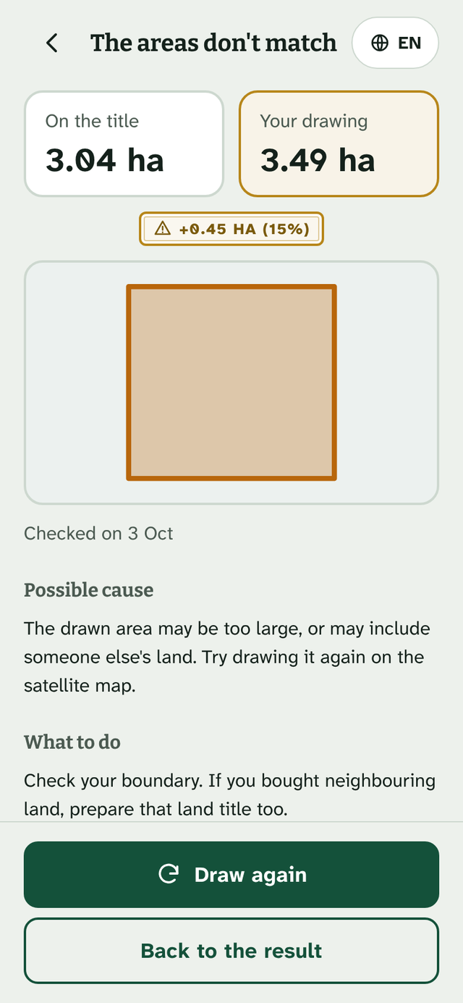
Snapshots of the prototype
The phone app: photograph, draw, check, fix
1 Sign in
phone number and code; Malay or English
2 Photograph
land title (2 pages), MPOB licence
3 Draw
boundary on a satellite map, about 3.29 ha
4 Check
steps tick off as they finish
5 Verdict
yellow: two things to do
6 Why
title 3.04 ha, drawing 3.49 ha
Working prototype with synthetic demo data (documents are watermarked SIMULATED). Seeded plots carry pre-computed forest values; new checks call Earth Engine.
Notes:
All screens are real screenshots of the working prototype (build of commit c9e762c) running on the synthetic demo data set: 200 plots, documents watermarked SIMULATED. Screens were captured from a local run of the same code because the live site could not be reached from the capture machine.
The forest note on the result screen ('demonstration data only') appears for seeded demo plots, whose forest values are pre-computed. New checks call Earth Engine (FOREST_BACKEND=earthengine on Cloud Run).

Slide 11
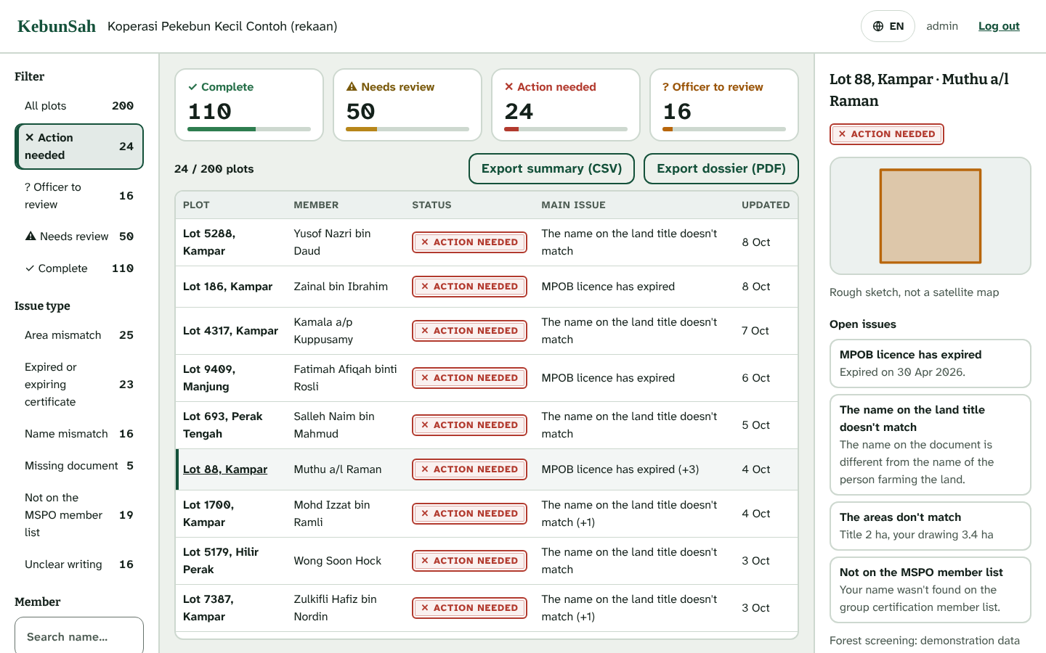
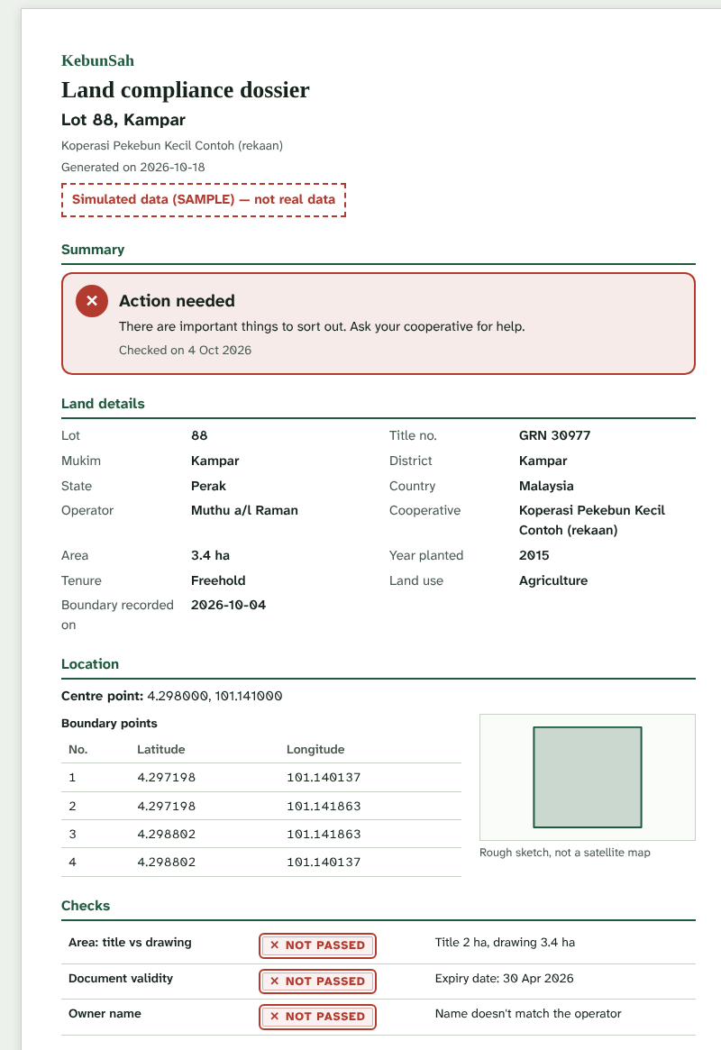
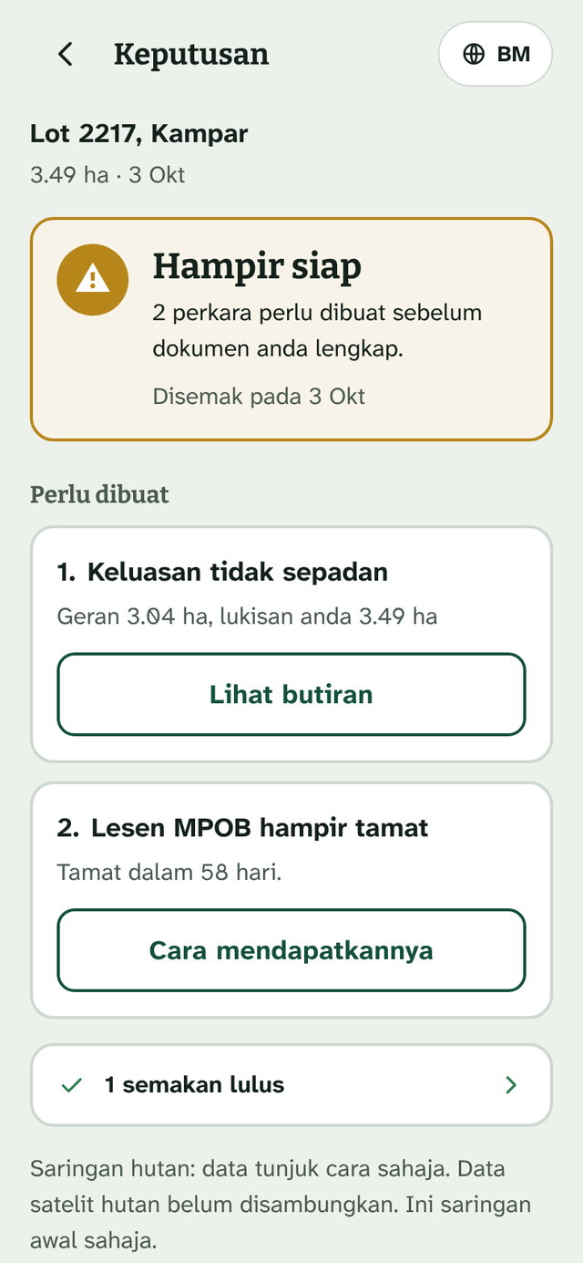
Snapshots of the prototype
The cooperative dashboard, the dossier and Malay-first screens
Cooperative dashboard (computer)
200 member plots by status and issue, with reasons and exports.
Dossier per plot
A4 layout, saved as PDF
Malay first
one tap to English
Working prototype with synthetic demo data. The cooperative admin role is read-only.
Notes:
Cooperative dashboard: 200 demo plots (110 complete, 50 needs review, 24 action needed, 16 officer to review). The red plot Lot 88 shows an expired MPOB licence, a name mismatch (title still in a late relative's name), an area mismatch and a missing MSPO membership.
The dossier is supporting material and says so: it is not an official Due Diligence Statement and not a compliance certification.

Slide 12
Prototype Performance report/Benchmarking
Measured on the submitted build: 1,840 tests pass, 40 of 40 fields read
1,840
40 / 40
200 / 200
30 s – 2 min
automated tests pass: 847 back end (pytest) and 993 front end (Vitest)
fields read correctly by Gemini on 16 synthetic photos, with handwriting, blur, tilt and low light
demo plots get the same verdict from the Python rules engine as from the independent seed generator
from tap to verdict with real Gemini calls (about 30 s locally; up to 2 min on free-tier quota)
What we measured | How | Result
Rules engine | 434 tests: area 10% or 0.1 ha, expiry 90 days, name match 0.85, confidence 0.7 | pass
AI pipeline | 295 tests: quota retry, back-off, model fallback, a failed step degrades to review | pass
API | 118 tests: sign-in, roles (cooperative admin read-only), signed URLs, assess, delete, voice | pass
Front end | 993 tests; browser code has no Firestore writes; production bundle has no emulator traces | pass
Phone app weight | Production build, initial load: 485 kB raw, about 129 kB compressed | measured
Known limits
Free-tier Gemini allows 5 requests a minute per model, so back-to-back checks slow down.
Forest data are public global datasets: a preliminary screening; small plots can be misjudged.
Seeded demo plots carry pre-computed forest values, labelled as such.
The satellite map needs signal; walking the corners and one-point entry work offline.
Run on 18 Oct 2026, commit c9e762c. Gemini accuracy: team smoke test (scripts/gemini_smoke.py).
Notes:
Measured 18 Oct 2026 on commit c9e762c. Back end: pytest 847 passed (core 434, API 118, AI worker 295; 4 emulator-only tests deselected by default). Front end: Vitest 993 passed in 55 files. Production build: initial total 485 kB raw, about 129 kB estimated transfer.
Gemini accuracy (40 of 40 fields on 16 synthetic photos) is the team's own smoke test (scripts/gemini_smoke.py) recorded in seed/photos/README.md; it needs a Gemini key so it is not part of CI.
200/200: core/tests/test_golden_seed.py checks status, expected and actual values and gaps for every seeded plot against the independent JavaScript seed generator.

Slide 13
Additional Details/Future Development (if any)
Free for smallholders; those who carry the EUDR duty pay
Business model
Impact
Who pays | How | What they get
Cooperatives | Annual fee per member plot | All members' compliance in one place; dossiers for buyers
Mills and dealers | Subscription by fruit volume or supplier plots | Traceable fruit, fewer rejections by EU buyers
Exporters and EU buyers | API access fee | Upstream compliance dossiers delivered directly
Government and NGO programmes | Project partnerships | Smallholder digitisation at scale
450,000+ Malaysian oil-palm smallholders can learn what is missing before a buyer turns their fruit away.
Cooperatives see risk across all members in one view, and can act early.
Responsible AI
A preliminary screening, not legal advice or certification; results say so.
Gemini reads and explains; rules decide. Unsure fields go back to a person.
Synthetic demo data only; ID numbers are never stored in full.
Why the buyers pay: under the EUDR the due-diligence duty sits with operators and traders, who need clean plot data from thousands of smallholders. KebunSah is how they get it without visiting every farm.
Notes:
Business model from the team plan: smallholders use KebunSah free; cooperatives, mills, exporters and programmes pay because they carry the due-diligence duty.
Impact is stated as a potential: the app tells a smallholder what is missing before a buyer turns the fruit away. No adoption numbers are claimed yet; a pilot with a real cooperative is the next step.

Slide 14
Additional Details/Future Development (if any)
From Malaysian palm oil to every EUDR commodity
Today
Next
Then
Later
Malaysia palm oil
Pilot with a cooperative
Indonesia and Thailand
Other EUDR commodities
Prototype live; three document types; Malay and English; synthetic data.
Masked real documents from 2–3 smallholders; verify fields against e-MSPO and E-LesenPK.
Palm smallholders; language and land-office process become configuration.
Rubber, cocoa, coffee, timber: new document types and rules, same app.
Engineering next
Why it scales
Cloud Tasks and a separate AI worker for volume
Vertex AI for production quotas and data residency
Firestore rules scoped to each cooperative and farmer
Regulation text retrieval, with citations in the notes
Official-site verification (e-MSPO, MPOB E-LesenPK)
Mill ERP integration and chain of custody
Sabah and Sarawak land systems
Admin override with a reason; server-side PDF
Thresholds already live in a config document, not in code.
A new commodity means new document types and rules, not a new app.
The rules engine has no cloud imports, so it can move to any service.
Notes:
Roadmap: pilot with a real cooperative (masked documents), then other palm-oil countries, then other EUDR commodities. Known limits and engineering next steps are taken from the repository README.

Slide 15



Provide links to your:
Try it, read it, watch it
GitHub Public Repository
github.com/longrong1110/KebunSah
Source code, English README, tests, API contract and the 200-plot demo data generator.
Demo Video Link (3 Minutes)
[paste the YouTube / Vimeo / Drive link here]
Narrated in English: problem, farmer's phone, check, cooperative dashboard, impact.
Final Product Link
kebunsah.web.app
Open on a phone. On the sign-in page use "Demo access for judges".
Judge access (all data is synthetic)
Phone app
Open the Final Product Link on a phone, tap "Demo access for judges". No SMS is sent; the code is 123456.
+60 10-000 0011 smallholder, mostly green
+60 10-000 0012 yellow plot
+60 10-000 0013 red plot
+60 10-000 0001 field officer
Cooperative dashboard (computer)
Open kebunsah.web.app/coop/login and use the demo box on that page.
Email koperasi@kebunsah.demo
Password Koperasi-Demo-2026
Notes:
Judge access: the demo code 123456 and the demo cooperative login are intentionally public; all data is synthetic.
Before submitting: paste the demo video link (YouTube, Vimeo or a public Google Drive link) and test it in a private window.

Slide 16


