Slide 1
Guided Transcoding for Next-Generation Video Coding

Slide 2
Structure of presentation
Introduction to video coding
Adaptive streaming
Guided transcoding
Evaluation environment
Test data

Slide 3

The need for video coding
Video needs to be compressed to be stored or transmitted
Reduces size several hundreds of times
But encoding takes a long time

Slide 4
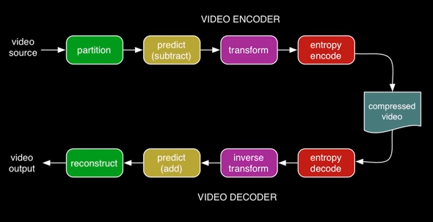
Coding steps
Partitioning
Prediction
Frequency transform
Quantization
Arithmetic coding

Slide 5
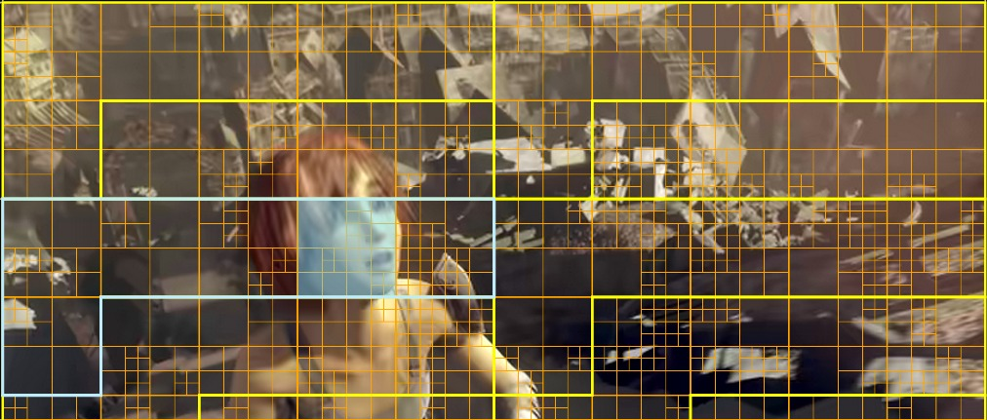
Partitioning
Frames are divided into blocks of different sizes
Encoder tries each option to come up with the most effective partitioning

Slide 6
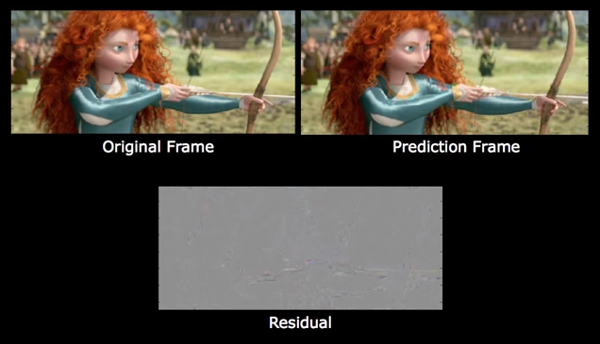
Prediction
Data from previous frames are used to predict new frames
The encoder chooses the prediction with the smallest error
The residual is calculated and encoded
This procedure is lossless

Slide 7
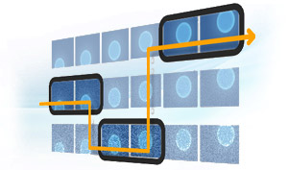
Adaptive streaming
We want to transmit video of different resolutions
Video is divided into small chunks
Depending on the current bandwidth we want to adjust the quality up or down

Slide 8
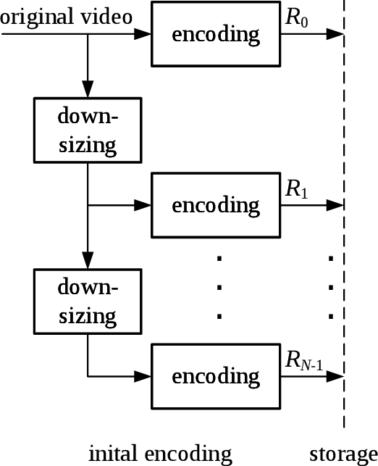
Simulcasting
Each resolution is encoded and stored
Requires a lot of space
Many videos may never be used

Slide 9
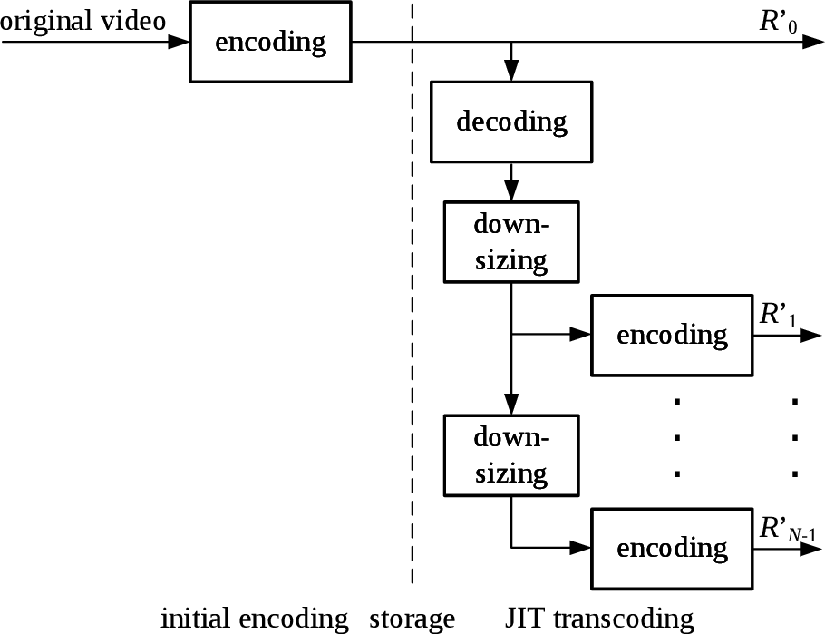
Just-in-time transcoding
Lower-resolution videos are generated on-demand
Generally not possible because encoding/transcoding is so expensive

Slide 10
Guided transcoding
Tries to get around the problems of the two previous methods
Side-information is extracted from the lower-quality videos
The side-info can then be used to quickly regenerate the sequence

Slide 11
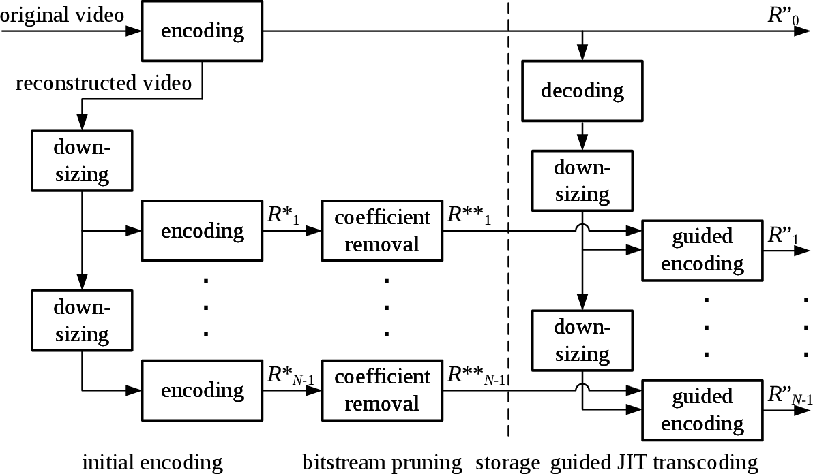
Pruning
Transform coefficients are set to 0
Partitionings and prediction modes are kept (the side-info)
Highest-quality video together with side-info is used to regenerate videos on-demand
Re-encoding step introduces distortion

Slide 12

Pruned frame

Slide 13
Partial pruning
Full pruning may still be too slow
If we only prune certain frames then the regeneration becomes faster
Excluding frames that heavily reference other frames will have minimal impact on bit rate but will save complexity

Slide 14

Partially pruned frame

Slide 15
Deflation and inflation
All videos encoded from original, so no transcoding loss
Deflation is a two-step process where a prediction is generated and encoded, then subtracted from the transform coefficients of the LQ to create side-info
Inflation reverses process to give a perfect reconstruction

Slide 16
Evaluation environment
5 standardized H.265 test sequences at 1080p: Kimono, ParkScene, Cactus, BasketballDrive and BQTerrace
Encoded with quantization parameters (QPs): 22, 26, 30, 34
Downscaled to 720p, 540p and 360p
Re-encoded at QP and QP+2
Gives a total of 5×4×3×2 =120 test cases

Slide 17
Collecting data
We run the simulations on a cluster
Measure bit rate and PSNR (peak signal-to-noise ratio) at several points and store in text files
Script for exporting all data to Excel to calculate averages

Slide 18
Full pruning
Average bitrates (kbit/s)
 | QP |  |  |  | QP+2 |  |  | Totals
 | 1080p | 720p | 540p | 360p | 720p | 540p | 360p | GT gain | Max gain
Kimono1 | 2409 | 1058 | 769 | 477 | 846 | 599 | 363 | 35.5% | 63.0%
ParkScene | 3530 | 1353 | 893 | 472 | 1061 | 682 | 354 | 28.1% | 58.0%
Cactus | 8275 | 2823 | 1944 | 1119 | 2259 | 1527 | 868 | 29.4% | 59.2%
BasketballDrive | 8078 | 2886 | 2048 | 1212 | 2323 | 1615 | 941 | 27.8% | 60.2%
BQTerrace | 13791 | 2626 | 1728 | 887 | 1971 | 1297 | 661 | 25.8% | 48.6%
Averages | 7217 | 2149 | 1476 | 834 | 1692 | 1144 | 638 | 29.3% | 57.8%

Slide 19
Full pruning
Rate reductions
 | QP |  |  | QP+2 |  |  | Totals
 | 720p | 540p | 360p | 720p | 540p | 360p
Kimono1 | 58.2% | 56.4% | 55.0% | 57.4% | 55.1% | 52.5% | 55.8%
ParkScene | 48.1% | 49.1% | 51.7% | 47.4% | 47.5% | 48.8% | 48.8%
Cactus | 50.4% | 51.1% | 53.4% | 49.1% | 49.0% | 50.4% | 50.6%
BasketballDrive | 46.8% | 47.2% | 49.4% | 45.7% | 45.3% | 46.2% | 46.8%
BQTerrace | 54.0% | 54.7% | 56.8% | 53.6% | 53.2% | 54.3% | 54.4%
Averages | 51.5% | 51.7% | 53.2% | 50.6% | 50.0% | 50.4% | 51.3%

Slide 20
Full pruning
Average costs
 | QP |  |  | QP+2 |  |  | Totals
 | 720p | 540p | 360p | 720p | 540p | 360p
Kimono1 | 17.0% | 9.7% | 4.4% | 11.0% | 6.3% | 2.6% | 8.5%
ParkScene | 15.3% | 8.2% | 3.8% | 9.7% | 5.1% | 2.4% | 7.4%
Cactus | 14.3% | 7.6% | 3.5% | 9.0% | 4.8% | 2.1% | 6.9%
BasketballDrive | 15.8% | 8.8% | 4.1% | 9.9% | 5.5% | 2.5% | 7.8%
BQTerrace | 16.9% | 8.8% | 3.7% | 10.8% | 5.7% | 2.4% | 8.1%
Averages | 15.9% | 8.6% | 3.9% | 10.1% | 5.5% | 2.4% | 7.7%

Slide 21
Full pruning
Average reconstruction speed (fps)
 | 720p |  | 540p |  | 360p |  | Totals
 | QP | QP+2 | QP | QP+2 | QP | QP+2
qp 22/24 | 12.5 | 13.0 | 15.0 | 15.4 | 14.7 | 15.0 | 14.3
qp 26/28 | 16.7 | 17.0 | 20.1 | 20.6 | 19.2 | 19.4 | 18.8
qp 30/32 | 19.8 | 19.9 | 23.9 | 24.3 | 22.2 | 22.2 | 22.1
qp 34/36 | 21.7 | 22.3 | 26.7 | 26.8 | 24.2 | 24.2 | 24.3
Averages | 17.7 | 18.1 | 21.4 | 21.8 | 20.1 | 20.2 | 19.9

Slide 22
Partial Pruning, level 2
Average bitrates
 | QP |  |  |  | QP+2 |  |  | Totals
 | 1080p | 720p | 540p | 360p | 720p | 540p | 360p | GT gain | Max gain
Kimono1 | 2409 | 1058 | 769 | 477 | 846 | 599 | 363 | 28.3% | 63.0%
ParkScene | 3530 | 1353 | 893 | 472 | 1061 | 682 | 354 | 25.2% | 58.0%
Cactus | 8275 | 2823 | 1944 | 1119 | 2259 | 1527 | 868 | 24.3% | 59.2%
BasketballDrive | 8078 | 2886 | 2048 | 1212 | 2323 | 1615 | 941 | 19.4% | 60.2%
BQTerrace | 13791 | 2626 | 1728 | 887 | 1971 | 1297 | 661 | 24.3% | 48.6%
Averages | 7217 | 2149 | 1476 | 834 | 1692 | 1144 | 638 | 24.3% | 57.8%

Slide 23
Partial Pruning, level 2
Rate reductions
 | QP |  |  | QP+2 |  |  | Totals
 | 720p | 540p | 360p | 720p | 540p | 360p
Kimono1 | 43.2% | 44.6% | 45.8% | 45.7% | 45.9% | 45.7% | 45.1%
ParkScene | 42.0% | 43.9% | 46.9% | 43.0% | 43.8% | 45.4% | 44.2%
Cactus | 39.9% | 41.5% | 44.2% | 40.8% | 41.3% | 43.1% | 41.8%
BasketballDrive | 29.4% | 32.4% | 36.1% | 31.9% | 33.5% | 35.9% | 33.2%
BQTerrace | 49.2% | 50.0% | 52.5% | 50.8% | 50.4% | 51.8% | 50.8%
Averages | 40.7% | 42.5% | 45.1% | 42.4% | 43.0% | 44.4% | 43.0%

Slide 24
Partial Pruning, level 2
Average costs
 | QP |  |  | QP+2 |  |  | Totals
 | 720p | 540p | 360p | 720p | 540p | 360p
Kimono1 | 17.0% | 9.7% | 4.4% | 11.0% | 6.3% | 2.6% | 8.5%
ParkScene | 15.3% | 8.2% | 3.8% | 9.7% | 5.1% | 2.4% | 7.4%
Cactus | 14.3% | 7.6% | 3.5% | 9.0% | 4.8% | 2.1% | 6.9%
BasketballDrive | 15.8% | 8.8% | 4.1% | 9.9% | 5.5% | 2.5% | 7.8%
BQTerrace | 16.9% | 8.8% | 3.7% | 10.8% | 5.7% | 2.4% | 8.1%
Averages | 15.9% | 8.6% | 3.9% | 10.1% | 5.5% | 2.4% | 7.7%

Slide 25
Partial Pruning, level 2
Average reconstruction speed (fps)
 | 720p |  | 540p |  | 360p |  | Totals
 | QP | QP+2 | QP | QP+2 | QP | QP+2
qp 22/24 | 30.4 | 31.5 | 35.9 | 36.7 | 37.4 | 37.8 | 35.0
qp 26/28 | 41.3 | 41.9 | 49.2 | 50.1 | 50.5 | 51.3 | 47.4
qp 30/32 | 48.8 | 52.3 | 60.3 | 62.2 | 61.5 | 61.6 | 57.8
qp 34/36 | 59.1 | 61.8 | 72.1 | 72.2 | 71.6 | 71.7 | 68.1
Averages | 44.9 | 46.9 | 54.4 | 55.3 | 55.2 | 55.6 | 52.1

Slide 26
Deflation
Average bitrates
 | QP |  |  |  | QP+2 |  |  | Totals
 | 1080p | 720p | 540p | 360p | 720p | 540p | 360p | GT gain | Max gain
Kimono1 | 2419 | 1407 | 927 | 536 | 1045 | 690 | 397 | 25.3% | 67.5%
ParkScene | 3552 | 1761 | 1056 | 518 | 1288 | 771 | 380 | 21.4% | 62.4%
Cactus | 8283 | 3557 | 2240 | 1212 | 2662 | 1694 | 920 | 22.2% | 62.8%
BasketballDrive | 8058 | 3647 | 2370 | 1315 | 2738 | 1791 | 997 | 20.8% | 63.8%
BQTerrace | 13605 | 3395 | 2000 | 955 | 2342 | 1439 | 699 | 20.7% | 52.7%
Averages | 7183 | 2753 | 1719 | 907 | 2015 | 1277 | 679 | 22.1% | 61.8%

Slide 27
Deflation
Rate reductions
 | QP |  |  | QP+2 |  |  | Totals
 | 720p | 540p | 360p | 720p | 540p | 360p
Kimono1 | 34.9% | 38.5% | 40.1% | 36.7% | 39.2% | 39.6% | 38.2%
ParkScene | 31.5% | 35.8% | 40.8% | 32.5% | 35.8% | 39.6% | 36.0%
Cactus | 32.6% | 37.1% | 41.8% | 33.5% | 36.9% | 40.5% | 37.1%
BasketballDrive | 30.1% | 34.1% | 38.3% | 30.9% | 33.8% | 36.8% | 34.0%
BQTerrace | 36.7% | 41.0% | 46.0% | 38.7% | 41.6% | 45.4% | 41.6%
Averages | 33.2% | 37.3% | 41.4% | 34.5% | 37.5% | 40.4% | 37.4%

Slide 28
Deflation
Average costs
 | QP |  |  | QP+2 |  |  | Totals
 | 720p | 540p | 360p | 720p | 540p | 360p
Kimono1 | 0.0% | 0.0% | 0.0% | 0.0% | 0.0% | 0.0% | 0.0%
ParkScene | 0.0% | 0.0% | 0.0% | 0.0% | 0.0% | 0.0% | 0.0%
Cactus | 0.0% | 0.0% | 0.0% | 0.0% | 0.0% | 0.0% | 0.0%
BasketballDrive | 0.0% | 0.0% | 0.0% | 0.0% | 0.0% | 0.0% | 0.0%
BQTerrace | 0.0% | 0.0% | 0.0% | 0.0% | 0.0% | 0.0% | 0.0%
Averages | 0.0% | 0.0% | 0.0% | 0.0% | 0.0% | 0.0% | 0.0%

Slide 29
Summary
Totals
 | GT gain | Rate reductions | Cost
Full pruning | 29.3% | 51.3% | 7.7%
Partial pruning, lvl 2 | 24.3% | 43.0% | 7.7%
Deflation | 22.1% | 37.4% | 0.0%

