Slide 1


Learning to Compress:
Unlocking the Potential of Large Language Models for Text Representation
Yeqin Zhang, Yizheng Zhao, Chen Hu, Binxing Jiao, Daxin Jiang, Ruihang Miao, Cam-Tu Nguyen
Notes:
Hello, everyone. My name is Yeqin Zhang, and I am the first author of this paper. It is my pleasure to present our work. The title of our paper is Learning to Compress: Unlocking the Potential of Large Language Models for Text Representation.

Slide 2
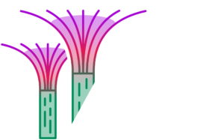
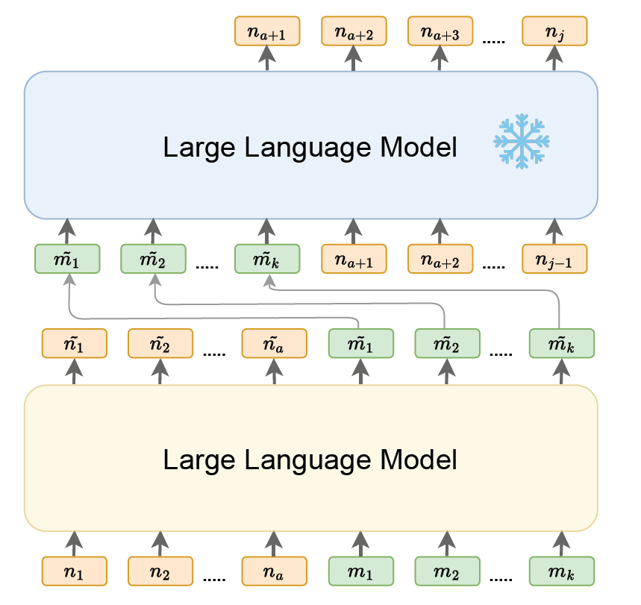
01
Introduction
What is Context Compression?
Context compression seeks to reduce long context into a compact text embedding or token sequence for large language models (LLMs) without losing key information.
Notes:
First, I will introduce a key concept: context compression. Context compression reduces a long context into a compact text embedding or a short token sequence for large language models (LLMs), while preserving the key information.

Slide 3
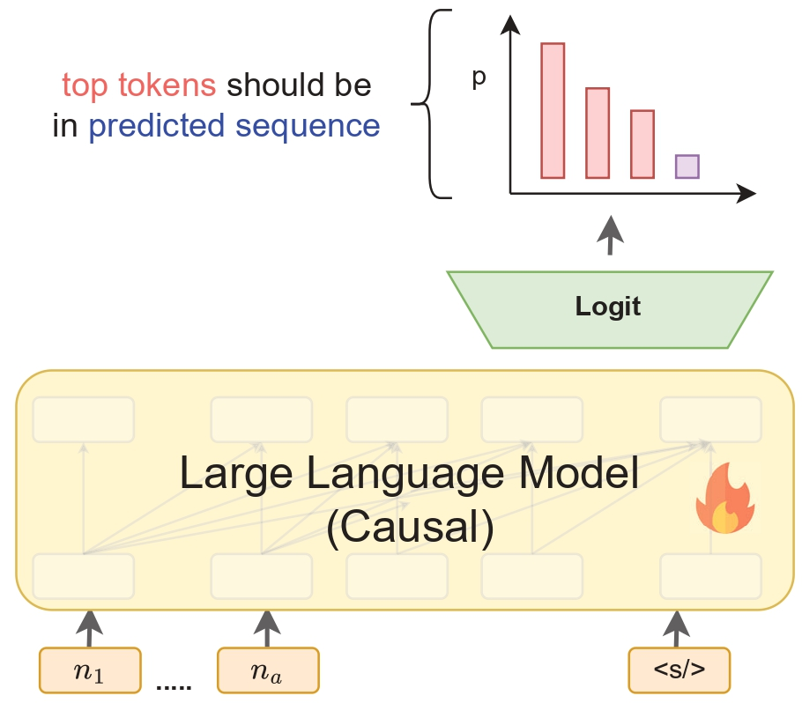
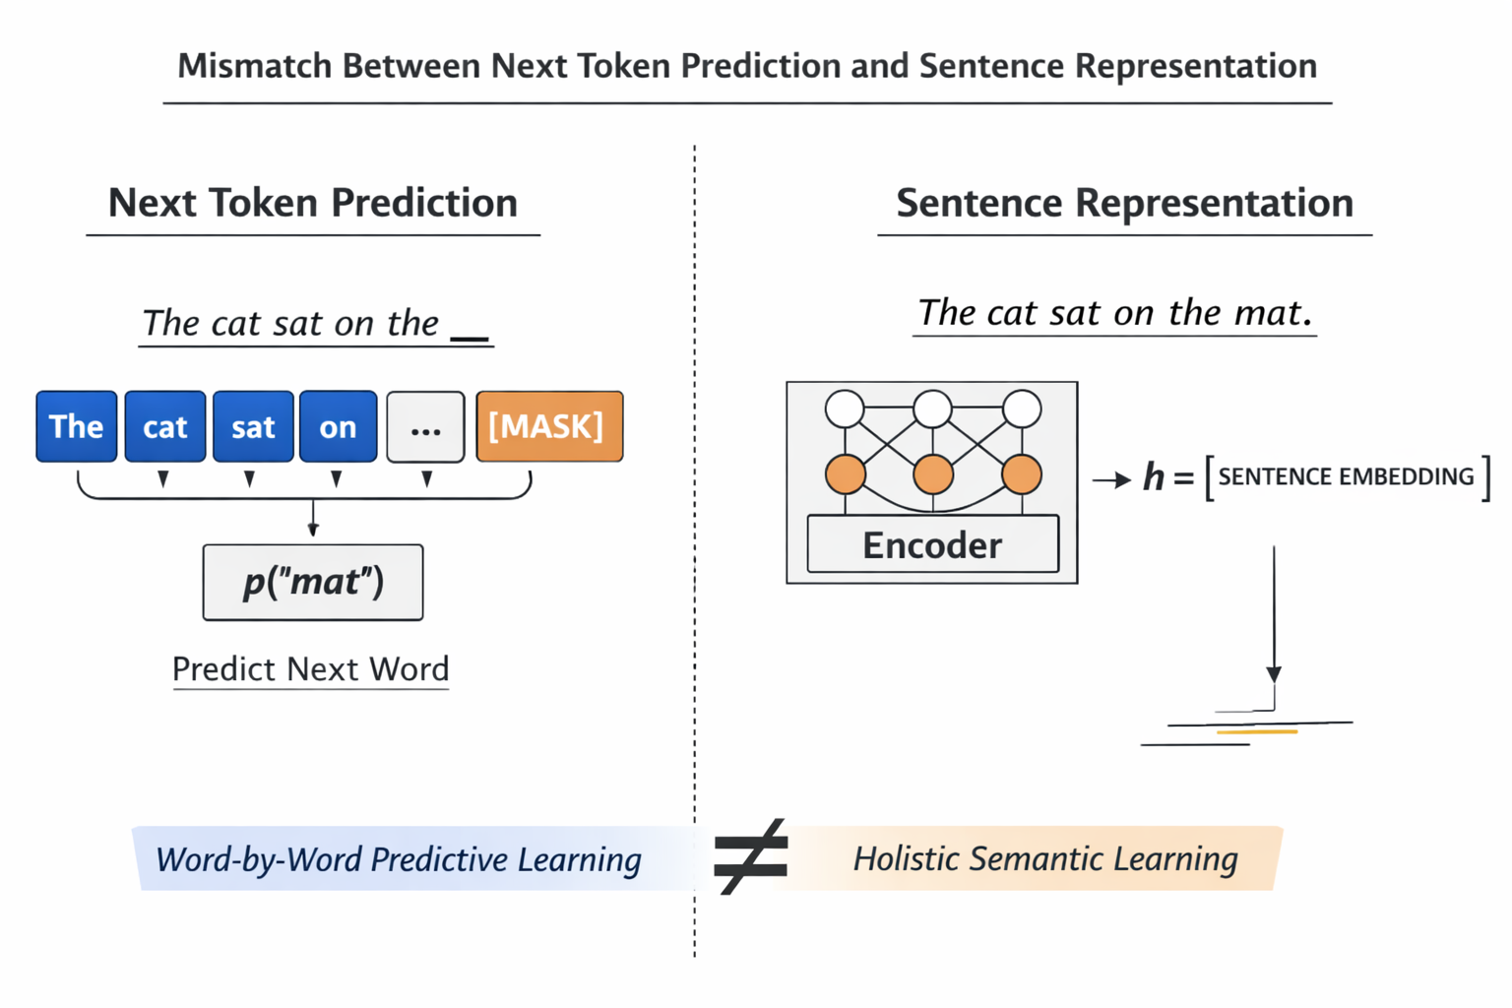
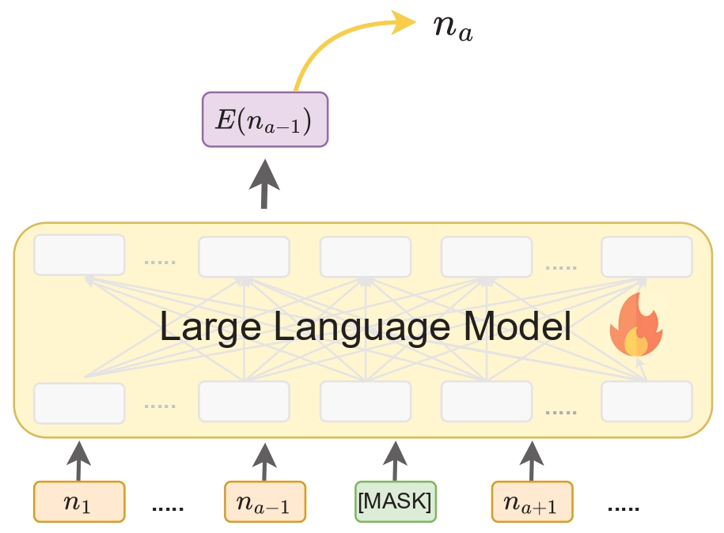
02
Motivation
Most LLMs are inherently causal and optimized for next-token prediction, which makes them inherently suboptimal for generating holistic, coherent representations of entire sequences.
Other pretext tasks remain fundamentally token-level rather than sequence-level prediction.
LLM2Vec
LLama2Vec
Notes:
Our motivation comes from two main considerations.
First, most current LLMs are causal and trained for next-token prediction. As a result, they are not naturally optimized to produce a single holistic representation for an entire sequence.
Second, many alternative pretext tasks are still fundamentally token-level, rather than sequence-level prediction. For example, LLM2Vec first modifies the causal attention of an LLM into a bidirectional form, and then uses masked next token prediction (MNTP) to better match the training objective of bidirectional encoders such as BERT. In MNTP, tokens are randomly masked, and the model uses context to predict the masked tokens. Llama2vec adopts two pretext tasks, Embedding-Based Auto-Encoding (EBAE) and Embedding-Based Auto-Regression (EBAR), which predict tokens in the original sequence or in a continued sequence. While these objectives can capture “bag-of-tokens” information, they still struggle to preserve the coherent semantic meaning of the full sequence as a single representation.

Slide 4
03
Contributions
We explore the potential of compression pretraining for adapting LLMs to text representation tasks. Our empirical analysis highlights key factors for success, such as the optimal training objective (CTKD) and the ideal number of memory tokens.
We show that CTKD outperforms other compression objectives by mitigating dimensional collapse, making it more effective for downstream tasks. Additionally, we demonstrate that contrastive learning further alleviates dimensional collapse.
The CTKD task lays a strong foundation for text representation, enabling our model to outperform models like LLM2Vec and Llama2Vec with less training data.
Notes:
Next, I will summarize our contributions.
First, we systematically study compression pretraining as a way to adapt LLMs for text representation. Through empirical analysis, we identify key factors for success, including the best training objective (CTKD) and the appropriate number of memory tokens.
Second, we analyze why CTKD outperforms other compression objectives, and show that it is less affected by dimensional collapse, which makes it better suited for downstream text representation.
Third, we show that adding contrastive learning further reduces dimensional collapse. With CTKD as a strong foundation, our model,LLM2Comp-kl, significantly outperforms recent methods such as LLM2Vec and LLaMA2Vec, while using less training data.

Slide 5
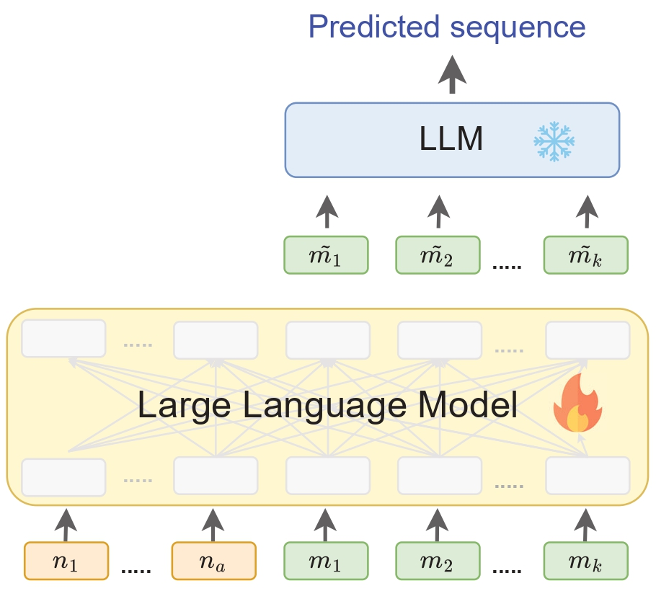
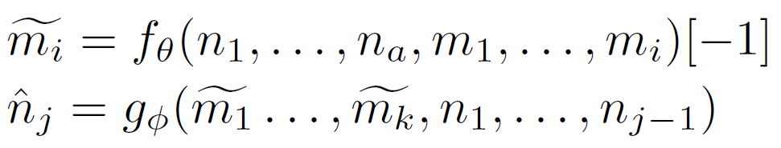
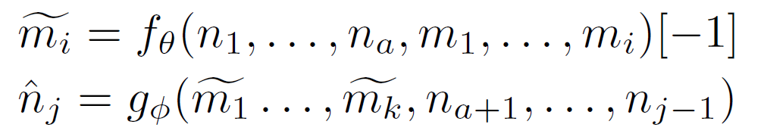
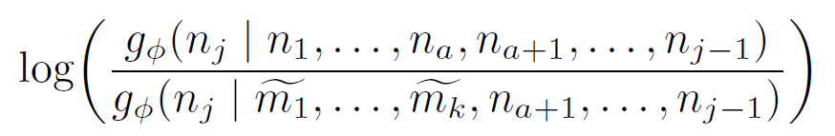
03
Method
Compression as Pretext Task
Reconstruction Task
A long context
Last token’s last hidden state
The encoder is responsible for producing the embeddings of special (memory) tokens
memory tokens
Original LLM
Continuation Task
Subsequent/Continual Tokens
Continuation Task with Knowledge Distillation
Notes:
Now I will introduce our method. We treat compression as a pretext task to capture sequence-level information. We consider two compression tasks: reconstruction and continuation. To further improve encoder training, we propose a third pretext task that combines the continuation objective with knowledge distillation (CTKD). Here .. means ....

Slide 6
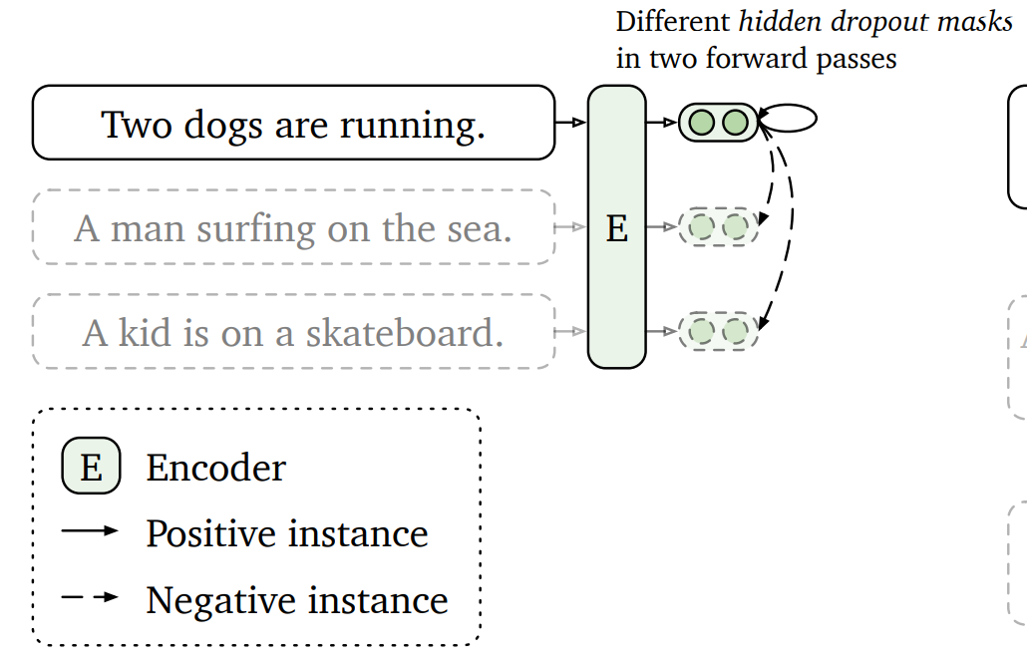
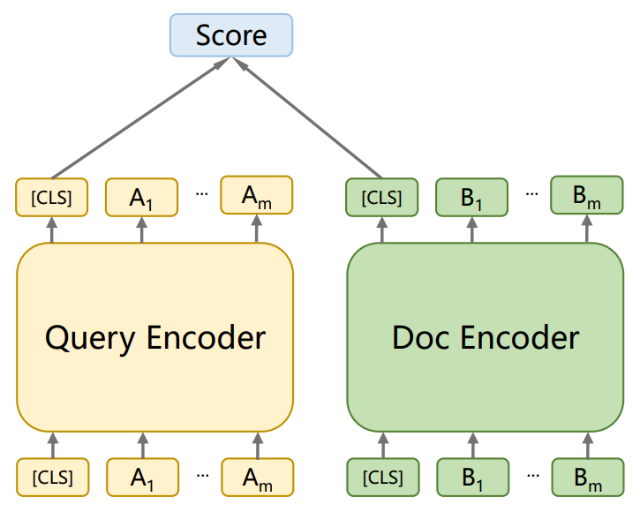
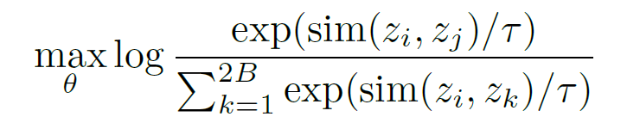
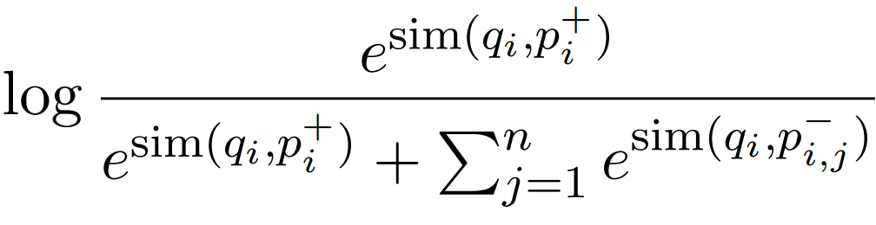

03
Method
Unsupervised Contrastive Learning(UCL)
Supervised Contrastive Learning(SCL)
positive samples of a particular sentence through dropout
Query and its relevant(positive) passage
current sample pair with other samples within same batch
Query and in-batch negative passages
Gao, T.; Yao, X.; and Chen, D. 2021. SimCSE: Simple Contrastive Learning of Sentence Embeddings. In Conference on Empirical Methods in Natural Language Processing.
Vladimir Karpukhin, Barlas Oguz, Sewon Min; et al. 2020. Dense passage retrieval for open domain question answering. In Proceedings of the Conference on Empirical Methods in Natural Language Processing,
Notes:
After pretext-task training, we follow a standard representation learning setup: we first run unsupervised contrastive learning (UCL) and then supervised contrastive learning (SCL). For UCL, we construct positive samples for the same sentence using dropout, and treat other sentences in the batch as negatives. We then perform SCL using supervised data, where relevant pairs are manually annotated. Negative samples are selected using in-batch negative sampling and hard-negative sampling. Here .. means ....

Slide 7
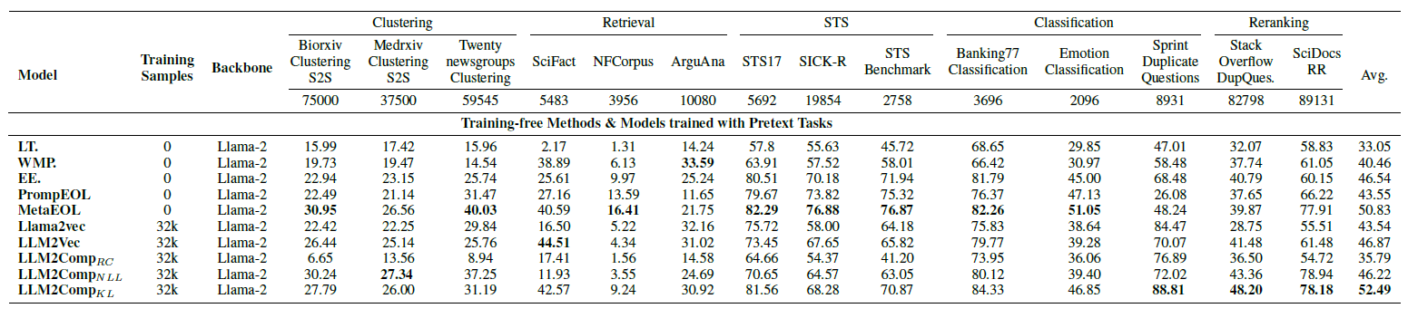
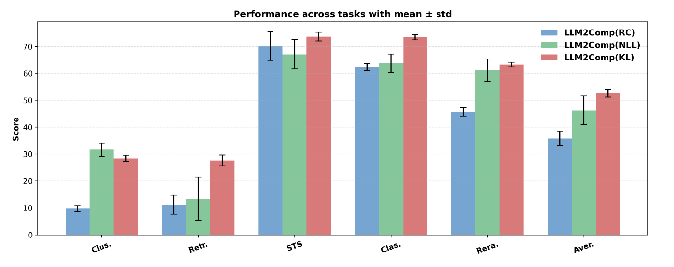
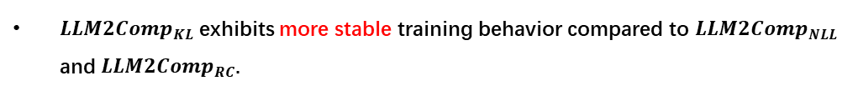
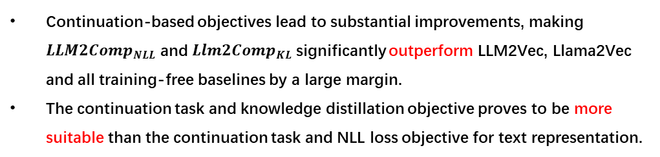
04
Experiment
$LLM2Comp_{RC}$ performs only slightly better than simple last-token pooling (LT).
Continuation-based objectives lead to substantial improvements, making $LLM2Comp_{NLL}$ and $Llm2Comp_{KL}$significantly outperform LLM2Vec, Llama2Vec and all training-free baselines by a large margin.
The continuation task and knowledge distillation objective proves to be more suitable than the continuation task and NLL loss objective for text representation.
$LLM2Comp_{KL}$exhibits more stable training behavior compared to $LLM2Comp_{NLL}$ and $LLM2Comp_{RC}$.
Notes:
Next, I will present our experimental results. This figure shows results for the pretext-task stage.
We see that LLM2Comp-reconstruction performs only slightly better than a simple last-token pooling baseline.
In contrast, continuation-based objectives produce large improvements: both LLM2Comp-NLL and LLM2Comp-KL significantly outperform LLM2Vec, LLaMA2Vec, and other training-free baselines by a wide margin. Moreover, combining continuation with knowledge distillation (LLM2Comp-KL / CTKD) is more suitable for text representation than combining continuation with an NLL objective.
From the left figure, we also observe that LLM2Comp-KL shows more stable training behavior than LLM2Comp-NLL and LLM2Comp-reconstruction.

Slide 8
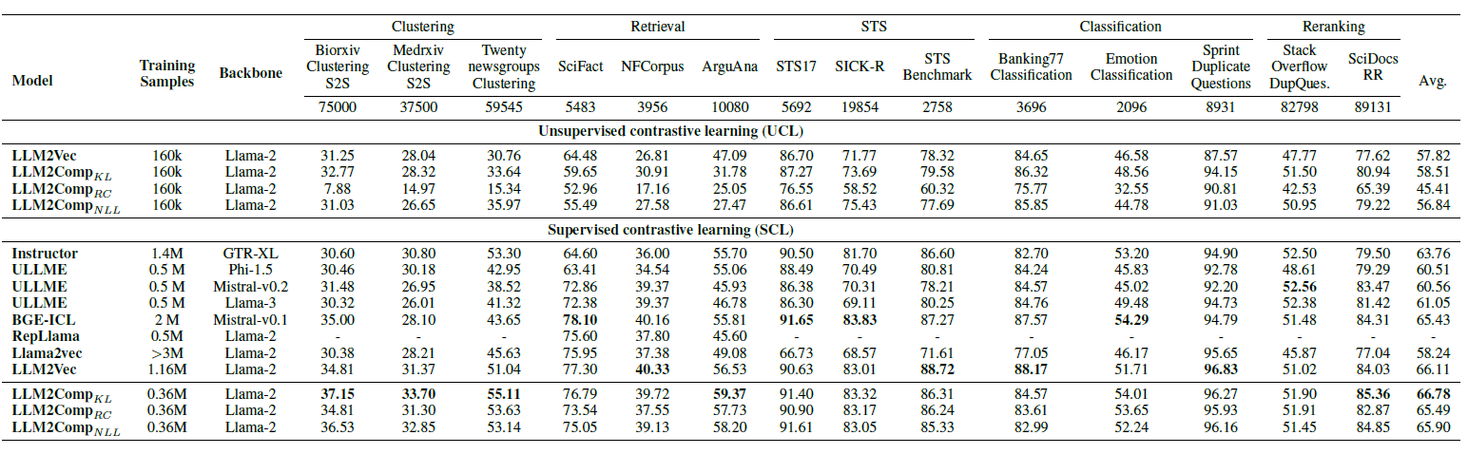
04
Experiment
In the UCL stage, $LLM2Comp_{KL}$ surpasses $LLM2Vec$, confirming that the benefits of our compression-based pretext task carry over to the subsequent training.
In the SCL stage after UCL, $LLM2Comp_{KL}$ is superior to $LLM2Vec$, and other contemporary models.
$LLM2Comp_{KL}$ achieves this using a much smaller amount of supervised data compared to $LLM2Vec$.
Notes:
This figure shows results after contrastive learning, including both the UCL stage and the SCL stage.
In UCL, LLM2Comp-KL surpasses LLM2Vec, which shows that the benefit of our compression-based pretext task transfers to later training.
In SCL after UCL, LLM2Comp-KL remains stronger than LLM2Vec and other recent models.
Importantly, LLM2Comp-KL achieves this using much less supervised data than LLM2Vec.

Slide 9
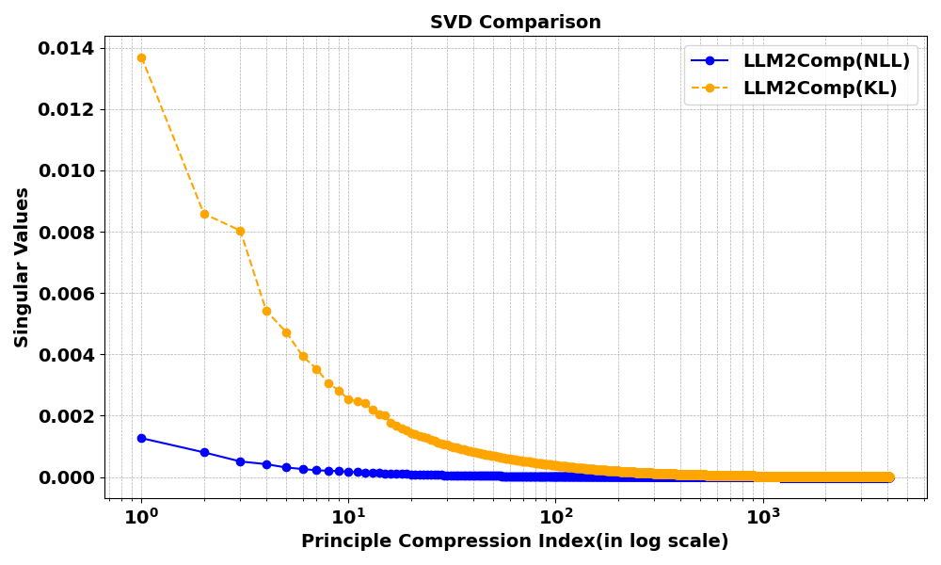
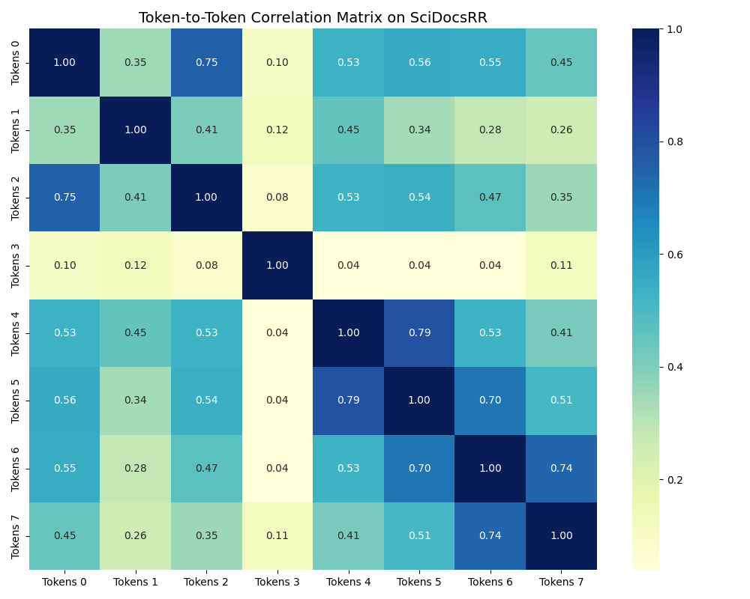
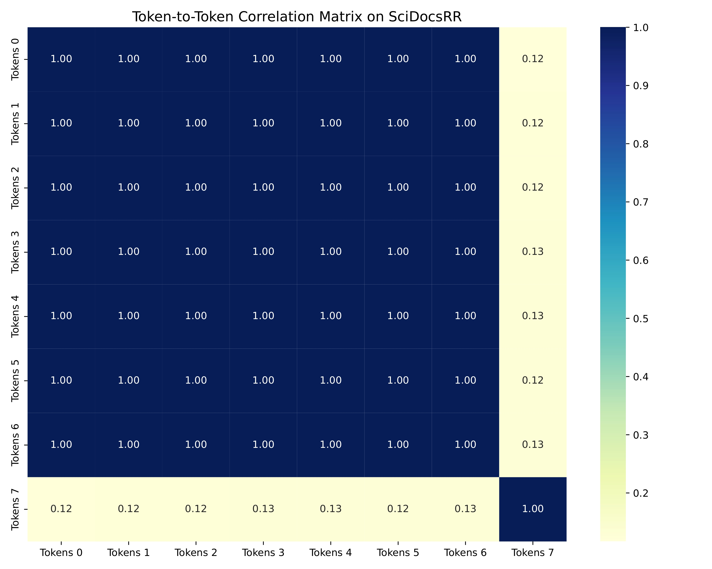
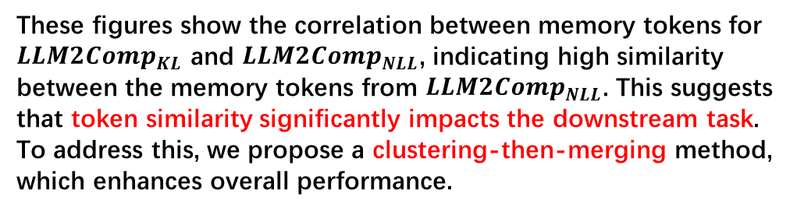
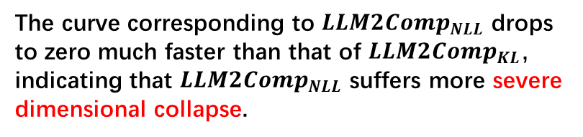
05
Dimension Collapse
Effective Dimension After Meanpooling
Effective Dimension Before Meanpooling
These figures show the correlation between memory tokens for $LLM2Comp_{KL}$ and $LLM2Comp_{NLL}$, indicating high similarity between the memory tokens from $LLM2Comp_{NLL}$. This suggests that token similarity significantly impacts the downstream task. To address this, we propose a clustering-then-merging method, which enhances overall performance.
The curve corresponding to $LLM2Comp_{NLL}$ drops to zero much faster than that of $LLM2Comp_{KL}$, indicating that $LLM2Comp_{NLL}$ suffers more severe dimensional collapse.
Notes:
Finally, I will discuss our findings on dimensional collapse.
After training with the compression pretext tasks, we analyze the effective dimension of representations using SVD. We find that the curve for LLM2Comp-NLL drops toward zero much faster than the curve for LLM2Comp-KL, indicating that LLM2Comp-NLL suffers more severe dimensional collapse. Intuitively, the KL divergence acts as a regularizer: it helps preserve information from less frequent tokens, which reduces this collapse.
The figures on the right show correlations among memory tokens for LLM2Comp-KL and LLM2Comp-NLL. We observe high similarity among memory tokens from LLM2Comp-NLL, suggesting that memory-token similarity has a strong effect on downstream performance. To address this issue, we propose a clustering-then-merging method, which improves overall results.

