Slide 1
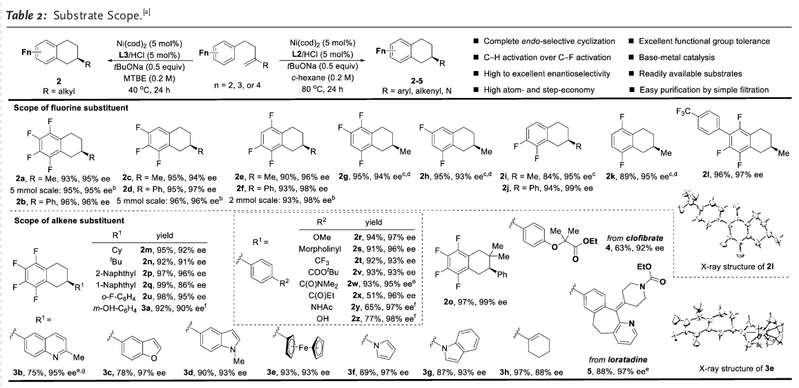
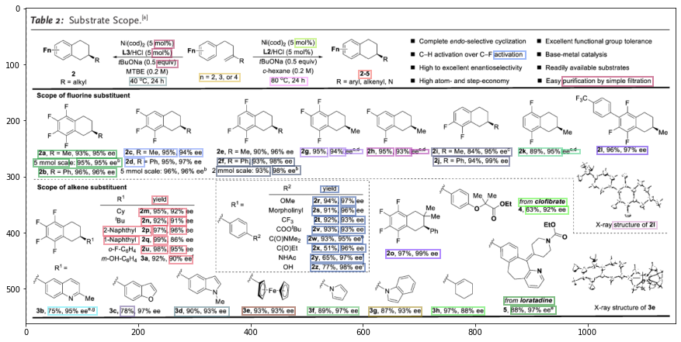
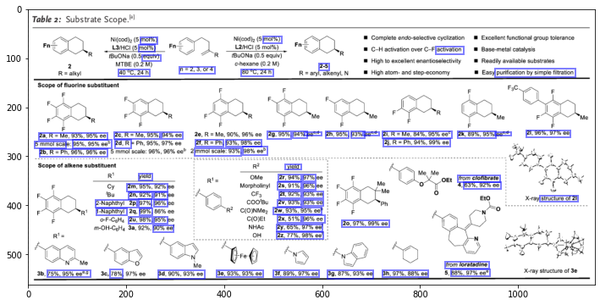
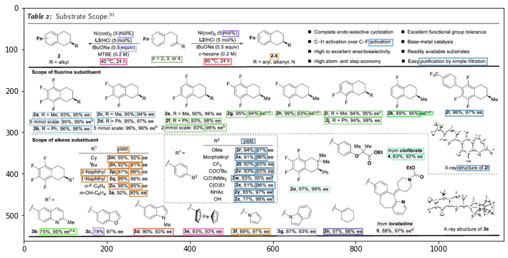
Algorithm to detect, filter, and merge text boxes:
Aim: boxes from the description of the same figure will be put into a group (same color in figure below)
Use EasyOCR to extract all text boxes
Set rules to remove all undesired boxes, e.g ‘Me’, ‘Ph’, ‘Cl’ – chemical name <- not description
set more rules when merging e.g boxes with text ‘4a…’ and ‘4b…’ only be merged if their x-axis overlap is large
anie-2.png
errors
Loop:
Pick one among the rest, put on group
Only consider boxes < 200 distance units (pixels) from the chosen
if box is close enough to some boxes in group -> put into group. until no more box can be put
-> groups of boxes, still get error!
Notes:
This is the slide of DO, Van Quyet

Slide 2
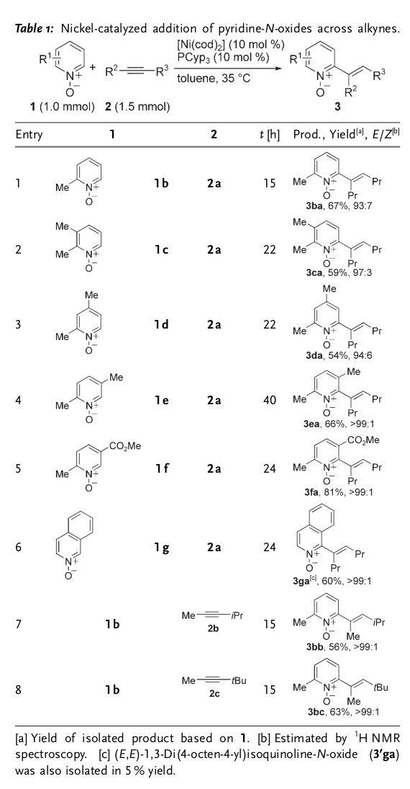
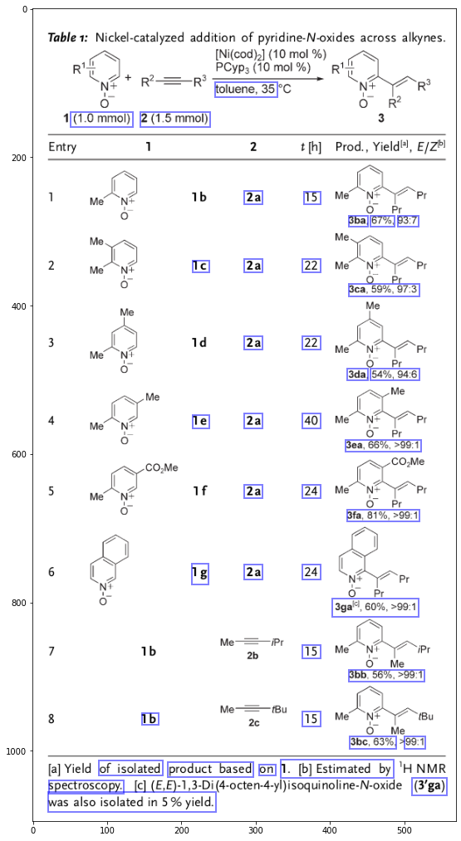
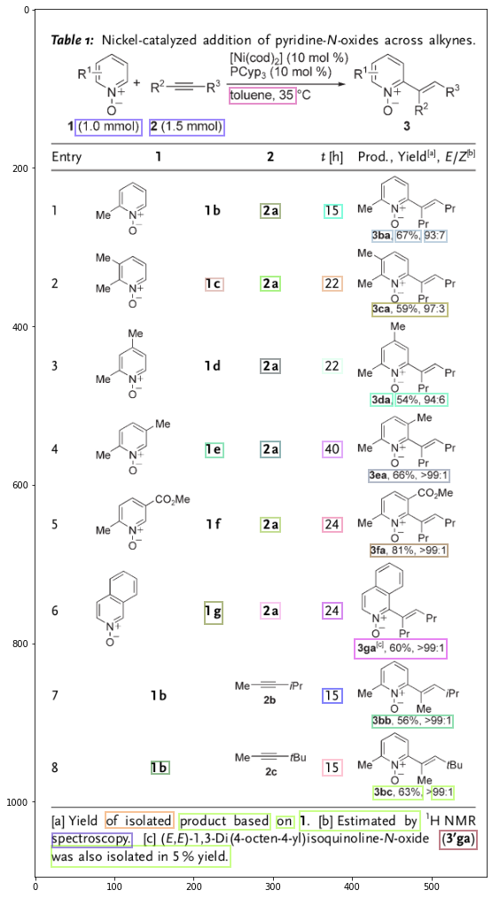
Some examples
anie-1.png
Good

Slide 3
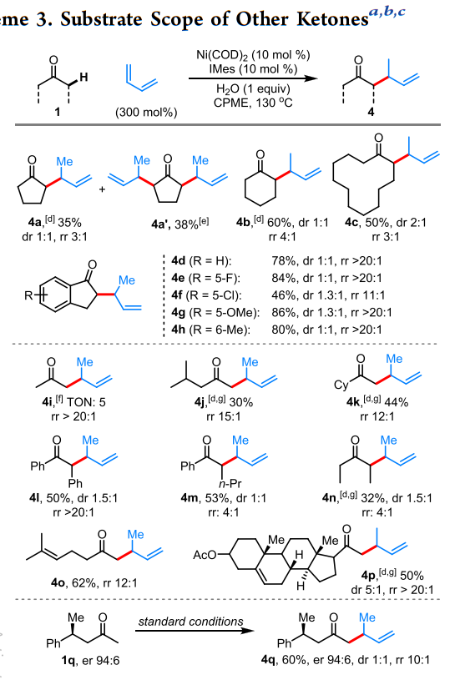
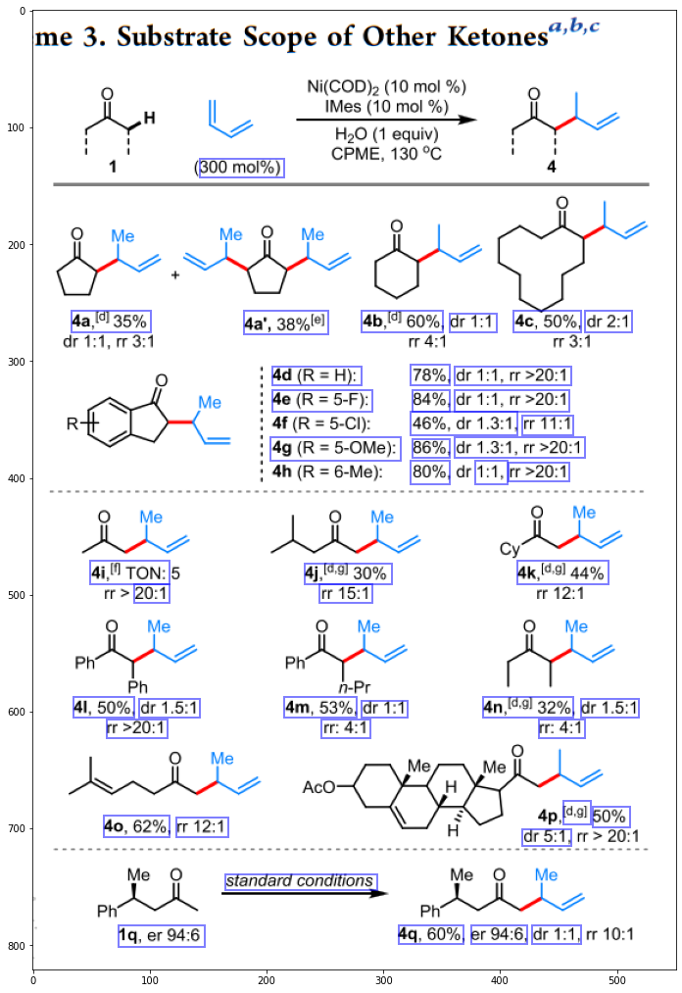
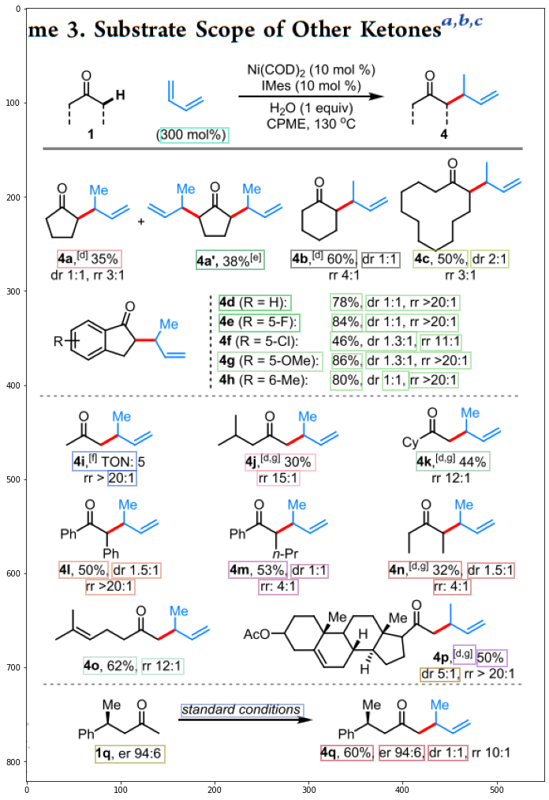
Some examples
catal-4.png
Good

Slide 4
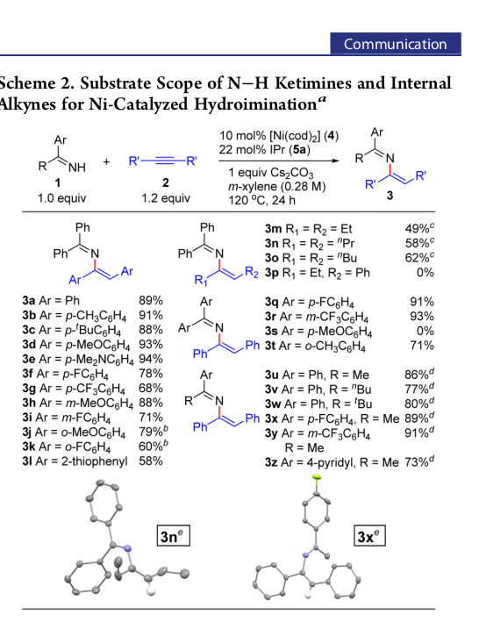
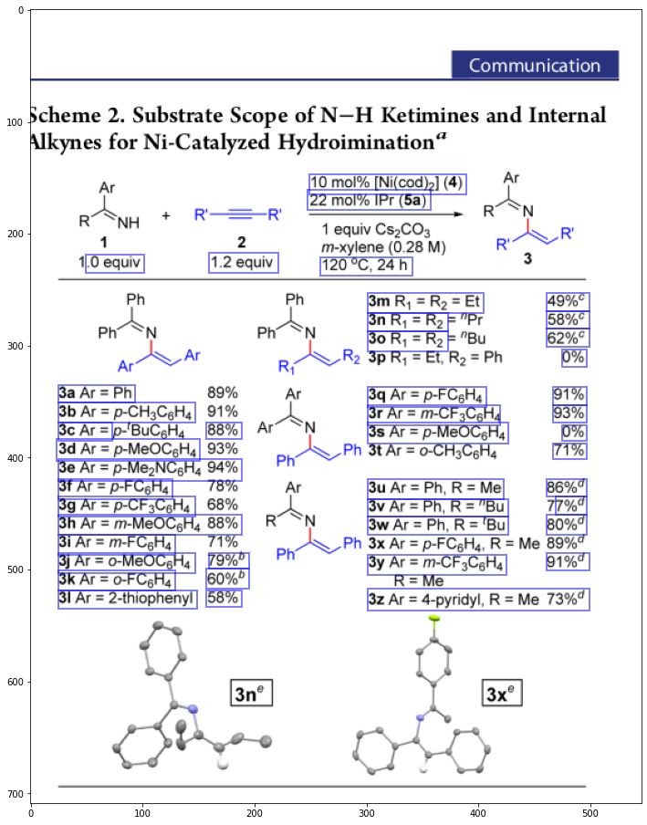
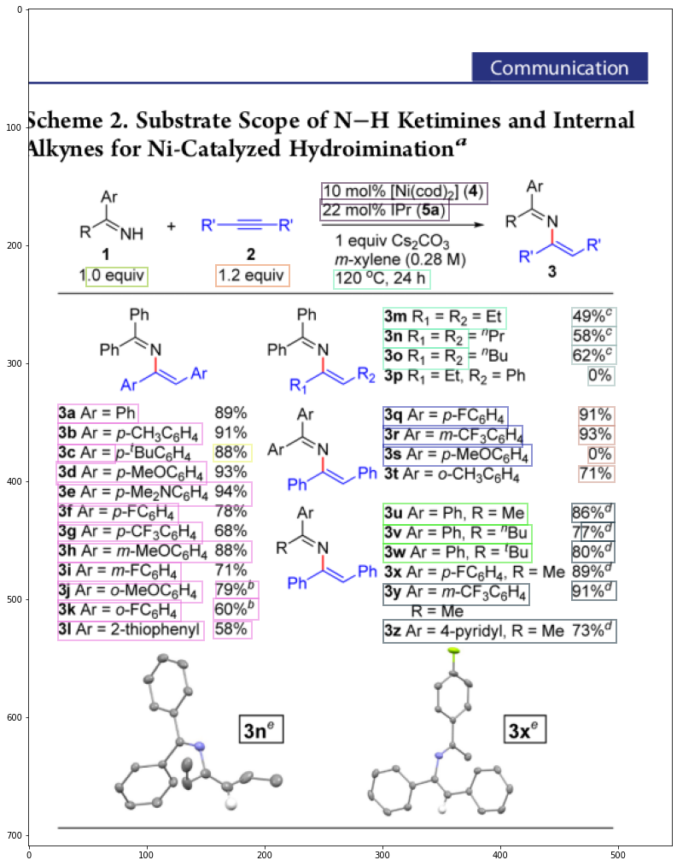
Some examples
jacs-5.png
Quite lots of errors

Slide 5
Algorithm to match text box to its corresponding chem. struct. figure:
before run it, remember to cover each group of text boxes by a big box
Q
(big) text box
Q
figure
for each chemical figure,
scan all text boxes,
only consider those are < (some constant ~ 100 pixels) from figure
From positive x direction, rotate the arm clockwise until meeting a text box.
Take this text box as description box

Slide 6
Comment:
Many failed cases are caused by mis-detection of EasyOCR
Algorithm does not work well on aligned table, because text seems to gather at one area, so do figures (e.g jacs-5). In this case, matching will also not work well since text is not close to the corresponding figure
-> modify code to solve this Q case
In other case when fig-text are close (e.g. anie-1,2; catal-4), by observation (but not the detailed counting), we have the correctness rate of algorithm is > 90%

