Slide 1

Management of Software Development Project ShopeeFood Clone System
Work Breakdown Structure
Group 5
Members:
ThaiND - ThanhDT – ThanhLD – LongLD – DucLT – LongT – TungNT - MinhNQ

Slide 2
Overview

Slide 3
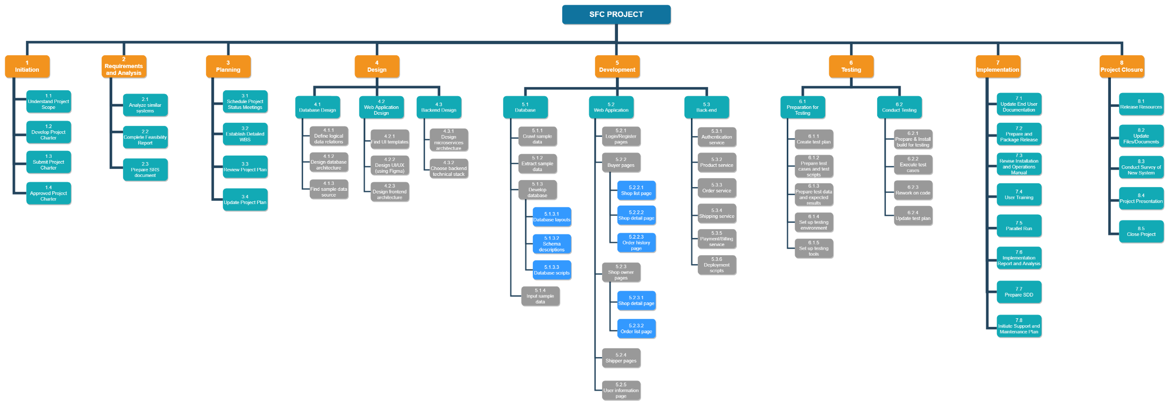

Slide 4
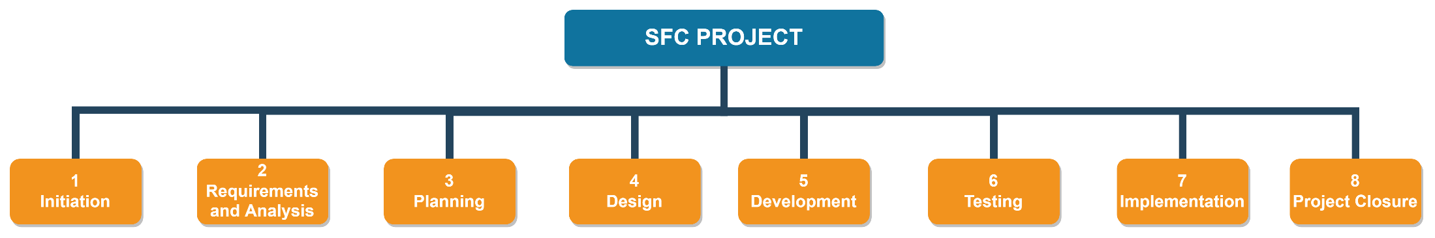
First level Staged in Sequence

Slide 5
Detail Structure

Slide 6
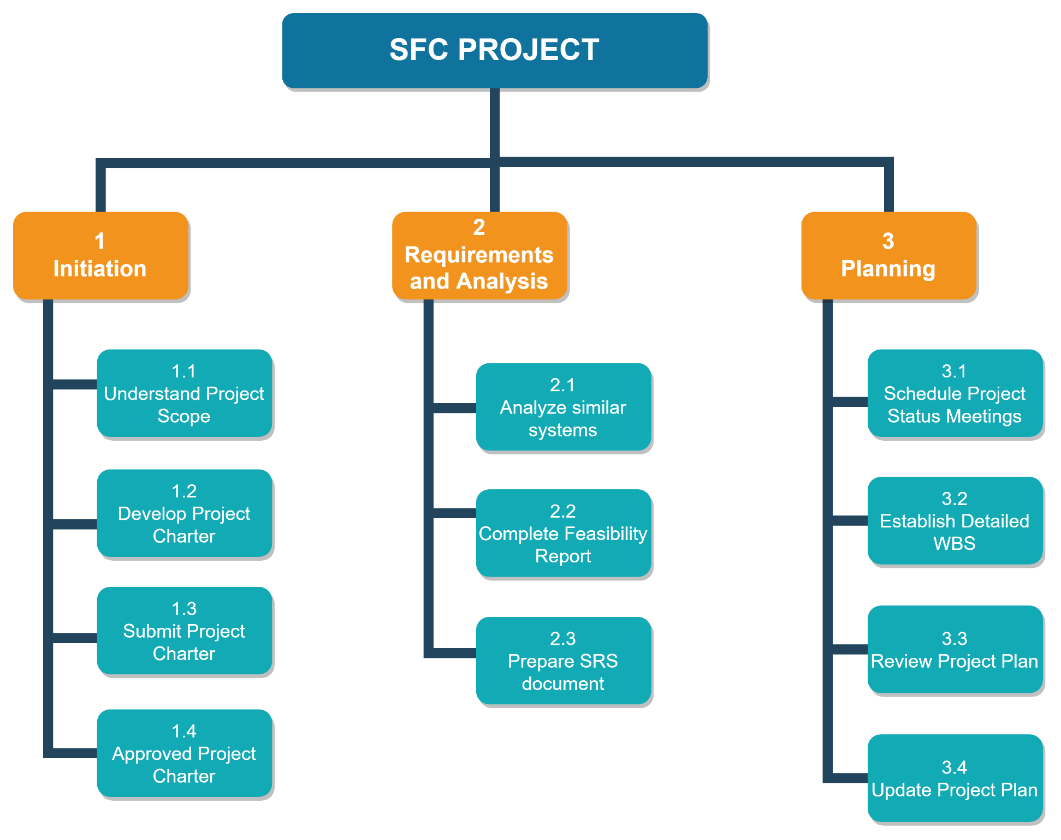

Slide 7
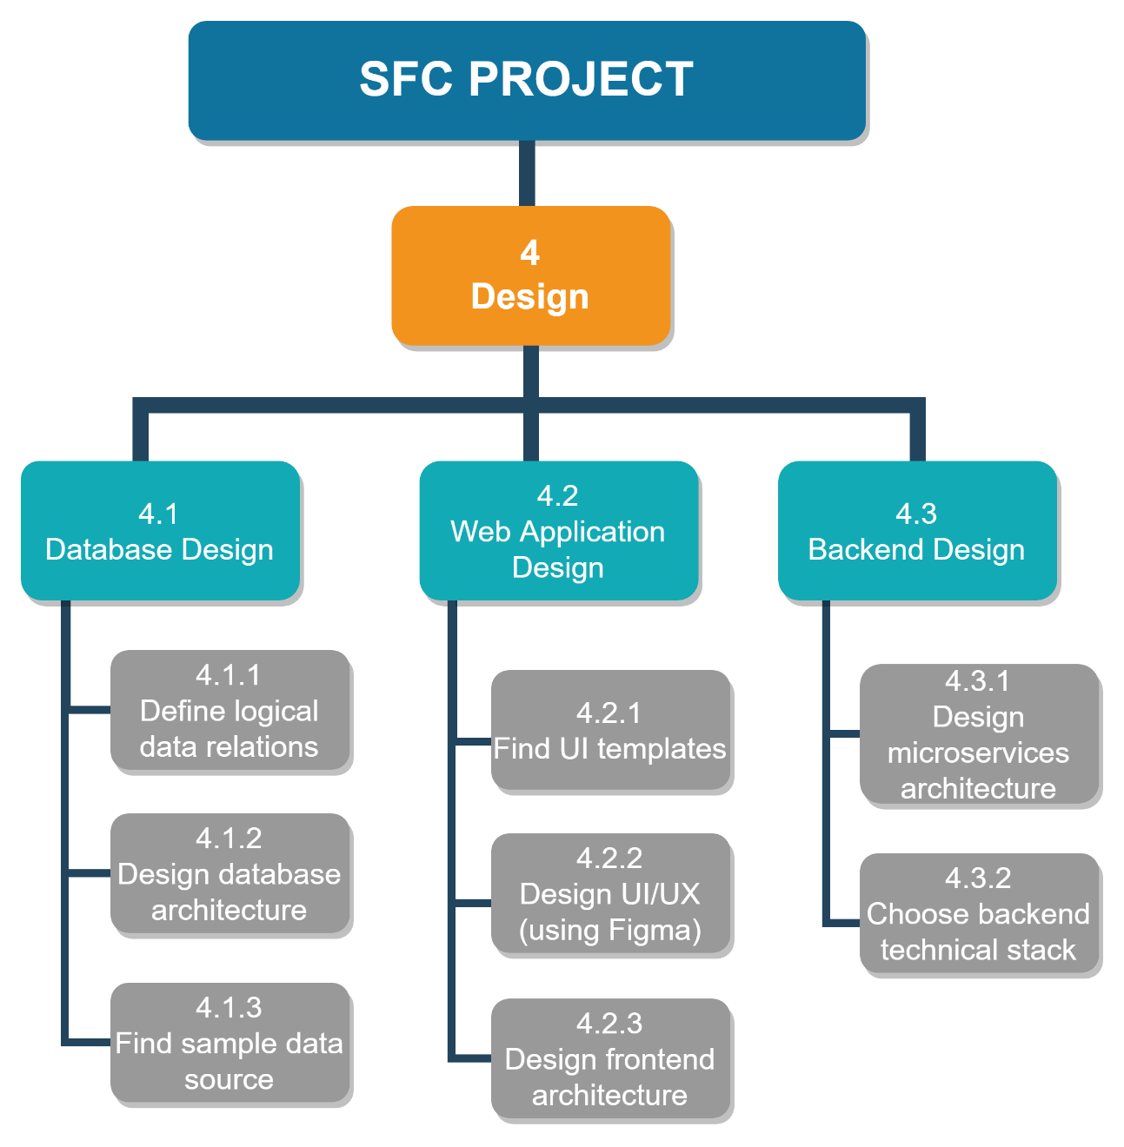

Slide 8
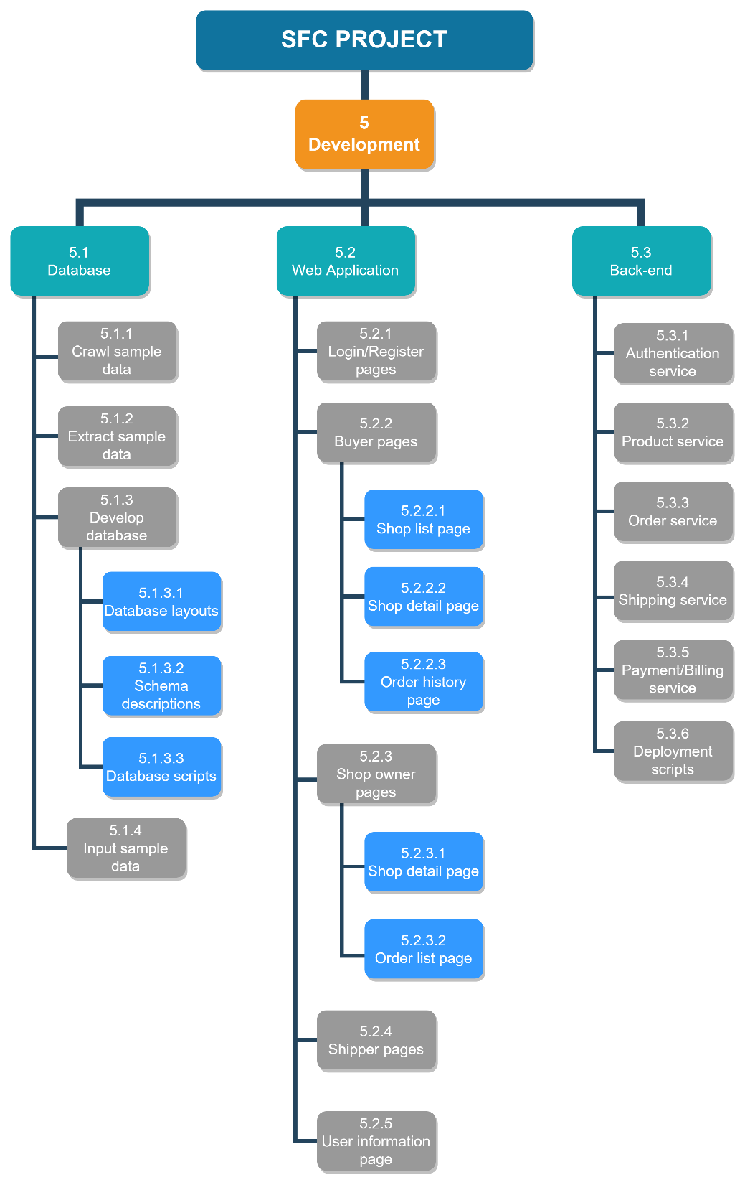

Slide 9
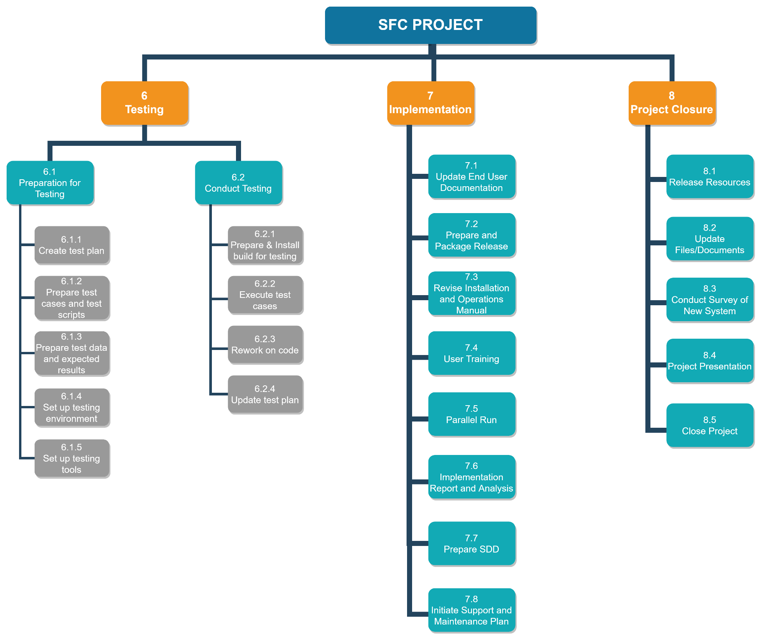

Slide 10
THANK YOU FOR LISTENING

