Slide 1
Java Core – OOP section 4
Vo Hoang Long (Lead Engineering – TBV TechnicalGroup)

Slide 2
Agenda
Encapsulation
Association
Aggregation
Composition
CRC

Slide 3
Encapsulation in Java
Encapsulation in Java is a process of wrapping code and data together into a single unit, for example, a capsule which is mixed of several medicines.
We can create a fully encapsulated class in Java by making all the data members of the class private. Now we can use setter and getter methods to set and get the data in it.
The Java Bean class is the example of a fully encapsulated class.

Slide 4
Advantage of Encapsulation in Java
By providing only a setter or getter method, you can make the class read-only or write-only. In other words, you can skip the getter or setter methods.
It provides you the control over the data. Suppose you want to set the value of id which should be greater than 100 only, you can write the logic inside the setter method. You can write the logic not to store the negative numbers in the setter methods.
It is a way to achieve data hiding in Java because other class will not be able to access the data through the private data members.
The encapsulate class is easy to test. So, it is better for unit testing.

Slide 5
Association
Association is relation between two separate classes which establishes through their Objects. Association can be one-to-one, one-to-many, many-to-one, many-to-many.
In Object-Oriented programming, an Object communicates to other Object to use functionality and services provided by that object. Composition and Aggregationare the two forms of association.

Slide 6
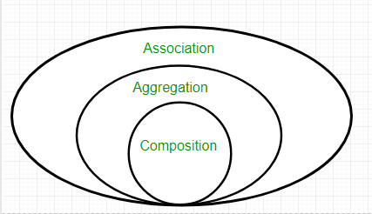
Association

Slide 7
Aggregation
It represents Has-A relationship.
It is a unidirectional association i.e. a one way relationship. For example, department can have students but vice versa is not possible and thus unidirectional in nature.
In Aggregation, both the entries can survive individually which means ending one entity will not effect the other entity
When do we use Aggregation ?? Code reuse is best achieved by aggregation.

Slide 8
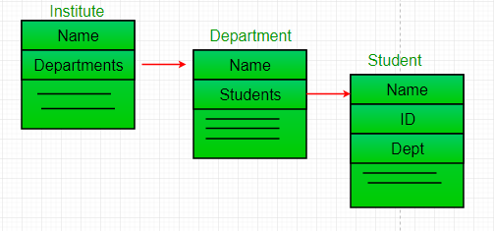
Aggregation

Slide 9
Composition
Composition is a restricted form of Aggregation in which two entities are highly dependent on each other.
It represents part-of relationship.
In composition, both the entities are dependent on each other.
When there is a composition between two entities, the composed object cannot exist without the other entity.

Slide 10
Aggregation vs Composition
Dependency: Aggregation implies a relationship where the child can exist independently of the parent. For example, Bank and Employee, delete the Bank and the Employee still exist. whereas Composition implies a relationship where the child cannot exist independent of the parent. Example: Human and heart, heart don’t exist separate to a Human
Type of Relationship: Aggregation relation is “has-a” and composition is “part-of” relation.
Type of association: Composition is a strong Association whereas Aggregation is a weak Association.

Slide 11
Class Responsibility Collaborator (CRC) Models
A Class Responsibility Collaborator (CRC) model (Beck & Cunningham 1989; Wilkinson 1995; Ambler 1995) is a collection of standard index cards that have been divided into three sections, as depicted

Slide 12
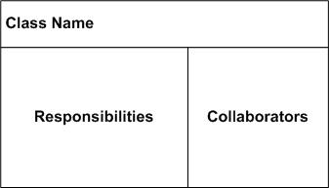
Class Responsibility Collaborator (CRC) Models

Slide 13
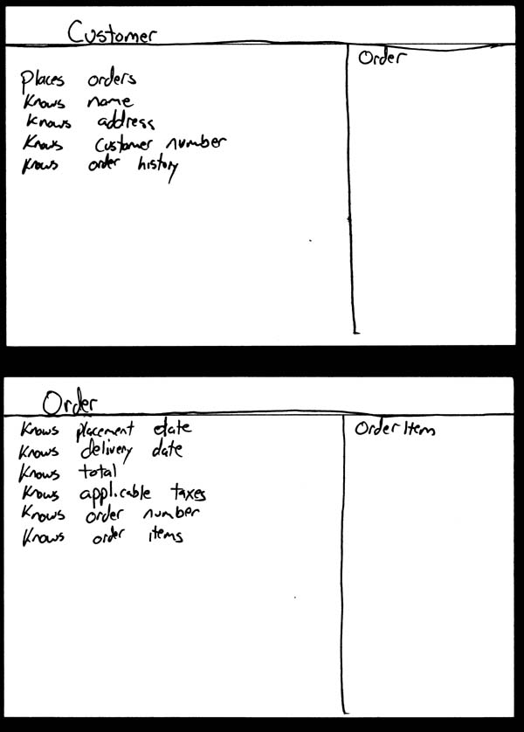
Class Responsibility Collaborator (CRC) Models

Slide 14
Class Responsibility Collaborator (CRC) Models
Although CRC cards were originally introduced as a technique for teaching object-oriented concepts, they have also been successfully used as a full-fledged modeling technique. My experience is that CRC models are an incredibly effective tool for conceptual modeling as well as for detailed design. CRC cards feature prominently in eXtreme Programming (XP) (Beck 2000) as a design technique. My focus here is on applying CRC cards for conceptual modeling with your stakeholders.
A class represents a collection of similar objects. An object is a person, place, thing, event, or concept that is relevant to the system at hand. For example, in a university system, classes would represent students, tenured professors, and seminars. The name of the class appears across the top of a CRC card and is typically a singular noun or singular noun phrase, such as Student, Professor, and Seminar. You use singular names because each class represents a generalized version of a singular object. Although there may be the student John O'Brien, you would model the class Student. The information about a student describes a single person, not a group of people. Therefore, it makes sense to use the name Student and not Students. Class names should also be simple. For example, which name is better: Student or Person who takes seminars?
A responsibility is anything that a class knows or does. For example, students have names, addresses, and phone numbers. These are the things a student knows. Students also enroll in seminars, drop seminars, and request transcripts. These are the things a student does. The things a class knows and does constitute its responsibilities. Important: A class is able to change the values of the things it knows, but it is unable to change the values of what other classes know.

Slide 15
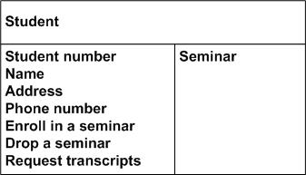
Class Responsibility Collaborator (CRC) Models

Slide 16
Class Responsibility Collaborator (CRC) Models
Collaboration takes one of two forms: A request for information or a request to do something. For example, the card Student requests an indication from the card Seminar whether a space is available, a request for information. Student then requests to be added to the Seminar, a request to do something. Another way to perform this logic, however, would have been to have Student simply request Seminar to enroll himself into itself. Then have Seminar do the work of determining if a seat is available and, if so, then enrolling the student and, if not, then informing the student that he was not enrolled.

Slide 17
Class Responsibility Collaborator (CRC) Models
So how do you create CRC models? Iteratively perform the following steps:
Find classes. Finding classes is fundamentally an analysis task because it deals with identifying the building blocks for your application. A good rule of thumb is that you should look for the three-to-five main classes right away, such as Student, Seminar, and Professor in Figure 4. I will sometimes include UI classes such as Transcript and Student Schedule, both are reports, although others will stick to just entity classes. Also, I'll sometimes include cards representing actors when my stakeholders are struggling with the concept of a student in the real world (the actor) versus the student in the system (the entity).
Find responsibilities. You should ask yourself what a class does as well as what information you wish to maintain about it. You will often identify a responsibility for a class to fulfill a collaboration with another class.
Define collaborators. A class often does not have sufficient information to fulfill its responsibilities. Therefore, it must collaborate (work) with other classes to get the job done. Collaboration will be in one of two forms: a request for information or a request to perform a task. To identify the collaborators of a class for each responsibility ask yourself "does the class have the ability to fulfill this responsibility?". If not then look for a class that either has the ability to fulfill the missing functionality or the class which should fulfill it. In doing so you'll often discover the need for new responsibilities in other classes and maybe even the need for a new class or two.
Move the cards around. To improve everyone's understanding of the system, the cards should be placed on the table in an intelligent manner. Two cards that collaborate with one another should be placed close together on the table, whereas two cards that don't collaborate should be placed far apart. Furthermore, the more two cards collaborate, the closer they should be on the desk. By having cards that collaborate with one another close together, it's easier to understand the relationships between classes.

Slide 18
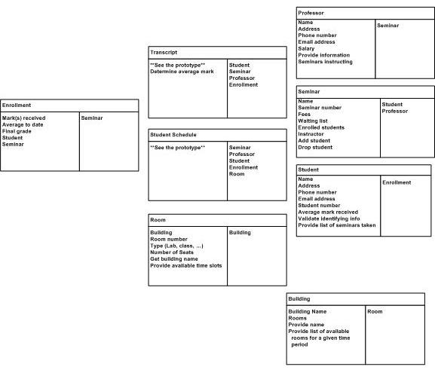
Class Responsibility Collaborator (CRC) Models

