Slide 1
Java core – OOP section 3
Vo Hoang Long (Lead of Engineering – TBV Technical Group)

Slide 2
Agenda
Abstract class
Interface
Access modifier

Slide 3
Abstraction in Java
Abstraction is a process of hiding the implementation details and showing only functionality to the user.
Another way, it shows only essential things to the user and hides the internal details, for example, sending SMS where you type the text and send the message. You don't know the internal processing about the message delivery.
Abstraction lets you focus on what the object does instead of how it does it.
Ways to achieve Abstraction
There are two ways to achieve abstraction in java
Abstract class (0 to 100%)
Interface (100%)

Slide 4
Abstract class in Java
A class which is declared as abstract is known as an abstract class. It can have abstract and non-abstract methods. It needs to be extended and its method implemented. It cannot be instantiated.
Points to Remember
An abstract class must be declared with an abstract keyword.
It can have abstract and non-abstract methods.
It cannot be instantiated.
It can have constructors and static methods also.
It can have final methods which will force the subclass not to change the body of the method.

Slide 5
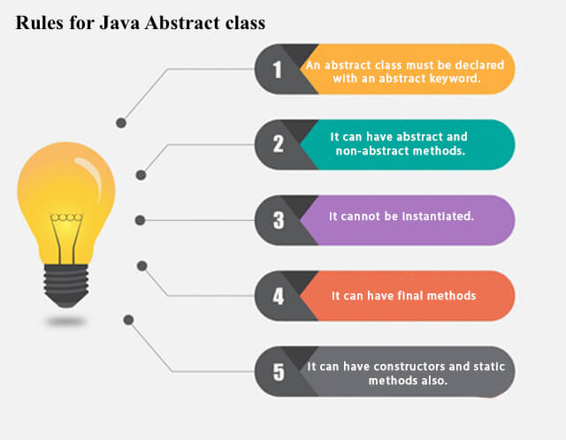
Abstract class in Java

Slide 6
Interface in Java
An interface in java is a blueprint of a class. It has static constants and abstract methods.
The interface in Java is a mechanism to achieve abstraction. There can be only abstract methods in the Java interface, not method body. It is used to achieve abstraction and multiple inheritance in Java.
In other words, you can say that interfaces can have abstract methods and variables. It cannot have a method body.
Java Interface also represents the IS-A relationship.
It cannot be instantiated just like the abstract class.
Since Java 8, we can have default and static methods in an interface.
Since Java 9, we can have private methods in an interface.

Slide 7
Why use Java interface?
There are mainly three reasons to use interface. They are given below.
It is used to achieve abstraction.
By interface, we can support the functionality of multiple inheritance.
It can be used to achieve loose coupling.

Slide 8
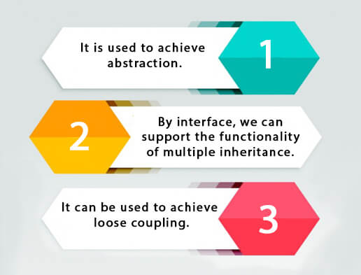
Why use Java interface?

Slide 9
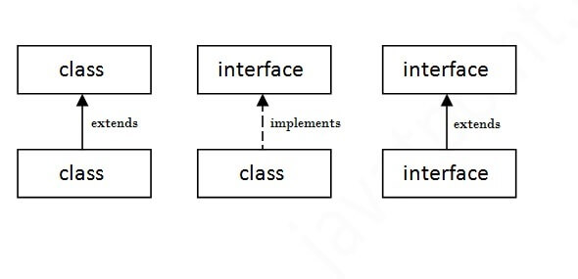
The relationship between classes and interfaces
As shown in the figure given below, a class extends another class, an interface extends another interface, but a class implements an interface.

Slide 10
Marker or tagged interface
An interface which has no member is known as a marker or tagged interface, for example, Serializable, Cloneable, Remote, etc. They are used to provide some essential information to the JVM so that JVM may perform some useful operation.

Slide 11
Difference between abstract class and interface
Abstract class | Interface
Abstract class can have abstract and non-abstract methods. | Interface can have only abstract methods. Since Java 8, it can have default and static methods also.
Abstract class doesn't support multiple inheritance. | Interface supports multiple inheritance.
Abstract class can have final, non-final, static and non-static variables. | Interface has only static and final variables.
Abstract class can provide the implementation of interface. | Interface can't provide the implementation of abstract class.
The abstract keyword is used to declare abstract class. | The interface keyword is used to declare interface.
An abstract class can extend another Java class and implement multiple Java interfaces. | An interface can extend another Java interface only.
An abstract class can be extended using keyword "extends". | An interface can be implemented using keyword "implements".
A Java abstract class can have class members like private, protected, etc. | Members of a Java interface are public by default.
Example: public abstract class Shape{ public abstract void draw(); } | Example: public interface Drawable{ void draw(); }

Slide 12
Access Modifiers in Java
There are two types of modifiers in Java: access modifiers and non-access modifiers.
The access modifiers in Java specifies the accessibility or scope of a field, method, constructor, or class. We can change the access level of fields, constructors, methods, and class by applying the access modifier on it.

Slide 13
Access Modifiers in Java
There are four types of Java access modifiers:
Private: The access level of a private modifier is only within the class. It cannot be accessed from outside the class.
Default: The access level of a default modifier is only within the package. It cannot be accessed from outside the package. If you do not specify any access level, it will be the default.
Protected: The access level of a protected modifier is within the package and outside the package through child class. If you do not make the child class, it cannot be accessed from outside the package.
Public: The access level of a public modifier is everywhere. It can be accessed from within the class, outside the class, within the package and outside the package.
There are many non-access modifiers, such as static, abstract, synchronized, native, volatile, transient, etc. Here, we are going to learn the access modifiers only.

Slide 14
Access Modifiers in Java
Understanding Java Access Modifiers
Let's understand the access modifiers in Java by a simple table.
Access Modifier | within class | within package | outside package by subclass only | outside package
Private | Y | N | N | N
Default | Y | Y | N | N
Protected | Y | Y | Y | N
Public | Y | Y | Y | Y

Slide 15
Access Modifiers in Java
Private
The private access modifier is accessible only within the class.
A class cannot be private or protected except nested class.
Default
If you don't use any modifier, it is treated as default by default. The default modifier is accessible only within package. It cannot be accessed from outside the package. It provides more accessibility than private. But, it is more restrictive than protected, and public.
Protected
The protected access modifier is accessible within package and outside the package but through inheritance only.
The protected access modifier can be applied on the data member, method and constructor. It can't be applied on the class.
It provides more accessibility than the default modifer.
Public
The public access modifier is accessible everywhere. It has the widest scope among all other modifiers.

