Slide 1
Collection API – section 2
Vo Hoang Long (Lead of Engineering – TBV Technical Group)

Slide 2
Agenda
HashSet
Map
HashMap
Sorting Collection
Comparable
Comparator
Stack
Queue
Enum
Lambda Expression

Slide 3
Java HashSet
Java HashSet class is used to create a collection that uses a hash table for storage. It inherits the AbstractSet class and implements Set interface.
The important points about Java HashSet class are:
HashSet stores the elements by using a mechanism called hashing.
HashSet contains unique elements only.
HashSet allows null value.
HashSet class is non synchronized.
HashSet doesn't maintain the insertion order. Here, elements are inserted on the basis of their hashcode.
HashSet is the best approach for search operations.
The initial default capacity of HashSet is 16, and the load factor is 0.75.

Slide 4
Java HashSet
Difference between List and Set
A list can contain duplicate elements whereas Set contains unique elements only.
Hierarchy of HashSet class
The HashSet class extends AbstractSet class which implements Set interface. The Set interface inherits Collection and Iterable interfaces in hierarchical order.

Slide 5

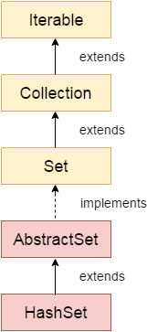
Java HashSet

Slide 6
Java Map Interface
A map contains values on the basis of key, i.e. key and value pair. Each key and value pair is known as an entry. A Map contains unique keys.
A Map is useful if you have to search, update or delete elements on the basis of a key.

Slide 7
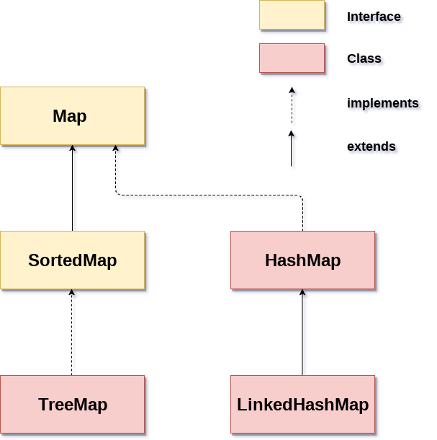
Java Map Interface

Slide 8
Java HashMap class
Java HashMap class implements the map interface by using a hash table. It inherits AbstractMap class and implements Map interface.
Points to remember
Java HashMap class contains values based on the key.
Java HashMap class contains only unique keys.
Java HashMap class may have one null key and multiple null values.
Java HashMap class is non synchronized.
Java HashMap class maintains no order.
The initial default capacity of Java HashMap class is 16 with a load factor of 0.75.

Slide 9
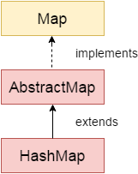
Java HashMap class

Slide 10
Java Hashtable class
Java Hashtable class implements a hashtable, which maps keys to values. It inherits Dictionary class and implements the Map interface.
Points to remember
A Hashtable is an array of a list. Each list is known as a bucket. The position of the bucket is identified by calling the hashcode() method. A Hashtable contains values based on the key.
Java Hashtable class contains unique elements.
Java Hashtable class doesn't allow null key or value.
Java Hashtable class is synchronized.
The initial default capacity of Hashtable class is 11 whereas loadFactor is 0.75.

Slide 11
Difference between HashMap and Hashtable
HashMap and Hashtable both are used to store data in key and value form. Both are using hashing technique to store unique keys.
But there are many differences between HashMap and Hashtable classes that are given below.
HashMap | Hashtable
1) HashMap is non synchronized. It is not-thread safe and can't be shared between many threads without proper synchronization code. | Hashtable is synchronized. It is thread-safe and can be shared with many threads.
2) HashMap allows one null key and multiple null values. | Hashtable doesn't allow any null key or value.
3) HashMap is a new class introduced in JDK 1.2. | Hashtable is a legacy class.
4) HashMap is fast. | Hashtable is slow.
5) We can make the HashMap as synchronized by calling this code Map m = Collections.synchronizedMap(hashMap); | Hashtable is internally synchronized and can't be unsynchronized.
6) HashMap is traversed by Iterator. | Hashtable is traversed by Enumerator and Iterator.
7) Iterator in HashMap is fail-fast. | Enumerator in Hashtable is not fail-fast.
8) HashMap inherits AbstractMap class. | Hashtable inherits Dictionary class.

Slide 12
Sorting in Collection
We can sort the elements of:
String objects
Wrapper class objects
User-defined class objects
Collections class provides static methods for sorting the elements of a collection. If collection elements are of a Set type, we can use TreeSet. However, we cannot sort the elements of List. Collections class provides methods for sorting the elements of List type elements.

Slide 13
Java Comparable interface
Java Comparable interface is used to order the objects of the user-defined class. This interface is found in java.lang package and contains only one method named compareTo(Object). It provides a single sorting sequence only, i.e., you can sort the elements on the basis of single data member only. For example, it may be rollno, name, age or anything else.
We can sort the elements of:
String objects
Wrapper class objects
User-defined class objects

Slide 14
Java Comparable interface
compareTo(Object obj) method
public int compareTo(Object obj): It is used to compare the current object with the specified object. It returns
positive integer, if the current object is greater than the specified object.
negative integer, if the current object is less than the specified object.
zero, if the current object is equal to the specified object.

Slide 15
Java Comparator interface
Java Comparator interface is used to order the objects of a user-defined class.
This interface is found in java.util package and contains 2 methods compare(Object obj1,Object obj2) and equals(Object element).
It provides multiple sorting sequences, i.e., you can sort the elements on the basis of any data member, for example, rollno, name, age or anything else.

Slide 16
Java Comparator interface
Methods of Java Comparator Interface
Method | Description
public int compare(Object obj1, Object obj2) | It compares the first object with the second object.
public boolean equals(Object obj) | It is used to compare the current object with the specified object.

Slide 17
Difference between Comparable and Comparator
Comparable | Comparator
1) Comparable provides a single sorting sequence. In other words, we can sort the collection on the basis of a single element such as id, name, and price. | The Comparator provides multiple sorting sequences. In other words, we can sort the collection on the basis of multiple elements such as id, name, and price etc.
2) Comparable affects the original class, i.e., the actual class is modified. | Comparator doesn't affect the original class, i.e., the actual class is not modified.
3) Comparable provides compareTo() method to sort elements. | Comparator provides compare() method to sort elements.
4) Comparable is present in java.lang package. | A Comparator is present in the java.util package.
5) We can sort the list elements of Comparable type by Collections.sort(List) method. | We can sort the list elements of Comparator type by Collections.sort(List, Comparator) method.

Slide 18
Stack
The stack is the subclass of Vector. It implements the last-in-first-out data structure, i.e., Stack. The stack contains all of the methods of Vector class and also provides its methods like boolean push(), boolean peek(), boolean push(object o), which defines its properties.

Slide 19
Queue Interface
Queue interface maintains the first-in-first-out order. It can be defined as an ordered list that is used to hold the elements which are about to be processed. There are various classes like PriorityQueue, Deque, and ArrayDeque which implements the Queue interface.

Slide 20
PriorityQueue
The PriorityQueue class implements the Queue interface. It holds the elements or objects which are to be processed by their priorities. PriorityQueue doesn't allow null values to be stored in the queue.

Slide 21
Enum in Java
Enumerations serve the purpose of representing a group of named constants in a programming language. For example the 4 suits in a deck of playing cards may be 4 enumerators named Club, Diamond, Heart, and Spade, belonging to an enumerated type named Suit.
Enums are used when we know all possible values at compile time, such as choices on a menu, rounding modes, command line flags, etc. It is not necessary that the set of constants in an enum type stay fixed for all time.

Slide 22
Enum in Java
Enum and Inheritance :
All enums implicitly extend java.lang.Enum class. As a class can only extend one parent in Java, so an enum cannot extend anything else.
toString() method is overridden in java.lang.Enum class,which returns enum constant name.
enum can implement many interfaces.
values(), ordinal() and valueOf() methods :
These methods are present inside java.lang.Enum.
values() method can be used to return all values present inside enum.
Order is important in enums.By using ordinal() method, each enum constant index can be found, just like array index.
valueOf() method returns the enum constant of the specified string value, if exists.

Slide 23
Enum in Java
enum and constructor :
enum can contain constructor and it is executed separately for each enum constant at the time of enum class loading.
We can’t create enum objects explicitly and hence we can’t invoke enum constructor directly.
enum and methods :
enum can contain concrete methods only i.e. no any abstract method.

Slide 24
Lambda Expressions in Java 8
Lambda expressions basically express instances of functional interfaces (An interface with single abstract method is called functional interface. An example is java.lang.Runnable). lambda expressions implement the only abstract function and therefore implement functional interfaces
lambda expressions are added in Java 8 and provide below functionalities.
Enable to treat functionality as a method argument, or code as data.
A function that can be created without belonging to any class.
A lambda expression can be passed around as if it was an object and executed on demand.

Slide 25
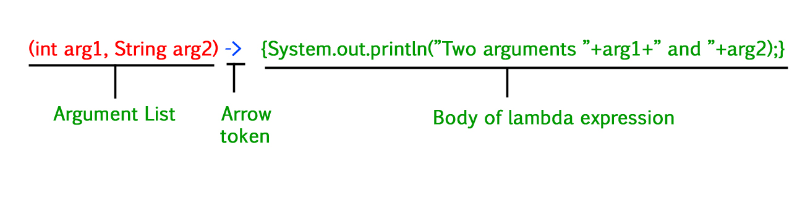
Lambda Expressions in Java 8

Slide 26
Lambda Expressions in Java 8
Syntax:
lambda operator -> body
where lambda operator can be:
Zero parameter:() -> System.out.println("Zero parameter lambda");
One parameter:–(p) -> System.out.println("One parameter: " + p);
It is not mandatory to use parentheses, if the type of that variable can be inferred from the context
Multiple parameters :(p1, p2) -> System.out.println("Multiple parameters: " + p1 + ", "

