Slide 1

INDUSTRIAL INSTRUMENTATION
PROJECT REPORT
Design & Calibration of a Digital Weighing Scale using
STM32 and Load Cell

Slide 2
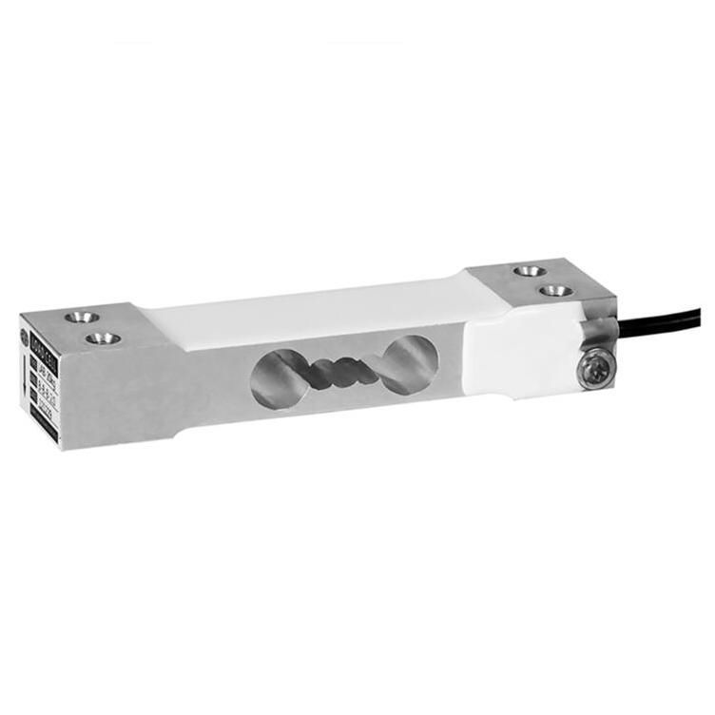
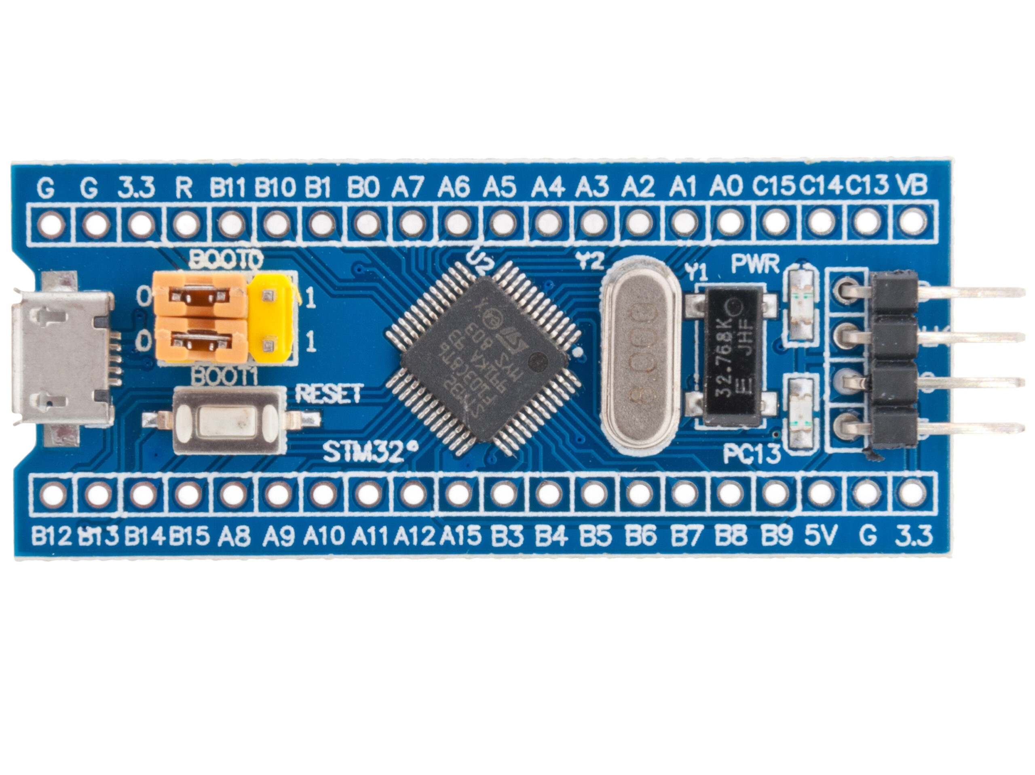
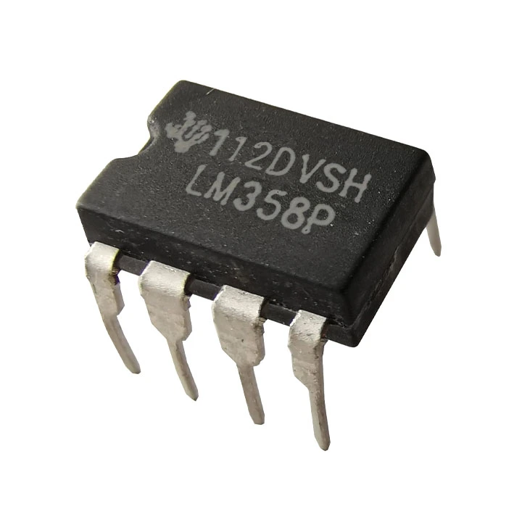
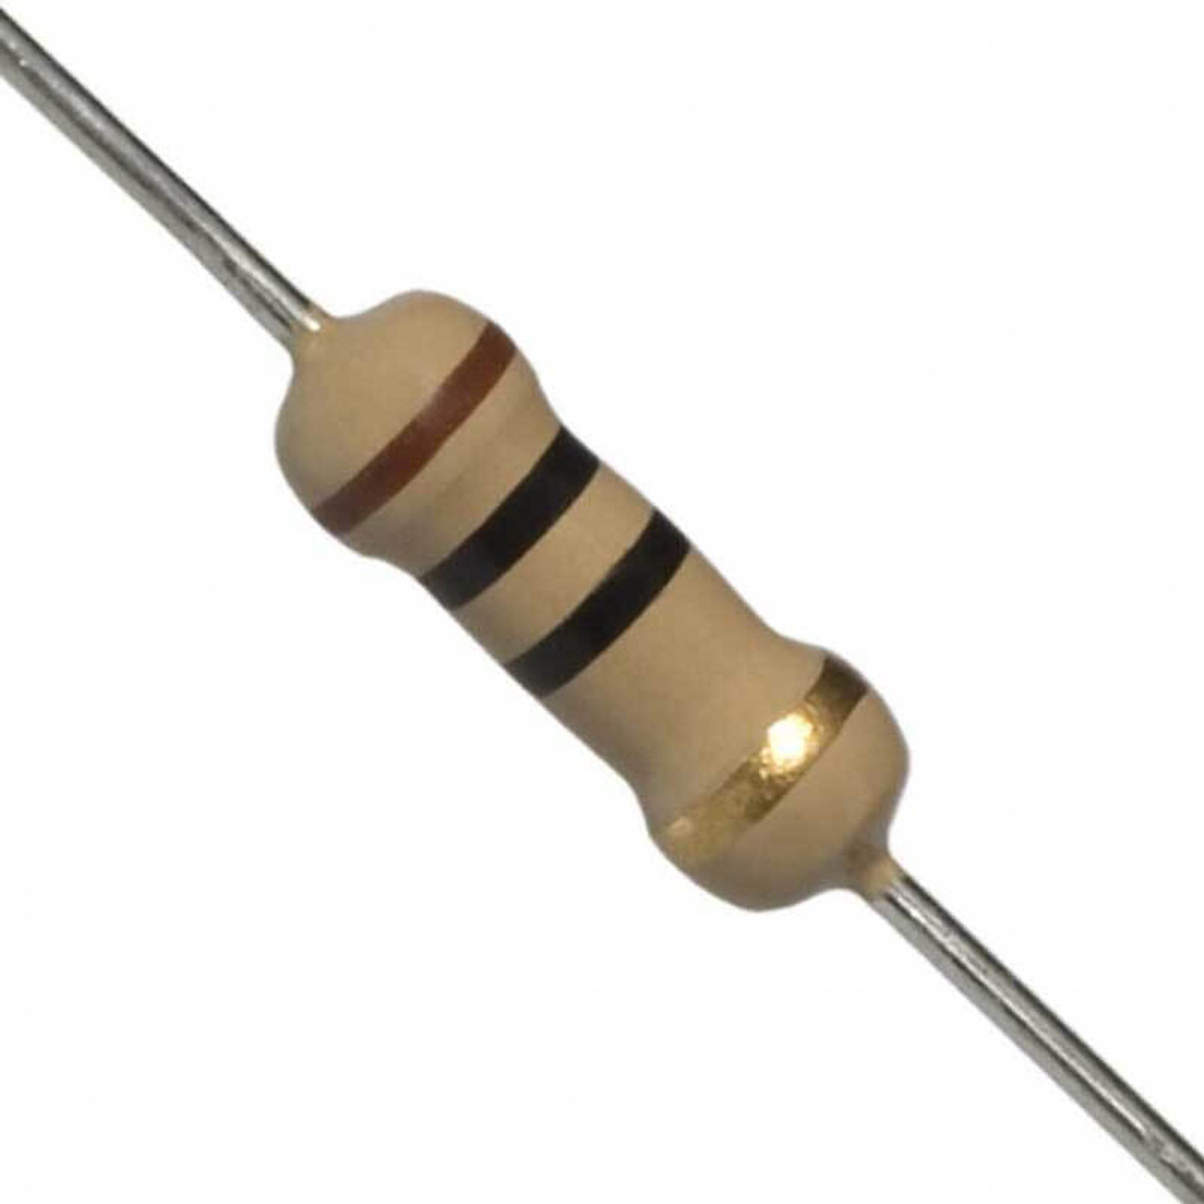
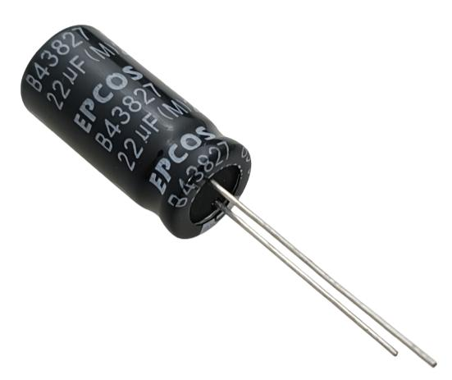
Hardware Design & Implementation
  Preparation
Load Cell (1Kg type)
  Wiring
  Select resistor
  Hardware connection
KIT STM32 Blue Pill
Op-amp LM358
Configuration & Programming
  Configure
  C Code
  GUI
Resistor
Capacitor
Result

Slide 3
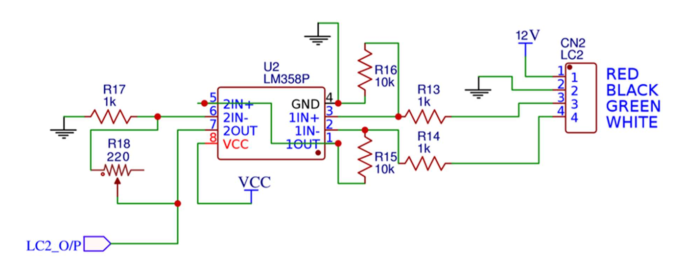
Hardware Design & Implementation
  Preparation
Load Cell (1Kg type)
KIT STM32 Blue Pill
Op-amp LM358
Resistor
Capacitor
  Wiring
  Select resistor
  Hardware connection
Configuration & Programming
  Configure
  C Code
  GUI
Result

Slide 4
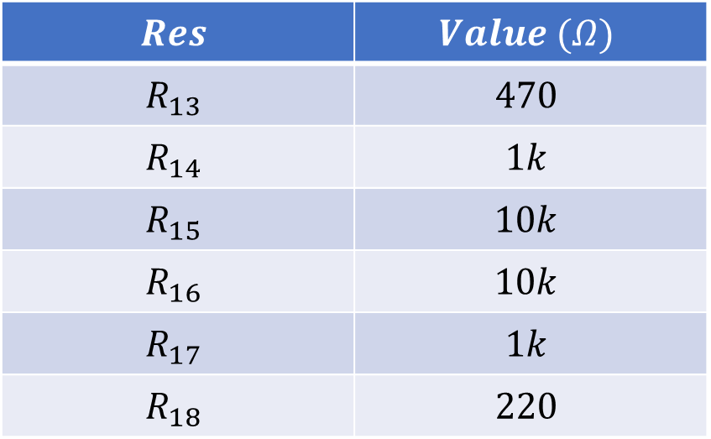
Hardware Design & Implementation
  Preparation
  Wiring
Load Cell (1Kg type)
KIT STM32 Blue Pill
Op-amp LM358
Resistor
Capacitor
  Select resistor
  Hardware connection
Configuration & Programming
$$Res$$ | $$Value (Ω)$$
$$R_{13}$$ | $$470$$
$$R_{14}$$ | $$1k$$
$$R_{15}$$ | $$10k$$
$$R_{16}$$ | $$10k$$
$$R_{17}$$ | $$1k$$
$$R_{18}$$ | $$220$$
  Configure
  C Code
  GUI
Result

Slide 5
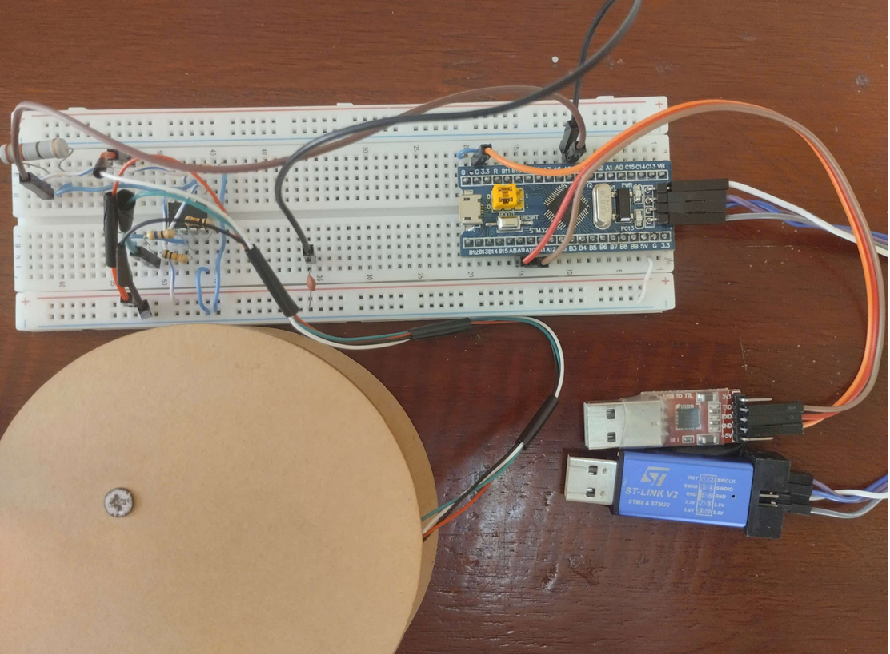
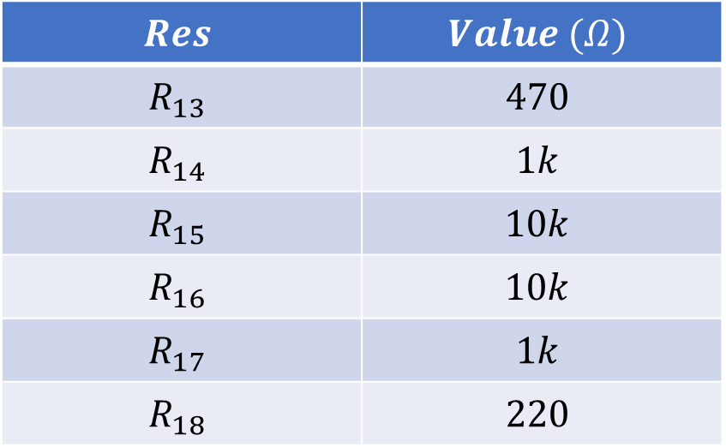
Hardware Design & Implementation
  Preparation
  Wiring
  Select resistor
$$Res$$ | $$Value (Ω)$$
$$R_{13}$$ | $$470$$
$$R_{14}$$ | $$1k$$
$$R_{15}$$ | $$10k$$
$$R_{16}$$ | $$10k$$
$$R_{17}$$ | $$1k$$
$$R_{18}$$ | $$220$$
KIT STM32 Blue Pill
Resistor
  Hardware connection
Configuration & Programming
  Configure
  C Code
  GUI
Result

Slide 6
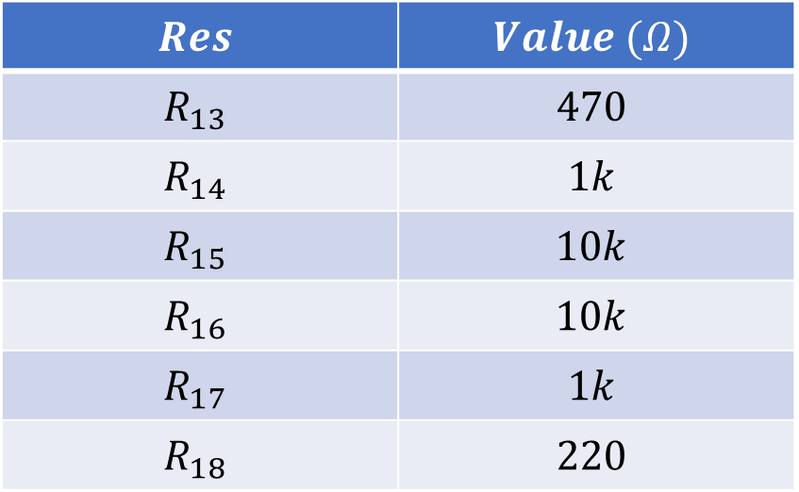
$$Res$$ | $$Value (Ω)$$
$$R_{13}$$ | $$470$$
$$R_{14}$$ | $$1k$$
$$R_{15}$$ | $$10k$$
$$R_{16}$$ | $$10k$$
$$R_{17}$$ | $$1k$$
$$R_{18}$$ | $$220$$
Hardware Design & Implementation
  Preparation
  Wiring
  Select resistor
  Hardware connection
KIT STM32 Blue Pill
Resistor
Configuration & Programming
  Config
  C Code
  GUI
Result

Slide 7
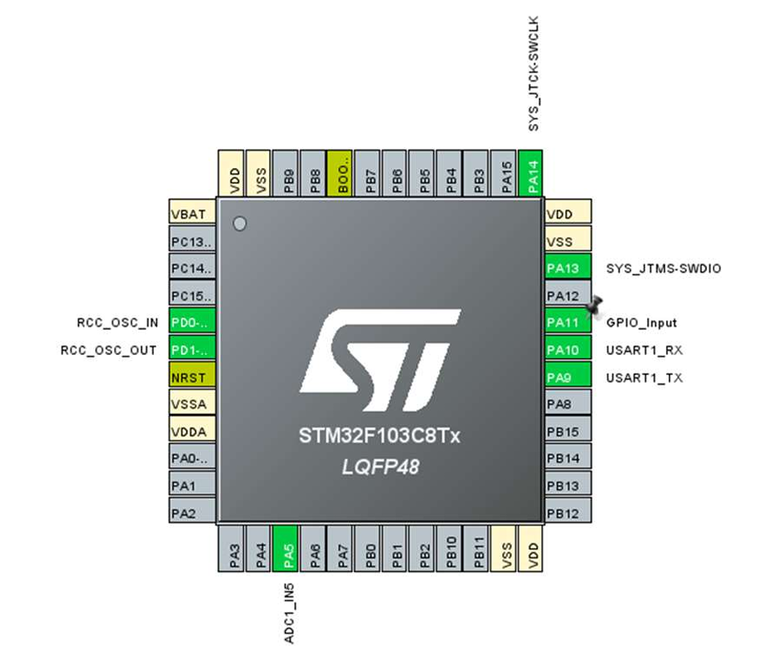
  Preparation
  Wiring
  Select resistor
  Hardware connection
Hardware Design & Implementation
  Preparation
  Wiring
  Select resistor
  Hardware connection
KIT STM32 Blue Pill
Configuration & Programming
  Config
Resistor
  C Code
  GUI
Result

Slide 8
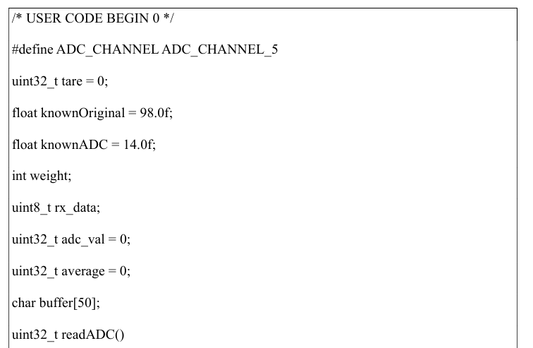
  Preparation
  Wiring
  Select resistor
  Hardware connection
Hardware Design & Implementation
  Preparation
  Wiring
  Select resistor
  Hardware connection
Configuration & Programming
  Config
KIT STM32 Blue Pill
Resistor
  C Code
  GUI
Result

Slide 9
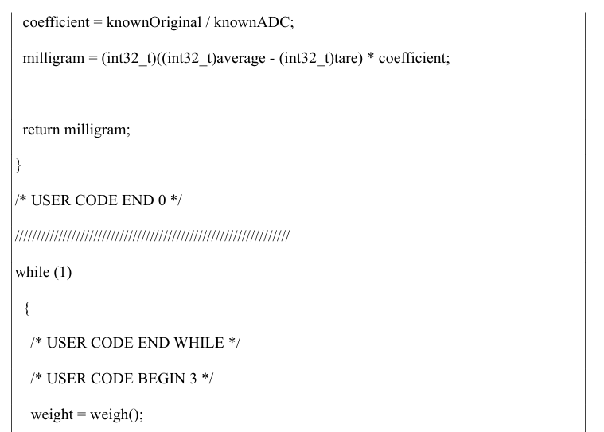
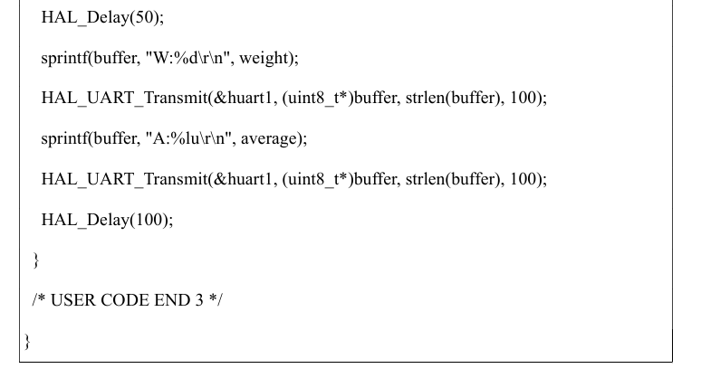
  Preparation
  Wiring
  Select resistor
  Hardware connection
Hardware Design & Implementation
  Preparation
  Wiring
  Select resistor
  Hardware connection
Configuration & Programming
  Config
  C Code
KIT STM32 Blue Pill
Resistor
  GUI
Result

Slide 10
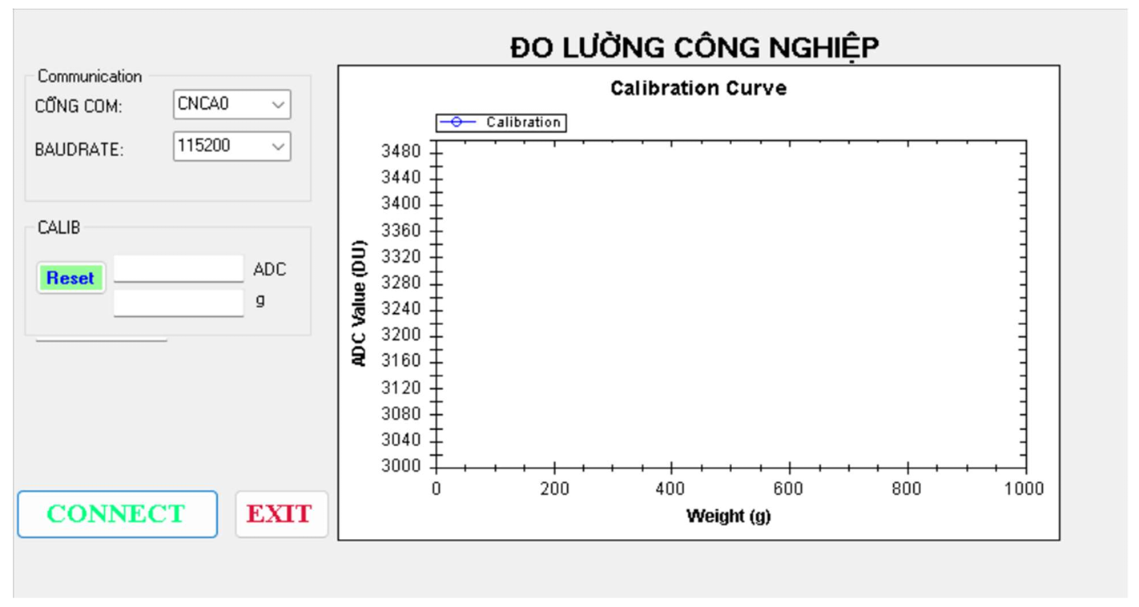
  Preparation
  Wiring
  Select resistor
  Hardware connection
Hardware Design & Implementation
  Preparation
  Wiring
  Select resistor
  Hardware connection
Configuration & Programming
  Config
  C Code
KIT STM32 Blue Pill
Resistor
  GUI
Result

Slide 11
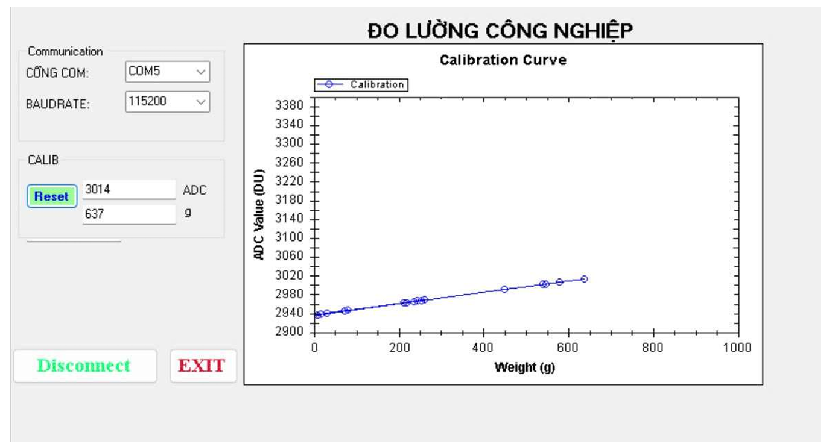
  Preparation
  Wiring
  Select resistor
  Hardware connection
Hardware Design & Implementation
  Preparation
  Wiring
  Select resistor
  Hardware connection
Configuration & Programming
  Config
  C Code
  GUI
KIT STM32 Blue Pill
Resistor
Result

Slide 12
Hardware Design & Implementation
  Preparation
  Wiring
  Select resistor
  Hardware connection
Configuration & Programming
  Configure
  C Code
  GUI
Result

