Slide 1


Qt WebKit
Integrated Computer Solutions (ICS)‏
May/June 2013

Slide 2
Outline
Introduction
Overview
Network Access
Requests and Cookies
Qt WebKit Architecture
Pages and Frames
History and Settings
Plugins
JavaScript
Beyond the Web Browser

Slide 3
What Is Qt WebKit?
Qt's web browser engine
    Based on the Open Source WebKit engine
    http://webkit.org/
Fully featured, compact, standards compliant
    HTML/XHTML, CSS, JavaScript, SVG, XPath, AJAX
    Passes Acid2 (100% Acid3 with Qt 4.8)
Supports cookies, history, native plugins, settings
    Netscape Plugin API (e.g. Flash, Java support)
Native application integration
    Merge local and web content
    Web/rich clients

Slide 4
Other Related Classes
Qt includes other classes to provide a complete browser framework
    QNetworkAccessManager, QNetworkRequest
    QNetworkCookieJar, QNetworkCookie
    QTcpSocket, QSslSocket, QAuthenticator, etc.
    XQuery class
What about QTextBrowser?
    Only supports a limited subset of HTML and CSS
    Okay for help pages, woefully inadequate for the web

Slide 5
History of WebKit
2000 – KDE Konqueror
    KHTML, KJS engines based on Qt
    Clean design and standards compliance
2003 – Apple Safari
    WebKit engine based on KHTML/KJS
    Mac OSX, Cocoa only
2005 – WebKit released as Open Source
    Abstracted toolkit-independent code base
2008 – Qt WebKit released
    First stable cross-platform WebKit release
  2010 – Used in Safari and Chrome
  2012 – WebKit2: included in Qt 5.0

Slide 6
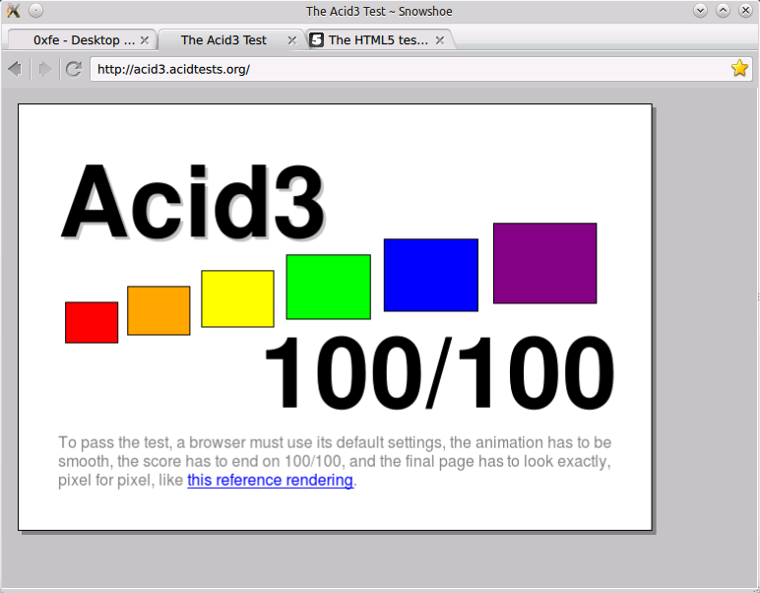
acid3.acidtests.org

Slide 7
Webkit 2
Under active development
  Qt 5's stable version is a few months behind the trunk
Multi-Process, rather than mono-process
  IPC is developed by Apple, not Google
Qt 5 includes a “stable” version of Webkit 2
High level of HTML5 compliance
http://html5test.com/
  Firefox 20 score: 379
  QtWebKit 2 score: 364 (Qt 5.0.2)
  Chrome 25 score: 463

Slide 8
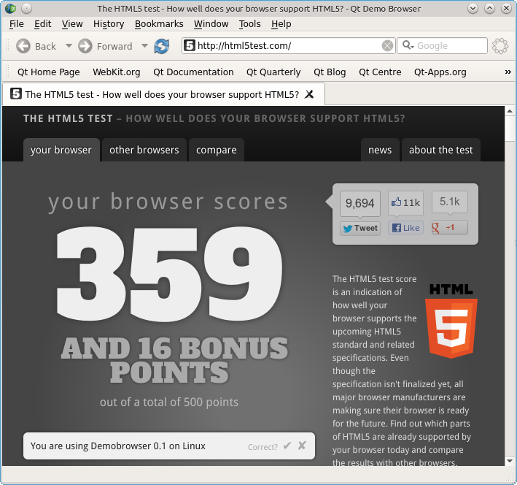
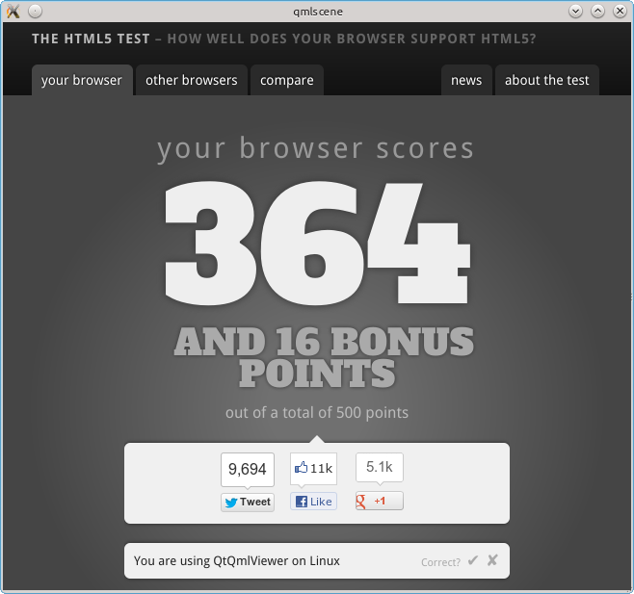
html5test.com

Slide 9
Hello World!
#include <QApplication>
#include <QWebView>
int main(int argc, char **argv)
{
QApplication app(argc, argv);
QWebView *view = new QWebView();
view->load(QUrl("http://acid3.acidtests.org/"));
view->show();
return app.exec();
}

Slide 10
Below the Surface
Below Qt WebKit is the network:
    Network Manager
    Network Requests and Replies
    Cookies and Cookie Jars
    Authentication and Security

Slide 11
QNetworkAccessManager
A class to manage network access
    Used by WebKit for sending and receiving data
Send network requests and receive replies
    get(), put() - Send and receive network data
    head(), post() - Send HTTP requests
Requests encapsulated in QNetworkRequest
Replies encapsulated in QNetworkReply
Stores cookies, caches credentials
Manages cache
  cache(), setCache()

Slide 12
Requests and Replies
QNetworkRequest
    Holds information necessary to send a network request
QNetworkReply
    Result of a request is a QNetworkReply
    Contains header and data for the request
    Sequential-access QIODevice
    Signals:
      readyRead(), finished(), error()
      downloadProgress(), uploadProgress()

Slide 13
Network Access
QNetworkReply
httpd
QNetworkAccessManager
QNetworkRequest

Slide 14
Network Access Example
#include <QCoreApplication>
#include <QtNetwork>
int main(int argc, char **argv)
{
QCoreApplication app(argc, argv);
QNetworkAccessManager manager;
QUrl url(app.arguments().value(1));
QNetworkRequest request(url);
QNetworkReply *reply = manager.get(request);
app.exec();
...

Slide 15
Network Access Example cont'd
...
QFile outfile("request.header");
if (outfile.open(QIODevice::WriteOnly | QIODevice::Text)) {
QTextStream ts(&outfile);
QList<QByteArray> list = reply->rawHeaderList();
foreach (QByteArray name, list) {
ts << name << ": " << reply->rawHeader(name) << endl;
}
outfile.close();
}
outfile.setFileName("request.data");
if (outfile.open(QIODevice::WriteOnly)) {
outfile.write(reply->readAll());
outfile.close();
}
delete reply;
}

Slide 16
Cookies
QNetworkCookie is a piece of data
    Have name, value, expiration, and other information
    Used to maintain persistent information between requests
    Set by a server when replying to a request
QNetworkCookieJar is a container for cookies
Get jar with QNetworkAccessManager::cookieJar()
Need to subclass in order to:
    Implement persistent storage of cookies
    Implement cookie acceptance policy

Slide 17
Authentication Signals
An authenticationRequired() signal emitted when a server requests authentication
    Fill in the QAuthenticator object with name and password
    There is also a proxyAuthenticationRequired() signal
sslErrors() is emitted if there are SSL or TLS errors
    Not all of SSL errors are fatal (e.g. certification verification)
    Call QNetworkReply::ignoreSslErrors() from slot to ignore

Slide 18
Qt WebKit Architecture
QWebPage
QWebFrame
QWebView
QWebFrame
QWebFrame

Slide 19
QWebView
Widget used to view and edit web pages
Can load URLs or QNetworkRequests
Can set content with QString or QByteArray
page() returns the underlying QWebPage object
Important slots:
    back(), forward(), reload(), stop()
Important signals:
    loadStarted(), loadProgress(), loadFinished(), urlChanged()
  In webkit module in Qt 4, webkitwidgets in Qt 5

Slide 20
QWebPage
Provides access to the structure of a web page
Contains content, history, settings
Holds the main frame, which may have subframes
Can be used without QWebView (e.g. thumbnails)
Common web oriented QActions
    action(), triggerAction()
    Back, Forward, OpenLink, DownloadLinkToDisk, etc.

Slide 21
QWebFrame
Represents a frame in a web page
    One main frame for the page
    One frame for each HTML <frame> or <iframe>
Frames can have child frames
    childFrames(), parentFrame()
Load or set content like QWebView
print() slot to print the frame
Access to JavaScript's window object

Slide 22
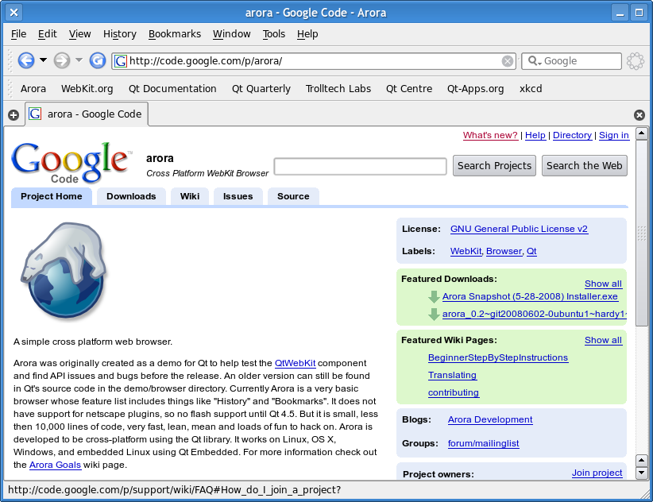
Arora Browser
http://code.google.com/p/arora/

Slide 23
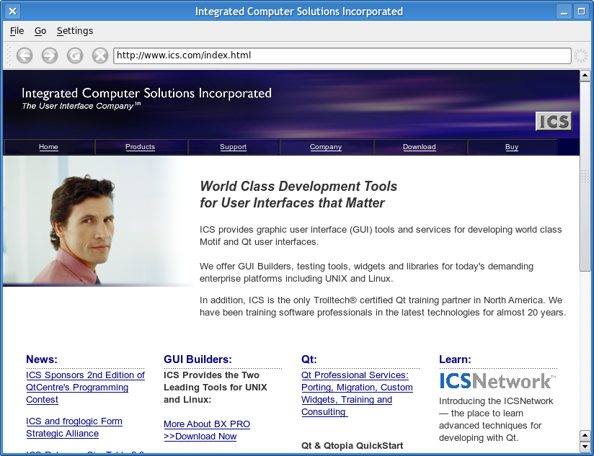
Mini Browser

Slide 24
Mini Browser: Load Page
void MiniBrowser::loadPage(const QString &page)
{
QUrl url;
QRegExp scheme("^[a-zA-Z]+\\:.*");
// convert string to url
if (scheme.exactMatch(page)) {
url.setUrl(page, QUrl::TolerantMode);
} else {
if (page.startsWith("ftp")) {
page = "ftp://" + page;
} else {
page = "http://" + page;
}
url.setUrl(page, QUrl::TolerantMode);
}
// load url
webView->load(url);
webView->setFocus();
}

Slide 25
Mini Browser: Loading Signals
connect(webView, SIGNAL(loadStarted()),
this, SLOT(onLoadStarted()));
connect(webView, SIGNAL(loadFinished(bool)),
this, SLOT(onLoadFinished()));
...
void MiniBrowser::onLoadStarted()
{
spinner->setAnimation(true);
}
void MiniBrowser::onLoadFinished()
{
spinner->setAnimation(false);
setWindowIcon(QWebSettings::iconForUrl(webView->url()));
}

Slide 26
QWebHistory
Represents the navigation history of a web page
Get the history of a page with QWebPage::history()
Contains a list of QWebHistoryItem objects
    items(), currentItem(), forward(), back()
QWebHistoryItem has title, url, and access information

Slide 27
Web History Example
// Update the history menu
void MiniBrowser::onHistoryAboutToShow()
{
QList<QWebHistoryItem> items = webView->history()->items();
QAction *action;
historyMenu->clear();
foreach (QWebHistoryItem item, items) {
action = new QAction(item.icon(), item.title(), this);
action->setData(item.url());
connect(action, SIGNAL(triggered()),
this, SLOT(onHistoryTriggered()));
historyMenu->addAction(action);
}
}

Slide 28
QWebSettings
Stores settings used by a QWebPage object
Each page has its own settings object
    Individual settings will default to a global settings object
Global properties:
    Page cache, icon database, web graphics
Page properties:
    Fonts, font sizes
    User style sheets
    Enable JavaScript, plugins, etc.

Slide 29
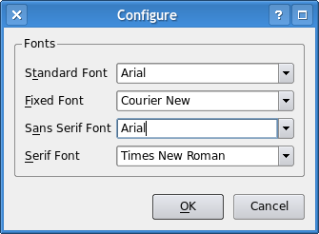
Web Settings Example
...
QSettings settings("ICS", "Mini Browser");
webView->settings()->setFontFamily(QWebSettings::StandardFont,
settings.value("font/standard").toString());
webView->settings()->setFontFamily(QWebSettings::FixedFont,
settings.value("font/fixed").toString());
webView->settings()->setFontFamily(QWebSettings::SansSerifFont,
settings.value("font/sansserif").toString());
webView->settings()->setFontFamily(QWebSettings::SerifFont,
settings.value("font/serif").toString());
...

Slide 30
Widget Plugins
Qt widgets can be embedded in a web page
Create an <object> element for the widget
    type="application/x-qt-plugin" classid="[classname]"
    <param> elements may be specified
Subclass QWebPage and implement createPlugin()
    Return new widget of type classid
Embedded widgets are also accessible by JavaScript
    Widget properties are exposed as JavaScript properties
    Widget slots are accessible as JavaScript methods
Plugins must be enabled through QWebSettings

Slide 31
Widget Plugins Example
QObject *WebPage::createPlugin(const QString &classId,
const QUrl &url,
const QStringList &paramNames,
const QStringList &paramValues)
{
// use QUiLoader as generic widget factory
QUiLoader loader;
QWidget *widget = loader.createWidget(classId, view());
// set parameters
if (widget) {
int index = paramNames.indexOf("name");
if (index && paramValues.size() > index) {
widget->setObjectName(paramValues.at(index));
}
}
return widget;
}

Slide 32
Widget Plugins Example, cont
<html>
<head>
<title>Qt Plugin</title>
</head>
<body>
<h1>Qt Plugin</h1>
<object type="application/x-qt-plugin"
classid="QCalendarWidget"
title="Calendar"
name="calendar"
height="200" width="300">
</object>
<script>
document.calendar.selectedDate = "1776, 7, 4"
</script>
</body>
</html>

Slide 33
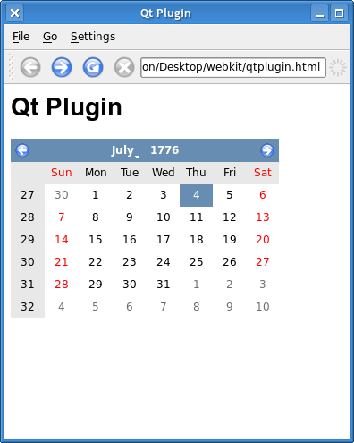
Widget Plugins Example

Slide 34
QWebPluginFactory
Plugins for other content can be created as well
QWebPluginFactory is installed on the webpage
    plugins() tells JavaScript what mimetypes are handled
    create() returns a plugin widget to handle mimetype
    Webpage object can have only one plugin factory
Data and parameters specified in <object> element
Java applets are supported
Netscape Plugin API supported on X11

Slide 35
QWebPluginFactory Example
QObject *PluginFactory::create(const QString &mimeType,
const QUrl &url,
const QStringList &paramNames,
const QStringList &paramValues) const
{
// handle phonon capable mimetypes
if (BackendCapabilities::availableMimeTypes().contains(mimeType)) {
MediaPlayer *player = new MediaPlayer(url.toString());
return player;
}
return 0;
}
<h1>Phonon Plugin</h1>
<object type="video/x-h264"
data="http://www.ics.com/IntroPilot.m4v"
height=320 width=340>
</object>

Slide 36
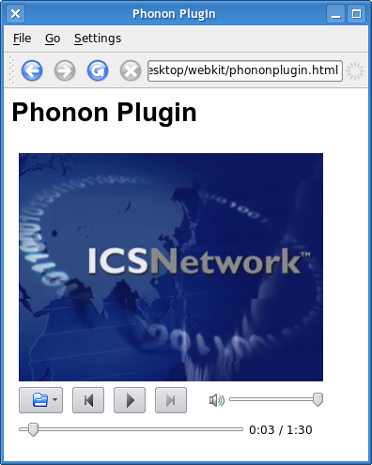
QWebFactoryPlugin Example

Slide 37
JavaScript
Webkit also includes a JavaScript environment
    Separate from QtScript
Widget plugins are available to JavaScript as objects
Other QObjects can be made available to JavaScript
QWebFrame::addToJavaScriptWindowObject()
Qt properties are be exposed as JavaScript properties
Qt slots are exposed as JavaScript methods
Can evaluate other scripts
QWebFrame::evaluateJavaScript()

Slide 38
JavaScript Example
<script type="text/javascript">
function setDate(month, day, year) {
var date = new Date()
date.setFullYear(year, month-1, day-1)
document.calendar.selectedDate = date
}
</script>
<form>
<label>Month:</label>
<input type="text" size="3" id="month">
<label>Day:</label>
<input type="text" size="3" id="day">
<label>Year:</label>
<input type="text" size="5" id="year">
<input type="button" value="Set"
onclick="setDate(month.value, day.value, year.value)">
</form>

Slide 39
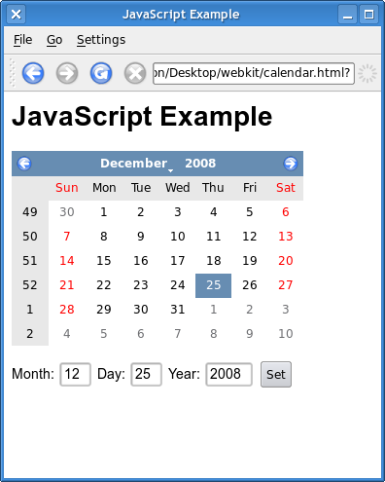
JavaScript Example

Slide 40
QML WebView Element
QML element to render web content
Introduced in Qt 4.7
Provides properties, methods, and signals
Minimal example (Qt 5):
import QtQuick 2.0
import QtWebKit 3.0
WebView {
height: 600; width: 800
url: "http://html5test.com"
}

Slide 41
QML WebView Element
WebView in Qt 4 provides many properties, signals, methods
Use “import QtWebKit 1.0”
Settings grouped property
Can evaluate JavaScript in web frame
Includes no scrolling, scaling, tool bars, or other common browser components
See QML Web Browser example

Slide 42
QML WebView Element
WebView in Qt 5 has much more limited set of properties, methods, signals
Use “import QtWebKit 3.0”
Uses WebKit2 where rendering engine runs in different address space from GUI
Experimental APIs to support messaging between QML and WebKit2 JavaScript engine
Enabled with “import QtWebKit.experimental 1.0”

Slide 43
Beyond the Browser
The boundary between web and desktop is blurring
    QWebView is a widget
    Widgets can be embedded in the web page
    QObjects can be exposed to JavaScript
Desktop applications with web content
Web pages with a desktop GUI

Slide 44
Address Book Example
void AddressBook::onReload()
{
if (street->text().isEmpty() ||
city->text().isEmpty() ||
state->currentText().isEmpty()) {
return;
}
QString address = QString("%1, %2, %3")
.arg(street->text())
.arg(city->text())
.arg(state->currentText());
frame->evaluateJavaScript("showAddress(" + address + ");");
}

Slide 45
Address Book Example, cont.
<script src="http://maps.google.com/maps?key=..." type="text/javascript"></script>
<script type="text/javascript">
var map = null;
var geocoder = null;
function showAddress(address) {
if (geocoder) {
geocoder.getLatLng(
address,
function(point) {
if (point) {
map.setCenter(point, 13);
var marker = new GMarker(point);
map.addOverlay(marker);
}
}
);
}
}
</script>

Slide 46
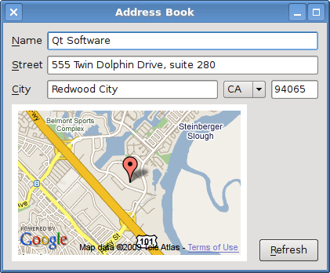
Address Book Example

Slide 47
Web Inspector
WebKit includes the Web Inspector debugging tool
    Displays DOM tree, resources, and other information
Enable in QWebSettings
    Set web attribute DeveloperExtrasEnabled
    Turns on "Inspect" item in context menu
    QWebPage::InspectElement action

Slide 48
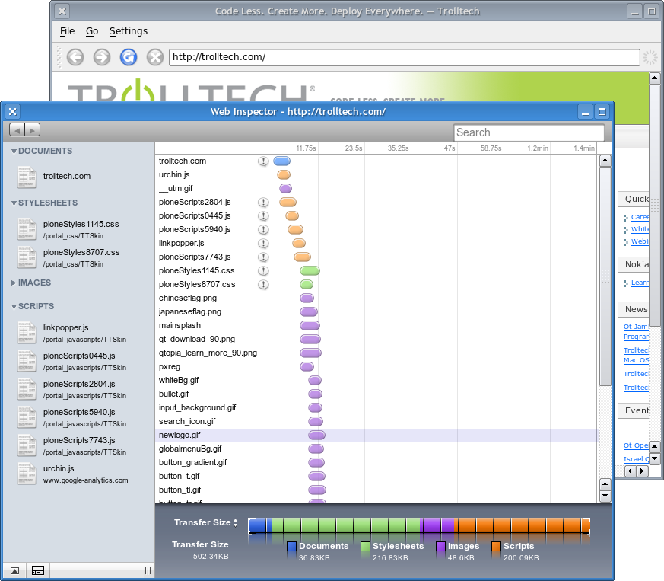
Web Inspector

Slide 49
Summary
Overview
Network Access
Requests and Cookies
Qt WebKit Architecture
Pages and Frames
History and Settings
Plugins
JavaScript
Beyond the Web Browser

Slide 50
Questions?
Thank you very much for attending!

