Slide 1
软件工程
Module: 设计工程
王斌 wb_csut@csu.edu.cn
QQ:50805772
PHONE:15974258941

Slide 2
设计工程
软件设计工程概述
软件设计的原则
软件设计的质量
软件设计的复用
@第6章.教材

Slide 3

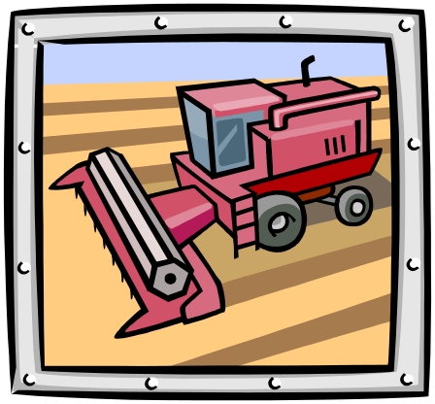
Change our viewpoint
Do the right things
Do the things right
What
How
软件需求工程解决“做什么”的问题
软件设计工程解决“怎么做”的问题

Slide 4
设计的步骤
架构设计
  又称概要设计，它定义了软件的全貌，记录了最重要的设计决策，并成为随后的设计与实现工作的战略指导原则。
详细设计
  又称构件级设计，它在软件架构的基础上定义各模块的内部细节，例如内部的数据结构、算法和控制流等，其所做的设计决策常常只影响单个模块的实现。

Slide 5
1）架构设计
架构设计(architecture design)的内容：
  选择软件质量属性的设计策略
  确定合适的架构风格(architecture style)和设计模式(design pattern)
  定义软件的主要结构元素――模块
  接口设计
目标：使得软件系统在架构层面的设计上满足拟建系统功能性和非功能性需求。
Notes:
RMUC Instructor Notes
Module 0 - About This Course

Slide 6
质量因素的架构设计战术（1）
质量因素 | 设计战术
易用性 | 1.为用户提供适当的反馈和协助 2.将用户接口与应用的其余部分分离 3.提供“取消”、“撤消”等命令 4.建立用户模型、任务模型和系统模型
可用性 即可靠性 | 1.错误检测，如心跳、异常、命令/响应 2.错误恢复，如表决、冗余、备件、检查点/回滚 3.错误预防，如事务、进程监视、从服务中删除
性能 | 1.资源需求，如提高计算效率、减少计算开销、控制采样频率、限制队列大小 2.资源管理，如引入并发、增加可用资源、维持数据或计算的多个副本 3.资源仲裁，如先进先出、优先级调度

Slide 7
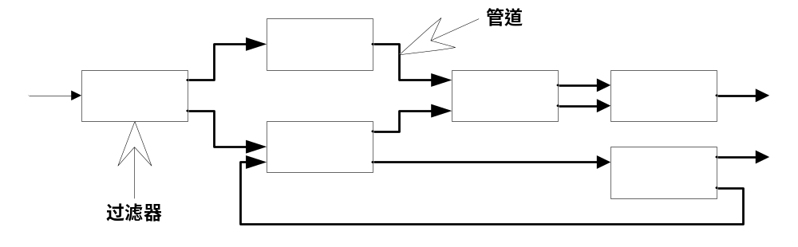
确定合适的软件架构风格
数据流风格 (Dataflow)：批处理序列、管道－过滤器风格 (Pipe-and-Filter)
调用/返回风格：主程序/子程序、面向对象风格 (ADT)、层次系统 (Layered Systems)
独立构件风格：进程通信、事件系统
虚拟机风格：解释器、基于规则的系统
仓库风格：数据库系统、超文本系统、黑板系统

Slide 8
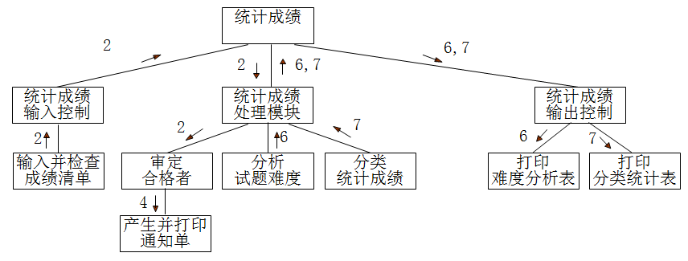
定义软件的主要结构元素――模块
Sale
seller
buyer
item sold
shipping mechanism
Salesperson
Customer
Product
Vehicle
Corporate
Individual
Truck
Train

Slide 9
接口设计
接口设计(interface design)描述了软件和协作系统之间、软件和使用人员之间是如何通信的。
接口就意味着信息流(如数据流、控制流)和特定的行为类型。
包括三个方面：
  软件模块间的内部接口
  模块和协作系统(如外部软件系统、外部设备、网络等)之间的外部接口
  使用人员和软件的接口(用户界面)
Notes:
RMUC Instructor Notes
Module 0 - About This Course

Slide 10
Characteristics of a Good Architecture
Resilient
Simple
Approachable
Clear separation of concerns
Balanced distribution of responsibilities
Balances economic and technology constraints

Slide 11
Architecture Constrains Design and Implementation
Architecture involves a set of strategic design decisions, rules or patterns that constrain design and construction.
Code
Implementation
Design
Architecture
Architecture decisions are the most fundamental decisions, and changing them will have significant effects.
Notes:
RMUC Instructor Notes
Module 0 - About This Course
Architectures can be viewed as a set of key design decisions.
The architecture is the initial set of constraints placed on the system. Such constraints are the the most important ones. They constitute the fundamental decisions about the software design. Architecture puts a framework around the design. Architecture has been called strategic design.
An architect’s job is to eliminate unnecessary creativity. As you move closer to code, creativity is eliminated. (The architecture constrains the design which constrains the implementation.) This is good because during Implementation, the creativity can be spent elsewhere (for example, for improving the quality, and performance) of the implementation (for example, code).
If architecture is strategic design, then the rest of the design is the tactical design.

Slide 12
2）详细设计
将软件架构的结构性元素变换为对软件模块的描述。
  为所有数据对象定义详细的数据结构
  为所有在模块内发生的处理定义算法细节、控制流和数据流
Notes:
RMUC Instructor Notes
Module 0 - About This Course

Slide 13
设计工程
软件设计工程概述
软件设计的原则 － 抽象和分解
软件设计的质量
软件设计的复用

Slide 14
抽象 abstraction
抽象，是在软件规模逐渐增大、软件复杂性逐渐增大下，控制复杂性的基本策略。软件开发过程就是对软件抽象层次的一次次细化的过程：需求、架构、设计、编码。
在软件设计中，主要抽象手段包括：
  数据抽象把一个数据对象的定义抽象为一个数据类型名，用此类型名可定义多个具有相同性质的数据对象
  过程抽象把完成一个特定功能的动作序列抽象为一个过程名和参数表，以后通过指定过程名和实际参数调用此过程
  对象抽象则通过操作和属性，组合了这两种抽象，即在抽象数据类型的定义中加入一组操作的定义，以确定在此类数据对象上可以进行的操作。
Notes:
RMUC Instructor Notes
Module 0 - About This Course

Slide 15
数据抽象Data Abstraction
door
manufacturer
model number
type
swing direction
inserts
lights
type
number
weight
opening mechanism
implemented as a data structure

Slide 16
过程抽象Procedural Abstraction
open
details of enter
algorithm
implemented with a "knowledge" of the
object that is associated with enter

Slide 17
分解和模块化
分解（decomposition）是控制复杂性的另一种有效方法，软件设计用分解来实现模块化设计。
模块化（modularity），即将一个复杂的软件系统自顶向下地分解成若干模块（module），每个模块完成一个软件的特性，所有的模块组装起来，成为一个整体，完成整个系统所要求的特性。
模块是能够单独命名并独立地完成一定功能的程序语句的集合
  例如，过程、函数、子程序、宏、类等
模块具有两个基本的特征：
  外部特征是指模块跟外部环境联系的接口和模块的功能；
  内部特征是指模块的内部环境具有的特点，即该模块的局部数据和处理逻辑。
Notes:
RMUC Instructor Notes
Module 0 - About This Course

Slide 18
分解 decomposition
C (P1+P2)>C (P1)+C (P2)
E (P1+P2)>E (P1)+E (P2)
C为问题的复杂度，E为解题需要的工作量
思考：
  如果我们无限制地划分软件，开发它所需的工作量会变得小到可以忽略？！
  事实上，影响软件开发的工作量的因素还有很多，例如模块接口费用等等
  上述不等式只能说明，当模块的总数增加时，单独开发各个子模块的工作量之和会有所减少

Slide 19
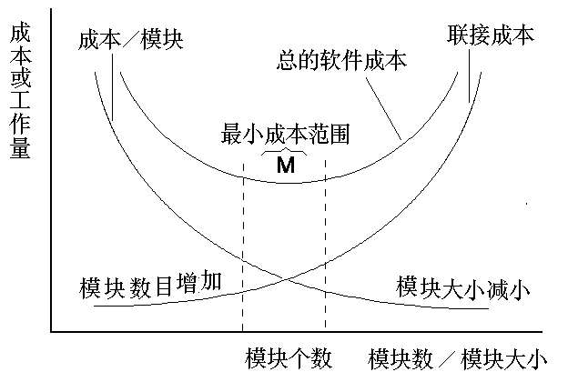
模块化的成本
如果模块是相互独立的，当模块变得越小，每个模块花费的工作量越低；
但当模块数增加时，模块间的联系也随之增加，把这些模块联接起来的工作量也随之增加。
Notes:
RMUC Instructor Notes
Module 0 - About This Course

Slide 20
信息隐藏 Information Hiding
每个模块的实现细节对于其它模块来说应该是隐蔽的
module
• algorithm
controlled
interface
• data structure
• details of external interface
• resource allocation policy
clients
"secret"
a specific design decision

Slide 21
模块独立
模块独立的定义：
  模块完成独立的功能并且与其他模块的接口简单
模块独立的重要性：
  功能被划分，并且接口被简化，所以具有有效模块化的软件更易于开发。当多人分工合作开发同一个软件时，这个优点尤其重要。
  由于因设计和编码修改引起的副作用受到局限，错误传播被减小，并且模块复用成为可能，所以独立的模块更易于维护和测试 。
Notes:
RMUC Instructor Notes
Module 0 - About This Course

Slide 22
模块独立的衡量指标
模块独立可以由两项指标来衡量：
  内聚（cohesion），是一个模块内部各个元素彼此结合的紧密程度的度量
  耦合（coupling），是模块之间的相对独立性（互相连接的紧密程度）的度量
模块独立追求高内聚和低耦合。
Notes:
RMUC Instructor Notes
Module 0 - About This Course

Slide 23
内聚
一般模块的内聚性分为七种类型：
  1. 偶然内聚 coincidental cohesion
  2. 逻辑内聚 logical cohesion
  3. 时间内聚 temporal cohesion
  4. 过程内聚 procedural cohesion
  5. 通信内聚 communicational cohesion
  6. 顺序内聚 sequential cohesion
  7. 功能内聚 functional cohesion
确定内聚的精确级别是不必要的，重要的该是尽量争取高内聚和识别低内聚
低
高
Notes:
RMUC Instructor Notes
Module 0 - About This Course

Slide 24
低、中、高内聚
低内聚：
  有时在写完一个程序之后，发现一组语句在两处或多处出现，于是把这些语句作为一个模块，这样就出现了偶然内聚的模块。
  如果一个模块完成的任务在逻辑上属于相同或相似的一类（例如，一个模块产生各种类型的全部输出），则称为逻辑内聚。
  如果一个模块包含的任务必须在同一段时间内执行（例如，模块完成各种初始化工作），就叫时间内聚。
中内聚：
  如果一个模块内的处理元素是相关的，而且必须以特定次序执行，则称为过程内聚。
  如果模块中所有元素都使用同一个输入数据和（或）产生同一个输出数据，则称为通信内聚。
高内聚：
  如果一个模块内的处理元素和同一个功能密切相关，而且这些处理必须顺序执行，则称为顺序内聚。
  如果模块内所有处理元素属于一个整体，完成一个单一的功能，则称为功能内聚。功能内聚是最高程度的内聚。

Slide 25
耦合
一般模块之间可能的耦合方式有七种类型
  1. 非直接耦合 no direct coupling
  2. 数据耦合 data coupling
  3. 特征耦合 stamp coupling
  4. 控制耦合 control coupling
  5. 外部耦合 external coupling
  6. 公共耦合 common coupling
  7. 内容耦合 content coupling
确定耦合的精确级别是不必要的，重要的该是尽量争取低耦合和识别高耦合
低
高
Notes:
RMUC Instructor Notes
Module 0 - About This Course
非直接耦合
两个模块之间没有直接关系，它们之间的联系完全是通过主模块的控制和调用来实现的。耦合度最弱，模块独立性最强。
子模块无需知道对方的存在，子模块之间的联系，全部变成子模块和主模块之间的联系。
数据耦合
调用模块和被调用模块之间只传递简单的数据项参数。相当于高级语言中的值传递。
标记耦合
调用模块和被调用模块之间传递数据结构而不是简单数据，同时也称作特征耦合。
控制耦合
模块之间传递的不是数据信息，而是控制信息例如标志、开关量等，一个模块控制了另一个模块的功能。
从控制耦合开始，模块的数据就放在自己内部了，不同模块之间通过接口互相调用。
内容耦合
内容耦合是最紧的耦合程度，一个模块直接访问另一模块的内容，则称这两个模块为内容耦合。
公共耦合
一组模块都访问同一个全局数据结构，则称之为公共耦合。
外部耦合
一组模块都访问同一全局简单变量，而且不通过参数表传递该全局变量的信息，则称之为外部耦合。外部耦合和公共耦合很像，区别就是一个是简单变量，一个是复杂数据结构。

Slide 26
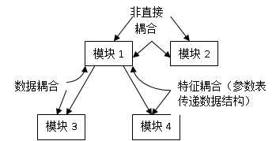
弱耦合示例
模块1与模块2为同级模块，相互之间没有信息传递，属于非直接耦合。
模块1调用模块3，交换的是简单变量，便构成数据耦合；
模块1调用模块4，交换的是数据结构，则构成特征耦合。

Slide 27
设计工程
软件设计工程概述
软件设计的原则
软件设计的质量
软件设计的复用

Slide 28
软件设计的质量要求
1) 设计应当模块化，高内聚、低耦合。
  支持多人合作开发
  易于测试和修改
  能够以演化过程实现
2) 设计应当包含数据、体系结构、接口和构件的清楚的表示。
设计应根据软件需求采用可重复使用的方法进行。
应使用能够有效传达其意义的表示法来表达设计模型。
Notes:
RMUC Instructor Notes
Module 0 - About This Course

Slide 29
7种软件设计的坏味道
1）僵化性（Rigidity）
  很难对软件进行改动，因为每个改动都会迫使对系统其他部分的许多改动
2）脆弱性（Fragility）
  对系统的改动会导致系统中和改动的地方在概念上无关的许多地方出现问题
3）牢固性（Immobility）
  很难解开系统中某部分与其它部分之间的纠结，从而难以使其中的任何部分可以被分离出来被其它系统复用

Slide 30
4）粘滞性（Viscosity）
  做正确的事情要比做错误的事情困难。表现为两种形式：
    软件粘滞性
      需要对软件进行修改时，可能存在多种方法。有的方法可以保持原有的设计质量，另一些方法则会破坏原有的设计质量。如果，破坏软件质量的修改比保持原有设计质量的修改更容易实施时，我们就称该软件具有“软件粘滞性”。
    环境粘滞性
      当开发环境迟钝、低效时，就会产生环境粘滞性。
      例如：如果编译时间很长，那么开发人员可能会放弃那些能保持设计质量，但是却需要导致大规模重新编译的改动。

Slide 31
5）不必要的复杂性（Needless Complexity）
  设计中包含不具有任何好处的基础结构。
6）不必要的重复（Needless Repetition）
  设计中包含一些重复的结构，这些结构本来可以通过单一的抽象进行统一
    使用Cut/Copy/Paste实施源代码级的软件复用容易导致这一问题
    这种代码级别的冗余，将带来修改上的问题
7）晦涩性（Opacity）
  很难阅读和理解，不要相信你永远都会如此清楚的了解你的每一行代码，“时间会冲淡一切”。要站在阅读者的角度进行设计

Slide 32
设计工程
软件设计工程概述
软件设计的原则
软件设计的质量
软件设计的复用

Slide 33
设计重用 Design Reuse
Pattern
  Architectural style
  Design pattern
  Idiom
Framework
Notes:
RMUC Instructor Notes
Module 0 - About This Course
Frameworks enable scalability of development: the ability to develop and deliver systems as quickly as the market requires by using a leveraged solution.
An analogy in bridge building may help clarify this. Examples of frameworks are suspension bridge, piling-and-trestle bridge, and cantilever bridge. Examples of design patterns are rivet fastener, bolt, and weld. In building a bridge, each is substitutable in some cases, and each is uniquely superior in other cases. (Both a weld and a bolt can be used to join two materials; the weld can be stronger if done correctly, but cannot be undone, or repaired, or replaced as the bolt can.)
Taking the analogy a bit further, a suspension bridge can be a footbridge or the Golden Gate bridge. Both represent the same basic design approach and principles, so that one could readily say “that is a suspension bridge,” but the extensions and localizations cause the end result to be quite different.
Rose Enterprise comes “stocked” with different frameworks for MTS, Java, Oracle-8, Outlook, RDO, SQL-DMO, and others. When the Rational Unified Process is purchased, a Rose framework add-in that supports the process will also be provided.
The selection of the upper-level layers may be affected by the choice of an architectural pattern or framework. Thus, it is important to define what these terms mean.
A pattern codifies specific knowledge collected from experience. Patterns provide examples of how good modeling solves real problems, whether you come up with the pattern yourself or you reuse someone else’s. Design patterns are discussed in more detail on the next slide.
Frameworks differ from Analysis and Design patterns in their scale and scope. Frameworks describe a skeletal solution to a particular problem that may lack many of the details, and that may be filled in by applying various Analysis and Design patterns.
A framework is a micro-architecture that provides an incomplete template for applications within a specific domain. Architectural frameworks provide the context in which the components run. They provide the infrastructure (plumbing, if you will) that allows the components to co-exist and perform in predictable ways. These frameworks may provide communication mechanisms, distribution mechanisms, error processing capabilities, transaction support, and so forth.
Frameworks may range in scope from persistence frameworks that describe the workings of a fairly complex but fragmentary part of an application to domain-specific frameworks that are intended to be customized (such as Peoplesoft, SanFransisco, Infinity, and SAP). For example, SAP is a framework for manufacturing and finance.

Slide 34
什么是模式(Pattern)
Christopher Alexander 说过：“每一个模式描述了一个在我们周围不断重复发生的问题，以及该问题的解决方案的核心。这样，你就能一次又一次地使用该方案而不必做重复劳动” ，1977年。
定义: “在一个上下文中对一种问题的解决方案”。

Slide 35
软件模式分类
An architectural pattern (architectural style) expresses a fundamental structural organization schema for software systems. It provides a set of predefined subsystems, specifies their responsibilities, and includes rules and guidelines for organizing the relationships between them.
A design pattern provides a scheme for refining the subsystems or components of a software system, or the relationships between them. It describes a commonly-recurring structure of communicating components that solves a general design problem within a particular context.
An idiom is a low-level pattern specific to a programming language. An idiom describes how to implement particular aspects of components or the relationships between them using the features of the given language.

Slide 36
常见的架构风格
From Mud to Structure: Organize components.
  Layers: Organize components into layers where layer's services are only used by layer i+1.
  Pipes and Filters: Divide the task into several sequential processing steps -- the output of task i is the input of task i+1.
  Blackboard: Several independent programs work cooperatively on a common data structure.
Distributed Systems :Handle distributed computation.
  Broker: Introduce a broker component to achieve better decoupling of clients and servers -- brokers accept requests from clients and forward the requests to servers, then return the results back to the clients.
  Client/Server
  3 Tiers

Slide 37
常见的架构风格（续）
Interactive Systems: Keep a program's functional core independent of the user interface
  Model - View - Controller: Divides the application into processing, output, and input. View and controller parts are usually observers of the model via the observer pattern
  Presentation - Abstract - Control: Divides the application up to heirarchies or MVC-like components. Each component is dependent upon and provides functionality for the a higher-level component. There is only one top-level component
Adaptable Systems : Design for change
  Microkernel Encapsulate the fundamental services of the application
  Reflection Divide the application into a meta-level and a base level to make the application "self-aware". The meta level encapsulates knowledge of the system; the base level encapsulates knowledge about the problem domain
Others

Slide 38
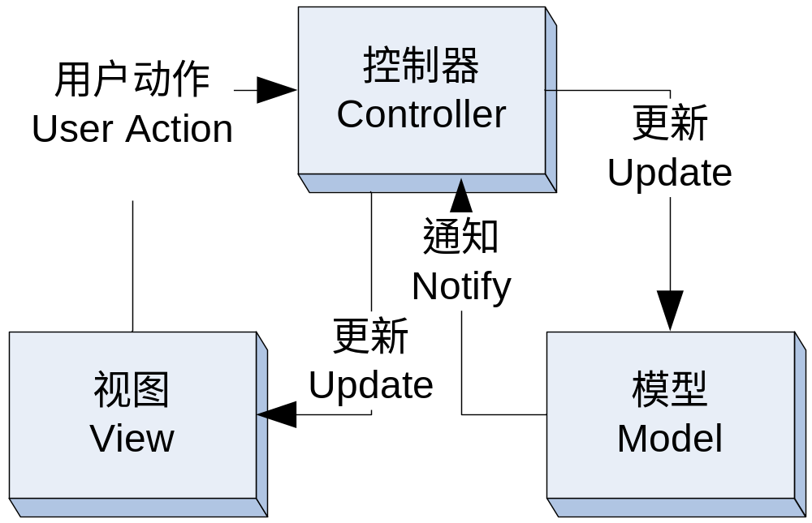
MVC
模型Model：管理系统中存储的数据和业务规则，并执行相应的计算功能。
视图View：根据模型生成提供给用户的交互界面，不同的视图可以对相同的数据产生不同的界面。
控制器Control：接收用户输入，通过调用模型获得响应，并通知视图进行用户界面的更新。
Notes:
RMUC Instructor Notes
Module 0 - About This Course
视图与模型分离，使程序结构清晰，不同功能模块耦合度降低，各司其职，互不干涉 ，可以方便改变视图而模型不变，或者保持视图不变而改变业务规则，有利于开发中的分工 。
多个视图共享一个模型，提高了代码复用。
控制器提高了应用的灵活性和可配置性。

Slide 39
管道和过滤器（Pipes and Filters）风格
In this style, each component has a set of inputs and a set of outputs.
A component reads streams of data on its inputs and produces streams of data on its output.

Slide 40
管道和过滤器架构举例
Linux的Shell程序可以看做是典型的管道与过滤器架构的例子
例如下面的Shell脚本：
  $cat TestResults | sort | grep Good
会将TestResults文件的文本进行排序，然后找出其中包含单词Good的行，并显出在屏幕上。Shell命令cat、sort和grep依次执行，就构成了一个管道-过滤器架构。

Slide 41
层次架构（layered architecture）风格
Specific functionality
Distinct application subsystems that make up an application — contains the value adding software developed by the organization.
Application Subsystems
Business specific — contains a number of reusable subsystems specific to the type of business.
Business-Specific
Middleware — offers subsystems for utility classes and platform-independent services for distributed object computing in heterogeneous environments and so on.
Middleware
System software — contains the software for the actual infrastructure such as operating systems, interfaces to specific hardware, device drivers, and so on.
System Software
General functionality
上一层依赖下一层
Notes:
RMUC Instructor Notes
Module 0 - About This Course
Remind the students that during Architectural Analysis, the focus is normally on the high-level layers — the application and business-specific layers. The other lower-level layers are focused on during Incorporate Existing Design Elements.
Layering is another realization of the basic OO principles discussed in the Introduction to Object Orientation module: abstraction, encapsulation, modularity, and hierarchy.
Layering is a fundamental separation of concerns.
Note: Most of the GUI and persistence frameworks cut across layers in a somewhat transparent way, so instead of visualizing layers in only two dimensions, think of a framework as layering in a third dimension that cuts across the normal layering dimensions (or “plugs into” the side of the layering diagram, cutting across layers). This is part of what makes frameworks so hard to explain — they don’t behave like “service providers” (classes and subsystems), but instead act more like skeletal architectures and proto-services that both extend and are extended by the project-specific stuff. The “GUI layer” is really not so much a layer as a framework that extends across a number of layers.
Layering represents an ordered grouping of functionality, with the application-specific functions located in the upper layers, functionality that spans application domains in the middle layers, and functionality specific to the deployment environment at the lower layers.
The number and composition of layers is dependent upon the complexity of both the problem domain and the solution space:
There is generally only a single application-specific layer.
In domains with existing systems, or that have large systems composed of inter-operating smaller systems, the Business-Specific layer is likely to partially exist and may be structured into several layers for clarity.
Solution spaces, which are well-supported by middleware products and in which complex system software plays a greater role, have well-developed lower layers, with perhaps several layers of middleware and system software.
This slide shows a sample architecture with four layers:
The top layer, Application layer, contains the application-specific services.
The next layer, Business-Specific layer, contains business-specific components used in several applications.
The Middleware layer contains components such as GUI-builders, interfaces to database management systems, platform-independent operating system services, and OLE-components such as spreadsheets and diagram editors.
The bottom layer, System Software layer, contains components such as operating systems, databases, interfaces to specific hardware, and so on.

Slide 42
层次架构实例
数字出纳员
应用系统
ATM
出纳员
付款
开发票
特定业务
现金管理
帐户管理
发票管理
银行客户管理
中间件
Java
HP ORB Plus
系统软件
NT
Workstation
TCP/IP

Slide 43

3 Tiers
表
示
层
业务逻辑层
数据访问层
数据库
表示层：负责向用户呈现界面，并接收用户请求发送给业务逻辑层；
业务逻辑层：负责执行业务逻辑以处理用户请求，并调用数据访问层提供的持久性操作；
数据访问层：负责执行数据库持久性操作。

Slide 44
设计模式 Design Patterns
A design pattern is a solution to a common design problem.
  Describes a common design problem
  Describes the solution to the problem
  Discusses the results and trade-offs of applying the pattern
Design patterns provide the capability to reuse successful designs.
Template
Parameters
Pattern Name
Parameterized
Collaboration
Structural Aspect
Behavioral Aspect
Notes:
RMUC Instructor Notes
Module 0 - About This Course
OOAD is not intended to be a patterns course, but will use/introduce patterns to solve particular problems.
We will look at a number of design patterns throughout this course. Thus, it is important to define what a design pattern is up front.
Design patterns are being collected and cataloged in a number of publications and mediums.You can use design patterns to solve issues in your design without “reinventing the wheel.” You can also use design patterns to validate and verify your current approaches.
Using design patterns can lead to more maintainable systems and increased productivity.They provide excellent examples of good design heuristics and design vocabulary. In order to use design patterns effectively, you should become familiar with some common design patterns and the issues that they mitigate.
A design pattern is modeled in the UML as a parameterized collaboration.Thus it has a structural aspect and a behavioral aspect. The structural part is the classes whose instances implement the pattern, and their relationships (the static view).The behavioral aspect describes how the instance collaborate — usually by sending messages to each other — to implement the pattern (the dynamic view).
A parameterized collaboration is a template for a collaboration.The Template Parameters are used to adapt the collaboration for a specific usage.These parameters may be bound to different sets of abstractions, depending on how they are applied in the design.

Slide 45
GOF 23个设计模式
创建型模式
  ABSTRACT FACTORY (抽象工厂）；BUILDER (生成器）；FACTORY METHOD (工厂方法）；PROTOTYPE (原型）；SINGLETON (单件）
结构型模式
  ADAPTER（适配器）；BRIDGE（桥接）；COMPOSITE（组合）；DECORATOR（装饰）；FACADE（外观）；FLYWEIGHT（享元）；PROXY（代理）
行为模式
  CHAIN OF RESPONSIBILITY (职责链)； COMMAND (命令）；INTERPRETER (解释器）；ITERATOR (迭代器）；MEDIATOR (中介者）；*MEMENTO (备忘录）；OBSERVER (观察者）；STATE (状态）；STRATERY (策略）；TEMPLATE METHOD (模板方法）；VISITOR (访问者）

Slide 46
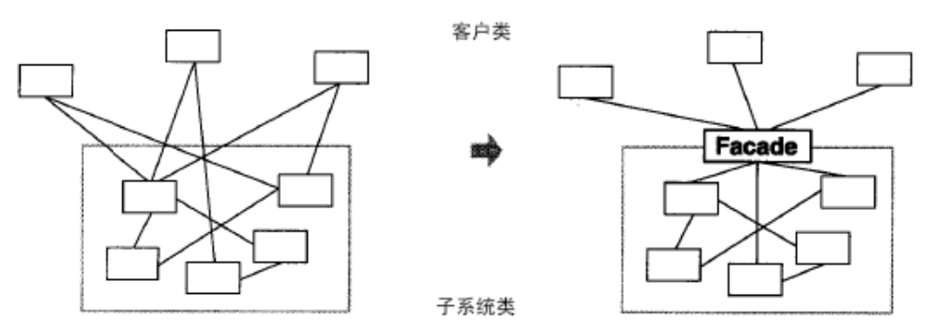
举例：Facade模式

Slide 47
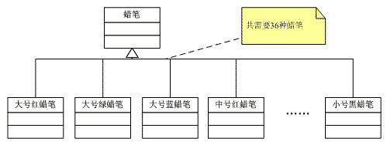
举例： Bridge模式
蜡笔和毛笔的故事
    我们需要用蜡笔或者毛笔绘制图画，画里有山水、花鸟、人物等；
    我们需要
      不同粗细的笔（填充颜色用细笔不方便，勾勒细节用粗笔无法完成）
      不同的色彩（彩色图画）
  36只蜡笔
    购置了粗、中、细3套蜡笔，一套12色，一共36只蜡笔

Slide 48
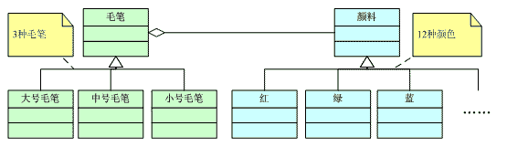
蜡笔和毛笔的故事（续）
  我们也需要36只毛笔吗？
3只毛笔，12种颜料，不同的毛笔使用不同的颜料

Slide 49
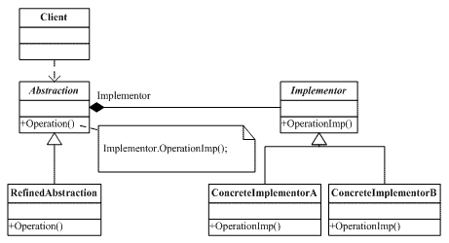
Bridge模式
意图：
  将抽象与其实现解耦，使它们可以独立变化
图示：

Slide 50
框架(Framework)
框架是一个代码骨架，可以使用为解决问题而设计的特定类或功能来填充这个代码骨架，使之丰满。
Selectable Plug-ins
Frameworks with Plug-ins

Slide 51
框架举例
1. MVC框架
  J2EE
  Struts
2. ORM 框架
  EJB
  Hibernate
3. 界面框架
  Java界面框架：AWT, Swing, SWT, SwingWT, Java 2D, Java 3D，JSF
  AJAX界面框架：DWR， DOJO
4. 复合框架
  Spring包含Web MVC, IOC, ...
  Java EE 包含JSF、EJB 、JAX-WS 、IOC, ...

