Slide 1
SigAisa20反馈

Slide 2
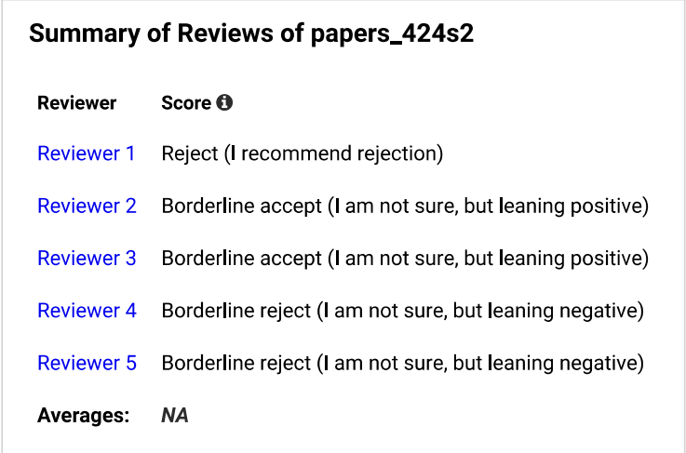
总体评价

Slide 3
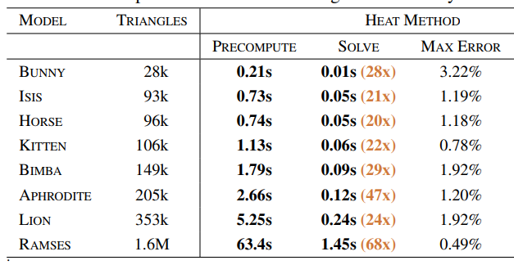
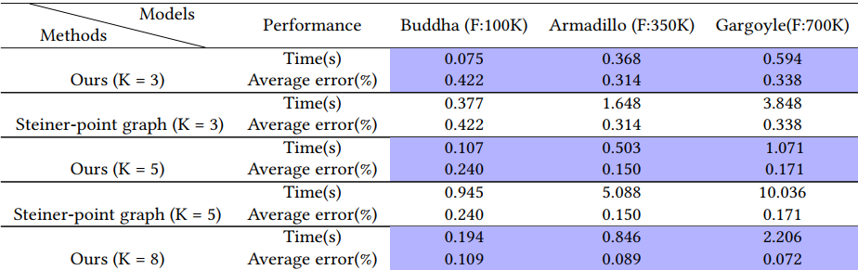
审稿人1意见
Clarity of Expostion
Very clear
Quality of References
Good
Reproducibility
The algorithm is described in details, it should be reproducible.
审稿人意见
The algorithm uses Steiner points to replace windows to seek a balance between accuracy and speed. It is 6 times faster than an exact method but produces less accurate results. It is slower than more approximate methods, such as geodesics in heat, that can compute one to many distances in one evaluation. It is unclear to me which application this algorithm is targeting since it is not exact and, at the same time, not particularly fast.

Slide 4
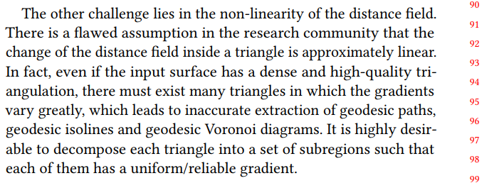
审稿人1意见
Line 91: can you cite where this flawed assumption shows up? I was not aware of it

Slide 5
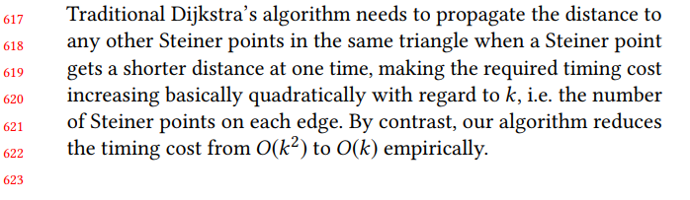
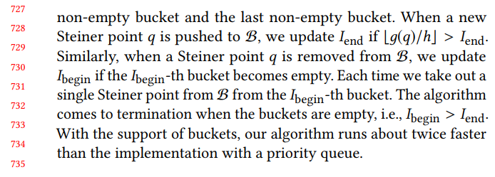
审稿人1意见
*Line 622: what does empirically mean? Please provide experimental evidence or proof.
*Line 733: this is an implementation detail that I think could go in an appendix not to break the flow.

Slide 6
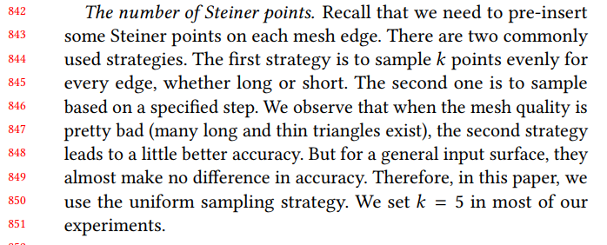
审稿人1意见
*Line 844: which strategy do you use for the experiments? Please show experiments comparing the 2 to justify your choice.
*Does the distance computed by this algorithm satisfy triangular inequality and symmetry? lt looks like it should, but the algorithm is not trivial, and a direct proof would be preferable.

Slide 7

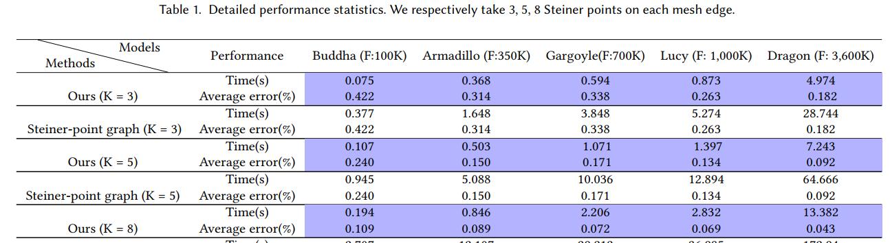
审稿人1意见
*Line 1006: which applications need a 5x speedup and can tolerate an error of 0.2%?
*Table 1: average error is a potentially confusing measure. Could you show a max error or even better the error distribution?

Slide 8
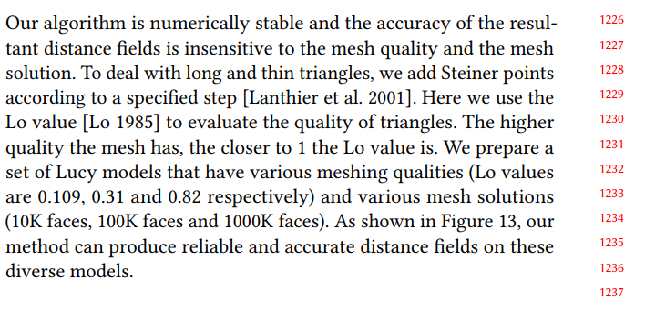
审稿人1意见
*Line 1226: why are you changing your strategy for adding Steiner points for bad triangulations? Having the number of splits depend on the edge length seems a good idea, why don't you do it as a default for all experiments?

Slide 9
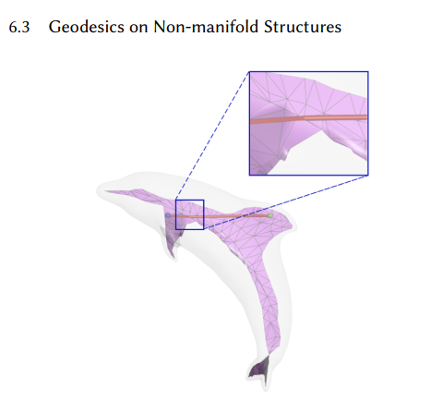
审稿人1意见
*Figure 13: all meshes have decent quality, I recommend to test it on the Thingi10k dataset to test s, there are many challenging models.
*Section 6.3: this is a good idea, but I don't see how it is connected to the contribution: the same approach could be realized with any other geodesic distance algorithm, I think.

Slide 10
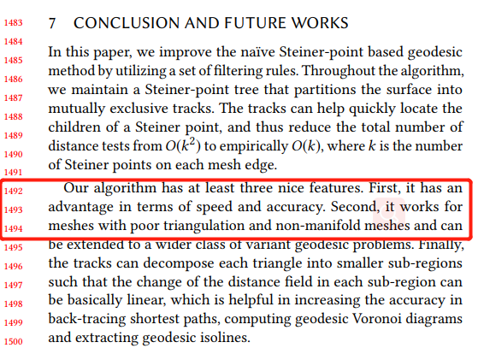
审稿人1意见
*Line 1493: to claim robustness the algorithm should be tested on a large collection of low-quality data (for example the MPZ dataset or thingi10k), the meshes used in the paper seems quite benign.

Slide 11
审稿人2意见
Clarity of Expostion
The paper is mostly clear
Quality of Reference
Yes, to the best of my knowledge
Reproducibility
Yes
审稿人意见
This paper presents an approximate algorithm to compute geodesic distances that affords a more favorable speed-accuracy trade-off than previous work. This is achieved using a number of technical improvements. The contribution of the paper seems somewhat incremental, but the resulting algorithm is practical and has tangible benefits over the state of the art in approximate geodesic distance computation. Finally, the evaluation includes useful discussion of related techniques including comparisons of runtime and memory. Hence I am leaning slightly positive.

Slide 12
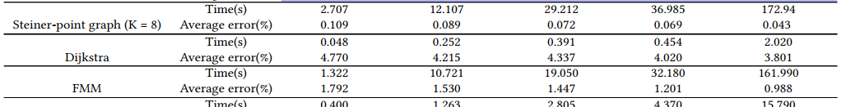
审稿人3意见
Clarity of Expostion
The writing is ok. It is somewhat verbose and the English level could much improved but overall the exposition is clear. Beyond the English level, there are many typos which could have been cleared if the authors would have performed a read proof pass.
Quality of Reference
References seems ok. Please add parallel methods as well.
Reproducibility
Yes
审稿人意见
On the bright side, the algorithm seems to accelerate significantly the speed of the naive Steiner based approach. Moreover, the partitioning of the triangles into zones allows for better path and contour tracing.
On the downside I'm a bit suspicious about the results and would like to here what the other reviewers think about it.
First, I find it strange that only the mean error is reported while the the maximal error isn’t.
Second, the timing for FMM seems to be considerably worse than that of Dijkstra even though these are pretty similar methods that only differ by the update scheme. This makes me wonder what implementation was used for FMM.

Slide 13
审稿人3意见
In addition, the timings for the heat method seems worse than they should be. Excluding the preprocessing time, the complexity of this method is near in the number of mesh vertices and can also be accelerated if a parallel linear solver is used It is important to note what implementation was used and in particular, what linear solver was 'used and whether the preprocessing time was included in the timings report. Leaving all these details out gives the impression that the comparison made is not fair and less reliable. The heat method is one of the fastest approximation methods out there and according to Table 1, it performs similarly to the exact VTP method which doesn't make sense to me.
In addition, the mean errors of the heat method seems too high. It is true that the heat method is sensitive to bad triangulations but the recent "Navigating Intrinsic Triangulations" paper shows how to reduce the error dramatically with little effort.

Slide 14
审稿人4意见
Clarity of Expostion
Yes. As a very minor note I think that in the figure the shadows behind graphs make them less readable.
Quality of Reference
Mostly yes. These two references could be added.
R. Farias and M. Kallmann, "Optimal Path Maps on the GPU," in IEEE Transactions on Visualization and Computer Graphics, doi: 10.1109/TVCG.2019.2904271.
Calla, Luciano A. Romero, Lizeth J. Fuentes Perez, and Anselmo A. Montenegro. "A minimalistic approach for fast computation of geodesic distances on triangular meshes." Computers 8Graphics 84 (2019): 77-92.
Reproducibility
It seems ok. The description of the algorithm is very detailed. I expect (ask) the authors will release the code.
审稿人意见
The proposed algorithm while it is mostly based on the existing idea of pruning by [Qin et al. 2016] is sufficiently novel. The results seems encouraging enough in terms of accuracy, timings and memory consumption to make its use practical.
Particularly I would like to see also the approach of Surazhsky (that obtained similar accuracy) and for which it would be important to see the performance on a modern machine; it was better than fast marching method (FMM)). Similarly also the Short-Term Vector Dijkstra approach of [Campen et al 2013]. This one should be evaluated also with respect to computing geodesic with different anisotropic metrics.

Slide 15
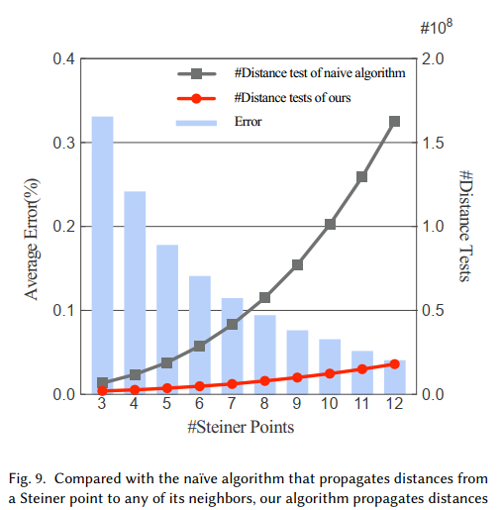
The sentence that the presented algorithm is basically linear to k (sec. 5.1) seems to me not well demonstrated. Fig 9 should be extended to very high k to make it more acceptable. I have seen cited in some papers the use of k=200 for obtaining a very accurate solution.
The other interesting question is for what value of K the proposed approach become slower than the exact VTP? and what is the precision it can reach before becoming slower?

Slide 16
审稿人5意见
Clarity of Expostion
While clear, I think the exposition is overall too detailed. An effort should be made to convey the basic choices, leaving the implementation details to a reference implementation (which the authors "promise" but don't yet deliver).
Quality of References
No problem in this area. The work below is not cited and seems relevant, as it also uses pointed added on edges in order to compute a accurate geodesic lines by exploiting some a-priori to speed up computation. I am not familiar with the details to make a final assessment or comparison, but it should probably be discussed.
[1] Tracing field&#8208:coherent quad layouts. Pietroni et al. CG Forum, 2016.
Reproducibility
The algorithm is described in details, it should be reproducible.
The authors should provide the implementation even during the review phase.
审稿人意见

Slide 17
审稿人5意见
I think the presented algorithms and its optimization are too small an advancement to warrant a 14 pages Siggraph paper. It amounts to a few optimizations that are described in a level of details which is excessive and too low level. Similar ideas have been proposed below (especially [Qin et al. 2016]), and while a significative speed-up is claimed here, there is no clear cut algorithmic advances other than somewhat minor optimizations. This falls shorts of the expectation for a TOG/SIGGRAPH/SIGGRAPH-ASIA paper, especially a long one.
Another huge weakness is that an actual implementation is not provided (but it's promised). This detracts quite considerably from any work that claims an advantage on immediate precedessors mainly in terms of implementation simplicity (and empirical speed measurements).

Slide 18
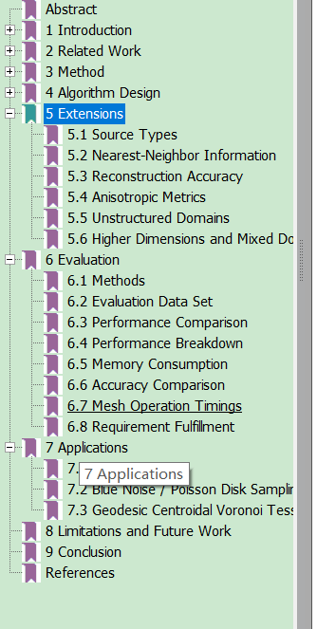
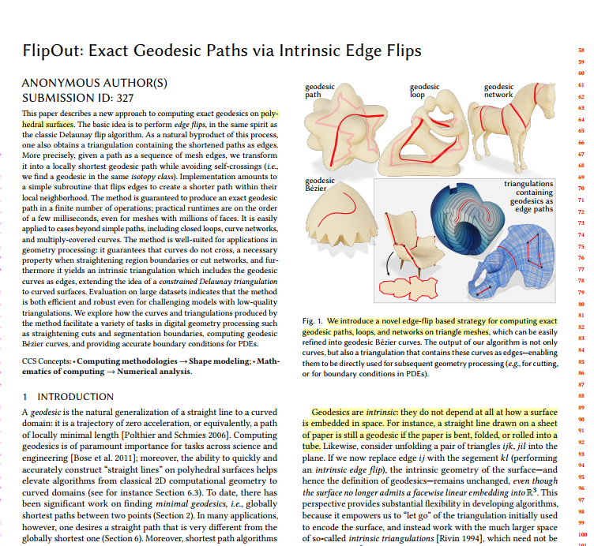

Slide 19
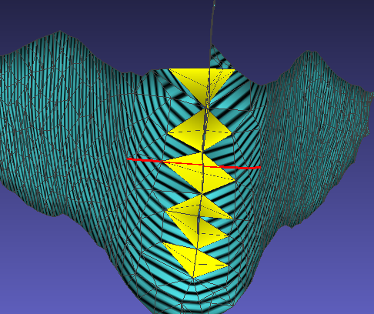
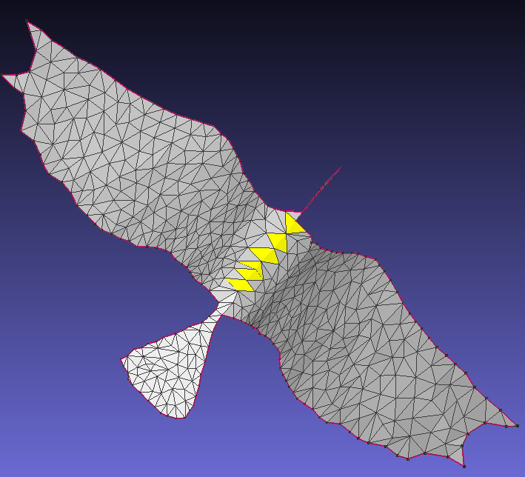
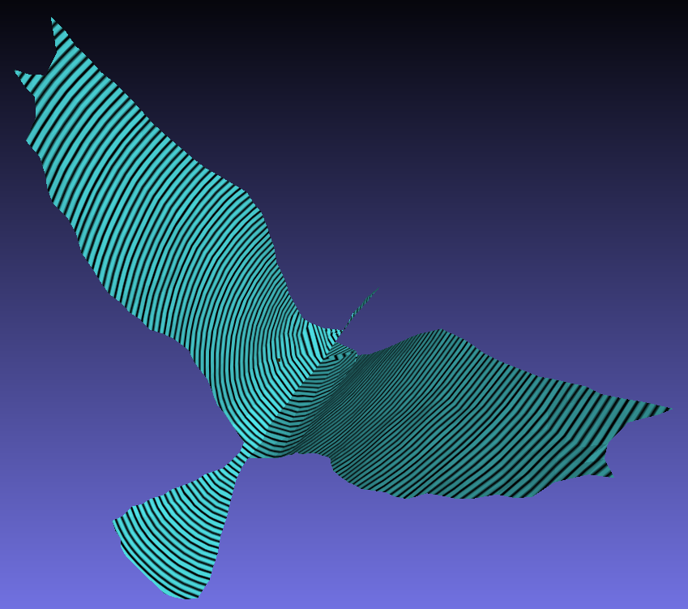
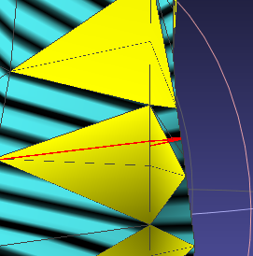
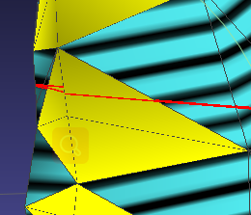
Double Covering 进展
Source
Destination
非流型面
边界
输入
测地距离场
测地路径

Slide 20
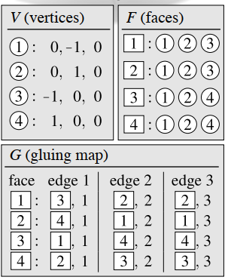
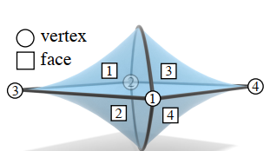
Tufted covering
we make two logical copies of each input triangle, and systematically glue along edges to form a closed, edge-manifold mesh.
We therefore augment this list with a gluing map G that can represent any edge-manifold. G stores the corresponding side of the adjacent triangle. A side is encoded as a pair (f,s).
Tufted cover of an input mesh M = (V,E,F) is a triangle mesh M_{e} = (V_{e,}E_{e,}F_{e}) with the same vertices (V_{e} = V), together with a gluing map G_{e}.

Slide 21
Note
We assume a unique ordering of faces around e, which may not be available in degenerate cases (e.g., coplanar faces incident on e).

