Slide 1
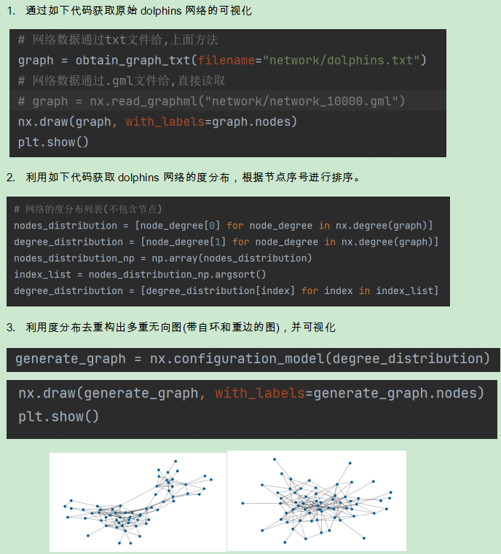
作业
生成N=1000，连边概率p=0.05的随机网络，计算最大连通子图的规模。求最大连通子图的平均路径长度，平均聚类系数，统计度分布。
生成N=1000，平均度为6，重连概率p=0.02的WS小世界网络，计算最大连通子图的规模。求最大连通子图的平均路径长度，平均聚类系数，统计度分布。
生成N=1000，m=3的BA网络，求网络的平均路径长度，平均聚类系数，统计度分布。
生成一个配置网络，使得其节点规模数以及度分布和Email网络相同

Slide 2
复杂网络设计第二次平时作业
生成N=1000，连边概率p=0.05的随机网络，计算最大连通子图的规模。求最大连通子图的平均路径长度，平均聚类系数，统计度分布。
def is_connected(G):
start = next(iter(G.nodes)) # 选择任意一个节点作为起点
target = None # 设置目标节点为 None，因为我们只关心访问的节点数量
node_distances = breadth_first_search(G, start, target)
visited_nodes = [node for node, (distance, visited) in node_distances.items() if visited]
if len(visited_nodes) == len(G.nodes):
print("Graph is connected")
return True
else:
print("Graph is not connected")
return False
def random_network(n, p):
# 创建一个空的网络
G = nx.Graph()
# 添加节点
G.add_nodes_from(range(1, n+1))
# 添加边，因为是无向网若络j从i+1开始
for i in range(1, n + 1):
for j in range(i + 1, n + 1):
if random.random() < p:
G.add_edge(i, j)
G.add_edge(j, i)
return G
Graph is connected

Slide 3
输入： G：一个图，表示节点及其相互之间的连接关系。在这里，它应该是一个 NetworkX 图对象。
source：源节点，是 BFS 算法的起点。
target（可选）：目标节点，如果提供了这个参数，函数将返回源节点到目标节点的最短距离。
输出： 如果没有指定目标节点，函数将返回一个字典，键为图中的每个节点，值为一个元组，包含两个元素：该节点到源节点的最短距离和该节点是否已被访问过。
如果指定了目标节点，函数将返回一个整数，表示源节点到目标节点的最短距离。
def breadth_first_search(G, source, target=None):
# 初始化队列，将源节点加入队列
queue = deque([source])
# 为图中的每个节点创建一个字典，键为节点，值为一个包含两个元素的元组：距离和是否访问过的布尔值
node_info = {node: (0, False) for node in G.nodes}
# 将源节点的距离设置为 0，并将其访问状态设置为 True
node_info[source] = (0, True)
# 当队列非空时，继续执行循环
while queue:
# 从队列左侧移除并返回一个节点，将其作为当前节点
current_node = queue.popleft() # 如果目标节点不为空，且当前节点等于目标节点，退出循环
if target is not None and current_node == target:
break # 获取当前节点的相邻节点列表
neighbors = list(G.neighbors(current_node))
# 遍历相邻节点
for neighbor in neighbors:
# 获取相邻节点的距离和访问状态
distance, visited = node_info[neighbor]
# 如果相邻节点未访问过
if not visited:
# 更新相邻节点的距离和访问状态
node_info[neighbor] = (node_info[current_node][0] + 1, True)
# 将相邻节点添加到队列的右侧
queue.append(neighbor)
# 如果没有指定目标节点，返回包含所有节点信息的字典
if target is None:
return node_info
# 如果指定了目标节点，返回目标节点的距离
else:
return node_info[target][0]

Slide 4
def get_largest_connected_component(graph): visited = set()
largest_cc = set() # Here, we create an empty set `visited` and an empty largest connected component set `largest_cc`. for node in graph: # This is a loop iterating through each node in the graph. if node not in visited: # This condition checks if `node` has already been visited. If not, we will perform the following: current_cc = set()
bfs(graph, node, current_cc) # We create an empty set `current_cc` and use the breadth-first search algorithm `bfs()` to find all nodes connected to `node` and add them to `current_cc`. if len(current_cc) > len(largest_cc):
largest_cc = current_cc # If `current_cc` is larger than `largest_cc`, we set `largest_cc` to `current_cc`. return largest_cc # At the end of the function, we return the largest connected component set `largest_cc`.
# The purpose of this function is to find the largest connected component in a graph, which is the connected component with the most nodes.

Slide 5
def bfs(graph, start_node, visited):
# 这是一个广度优先搜索算法的函数定义。它接受三个参数：graph，表示要搜索的图；start_node，表示要从哪个节点开始搜索；visited，表示包含已经访问过的节点的集合。
queue = [start_node]
visited.add(start_node)
# 在这里，我们创建一个包含start_node的queue列表，并将其添加到visited集合中。
while queue:
# 这是一个循环，只要queue不为空就会继续。
current_node = queue.pop(0)
# 这一行从queue列表中弹出第一个元素，并将其赋值给current_node。
for neighbor in graph[current_node]:
# 这个循环迭代current_node在graph中的邻居。
if neighbor not in visited:
# 这个条件检查neighbor是否已经被访问过。
visited.add(neighbor)
queue.append(neighbor)
# 如果neighbor没有被访问过，我们将其添加到visited集合中，并将其入队到queue列表中。
# 该算法使用广度优先搜索方法遍历图，从start_node开始，访问所有可达节点。

Slide 6
def average_path_length(G):
n = G.number_of_nodes() # 获取图G中的节点数量
matrix = [np.zeros((n, n))] # 初始化一个全为0的矩阵
shortest_path = np.zeros((n, n)) # 初始化一个用于存储最短路径的矩阵
adj_matrix = np.array(nx.to_numpy_array(G)) # 获取图G的邻接矩阵
matrix = adj_matrix # 将邻接矩阵赋给matrix
np.fill_diagonal(shortest_path, np.inf) # 将最短路径矩阵的对角线填充为无穷大
for i in range(1, n):
if shortest_path.all() != 0: # 如果最短路径矩阵中的值全部不等于0，说明已经计算完毕，跳出循环
break
for p in range(n):
for q in range(n):
if q != p:
if matrix[p][q] != 0 and shortest_path[p][q] == 0: # 找到matrix中的值不等于0，最短路径矩阵中的值等于0时i的值，说明找到了最短路径就是i
shortest_path[p][q] = i # 更新最短路径矩阵中的值
matrix = matrix @ adj_matrix # 矩阵乘法，更新matrix
# 将对角线上的值设置为0，因为节点到自身的距离为0
np.fill_diagonal(shortest_path, 0)
# 计算平均最短路径长度
average = np.sum(shortest_path) / (n * (n - 1))
print(f'平均路径长度为：{average}')
return average
Average Path Length is 2.0312192192192193
python NetworkX results:2.0312192192192193

Slide 7
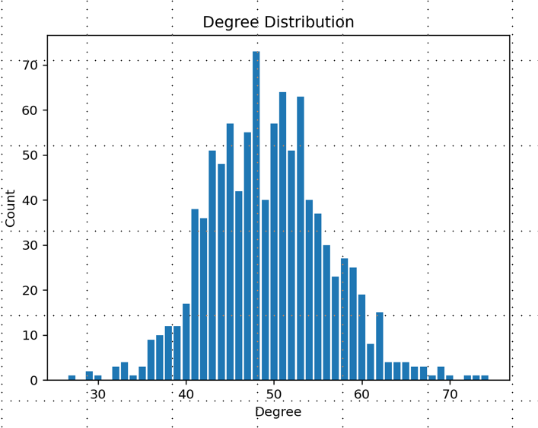
def degree_distribution(G):
# 获取所有节点的度并创建Counter对象，记录每个度出现的次数
counts = Counter(deg for _, deg in G.degree)
# 找到最小和最大的度
_, max_degree = min(counts), max(counts)
max_degree = max(counts.keys())
degree_counts = [0] * (max_degree + 1)
for degree, count in counts.items():
degree_counts[degree] = count
print('\n度分布：')
print(degree_counts)
# 绘制度分布直方图
plt.bar(counts.keys(), counts.values())
plt.xlabel(‘Degree')
plt.ylabel(‘Count')
plt.title(‘Degree Distribution')
# plt.xticks(range(min_degree, max_degree + 1))
plt.show()
Degree Distribution:
[0, 0, 0, 0, 0, 0, 0, 0, 0, 0, 0, 0, 0, 0, 0, 0, 0, 0, 0, 0, 0, 0, 0, 0, 0, 1, 0, 0, 0, 0, 0, 0, 2, 3, 6, 6, 10, 11, 20, 11, 21, 37, 34, 28, 44, 41, 41, 50, 52, 66, 51, 66, 58, 51, 66, 32, 38, 38, 30, 14, 17, 14, 8, 7, 6, 5, 4, 3, 5, 2, 1]
python NetworkX results:
[0, 0, 0, 0, 0, 0, 0, 0, 0, 0, 0, 0, 0, 0, 0, 0, 0, 0, 0, 0, 0, 0, 0, 0, 0, 1, 0, 0, 0, 0, 0, 0, 2, 3, 6, 6, 10, 11, 20, 11, 21, 37, 34, 28, 44, 41, 41, 50, 52, 66, 51, 66, 58, 51, 66, 32, 38, 38, 30, 14, 17, 14, 8, 7, 6, 5, 4, 3, 5, 2, 1]
Graph is connected
Average Path Length is 2.0312192192192193
python NetworkX results:2.0312192192192193
Average Clustering Coefficient:0.049714732781362785
python NetworkX results:0.049714732781362785
Degree Distribution:
[0, 0, 0, 0, 0, 0, 0, 0, 0, 0, 0, 0, 0, 0, 0, 0, 0, 0, 0, 0, 0, 0, 0, 0, 0, 1, 0, 0, 0, 0, 0, 0, 2, 3, 6, 6, 10, 11, 20, 11, 21, 37, 34, 28, 44, 41, 41, 50, 52, 66, 51, 66, 58, 51, 66, 32, 38, 38, 30, 14, 17, 14, 8, 7, 6, 5, 4, 3, 5, 2, 1]
python NetworkX results:
[0, 0, 0, 0, 0, 0, 0, 0, 0, 0, 0, 0, 0, 0, 0, 0, 0, 0, 0, 0, 0, 0, 0, 0, 0, 1, 0, 0, 0, 0, 0, 0, 2, 3, 6, 6, 10, 11, 20, 11, 21, 37, 34, 28, 44, 41, 41, 50, 52, 66, 51, 66, 58, 51, 66, 32, 38, 38, 30, 14, 17, 14, 8, 7, 6, 5, 4, 3, 5, 2, 1]

Slide 8
def clustering_coefficient(G):
'''在上述代码中, 我们首先将聚类系数 coefficient 初始化为 0 , 然后遍历图中的每个节点。
对于每个节点, 我们获取其所有邻居节点, 并计 算该节点的度数 k 。
如果该节点的度数大于 1 , 则计算该节点的聚类系数 num_edges, 并将其加入总聚类系数中。
在计算聚类系数时, 我们使用 combinations 函数生成该节点所有邻居节点中的两两组合, 然后计算相邻节点之间是否存在边。
最后, 我们将总聚类系数除以节点数, 得到平均聚类系数, 并返回该值。
这样做的时间复杂度为 O(n^2), 其中 n 是节点数。由于 combinations 函数的空间复杂度为 O(k^2), 其中 k 是节点的平均度数, 因此总的空间复杂度为 O(n*k^2) 。'''
# 计算图对象 G 的平均聚类系数,输入是图对象，输出是平均聚类系数
coefficient = 0 # 初始化聚类系数为0
for node in G.nodes: # 遍历图中每个节点
neighbors = list(G.neighbors(node)) # 获取该节点的所有邻居节点
k = len(neighbors) # 该节点的度数
if k > 1: # 只有度数大于1的节点才有聚类系数
# 计算该节点的聚类系数
num_edges = sum(1 for v, w in combinations(neighbors, 2) if G.has_edge(v, w))
coefficient += 2 * num_edges / (k * (k - 1))
print(f"\nAverage Clustering Coefficient:{coefficient / G.number_of_nodes()}")
return coefficient / G.number_of_nodes() # 返回平均聚类系数
Average Clustering Coefficient:0.049714732781362785
python NetworkX results:0.049714732781362785

Slide 9
G = random_network(1000, 0.05)
# 判断是否连通，如果不连通，删除不连通的节点
if not is_connected(G):
G_set = get_largest_connected_component(G)
G_list = list(G_set)
for i in list(G.nodes()):
if i not in G_list:
G.remove_node(i)
# 输出平均最短路径长度
average_path_length(G)
print(f"python NetworkX results:{nx.average_shortest_path_length(G)}")
# 输出平均聚类系数
clustering_coefficient(G)
print(f"python NetworkX results:{nx.average_clustering(G)}")
# 输出度分布序列
degree_distribution(G)
print(f"python NetworkX results:\n{nx.degree_histogram(G)}")
Graph is connected
Average Path Length is 2.0283023023023024
python NetworkX results:2.0283023023023024
Average Clustering Coefficient:0.04980091553303759
python NetworkX results:0.04980091553303759
Degree Distribution:
[0, 0, 0, 0, 0, 0, 0, 0, 0, 0, 0, 0, 0, 0, 0, 0, 0, 0, 0, 0, 0, 0, 0, 0, 0, 0, 1, 0, 0, 0, 0, 0, 0, 2, 6, 5, 5, 9, 14, 11, 24, 28, 28, 37, 38, 42, 59, 50, 64, 64, 56, 70, 57, 50, 49, 36, 39, 21, 31, 18, 24, 19, 15, 6, 4, 3, 3, 6, 4, 1, 1]
python NetworkX results:
[0, 0, 0, 0, 0, 0, 0, 0, 0, 0, 0, 0, 0, 0, 0, 0, 0, 0, 0, 0, 0, 0, 0, 0, 0, 0, 1, 0, 0, 0, 0, 0, 0, 2, 6, 5, 5, 9, 14, 11, 24, 28, 28, 37, 38, 42, 59, 50, 64, 64, 56, 70, 57, 50, 49, 36, 39, 21, 31, 18, 24, 19, 15, 6, 4, 3, 3, 6, 4, 1, 1]

Slide 10
def generate_ws_small_world_network(N, k, p):
# 创建一个空的NetworkX图对象G和一个大小为(N, N)的零邻接矩阵adj
G = nx.Graph()
adj = np.zeros((N, N)) # 将邻接矩阵adj初始化为一个环形的规则图，每个节点连接到其相邻的k // 2个节点
for i in range(N):
for j in range(1, k // 2 + 1):
adj[i, (i + j) % N] = 1
adj[i, (i - j) % N] = 1 # 将邻接矩阵表示为NetworkX图对象G。我们使用np.triu()函数将邻接矩阵的下三角设置为零
adj1 = np.triu(adj)
G = nx.from_numpy_matrix(adj1) # 计算G的平均度数，并将G的边列表存储在edges变量中
avg_degree = sum(dict(G.degree()).values()) / len(G)
edges = list(G.edges()) # 按概率p对每条边进行重连
for m, e in enumerate(edges):
i, j = e
if random.random() > 1 - p:
non_one_indices = np.where((adj[i, :] != 1) & (np.arange(N) != i))[0]
if len(non_one_indices) > 0:
k = random.choice(non_one_indices)
adj[i, k] = 1
adj[k, i] = 1
adj[i, j] = 0
adj[j, i] = 0 # 将更新后的邻接矩阵表示为NetworkX图对象G。我们再次使用np.triu()函数将邻接矩阵的下三角设置为零
adj2 = np.triu(adj)
G = nx.from_numpy_matrix(adj2) # 返回新生成的小世界网络G
return G
生成N=1000，平均度为6，重连概率p=0.02的WS小世界网络，计算最大连通子图的规模。求最大连通子图的平均路径长度，平均聚类系数，统计度分布。

Slide 11
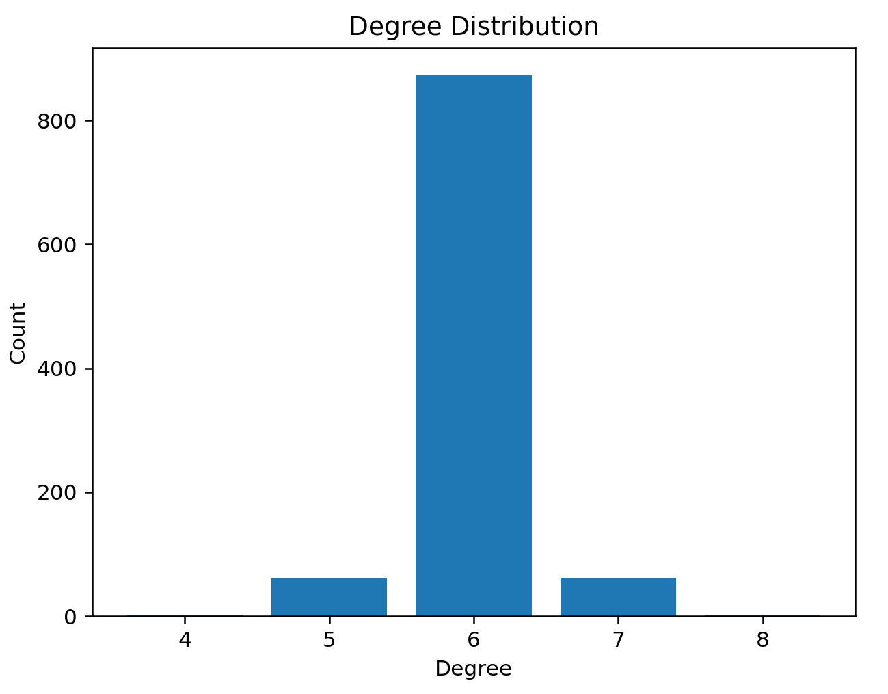
N = 1000
k = 6
p = 0.02
G = generate_ws_small_world_network(N, k, p)
Graph is connected
Average Path Length is 11.482038038038038
python NetworkX results:11.482038038038038
Average Clustering Coefficient:0.5644047619047697
python NetworkX results:0.5644047619047697
Degree Distribution:
[0, 0, 0, 0, 0, 58, 884, 58]
python NetworkX results:
[0, 0, 0, 0, 0, 58, 884, 58]

Slide 12
生成N=1000，m=3的BA网络，求网络的平均路径长度，平均聚类系数，统计度分布。
def generate_ba_small_world_network(N, m0, m):
# 创建一个空的NetworkX图对象G，添加节点1到m0
G = nx.Graph()
G.add_nodes_from(range(1, m0+1))
# 将节点1与所有其他节点相连
G.add_edges_from([[1,edge] for edge in [node for node in G.nodes() if node != 1]])
# 对于每个新的节点i，将其连接到m个已有节点
for i in range(m0+1, N+1):
# 计算每个节点的度数，并将其转换为概率
degree = dict(G.degree())
degree = {k: v / sum(degree.values()) for k, v in degree.items()}
# 按概率选择要连接的节点
sorted_degree = sorted(degree.items(), key=lambda x: x[1], reverse=True)
node = random.choices([node[0] for node in sorted_degree], degree.values(), k=m)
# 将新节点与已有节点相连
for n in node:
G.add_edge(i, n)
# 返回新生成的BA小世界网络G
return G

Slide 13
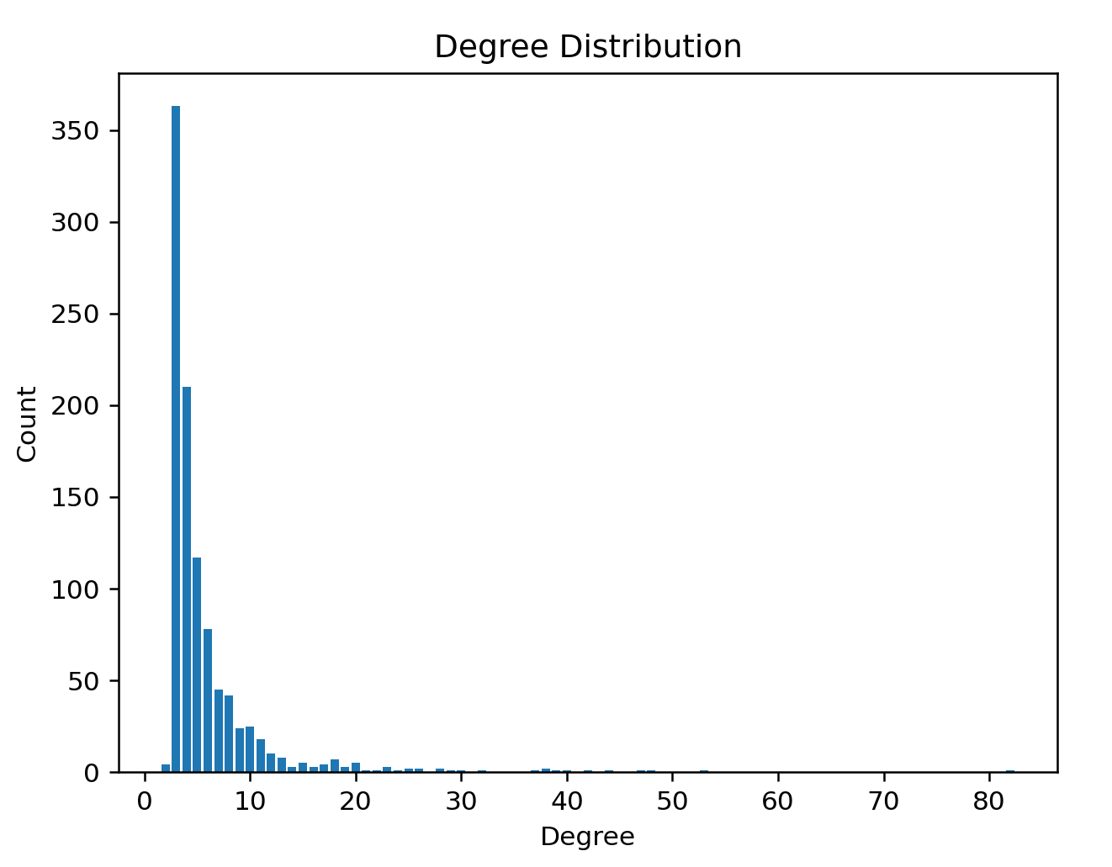
Average Path Length is 3.6052652652652655
NetworkX average_shortest_path_length 3.6052652652652655
Average Clustering Coefficient:0.0209988456608948
NetworkX average_clustering:0.0209988456608948
Degree Distribution:
[0, 0, 4, 363, 210, 117, 78, 45, 42, 24, 25, 18, 10, 8, 3, 5, 3, 4, 7, 3, 5, 1, 1, 3, 1, 2, 2, 0, 2, 1, 1, 0, 1, 0, 0, 0, 0, 1, 2, 1, 1, 0, 1, 0, 1, 0, 0, 1, 1, 0, 0, 0, 0, 1, 0, 0, 0, 0, 0, 0, 0, 0, 0, 0, 0, 0, 0, 0, 0, 0, 0, 0, 0, 0, 0, 0, 0, 0, 0, 0, 0, 0, 1]
NetworkX Degree Distribution:
[0, 0, 4, 363, 210, 117, 78, 45, 42, 24, 25, 18, 10, 8, 3, 5, 3, 4, 7, 3, 5, 1, 1, 3, 1, 2, 2, 0, 2, 1, 1, 0, 1, 0, 0, 0, 0, 1, 2, 1, 1, 0, 1, 0, 1, 0, 0, 1, 1, 0, 0, 0, 0, 1, 0, 0, 0, 0, 0, 0, 0, 0, 0, 0, 0, 0, 0, 0, 0, 0, 0, 0, 0, 0, 0, 0, 0, 0, 0, 0, 0, 0, 1]
N = 1000
m0 = 3
m = 3
G = generate_ba_small_world_network(N, m0, m)

Slide 14
def create_configuration_model(N, degree_sequence):
# 创建一个空的无向图
G = nx.Graph() # 添加 N 个节点
G.add_nodes_from(range(N)) # 生成每个节点的桩子
stubs=[node for node, degree in enumerate(degree_sequence) for _ in range(degree)]
i = 0
# 随机连接桩子，生成边
while len(stubs) > 1:
stub1 = random.choice(stubs)
stub2 = random.choice(list(filter(lambda x: x != stub1, stubs))) # 避免自环
print(i)
i += 1
if not G.has_edge(stub1, stub2): # 避免多重边
G.add_edge(stub1, stub2)
else:
continue
stubs.remove(stub1)
stubs.remove(stub2)
return G
生成一个配置网络，使得其节点规模数以及度分布和Email网络相同

Slide 15
def degree_distribution(G):
# 获取所有节点的度并创建 Counter 对象，记录每个度出现的次数
counts = Counter(deg for _, deg in G.degree)
# 初始化一个空列表来存储输出
output = []
# 遍历 Counter 对象
for degree, count in counts.items():
# 将每个度数添加到输出列表中，次数等于其在 Counter 中的计数值
output.extend([degree] * count)
return output

Slide 16
# 定义文件路径
file_path = ‘email.txt' # 从文件中读取边列表，创建一个图，其中节点的类型为整数，边的权重为整数
G = nx.read_edgelist(
file_path,
nodetype=int,
data=(('weight', int),)
) # 获取原始图的节点数和度分布
N = G.number_of_nodes()
degree_sequence = degree_distribution(G) # 创建一个具有email网络节点个数和给定度序列的配置
G_config = create_configuration_model(N, degree_sequence) # 计算配置模型的度直方图并删除值为 0 的元素
histogram = nx.degree_histogram(G)
histogram = [x for x in histogram if x != 0] # 计算配置模型的度分布
counts = Counter(deg for _, deg in G_config.degree)
degree_counts = list(counts.values()) # 比较度直方图和度分布是否相同,升序排列
comparison_result = (sorted(histogram) == sorted(degree_counts))
print(f"度分布进行比较：{comparison_result}")
[1, 1, 1, 1, 1, 1, 1, 2, 3, 3, 3, 3, 4, 4, 4, 4, 4, 5, 5, 6, 6, 7, 10, 11, 12, 12, 12, 12, 14, 15, 16, 16, 20, 21, 25, 36, 40, 42, 44, 45, 48, 48, 65, 68, 71, 93, 116, 151]

Slide 17
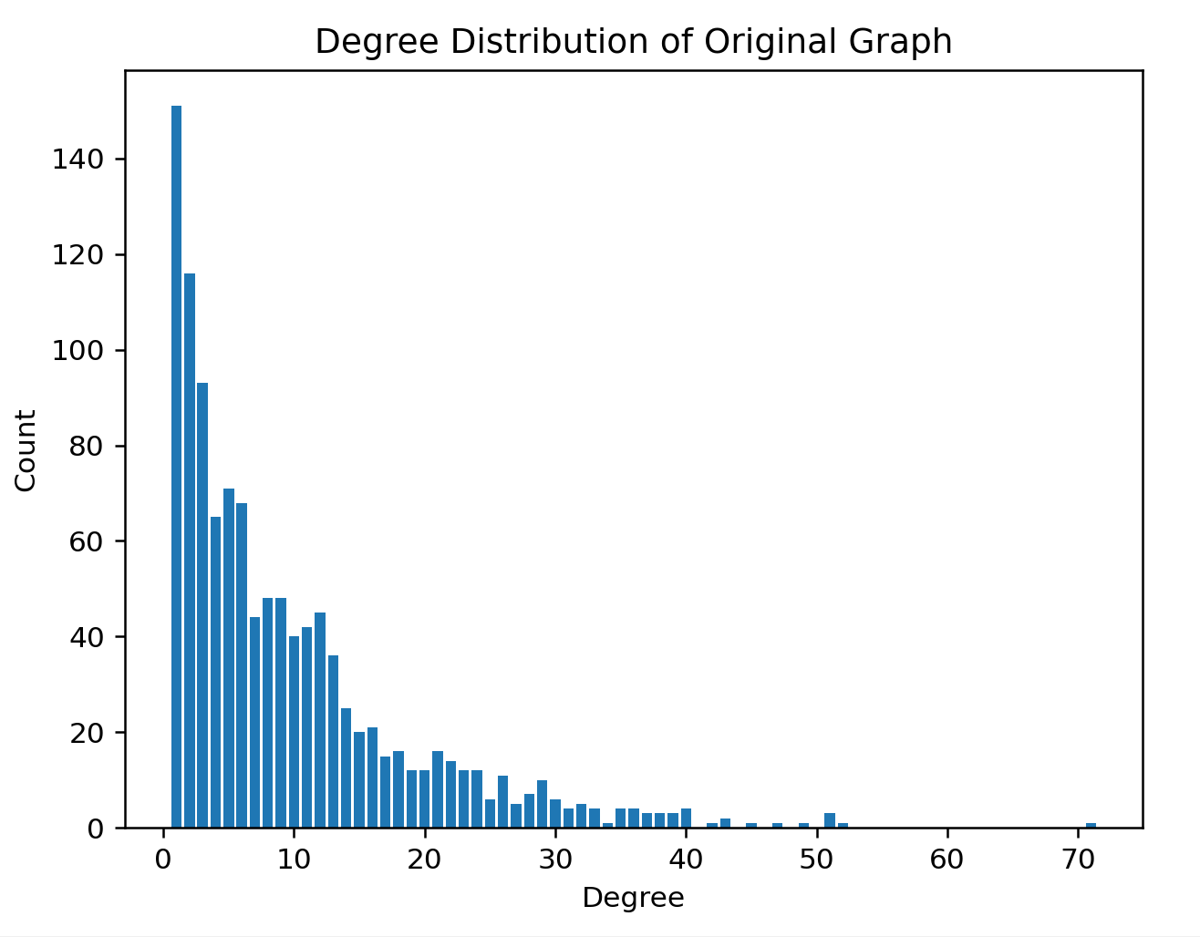
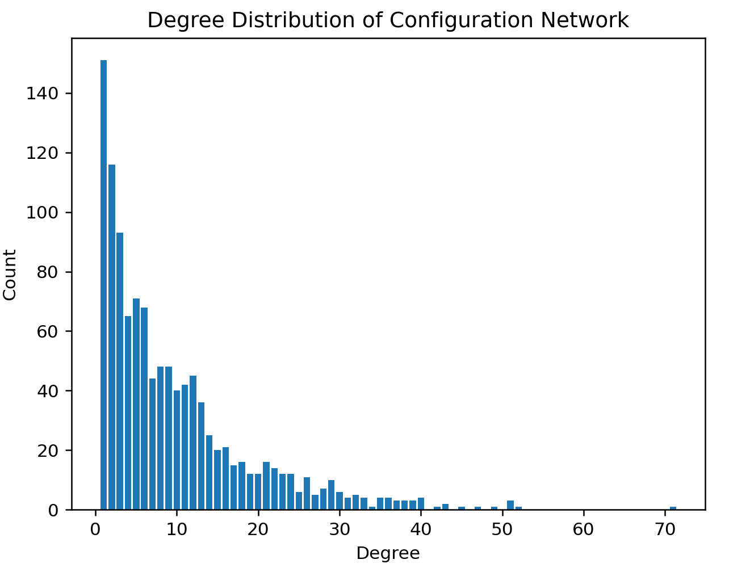
def degree_distribution_plot(G):
# 获取所有节点的度并创建Counter对象，记录每个度出现的次数
counts = Counter(deg for _, deg in G.degree)
# 找到最大的度
max_degree = max(counts.keys())
degree_counts = [0] * (max_degree + 1)
for degree, count in counts.items():
degree_counts[degree] = count
print('\nDegree Distribution:')
print(degree_counts)
# 绘制度分布直方图
plt.bar(counts.keys(), counts.values())
plt.xlabel('Degree')
plt.ylabel('Count')
plt.title('Degree Distribution of Configuration Network')
plt.show()

