Slide 1
Python Trio: Alembic, SQLAlchemy & FastAPI
A Practical Introduction to the Python Ecosystem

Slide 2

Why FastAPI?
Modern, fast, developer-friendly
Async & Blazing Fast
Auto-Generated Docs
Built on Starlette and Pydantic.
One of the fastest Python frameworks available.
Swagger UI & ReDoc out of the box.
Interactive API exploration for free.
Type Safety
Easy to Learn
Python type hints drive validation,
serialization, and editor support.
Minimal boilerplate. Intuitive decorators.
Productive from day one.

Slide 3
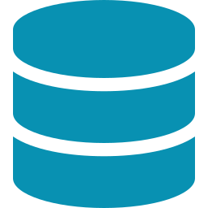
Why SQLAlchemy?
The Python SQL toolkit and ORM
Mature & Battle-Tested
ORM + Core
15+ years of production use.
The standard for Python database access.
Use high-level ORM models or drop
to raw SQL — your choice per query.
Database Agnostic
Relationship Mapping
PostgreSQL, MySQL, SQLite and more.
Switch engines without rewriting code.
Declare relationships between models.
Lazy/eager loading, cascades, joins.

Slide 4

Why Alembic?
Database migrations done right
Auto-Generate Migrations
Version Control for DB
Detects model changes and writes
migration scripts automatically.
Track every schema change.
Upgrade, downgrade, branch — like Git.
Safe Rollbacks
Built for SQLAlchemy
Downgrade to any previous revision.
Test migrations before production.
Native integration. Reads your models
directly — zero extra configuration.

Slide 5
Python Web Apps 101
Tool | Layer | Job
SQLAlchemy | Database access | Maps Python classes → database tables (ORM)
Alembic | Schema management | Tracks and applies changes to the database structure
FastAPI | HTTP layer | Exposes your data as a REST API with automatic validation

Slide 6
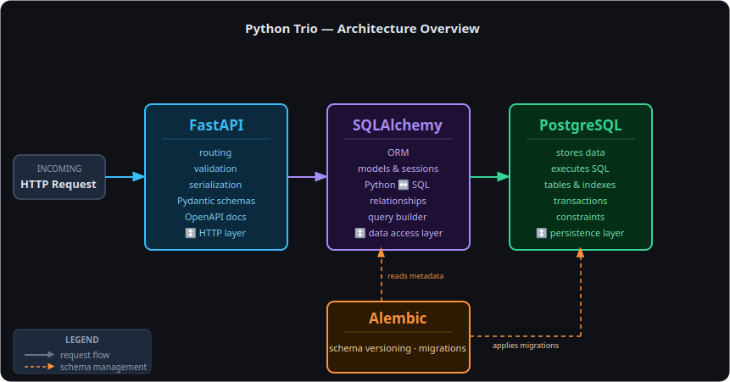
Python Web Apps 101

Slide 7
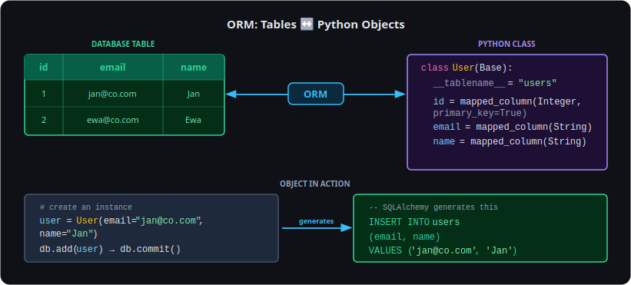
SQLAlchemy ORM: The Core Idea

Slide 8
Alembic - Installation
pip install alembic sqlalchemy psycopg2-binary
alembic init alembic
alembic.ini — main config file (database URL, log settings)
alembic/env.py — the script Alembic runs when generating or applying migrations
alembic/versions/ — empty folder where migration files will live

Slide 9
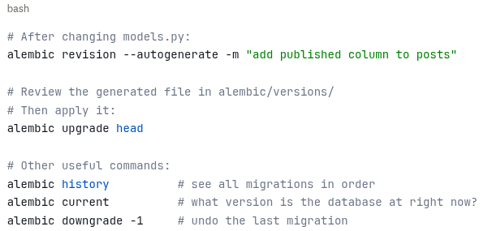
Alembic - Commands

Slide 10
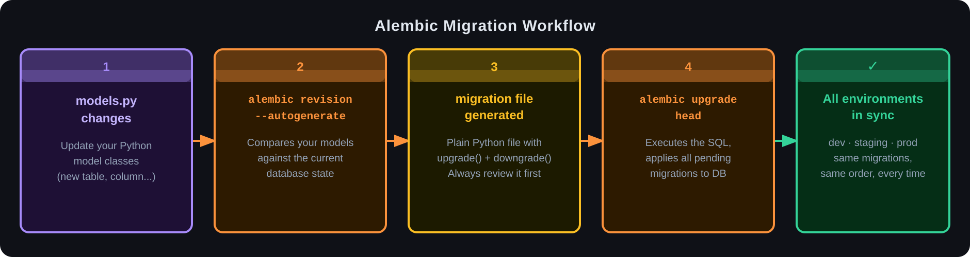
Alembic – Migration Workflow

Slide 11
Pydantic
SQLAlchemy model (models.py) ≠ Pydantic schema (schemas.py)
User ORM model UserResponse schema
→ represents a database row → represents what the API returns
→ has relationships, lazy loading → is a clean, serializable dict
→ tied to a DB session → knows nothing about the database

Slide 12
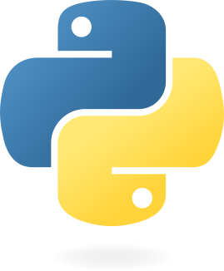
Thank You!

