Slide 1
Chapter 13: Direct Memory Access and DMA-Controlled I/O

Slide 2
Introduction
The DMA I/O technique provides direct access to the memory while the microprocessor is temporarily disabled.
This allows data to be transferred between memory and I/O at a speed limited by the speed of the memory component and the DMA controller (33 to 150 M-bytes transfer rates).
The common purposes of DMA are DRAM refresh, video displays for refreshing the screen, disk memory system write and read and also high-speed memory-to-memory transfer.

Slide 3
Introduction
DMA is designed by Intel to transfer data at the fastest rate.
It allows the device to transfer the data directly to/from memory
without any interference of the CPU.
Using a DMA controller, the device requests the CPU to hold its
data, address and control bus, so the device is free to transfer
data directly to/from the memory.
The DMA data transfer is initiated only after receiving HLDA
signal from the CPU.
Programmed I/O and Interrupt driven I/O are the alternative
methods of data transferring against Direct Memory Access(DMA)

Slide 4
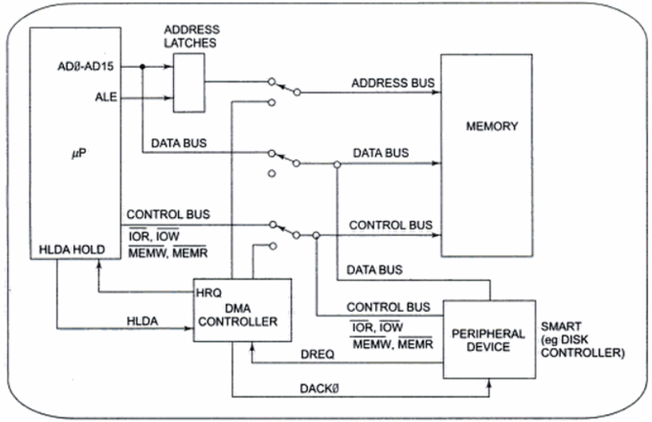
Figure: Block diagram showing how a DMA controller operates in a microcomputer system.
Ref.- Microprocessors & Interfacing by Douglas V. Hall, 2nd Edition, Pp. 348-351)

Slide 5
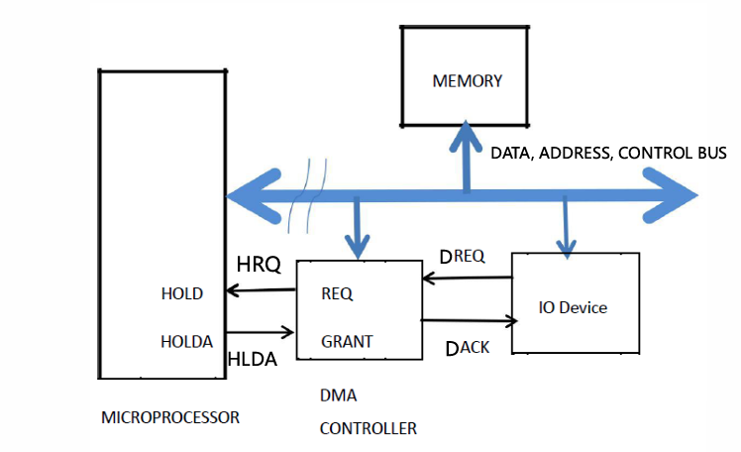
Figure: Block diagram showing how a DMA controller operates in a microcomputer system.

Slide 6
BASIC DMA OPERATION
Two control signals are used to request and acknowledge a direct memory access (DMA) transfer in the microprocessor-based system.
the HOLD pin is an input used to request a DMA action
the HLDA pin is an output that acknowledges the DMA action

Slide 7
BASIC DMA OPERATION
when the processor recognizes the hold, it stops executing software and enters hold cycles
HOLD input has higher priority than INTR or NMI
the only microprocessor pin that has a higher priority than a HOLD is the RESET pin

Slide 8
BASIC DMA OPERATION
Initially, when any device has to send data between the device and the memory, the device has to send DMA request (DRQ) to DMA controller.
The DMA controller sends Hold request (HRQ) to the CPU and waits for the CPU to assert the HLDA.
Then the microprocessor leaves the control over the data bus,
address bus, and control bus; and acknowledges the HOLD
request through HLDA signal.
Now the CPU is in HOLD state and the DMA controller has to
manage the operations over buses between the CPU, memory,
and I/O devices.

Slide 9
Basic DMA Definitions
Direct memory accesses normally occur between an I/O device and memory without the use of the microprocessor.
a DMA read transfers data from the memory to the I/O device
A DMA read causes both the MRDC and IOWC signals to activate simultaneously
A DMA write transfers data from an I/O device to memory
A DMA write causes the MWTC and IORC signals to both activate
Memory & I/O are controlled simultaneously.
The data transfer speed is determined by the speed of the memory device or a DMA controller that often controls DMA transfers.

Slide 10
THE 8237 DMA CONTROLLER
The 8237 supplies memory & I/O with control signals and memory address information during the DMA transfer.
actually a special-purpose microprocessor whose job is high-speed data transfer between memory and I/O
It has four channels, which can be used over four I/O devices.
Figure 13–3 shows the pin-out and block diagram of the 8237 programmable DMA controller.

Slide 11
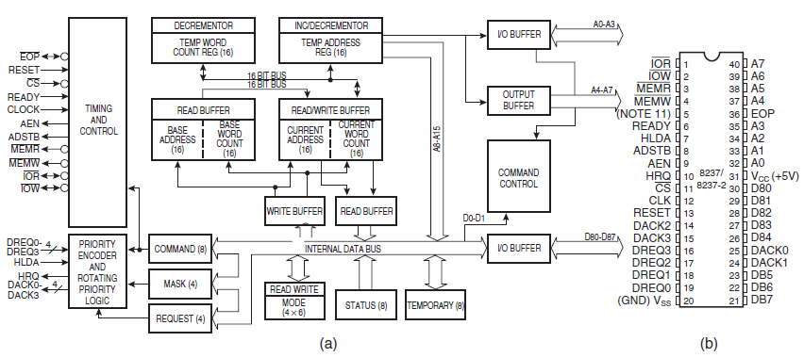
Figure 13–3 The 8237A-5 programmable DMA controller. (a) Block diagram and (b) pin-out. (Courtesy of Intel Corporation.)

Slide 12
THE 8237 DMA CONTROLLER
8237 is not a discrete component in modern microprocessor-based systems.
it appears within many system controller chip sets
8237 is a four-channel device compatible with 8086/8088, adequate for small systems.
expandable to any number of DMA channel inputs
8237 is capable of DMA transfers at rates up to 1.6M bytes per second.
each channel is capable of addressing a full 64K-byte section of memory and transfer up to 64K bytes with a single programming

Slide 13
8237 Internal Registers
CAR
The current address register holds a 16-bit memory address used for the DMA transfer.
each channel has its own current address register for this purpose
When a byte of data is transferred during a DMA operation, CAR is either incremented or decremented.
depending on how it is programmed

Slide 14
8237 Internal Registers
CWCR
The current word count register programs a channel for the number of bytes (up to 64K) transferred during a DMA action.
The number loaded into this register is one less than the number of bytes transferred.
for example, if a 10 is loaded to CWCR, then 11 bytes are transferred during the DMA action

Slide 15
8237 Internal Registers
BA and BWC
The base address (BA) and base word count (BWC) registers are used when auto-initialization is selected for a channel.
In auto-initialization mode, these registers are used to reload the CAR and CWCR after the DMA action is completed.
allows the same count and address to be used to transfer data from the same memory area

Slide 16
8237 Internal Registers
CR
The command register programs the operation of the 8237 DMA controller.
The register uses bit position 0 to select the memory-to-memory DMA transfer mode.
memory-to-memory DMA transfers use DMA channel 0 to hold the source address
DMA channel 1 holds the destination address

Slide 17
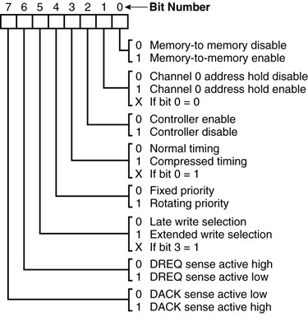
Figure: 8237A-5 command register. (Courtesy of Intel Corporation.)

Slide 18
8237 Internal Registers
MR
The mode register programs the mode of operation for a channel.
Each channel has its own mode register as selected by bit positions 1 and 0.
remaining bits of the mode register select operation, auto-initialization, increment/decrement, and mode for the channel

Slide 19
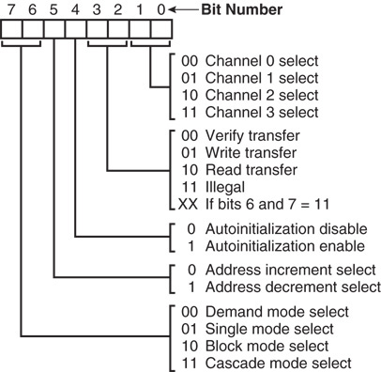
Figure 13–5 8237A-5 mode register. (Courtesy of Intel Corporation.)

Slide 20
8237 Internal Registers
BR
The bus request register is used to request a DMA transfer via software.
very useful in memory-to-memory transfers, where an external signal is not available to begin the DMA transfer

Slide 21
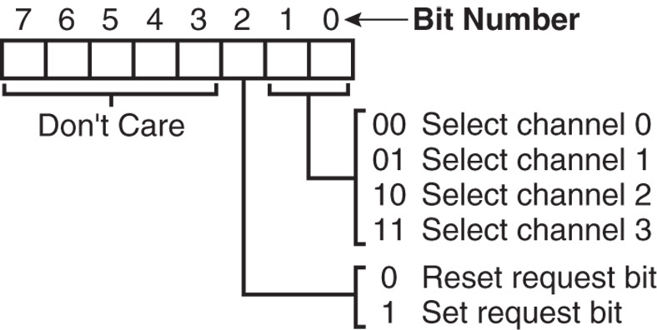
Figure 13–6 8237A-5 request register. (Courtesy of Intel Corporation.)

Slide 22
8237 Internal Registers
MRSR
The mask register set/reset sets or clears the channel mask.
if the mask is set (1), the channel is disabled
the RESET signal sets all channel masks to disable them

Slide 23
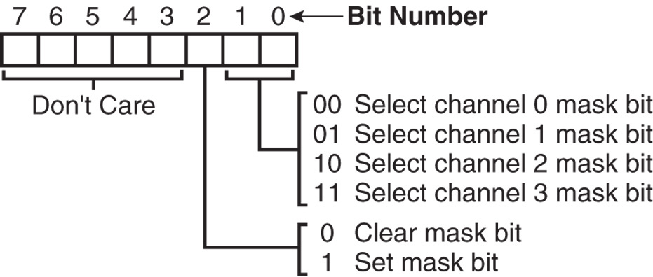
Figure 13–7 8237A-5 mask register set/reset mode. (Courtesy of Intel Corporation.)

Slide 24
8237 Internal Registers
MSR
The mask register clears or sets all of the masks with one command instead of individual channels, as with the MRSR.

Slide 25
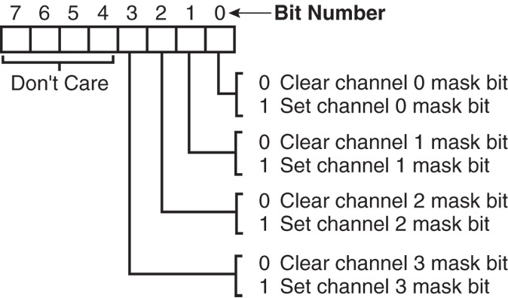
Figure 13–8 8237A-5 mask register. (Courtesy of Intel Corporation.)

Slide 26
8237 Internal Registers
SR
The status register shows status of each DMA channel. The TC bits indicate if the channel has reached its terminal count (transferred all its bytes).
When the terminal count is reached, the DMA transfer is terminated for most modes of operation.
the request bits indicate whether the DREQ input for a given channel is active

Slide 27
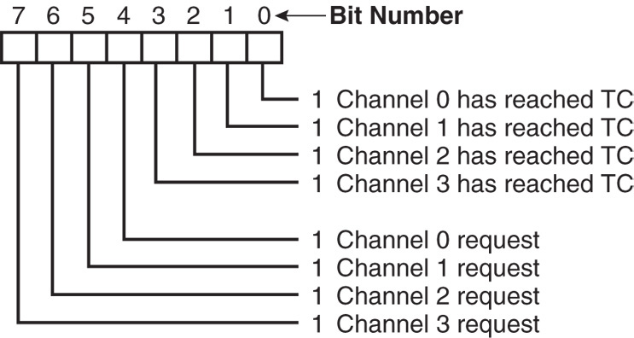
Figure 13–9 8237A-5 status register. (Courtesy of Intel Corporation.)

Slide 28
Software Commands
Three software commands are used to control the operation of the 8237.
These commands do not have a binary bit pattern, as do various control registers within the 8237.
a simple output to the correct port number enables the software command
Fig 13–10 shows I/O port assignments that access all registers and the software commands.

Slide 29
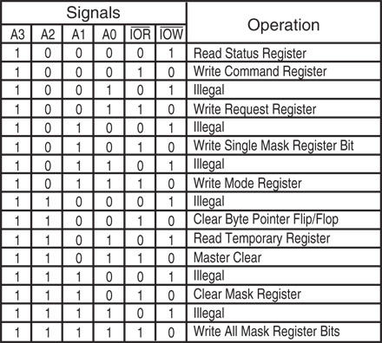
Figure 13–10 8237A-5 command and control port assignments. (Courtesy of Intel Corporation.)

Slide 30
Software Commands
Master clear
Acts exactly the same as the RESET signal to the 8237.
as with the RESET signal, this command disables all channels
Clear mask register
Enables all four DMA channels.

Slide 31
Software Commands
Clear the first/last flip-flop
Clears the first/last (F/L) flip-flop within 8237.
The F/L flip-flop selects which byte (low or high order) is read/written in the current address and current count registers.
if F/L = 0, the low-order byte is selected
if F/L = 1, the high-order byte is selected
Any read or write to the address or count register automatically toggles the F/L flip-flop.

Slide 32
Programming the Address and Count Registers
Figure 13–11 shows I/O port locations for programming the count and address registers for each channel.
The state of the F/L flip-flop determines whether the LSB or MSB is programmed.
if the state is unknown, count and address could be programmed incorrectly
It is important to disable the DMA channel before the address and count are programmed.

Slide 33
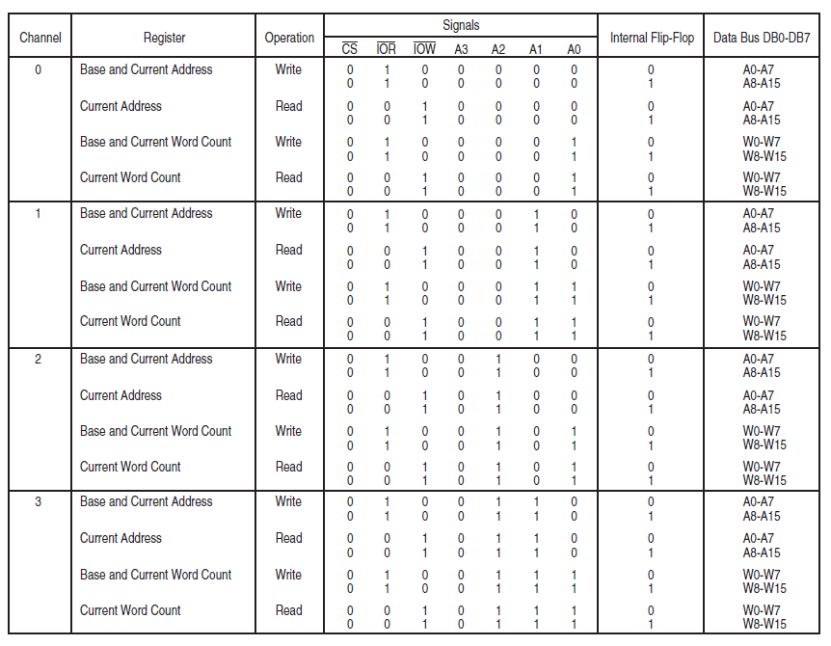
Figure 13–11 8237A-5 DMA channel I/O port addresses. (Courtesy of Intel Corporation.)

Slide 34
Programming the 8237
Four steps are required to program the 8237:
(1) The F/L flip-flop is cleared using a clear F/L command
(2) the channel is disabled
(3) LSB & MSB of the address are programmed
(4) LSB & MSB of the count are programmed
Once these four operations are performed, the channel is programmed and ready to use.
additional programming is required to select the mode of operation before the channel is enabled and started

Slide 35
The 8237 Connected to the 80X86
The address enable (AEN) output of 8237 controls the output pins of the latches and outputs of the 74LS257 (E).
during normal operation (AEN=0), latches A & C and the multiplexer (E) provide address bus bits A₁₉–A₁₆ and A₇–A₀
See Figure 13-12.

Slide 36
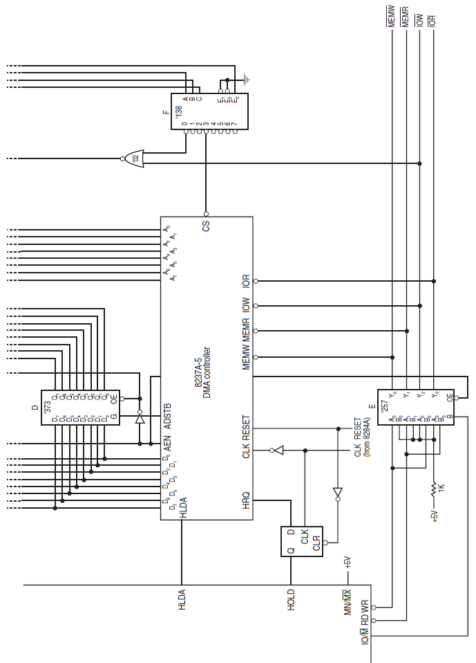
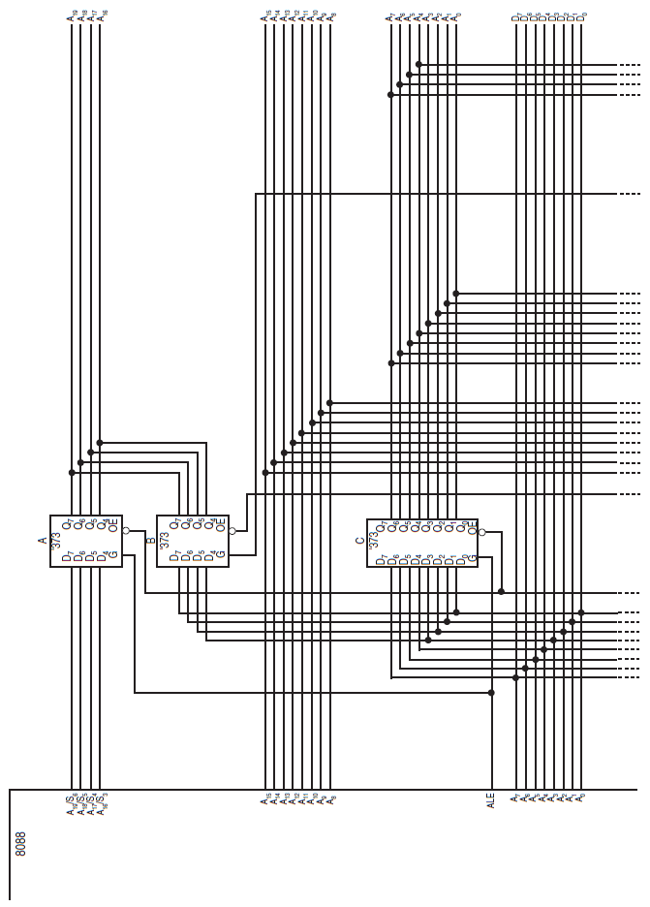
Figure 13–12 Complete 8088 minimum mode DMA system.

Slide 37
The 8237 Connected to the 80X86
The multiplexer provides the system control signals as long as the 80X86 is in control of the system.
during a DMA action (AEN=1), latches A & C are disabled along with the multiplexer (E)
latches D and B now provide address bits A₁₉–A₁₆ and A₁₅–A₈
Address bus bits A₇–A₀ are provided directly by the 8237 and contain part of the DMA transfer address.
The DMA controller provides control signals.

Slide 38
The 8237 Connected to the 80X86 (Summary)
Normal Operation
AEN=0,
A, C, E ON
A A₁₉-A₁₆
Directly A₁₅-A₈
C A₇-A₀
DMA Operation
AEN=1,
B, D ON
B A₁₉-A₁₆
D A₁₅-A₈
Directly A₇-A₀

Slide 39
An 8086 microprocessor system uses the 8237A DMA controller to transfer a block of data. The DMA controller is connected in I/O mapped I/O space with the following port assignments:
Channel 0 Address Register: 70H
Channel 1 Address Register: 72H
Channel 1 Count Register: 73H
Mode Register: 7BH
Command Register: 78H
Request Register: 79H
Single Mask Register: 7FH
Page Latch (A16–A19): 10H
Clear First/Last Flip-Flop: 7CH
The system must transfer 512 bytes of data from I/O port (address 40H) to a memory buffer starting at 2000:1000H. Assume incrementing addresses and single transfer mode.
Question:
Describe step by step how the microprocessor programs the DMA controller registers before the transfer begins.
After programming, explain how the actual transfer is carried out by the DMA controller until all bytes are moved.

Slide 40
Question:
Describe step by step how the microprocessor programs the DMA controller registers before the transfer begins.
After programming, explain how the actual transfer is carried out by the DMA controller until all bytes are moved.

Slide 41
Memory-to-Memory Transfer with the 8237
Memory-to-memory transfer is much more powerful
8237 requires only 2.0 µs per byte, which is over twice as fast as a software data transfer.
This is not true if an 80386, 80846, or Pentium is in use in the system.

Slide 42
Sample Memory-to-Memory DMA Transfer
Suppose contents of memory locations 10000H–13FFFH are to be transferred to locations 14000H–17FFFH.
accomplished with the DMA controller
Example 13–1 shows the software required to initialize the 8237 and program latch B in Figure 13–12 for this DMA transfer.

Slide 43
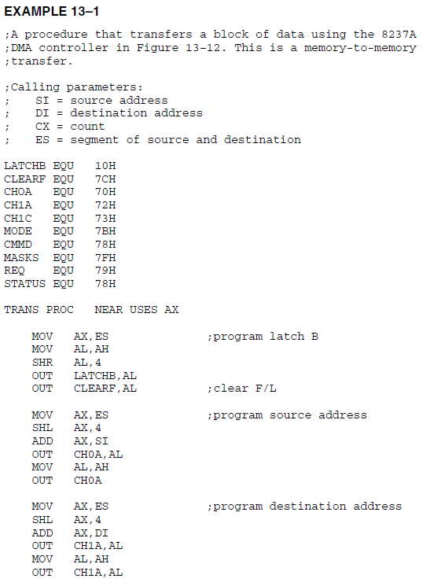

Slide 44
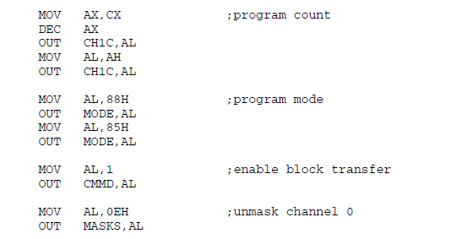
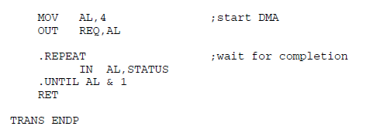
(Cont.)

Slide 45
Thank You

