Slide 1


Computer Security
Introduction

Slide 2
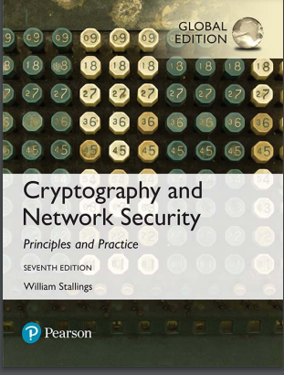
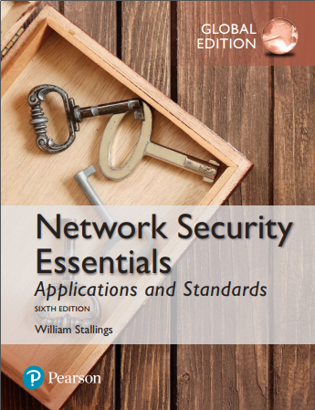

Text Book
Textbook
Cryptography and Network Security: Principles and Practice, Global Edition
Ref
Network Security: Private Communication in a Public World
Charlie Kaufman, Rad ia Perlman, Mike Speciner, Michael Speciner, Prentice Hall
Network Security Essentials Applications and Standards- William Stalling-Applications and Standards

Slide 3
Learning Objectives
Describe the key security requirements of confidentiality, integrity, and availability
Discuss the types of security threats and attacks
Summarize the functional requirements for computer security
Describe the X.800 security architecture for OSI
Cryptography applications

Slide 4
Introduction
Humans have been in conflict since prehistoric times.
In The Art of War 1, Sun Tzu says “The entire art of war is based on deception”.

Slide 5
History – Pre-Renaissance
Paper was first introduced to Europe by Crusaders around 1200 A.D.
Information was stored using tokens, tablets, knotted strings, notched sticks or handwritten parchment.

Slide 6
History – Pre-Renaissance
Perhaps the best illustration of the importance of information security to ancient societies is the relatively advanced state of cryptography and steganography, technologies devoted to keeping information secret, when compared to the other technologies available for computing and communication.
Cryptography is the science of writing in codes that are hard to decipher, and steganography is the art of hiding information to make it hard to detect.
In Rome, Julius Caesar used a simple substitution cipher to hide information from his enemies
During Abbasid caliphate [750 A.D], instruction to administrators explained how to use substitution ciphers. Muslim texts of that era explain how frequency counting can easily break substitution ciphers.

Slide 7
History – Pre-Renaissance
Even more effort was devoted to finding tools for steganography. Recorded ancient approaches for information hiding include
Texts written on shaved skulls that were later covered by letting hair grow (Greece),
Invisible inks (Rome),
Pin pricks placed above letters in a text to indicate letters in a secret message (Greece),
Messages hidden in images and hieroglyphics (Egypt), and
Messages written on a thin sheet, rolled into a wax ball, and hidden or swallowed (China).

Slide 8
History – Renaissance to World War I
The Renaissance was a period of renewed intellectual activity in Europe starting in the 14th century.
Napier’s bones used for multiplication, division, and finding square roots [1617]
Blaise Pascal produced around 50 mechanical calculators starting in 1642.
In 1800s Herman Hollerith developed a punch card tabulation system
Charles Babbage produced the first programmable machines, the difference and analytical engines, in the mid-1800s
Poly-alphabetic solution ciphers

Slide 9
History –World War II
During WWII, German cryptographers secured their communications using the Enigma encryption
The Japanese had a cipher device that was their equivalent to Enigma. It was code-named Purple.

Slide 10
History –Cold War
The new availability of computers allowed the science of cryptography to make major advances.
In the United States, the National Security Agency (NSA) is in charge of cryptographic research for the United States government
Cryptography also became available for civilian use.
In the 1970s the U.S. National Bureau of Standards4, with NSA approval, agreed to the release of the Data Encryption Standard (DES) with a 56-bit key-space.
The development of public key cryptography is a major step towards solving the problem of key distribution

Slide 11
History –Cold War
The new availability of computers allowed the science of cryptography to make major advances.
In the United States, the National Security Agency (NSA) is in charge of cryptographic research for the United States government
Cryptography also became available for civilian use.
In the 1970s the U.S. National Bureau of Standards4, with NSA approval, agreed to the release of the Data Encryption Standard (DES) with a 56-bit key-space.
The development of public key cryptography is a major step towards solving the problem of key distribution

Slide 12
History – The Modern Era
Computers!
Examples
Lucifer
Rijndael
RSA
ElGamal

Slide 13
Organized Crime and Botnets
Current cybercrime technologies and techniques include
botnets – networks of compromised machines,
spam – unsolicited e-mail advertisements, usually fraudulent,
phishing – attempts to fraudulently collect sensitive personal information,
pharming – redirecting web traffic to a fraudulent site,
identity theft and identity fraud – fraudulent use of personal information,
cross site scripting – inserting script commands into another’s website,
cross site request forgery – tricking a user’s browser to making requests on another party’s website, • underground forums, and
money laundering.

Slide 14
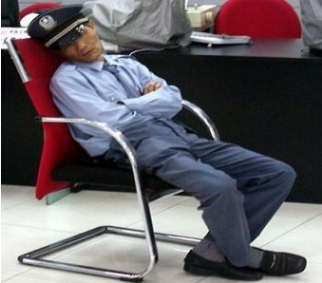
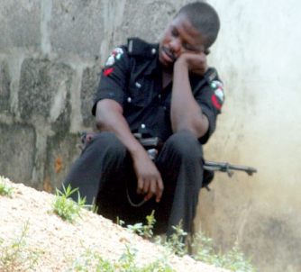
What is Security?
Security according to two boys of 10 years old-

Slide 15

What is Security?
Security According to Junior High School ICT teacher-

Slide 16

What is Security?
There is no clear cut definition.

Slide 17
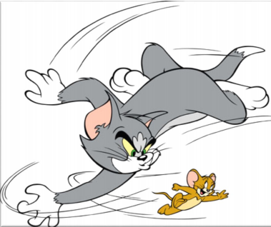
What is Security?
Security is a process, not an end state

Slide 18
Computer Security Concepts
Before the widespread use of data processing equipment, the security of information valuable to an organization was provided primarily by physical and administrative means
With the introduction of the computer, the need for automated tools for protecting files and other information stored on the computer became evident
Another major change that affected security is the introduction of distributed systems and the use of networks and communications facilities for carrying data between terminal user and computer and between computers

Slide 19
Computer and Internet Security
Computer security
The generic name for the collection of tools designed to protect data and to thwart hackers
Internet security
Consists of measures to, deter, prevent, detect and correct security violations that involve the transmission of information

Slide 20
What security is about in general?
Security is about protection of assets
D. Gollmann, Computer Security, Wiley
Need
Prevention
take measures that prevent your assets from being damaged (or stolen)
Detection
take measures so that you can detect when, how, and by whom an asset has been damaged
Reaction
take measures so that you can recover your assets

Slide 21
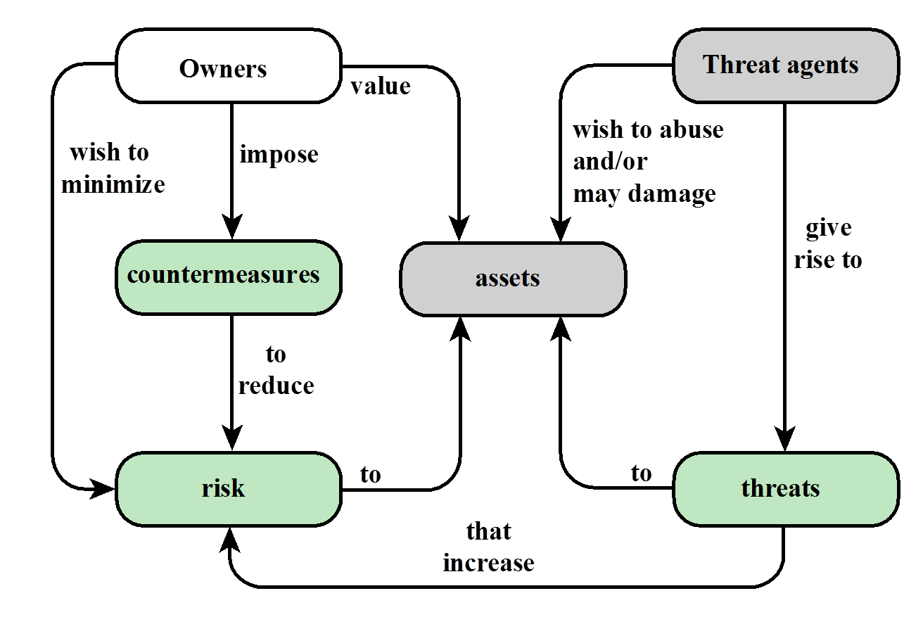
Relationships among the security Concepts

Slide 22
Real world example
Prevention
locks at doors, window bars, secure the walls around the property, hire a guard
Detection
missing items, burglar alarms, closed circuit TV
Reaction
attack on burglar (not recommended ☺), call the police, replace stolen items, make an insurance claim

Slide 23
Information security in past & present
Traditional Information Security
keep the cabinets locked
put them in a secure room
human guards
electronic surveillance systems
in general: physical and administrative mechanisms
Modern World
Data are in computers
Computers are interconnected
Data/ Computer and Network Security-> Cyber Security
Notes:
Traditionally information security provided by physical (eg. rugged filing cabinets with locks) and administrative mechanisms (eg. Personnel screening procedures during hiring process).
Growing computer use implies a need for automated tools for protecting files and other information stored on it.
This is especially the case for a shared system, such as a time-sharing system, and even more so for systems that can be
accessed over a public telephone network, data network, or the Internet.

Slide 24
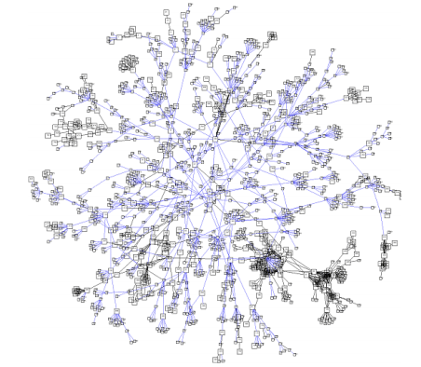
Definition
Cyber space: Cyberspace is "the environment in which communication over computer networks occurs.“
And almost everybody in one way or the other is connected to it
Cyber security: also referred to as information technology security, focuses on protecting computers, networks, programs and data from unintended or unauthorized access, change or destruction.
https://www.itu.int/en/ITU-D/Cybersecurity/Documents/Introduction%20to%20the%20Concept%20of%20IT%20Security.pdf
Notes:
Traditionally information security provided by physical (eg. rugged filing cabinets with locks) and administrative mechanisms (eg. Personnel screening procedures during hiring process).
Growing computer use implies a need for automated tools for protecting files and other information stored on it.
This is especially the case for a shared system, such as a time-sharing system, and even more so for systems that can be
accessed over a public telephone network, data network, or the Internet.

Slide 25
Definition
Four domains of cybersecurity: a risk-based systems approach to cyber decisions
https://link.springer.com/article/10.1007/s10669-013-9484-z
Notes:
Traditionally information security provided by physical (eg. rugged filing cabinets with locks) and administrative mechanisms (eg. Personnel screening procedures during hiring process).
Growing computer use implies a need for automated tools for protecting files and other information stored on it.
This is especially the case for a shared system, such as a time-sharing system, and even more so for systems that can be
accessed over a public telephone network, data network, or the Internet.

Slide 26
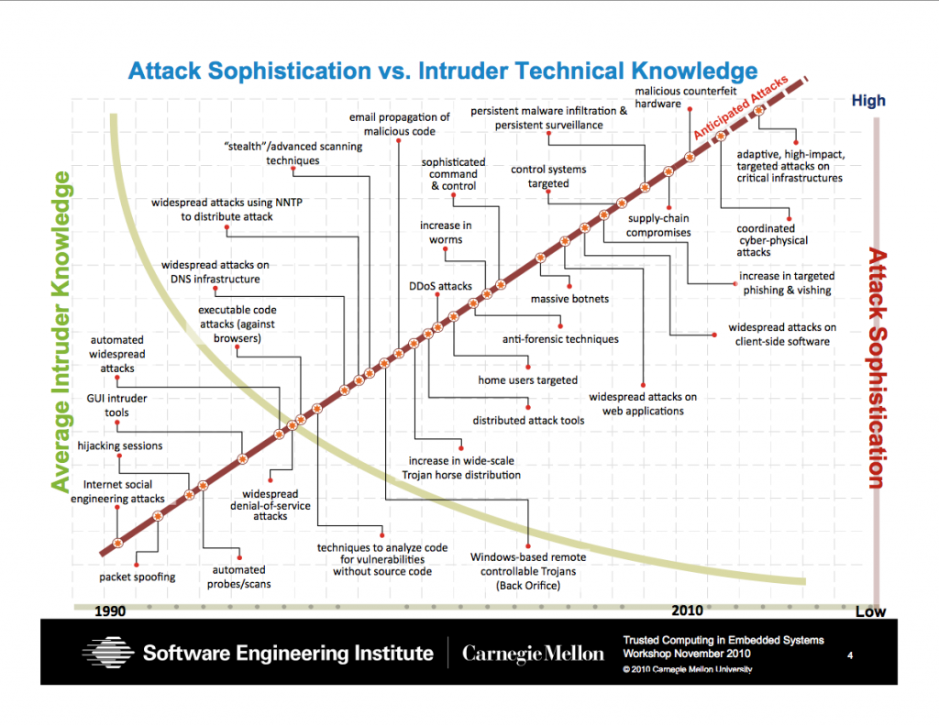
Security Trends
Skill and knowledge required to mount an attack
Notes:
Discussion: Attacks became more sophisticated to find out and more automated so that any kid can mount.

Slide 27
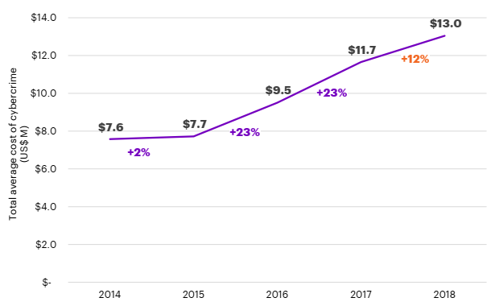
The global average cost of cyber crime/attacks
2018 Cost of Cyber Crime Study by Accenture*
Steeper increasing trend in the recent years
https://www.accenture.com/us-en/insights/security/cost-cybercrime-study

Slide 28
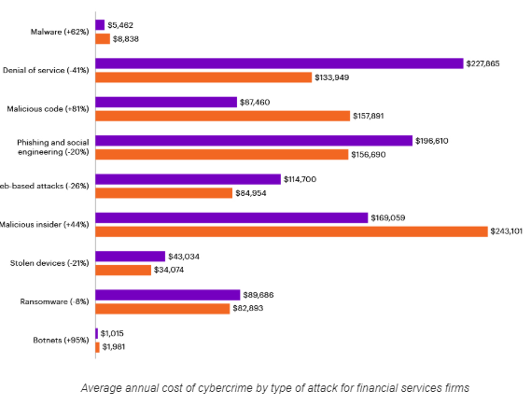
Types of cyber attacks experienced
2018 Cost of Cyber Crime Study by Accenture*
https://www.accenture.com/us-en/insights/security/cost-cybercrime-study

Slide 29
Computer Security
The NIST Computer Security Handbook defines the term computer security as:
“The protection afforded to an automated information system in order to attain the applicable objectives of preserving the integrity, availability, and confidentiality of information system resources (includes hardware, software, firmware, information/data, and telecommunications)”
NIST: National Institute of Standards and Technology
This definition introduces three key objectives that are at the heart of computer security.

Slide 30
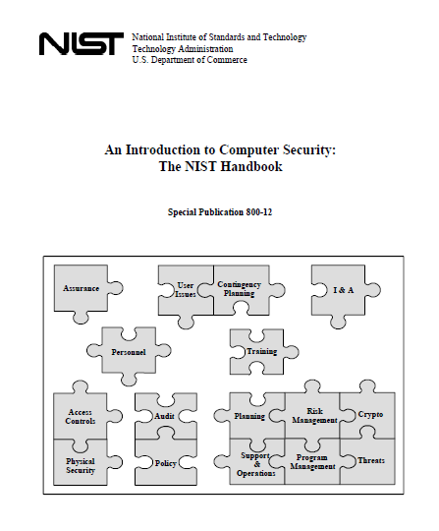
NIST

Slide 31
Computer Security Objectives
Confidentiality
Data confidentiality
Assures that private or confidential information is not made available or disclosed to unauthorized individuals
Privacy
Assures that individuals control or influence what information related to them may be collected and stored and by whom and to whom that information may be disclosed
Availability
Assures that systems work promptly and service is not denied to authorized users

Slide 32
Integrity
Data integrity
Assures that information and programs are changed only in a specified and authorized manner
System integrity
Assures that a system performs its intended function in an unimpaired manner, free from deliberate or inadvertent unauthorized manipulation of the system

Slide 33
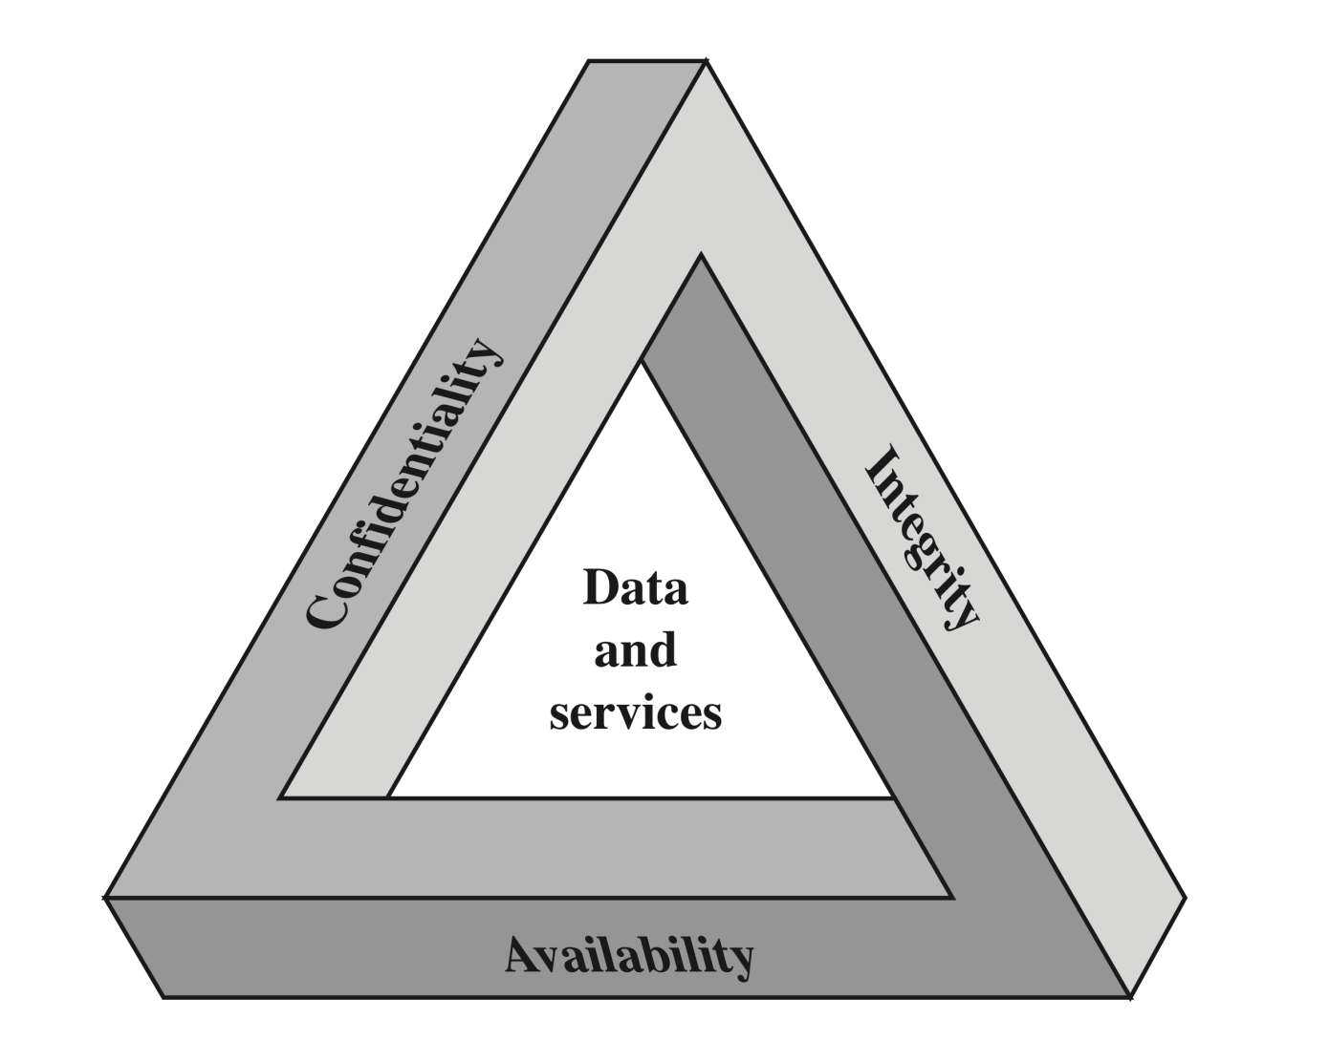
CIA Triad
The Security Requirements Triad

Slide 34
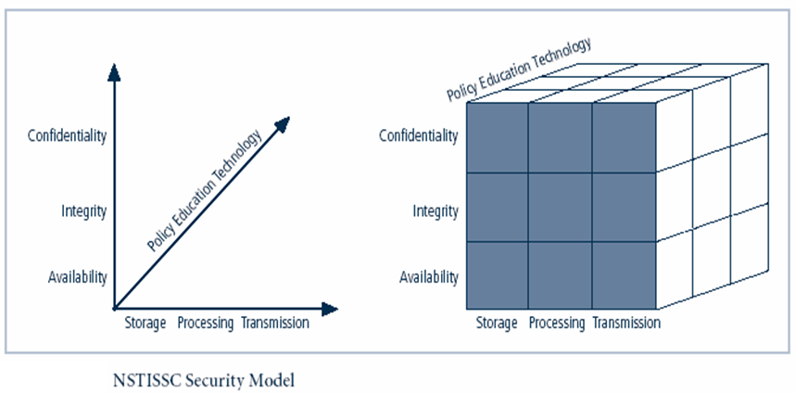
NSTISSC Security Model
‘National Security Telecommunications & Information systems security committee’ document.
It is now called the National Training Standard for Information security professionals.
Notes:
This graphic informs the fundamental approach of the chapter and can be used to illustrate the intersection of information states (x-axis), key objectives of C.I.A. (y-axis), and the three primary means to implement (policy, education, and technology).

Slide 35
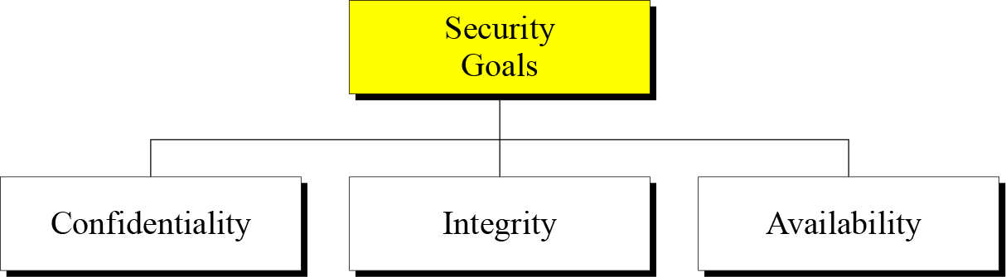

Slide 36
Confidentiality is probably the most common aspect of information security. We need to protect our confidential information. An organization needs to guard against those malicious actions that endanger the confidentiality of its information.
Integrity : Information needs to be changed constantly. Integrity means that changes need to be done only by authorized entities and through authorized mechanisms.
Availability : The information created and stored by an organization needs to be available to authorized entities. Information needs to be constantly changed, which means it must be accessible to authorized entities.

Slide 37
Possible additional concepts:
Authenticity
Verifying that users are who they say they are and that each input arriving at the system came from a trusted source
Accountability
The security goal that generates the requirement for actions of an entity to be traced uniquely to that entity

Slide 38
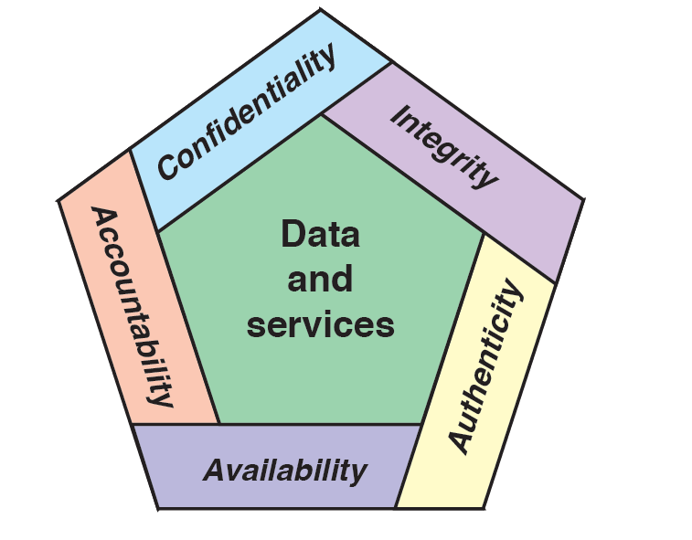
Possible additional concepts:

Slide 39
Breach of Security 3 Levels of Impact (These levels are defined in FIPS 199)
High
The loss could be expected to have a severe or catastrophic adverse effect on organizational operations, organizational assets, or individuals
Moderate
The loss could be expected to have a serious adverse effect on organizational operations, organizational assets, or individuals
Low
The loss could be expected to have a limited adverse effect on organizational operations, organizational assets, or individuals

Slide 40
Examples of Security Requirements
Confidentiality
Student grade information is an asset whose confidentiality is considered to be highly important by students
Regulated by the Family Educational Rights and Privacy Act (FERPA)
Integrity
(consistency)
Patient information stored in a database – inaccurate information could result in serious harm or death to a patient and expose the hospital to massive liability
A Web site that offers a forum to registered users to discuss some specific topic would be assigned a moderate level of integrity
An example of a low-integrity requirement is an anonymous online poll
Availability
The more critical a component or service, the higher the level of availability required
A moderate availability requirement is a public Web site for a university
An online telephone directory lookup application would be classified as a low-availability requirement
Notes:
Confidentiality
Student grade information is an asset whose confidentiality is
considered to be highly important by students. In the United States, the release of
such information is regulated by the Family Educational Rights and Privacy Act
(FERPA). Grade information should only be available to students, their parents,
and employees that require the information to do their job. Student enrollment
information may have a moderate confidentiality rating. While still covered by
FERPA, this information is seen by more people on a daily basis, is less likely to be
targeted than grade information, and results in less damage if disclosed. Directory
information (such as lists of students, faculty, or departmental lists) may be assigned
a low confidentiality rating or indeed no rating. This information is typically freely
available to the public and published on a school’s Web site.
Integrity
Several aspects of integrity are illustrated by the example of a hospital
patient’s allergy information stored in a database. The doctor should be able to
trust that the information is correct and current. Now suppose that an employee
(e.g., a nurse) who is authorized to view and update this information deliberately
falsifies the data to cause harm to the hospital. The database needs to be restored
to a trusted basis quickly, and it should be possible to trace the error back to the
person responsible. Patient allergy information is an example of an asset with a high
requirement for integrity. Inaccurate information could result in serious harm or
death to a patient and expose the hospital to massive liability.
An example of an asset that may be assigned a moderate level of integrity
requirement is a Web site that offers a forum to registered users to discuss some
specific topic. Either a registered user or a hacker could falsify some entries or deface
the Web site. If the forum exists only for the enjoyment of the users, brings
in little or no advertising revenue, and is not used for something important such
as research, then potential damage is not severe. The Web master may experience
some data, financial, and time loss.
An example of a low-integrity requirement is an anonymous online poll. Many
Web sites, such as news organizations, offer these polls to their users with very few
safeguards. However, the inaccuracy and unscientific nature of such polls are well
understood.
Availability
The more critical a component or service, the higher is the level of
availability required. Consider a system that provides authentication services for
critical systems, applications, and devices. An interruption of service results in the
inability for customers to access computing resources and for the staff to access
the resources they need to perform critical tasks. The loss of the service translates
into a large financial loss due to lost employee productivity and potential
customer loss.
An example of an asset that typically would be rated as having a moderate
availability requirement is a public Web site for a university; the Web site provides
information for current and prospective students and donors. Such a site is not a
critical component of the university’s information system, but its unavailability will
cause some embarrassment.
An online telephone directory lookup application would be classified as a low availability
requirement. Although the temporary loss of the application may be
an annoyance, there are other ways to access the information, such as a hardcopy
directory or the operator.

Slide 41

Computer Security Challenges
Security is not simple
Potential attacks on the security features need to be considered
Procedures used to provide particular services are often counter-intuitive
It is necessary to decide where to use the various security mechanisms
Requires constant monitoring
Is too often an afterthought
Security mechanisms typically involve more than a particular algorithm or protocol
Security is essentially a battle of wits between a perpetrator and the designer
Little benefit from security investment is perceived until a security failure occurs
Strong security is often viewed as an impediment to efficient and user-friendly operation
Notes:
Computer and network security is both fascinating and complex. Some of the reasons
include:
1. Security is not as simple as it might first appear to the novice. The requirements
seem to be straightforward; indeed, most of the major requirements for
security services can be given self-explanatory, one-word labels: confidentiality,
authentication, nonrepudiation, and integrity. But the mechanisms used to
meet those requirements can be quite complex, and understanding them may
involve rather subtle reasoning.
2. In developing a particular security mechanism or algorithm, one must always
consider potential attacks on those security features. In many cases, successful
attacks are designed by looking at the problem in a completely different way,
therefore exploiting an unexpected weakness in the mechanism.
3. Because of point 2, the procedures used to provide particular services are
often counterintuitive. Typically, a security mechanism is complex, and it is not
obvious from the statement of a particular requirement that such elaborate
measures are needed. It is only when the various aspects of the threat are considered
that elaborate security mechanisms make sense.
4. Having designed various security mechanisms, it is necessary to decide where
to use them. This is true both in terms of physical placement (e.g., at what points
in a network are certain security mechanisms needed) and in a logical sense
[e.g., at what layer or layers of an architecture such as TCP/IP (Transmission
Control Protocol/Internet Protocol) should mechanisms be placed].
5. Security mechanisms typically involve more than a particular algorithm or
protocol. They also require that participants be in possession of some secret information
(e.g., an encryption key), which raises questions about the creation,
distribution, and protection of that secret information. There also may be a reliance
on communications protocols whose behavior may complicate the task
of developing the security mechanism. For example, if the proper functioning
of the security mechanism requires setting time limits on the transit time of a
message from sender to receiver, then any protocol or network that introduces
variable, unpredictable delays may render such time limits meaningless.
6. Computer and network security is essentially a battle of wits between a perpetrator
who tries to find holes and the designer or administrator who tries to
close them. The great advantage that the attacker has is that he or she need
only find a single weakness, while the designer must find and eliminate all
weaknesses to achieve perfect security.
7. There is a natural tendency on the part of users and system managers to
perceive little benefit from security investment until a security failure occurs.
8. Security requires regular, even constant, monitoring, and this is difficult in
today’s short-term, overloaded environment.
9. Security is still too often an afterthought to be incorporated into a system after
the design is complete rather than being an integral part of the design process.
10. Many users (and even security administrators) view strong security as an
impediment to efficient and user-friendly operation of an information
system or use of information.
The difficulties just enumerated will be encountered in numerous ways as we
examine the various security threats and mechanisms throughout this book.

Slide 42
The OSI Security Architecture
To assess effectively the security needs of an organization and to evaluate and choose various security products and policies, the manager responsible for computer and network security needs some systematic way of defining the requirements for security and characterizing the approaches to satisfying those requirements.
ITU-T Recommendation X.800, Security Architecture for OSI, defines such a systematic approach.
The OSI security architecture is useful to managers as a way of organizing the task of providing security.
Notes:
Computer and network security is both fascinating and complex. Some of the reasons
include:
1. Security is not as simple as it might first appear to the novice. The requirements
seem to be straightforward; indeed, most of the major requirements for
security services can be given self-explanatory, one-word labels: confidentiality,
authentication, nonrepudiation, and integrity. But the mechanisms used to
meet those requirements can be quite complex, and understanding them may
involve rather subtle reasoning.
2. In developing a particular security mechanism or algorithm, one must always
consider potential attacks on those security features. In many cases, successful
attacks are designed by looking at the problem in a completely different way,
therefore exploiting an unexpected weakness in the mechanism.
3. Because of point 2, the procedures used to provide particular services are
often counterintuitive. Typically, a security mechanism is complex, and it is not
obvious from the statement of a particular requirement that such elaborate
measures are needed. It is only when the various aspects of the threat are considered
that elaborate security mechanisms make sense.
4. Having designed various security mechanisms, it is necessary to decide where
to use them. This is true both in terms of physical placement (e.g., at what points
in a network are certain security mechanisms needed) and in a logical sense
[e.g., at what layer or layers of an architecture such as TCP/IP (Transmission
Control Protocol/Internet Protocol) should mechanisms be placed].
5. Security mechanisms typically involve more than a particular algorithm or
protocol. They also require that participants be in possession of some secret information
(e.g., an encryption key), which raises questions about the creation,
distribution, and protection of that secret information. There also may be a reliance
on communications protocols whose behavior may complicate the task
of developing the security mechanism. For example, if the proper functioning
of the security mechanism requires setting time limits on the transit time of a
message from sender to receiver, then any protocol or network that introduces
variable, unpredictable delays may render such time limits meaningless.
6. Computer and network security is essentially a battle of wits between a perpetrator
who tries to find holes and the designer or administrator who tries to
close them. The great advantage that the attacker has is that he or she need
only find a single weakness, while the designer must find and eliminate all
weaknesses to achieve perfect security.
7. There is a natural tendency on the part of users and system managers to
perceive little benefit from security investment until a security failure occurs.
8. Security requires regular, even constant, monitoring, and this is difficult in
today’s short-term, overloaded environment.
9. Security is still too often an afterthought to be incorporated into a system after
the design is complete rather than being an integral part of the design process.
10. Many users (and even security administrators) view strong security as an
impediment to efficient and user-friendly operation of an information
system or use of information.
The difficulties just enumerated will be encountered in numerous ways as we
examine the various security threats and mechanisms throughout this book.

Slide 43
ITU-T
The ITU Telecommunication Standardization Sector (ITU-T) is one of the three sectors (divisions or units) of the International Telecommunication Union (ITU); it coordinates standards for telecommunications.
The ITU-T mission is to ensure the efficient and timely production of standards covering all fields of telecommunications on a worldwide basis, as well as defining tariff and accounting principles for international telecommunication services.

Slide 44
OSI
ISO- The International Organization for Standardization (French: Organisation internationale de normalisation;) produced OSI (Open Systems Interconnection Reference Model, the OSI Reference Model, or even just the OSI Model)

Slide 45
History of OSI
In the late 1970s, two projects began independently, with the same goal: to define a unifying standard for the architecture of networking systems.
One was administered by the International Organization for Standardization (ISO), while the other was undertaken by the International Telegraph and Telephone Consultative Committee, or CCITT (the abbreviation is from the French version of the name).
These two international standards bodies each developed a document that defined similar networking models. ISO 7498, ITU-T (formerly CCITT ) standard X.200 (1984)

Slide 46
Security Services: X.800
X.800 defines a security service as a service that is provided by a protocol layer of communicating open systems and that ensures adequate security of the systems or of data transfers.
X.800 Recommendation:
1. provides a general description of security services and related mechanisms, which may be provided by the Reference Model; and
2. defines the positions within the Reference Model where the services and mechanisms may be provided.
This Recommendation extends the field of application of recommendation X.200, to cover secure communications between open systems.

Slide 47
OSI Security Architecture
ITU-T Recommendation X.800, Security Architecture for OSI describes a systematic way of defining the requirements for security and characterizing the approaches to satisfying those requirements. Focus
Security attack
Any action that compromises the security of information owned by an organization
Security mechanism
A process (or a device incorporating such a process) that is designed to detect, prevent, or recover from a security attack
Security service
A processing or communication service that enhances the security of the data processing systems and the information transfers of an organization
Intended to counter security attacks, and they make use of one or more security mechanisms to provide the service

Slide 48
IETF and RFC
The Internet Engineering Task Force (IETF) (1986) develops and promotes voluntary Internet standards, in particular the standards that comprise the Internet protocol suite (TCP/IP).
A Request for Comments (RFC) is a publication of the Internet Engineering Task Force (IETF) and the Internet Society, the principal technical development and standards-setting bodies for the Internet.
The Internet Society (ISoc) is an international, non-profit organization founded in 1992 to provide leadership in Internet related standards, education, and policy.

Slide 49
ATTACKS
The three goals of security, confidentiality, integrity, and availability can be threatened by security attacks.

Slide 50
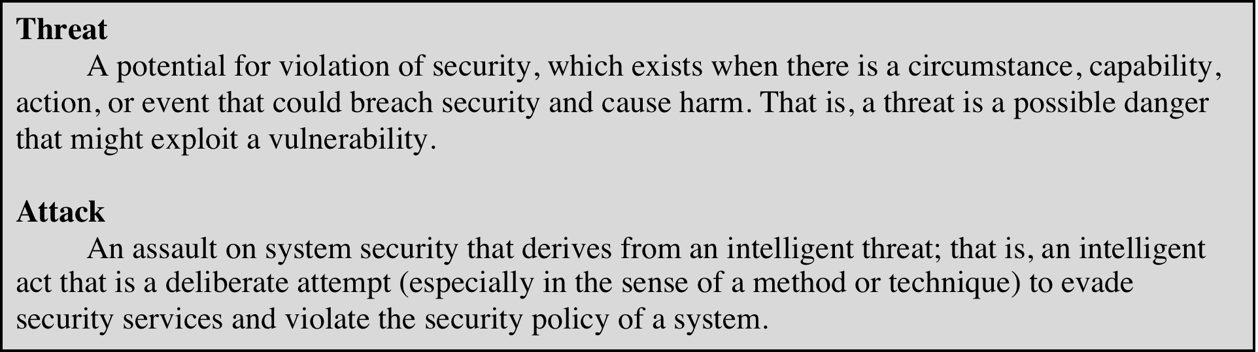
Threats and Attacks (RFC 4949)
Internet Security Glossary, Version 2
This Glossary provides definitions, abbreviations, and explanations of terminology for information system security.
Notes:
In the literature, the terms threat and attack are commonly used to mean more
or less the same thing. Table 1.1 provides definitions taken from RFC 4949, Internet
Security Glossary.

Slide 51
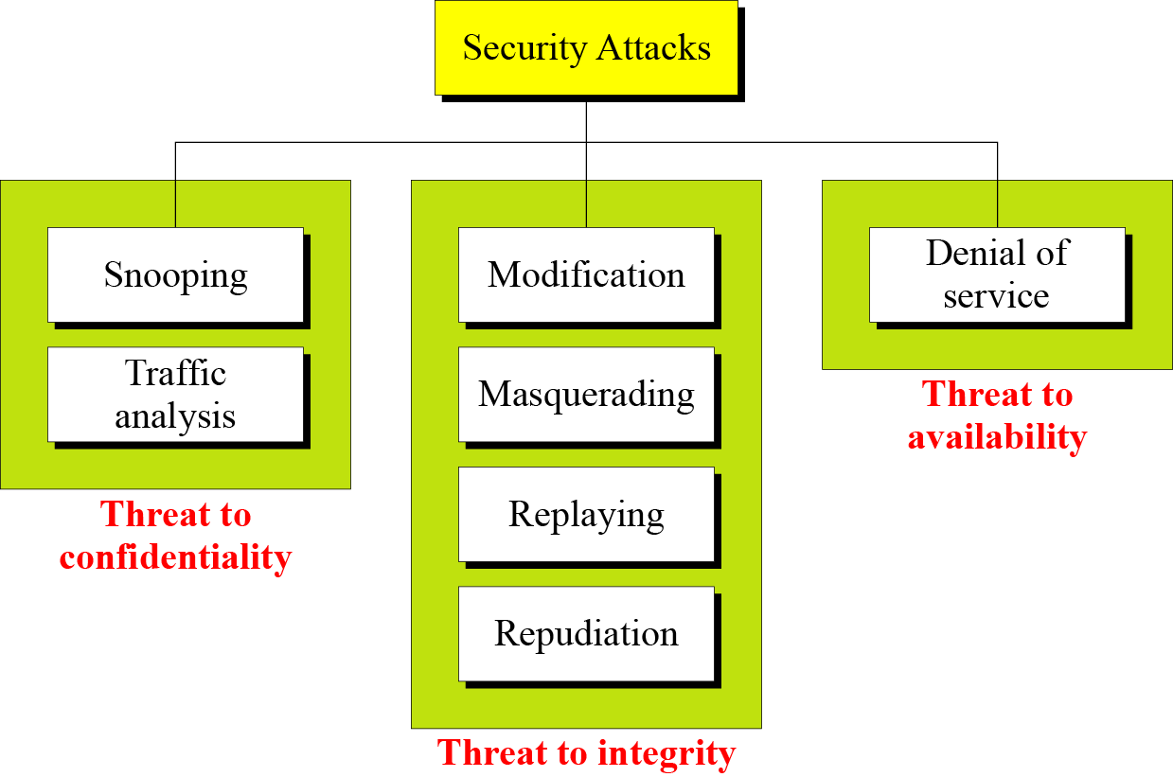

Slide 52
Security Attacks
A means of classifying security attacks, used both in X.800 and RFC 4949, is in terms of passive attacks and active attacks
A passive attack attempts to learn or make use of information from the system but does not affect system resources
An active attack attempts to alter system resources or affect their operation

Slide 53
Passive Attacks (Two types)
Are in the nature of eavesdropping on, or monitoring of, transmissions
Goal of the opponent is to obtain information that is being transmitted
Two types of passive attacks are:
The release of message contents
Traffic analysis

Slide 54
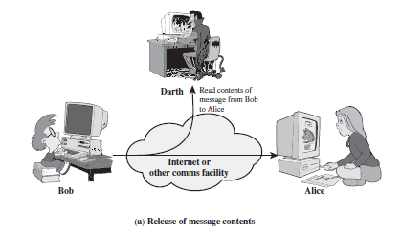
Snooping refers to unauthorized access to or interception of data.

Slide 55
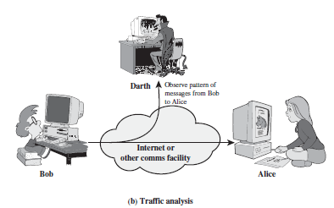
Traffic analysis refers to obtaining some other type of information by monitoring online traffic.

Slide 56
Active Attacks (4 types)
Involve some modification of the data stream or the creation of a false stream
Difficult to prevent because of the wide variety of potential physical, software, and network vulnerabilities
Goal is to detect attacks and to recover from any disruption or delays caused by them

Slide 57
Modification means that the attacker intercepts the message and changes it.
Masquerading or spoofing happens when the attacker impersonates somebody else.
Replaying means the attacker obtains a copy of a message sent by a user and later tries to replay it.
Repudiation means that sender of the message might later deny that she has sent the message; the receiver of the message might later deny that he has received the message.

Slide 58
Denial of service (DoS) is a very common attack. It may slow down or totally interrupt the service of a system.

Slide 59
Active Attacks (4 types)
Masquerade
Takes place when one entity pretends to be a different entity
Usually includes one of the other forms of active attack
Replay
Involves the passive capture of a data unit and its subsequent retransmission to produce an unauthorized effect
Denial of service
Prevents or inhibits the normal use or management of communications facilities
Some portion of a legitimate message is altered, or messages are delayed or reordered to produce an unauthorized effect
Modification of messages

Slide 60
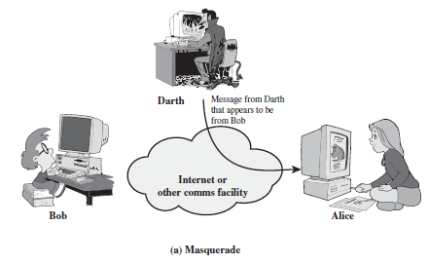
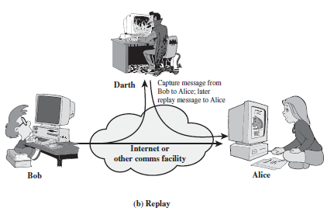

Slide 61
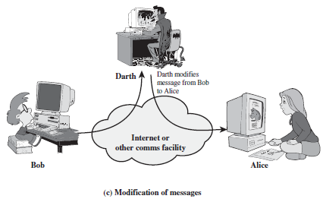
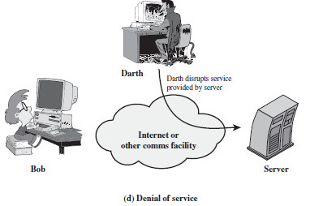

Slide 62
Security Services
to prevent or detect attacks
to enhance the security
replicate functions of physical documents
e.g.
have signatures, dates
need protection from disclosure, tampering, or destruction
notarize
record

Slide 63
Basic Security Services
Authentication
assurance that the communicating entity is the one it claims to be
peer entity authentication
mutual confidence in the identities of the parties involved in a connection
Data-origin authentication
assurance about the source of the received data
Access Control
prevention of the unauthorized use of a resource
to achieve this, each entity trying to gain access must first be identified and authenticated, so that access rights can be tailored to the individual

Slide 64
Basic Security Services
Non-Repudiation
protection against denial by one of the parties in a communication
Origin non-repudiation
proof that the message was sent by the specified party
Destination non-repudiation
proof that the message was received by the specified party

Slide 65
Relationships
among integrity, data-origin authentication and non-repudiation
Non-repudiation
Authentication
Integrity

Slide 66
Services and Mechanisms
ITU-T provides some security services and some mechanisms to implement those services. Security services and mechanisms are closely related because a mechanism or combination of mechanisms are used to provide a service.

Slide 67
Security Services
Security service defined by X.800 as:
A service provided by a protocol layer of communicating open systems and that ensures adequate security of the systems or of data transfers
Defined by RFC 4949 as:
A processing or communication service provided by a system to give a specific kind of protection to system resources

Slide 68
X.800 Service Categories
X.800 divides these services into five categories and fourteen specific services
Authentication
Access control
Data confidentiality
Data integrity
Nonrepudiation

Slide 69
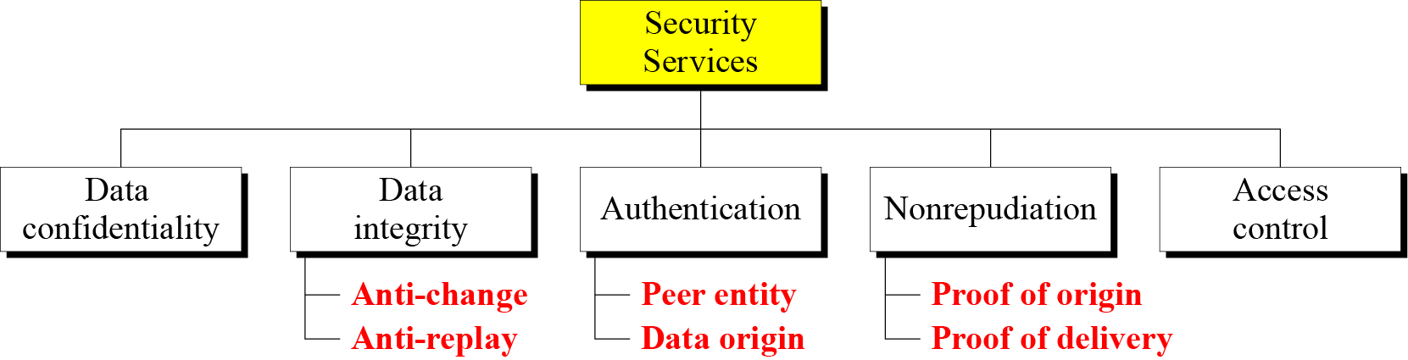

Slide 70
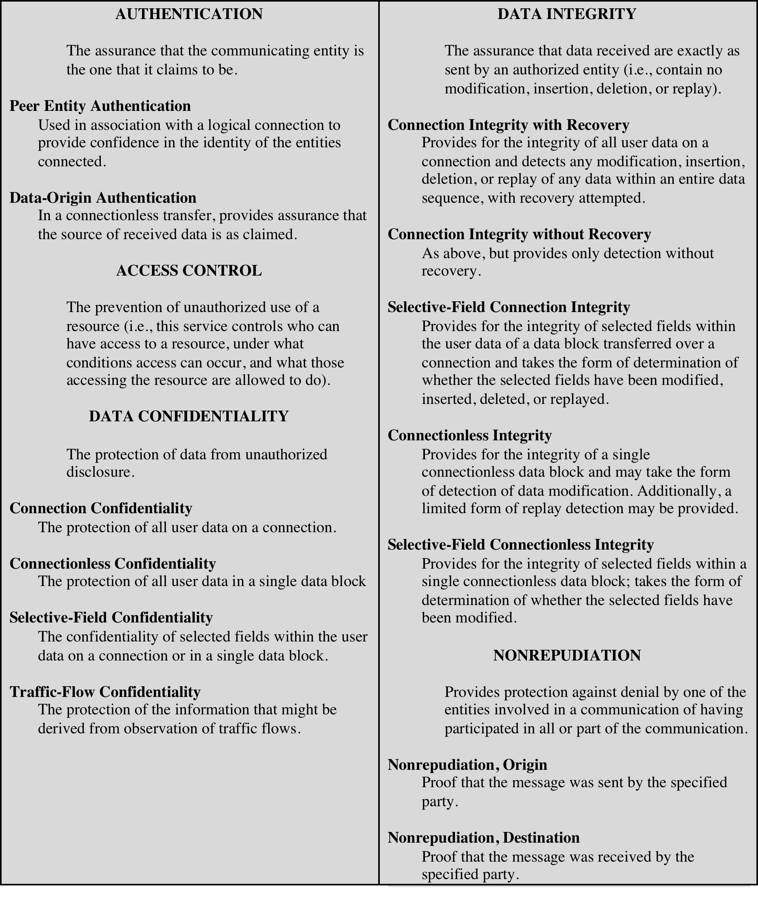
Security Services
(X.800)

Slide 71
Authentication
Concerned with assuring that a communication is authentic
In the case of a single message, assures the recipient that the message is from the source that it claims to be from.
In the case of ongoing interaction, assures the are authentic and that the connection is not interfered with in such a way that a third party can masquerade as one of the two legitimate parties
Two specific authentication services are defined in X.800:
Peer entity authentication
Data origin authentication
Two entities are considered peers if they implement the same protocol in different systems (e.g., two TCP modules in two communicating systems).

Slide 72
Access Control
The ability to limit and control the access to host systems and applications via communications links
To achieve this, each entity trying to gain access must first be identified, or authenticated, so that access rights can be tailored to the individual

Slide 73

Data Confidentiality
The protection of transmitted data from passive attacks
Broadest service protects all user data transmitted between two users over a period of time
Narrower forms of service include the protection of a single message or even specific fields within a message
The protection of traffic flow from analysis
This requires that an attacker not be able to observe the source and destination, frequency, length, or other characteristics of the traffic on a communications facility

Slide 74
Data Integrity
Can apply to a stream of messages, a single message, or selected fields within a message
Connection-oriented integrity service deals with a stream of messages and assures that messages are received as sent with no duplication, insertion, modification, reordering, or replays
A connectionless integrity service deals with individual messages without regard to any larger context and generally provides protection against message modification only

Slide 75

Nonrepudiation
Prevents either sender or receiver from denying a transmitted message
When a message is sent, the receiver can prove that the alleged sender in fact sent the message
When a message is received, the sender can prove that the alleged receiver in fact received the message

Slide 76
Availability service
Availability
The property of a system or a system resource being accessible and usable upon demand by an authorized system entity, according to performance specifications for the system
Availability service
One that protects a system to ensure its availability
Addresses the security concerns raised by denial-of-service attacks
Depends on proper management and control of system resources

Slide 77
Security Mechanisms
Security mechanisms defined in X.800:
The mechanisms are di vided into those that are implemented in a specific protocol layer, such as TCP or an application-layer protocol, and those that are not specific to any particular protocol layer or security service.

Slide 78
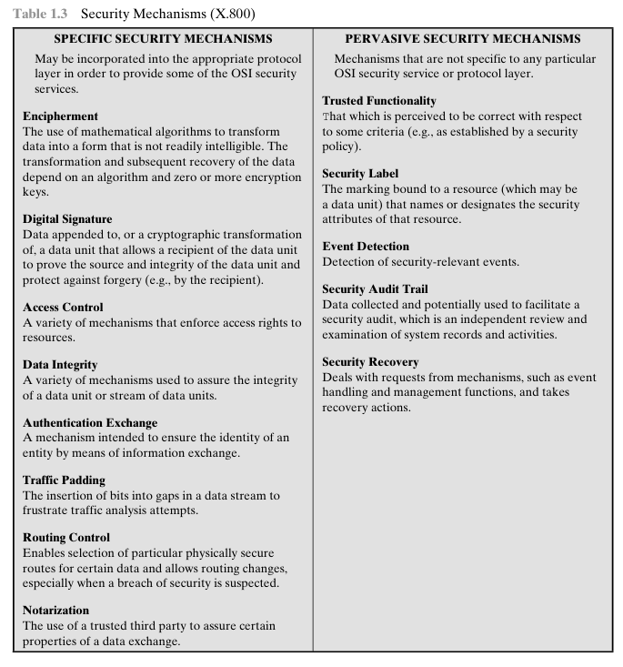
Security Mechanisms

Slide 79
Cryptographic Security Mechanisms
Encryption (a.k.a. Encipherment)
use of mathematical algorithms to transform data into a form that is not readily intelligible
keys are involved

Slide 80
Cryptographic Security Mechanisms
Message Digest
similar to encryption, but one-way (recovery not possible)
generally no keys are used
Digital Signatures and Message Authentication Codes
Data appended to, or a cryptographic transformation of, a data unit to prove the source and the integrity of the data
Authentication Exchange
ensure the identity of an entity by exchanging some information

Slide 81
Security Mechanisms
Notarization
use of a trusted third party to assure certain properties of a data exchange
Timestamping
inclusion of correct date and time within messages

Slide 82
Security Mechanisms (X.800)
Specific security mechanisms: incorporated into the appropriate protocol layer in order to provide some of the OSI security services
Encipherment
digital signatures
access controls
data integrity
authentication exchange
traffic padding
routing control
notarization

Slide 83
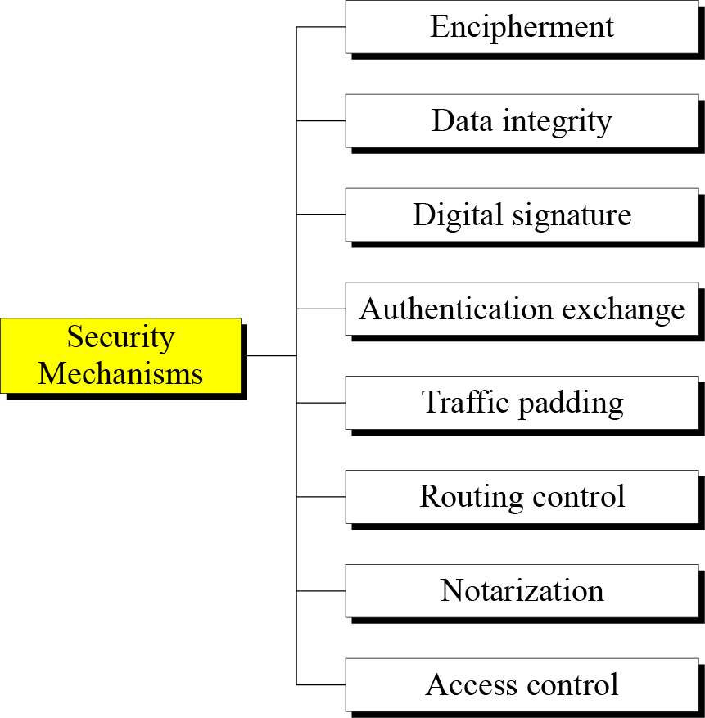

Slide 84
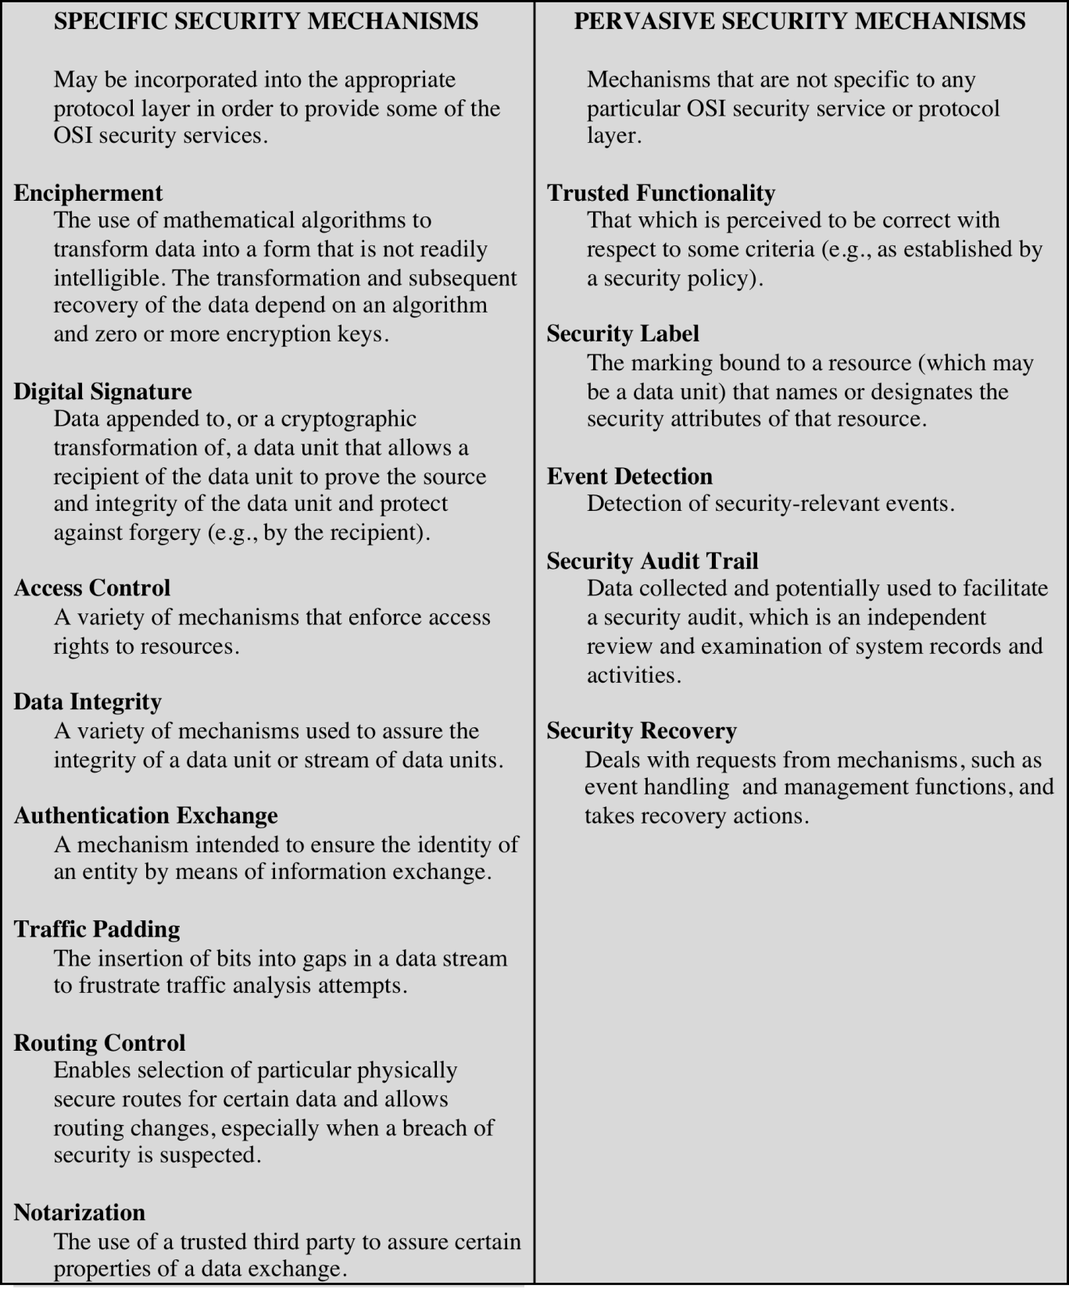
Security Mechanisms
(X.800)

Slide 85
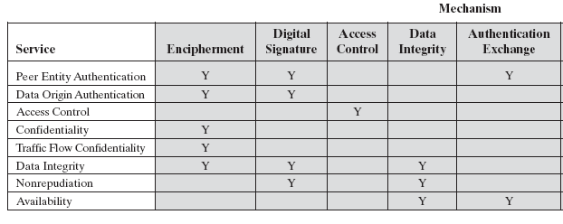
Relationship Between Security Services and Mechanisms

Slide 86
Relationship Between Security Services and Mechanisms

Slide 87
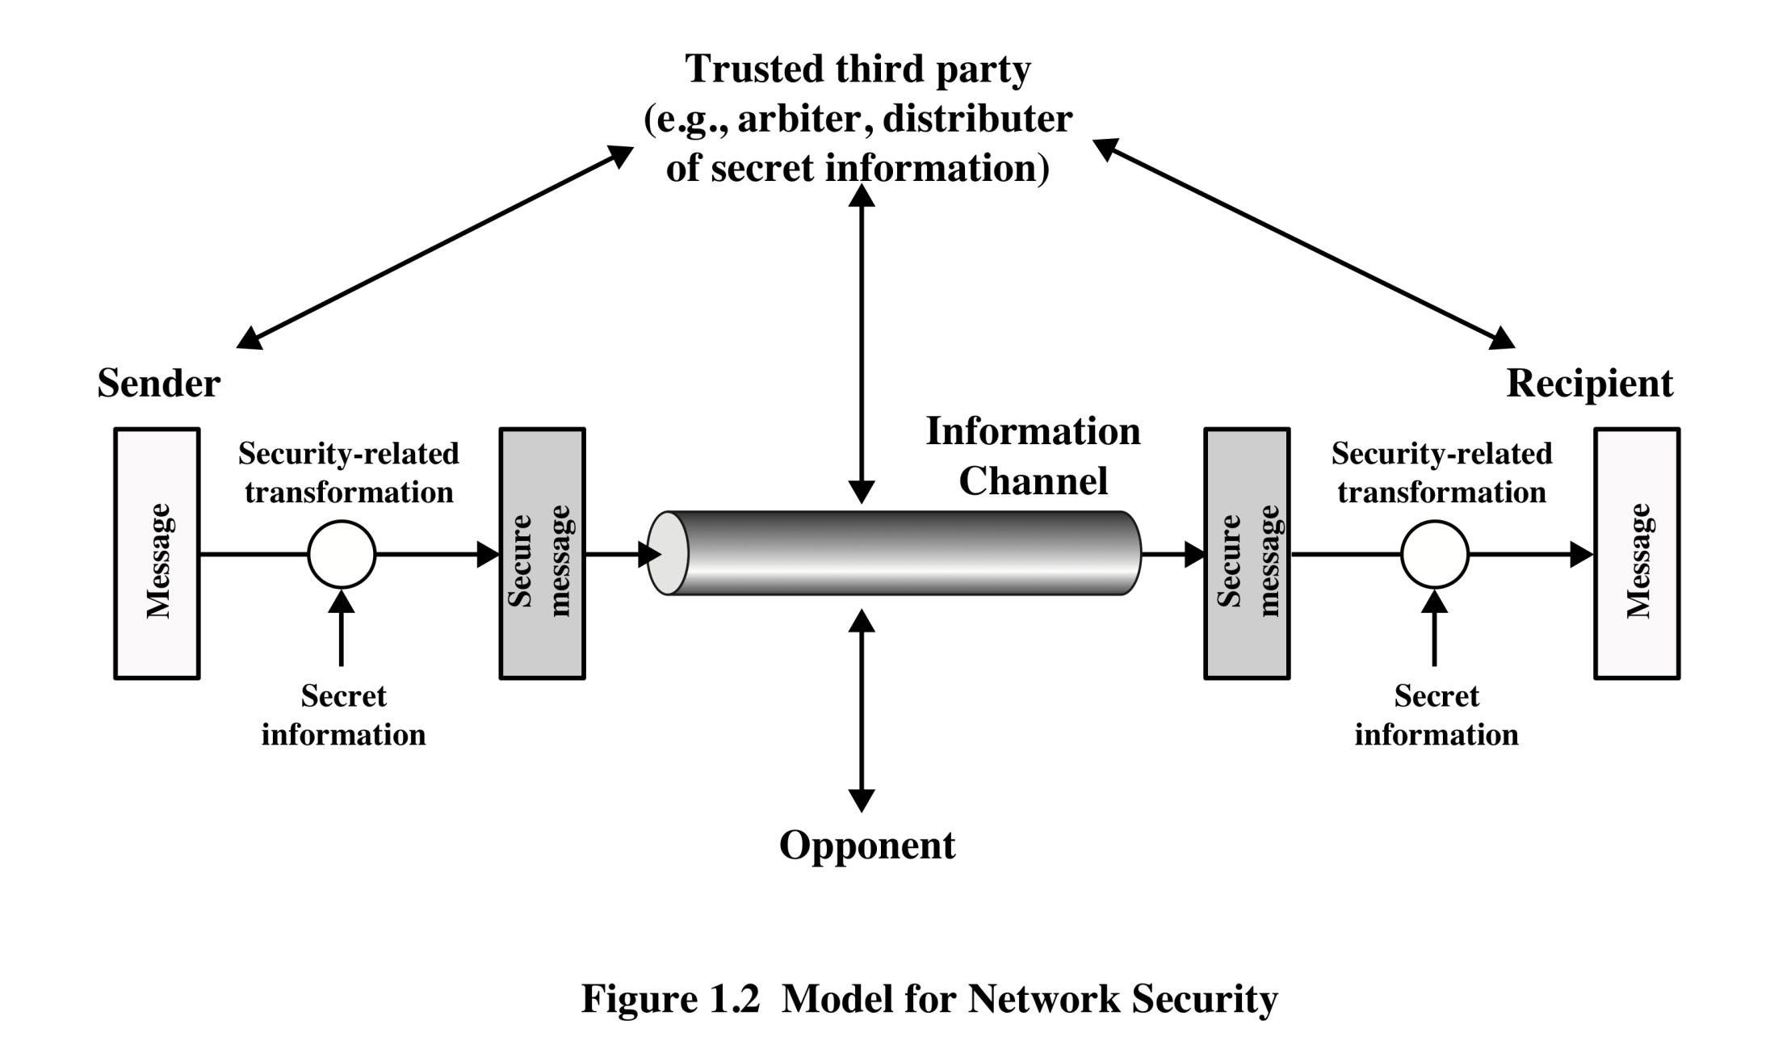
Model for Network Security

Slide 88
A Model for Network Security
Using this model requires us to:
Design a suitable algorithm for the security transformation
Generate the secret information (keys) used by the algorithm
Develop methods to distribute and share the secret information
Specify a protocol enabling the principals to use the transformation and secret information for a security service

Slide 89
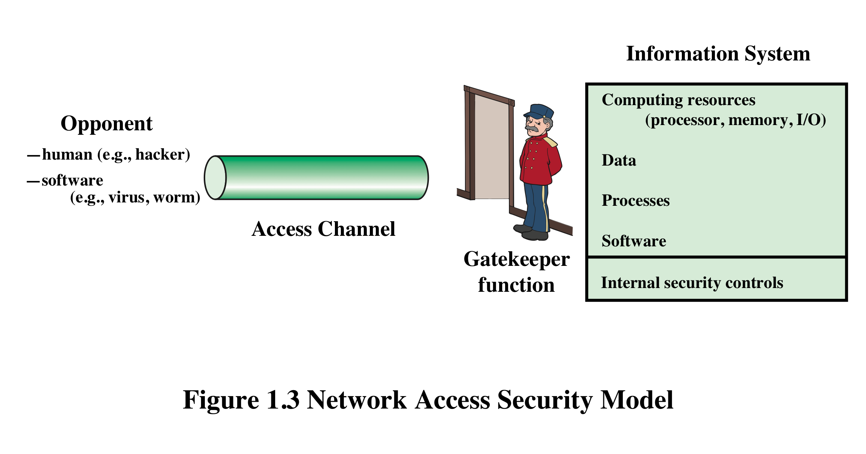
Network Access Security Model

Slide 90
Fundamental Security design Principals
■ Economy of mechanism
■ Fail-safe defaults (default is lack of access)
■ Complete mediation (every access must be checked against the access control mechanism. )
■ Open design
■ Separation of privilege (practice in which multiple privilege attributes are required to achieve access to a restricted resource. )
■ Least privilege
■ Least common mechanism
■ Psychological acceptability
■ Isolation
■ Encapsulation
■ Modularity
■ Layering
■ Least astonishment
The National Centers of Academic Excellence in Information Assurance/Cyber Defense, which is jointly sponsored by the U.S. National Security Agency and the U.S. Department of Homeland Security, list the following as fundamental security design principles [NCAE13]:

Slide 91
A Model for Network Access Security
Using this model requires us to:
Select appropriate gatekeeper functions to identify users
Implement security controls to ensure only authorized users access designated information or resources

Slide 92
More on Computer System Security
Based on “Security Policies”
Set of rules that specify
How resources are managed to satisfy the security requirements
Which actions are permitted, which are not
Ultimate aim
Prevent security violations such as unauthorized access, data loss, service interruptions, etc.
Scope
Organizational or Individual
Implementation
Partially automated, but mostly humans are involved
Assurance and Evaluation
Assurance: degree of confidence to a system
Security products and systems must be evaluated using certain criteria in order to decide whether they assure security or not
Notes:
Organizational security policy: Laws, rules, and practices that regulate how an organization manages and protects resources to achieve its security objectives.
Automated security policy: Restrictions and properties that specify how a computing system prevents security violations.

Slide 93
Attack Surfaces
An attack surface consists of the reachable and exploitable vulnerabilities in a system
Examples:
Open ports on outward facing Web and other servers, and code listening on those ports
Services available in a firewall
Code that processes incoming data, email, XML, office documents, etc.
Interfaces and Web forms
An employee with access to sensitive information vulnerable to a social engineering attack
Notes:
An attack surface consists of the reachable and exploitable vulnerabilities in a system
[MANA11, HOWA03]. Examples of attack surfaces are the following:
■ Open ports on outward facing Web and other servers, and code listening on
those ports
■ Services available on the inside of a firewall
■ Code that processes incoming data, email, XML, office documents, and industry-
specific custom data exchange formats
■ Interfaces, SQL, and Web forms
■ An employee with access to sensitive information vulnerable to a social
Engineering attack

Slide 94
Attack Surface Categories
Network attack surface
Refers to vulnerabilities over an enterprise network, wide-area network, or the Internet
E.g. DoS, intruders exploiting network protocol vulnerabilities
Software attack surface
Refers to vulnerabilities in application, utility, or operating system code
Human attack surface
Refers to vulnerabilities created by personnel or outsiders
E.g. social engineering, insider traitors
An attack surface analysis is useful for assessing the scale and severity of threats to a system.
Notes:
Attack surfaces can be categorized as follows:
■ Network attack surface: This category refers to vulnerabilities over an enterprise
network, wide-area network, or the Internet. Included in this category are network
protocol vulnerabilities, such as those used for a denial-of-service attack,
disruption of communications links, and various forms of intruder attacks.
■ Software attack surface: This refers to vulnerabilities in application, utility,
or operating system code. A particular focus in this category is Web server
Software.
■ Human attack surface: This category refers to vulnerabilities created by
personnel or outsiders, such as social engineering, human error, and trusted
insiders.

Slide 95
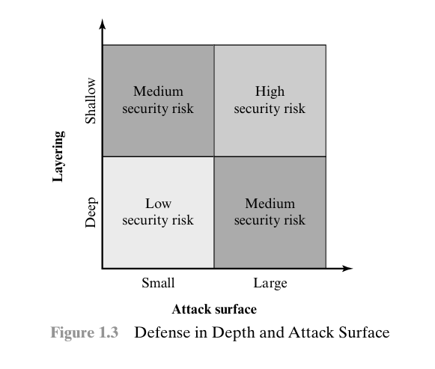
Attack Surface Categories
As illustrated in Figure 1.3, the use of layering, or defense in depth, and attack surface reduction complement each other in mitigating security risk.
Notes:
Attack surfaces can be categorized as follows:
■ Network attack surface: This category refers to vulnerabilities over an enterprise
network, wide-area network, or the Internet. Included in this category are network
protocol vulnerabilities, such as those used for a denial-of-service attack,
disruption of communications links, and various forms of intruder attacks.
■ Software attack surface: This refers to vulnerabilities in application, utility,
or operating system code. A particular focus in this category is Web server
Software.
■ Human attack surface: This category refers to vulnerabilities created by
personnel or outsiders, such as social engineering, human error, and trusted
insiders.

Slide 96
Attack Trees
An attack tree is a branching, hierarchical data structure that represents a set of potential techniques for exploiting security vulnerabilities
The security incident that is the goal of the attack is represented as the root node of the tree, and the ways that an attacker could reach that goal are itera tively and incrementally represented as branches and sub nodes of the tree.
The motivation for the use of attack trees is to effectively exploit the information available on attack patterns.
Notes:
Attack surfaces can be categorized as follows:
■ Network attack surface: This category refers to vulnerabilities over an enterprise
network, wide-area network, or the Internet. Included in this category are network
protocol vulnerabilities, such as those used for a denial-of-service attack,
disruption of communications links, and various forms of intruder attacks.
■ Software attack surface: This refers to vulnerabilities in application, utility,
or operating system code. A particular focus in this category is Web server
Software.
■ Human attack surface: This category refers to vulnerabilities created by
personnel or outsiders, such as social engineering, human error, and trusted
insiders.

Slide 97
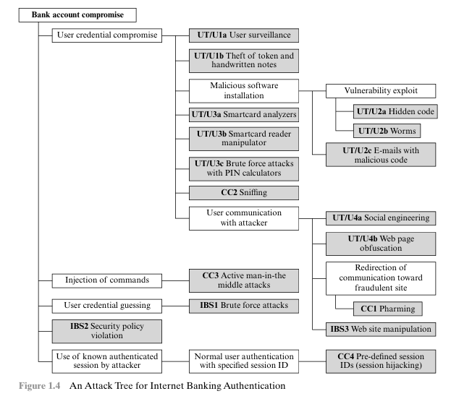
Attack Trees
Notes:
Attack surfaces can be categorized as follows:
■ Network attack surface: This category refers to vulnerabilities over an enterprise
network, wide-area network, or the Internet. Included in this category are network
protocol vulnerabilities, such as those used for a denial-of-service attack,
disruption of communications links, and various forms of intruder attacks.
■ Software attack surface: This refers to vulnerabilities in application, utility,
or operating system code. A particular focus in this category is Web server
Software.
■ Human attack surface: This category refers to vulnerabilities created by
personnel or outsiders, such as social engineering, human error, and trusted
insiders.

Slide 98
Unwanted Access
Placement in a computer system of logic that exploits vulnerabilities in the system and that can affect application programs as well as utility programs
Programs can present two kinds of threats:
Information access threats
Intercept or modify data on behalf of users who should not have access to that data
Service threats
Exploit service flaws in computers to inhibit use by legitimate users

Slide 99
Standards
NIST
ISOC
National Institute of Standards and Technology
U.S. federal agency that deals with measurement science, standards, and technology related to U.S. government use and to the promotion of U.S. private-sector innovation
NIST Federal Information Processing Standards (FIPS) and Special Publications (SP) have a worldwide impact
Internet Society
Professional membership society with worldwide organizational and individual membership
Provides leadership in addressing issues that confront the future of the Internet
Is the organization home for the groups responsible for Internet infrastructure standards, including the Internet Engineering Task Force (IETF) and the Internet Architecture Board (IAB)
Internet standards and related specifications are published as Requests for Comments (RFCs)

Slide 100
Techniques
Mechanisms discussed already are only theoretical recipes to implement security. The actual implementation of security goals needs some techniques. Two techniques are prevalent today: cryptography and steganography.

Slide 101
Cryptography
Cryptography, a word with Greek origins, means “secret writing.” However, we use the term to refer to the science and art of transforming messages to make them secure and immune to attacks.

Slide 102
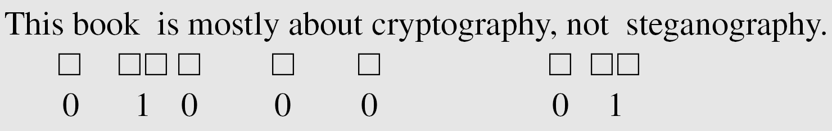
Steganography
The word steganography, with origin in Greek, means “covered writing,” in contrast with cryptography, which means “secret writing.”
Example: covering data with text

Slide 103
Example: using dictionary
Example: covering data under color image

Slide 104
Cryptographic Services
Cryptography supports the following services:
Confidentiality
2. Integrity
3. Authentication
4. Identity
5. Timeliness
6. Proof of ownership
Each has various different requirements in different circumstances, and each issupported by a wide variety of schemes.

Slide 105
Applications
1. Communications (encryption or authentication)
2. File and data base security
3. Electronic funds transfer
4. Electronic Commerce
5. Digital cash
6. Contract signing
7. Electronic mail
8. Authentication: Passwords, PINs
9. Secure identification, Access control
10. Secure protocols
11. Proof of knowledge

Slide 106
Applications (cont.)
12. Construction by collaborating parties (secret sharing)
13. Copyright protection
14. etc.

Slide 107
Some Other Security Facts
Not as simple as it might first appear to the novice
Must consider all potential attacks when designing a system
Generally yields complex and counterintuitive systems
Battle of intelligent strategies between attacker and admin
Requires regular monitoring
Not considered as a beneficial investment until a security failure occurs
Actually security investments must be considered as insurance against attacks
too often an afterthought
Not only from investment point of view, but also from design point of view

Slide 108
Summary
Computer security concepts
Definition
Examples
Challenges
The OSI security architecture
Security attacks
Passive attacks
Active attacks
Security services
Authentication
Access control
Data confidentiality
Data integrity
Nonrepudiation
Availability service
Security mechanisms
Model for network security
Standards
Notes:
Chapter 1 summary.

Slide 109
Cryptographic Functions
A communication game
Protocol
Magic function
Cryptographic functions

Slide 110
Cryptographic Functions
Alice and Bob are two parties
Want to go for dinner
Alice for Chinese, Bob for Japanese
How to resolve?

Slide 111
Use of Unbiased Coin
Alice tosses an unbiased coin with her hands covering, asks Bob of his choice: HEADS or TAILS
If Bob’s choice matches with the outcome of the toss, they go for Japanese food
Consider the situation when they are far apart
They can communicate with a telephone
What is the problem?

Slide 112
Problem of Trust
Bob can not trust Alice, as Alice can tell a lie:
How do we solve the problem
Solution to these kind of multi-party(plural number of players) problem are called technically “protocols”
In order to resolve the problem, they engage “a protocol”
They use a magic function, f(x)

Slide 113
The Protocol
Both of them agree on the function f(x)
An even number x represents HEAD
An odd number x represents TAIL

Slide 114
The Protocol
Both of them agree on the function f(x)
An even number x represents HEAD
An odd number x represents TAIL

Slide 115
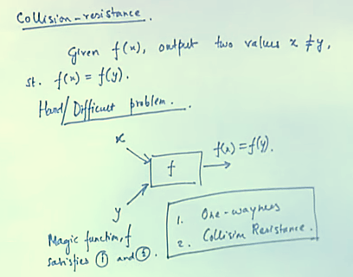
Problem of Trust

Slide 116
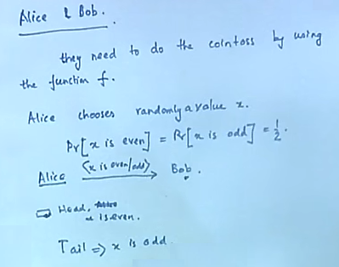
The Protocol
Use function f to resove

Slide 117
Coin Flipping over Telephone
Alice picks up a randomly large integer, x and computes f(x)
Bob tells Alice his guess of whether x is odd or even
Alice hen sends x to Bob
Bob verifies by computing f(x)

Slide 118
Security Analysis
Can Alice cheat?
For that Alice need to create a y<>x, st f(x)=f(y). Hard to do.
Can Bob guess beter than a random guess?
Bob listens to f(x) which speaks nothing of x. so his probability of guess is ½ (random guess)

Slide 119
An Example
Alice and Bob wish to resole a dispute over telephone. We can encode the possibilties of the dispute by a binary value. For this they engage a protocol:
Alice to Bob: Alice picks up randomly an x, which is a 200 bit number and comptes the function f(x). Alice sends f(x) to Bob.
Bob to Alice: Bob tells Alice whether x was even or odd
Alice to Bob: lice then sends x to Bob, so Bob can verify whether his guess is correct.

Slide 120
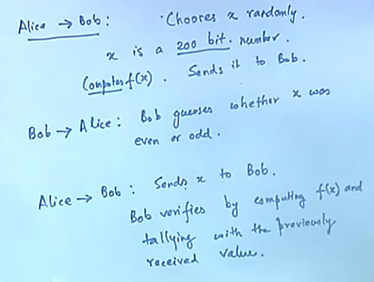
An Example

Slide 121
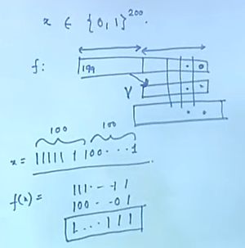

An Example

Slide 122
Bob’s Strategy
Bob’s Experiment:
-Input f(x)
-Output parity of x
Algorithm
If [f(x)] ₀=0 the x is even
Else x is odd

Slide 123
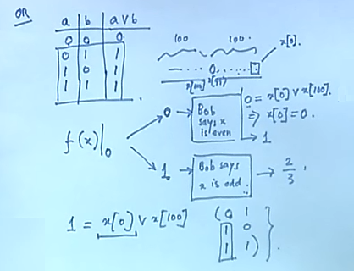
Bob’s Strategy

Slide 124
Bob’s Prob of Success
If X is chosen at random
Pr[X is even]=Pr[X is odd]=1/2
Pr[Bob succeds] = Pr[X is even] Pr[Bob succeeds|X is even] + Pr[X is odd]Pr[Bob succeeds|X is odd]=1/2 ½ +1/2 1=3/4

Slide 125
Bob’s Prob of Success
Remember we compute alice’s cheating probability irrespective of Bob’s strategy

Slide 126
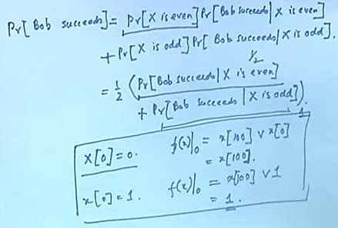
Bob’s Prob of Success

