Slide 1
Classical Encryption Techniques
Dr. Md. Mahbubur Rahman

Slide 2
Outline
To define the terms and the concepts of symmetric key ciphers
To emphasize the two categories of traditional ciphers: substitution and transposition ciphers
To describe the categories of cryptanalysis used to break the symmetric ciphers
To introduce the concepts of the stream ciphers and block ciphers
To discuss some very dominant ciphers used in the past, such as the Enigma machine

Slide 3
Cryptographic Algorithms
Symmetric encryption: Used to conceal the contents of blocks or streams of data of any size, including messages, files, encryption keys and passwords.
Asymmetric encryption: Used to conceal small blocks of data, such as encryption keys and hash function values, which are used in digital signatures.
Data integrity algorithms: Used to protect blocks of data, such as messages, from alteration.
Authentication protocols: These are schemes based on the use of cryptographic algorithms designed to authenticate the identity of entities.

Slide 4
Encryption for Confidentiality
Aim: assure confidential information not made available to unauthorized individuals (data confidentiality)
How: encrypt the original data; anyone can see the encrypted data, but only authorized individuals can decrypt to see the original data
Used for both sending data across network and storing data on a computer system

Slide 5
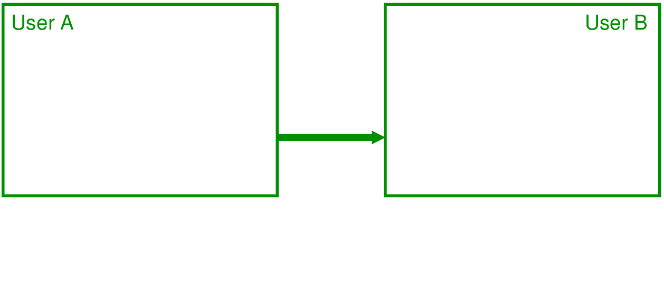
Model of Encryption for Confidentiality

Slide 6
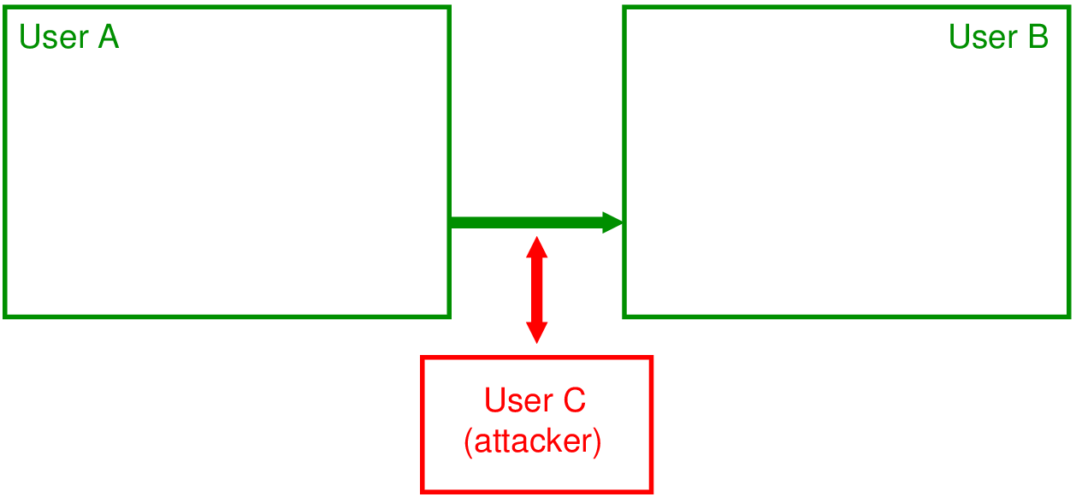
Model of Encryption for Confidentiality

Slide 7
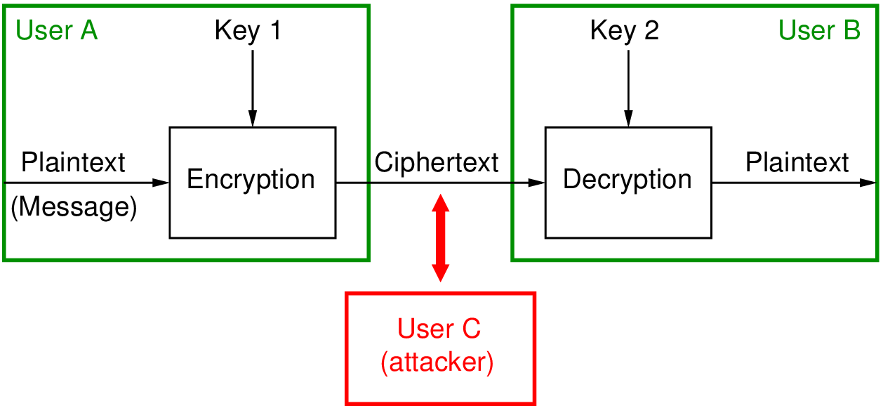
Model of Encryption for Confidentiality

Slide 8
Terminology
Plaintext original message
Ciphertext encrypted or coded message
Encryption convert from plaintext to ciphertext (enciphering)
Decryption restore the plaintext from ciphertext (deciphering)
Key information used in cipher known only to sender/receiver
Cipher a particular algorithm (cryptographic system)
Cryptography study of algorithms used for encryption
Cryptanalysis study of techniques for decryption without
knowledge of plaintext
Cryptology areas of cryptography and cryptanalysis

Slide 9
Symmetric Encryption
or conventional / private-key / single-key
sender and recipient share a common key
all classical encryption algorithms are private-key
was only type prior to invention of public-key in 1970’s
and by far most widely used
Notes:
Symmetric encryption, also referred to as conventional encryption or single-key encryption, was the only type of encryption in use prior to the development of public-key encryption in the 1970s. It remains by far the most widely used of the two types of encryption. All traditional schemes are symmetric / single key / private-key encryption algorithms, with a single key, used for both encryption and decryption. Since both sender and receiver are equivalent, either can encrypt or decrypt messages using that common key.

Slide 10
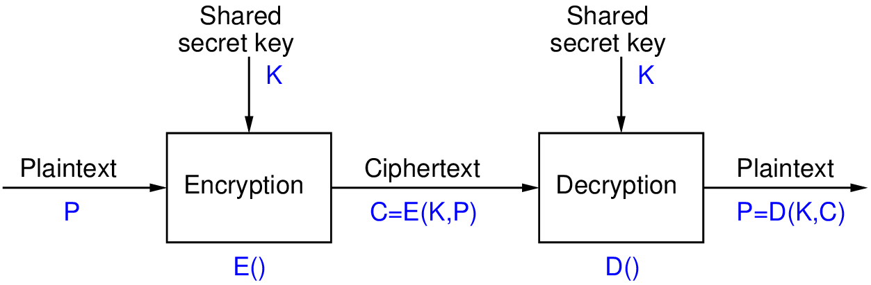
Symmetric Cipher Model
Notes:
Detail the five ingredients of the symmetric cipher model, shown in Stallings Figure 2.1:
plaintext - original message
encryption algorithm – performs substitutions/transformations on plaintext
secret key – control exact substitutions/transformations used in encryption algorithm
ciphertext - scrambled message
decryption algorithm – inverse of encryption algorithm

Slide 11
Requirements and assumptions
two requirements for secure use of symmetric encryption:
a strong encryption algorithm (cannot decrypt and know key)
a secret key known only to sender / receiver
mathematically have:
C = E(K, P)
P = D(K, C)
Assumptions
encryption algorithm is known
a secure channel to distribute key
Notes:
There are two requirements for secure use of conventional encryption that mean we assume that it is impractical to decrypt a message on the basis of the cipher- text plus knowledge of the encryption/decryption algorithm, and hence do not need to keep the algorithm secret; rather we only need to keep the key secret. This feature of symmetric encryption is what makes it feasible for widespread use. It allows easy distribution of s/w and h/w implementations.
Can take a closer look at the essential elements of a symmetric encryption scheme: mathematically it can be considered a pair of functions with: plaintext X, ciphertext Y, key K, encryption algorithm E, decryption algorithm D. The intended receiver, in possession of the key, is able to invert the transformation. An opponent, observing Y but not having access to K or X, may attempt to recover X or K.

Slide 12
Kerckhoff’s principle
Although it may appear that a cipher would be more secure if we hide both the encryption/decryption algorithm and the secret key, this is not recommended.
Based on Kerckhoff’s principle, one should always assume that the adversary , Eve, knows the encryption/decryption algorithm. The resistance of the cipher to attack must be based only on the secrecy of key.
In other words, guessing the key should be so difficult that there is no need to hide the encryption/decryption algorithm.

Slide 13
Characterizing Cryptographic Systems
Operations used for encryption:
Substitution replace one element in plaintext with another
Transposition re-arrange elements
Product systems multiple stages of substitutions and transpositions
Number of keys used:
Symmetric sender/receiver use same key (single-key, secret-key, shared-key, conventional)
Public-key sender/receiver use dierent keys (asymmetric)
Processing of plaintext:
Block cipher process one block of elements at a time
Stream cipher process input elements continuously

Slide 14
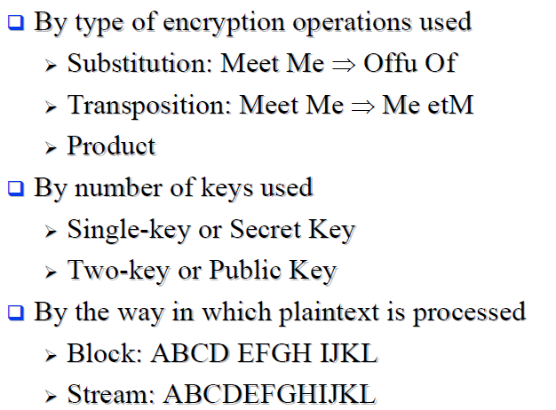
Cryptography Classification

Slide 15
Symmetric Key Encryption for Confidentiality
Requirements
Strong encryption algorithm: given algorithm, ciphertext and known pairs of (plaintext, ciphertext), attacker should be unable to find plaintext or key
Shared secret keys: sender and receiver both have shared a secret key; no-one else knows the key

Slide 16
Attacks
Goal of the Attacker
Discover the plaintext (good)
Discover the key (better)
Assumed Attacker Knowledge
Ciphertext (want to decrypt)
Algorithm (nature of the algorithm) or general idea of the type of plaintext
Other pairs of (plaintext, ciphertext) using same key (not the plaintext in question)
Attack Methods
Brute-force attack Try every possible key on ciphertext
Cryptanalysis Exploit characteristics of algorithm to deduce plaintext or key
Assumption: attacker can recognize correct plaintext

Slide 17
Attacks on Block Ciphers
Brute Force Attack
Approach: try all keys in key space
Metric: number of operations (time)
k bit key requires 2^{k} operations
Depends on key length and computer speed
Cryptanalysis
Approach: Find weaknesses in algorithms
Methods: Linear cryptanalysis, differential cryptanalysis, meet-in-the-middle attack, side-channel attacks
Metrics: Number of operations
Amount of memory
Number of known plaintexts/ciphertexts
If either succeed all key usages are compromised

Slide 18
Cryptanalysis and Brute-Force Attack
Cryptanalysis : Cryptanalytic attacks rely on the nature of the algorithm plus perhaps some knowledge of the general haracteristics of the plaintext or even some sample plaintext–ciphertext pairs.
Brute-Force Attack :The attacker tries every possible key on a piece of ciphertext until an intelligible translation into plaintext is obtained.

Slide 19
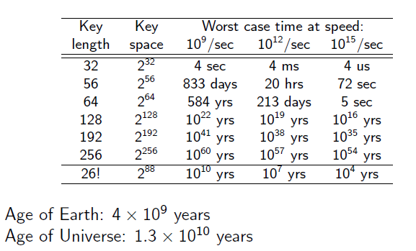
Brute Force Attack
always possible to simply try every key
most basic attack, proportional to key size
assume either know / recognise plaintext
Notes:
A brute-force attack involves trying every possible key until an intelligible translation of the ciphertext into plaintext is obtained. On average, half of all possible keys must be tried to achieve success. Stallings Table 2.2 shows how much time is required to conduct a brute-force attack, for various common key sizes (DES is 56, AES is 128, Triple-DES is 168, plus general mono-alphabetic cipher), where either a single system or a million parallel systems, are used.

Slide 20
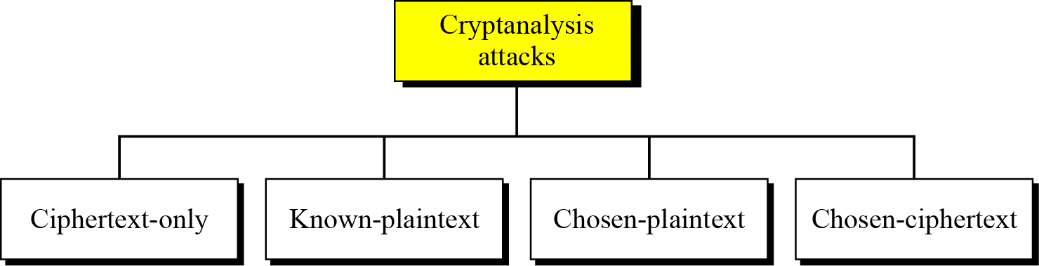
Cryptanalysis
As cryptography is the science and art of creating secret codes, cryptanalysis is the science and art of breaking those codes.
Cryptanalysis attacks

Slide 21
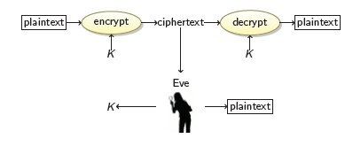
Cryptanalysis (Cont.)
Ciphertext-only attack
We have: the ciphertext of several messages that have been encrypted with the same key, K.
We recover: the plaintexts, or K.

Slide 22
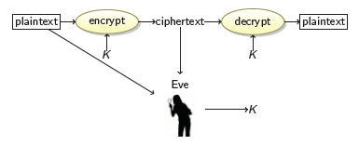
Cryptanalysis (Cont.)
Known-Plaintext Attack
We have: the ciphertexts and corresponding plaintexts of several messages, all encrypted with the same key K.
We recover: the key K.

Slide 23
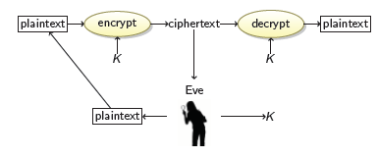
Cryptanalysis (Cont.)
Chosen-Plaintext Attack
We have: the ciphertext of several messages that have been encrypted with the same key K, such that we get to choose the plaintexts.
We recover: the key K.

Slide 24
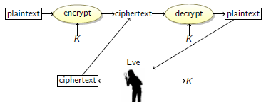
Cryptanalysis (Cont.)
Chosen-Ciphertext Attack
We have: the plaintext of several messages that have been encrypted with the same key K, such that we get to choose the ciphertexts.
We recover: the key K.

Slide 25
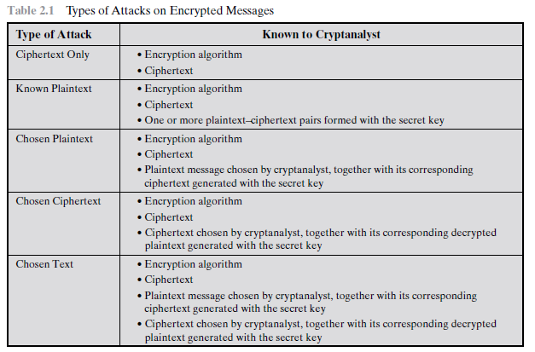
Cryptanalysis: Summary

Slide 26
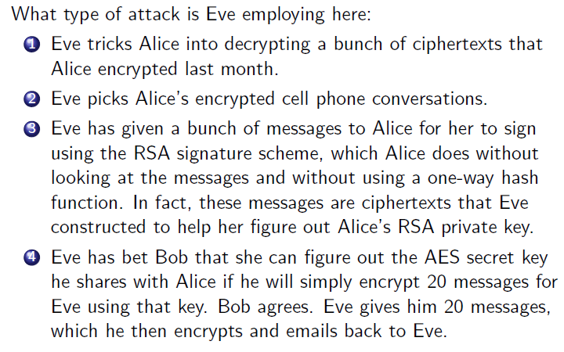
Exercise

Slide 27
Cryptography
Cryptographic systems are characterized along three independent dimensions:
1. The type of operations used for transforming plaintext to ciphertext.—substitution and transposition (or product)
2. The number of keys used. (sym. and asym.)
3 The way in which the plaintext is processed. (block and stream)

Slide 28
Measures of Security
Unconditionally Secure
Ciphertext does not contained enough information to
derive plaintext or key
One-time pad is only unconditionally secure cipher ( but not very practical )
Computationally Secure
If either:
- Cost of breaking cipher exceeds value of encrypted information
-Time required to break cipher exceeds useful lifetime of encrypted information
Hard to estimate value/lifetime of some information
Hard to estimate how much effort needed to break cipher

Slide 29
Motivation for cryptanalysts
All forms of cryptanalysis for symmetric encryption schemes are designed to exploit the fact that traces of structure or pattern in the plaintext may survive encryption and be discernible in the ciphertext.

Slide 30
Substitution ciphers
A substitution cipher replaces one symbol with another. Substitution ciphers can be categorized as either monoalphabetic ciphers or polyalphabetic ciphers.
A substitution cipher replaces one symbol with another.
Topics:
Monoalphabetic Ciphres Polyalphabetic Ciphers

Slide 31
Monoalphabetic Ciphers
In monoalphabetic substitution, the relationship between a symbol in the plaintext to a symbol in the ciphertext is always one-to-one.

Slide 32
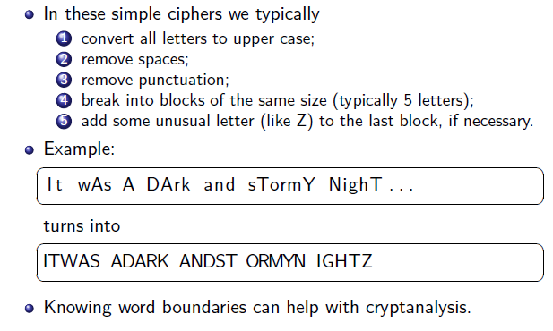
Encoding

Slide 33
Continued
Example
The following shows a plaintext and its corresponding ciphertext. The cipher is probably monoalphabetic because both l’s (els) are encrypted as O’s.
Plaintext: hello Ciphertext: KHOOR
Example
The following shows a plaintext and its corresponding ciphertext. The cipher is not monoalphabetic because each l (el) is encrypted by a different character.
Plaintext: hello Ciphertext: KHOLR

Slide 34
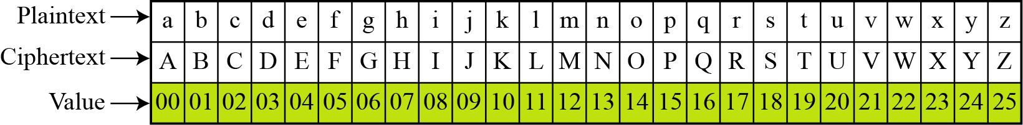
Additive Cipher
The simplest monoalphabetic cipher is the additive cipher.
This cipher is sometimes called a shift cipher and sometimes a Caesar cipher, but the term additive cipher better reveals its mathematical nature.
Plaintext and ciphertext in Z₂₆

Slide 35
Additive Cipher
Replace each letter by the letter three positions along in alphabet
Plain : a b c d e f g h i j k l m n o p q r s t u v w x y z
Cipher: D E F G H I J K L M N O P Q R S T U V W X Y Z A B C
Generalized Caesar Cipher
Allow shift by k positions
Assume each letter assigned number (a = 0, b = 1, . . . )
C = E(k,p) = (p + k) mod 26
p = D(k,C) = (C - k) mod 26

Slide 36
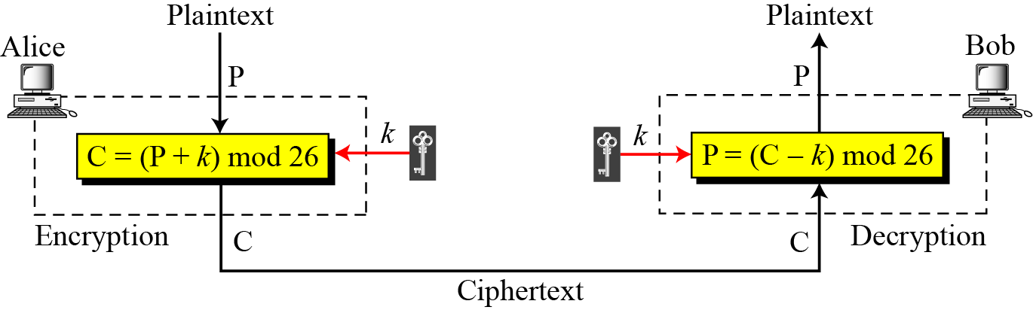
Additive Cipher
When the cipher is additive, the plaintext, ciphertext, and key are integers in Z₂₆.

Slide 37
Additive Cipher
Use the additive cipher with key = 15 to encrypt the message “hello”.
Solution
We apply the encryption algorithm to the plaintext, character by character:

Slide 38
Continued
Shift Cipher and Caesar Cipher
Hitorically, additive ciphers are called shift ciphers. Julius Caesar used an additive cipher to communicate with his officers. For this reason, additive ciphers are sometimes referred to as the Caesar cipher. Caesar used a key of 3 for his communications.
Additive ciphers are sometimes referred to as shift ciphers or Caesar cipher.

Slide 39
Continued
Eve has intercepted the ciphertext “UVACLYFZLJBYL”. Show how she can use a brute-force attack to break the cipher.
Solution
Eve tries keys from 1 to 7. With a key of 7, the plaintext is “not very secure”, which makes sense.

Slide 40
Breaking the Caesar Cipher
Brute force attack
-The encryption and decryption algorithms are known.
-Try all 25 keys, e.g. k = 1, k = 2, . . .
-Plaintext should be recognised
Recognising plaintext in brute force attacks
-Need to know “structure" of plaintext
-Language? Compression?
How to improve against brute force?
-Hide the encryption/decryption algorithm: Not practical
-Compress, use different language: Limited options
-Increase the number of keys

Slide 41
Substitution in other forms: Monoalphabetic Ciphers
With only 25 possible keys, the Caesar cipher is far from secure. A dramatic increase in the key space can be achieved by allowing an arbitrary substitution (Random substitution).
Permutation: A permutation of a finite set of elements S
is an ordered sequence of all the elements of S, with each element appearing exactly once.
For example, if S = {a, b, c}, there are six permutations of S:
abc, acb, bac, bca, cab, cba
For n elementts, n! permutations.

Slide 42
For Caesar cipher:
plain: a b c d e f g h i j k l m n o p q r s t u v w x y z
cipher: D E F G H I J K L M N O P Q R S T U V W X Y Z A B C
For mono-alphabetic substitution:
If, instead, the “cipher” line can be any permutation of the 26 alphabetic characters,
then there are 26! or greater than 4 * 10²⁶ possible keys

Slide 43
Example
We can use the key in Figure in previous slide to encrypt the message
The ciphertext is

Slide 44
Attacks on Mono-alphabetic Ciphers
Exploit the regularities of the language
-Frequency of letters, digrams, trigrams
-Expected words
Fundamental problem with mono-alphabetic ciphers
-Ciphertext reflects the frequency data of original
plaintext
-Solution 1: encrypt multiple letters of plaintext
-Solution 2: use multiple cipher alphabets

Slide 45
Language Redundancy and Cryptanalysis
Human languages are redundant
e.g., "th lrd s m shphrd shll nt wnt"
Letters are not equally commonly used
In English E is by far the most common letter
followed by T,R,N,I,O,A,S
Other letters like Z,J,K,Q,X are fairly rare
Have tables of single, double & triple letter frequencies for various languages
Notes:
45
As the example shows, we don't actually need all the letters in order to understand written English text. Here vowels were removed, but they're not the only redundancy. cf written Hebrew has no vowels for same reason. Are usually familiar with "party conversations", can hear one person speaking out of hubbub of many, again because of redundancy in aural language also. This redundancy is also the reason we can compress text files, the computer can derive a more compact encoding without losing any information. Basic idea is to count the relative frequencies of letters, and note the resulting pattern.

Slide 46
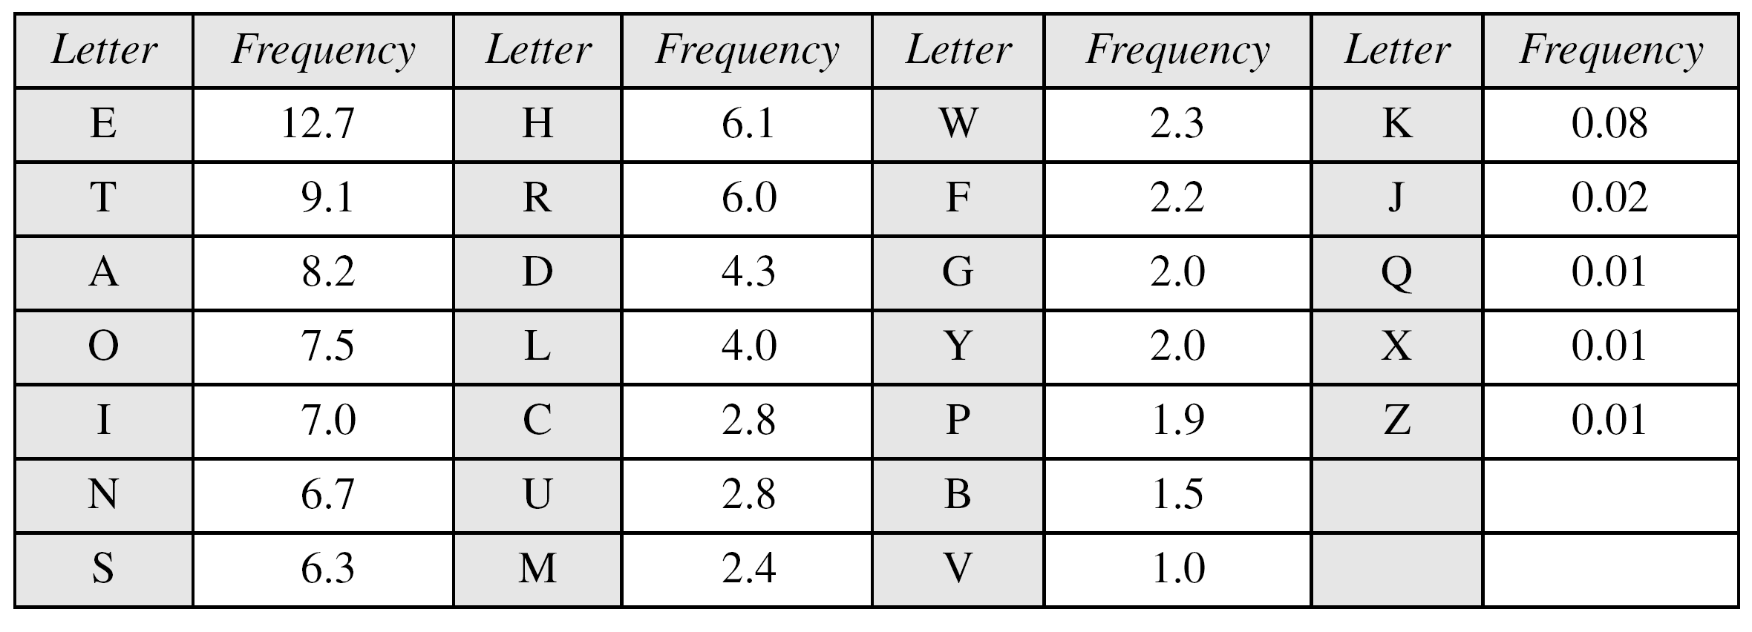
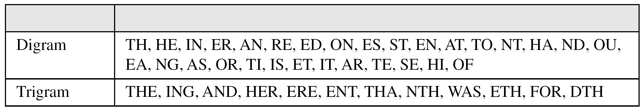
Continued
Frequency of characters in English
Frequency of diagrams and trigrams

Slide 47
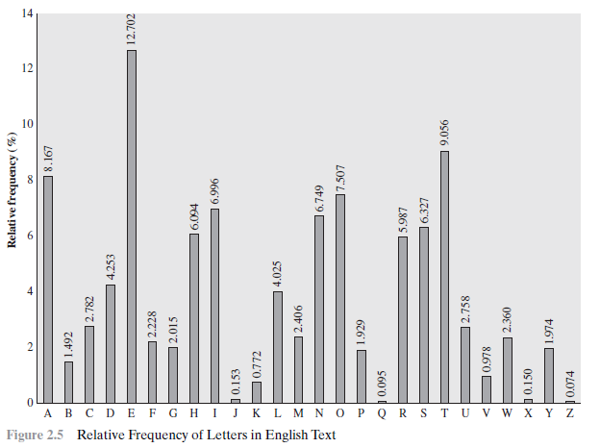
Relative Frequency of Letters in English Text

Slide 48
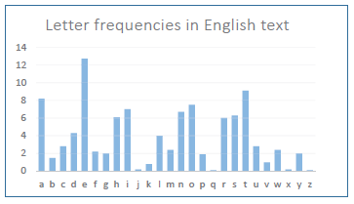
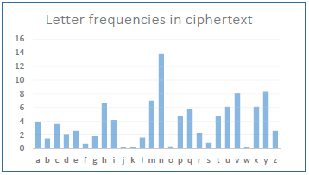
Breaking Monoalphabetic Substitution Cipher
Letter Frequency Analysis results:

Slide 49
English Letter Frequencies

Slide 50

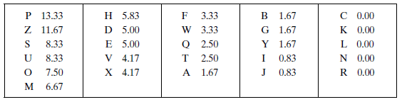
Example cryptanalysis
frequency
As a first step, the relative frequency of the letters can be determined and compared to a standard frequency distribution for English

Slide 51
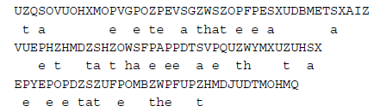
So far, then, we have

Slide 52
Example Cryptanalysis
given ciphertext
UZQSOVUOHXMOPVGPOZPEVSGZWSZOPFPESXUDBMETSXAIZ
VUEPHZHMDZSHZOWSFPAPPDTSVPQUZWYMXUZUHSX
EPYEPOPDZSZUFPOMBZWPFUPZHMDJUDTMOHMQ
guess P & Z are e and t
guess ZW is th and hence ZWP is “the”
proceeding with trial and error finally get:
it was disclosed yesterday that several informal but
direct contacts have been made with political
representatives of the viet cong in moscow
Notes:
52
Illustrate the process with this example from the text in Stallings section 2.2. Comparing letter frequency breakdown with Figure 2.5, it seems likely that cipher letters P and Z are the equivalents of plain letters e and t, but it is not certain which is which. The letters S, U, O, M, and H are all of relatively high frequency and probably correspond to plain letters from the set {a, h, i, n, o, r, s}. The letters with the lowest frequencies (namely, A, B, G, Y, I, J) are likely included in the set {b, j, k, q, v, x, z}. A powerful tool is to look at the frequency of two-letter combinations, known as digrams. A table similar to Figure 2.5 could be drawn up showing the relative frequency of digrams. The most common such digram is th. In our ciphertext, the most common digram is ZW, which appears three times. So we make the correspondence of Z with t and W with h. Then, by our earlier hypothesis, we can equate P with e. Now notice that the sequence ZWP appears in the ciphertext, and we can translate that sequence as "the." This is the most frequent trigram (three- letter combination) in English, which seems to indicate that we are on the right track. Next, notice the sequence ZWSZ in the first line. We do not know that these four letters form a complete word, but if they do, it is of the form th_t. If so, S equates with a. Only four letters have been identified, but already we have quite a bit of the message. Continued analysis of frequencies plus trial and error should easily yield a solution from this point. The complete plaintext, with spaces added between words, is shown on slide.

Slide 53
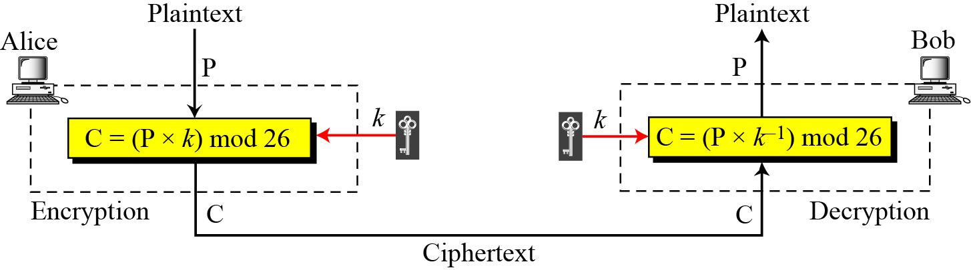
Multiplicative Ciphers
Multiplicative cipher
In a multiplicative cipher, the plaintext and ciphertext are integers in Z₂₆; the key is an integer in Z₂₆*.

Slide 54
Continued.
Example
What is the key domain for any multiplicative cipher?
Solution
The key needs to be in Z₂₆*. This set has only 12 members: 1, 3, 5, 7, 9, 11, 15, 17, 19, 21, 23, 25.
Example
We use a multiplicative cipher to encrypt the message “hello” with a key of 7. The ciphertext is “XCZZU”.

Slide 55
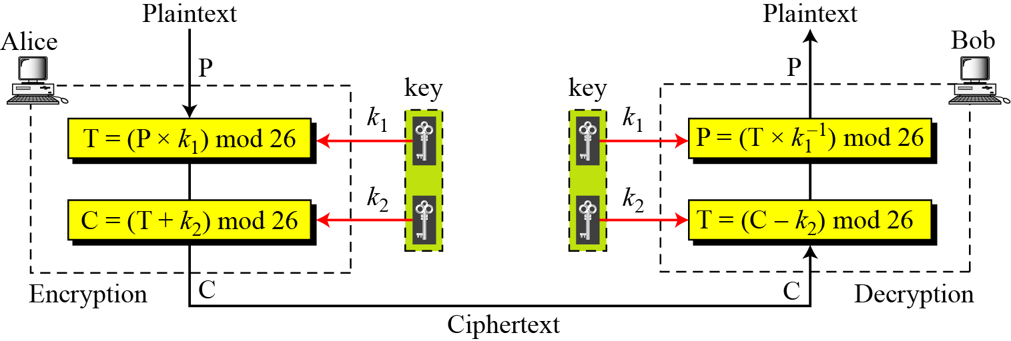
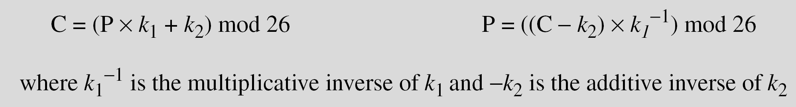
Affine Ciphers
Combining additive and multiplicative cipher

Slide 56
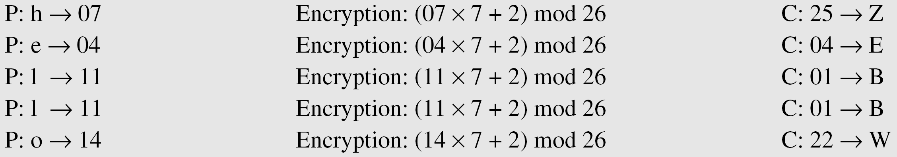
Affine Ciphers
Example
The affine cipher uses a pair of keys in which the first key is from Z₂₆* and the second is from Z₂₆. The size of the key domain is 26 × 12 = 312.
Example
Use an affine cipher to encrypt the message “hello” with the key pair (7, 2).

Slide 57
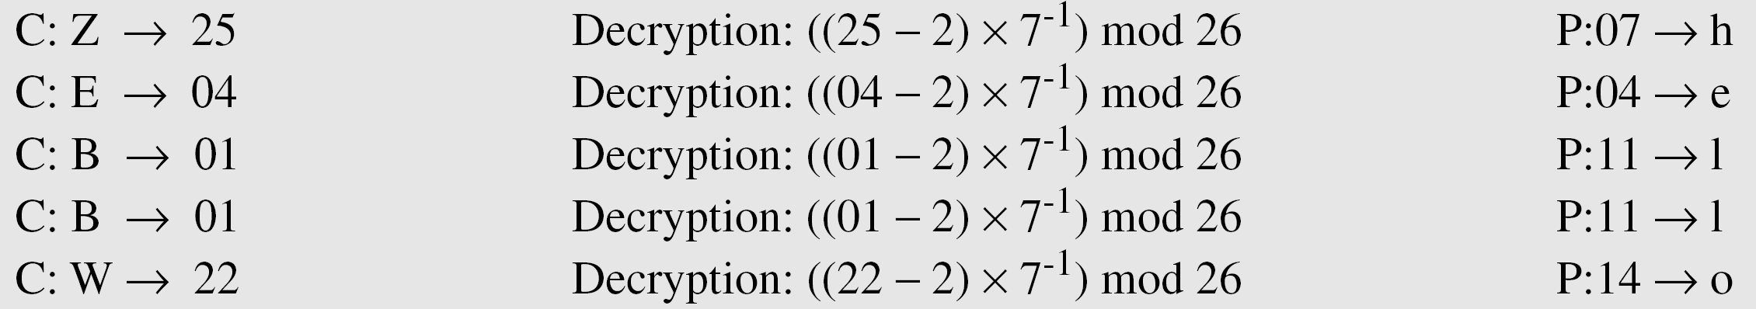
Affine Ciphers
Example
Use the affine cipher to decrypt the message “ZEBBW” with the key pair (7, 2) in modulus 26.
Solution
Example
The additive cipher is a special case of an affine cipher in which k₁ = 1. The multiplicative cipher is a special case of affine cipher in which k₂ = 0.

Slide 58
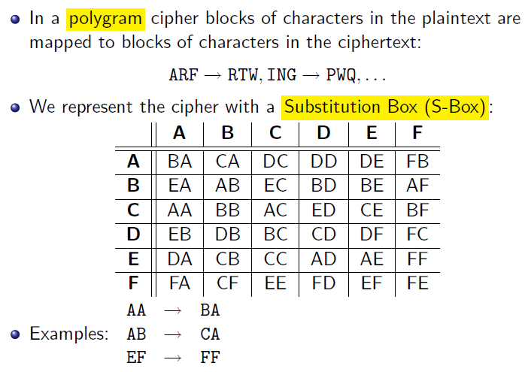
Polygraphic Substitution Ciphers

Slide 59
Substitution: Other forms (Cont)
Use two-letter combinations: Playfair Cipher
Use multiple letter combinations: Hill Cipher
Use multiple ciphers. Use a key to select which alphabet (code) is used for each letter of the message

Slide 60
Poly-alphabetic Ciphers
Monoalphabetic ciphers are easy to break because they reflect the frequency data of the original alphabet. A countermeasure is to provide multiple substitutes known as homophones, for a single letter.
For example, the letter e could be assigned a number of different cipher symbols, such as 16, 74, 35, and 21, with each homophone assigned to a letter in rotation or randomly.
Use different mono-alphabetic substitutions as proceed
through plaintext
Set of mono-alphabetic ciphers
Key determines which mono-alphabetic cipher to use for each plaintext letter
Examples: Vigenere cipher, Vernam cipher, One time pad

Slide 61
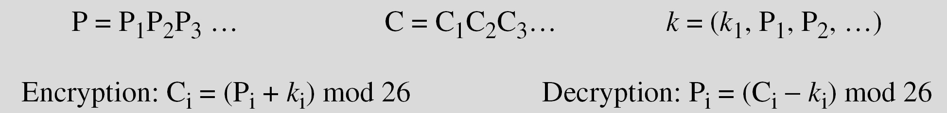
Polyalphabetic Ciphers
In polyalphabetic substitution, each occurrence of a character may have a different substitute. The relationship between a character in the plaintext to a character in the ciphertext is one-to-many.
Autokey Cipher

Slide 62
Autokey Cipher
Assume that Alice and Bob agreed to use an autokey cipher with initial key value k1 = 12. Now Alice wants to send Bob the message “Attack is today”. Enciphering is done character by character.

Slide 63

Autokey Cipher
Vigenère proposed what is referred to as an autokey system, in which a keyword is concatenated with the plaintext itself to provide a running key. For our example,
Even this scheme is vulnerable to cryptanalysis. Because the key and the plaintext share the same frequency distribution of letters, a statistical technique can be applied.

Slide 64
Playfair Cipher
Not even the large number of keys in a monoalphabetic cipher provides security
One approach to improving security was to encrypt multiple letters
The Playfair Cipher is an example
Invented by Charles Wheatstone in 1854, but named after his friend Baron Playfair
Notes:
64
Consider ways to reduce the "spikyness" of natural language text, since if just map one letter always to another, the frequency distribution is just shuffled. One approach is to encrypt more than one letter at once. The Playfair cipher is an example of doing this, treats digrams in the plaintext as single units and translates these units into ciphertext digrams.

Slide 65
Playfair Cipher
Initialization
1. Create 5x5 matrix and write keyword (row by row)
2. Fill out remainder with alphabet, not repeating any
letters
3. Special: Treat I and J as same letter
Encryption
1. Operate on pair of letters (digram) at a time
2. Special: if digram with same letters, separate by special
letter (e.g. x)
3. Plaintext in same row: replace with letters to right
4. Plaintext in same column: replace with letters below
5. Else, replace by letter in same row as it and same
column as other plaintext letter

Slide 66
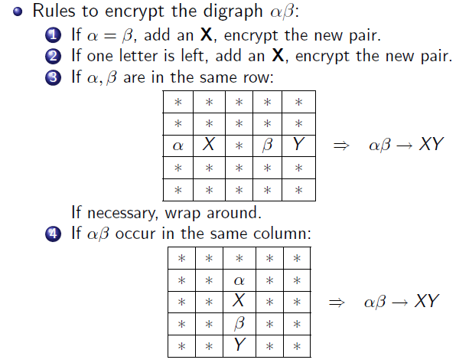
Playfair Cipher

Slide 67
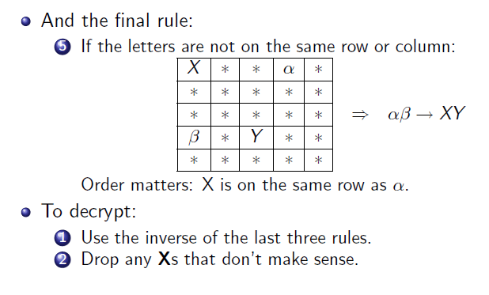
Playfair Cipher

Slide 68
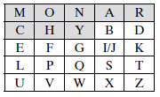

 | balxloxon
ar | RM
mu | CM
hs | BP
ea | IM
balloon
In this case, the keyword is monarchy.
Plaintext is encrypted two letters at a time

Slide 69
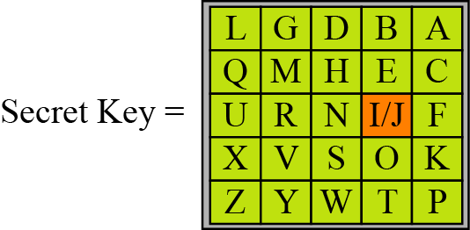
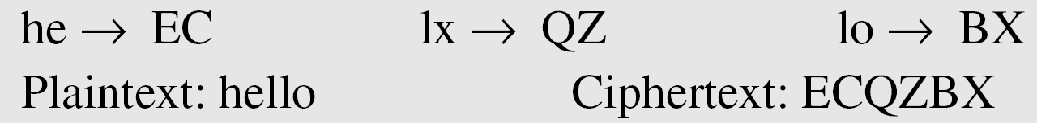
An example of a secret key in the Playfair cipher
Example
Let us encrypt the plaintext “hello” using the key in Figure

Slide 70
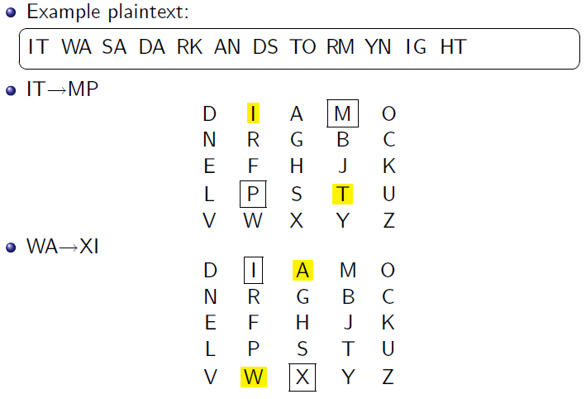
An example of a secret key in the Playfair cipher

Slide 71
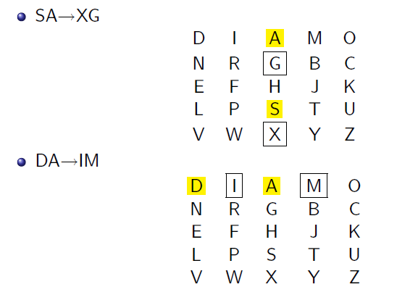
An example of a secret key in the Playfair cipher

Slide 72
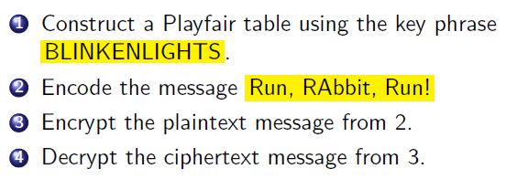
Exercise

Slide 73
Measuring Effectiveness of the Playfair and other ciphers
The following plot is developed: (i) The number of occurrences of each letter in the text is counted and divided by the number of occurrences of the most frequently used letter. e is the most frequently used letter.
To normalize the plot, the number of occurrences of each letter in the ciphertext was again divided by the number of ccurrences of e in the plaintext.
If the frequency distribution information were totally concealed in the encryption process, the ciphertext plot
of frequencies would be flat, and cryptanalysis using ciphertext only would be effectively impossible.

Slide 74
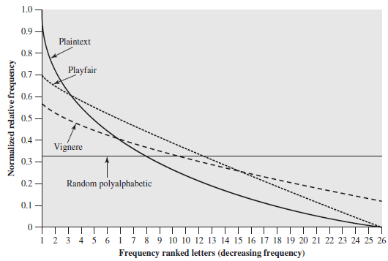
Relative Frequency of Occurrence of Letters

Slide 75
Security of Playfair Cipher
Security much improved over monoalphabetic since have 26 x 26 = 676 digrams
Would need a 676 entry frequency table to analyse (versus 26 for a monoalphabetic) and correspondingly more ciphertext was widely used for many years
E.g. by US & British military in WW1
It can be broken, given a few hundred letters since still has much of plaintext structure
Notes:
75
The Playfair cipher is a great advance over simple monoalphabetic ciphers, since there are 26*26=676 digrams (vs 26 letters), so that identification of individual digrams is more difficult. Also,the relative frequencies of individual letters exhibit a much greater range than that of digrams, making frequency analysis much more difficult. The Playfair cipher was for a long time considered unbreakable. It was used as the standard field system by the British Army in World War I and still enjoyed considerable use by the U.S.Army and other Allied forces during World War II. Despite this level of confidence in its security, the Playfair cipher is relatively easy to break because it still leaves much of the structure of the plaintext language intact. A few hundred letters of ciphertext are generally sufficient.

Slide 76
Playfair Cipher - Is it Breakable?
Better than mono-alphabetic: relative frequency of
digrams much less than of individual letters
But relatively easy (digrams, trigrams, expected words)

Slide 77
Vigenere Cipher
Set of 26 general Caesar ciphers
26 Caesar ciphers with shifts of 0 through 25.
Letter in key determines the Caesar cipher to use
Key must be as long as plaintext: repeat a keyword
Key: pqr
Plaintext: attack is today
Example:
Plain: a t t a c k i s t o d a y
Key: p q r p q r p q r p q r p
Cipher:
Multiple ciphertext letters for each plaintext letter

Slide 78

For the next m letters of the plaintext, the key letters are repeated.

Slide 79



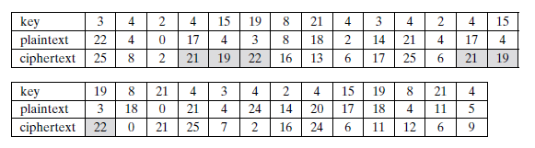
Expressed numerically, we have the following result.

Slide 80
Vigenere Cipher

Slide 81
Vigenere Cipher
Example
We can encrypt the message “She is listening” using the 6-character keyword “PASCAL”.
Let us see how we can encrypt the message “She is listening” using the 6-character keyword “PASCAL”. The initial key stream is (15, 0, 18, 2, 0, 11). The key stream is the repetition of this initial key stream (as many times as needed).

Slide 82
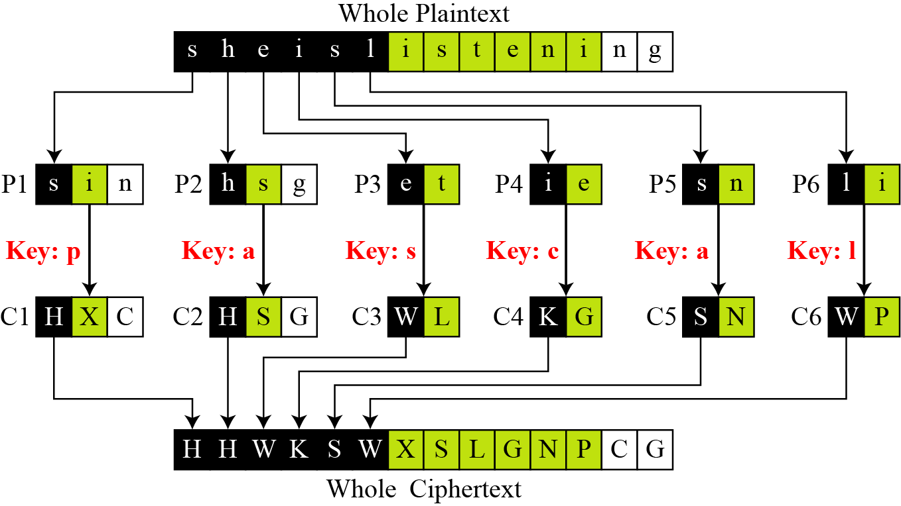
Vigenere Cipher
Vigenere cipher can be seen as combinations of m additive ciphers.
Figure A Vigenere cipher as a combination of m additive ciphers

Slide 83
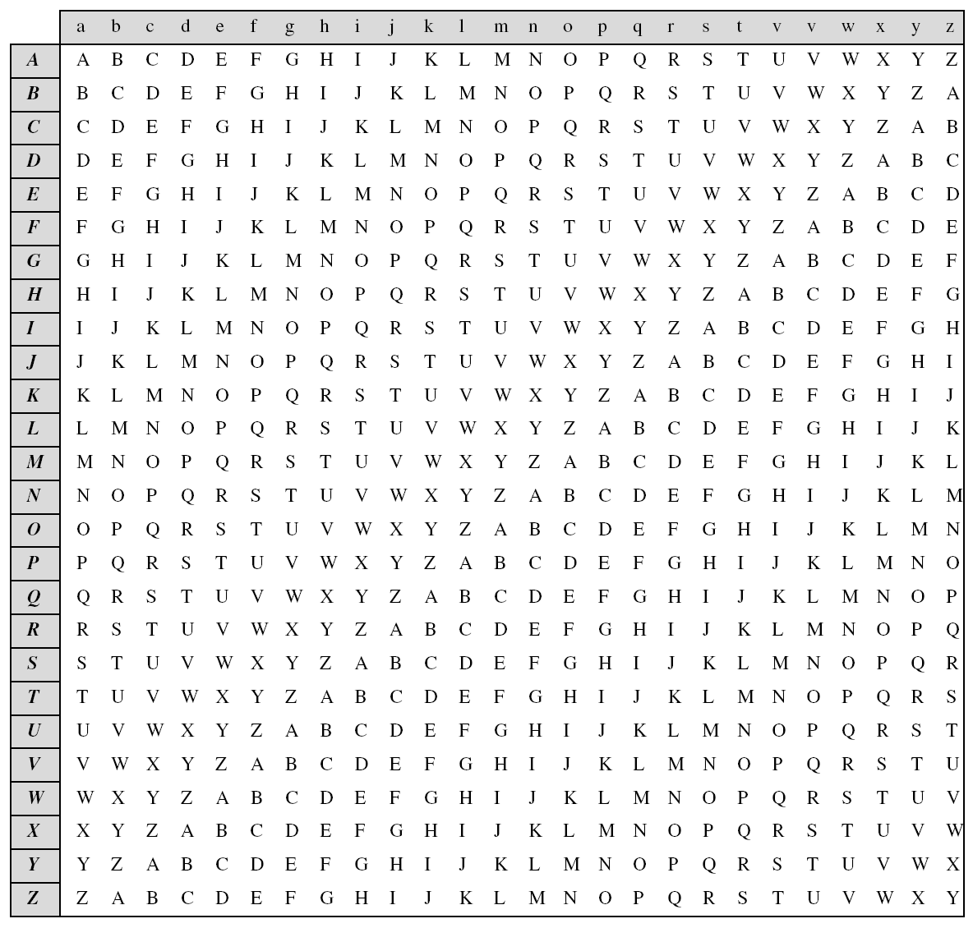
Vigenere Cipher
Using Example , we can say that the additive cipher is a special case of Vigenere cipher in which m = 1.
Table
A Vigenere Tableau

Slide 84
Vigenere Cipher
(Cryptanalysis)
Example
Let us assume we have intercepted the following ciphertext:
The Kasiski test for repetition of three-character segments yields the results shown in Table .

Slide 85
Vigenere Cipher
(Crypanalysis)
Example Cont.
Let us assume we have intercepted the following ciphertext:
The Kasiski test for repetition of three-character segments in ciphertext yields the results shown in Table

Slide 86
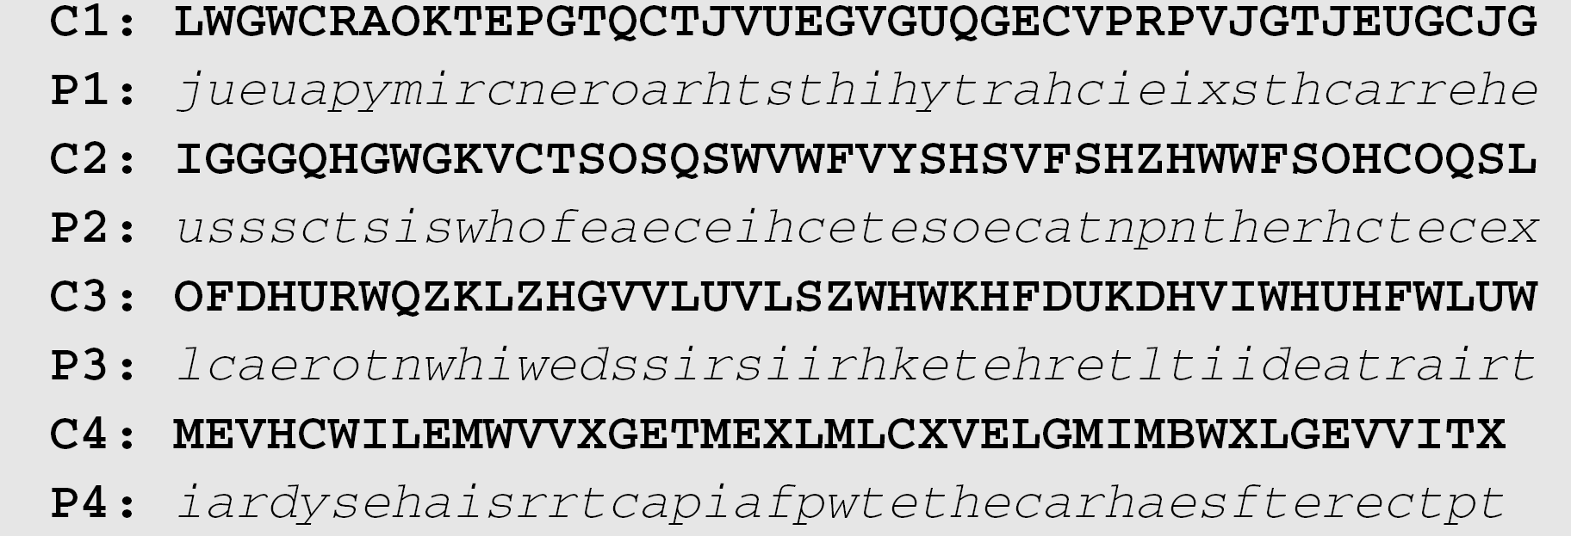
Example Cont.
The greatest common divisor of differences is 4, which means that the key length is multiple of 4. First try m = 4.
In this case, the plaintext makes sense.

Slide 87
Vigenere Cipher - Is it Breakable?
Yes
Monoalphabetic or Vigenere cipher? Letter frequency
analysis
Determine length of keyword
For keyword length m, Vigenere is m mono-alphabetic
substitutions
Break the mono-alphabetic ciphers separately
Weakness is repeating, structured keyword

Slide 88
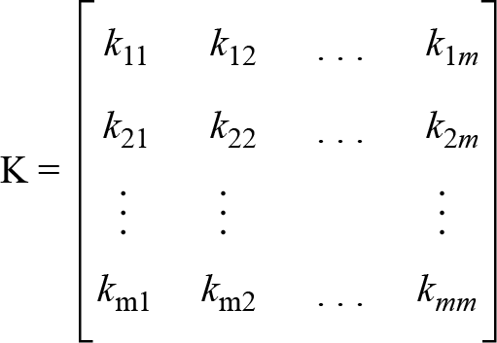
Hill Cipher
Another interesting multiletter cipher is the Hill cipher, developed by the mathematician Lester Hill in 1929.
Plaintext are divided into equal size blocks. Each character in a block contributes to the encryption of the other characters in the block. (Block Cipher)
The key matrix in the Hill cipher needs to have a multiplicative inverse.

Slide 89
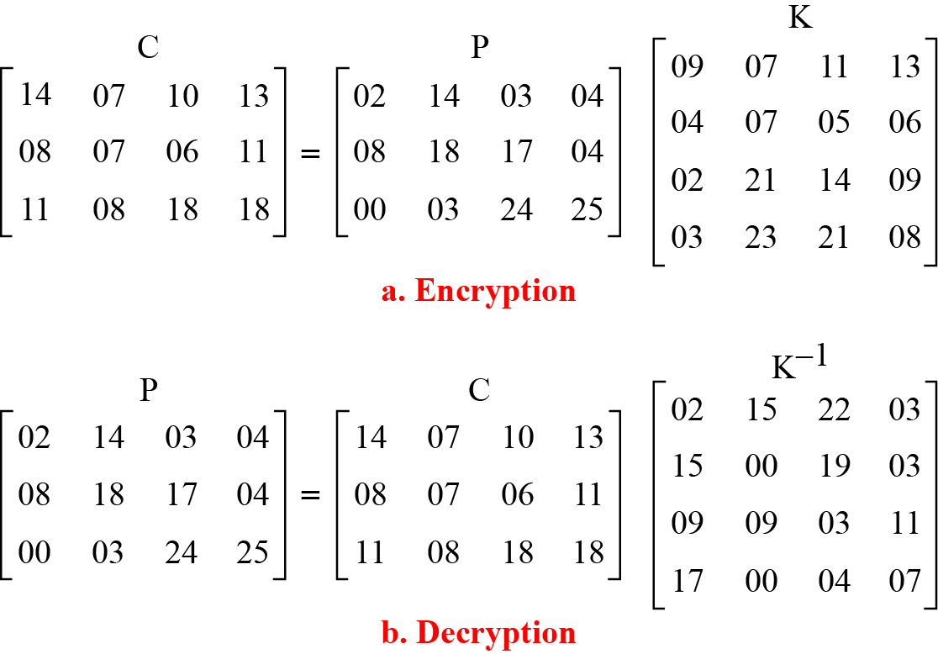
Examp Hilll1
For example, the plaintext “code is ready” can make a 3 × 4 matrix when adding extra bogus character “z” to the last block and removing the spaces. The ciphertext is “OHKNIHGKLISS”.
Figure Example

Slide 90
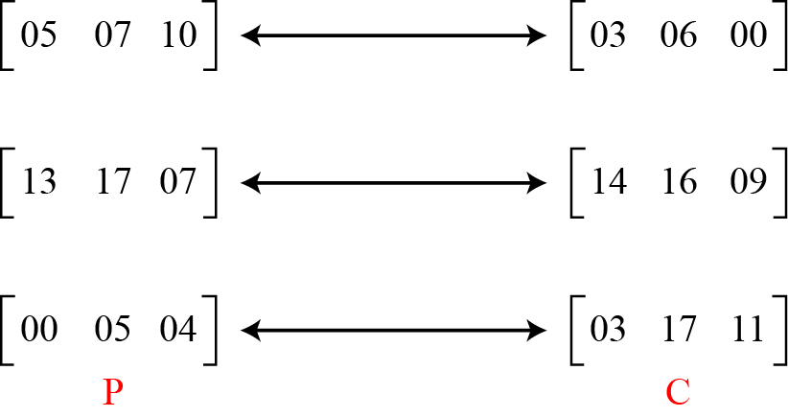
Example Hill2
Assume that Eve knows that m = 3. She has intercepted three plaintext/ciphertext pair blocks (not necessarily from the same message) as shown in Figure .
Figure

Slide 91
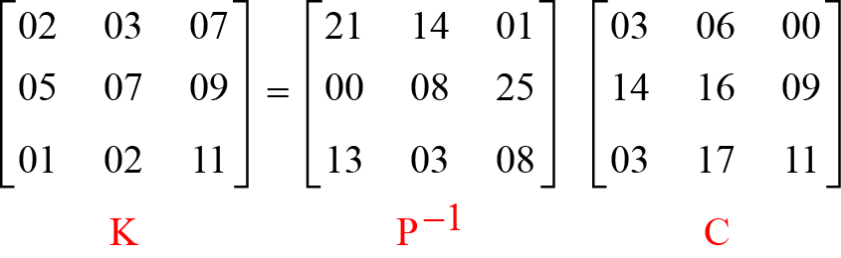
Example Hill2 cont.
She makes matrices P and C from these pairs. Because P is invertible, she inverts the P matrix and multiplies it by C to get the K matrix as shown in Figure.
Figure Example
Now she has the key and can break any ciphertext encrypted with that key.

Slide 92
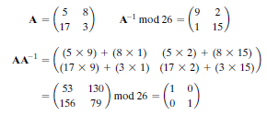
Hill Cipher
Concepts from Linear Algebra
We define the inverse M⁻¹ of a square matrix M by the equation M(M⁻¹) = M⁻¹M = I, where I is the identity matrix. I is a square matrix that is all zeros except for ones along the main diagonal from upper left to lower right.
(we are concerned with matrix arithmetic modulo 26).

Slide 93
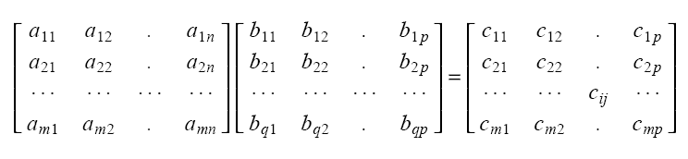
Matrix Operations
Matrix addition/subtraction
Matrices must be of same size.
Matrix multiplication
m x n
nx p
m x p
n
Condition: n = q

Slide 94
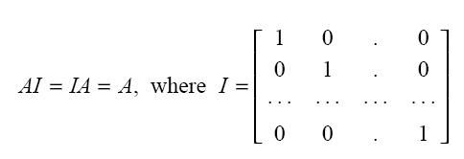
Identity Matrix

Slide 95
Matrix Transpose

Slide 96

Symmetric Matrices
Example:

Slide 97
Determinants
2 x 2
3 x 3
n x n
Properties:

Slide 98

Matrix Inverse
The inverse A⁻¹ of a matrix A has the property:
AA⁻¹=A⁻¹A=I
A⁻¹ exists only if
Terminology
Singular matrix: A⁻¹ does not exist
Ill-conditioned matrix: A is “close” to being singular

Slide 99

Matrix Inverse (cont’d)
Properties of the inverse:

Slide 100


Inverse of a Matrix
Determinant
For any square matrix (m × m), the determinant equals the sum of all the products that can be formed by taking exactly one element from each row and exactly one element from each column, with certain of the product terms preceded by a minus sign

Slide 101


Det(A)=
Det(A)⁻¹= 9⁻¹ mod 26 =3 (not 1/9)
As,
Note:

Slide 102

Det(A)=
Det(A)⁻¹= 9⁻¹ mod 26=3
As,

Slide 103


We can show that 9⁻¹ mod 26 = 3, because 9 ×3 = 27 mod 26 = 1 Therefore, we compute the inverse of A as

Slide 104


The Hill Algorithm
This encryption algorithm takes m successive plaintext letters and substitutes for them m ciphertext letters. The substitution is determined by m linear equations in which each character is assigned a numerical value (a = 0, b = 1, c, z = 25). For m = 3, the system can be described as

Slide 105



In general
“paymoremoney”

Slide 106
One-Time Pad
One of the goals of cryptography is perfect secrecy.
A study by Shannon has shown that perfect secrecy can be achieved if each plaintext symbol is encrypted with a key randomly chosen from a key domain.
This idea is used in a cipher called one-time pad, invented by Vernam.

Slide 107
One Time Pad
Similar to Vigenere, but use random key as long as plaintext
Only known scheme that is unbreakable (unconditional
security or perfect security)
Ciphertext has no statistical relationship with plaintext
Given two potential plaintext messages, attacker cannot identify the correct message
A cipher system has perfect secrecy if the ciphertext gives the cryptanalyst no information about the key. The one time pad achieves perfect secrecy.

Slide 108
Continued
Mauborgne suggested using a random key that is as long as the message, so that the key need not be repeated.
In addition, the key is to be used to encrypt and decrypt a single message, and then is discarded.
Each new message requires a new key of the same length as the new message.
Such a scheme, known as a one-time pad, is unbreakable.
Two practical limitations:
1. Difficult to provide large number of random keys
2. Distributing unique long random keys is difficult
Limited practical use

Slide 109

Ciphertext
We now show two different decryptions using two different keys:
So, for using random key, the cryptanalyst will be confused.

Slide 110

Vernam Cipher
The ultimate defense against such a cryptanalysis is to choose a keyword that is as long as the plaintext and has no statistical relationship to it.
His system works on binary data (bits) rather than letters. The system can be expressed succinctly as follows

Slide 111

Vernam proposed the use of a running loop of tape that eventually repeated the key, so that in fact the system worked with a very long but repeating keyword.

Slide 112

Rotor Cipher
Although one-tme pad is not practical, one step toward more secured encipherment is rotor cipher.
It uses the idea behind monalphabetic substitution, but changes the mapping between plaintext and cipphertext characters for each plaintext character.
Figure A rotor cipher

Slide 113
Rotor Cipher
It uuses only 6 letter, but actual rotor uses 26 letters.
Initial setting is the secret key.
‘bee’ encrypts as “BAA” if rotor is stationery,but become “BCA” as rotates.

Slide 114

Enigma Machine
Originally degined by Sherbius, modified by Geerman army and extensively used in WWII.
‘.
Figure A schematic of the Enigma machine

Slide 115
Rotor machines
The machine consists of a set of independently rotating cylinders through which electrical pulses can flow.
Each cylinder has 26 input pins and 26 output pins, with internal wiring that connects each input pin to a unique output pin.
After each input key is depressed, the cylinder rotates one position, so that the internal connections are shifted accordingly.
After 26 letters of plaintext, the cylinder would be back to the initial position.

Slide 116
For every complete rotation of the inner cylinder, the middle cylinder rotates one pin position. Finally, for every complete rotation of the middle cylinder, the outer cylinder rotates one pin position.
Thus, a given setting of a 5-rotor machine is equivalent to a Vigenère cipher with a key length of 11,881,376.

Slide 117


Slide 118
Poly-alphabetic Ciphers Summary
polyalphabetic substitution ciphers
improve security using multiple cipher alphabets
make cryptanalysis harder with more alphabets to guess and flatter frequency distribution
use a key to select which alphabet is used for each letter of the message
use each alphabet in turn
repeat from start after end of key is reached
Notes:
118
One approach to reducing the "spikyness" of natural language text is used the Playfair cipher which encrypts more than one letter at once. We now consider the other alternative, using multiple cipher alphabets in turn. This gives the attacker more work, since many alphabets need to be guessed and because the frequency distribution is more complex, since the same plaintext letter could be replaced by several ciphertext letters, depending on which alphabet is used. The general name for this approach is a polyalphabetic substitution cipher. All these techniques have the following features in common:
A set of related monoalphabetic substitution rules is used.
A key determines which particular rule is chosen for a given transformation.

Slide 119
Frequencies After Polyalphabetic Encryption
Notes:
119

Slide 120
Frequencies After Polyalphabetic Encryption
Notes:
120

Slide 121
Transposition Ciphers
A transposition cipher does not substitute one symbol for another, instead it changes the location of the symbols.
A transposition cipher reorders symbols.
Topics:
Keyless Transposition Ciphers Keyed Transposition Ciphers Combining Two Approaches

Slide 122
Keyless Transposition Ciphers
Simple transposition ciphers, which were used in the past, are keyless.
Example
A good example of a keyless cipher using the first method is the rail fence cipher. The ciphertext is created reading the pattern row by row. For example, to send the message “Meet me at the park” to Bob, Alice writes
She then creates the ciphertext “MEMATEAKETETHPR”.

Slide 123
Example
Alice and Bob can agree on the number of columns and use the second method. Alice writes the same plaintext, row by row, in a table of four columns.
She then creates the ciphertext “MMTAEEHREAEKTTP”.

Slide 124
Example
The cipher in Example is actually a transposition cipher. The following shows the permutation of each character in the plaintext into the ciphertext based on the positions.
The second character in the plaintext has moved to the fifth position in the ciphertext; the third character has moved to the ninth position; and so on. Although the characters are permuted,
there is a pattern in the permutation: (01, 05, 09, 13), (02, 06, 10, 13), (03, 07, 11, 15), and (08, 12). In each section, the difference between the two adjacent numbers is 4.

Slide 125
Keyed Transposition Ciphers
The keyless ciphers permute the characters by using writing plaintext in one way and reading it in another way The permutation is done on the whole plaintext to create the whole ciphertext.
Another method is to divide the plaintext into groups of predetermined size, called blocks, and then use a key to permute the characters in each block separately.

Slide 126
Example
Alice needs to send the message “Enemy attacks tonight” to Bob..
The key used for encryption and decryption is a permutation key, which shows how the character are permuted.
The permutation yields

Slide 127

Combining Two Approaches
Example
Figure

Slide 128

Keys
In Example , a single key was used in two directions for the column exchange: downward for encryption, upward for decryption. It is customary to create two keys.
Figure Encryption/decryption keys in transpositional ciphers

Slide 129

Continued
Figure Key inversion in a transposition cipher

Slide 130

Continued
We can use matrices to show the encryption/decryption process for a transposition cipher.
Example
Figure Representation of the key as a matrix in the transposition cipher

Slide 131
Continued
Figure shows the encryption process. Multiplying the 4 × 5 plaintext matrix by the 5 × 5 encryption key gives the 4 × 5 ciphertext matrix.
Figure Representation of the key as a matrix in the transposition cipher

Slide 132

Continued
Double Transposition Ciphers
Figure Double transposition cipher

Slide 133
Stream and Block Ciphers
The literature divides the symmetric ciphers into two broad categories: stream ciphers and block ciphers. Although the definitions are normally applied to modern ciphers, this categorization also applies to traditional ciphers.
Topics :
Stream Ciphers Block Ciphers
Combination

Slide 134


Stream Ciphers
Call the plaintext stream P, the ciphertext stream C, and the key stream K.
Figure Stream cipher

Slide 135
Continued
Example
Additive ciphers can be categorized as stream ciphers in which the key stream is the repeated value of the key. In other words, the key stream is considered as a predetermined stream of keys or K = (k, k, …, k). In this cipher, however, each character in the ciphertext depends only on the corresponding character in the plaintext, because the key stream is generated independently.
Example
The monoalphabetic substitution ciphers discussed in this chapter are also stream ciphers. However, each value of the key stream in this case is the mapping of the current plaintext character to the corresponding ciphertext character in the mapping table.

Slide 136
Continued
Example
Vigenere ciphers are also stream ciphers according to the definition. In this case, the key stream is a repetition of m values, where m is the size of the keyword. In other words,
Example
We can establish a criterion to divide stream ciphers based on their key streams. We can say that a stream cipher is a monoalphabetic cipher if the value of k_{i} does not depend on the position of the plaintext character in the plaintext stream; otherwise, the cipher is polyalphabetic.

Slide 137
Continued
Additive ciphers are definitely monoalphabetic because k_{i} in the key stream is fixed; it does not depend on the position of the character in the plaintext.
Monoalphabetic substitution ciphers are monoalphabetic because k_{i} does not depend on the position of the corresponding character in the plaintext stream; it depends only on the value of the plaintext character.
Vigenere ciphers are polyalphabetic ciphers because k_{i} definitely depends on the position of the plaintext character. However, the dependency is cyclic. The key is the same for two characters m positions apart.

Slide 138

Stream Ciphers
In a block cipher, a group of plaintext symbols of size m (m > 1) are encrypted together creating a group of ciphertext of the same size. A single key is used to encrypt the whole block even if the key is made of multiple values. Figure 3.27 shows the concept of a block cipher.
Figure 3.27 Block cipher

Slide 139
Continued
Example
Playfair ciphers are block ciphers. The size of the block is m = 2. Two characters are encrypted together.
Example
Hill ciphers are block ciphers. A block of plaintext, of size 2 or more is encrypted together using a single key (a matrix). In these ciphers, the value of each character in the ciphertext depends on
all the values of the characters in the plaintext. Although the key is made of m × m values, it is considered as a single key.
Example
From the definition of the block cipher, it is clear that every block cipher is a polyalphabetic cipher because each character in a ciphertext block depends on all characters in the plaintext block.

Slide 140
Combination
In practice, blocks of plaintext are encrypted individually, but they use a stream of keys to encrypt the whole message block by block. In other words, the cipher is a block cipher when looking at the individual blocks, but it is a stream cipher when looking at the whole message considering each block as a single unit.

Slide 141
Product Ciphers
ciphers using substitutions or transpositions are not secure because of language characteristics
hence consider using several ciphers in succession to make harder, but:
two substitutions make a more complex substitution
two transpositions make more complex transposition
but a substitution followed by a transposition makes a new much harder cipher
this is bridge from classical to modern ciphers
Notes:
141
Have seen that ciphers based on just substitutions or transpositions are not secure, and can be attacked because they do not sufficient obscure the underlying language structure
So consider using several ciphers in succession to make harder.
A substitution followed by a transposition is known as a Product Cipher, and makes a new much more secure cipher, and forms the bridge to modern ciphers.

Slide 142


The transposition cipher can be made significantly more secure by performing more than one stage of transposition. If we apply previous mapping again:
To visualize the result of this double transposition, designate the letters in the
original plaintext message by the numbers designating their position.

Slide 143


After the first transposition, we have
But after the second transposition, we have

Slide 144
The example just given suggests that multiple stages of encryption can produce an algorithm that is significantly more difficult to cryptanalyze
This is as true of substitution ciphers as it is of transposition ciphers.

Slide 145

S-box

Slide 146

P-box

Slide 147

P-box

Slide 148

Exclusive-OR

Slide 149

Exclusive-OR

Slide 150
Steganography & Cryptography
The methods of steganography conceal the existence of the message, whereas the methods of cryptography render the message unintelligible to outsiders by various transformations of the text

Slide 151
Steganography
Hide a real message in a fake, but meaningful, message
Assumes recipient knows the method of hiding
Examples:
Selected letters in a document are marked to form the hidden message
Invisible ink (letters only become visible when exposed to a chemical or heat)
Using selected bits in images or videos to carry the message
Advantages
Does not look like you are hiding anything
Disadvantages
Once attacker knows your method, everything is lost
Can be ineffcient (need to send lot of information to carry small message)

Slide 152
Steganography Example
Dear George,
Greetings to all at Oxford. Many thanks for your
letter and for the Summer examination package.
All Entry Forms and Fee Forms should be ready
for final despatch to the Syndicate by Friday
20th or at the very latest, I'm told, by the 21st.
Admin has improved here, though there's room
for improvement still; just give us all two or three
more years and we'll really show you! Please
don't let these wretched 16+ proposals destroy
your basic O and A pattern. Certainly this
sort of change, if implemented immediately,
would bring chaos.
Sincerely yours.

Slide 153
Review

Slide 154


Slide 155



Slide 156


Slide 157


Slide 158


 | a | b
k1 | 1 | 2
k2 | 2 | 3
k3 | 3 | 4

Slide 159

 | a | b
k1 | 1 | 2
k2 | 2 | 3
k3 | 3 | 4

Slide 160


Slide 161



Slide 162


Slide 163


Slide 164
Summary
have considered:
classical cipher techniques and terminology
monoalphabetic substitution ciphers
cryptanalysis using letter frequencies
Playfair cipher
polyalphabetic ciphers
transposition ciphers
product ciphers and rotor machines
steganography
Notes:
164
Chapter 2 summary.

