Slide 1

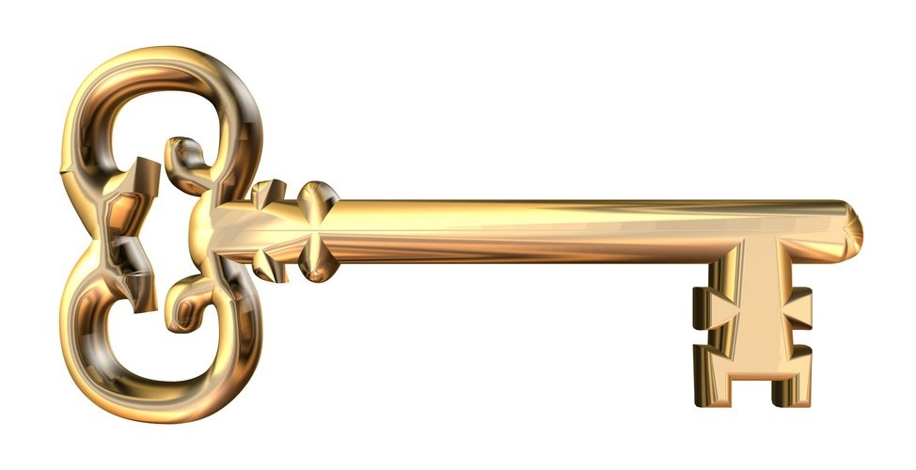
Public-Key Cryptography

Slide 2
Outline
1. Public Key Encryption
2. Symmetric vs. Public-Key
3. RSA Public Key Encryption
4. RSA Key Construction
5. Optimizing Private Key Operations
6. RSA Security

Slide 3
Misconceptions Concerning Public-Key Encryption
Public-key encryption is more secure from cryptanalysis than symmetric encryption
Public-key encryption is a general-purpose technique that has made symmetric encryption obsolete
There is a feeling that key distribution is trivial when using public-key encryption, compared to the cumbersome handshaking involved with key distribution centers for symmetric encryption
Notes:
Before proceeding, we should mention several common misconceptions concerning
public-key encryption. One such misconception is that public-key encryption
is more secure from cryptanalysis than is symmetric encryption. In fact, the
security of any encryption scheme depends on the length of the key and the computational
work involved in breaking a cipher. There is nothing in principle about
either symmetric or public-key encryption that makes one superior to another from
the point of view of resisting cryptanalysis.
A second misconception is that public-key encryption is a general-purpose
technique that has made symmetric encryption obsolete. On the contrary, because
of the computational overhead of current public-key encryption schemes, there
seems no foreseeable likelihood that symmetric encryption will be abandoned. As
one of the inventors of public-key encryption has put it [DIFF88], “the restriction
of public-key cryptography to key management and signature applications is almost
universally accepted.”
Finally, there is a feeling that key distribution is trivial when using public-key
encryption, compared to the rather cumbersome handshaking involved with
key distribution centers for symmetric encryption. In fact, some form of protocol
is needed, generally involving a central agent, and the procedures involved are not
simpler nor any more efficient than those required for symmetric encryption (e.g.,
see analysis in [NEED78]).

Slide 4
Principles of Public-Key Cryptosystems
The concept of public-key cryptography evolved from an attempt to attack two of the most difficult problems associated with symmetric encryption:
Whitfield Diffie and Martin Hellman from Stanford University achieved a breakthrough in 1976 by coming up with a method that addressed both problems and was radically different from all previous approaches to cryptography
Key distribution
Digital signatures
Notes:
The concept of public-key cryptography evolved from an attempt to attack two of
the most difficult problems associated with symmetric encryption. The first problem
is that of key distribution, which is examined in some detail in Chapter 14.
As Chapter 14 discusses, key distribution under symmetric encryption requires
either (1) that two communicants already share a key, which somehow has been distributed
to them; or (2) the use of a key distribution center. Whitfield Diffie, one
of the discoverers of public-key encryption (along with Martin Hellman, both at
Stanford University at the time), reasoned that this second requirement negated
the very essence of cryptography: the ability to maintain total secrecy over your
own communication. As Diffie put it [DIFF88], “what good would it do after all to
develop impenetrable cryptosystems, if their users were forced to share their keys
with a KDC that could be compromised by either burglary or subpoena?”
The second problem that Diffie pondered, and one that was apparently
unrelated to the first, was that of digital signatures . If the use of cryptography
was to become widespread, not just in military situations but for commercial and
private purposes, then electronic messages and documents would need the equivalent
of signatures used in paper documents. That is, could a method be devised
that would stipulate, to the satisfaction of all parties, that a digital message had
been sent by a particular person? This is a somewhat broader requirement than
that of authentication, and its characteristics and ramifications are explored in
Chapter 13.
Diffie and Hellman achieved an astounding breakthrough in 1976
[DIFF76 a, b] by coming up with a method that addressed both problems and was
radically different from all previous approaches to cryptography, going back over
four millennia.

Slide 5
Public-Key Cryptosystems
A public-key encryption scheme has six ingredients:
Plaintext
The readable message or data that is fed into the algorithm as input
Encryption algorithm
Performs various transforma-tions on the plaintext
Public key
Used for encryption or decryption
Private key
Used for encryption or decryption
Ciphertext
The scrambled message produced as output
Decryption algorithm
Accepts the ciphertext and the matching key and produces the original plaintext
Notes:
Asymmetric algorithms rely on one key for encryption and a different but related
key for decryption. These algorithms have the following important characteristic.
• It is computationally infeasible to determine the decryption key given only
knowledge of the cryptographic algorithm and the encryption key.
In addition, some algorithms, such as RSA, also exhibit the following characteristic.
• Either of the two related keys can be used for encryption, with the other used
for decryption.
A public-key encryption scheme has six ingredients (Figure 9.1a; compare
with Figure 3.1).
• Plaintext: This is the readable message or data that is fed into the algorithm as
input.
• Encryption algorithm: The encryption algorithm performs various transformations
on the plaintext.
• Public and private keys: This is a pair of keys that have been selected so that
if one is used for encryption, the other is used for decryption. The exact transformations
performed by the algorithm depend on the public or private key
that is provided as input.
• Ciphertext: This is the scrambled message produced as output. It depends on
the plaintext and the key. For a given message, two different keys will produce
two different ciphertexts.
• Decryption algorithm: This algorithm accepts the ciphertext and the matching
key and produces the original plaintext.

Slide 6
Symmetric and Asymmetric-key Cryptography
Symmetric and asymmetric-key cryptography will exist in parallel and continue to serve the community. We actually believe that they are complements of each other; the advantages of one can compensate for the disadvantages of the other.
Symmetric-key cryptography is based on sharing secrecy;
asymmetric-key cryptography is based on personal secrecy.

Slide 7
Need for Both
There is a very important fact that is sometimes misunderstood: The advent of asymmetric-key cryptography does not eliminate the need for symmetric-key cryptography.

Slide 8
Public Key Cryptography
Invented in 1975 by Diffie and Hellman at Stanford
Encrypted_Message = Encrypt (Key1, Message)
Message = Decrypt (Key2, Encrypted_Message)
Keys are interchangeable
One key is made public while the other is kept private
Sender knows only public key of the receiver =>Asymmetric

Slide 9
Public Key Cryptography
Key1
Key2
Plain text
Cipher text
Plain text
Key2
Key1
Plain text
Cipher text
Plain text

Slide 10
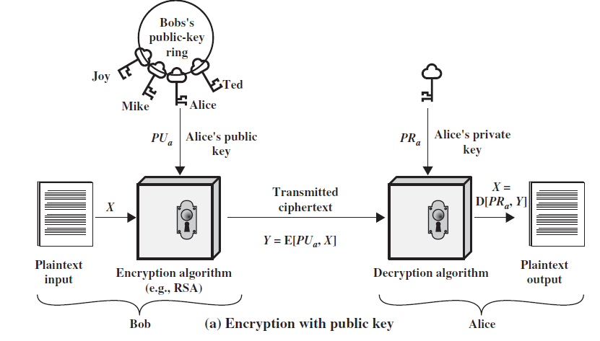
Encryption with Public Key

Slide 11
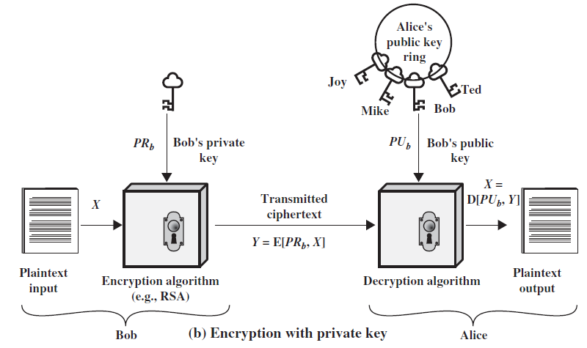
Encryption with Private Key

Slide 12
Why Public-Key Cryptography?
Developed to address two key issues:
key distribution – how to have secure communications in general without having to trust a KDC with your key
digital signatures – how to verify a message comes intact from the claimed sender
Notes:
The idea of public key schemes, and the first practical scheme, which was for key distribution only, was published in 1977 by Diffie & Hellman. The concept had been previously described in a classified report in 1970 by James Ellis (UK CESG) - and subsequently declassified in 1987. See History of Non-secret Encryption (at CESG). Its interesting to note that they discovered RSA first, then Diffie-Hellman, opposite to the order of public discovery!

Slide 13
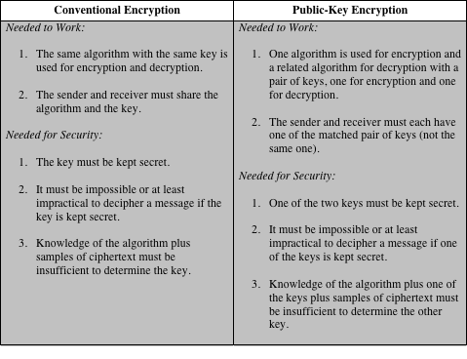
Conventional and Public-Key Encryption
Notes:
Table 9.2 summarizes some of the important aspects of symmetric and public-key
encryption. To discriminate between the two, we refer to the key used in symmetric
encryption as a secret key . The two keys used for asymmetric encryption are
referred to as the public key and the private key . Invariably, the private key is kept
secret, but it is referred to as a private key rather than a secret key to avoid confusion
with symmetric encryption.

Slide 14
Public-Key Characteristics
Public-Key algorithms rely on two keys with the characteristics that it is:
computationally infeasible to find decryption key knowing only algorithm & encryption key
computationally easy to en/decrypt messages when the relevant (en/decrypt) key is known
either of the two related keys can be used for encryption, with the other used for decryption (in some schemes)
Notes:
Public key schemes utilise problems that are easy (P type) one way but hard (NP type) the other way, eg exponentiation vs logs, multiplication vs factoring. Consider the following analogy using padlocked boxes: traditional schemes involve the sender putting a message in a box and locking it, sending that to the receiver, and somehow securely also sending them the key to unlock the box. The radical advance in public key schemes was to turn this around, the receiver sends an unlocked box to the sender, who puts the message in the box and locks it (easy - and having locked it cannot get at the message), and sends the locked box to the receiver who can unlock it (also easy), having the key. An attacker would have to pick the lock on the box (hard).

Slide 15
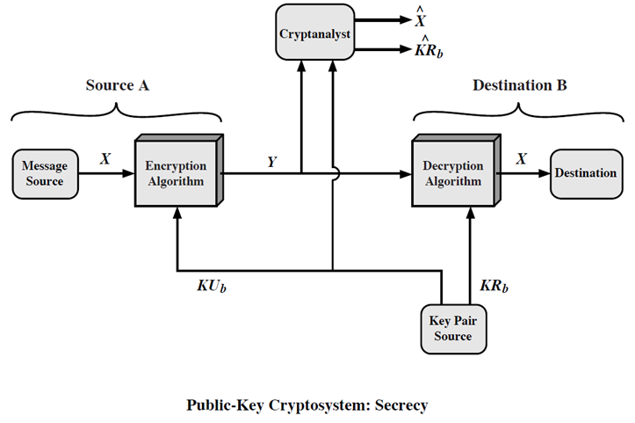
Public-Key: Secrecy
Notes:
Public key schemes utilise problems that are easy (P type) one way but hard (NP type) the other way, eg exponentiation vs logs, multiplication vs factoring. Consider the following analogy using padlocked boxes: traditional schemes involve the sender putting a message in a box and locking it, sending that to the receiver, and somehow securely also sending them the key to unlock the box. The radical advance in public key schemes was to turn this around, the receiver sends an unlocked box to the sender, who puts the message in the box and locks it (easy - and having locked it cannot get at the message), and sends the locked box to the receiver who can unlock it (also easy), having the key. An attacker would have to pick the lock on the box (hard).

Slide 16
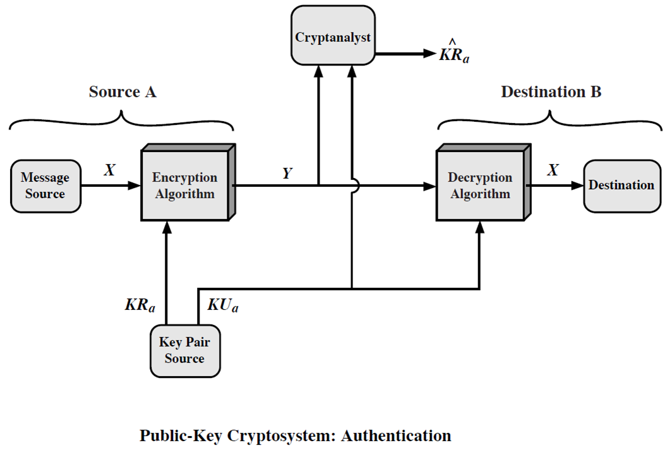
Public-Key: Authentication
Notes:
Public key schemes utilise problems that are easy (P type) one way but hard (NP type) the other way, eg exponentiation vs logs, multiplication vs factoring. Consider the following analogy using padlocked boxes: traditional schemes involve the sender putting a message in a box and locking it, sending that to the receiver, and somehow securely also sending them the key to unlock the box. The radical advance in public key schemes was to turn this around, the receiver sends an unlocked box to the sender, who puts the message in the box and locks it (easy - and having locked it cannot get at the message), and sends the locked box to the receiver who can unlock it (also easy), having the key. An attacker would have to pick the lock on the box (hard).

Slide 17
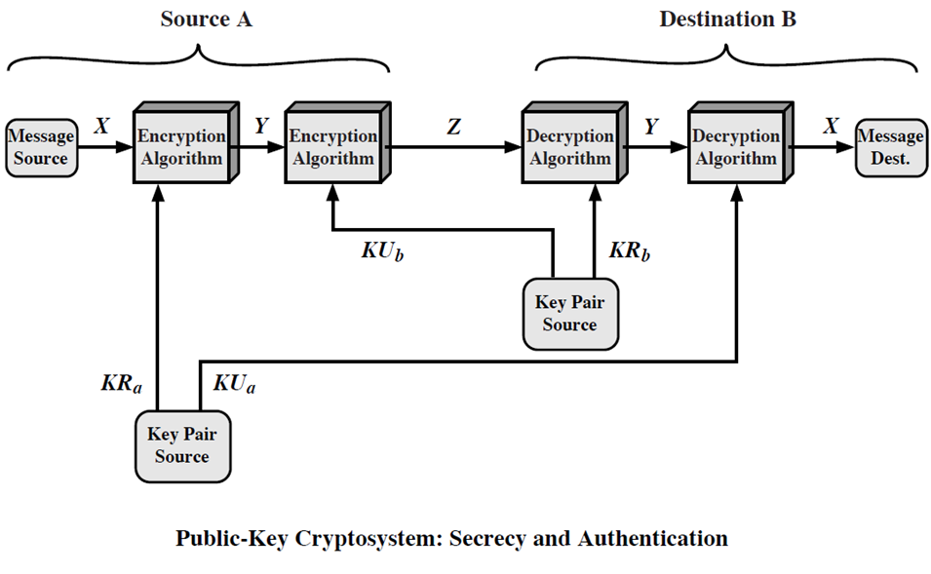
Public-Key: Secrecy and Authentication
Notes:
Public key schemes utilise problems that are easy (P type) one way but hard (NP type) the other way, eg exponentiation vs logs, multiplication vs factoring. Consider the following analogy using padlocked boxes: traditional schemes involve the sender putting a message in a box and locking it, sending that to the receiver, and somehow securely also sending them the key to unlock the box. The radical advance in public key schemes was to turn this around, the receiver sends an unlocked box to the sender, who puts the message in the box and locks it (easy - and having locked it cannot get at the message), and sends the locked box to the receiver who can unlock it (also easy), having the key. An attacker would have to pick the lock on the box (hard).

Slide 18
Public-Key Applications
Can classify uses into 3 categories:
encryption/decryption (provide secrecy)
digital signatures (provide authentication)
key exchange (of session keys)
Some algorithms are suitable for all uses, others are specific to one

Slide 19
Public-Key Cryptography: Requirements
The main idea behind asymmetric-key cryptography is the concept of the trapdoor one-way function.
A one-way function is one that maps a domain into a range such that every function value has a unique inverse, with the condition that the calculation of the function is easy, whereas the calculation of the inverse is infeasible
Y = f(X) easy
X = f^{–1}(Y) infeasible

Slide 20
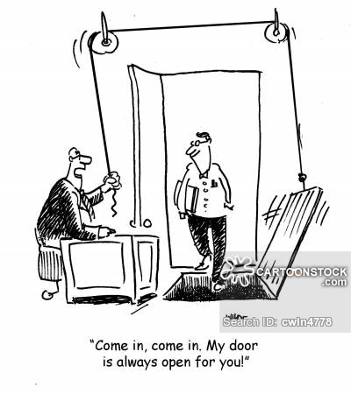
Trapdoor One-Way Function
A trap-door one-way function is a family of invertible functions f_{k}, such that
Y = f_{k}(X) easy, if k and X are known
X = f_{k}^{–1}(Y) easy, if k and Y are known
X = f_{k}^{–1}(Y) infeasible, if Y known but k not known
A practical public-key scheme depends on a suitable trap-door one-way function

Slide 21
Security of Public Key Schemes
Like private key schemes brute force exhaustive search attack is always theoretically possible
But keys used are too large (>512bits)
Security relies on a large enough difference in difficulty between easy (en/decrypt) and hard (cryptanalyse) problems
More generally the hard problem is known, but is made hard enough to be impractical to break
Requires the use of very large numbers
Hence is slow compared to private key schemes

Slide 22
Public-Key Cryptanalysis
A public-key encryption scheme is vulnerable to a brute-force attack
Countermeasure: use large keys
Key size must be small enough for practical encryption and decryption
Key sizes that have been proposed result in encryption /decryption speeds that are too slow for general-purpose use
Public-key encryption is currently confined to key management and signature applications

Slide 23
Public-Key Cryptanalysis (cont.)
Another form of attack is to find some way to compute the private key given the public key
To date it has not been mathematically proven that this form of attack is infeasible for a particular public-key algorithm
Finally, there is a probable-message attack
This attack can be thwarted by appending some random bits to simple messages
The public key is known- Encrypt all possible messages- Try to find a match between the ciphertext and one of the above encrypted messages
Probable message attack

Slide 24
RSA Cryptosystem
Developed in 1977 at MIT by Ron Rivest, Adi Shamir & Len Adleman
Most widely used general-purpose approach to public-key encryption
Is a cipher in which the plaintext and ciphertext are integers between 0 and n – 1 for some n
A typical size for n is 1024 bits, or 309 decimal digits

Slide 25
RSA Algorithm
RSA makes use of an expression with exponentials
Plaintext is encrypted in blocks with each block having a binary value less than some number n
Encryption and decryption are of the following form, for some plaintext block M and ciphertext block C
C = Me mod n
M = C^{d} mod n = (Me)^{d} mod n = M^{ed} mod n

Slide 26
RSA Algorithm (cont)
Both sender and receiver must know the value of n
The sender knows the value of e, and only the receiver knows the value of d
This is a public-key encryption algorithm with a public key of PU={e,n} and a private key of PR={d,n}

Slide 27
RSA Algorithm Requirements
For this algorithm to be satisfactory for public-key encryption, the following requirements must be met:
1. It is possible to find values of e, d, n such that M^{ed} mod n = M for all M < n
2. It is relatively easy to calculate Me mod n and C^{d} mod n for all values of M < n
3. It is infeasible to determine d given e and n

Slide 28
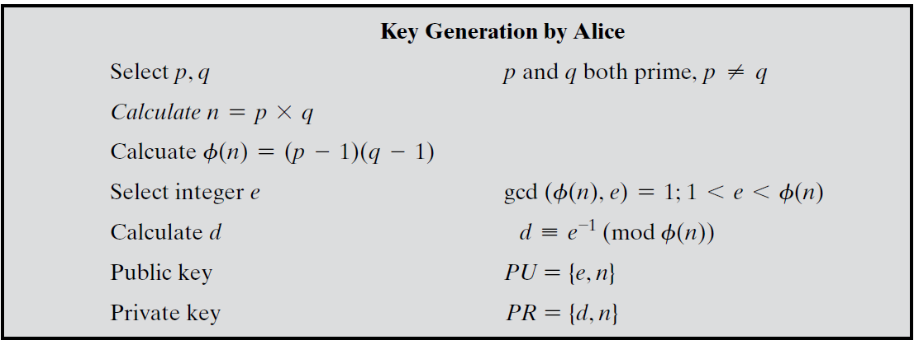



Slide 29
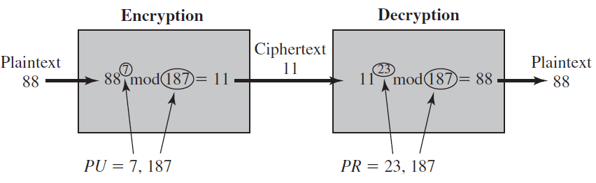
RSA: Example

Slide 30
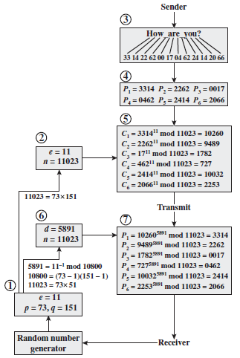
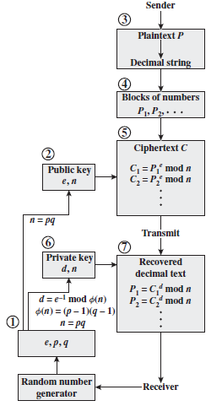
RSA: Processing of Multiple blocks

Slide 31
Exponentiation in Modular Arithmetic
Both encryption and decryption in RSA involve raising an integer to an integer power, mod n
Can make use of a property of modular arithmetic:
[(a mod n) x (b mod n)] mod n =(a x b) mod n
With RSA you are dealing with potentially large exponents so efficiency of exponentiation is a consideration

Slide 32

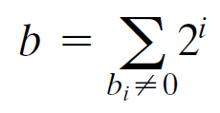

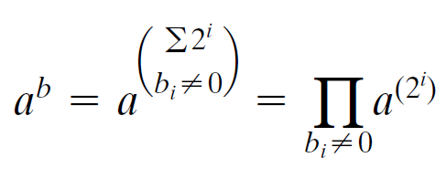
Exponentiation in Modular Arithmetic

Slide 33
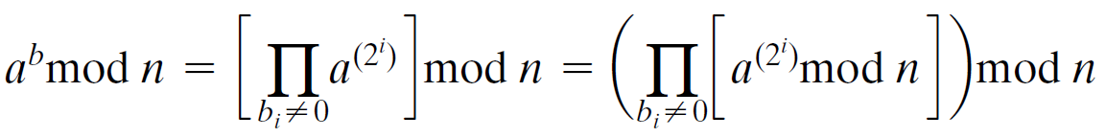
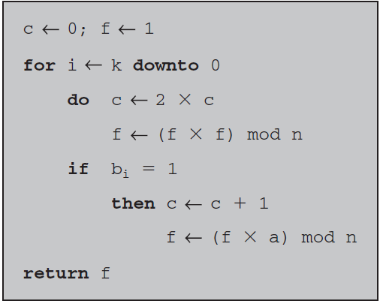

Algorithm for Computing a^{b} mod n
Note that
the variable c is not needed; it is included for explanatory purposes. The final value
of c is the value of the exponent.

Slide 34
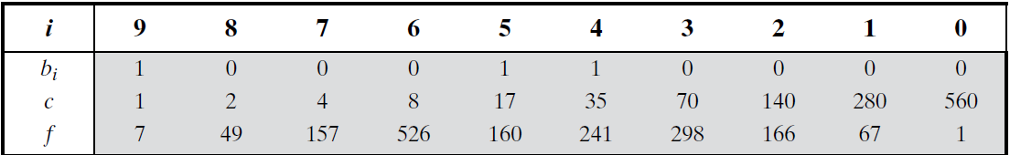
Algorithm for Computing a^{b} mod n

Slide 35
Efficient Operation Using the Public Key
To speed up the operation of the RSA algorithm using the public key, a specific choice of e is usually made
The most common choice is 65537 (2¹⁶ + 1)
Two other popular choices are e=3 and e=17
Each of these choices has only two 1 bits, so the number of multiplications required to perform exponentiation is minimized
With a very small public key, such as e = 3, RSA becomes vulnerable to a simple attack

Slide 36
Key Generation
Before the application of the public-key cryptosystem each participant must generate a pair of keys:
Determine two prime numbers p and q
Select either e or d and calculate the other
Because the value of n = pq will be known to any potential adversary, primes must be chosen from a sufficiently large set
The method used for finding large primes must be reasonably efficient

Slide 37
Procedure for Picking a Prime Number
Pick an odd integer n at random
Pick an integer a < n at random
Perform the probabilistic primality test with a as a parameter. If n fails the test, reject the value n and go to step 1
If n has passed a sufficient number of tests, accept n; otherwise, go to step 2

Slide 38
Security of RSA
Five possible approaches to attacking RSA are:
Brute force
This type of attack exploits properties of the RSA algorithm
Chosen ciphertext attacks
This involves inducing hardware faults in the processor that is generating digital signatures
Hardware fault-based attack
These depend on the running time of the decryption algorithm
Timing attacks
There are several approaches, all equivalent in effort to factoring the product of two primes
Mathematical attacks
Involves trying all possible private keys

Slide 39
Factoring Problem
We can identify three approaches to attacking RSA mathematically:
Factor n into its two prime factors. This enables calculation of ø(n) = (p – 1) x (q – 1), which in turn enables determination of d = e⁻¹ (mod ø(n))
Determine ø(n) directly without first determining p and q. Again this enables determination of d = e⁻¹ (mod ø(n))
Determine d directly without first determining ø(n)

Slide 40
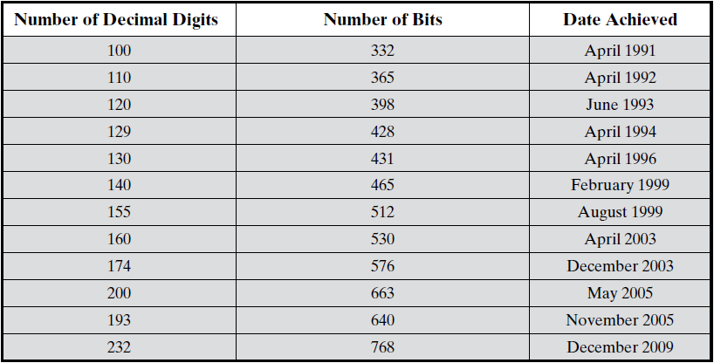
Progress in RSA Factorization

Slide 41
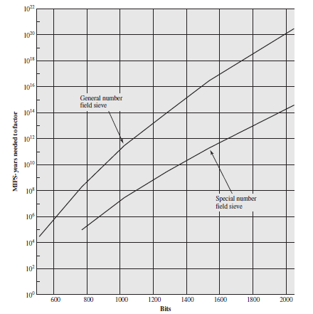
MIPS Years needed to Factor

Slide 42
Timing Attack
Paul Kocher, a cryptographic consultant, demonstrated that a snooper can determine a private key by keeping track of how long a computer takes to decipher messages
Are applicable not just to RSA but to other public-key cryptography systems
Are alarming for two reasons:
It comes from a completely unexpected direction
It is a ciphertext-only attack

Slide 43
Counter Measures
Constant exponentiation time
Ensure that all exponentiations take the same amount of time before returning a result; this is a simple fix but does degrade performance
Random delay
Better performance could be achieved by adding a random delay to the exponentiation algorithm to confuse the timing attack
Blinding
Multiply the ciphertext by a random number before performing exponentiation; this process prevents the attacker from knowing what ciphertext bits are being processed inside the computer and therefore prevents the bit-by-bit analysis essential to the timing attack

Slide 44
Fault-based Attack
An attack on a processor that is generating RSA digital signatures
Induces faults in the signature computation by reducing the power to the processor
The faults cause the software to produce invalid signatures which can then be analyzed by the attacker to recover the private key
The attack algorithm involves inducing single-bit errors and observing the results
While worthy of consideration, this attack does not appear to be a serious threat to RSA
It requires that the attacker have physical access to the target machine and is able to directly control the input power to the processor

Slide 45
Chosen CipherText Attack
The adversary chooses a number of ciphertexts and is then given the corresponding plaintexts, decrypted with the target’s private key
Thus the adversary could select a plaintext, encrypt it with the target’s public key, and then be able to get the plaintext back by having it decrypted with the private key
The adversary exploits properties of RSA and selects blocks of data that, when processed using the target’s private key, yield information needed for cryptanalysis

Slide 46
Chosen CipherText Attack
To counter such attacks, RSA Security Inc. recommends modifying the plaintext using a procedure known as optimal asymmetric encryption padding (OAEP)

Slide 47
Attacks on RSA
Attack bsed on the multiplicative property of RSA. Let Alice creates C=P^{e} mod n and sends it to Bob. Bob will decrypt an arbitrary ciphertext for Eve other than C. Eve intercepts C and do following steps to get P
Eve chooses a random integer X in Z_{n}*.
Eve calculates Y=C×Xe mod n.
Eve sends Y to Bob for decryption and get Z= Y^{d} mod n; This step is an instance of a chosen-ciphertext attack.
Eve can easily find P because
Z= Y^{d} mod n=(C× Xe )^{d} mod n
=( C^{d} × X^{ed} ) mod n=( C^{d} ×X) mod n
=(P × X) mod n → P=Z×X⁻¹ mod n

Slide 48
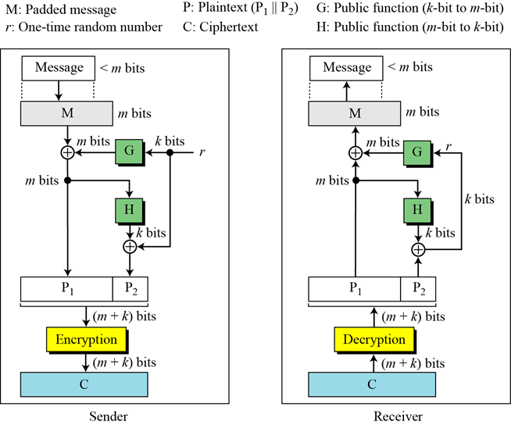
Optimal Asymmetric Encryption Padding (OAEP)

Slide 49
Continued
Proof of RSA

Slide 50
Some Trivial Examples
Example
Bob chooses 7 and 11 as p and q and calculates n = 77. The value of f(n) = (7 − 1)(11 − 1) or 60. Now he chooses two exponents, e and d, from Z₆₀∗. If he chooses e to be 13, then d is 37. Note that e × d mod 60 = 1 (they are inverses of each Now imagine that Alice wants to send the plaintext 5 to Bob. She uses the public exponent 13 to encrypt 5.
Bob receives the ciphertext 26 and uses the private key 37 to decipher the ciphertext:

Slide 51
Some Trivial Examples
Example
Now assume that another person, John, wants to send a message to Bob. John can use the same public key announced by Bob (probably on his website), 13; John’s plaintext is 63. John calculates the following:
Bob receives the ciphertext 28 and uses his private key 37 to decipher the ciphertext:

Slide 52
Some Trivial Examples
Example
Jennifer creates a pair of keys for herself. She chooses p = 397 and q = 401. She calculates n = 159197. She then calculates f(n) = 158400. She then chooses e = 343 and d = 12007. Show how Ted can send a message to Jennifer if he knows e and n.
Suppose Ted wants to send the message “NO” to Jennifer. He changes each character to a number (from 00 to 25), with each character coded as two digits. He then concatenates the two coded characters and gets a four-digit number. The plaintext is 1314. Figure 10.7 shows the process.

Slide 53
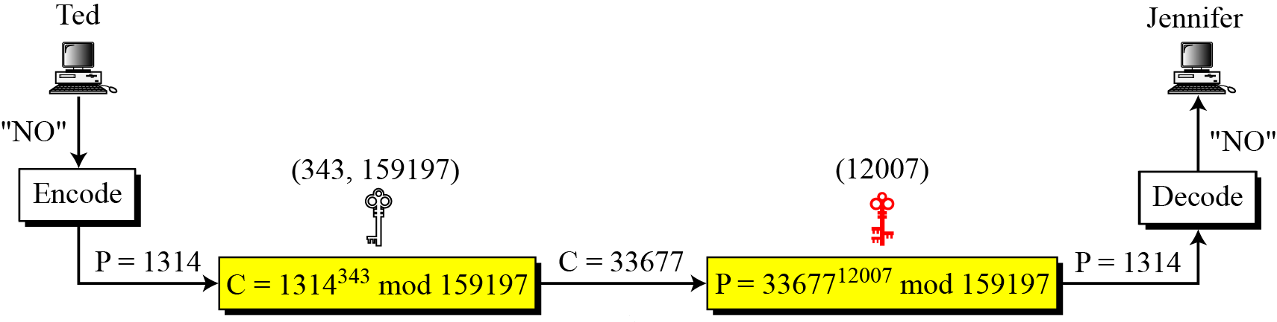
Continued
Figure Encryption and decryption in Example

Slide 54
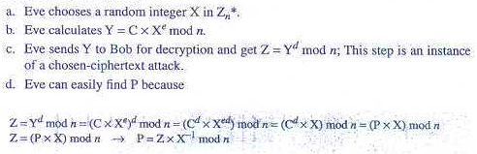
Attacks on RSA
Attack bsed on the multiplicative property of RSA. Let Alice creates C=P^{e} mod n and sends it to Bob. Bob will decrypt an arbitrary ciphertext for Eve other than C. Eve intercepts C and do following steps to get P

Slide 55
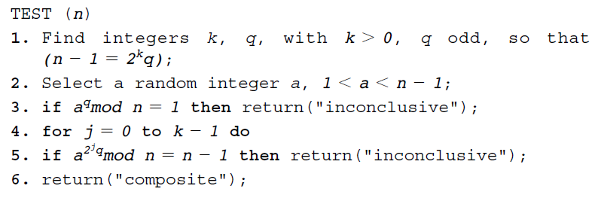
Miller-Rabin Algorithm for Primality Test
The procedure TEST takes a candidate integer n as input and returns the result composite if n is definitely not a prime, and the result inconclusive if n may or may not be a prime.
Notes:
This chapter continues our overview of public-key cryptography systems (PKCSs), and begins with a description of one of the earliest and simplest PKCS, Diffie-Hellman key exchange. This first published public-key algorithm appeared in the seminal paper by Diffie and Hellman that defined public-key cryptography [DIFF76b] and is generally referred to as Diffie-Hellman key exchange. The concept had been previously described in a classified report in 1970 by Williamson (UK CESG) - and subsequently declassified in 1987, see [ELLI99]. The purpose of the algorithm is to enable two users to securely exchange a key that can then be used for subsequent encryption of messages. The algorithm itself is limited to the exchange of secret values. A number of commercial products employ this key exchange technique.

Slide 56
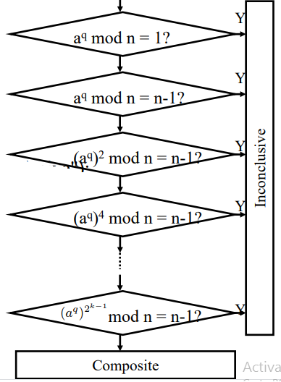
Miller-Rabin Algorithm for Primality Test
Notes:
This chapter continues our overview of public-key cryptography systems (PKCSs), and begins with a description of one of the earliest and simplest PKCS, Diffie-Hellman key exchange. This first published public-key algorithm appeared in the seminal paper by Diffie and Hellman that defined public-key cryptography [DIFF76b] and is generally referred to as Diffie-Hellman key exchange. The concept had been previously described in a classified report in 1970 by Williamson (UK CESG) - and subsequently declassified in 1987, see [ELLI99]. The purpose of the algorithm is to enable two users to securely exchange a key that can then be used for subsequent encryption of messages. The algorithm itself is limited to the exchange of secret values. A number of commercial products employ this key exchange technique.

Slide 57
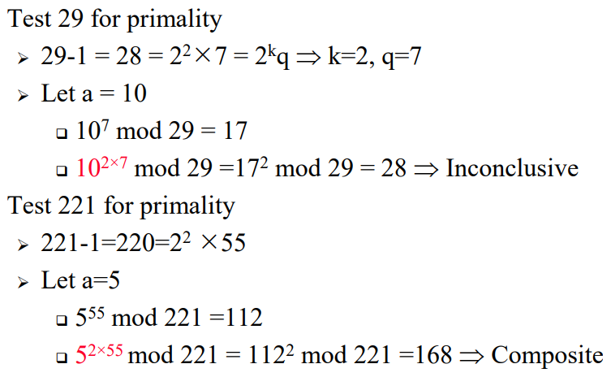
Miller-Rabin Algorithm for Primality Test
Notes:
This chapter continues our overview of public-key cryptography systems (PKCSs), and begins with a description of one of the earliest and simplest PKCS, Diffie-Hellman key exchange. This first published public-key algorithm appeared in the seminal paper by Diffie and Hellman that defined public-key cryptography [DIFF76b] and is generally referred to as Diffie-Hellman key exchange. The concept had been previously described in a classified report in 1970 by Williamson (UK CESG) - and subsequently declassified in 1987, see [ELLI99]. The purpose of the algorithm is to enable two users to securely exchange a key that can then be used for subsequent encryption of messages. The algorithm itself is limited to the exchange of secret values. A number of commercial products employ this key exchange technique.

Slide 58
Chinese Remainder Theorem (cont.)
The Chinese remainder theorem (CRT) is used to solve a set of congruent equations with one variable but different moduli, which are relatively prime, as shown
below:

Slide 59
Chinese Remainder Theorem (cont.)
Example
The following is an example of a set of equations with different moduli:
The solution to this set of equations is given in the next section; for the moment, note that the answer to this set of equations is x = 23. This value satisfies all equations: 23 ≡ 2 (mod 3), 23 ≡ 3 (mod 5), and 23 ≡ 2 (mod 7).

Slide 60
Chinese Remainder Theorem (cont.)
Solution To Chinese Remainder Theorem
1. Find M = m₁ × m₂ × … × m_{k}. This is the common modulus.
2. Find M₁ = M/m₁, M₂ = M/m₂, …, M_{k} = M/m_{k}.
3. Find the multiplicative inverse of M₁, M₂, …, M_{k} using the corresponding moduli (m₁, m₂, …, m_{k}). Call the inverses M₁⁻¹, M₂⁻¹, …, M_{k} ⁻¹.
4. The solution to the simultaneous equations is

Slide 61
Chinese Remainder Theorem (cont.)
Example
Find the solution to the simultaneous equations:
Solution We follow the four steps.
1. M = 3 × 5 × 7 = 105
2. M₁ = 105 / 3 = 35, M₂ = 105 / 5 = 21, M₃ = 105 / 7 = 15
3. The inverses are M₁⁻¹ = 2, M₂⁻¹ = 1, M₃ ⁻¹ = 1
4. x = (2 × 35 × 2 + 3 × 21 × 1 + 2 × 15 × 1) mod 105 = 23 mod 105

Slide 62
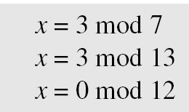
Chinese Remainder Theorem (cont.)
Example
Find an integer that has a remainder of 3 when divided by 7 and 13, but is divisible by 12.
Solution This is a CRT problem. We can form three equations and solve them to find the value of x.
If we follow the four steps, we find x = 276. We can check that 276 = 3 mod 7, 276 = 3 mod 13 and 276 is divisible by 12 (the quotient is 23 and the remainder is zero).

Slide 63
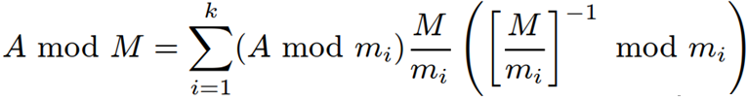
Chinese Remainder Theorem (cont.)
mod M = m₁m₂..m_{k}
Chinese Remainder theorem lets us work in each moduli m_{i} separately
Since computational cost is proportional to size, this is faster

Slide 64
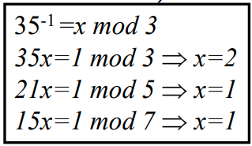
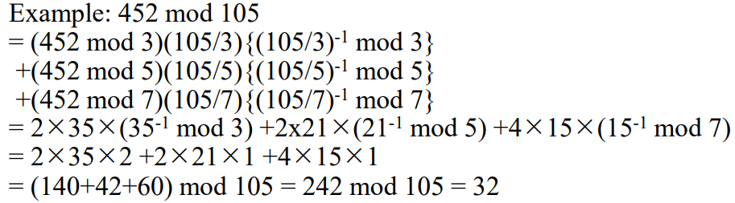
Chinese Remainder Theorem (cont.)

Slide 65
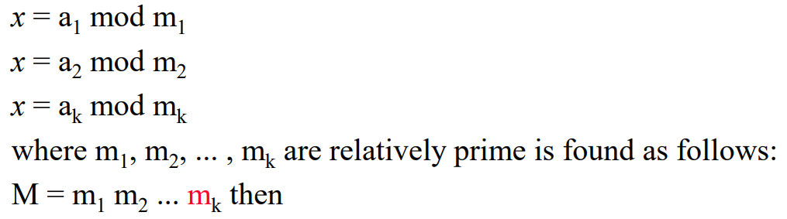
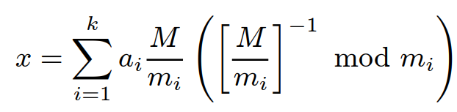
Chinese Remainder Theorem (cont.)

Slide 66
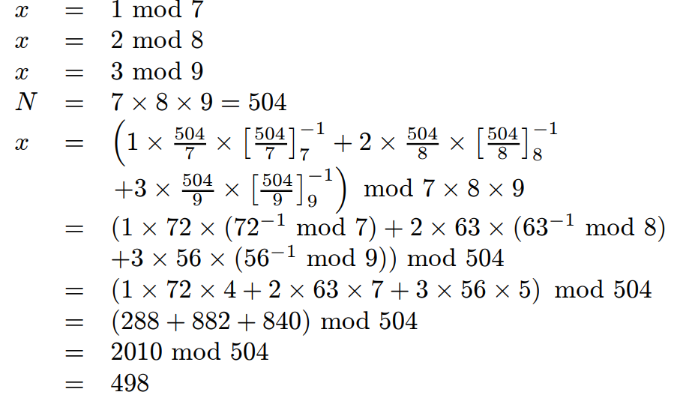
Chinese Remainder Theorem (cont.)

Slide 67
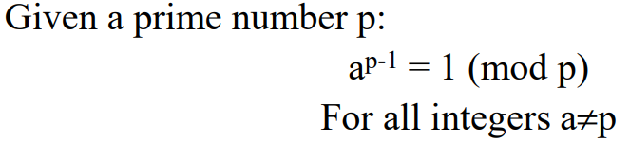


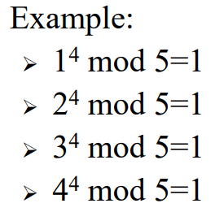
Fermat's Little Theorem

Slide 68
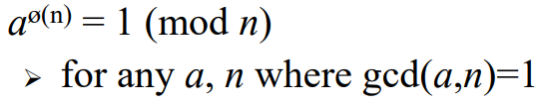
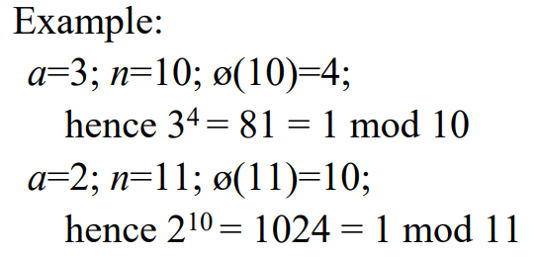

Euler's Theorem

Slide 69
RABIN CRYPTOSYSTEM
The Rabin cryptosystem can be thought of as an RSA cryptosystem in which the value of e and d are fixed. The encryption is C ≡ P² (mod n) and the decryption is P ≡ C^{1/2} (mod n).
Topics :
1 Procedure
2 Security of the Rabin System

Slide 70
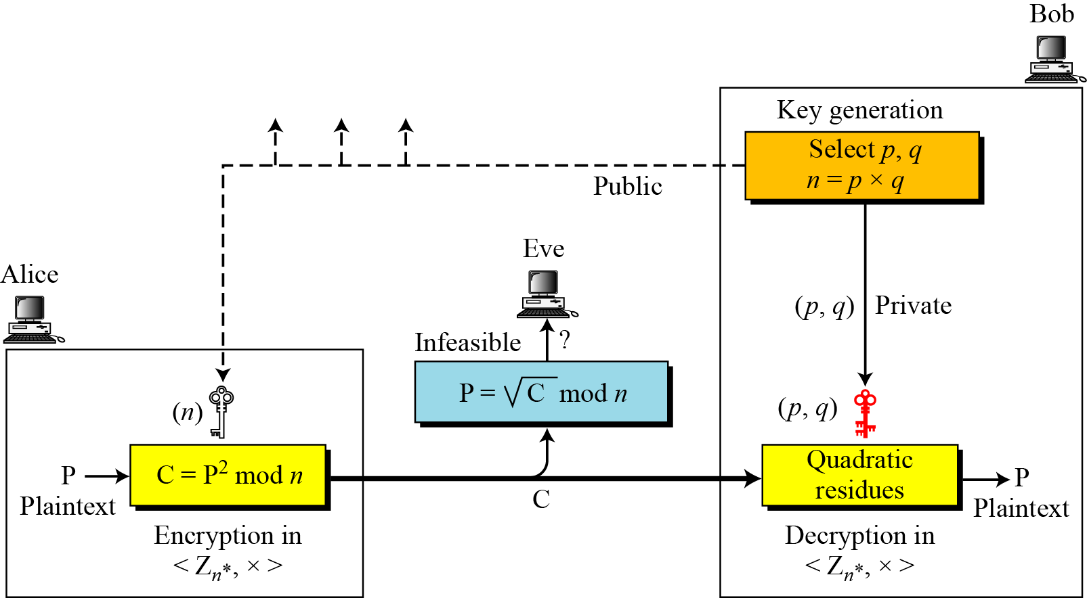
Continued
Figure Rabin cryptosystem

Slide 71
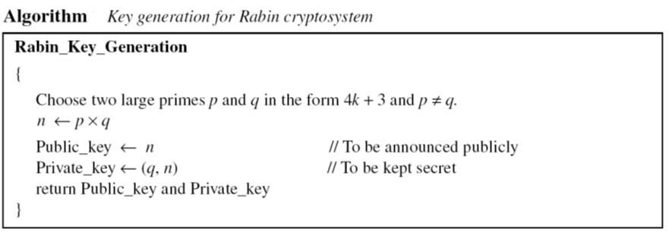
Continued

Slide 72
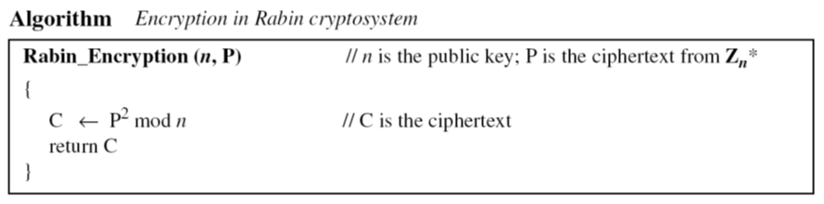
Continued
Encryption

Slide 73
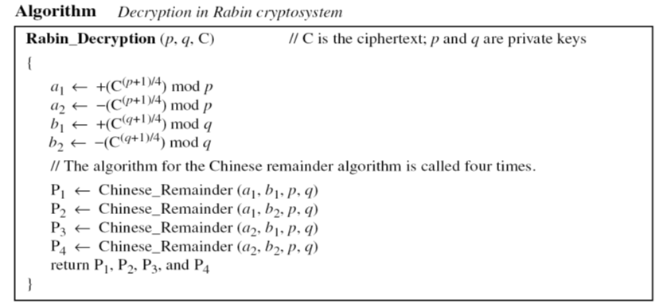
Continued
Decryption
The Rabin cryptosystem is not deterministic: Decryption creates four plaintexts.

Slide 74
Continued
Example
Here is a very trivial example to show the idea.
Bob selects p = 23 and q = 7. Note that both are congruent to 3 mod 4.
Bob calculates n = p × q = 161.
Bob announces n publicly; he keeps p and q private.
Alice wants to send the plaintext P = 24. Note that 161 and 24 are relatively prime; 24 is in Z₁₆₁*. She calculates C = 24² = 93 mod 161, and sends the ciphertext 93 to Bob.

Slide 75
Continued
Example
Bob receives 93 and calculates four values: a₁ = +(93 ^{(23+1)/4}) mod 23 = 1 mod 23 a₂ = −(93 ^{(23+1)/4}) mod 23 = 22 mod 23 b₁ = +(93 ^{(7+1)/4}) mod 7 = 4 mod 7 b₂ = −(93 ^{(7+1)/4}) mod 7 = 3 mod 7
Bob takes four possible answers, (a₁, b₁), (a₁, b₂), (a₂, b₁), and (a₂, b₂), and uses the Chinese remainder theorem to find four possible plaintexts: 116, 24, 137, and 45. Note that only the second answer is Alice’s plaintext.

Slide 76
Diffie-Hellman Key Exchange
First public-key type scheme proposed
By Diffie & Hellman in 1976 along with the exposition of public key concepts
note: now know that Williamson (UK CESG) secretly proposed the concept in 1970
Is a practical method for public exchange of a secret key
Used in a number of commercial products
Notes:
This chapter continues our overview of public-key cryptography systems (PKCSs), and begins with a description of one of the earliest and simplest PKCS, Diffie-Hellman key exchange. This first published public-key algorithm appeared in the seminal paper by Diffie and Hellman that defined public-key cryptography [DIFF76b] and is generally referred to as Diffie-Hellman key exchange. The concept had been previously described in a classified report in 1970 by Williamson (UK CESG) - and subsequently declassified in 1987, see [ELLI99]. The purpose of the algorithm is to enable two users to securely exchange a key that can then be used for subsequent encryption of messages. The algorithm itself is limited to the exchange of secret values. A number of commercial products employ this key exchange technique.

Slide 77
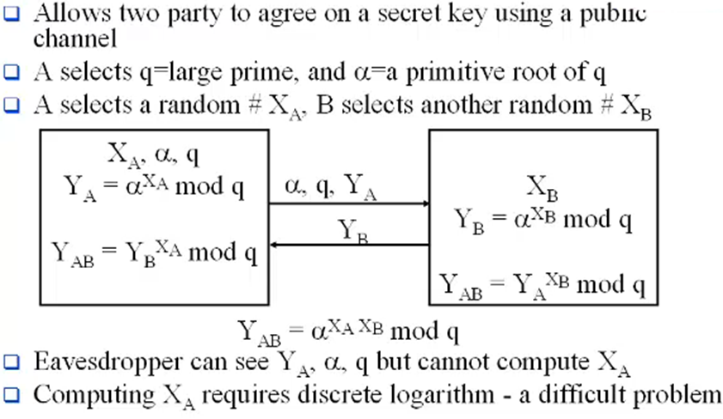
Diffie-Hellman Key Exchange

Slide 78
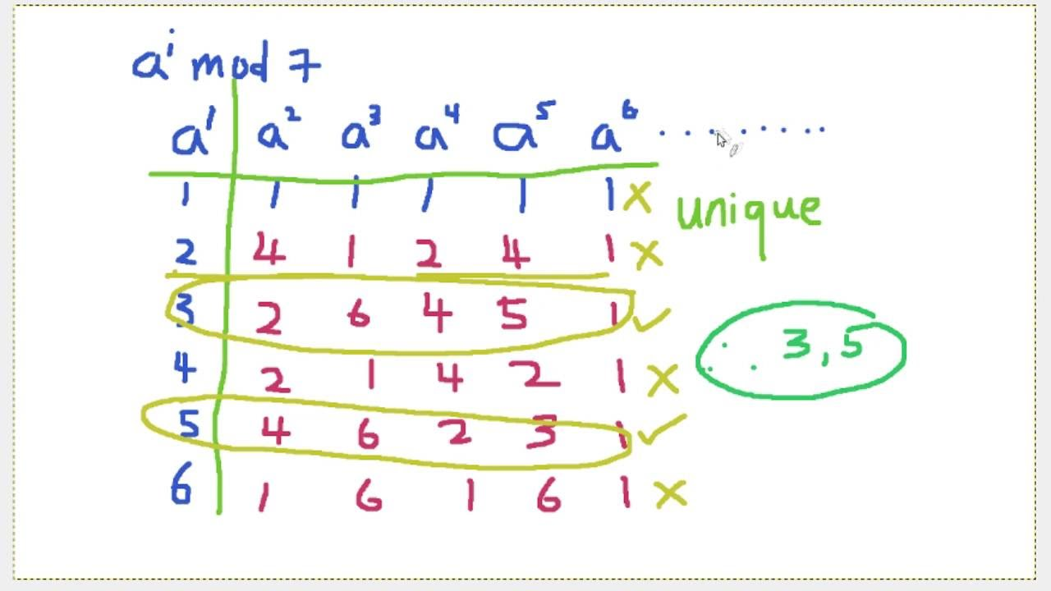
Diffie-Hellman Key Exchange

Slide 79
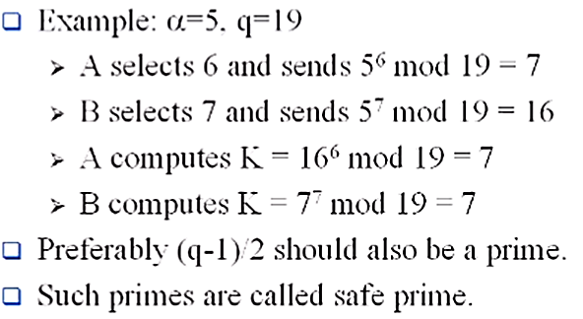
Diffie-Hellman Key Exchange (cont.)

Slide 80
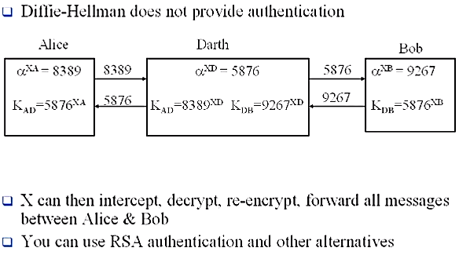
Man-in-the-Middle Attack

Slide 81
ELGAMAL CRYPTOSYSTEM
Besides RSA and Rabin, another public-key cryptosystem is ElGamal. ElGamal is based on the discrete logarithm problem.

Slide 82
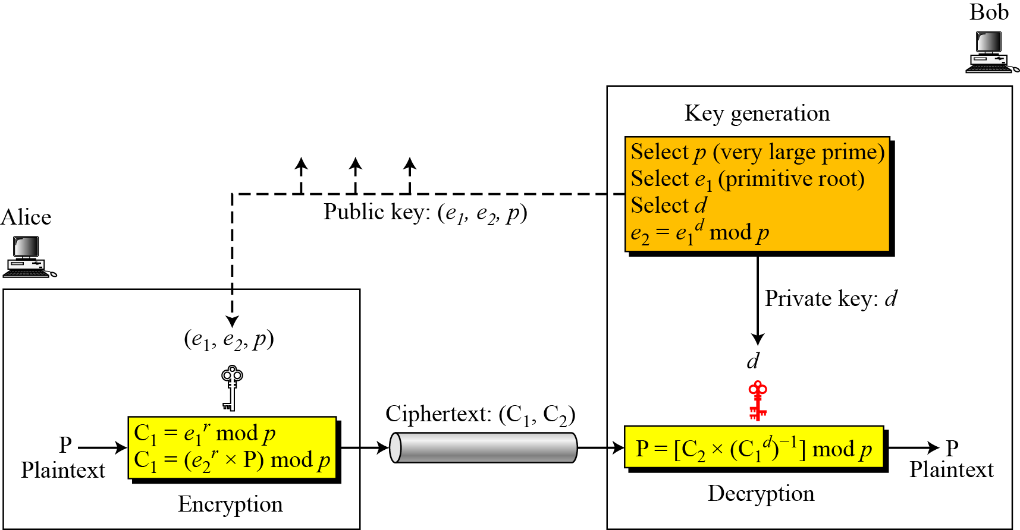
Procedure
Figure Key generation, encryption, and decryption in ElGamal

Slide 83
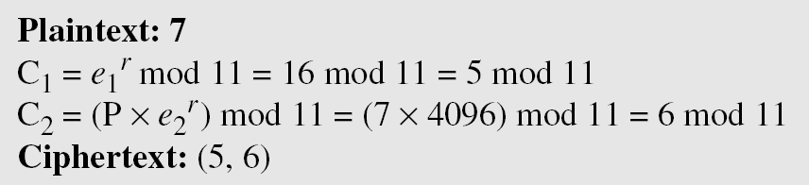
Continued
Example
Here is a trivial example. Bob chooses p = 11 and e₁ = 2. and d = 3 e₂ = e₁^{d} = 8. So the public keys are (2, 8, 11) and the private key is 3. Alice chooses r = 4 and calculates C1 and C2 for the plaintext 7.
Bob receives the ciphertexts (5 and 6) and calculates the plaintext.

Slide 84
Digital Signature

Slide 85
COMPARISON
Let us begin by looking at the differences between conventional signatures and digital signatures.
Topics discussed in this section:
Inclusion
Verification Method
Relationship
Duplicity

Slide 86
Inclusion
A conventional signature is included in the document; it is part of the document. But when we sign a document digitally, we send the signature as a separate document.

Slide 87
Verification Method
For a conventional signature, when the recipient receives a document, he/she compares the signature on the document with the signature on file. For a digital signature, the recipient receives the message and the signature. The recipient needs to apply a verification technique to the combination of the message and the signature to verify the authenticity.

Slide 88
Relationship
For a conventional signature, there is normally a one-to-many relationship between a signature and documents (same signature to many documents). For a digital signature, there is a one-to-one relationship between a signature and a message.

Slide 89
Duplicity
In conventional signature, a copy of the signed document can be distinguished from the original one on file. In digital signature, there is no such distinction unless there is a factor of time on the document.

Slide 90
PROCESS
Figure in the next slide shows the digital signature process. The sender uses a signing algorithm to sign the message. The message and the signature are sent to the receiver. The receiver receives the message and the signature and applies the verifying algorithm to the combination. If the result is true, the message is accepted; otherwise, it is rejected.
Topics
Need for Keys
Signing the Digest

Slide 91
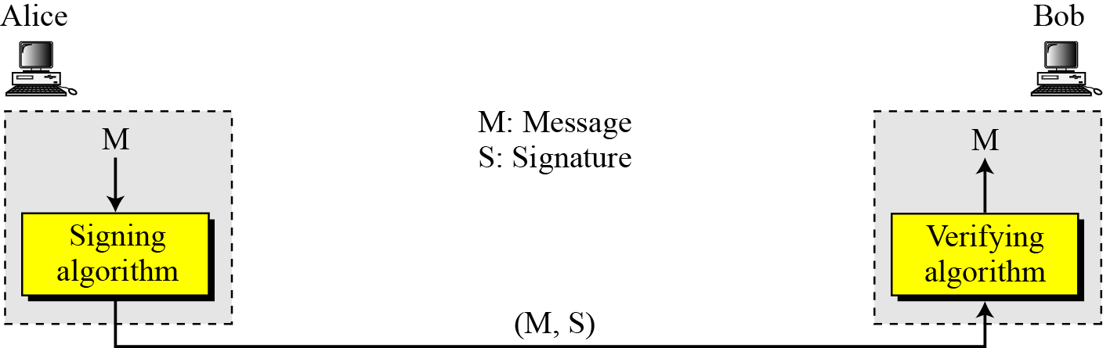
Continued
Figure Digital signature process

Slide 92
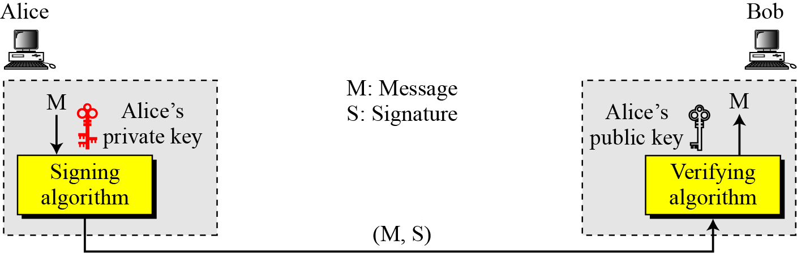
Need for Keys
Figure Adding key to the digital signature process
A digital signature needs a public-key system.
The signer signs with her private key; the verifier verifies with the signer’s public key.

Slide 93
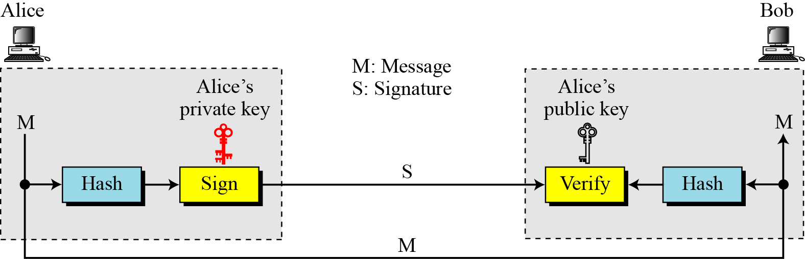
Signing the Digest
Figure Signing the digest

Slide 94
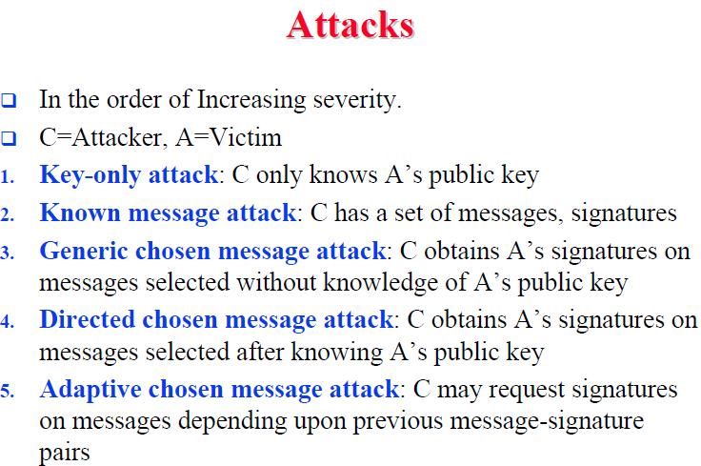

Slide 95


Slide 96


Slide 97
SERVICES
We discussed several security services including message confidentiality, message authentication, message integrity, and nonrepudiation. A digital signature can directly provide the last three; for message confidentiality we still need encryption/decryption.
Topics
Message Authentication
Message Integrity
Nonrepudiation
Confidentiality

Slide 98
Message Authentication
A secure digital signature scheme, like a secure conventional signature can provide message authentication.
A digital signature provides message authentication.

Slide 99
Message Integrity
The integrity of the message is preserved even if we sign the whole message because we cannot get the same signature if the message is changed.
A digital signature provides message integrity.

Slide 100

Nonrepudiation
Figure Using a trusted center for nonrepudiation
Nonrepudiation can be provided using a trusted party.

Slide 101

Confidentiality
Figure Adding confidentiality to a digital signature scheme
A digital signature does not provide privacy.
If there is a need for privacy, another layer of encryption/decryption must be applied.

Slide 102
DIGITAL SIGNATURE SCHEMES
Several digital signature schemes have evolved during the last few decades. Some of them have been implemented.
Topics
RSA Digital Signature Scheme
ElGamal Digital Signature Scheme
Schnorr Digital Signature Scheme
Digital Signature Standard (DSS)

Slide 103

RSA Digital Signature Scheme
Figure General idea behind the RSA digital signature scheme

Slide 104

Continued
Signing and with Message digest

Slide 105

Continued
ElGamal signature Scheme

Slide 106

Continued
ElGamal signature Scheme

Slide 107

Schnorr Digital Signature Scheme
Figure General idea behind the Schnorr digital signature scheme.
Based on ElGamal: reduce signature size

Slide 108

Digital Signature Standard (DSS) (NIST 1994)
Figure General idea behind DSS scheme
Based on ElGamal and Schnorr : reduce signature size

Slide 109
Continued
DSS Versus RSA
Computation of DSS signatures is faster than computation of RSA signatures when using the same p.
DSS Versus ElGamal
DSS signatures are smaller than ElGamal signatures because q is smaller than p.

Slide 110
Summary
Public-key cryptosystems
Applications for public-key cryptosystems
Requirements for public-key cryptography
Public-key cryptanalysis
The RSA algorithm
Description of the algorithm
Computational aspects
Security of RSA

