Slide 1
CSE-304 Compiler Sessional Lab-5 Intermediate Code Generator Using Flex and Bison

Slide 2
Three Address Code
Where RHS expression has at most one operator.
Sample Input:
2 + 3 * 5
Sample Output:
??

Slide 3
Three Address Code (Cont…)
Where RHS expression has at most one operator.
Sample Input:
2 + 3 * 5
Sample Output:
??
5
*
3
...

Slide 4
Three Address Code (Cont…)
Where RHS expression has at most one operator.
Sample Input:
2 + 3 * 5
Sample Output:
t1 = 3 * 5
t1
...

Slide 5
Three Address Code (Cont…)
Where RHS expression has at most one operator.
Sample Input:
2 + 3 * 5
Sample Output:
t1 = 3 * 5
t1
+
2
...

Slide 6
Three Address Code (Cont…)
Where RHS expression has at most one operator.
Sample Input:
2 + 3 * 5
Sample Output:
t1 = 3 * 5
t2 = 2 + t1
t2
...

Slide 7
Three Address Code (Cont…)
Where RHS expression has at most one operator.
Sample Input:
x = 2 / a * 5
Sample Output:
??

Slide 8
Three Address Code (Cont…)
Where RHS expression has at most one operator.
Sample Input:
x = 2 / a * 5
Sample Output:
??
a
/
2
...

Slide 9
Three Address Code (Cont…)
Where RHS expression has at most one operator.
Sample Input:
x = 2 / a * 5
Sample Output:
t1 = 2 / a
t1
...

Slide 10
Three Address Code (Cont…)
Where RHS expression has at most one operator.
Sample Input:
x = 2 / a * 5
Sample Output:
t1 = 2 / a
t2 = t1 * 5
5
*
t1
...

Slide 11
Three Address Code (Cont…)
Where RHS expression has at most one operator.
Sample Input:
x = 2 / a * 5
Sample Output:
t1 = 2 / a
t2 = t1 * 5
t2
...

Slide 12
Three Address Code (Cont…)
Where RHS expression has at most one operator.
Sample Input:
x = 2 / a * 5
Sample Output:
t1 = 2 / a
t2 = t1 * 5
x = t2
...

Slide 13
Three Address Code (Cont…)
How do we handle multiple data types in a stack?
In YACC file,
%union {
double dval;
char cvar[5];
}

Slide 14
Three Address Code (Cont…)
How do we handle multiple data types in a stack?
In YACC file,
%union {
double dval;
char cvar[5];
}
Write this in .l file:
strcpy (yylval.cvar, yytext);

Slide 15
Three Address Code (Cont…)
How do we handle multiple data types in a stack?
Lets see another way of handling the stack:
Changing the type of YYSTYPE as the symblolinfo class

Slide 16
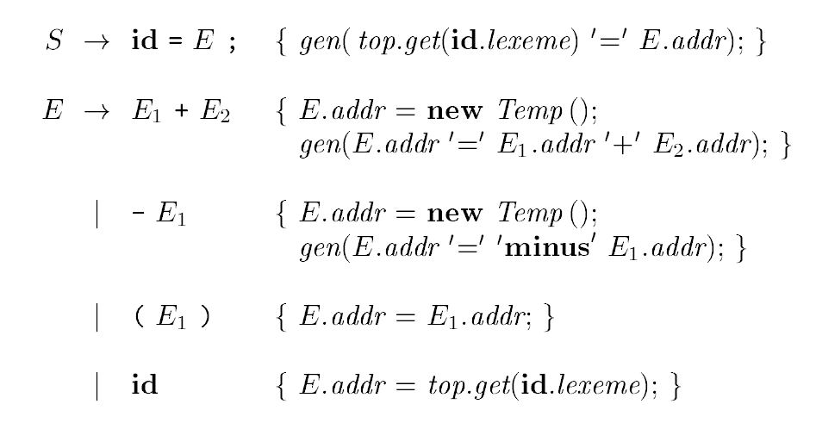
SDT for Three Address Code Generation

Slide 17
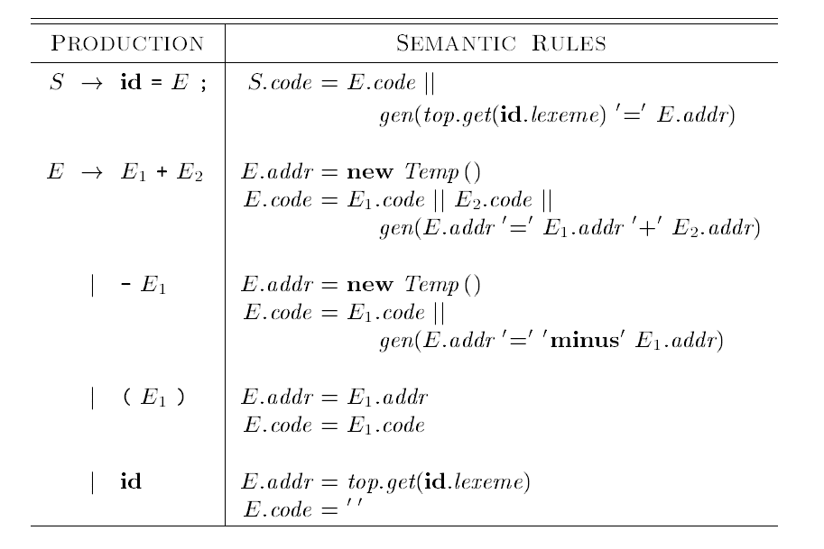
SDD for Three Address Code Generation

Slide 18
Lab Practice
Design a three address code generator for the following expression.
Sample Input:
x = 5 + 6 + 3
Sample Output:
t1 = 5+6
t2 = t1 + 3
x = t2

Slide 19
Thank You ☺
19

