Slide 1
Operating System Sessional POSIX THREAD - pthread
CSE-308
(SEC-A)
Lec Tasfia Sara, CSE
Spring 2024, CSE-22

Slide 2
Topics
pthread
pthread Introduction
Process vs Thread
Create Thread
Pass arguments
Join Thread
Critical Region
Lock
Try Lock
Example/ Simulation

Slide 3
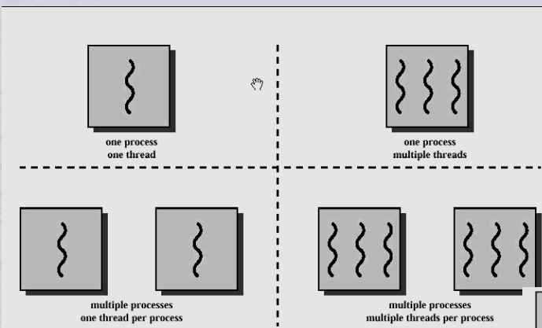
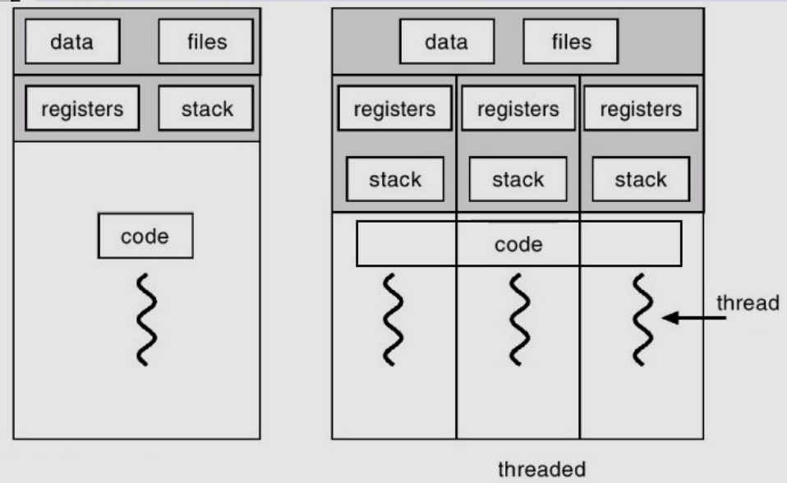
Thread Recap
A thread is a light weight process. Every thread belongs to exactly one process.
A thread is a single sequence stream within a process.
There is no need to allocate extra memory space for threads.
Each thread has its own program counter (PC), a register set, and a stack space.

Slide 4
Thread Recap
5. Threads shares with other threads’ their code section, data section and OS resources like open files and signals within the same process.
6. For switching one thread to another no need to interact with operating system, interacts with process only.
7. Threads are not independent from each other unlike processes. For example,
A failure in one thread (e.g., accessing invalid memory) can potentially crash the entire process, affecting all threads within it.
If one thread modifies a shared variable, this change is immediately visible to other threads.

Slide 5
Thread Recap
Threads are popular way to improve application through parallelism. For example, in a browser, multiple tabs can be different threads. MS word uses multiple threads, one thread to format the text, other thread to process inputs, etc.
Threads operate faster than processes due to following reasons:
1) Thread creation is much faster
2) Context switching between threads is much faster
3) Threads can be terminated easily
4) Communication between threads is faster
Parallelism is the practice of dividing a task into smaller sub-tasks that can be processed simultaneously to improve performance and efficiency.

Slide 6
Pthread
In computing, POSIX (Portable Operating System Interface) Threads, commonly known as pthreads, is an execution model that exists independently from a programming language, as well as a parallel execution model.
It allows a program to control multiple different flows of work that overlap in time.
Pthreads are used to leverage the power of multiple processors.
Here a process is broken into threads, each thread can use a processor to complete its execution and because there are multiple processors executing threads at the same time, parallelism in execution can be seen.

Slide 7
Pthread
Each flow of work is referred to as a thread, and creation and control over these flows is achieved by making calls to the POSIX Threads API.
POSIX Threads is an API (Application Programming Interface) defined by the Institute of Electrical and Electronics Engineers (IEEE) standard POSIX.1c, Threads extensions (IEEE Std 1003.1c-1995).
The POSIX Threads API includes functions for creating, controlling, and synchronizing threads.
POSIX (Portable Operating System Interface) is a set of standard operating system interfaces based on the Unix operating system.

Slide 8
pthread Syntax: Thread Creating
Create a pthread Instance
pthread_t obj;
Start Executing Thread
pthread_create function will create a kernel level thread
To mention the thread fn and fn args
int pthread_create(pthread_t *thread, const pthread_attr_t *attr, void *(*start)(void *), void *arg);
Join Thread or Wait For Thread to Finish
pthread_join will wait for a particular thread
To catch the return
int pthread_join(pthread_t thread, void **status);
Sleep Function (Yielding)
Gives chances to others
Sleep(int msec);
uSleep(int usec);

Slide 9
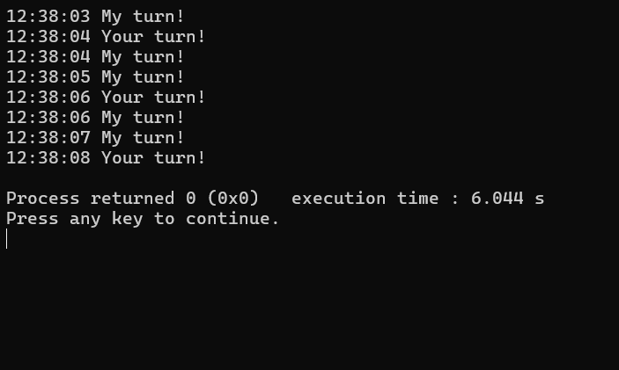

Slide 10
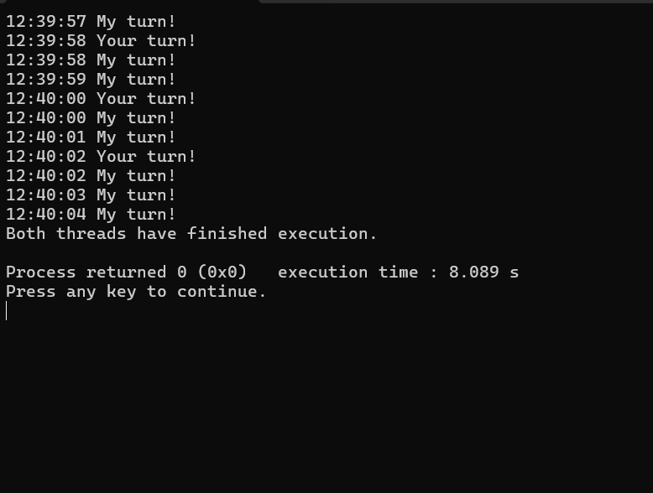

Slide 11
Pthread_create
Return as void *obj (any type of data)
pthread_t th
void* routine (void* arg)
&th | NULL | &routine | (void *) data
pthread_t obj *
pthread_attr * (to set the thread attrs)
Tasks of thread
Pass args as void *obj (any type of data)
We can pass a pointer to a pthread_attr_t structure to customize attributes like stack size, scheduling policy, etc.,

Slide 12
Pthread_join
Double pointer is used to capture the return value of the thread function
Returns a void pointer (any type of data)
void* routine (void* arg)
pthread_t th;
int* res;
th | (void**) &res
res- A pointer to a location where the exit status of the joined thread will be stored.
pthread_t obj
Catch returns (in a double pointer)
When you call pthread_join on a thread, it effectively blocks the calling thread (usually the main thread) until the specified thread has terminated. This is particularly useful when you need to ensure that a thread has completed its work before proceeding with the rest of the program.

Slide 13
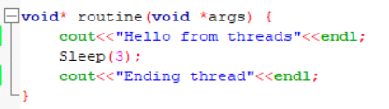
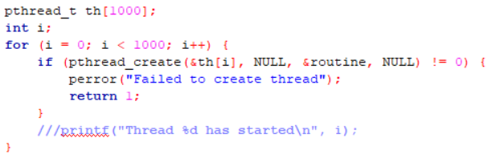
Threads and Critical Section
Thousands of threads performing the same routine function.
Though the instructions are same (they share the same address space), their context are not the same.
A critical section is a part of the code where shared resources (like std::cout) are accessed. As they share the standard output (std::cout), the terminal. Which means it’s the critical section!!
Since all threads are accessing std::cout at the same time, their outputs can get mixed up. For example, one thread might print "Hello" while another is in the middle of printing "Ending thread".

Slide 14
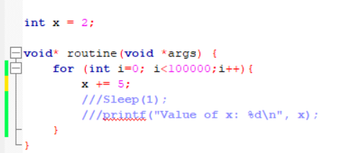
Critical Section
But x may be updated in T2. Say x contains 1000, but T1 uses the old value.
INC in x86 is not atomic!! (means it can be interrupted)
Instruction | T1
Read X | Done | AX = 505
Context Switch
Add 5 | Resume | AX = 510
Write x |  | x = 510
Critical Section
Context Switch in the middle of the instruction (as it’s not an atomic instruction)

Slide 15
pthread Syntax: Thread Synchronization
Critical Section
The critical section refers to the segment of code where processes access shared resources, such as common variables and files, and perform write operations on them.
Mutex
Mutex (mutual exclusion object) is a program object that is created so that multiple program thread can take turns sharing the same resource, such as access to a file.
Try Mutex
Same as Mutex but instead of waiting it returns 0.
Conditional Variable

Slide 16
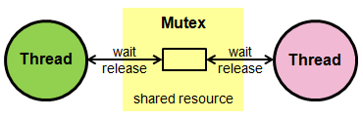
pthread Syntax: Mutex
Syntax
pthread_mutex_t mutex; //In Global Section
pthread_mutex_init(&mutex, NULL); //Before create thread
pthread_mutex_lock(&mutex); //Entre CR
pthread_mutex_unlock(&mutex); //Exit CR
pthread_mutex_destroy(&mutex); //After all threads join
Mutex
Wait till acquire the critical section.
Examples
Can be used for any critical regions
Simulate Bank Transaction: Three persons are withdrawing 20, 2000 and 60 dollars respectively from a shared account at the same time. Again simultaneously a credit of 40,000 dollars has been made into the same account. Simulate these transactions using threads among which three will perform withdraw and one will perform credit. If the amount was 3,00,000 before any transaction, then find out the current amount by simulating the threads.

Slide 17
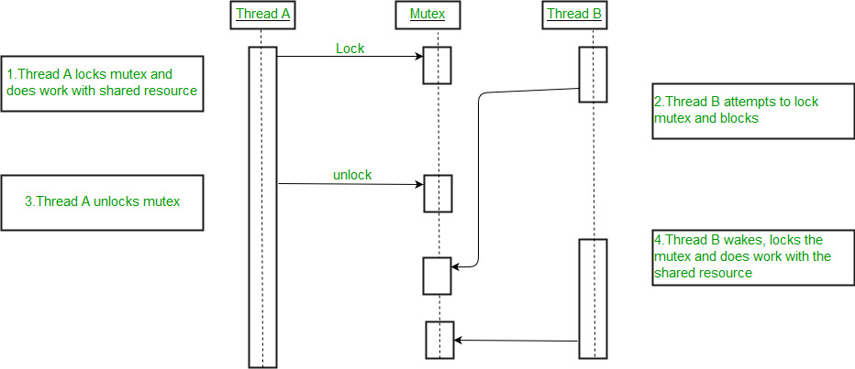
pthread Syntax: Mutex

Slide 18

pthread Syntax: Try Mutex
Syntax
pthread_mutex_t mutex; //In Global Section
pthread_mutex_init(&mutex, NULL); //Before create thread
pthread_mutex_trylock(&mutex); //Returns 0 if successfully locked the resource
pthread_mutex_unlock(&mutex); //Exit CR
pthread_mutex_destroy(&mutex); //After all threads join
Try Mutex
Does not wait to acquire the critical section
Multiple Mutexes and multiple resources
Each resources are using different locks
Use try lock to see which one is free and lock that
Don’t wait in one resource
Examples
Simulate Kitchen room (Multiple stoves and multiple Chefs): Where chefs represent threads and stoves represent the resources. A chef can use a stove at a single time, others can not access it. And find out how many times each stove has been used by simulating the threads.
Simulate Washroom (Multiple Toilets and multiple Persons): Where persons represent threads and toilets represent the resources. A person can use a toilet at a single time, others can not access it. And find out how many times each toilet has been used by simulating the threads.
Not waiting
Locked
Locked
Locked
Free

Slide 19
pthread Syntax: Conditional Variable
Syntax
pthread_cond_t condVar; //In Global Section
pthread_cond_init(&condVar, NULL); //Before create thread
pthread_cond_wait(&condVar, &mutex); //Relinquish Mutex Lock pthread_cond_signal(&condFuel); //Exit CR
pthread_cond_destroy(&condVar); //After all threads join
Conditional Variable
To relinquish a lock
Give access to other different threads in the CR for a particular valid reason (condition)
Same mutex lock in two different threads
Examples
Three Consumer threads are trying to access the Fuel Station
T1 gets the lock and T2, T3 are waiting for the lock
But T1 sees there is not enough fuel here
So he called the authority and waiting for the signal
Then the authority (T4) locks the Fuel and adds some fuel to it
Then T4 provides signal to T1 thread
Producer
T4
Fuel Station
T1
T2
T3
Consumers

Slide 20
pthread Syntax: Thread Synchronization
Barrier
A barrier for a group of threads or processes in the source code means any thread/process must stop at this point and cannot proceed until all other threads/processes reach this barrier.
Semaphore
Semaphore is an integer variable which is used as a signal to allow or not allow a process to access the critical section of the code or certain other resources. There are two types of semaphores:
Binary Semaphore - take on values 0 or 1.
Counting Semaphore - take on any integer value.

Slide 21
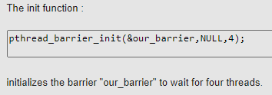
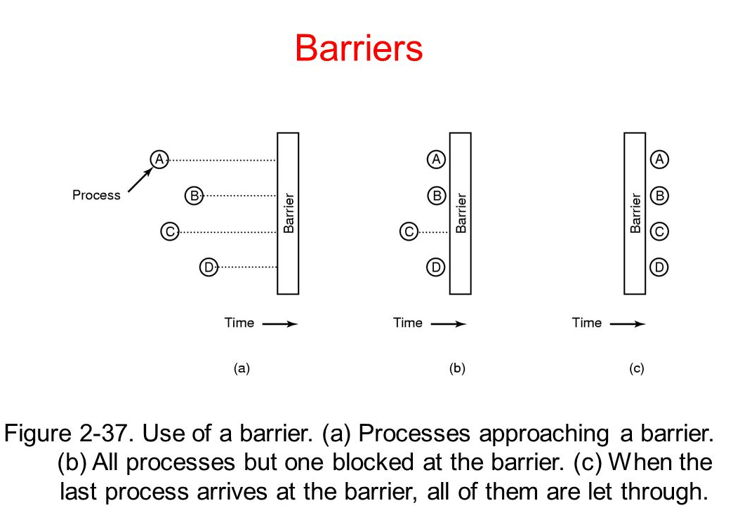
pthread Syntax: Barrier
Syntax
pthread_barrier_t barrier;
pthread_barrier_init(&barrier, NULL, 10);
pthread_barrier_wait(&barrier);
-- The pthread_barrier_wait() function shall synchronize participating threads at the barrier referenced by barrier.
pthread_barrier_destroy(&barrier);
Barrier
In barrier point all threads need to be present (all threads Program Counter or Instruction Pointer must be same) and then start execution independently.

Slide 22
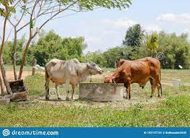
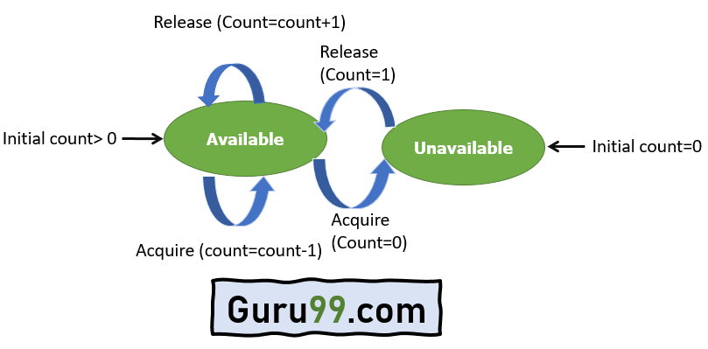
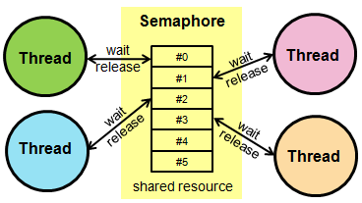
pthread Syntax: Semaphore
Syntax
sem_t semaphore;
sem_init(&semaphore, 0, #threads);
(The sem_init() function is used to initialise the unnamed semaphore referred to by sem.)
sem_wait(&semaphore);
The sem_wait() function decrements by one the value of the semaphore.
sem_post(&semaphore);
(The sem_post() function unlocks the semaphore referenced by sem by performing a semaphore unlock operation on that semaphore)
sem_destroy(&semaphore);
The sem_destroy() function destroys an unnamed semaphore that was previously initialized.
Semaphore
Multiple resources; It allows a number of threads to access shared resources.
Multiple thread can access the same critical region
Resource

Slide 23
Examples
Calculate the sum of an array of size n using pthread. Where there is m threads and the i^{th} thread locally calculates the sum from (n/m*i) to (n/m*(i+1) - 1).
Value | 31 | 42 | 27 | 59 | 1 | 20 | 120 | 77 | 12 | 3
Index | 0 | 1 | 2 | 3 | 4 | 5 | 6 | 7 | 8 | 9
Say the array size is 10(n). And there are 2(m) threads.
Then 1st thread will calculate:
sum of arr[0] to arr[4] = 31+42+27+59+1 =
And 2nd thread will calculate:
sum of arr[5] to arr[9] = 20+120+77+12+3 =

Slide 24
THANK YOU

