Slide 1
Improved Lexrank Summarization System
Harita Kannan, Xiaopei Wu, Lonny Strunk, Ben McCready
Notes:
Ben

Slide 2
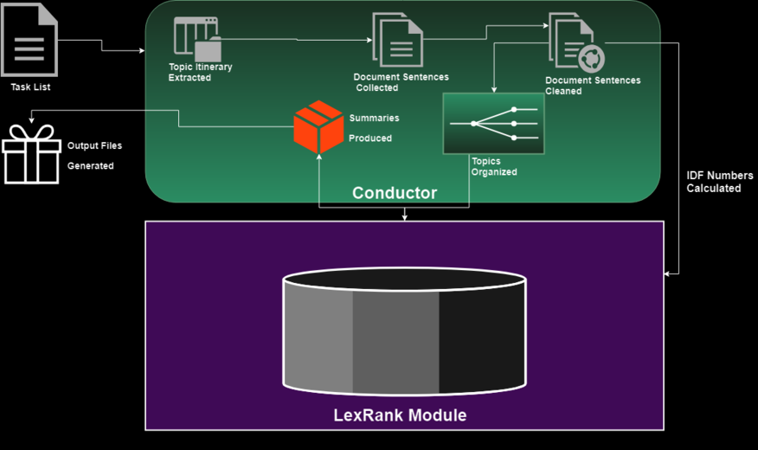
Recap of System Architecture
Information
Ordering
Notes:
Ben

Slide 3
Workflow Improvements
Created python modules
Unit testing (pytest: ~20 tests currently)
Git branches for new features; pull request for code review
Trello board
Slack integration of Trello
Git integration of Overleaf
Notes:
Ben

Slide 4
Improved Content Selection
Forked LexRank package
Added Snowball Stemmer (NLTK) in calculating LexRank scores
using stemmed sentences as BOW to calculate tf-idf based similarity scores
obtain indices of best sentences and map them to the original text for output
Baseline (from D2)
ROUGE-1:
R = 0.22780, P = 0.17634, F= 0.19742
ROUGE-2:
R = 0.04760, P = 0.03692, F = 0.04127
ROUGE-3:
R = 0.01727, P = 0.02248, F = 0.01936
ROUGE-4:
R = 0.00421, P = 0.00303, F = 0.00346
After Stemming
ROUGE-1:
R = 0.23356, P = 0.29925, F = 0.26067
ROUGE-2:
R = 0.05744, P = 0.07346, F = 0.06401
ROUGE-3:
R = 0.01640, P = 0.02090, F = 0.01822
ROUGE-4:
R = 0.00471, P = 0.00570, F = 0.00511

Slide 5
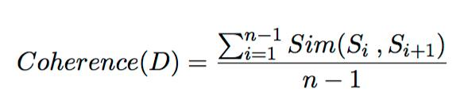
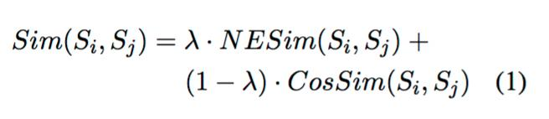
Information Ordering: The Greedy Approach
Nayeem, M.T., & Chali, Y. (2017). Extract with Order for Coherent Multi-Document Summarization.
Simple greedy algorithm
Text coherence - similarity between all adjacent sentences
Place sentence in document based on coherence score
Incrementally add sentences to document set D
Lexrank sentence similarity based on tf-idf modified cosine

Slide 6
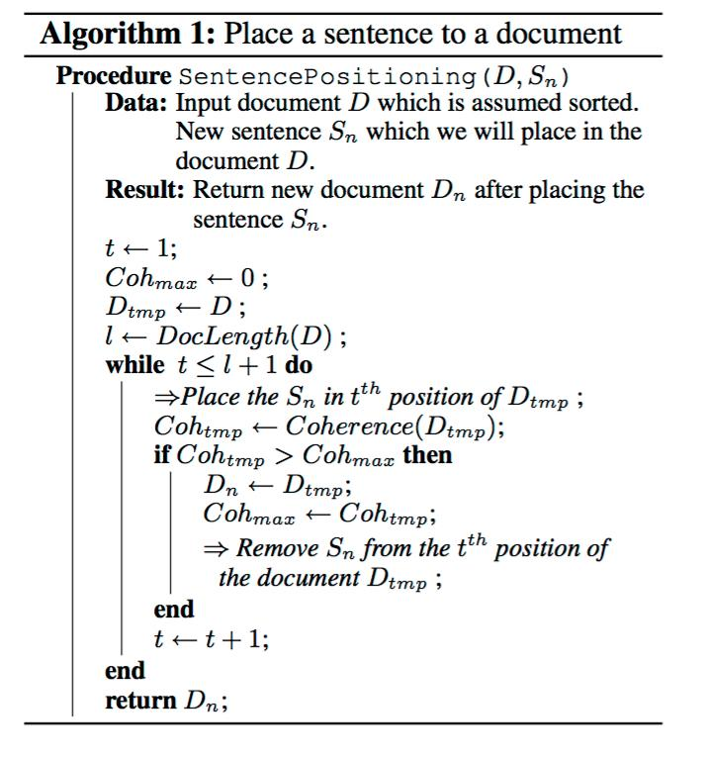
Greedy Algorithm
First iteration select random sentence (highest scoring sentence from LexRank)

Slide 7
Baseline (from D2)
ROUGE-1:
R = 0.22780, P = 0.17634, F = 0.19742
ROUGE-2:
R = 0.04760, P = 0.03692, F = 0.04127
ROUGE-3:
R = 0.01727, P = 0.02248, F = 0.01936
ROUGE-4:
R = 0.00421, P = 0.00303, F = 0.00346
(Only information ordering-no stemming)
ROUGE-1:
R = 0.22889, P = 0.30547, F = 0.25957
ROUGE-2:
R = 0.05749, P = 0.07682, F = 0.06527
ROUGE-3:
R = 0.01676, P = 0.02232, F = 0.01898
ROUGE-4:
R = 0.00550, P = 0.00720, F = 0.00620

Slide 8
Information Ordering: Greedy algorithm
Baseline (from D2)
The community outpouring has touched some Columbine students.
LITTLETON, Colo. (AP) -- The day that Columbine High School students are to return to class has been delayed because so many have been attending funerals for students killed in the April 20 massacre, an administrator said Tuesday.
Two days earlier, a massacre by two students at Columbine High, whose teams are called the Rebels, left 15 people dead and dozens wounded.
``One of the hidden truths of the human condition is that suffering binds us together.''
Littleton needs comfort.
``They wanted death and destruction.
And that somehow, life keeps moving.
(Only information ordering-no stemming)
Two days earlier, a massacre by two students at Columbine High, whose teams are called the Rebels, left 15 people dead and dozens wounded.
Tuesday morning 12 Columbine High School students and a teacher were murdered when Eric Harris and Dylan Klebold, also Columbine students, opened fire with at least four guns and dozens of bombs.
To accommodate the 1,965 Columbine students, the school day is being split with Chatfield students beginning early in the day and Columbine students showing up shortly before 1 p.m.
There are the communities that existed already, like Columbine students and Columbine Valley residents.

Slide 9
Information Ordering: Chronological
STEPS:
Pick best sentences within 100 words according to LexRank score
Order sentences by date
Improve readability

Slide 10
Information Ordering: Chronological
Vanilla LexRank
Before the plane crashed, the Greek fighter pilots reported seeing two people trying to take the controls in the cockpit.
Greek government spokesman Theodoros Roussopoulos said that when the F-16 pilots flew by the Helios Airways plane a second time, they saw two people apparently trying to take control of the Boeing 737.
Athens radio quoted eyewitnesses as saying that the plane was being accompanied by two Greek fighter jets when it went down.
Most of the passengers and crew were Greek Cypriot, the spokesman said.
LexRank with Chronological Ordering
A Cypriot Helios Airways Boeing 737 jetliner with 115 passengers and six crew members on board crashed Sunday north of Athens, Greek news media reported.
Before the plane crashed, the Greek fighter pilots reported seeing two people trying to take the controls in the cockpit.
Greek government spokesman Theodoros Roussopoulos said that when the F-16 pilots flew by the Helios Airways plane a second time, they saw two people apparently trying to take control of the Boeing 737.
Notes:
D1012

Slide 11
Information Ordering: Chronological
Baseline (from D2)
ROUGE-1:
R = 0.22780, P = 0.17634, F= 0.19742
ROUGE-2:
R = 0.04760, P = 0.03692, F = 0.04127
ROUGE-3:
R = 0.01727, P = 0.02248, F = 0.01936
ROUGE-4:
R = 0.00421, P = 0.00303, F = 0.00346
LexRank with Chronological Ordering
ROUGE-1:
R = 0.23697, P = 0.29408, F = 0.26133
ROUGE-2:
R = 0.06513, P = 0.08084, F = 0.07185
ROUGE-3:
R = 0.02116, P = 0.02585, F = 0.02319
ROUGE-4:
R = 0.00775, P = 0.00932, F = 0.00843
Notes:
Both precision and recall generally better

Slide 12
Current ROUGE scores
Baseline (from D2)
ROUGE-1:
R = 0.22780, P = 0.17634, F= 0.19742
ROUGE-2:
R = 0.04760, P = 0.03692, F = 0.04127
ROUGE-3:
R = 0.01727, P = 0.02248, F = 0.01936
ROUGE-4:
R = 0.00421, P = 0.00303, F = 0.00346
D3 (stemming + greedy ordering)
ROUGE-1:
R = 0.23441, P = 0.30199, F = 0.26228
ROUGE-2:
R = 0.05774, P = 0.07412, F = 0.06445
ROUGE-3:
R = 0.01629, P = 0.02085, F = 0.01813
ROUGE-4:
R = 0.00489, P = 0.00600, F = 0.00534
Notes:
Both precision and recall generally better

Slide 13
Outputs
Baseline (from D2)
By TOM JONES.
Felling said.
Among those receiving subpoenas is Joe Lebrun, who was involved in the Texas lawsuit accusing Citizens' former chief operating officer Paul Hulsebush with a bribery scheme.
BC-STEIN (St. Petersburg) -- A Q&A with the visiting Ben Stein, economist/Nixon White House protege/actor/author/political commentator.
"Is you the first girl she messed with?"
"If you had to sit back and just from a societal point of view, (ask) what impact does the media have by putting such focus on this case when a young boy is going to be affected, that's the balancing act."
Current
Lafave's lawyer, the veteran and able John Fitzgibbons of Tampa, objected because the state wished her to serve what he considered an unacceptable amount of prison time.
After Tuesday's hearing, Lafave's attorney, John Fitzgibbons, said the plea was "a fair resolution of this case."
After Tuesday's hearing, Lafave's attorney, John Fitzgibbons, said the plea was "a fair resolution of this case."
Fitzgibbons said in July that plea negotiations had broken off because prosecutors insisted on prison time, which he said would be too dangerous for someone as attractive as Lafave.
Notes:
Both precision and recall generally better

Slide 14
Issues and Successes
Redundant (even reduplicated) sentences
Sentence tokenization still splitting too often
News headers still in summaries
Streamlined workflow
Improved ROUGE scores

Slide 15
Next Steps
Add stemming to chronological ordering
Add topic-oriented summarization
Add sentence clustering to reduce redundancy
Add post-processing to improve content realization
Add training file to tf-idf calculation

Slide 16
Related Readings
Nayeem, M.T., & Chali, Y. (2017). Extract with Order for Coherent Multi-Document Summarization.
Notes:
Ben

