Slide 1
Lexrank Summarization System
Harita Kannan, Xiaopei Wu, Lonny Strunk, Ben McCready

Slide 2
Related Readings
Erkan, G. and Radev, D. (2004). Lexrank: graph-based lexical centrality as salience in text summarization.
Open-source LexRank Implementations:
http://dataexperiments.net/2015/01/31/using-lexrank-to-summarize-textusing-sumy-py/
https://github.com/wikibusiness/lexrank
https://pythonhosted.org/textgraphics/_modules/TextGraphics/Applications/summary.html
https://github.com/jtan25/LexRank

Slide 3
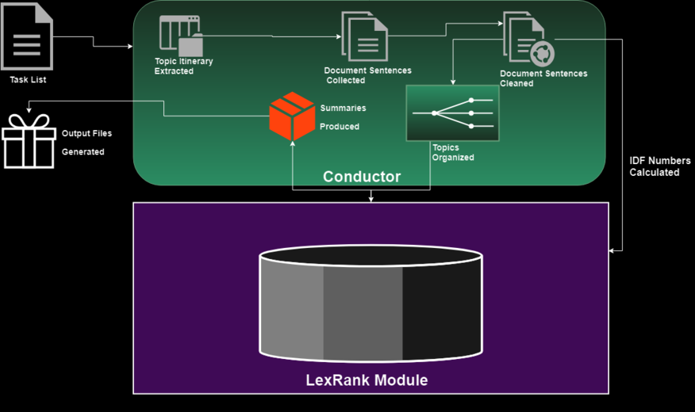
System Architecture

Slide 4
Content Selection Information Ordering
LexRank: unsupervised, graph-based approach
Within each docset:
Sentences are stored the order the documents are read in.
Summary ordering is not chronological (for D2)
Based on descending level of sentence informativeness from LexRank similarity scores
Document set
Sentences
Preprocessing each sentence
Similarity
Connected graph
Extracted sentences
Summary
Notes:
-mention multiple thresholds
In this system, information is ordered according to the LexRank score; that is, of all sentences in a given group of documents, the sentence with the highest LexRank score is appended to our summary, until our summary cannot accept the next highest sentence without exceeding the required word length.

Slide 5
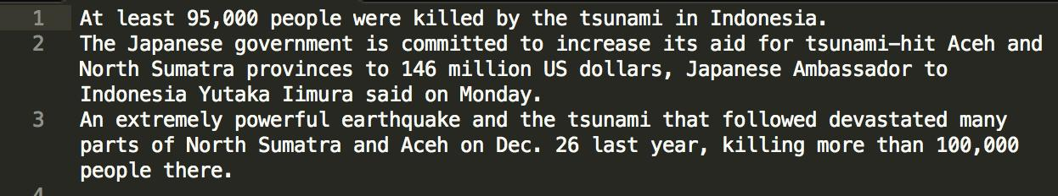
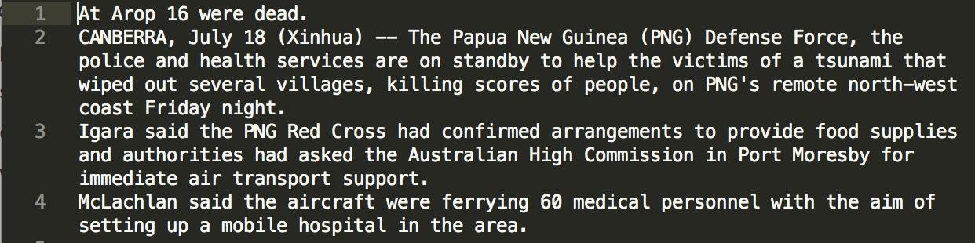
Sample Outputs

Slide 6
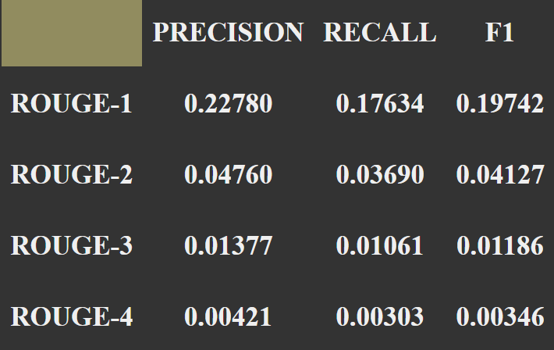
Results

Slide 7
Improvements
Remove unnecessary/redundant language, exclude fragments
Content-selection with continuous LexRank
Information ordering with chronological order
Improve ROUGE scores by incorporating MEAD framework
Improve idf scores by extending document set to include all corpora
Unit testing

Slide 8
Strategies for Groupwork
What worked
Agile Based Management:
Flexible deadlines
Weekly Standups for half hour after class Tuesdays and Thursdays
Group meetings every Sunday
Group chat on Slack
Collaborative environment: Github
Rubberducking
What we can improve on
Pair programming
Code Review
Dividing up tasks

