Slide 2
A
AA
F
F
F
A
W
W
W
W
F

Slide 3
F
A
F
F

Slide 4
 |  |  |  | M |  |  | F
F |  | M
 |  |  | A
 | F
 |  |  |  |  | M |  | F
F

Slide 5
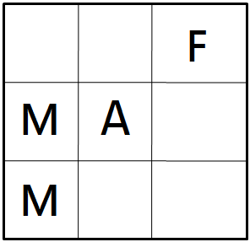

Slide 6
 |  |  | F
 |  |  | M
A

Slide 7
 |  |  | F
 |  |  | M
A

Slide 8
(0.9, -0.1, -0.1)
(0.9, -0.1, -0.1)
(0.9, -0.1, 1)
(0.9, -0.1, -0.1)
(0.9, -0.1, -0.1)
(0.9, -0.1, -0.1)
(0.9, -0.1, 1)
(0.9, 20, -0.1)
(0.9, -0.1, -0.1)
(0.9, -0.1, 1)
(0.9, -0.1, -0.1)
(0.9, 20, -0.1)
(0.9, -0.1, -0.1)
(0.9, -0.1, -0.1)
(0.9, -20, -0.1)
(0.9, -0.1, -0.1)
(0.9, -0.1, -0.1)
(0.9, -0.1, -0.1)
(0.9, -0.1, -1.5)
(0.0, 0, -30)
(0.9, 20, -0.1)
(0.9, -0.1, -1.5)
(0.9, -0.1, 1)
(0.0, 0, -30)
(0.9, -0.1, -0.1)
(0.9, -0.1, -0.1)
(0.0, 0, -30)
(0.9, -0.1, 1)
(0.9, -0.1, -0.1)
(0.9, -0.1, -0.1)
(0.9, -0.1, -0.1)
(0.9, -0.1, -0.1)
(0.0, 0, -30)
(0.9, -0.1, -0.1)
(0.9, -0.1, -0.1)
(0.9, -0.1, -0.1)
(0.9, -0.1, -1.5)
(0.9, -0.1, -1.5)
(0.9, -0.1, -0.1)
(0.9, -0.1, -0.1)
(0.9, -0.1, -0.1)
(0.9, -0.1, -0.1)
(0.9, -0.1, -0.1)
(0.9, -0.1, -0.1)
(0.9, -0.1, -0.1)
(0.9, -0.1, -0.1)
(0.9, -0.1, -0.1)
(0.9, -0.1, -0.1)

Slide 9
(0.9, 0)
(0.9, 0)
(0.9, 0)
(0.9, 0)
(0.9, 0)
(0.9, 0)
(0.9, 1)
(0.9, 18)
(0.9, 0)
(0.9, 1)
(0.9, -1.5)
(0.9,18)
(0.9, 0)
(0.9, 0)
(0.9, 18)
(0.9, -1.5)
(0.9, 0)
(0.9, 0)
(0.9, -1.5)
(0.0, -1.5)
(0.9, 18)
(0.9, -1.5)
(0.9, 1)
(0.0, -1.5)
(0.9, 0)
(0.9, 0)
(0.0, -1.5)
(0.9, 1)
(0.9, 0)
(0.9, 0)
(0.9, 0)
(0.9, 0)
(0.0, -1.5)
(0.9, 0)
(0.9, 0)
(0.9, 0)
(0.9, 0)
(0.9, 0)
(0.9, 0)
(0.9,0)
(0.9, 0)
(0.9, 0)
(0.9, 0)
(0.9, 0)
(0.9, 0)
(0.9, 0)
(0.9, 0)

Slide 11
(0.9, -0.1, -0.1)
(0.9, -0.1, -0.1)

Slide 12
S₂
+120
a, 0.5
S₁
a, 0.5
S₃
+120
b, 1.0
S₄
+100

Slide 14
 | S
 |  |  | A | P
 | P |  | B | P

Slide 15
 | S
 |  |  | A | P
 | P |  | B | P
1
2
3
4
5
6

Slide 16
0 1 2 3 4 5
0
1
2
3
4
5
 | S
 |  |  | A | P
 | P |  | B | P
1
2
3
4
5
6

Slide 17
Root
…
Move(1)
Move(6)
North
South
East
West

Slide 18
Root
…
Move(1)
Move(6)
North
South
East
West

Slide 19
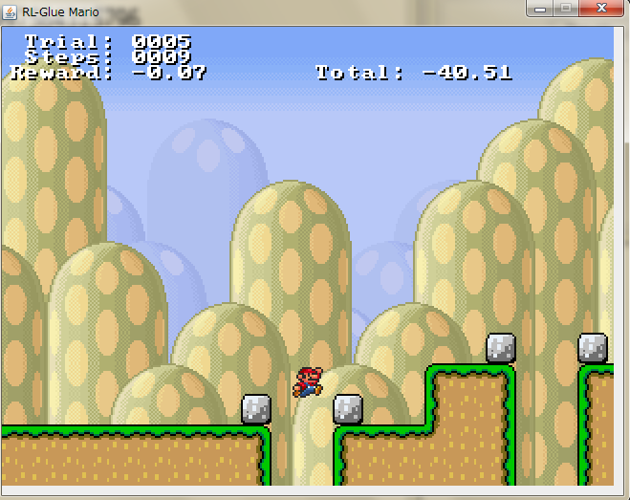

Slide 20
