Slide 2
A
AA
F
F
F
A
W
W
W
W
F

Slide 3
F
A
F
F

Slide 4
 |  |  |  | M |  |  | F
F |  | M
 |  |  | A
 | F
 |  |  |  |  | M |  | F
F

Slide 5
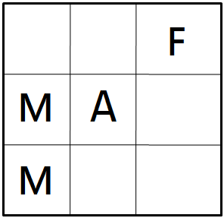

Slide 6
S₂
+120
a, 0.5
S₁
a, 0.5
S₃
+120
b, 1.0
S₄
+100

