Slide 1
Optimal Planning in Approximate Model-Based Reinforcement Learning
Hai-Feng Kao (haifeng@cs.ubc.ca)
MSc presentation
Computer Science Department
University of British Columbia

Slide 2
Overview
Markov Decision Processes (MDPs)
Model-Free RL
Model-Based RL
Hierarchical Reinforcement Learning (HRL)
Optimal Planning (My algorithm)
Experiment
School Bus
Super Mario Bros.

Slide 3
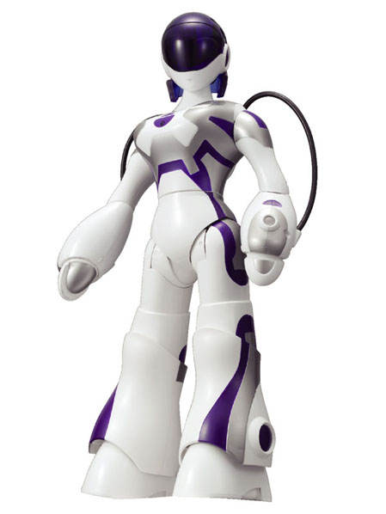
Classical Planning
Markov Decision Process(MDP)
Observations
Fully observable
No Prior Model
Perfect Model
A
B
Agent
C
Single Agent
Deterministic
Stochastic
World
Actions

Slide 4

Markov Decision Process
An MDP M = (S, A, P, R)
And bellman’s equation for V

Slide 5
Model-Free vs Model-Based
Model Free
Model Based
s
a
s
a
Q
P, R
v
r
S’

Slide 6
Linear Dyna (Sutton et. al 2009)
Model-Based:
1. Faster learning rate
2. Possibly worse policy because of structural modeling assumptions
3. Rapid adaptation
As before, Dyna-MG showed a distinct advantage over the model-free method in terms of learning rate. There was no clear advantage for either method in the second half of the experiment. We note that, asymptotically, model-free methods are never worse than model-based methods, and are often better because the model does not converge exactly to the true system because of structural modeling assumptions. The benefit of models, and of planning generally, is in rapid adaptation to new problems and situations
Model-Free:
Faster learning rate
Possibly worse policy
Rapid adaptation

Slide 7
Can we get the both of it?
Structural Assumption is not satisfied
Converge to optimal policy

Slide 8
Yes

Slide 9
But how?

Slide 10
We need a framework to include two different approaches

Slide 11
Hierarchical Reinforcement Learning

Slide 12
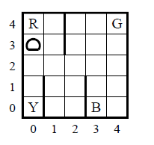

Taxi Domain

Slide 13
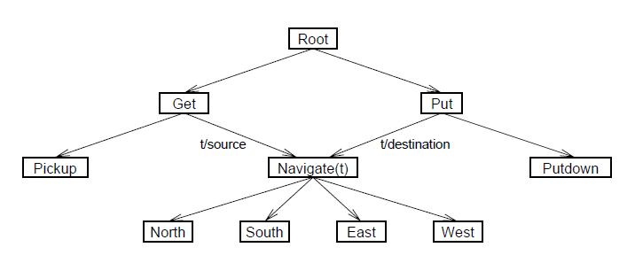

Slide 14
State Abstraction
Temporal Abstraction

Slide 15
Taxi example here
The subtask does not knows the consequence
Of its own action
Learn Recursive Optimal Policy

Slide 16
Taxi example here
The subtask knows the consequence
Of its own action
Learn Hierarchical Optimal Policy
The

Slide 18
A motivating example

Slide 19
MAXQ
HORDQ

Slide 20
Leaf Cover

Slide 21
The previous work on
Model-based approach + model-free one
Vlad
CMU tech report
Another
Include the school and conf name\
Their approach cannot learn the optimal policy
If model-based approach cannot

Slide 22

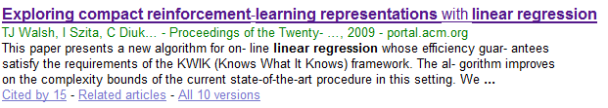

Slide 23
Algorithm

Slide 24
Theorem
Show that the optimal policy can be learned
Not just hierarchical optimal policy
if it will converge

Slide 25
Will it converge?
Open problem (russel and david andre fail to prove it(

Slide 26
Theorem for convergence
Taxi example here

Slide 27
TODO: add theorem to show that it’s necessary to add all primitive subtasks

Slide 28
application
Linear Dyna and decision tree Dyna
Peter’s model-based paper
No need to model everything
MAXQ
State abstraction is important
But it’s hard to find a “safe state abstraction”
Model-free + model-free

Slide 29
Pseudo-Reward
Hierarchically Optimal policy sounds great
But.... Useless
That’s why people uses MAXQ
Show with an experiment or motivating example
Boss asks you to make iRobot, but you make a terminator
Experiment -> hierarchically optimal is worse than Q-learning
But with Pseudo-Reward no more hierarchical optimal policy (nor optimal policy)
Pseudo-reward indicates how much we believe our model
But it’s the model-free one that learns the optimal policy
You can use large reward to encourage exporartion in the early stage
And decrease it overtime to learn the opitmal policy
But optimal policy is not important, I just want the agent
To finish the task
Show it with school bus domain
Model-based approach cannot finish the task

Slide 31
Pseduo-Reward high-> high confidence in
maxQ hierarchy
Low-> low confidence
High-pseudo reward increase the learning rate
But decrease the policy quality

Slide 32
How I played video games:
Prediction (planning)
In a complex secenario (too many monsters)
Planning doesn’t work
Trial and error-> use experience and memory

Slide 33
Sol: a pseudo-reward, and decrease over time

Slide 34
What is the implication of my theory in large domains
No more table lookup Q-learning
Not possible to learn the optimal policy
What’s is the use of my theory

Slide 35
Why Mario is important
A robot uses its sensor
Video camera
Computer vision, tracking
Build a model of it’s own dynamic through interaction
Other unknown object cannot be model
Use model-free instead
Learns how to destory koobma and save princess
Move around obstacles, avoid dangerous creature

Slide 36
Two Baseline Algorithm
Mario Competition 2009 Champion
RL Competition 2009 Champion

Slide 37
Mario Competition Champion
A*
Assume a perfect knowledge about the game
Have access to the simulator interface
My approach: A* with “learned model”
And static assumption

Slide 38
Root
Left
Left Speed
Right
Right Speed
Right Jump
Jump Speed
Jump
Right Speed Jump
Left Speed Jump

Slide 39
Root
Action 1
Action 2
Action 9

Slide 40
The Hierarchy for Mario
Pics here
9 actions
No temporal abstraction and spatial abstraction
No benefit from hierarchical representation
All subtasks finished in single step
The benefit from my appraoch
The combination of two complementary appraoch
Notes:
My work is not HRL

Slide 41
Static Assumption Planning
Learner
Regression Tree
Predict the future location of mario, and speed and reward
Heuristic to reduce the branch
Jump
From HORDQ

Slide 42
Mario:
Why model-based is neccessary->the pit
Model-based can model the terrain, but model-free cannot
Why model-free is neccessary ->
Not everything can be modeled –
We don’t know when
Moving monster
Turtle will be turned into shell Turtle->shell
Kick shell to the wall
Piraha flower
Monsters comes out from right edge of the screen
Fireball kills the monster
Mario is the only moving subject
No 100% accurary classifier
It will make a suboptimal decision at some point

Slide 43
A picture with moving path
No monster
To show how Model-based approach can work

Slide 44
No dynamic programming anymore
(x, y, dx, dy) is too huge to emeuerate
Use k-step look ahead planning
Similar to Robin’s idea
Search for N nodes

Slide 45
Model-free
Use xx’s idea
State abstraciton
Feature

Slide 46
Why model-based approach can handle pit?
Why model-free approach can’t?

Slide 47
Model-based approach encodes our prior knowledge about the system dynamics. It is beneficial if the agent possess such knowledge. However, our dynamical model may be not perfect....

Slide 48
RL Competition
Input Features:
Screen features
No onGround, isSliding, isMonsterAhead, isPit
Unlike Mario competition
No fireflower
22x16 Tiles (not including monsters)
List of monsters (including speed and position)
Linear Sarsa
3 nearest monster or pit
How to represent the pit
Theirs-> hand-coded the pit feature
Mine-> work on 5x5 tiles

Slide 49
Conclusion
I combine two champion approaches and produce a better one
A* is still the state of the art for Mario
With a perfect model
without, my approach is better
Compare to RL competition
We include the terrain information
Move efficiently
Less sample
Easier to generalize to new level

Slide 50
Optimality is not that important
There are many path to the goal
Little of them are completely wrong

Slide 51
Life or death
Suboptimality lead to certain death

Slide 52
A solution to many open problems
1. Linear Dyna 2008
2. Peter’s Stone (or rutegur) model-based cannot model everything
3. MAXQ -> no need to find safe state abstraction

Slide 53
Video: 30 min, 3 hour
Music
Other video on youtube

Slide 54
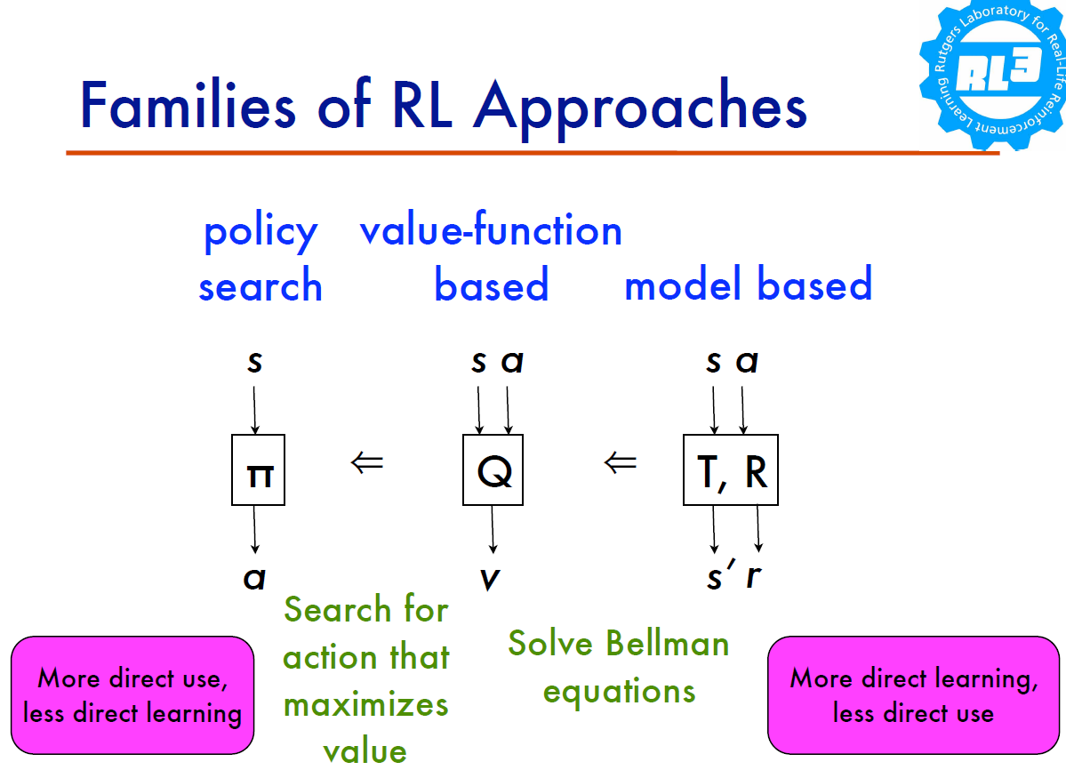

Slide 55
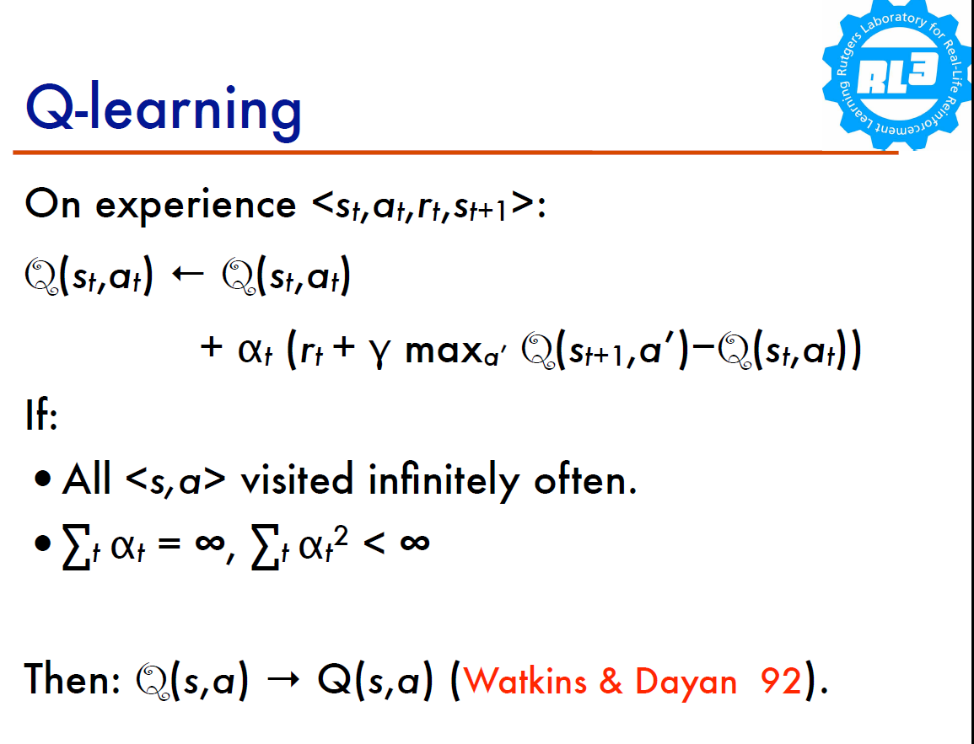

Slide 56
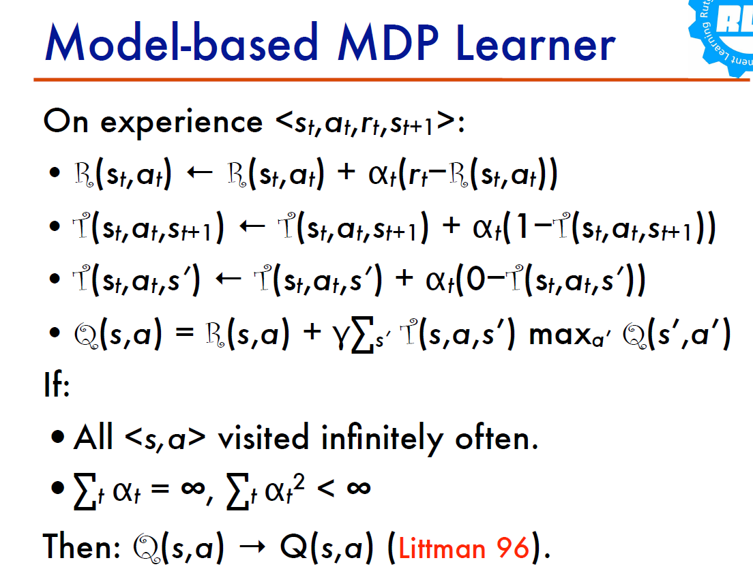

Slide 57
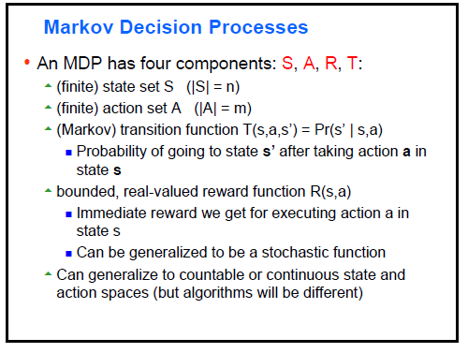

Slide 58
