Slide 1
A solution to the Grid world
Hai Feng Kao

Slide 2




Slide 4
Grid World
: +10 reward
: -30 reward
Huge state space
2^{^(9*9)}

Slide 5
My solution
=
+
+
+

Slide 6
My solution

Slide 7
My solution
+
+
+
=

Slide 8
Learning Individually
If Mario gets +10 reward...
+10?
+10?
+10?

Slide 9
Learning Individually
If Mario gets +10 reward...
Give every one +10 reward
+10?
+10?
+10?
+10
+10
+10

Slide 10
Champion of RL-Competition 2009
Mario: First Place: Pavlov’s Pets
SaeHoon Yi (USA)
Paul Ringstad (USA)
Fengming Wang (USA)

Slide 11
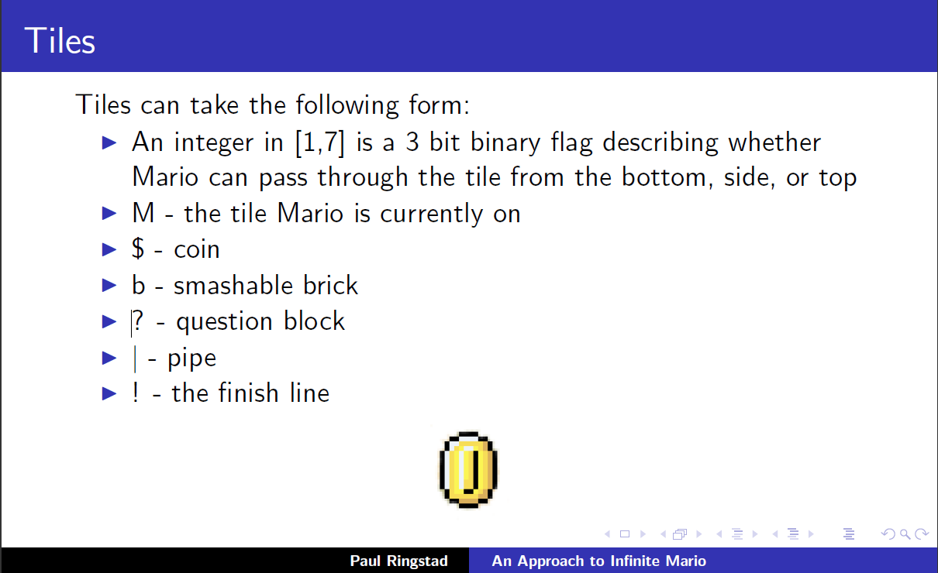
Mario: First Place

Slide 12
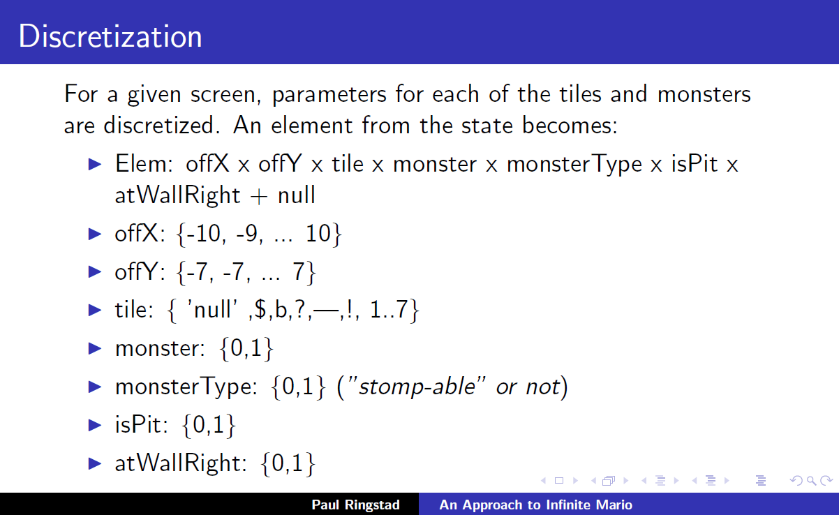
Mario: First Place
7 dims feature vectors!!
21x15x13x2x2x2x2=65520 states

Slide 13
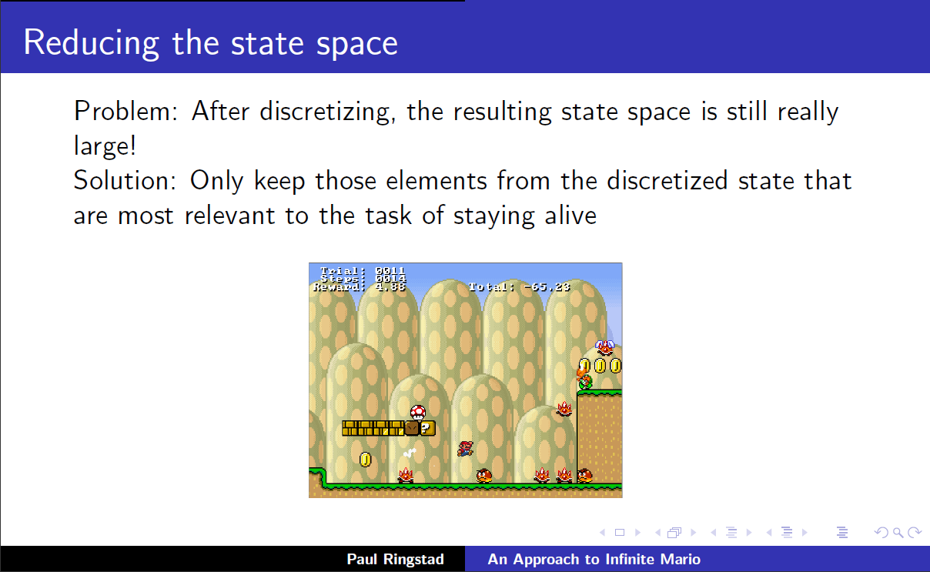
Mario: First Place

Slide 14
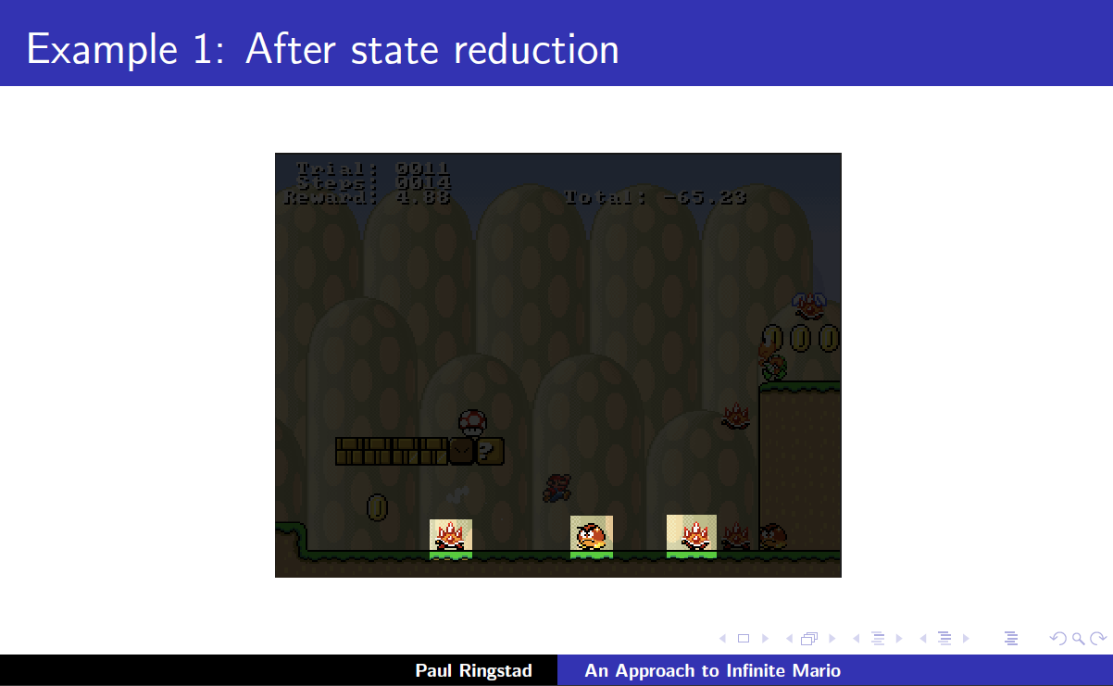
Mario: First Place
21 dims feature vectors!!
65520x65520x65520 states
My representation:
21x15x13 states

Slide 15
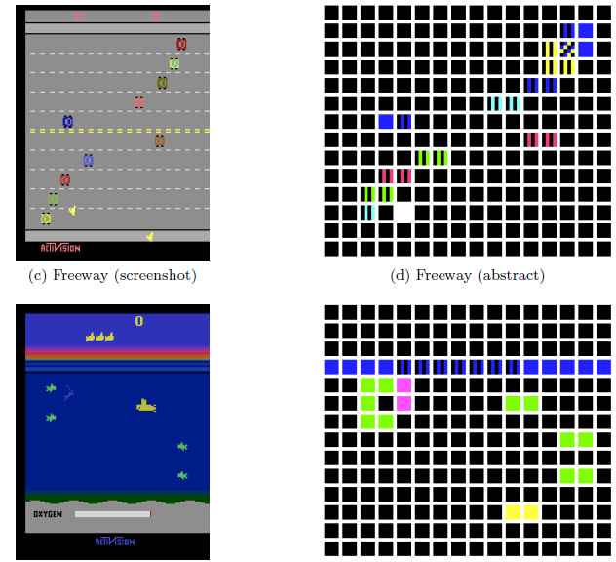
AI Agents for Playing Atari 2600
Game-Independent AI Agents for Playing Atari 2600 Console Games, Yavar Naddaf, Master Thesis, U of Alberta, 2010
14x16x8 dims feature vectors!!

Slide 16
Strength
State space grows linear wrt # object types
Rather than exponential wrt # objects

Slide 17
Weakness
Only captures pairwise relationship
Converge?

Slide 18
Future Work
Construct hierarchy among different objects
Based on spatial proximity

Slide 19
Fictitious play once we get the model of the objects (can generate any combination of the objects)
We don’t need Stone’s approach to build a simulation environment to learn the basic skill. We can let it to learn through the real game play and analyze the result to get the correct model in a simplified environment

Slide 20
Put a huge coin outside the current view to encourage navigation (make unseen area default with high rewards)

