Slide 1
Optimal Planning in Approximate Model-Based Reinforcement Learning
Hai-Feng Kao (haifeng@cs.ubc.ca)
MSc presentation
Computer Science Department, University of British Columbia

Slide 2
Overview
Markov Decision Processes (MDPs)
Hierarchical Reinforcement Learning (HRL)
Optimal Planning (My algorithm)
Experiment
School Bus
Super Mario Bros.

Slide 3
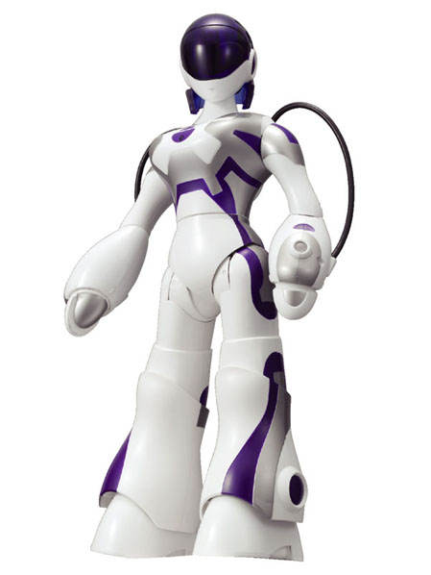
Classical Planning
Markov Decision Process(MDP)
Observations
Fully Observable
No Prior Model
Perfect Model
A
B
Agent
C
Sega EMA
Single Agent
Deterministic
Stochastic
World
Actions

Slide 4

Markov Decision Process
MDP M = (S, A, P, R)
S: states
A: actions
P: transition function
R: reward function

Slide 5
Model-Free vs Model-Based
Model-Free
Model-Based
s
a
s
a
Q
P, R
q
r
S’

Slide 6
Model-Free vs Model-Based
Model-Based:
1. Faster learning rate
2. Possibly worse policy because of structural modeling assumptions
3. Rapid adaptation to new problems
Model-Free:
Slower learning rate
Better policy
As before, Dyna-MG showed a distinct advantage over the model-free method in terms of learning rate. There was no clear advantage for either method in the second half of the experiment. We note that, asymptotically, model-free methods are never worse than model-based methods, and are often better because the model does not converge exactly to the true system because of structural modeling assumptions. The benefit of models, and of planning generally, is in rapid adaptation to new problems and situations -- Linear Dyna (Sutton et al. 2008)

Slide 7
Can we get both of it?
Use model-based approach to simulate the experiences
Learns the optimal policy
When structural assumption of the model is not satisfied
Notes:
Can we get both of it?
Structural Assumption is not satisfied
Converge to optimal policy

Slide 8
Yes

Slide 9
Idea: combine both approaches
Follow model-based approach when the model is correct
Follow model-free approach when the model is wrong

Slide 10
We need a framework to include two different approaches

Slide 11
Hierarchical Reinforcement Learning

Slide 12
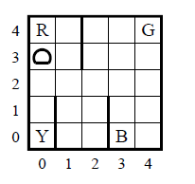




Taxi Domain
Root
Get
Put
Pickup
Navigate(t)
Putdown
North
East
South
West
HORDQ:
MAXQ:
Notes:
Say that they are both model-free approach
State Abstraction
Temporal Abstraction
Taxi example here
The subtask does not knows the consequence
Of its own action
Learn Recursive Optimal Policy
Taxi example here
The subtask knows the consequence
Of its own action
Learn Hierarchical Optimal Policy

Slide 13

Taxi Domain
Suboptimal
Root
Get
Put
HORDQ
Putdown
Pickup
Navigate(t)
Putdown
Pickup
North
East
South
West
Notes:
Hierarchical optimal
The two update I conducted
leaf cover
Change Q update rule
A motivating example
Leaf Cover
After update,
Separate primitive actions from suboptimal policies
For those directly accessed by suboptimal policies needs to be

Slide 14
Anything
HORDQ
Notes:
Show that the optimal policy can be learned
Not just hierarchical optimal policy
The optimal policy will be learned regardless of the policy on the top
Picture
We can put anything on top

Slide 15
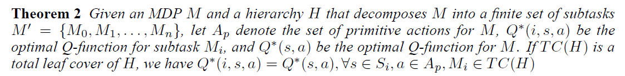
Theorem

Slide 16
Why is it useful?

Slide 17
Anything
HORDQ
Notes:
Show that the optimal policy can be learned
Not just hierarchical optimal policy
The optimal policy will be learned regardless of the policy on the top
Picture
We can put anything on top

Slide 18

Approximate Dyna
Is the structural assumption valid?
Notes:
STRIPS
Because the focus
here is on learning the transition probabilities (pis),
both learners were given the preconditions and effects
(ωi) of each action.

Slide 19
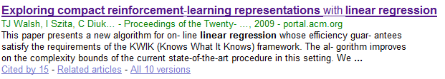
Learning the transition probabilities
Do we have any 100% accuracy supervised learning algorithm?
Can we learning every effects?
Notes:
1.Can we get a 100% accurray surpervised learning?
STRIPS
Littleman’s model-based paper
No need to model everything
2. We present an algorithm,
Reinforcement Learning with Decision Trees (rl-dt),
that uses supervised learning techniques to learn the model
by generalizing the relative effect of actions across states.
Because the focus
here is on learning the transition probabilities (pis),
both learners were given the preconditions and effects
(ωi) of each action.

Slide 20
MAXQ
Allow “unsafe” state abstraction
Notes:
State abstraction is important
But it’s hard to find a “safe state abstraction”
Model-free + model-free

Slide 21
No free lunch
Why MAXQ is the most popular HRL framework?

Slide 22
Pseudo-Reward
Pseudo-rewards encourage subtasks pursuing subgoals
High pseudo rewards → MAXQ
Faster learning
Low pseudo rewards → HORDQ
Slower learning
Non-zero pseudo rewards
Lose optimality
Decrease the pseudo-reward to zero
To learn the optimal policy
Notes:
Hierarchically Optimal policy sounds great
But.... Useless
That’s why people uses MAXQ
High pseudo reward behaves like→MAXQ (need to introduce MAXQ)
Higer learning rate, suboptimal policy
Lower Pseudo reward -> like HORDQ
Low pseudo reward with Leaf cover hierarchy →Q learning
Lower learning rate, near optimal policy
How to choose pseudo-reward
Show with an experiment or motivating example
Boss asks you to make iRobot, but you make a terminator
Experiment -> hierarchically optimal is worse than Q-learning
But with Pseudo-Reward no more hierarchical optimal policy (nor optimal policy)
Pseudo-reward indicates how much we believe our model
But it’s the model-free one that learns the optimal policy
You can use large reward to encourage exporartion in the early stage
And decrease it overtime to learn the opitmal policy
But optimal policy is not important, I just want the agent
To finish the task
Show it with school bus domain
Model-based approach cannot finish the task
Pseduo-Reward high-> high confidence in
maxQ hierarchy
Low-> low confidence
High-pseudo reward increase the learning rate
But decrease the policy quality

Slide 23
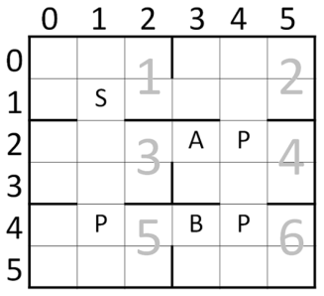
Experiment 1: School Bus
Actions:
North, South, West, East
Reward:
Step cost: -1
Pickup all passengers: 0
Breakdown: -50
Construction site:
Will damage the bus
May break down for each step

Slide 24
Experiment 1: School Bus
Ignore the damage status
Model Based
Root
…
Move(1)
Move(6)
HORDQ
North
East
South
West

Slide 25
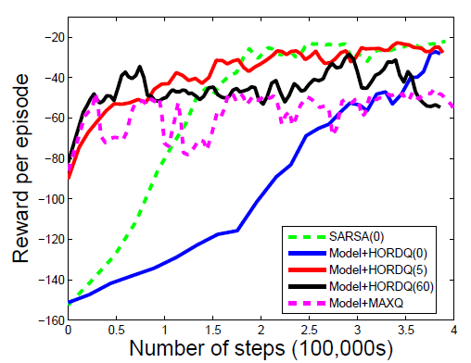
Experiment 1: Result
Notes:
An example of unsafe abstraction

Slide 26
Experiment 1: School Bus
Radom Policy!!!
Model Based
Root
…
Move(1)
Move(6)
HORDQ
North
East
South
West

Slide 27
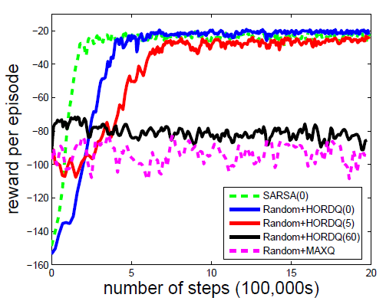
Experiment 1: Result

Slide 28
Discussion
Pseudo-reward shall
Larger than the step cost of reaching the subgoal
Necessary for good learning rate
Smaller than the breakdown penalty
To avoid break the bus
To learn the optimal policy
Decrease the pseudo-reward to zero
What is the decreasing rate?
Notes:
Choose as small reward as possible
Decrease it when the policy is “good enough”
No theory here

Slide 29
No more “toy problems”
What is the application to large domains?
No more table lookup Q-learning
Not possible to learn the optimal policy
Let the model-free approach handle the situations where the model-based approach fails
Notes:
What’s is the use of my theory

Slide 30
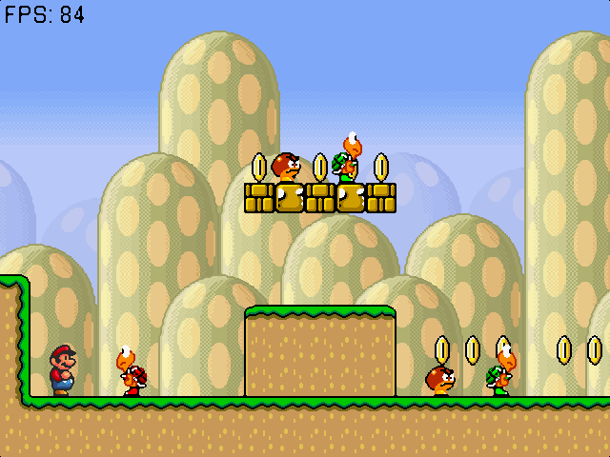
Experiment 2: Super Mario Bros.
RL Competition 2009
Image features:
22x16 Tiles
List of monsters
Type, Speed, Position
Actions:
Left, Right, Jump, Speed
Reward:
Finish the level: +100
Get killed: -50
Each coin: +1
Move forward: +1
Move backward: -1
Notes:
No onGround, isSliding, isMonsterAhead, isPit

Slide 31
Experiment 2: Super Mario Bros.
Why Mario is important?
Mario is like a mobile robot
Sensor:
Video camera
Dynamic:
Move around obstacles
Avoid dangerous creatures
Intelligence:
Execute a correct sequence of actions to achieve its goal
Notes:
Build a model of it’s own dynamic through interaction
Other unknown object cannot

Slide 32
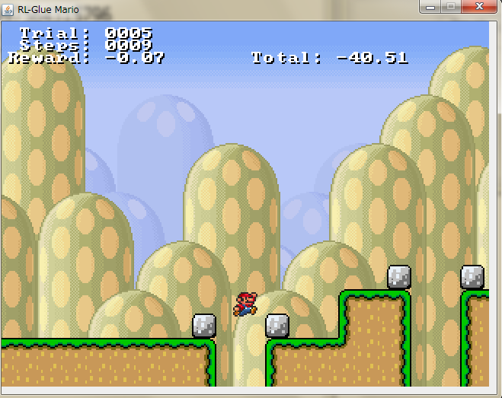
Model-Based Approach
Model the dynamics of Mario
Regression Tree
Use the idea from Helster and Stone 2009
Each action has its own tree
Features:
5x5 tiles around Mario
Include monsters
Current speed
Predicts:
The speed in the next state
The relative positions
Model the rewards
Regression Tree with the same feature

Slide 33
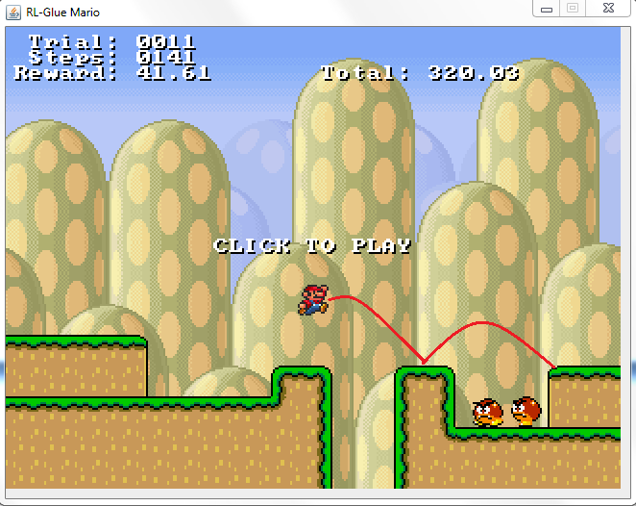
Model-Based Approach
A* search
Idea from Robin Baumgarten
The champion of Mario AI Competition 2009
Find a path which moves Mario forward as far as possible
Search for paths at most 6 step ahead
Prune the path when:
Mario gets killed
A jump action doesn’t increase the y-speed of Mario
Notes:
From HORDQ
Mario Competition 2009 A*
Assume a perfect knowledge about the game
Have access to the simulator interface
My approach: A* with “learned model”
And static assumption
Heuristic to reduce the branch
Jump

Slide 34

Model-Free Approach
Linear HORDQ:
Features:
Monsters in the screen
type, position (relative)
No pit information!!!
Not available from image features
How to represent a pit?

Slide 35
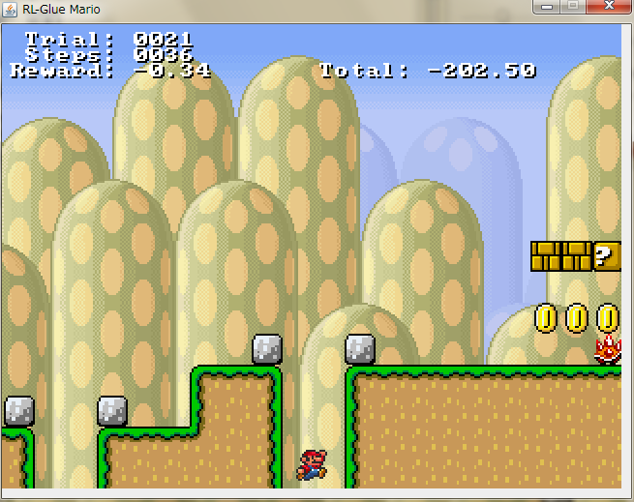
Model-Based Approach
Why model-based is necessary:
The terrain information
Let Mario move efficiently
The pit
Part of terrain information
Notes:
No 100% accurary classifier
It will make a suboptimal decision at some point

Slide 36
Model-Free Approach
Why model-free is necessary:
Handle the interaction between objects
Not everything can be modeled
Monster can be killed
Turtle -> shell
Kick the shell may kill monsters
Kick the shell may kill Mario
Monsters come out from the right edge of the screen
Fiery Mario can attack with fireballs
Fireball kills the monster
No monster dynamics from model-based approach
Notes:
Model this is equivelent to learn precondition and postcondition of strips style planning

Slide 37
Task Hierarchy for Mario
Root
A*
Action(t)
HORDQ
Action(t)
Idea: let A* handle the pit, HORDQ handle the monster

Slide 38
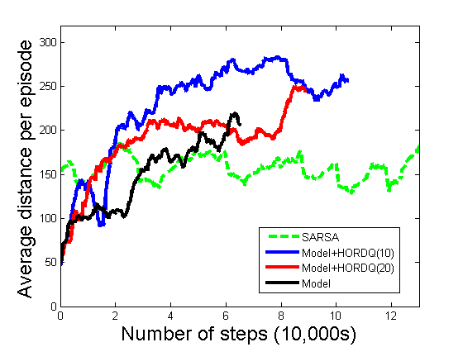
Experiment 2: Result
Random seed:1247
Difficulty: 3
Notes:
Model-free approaches fail to learn the
Model-based approaches
Build a model of it’s own dynamic through interaction
Other unknown object cannot

Slide 39
Experiment 2: Result
The number of times to pass the level:
SARSA: 1/1000
Model+HORDQ(10): 277/1000
Model+HORDQ(10): 64/1000
Model: 0/1000
Notes:
Model-free approaches fail to learn the
Model-based approaches
Build a model of it’s own dynamic through interaction
Other unknown object cannot

Slide 40
Discussion
The pseudo-reward shall
Large enough to let A* have access to all primitive actions when a pit is encountered
Small enough so Mario will not be killed by the monster
Decrease the pseudo-reward to 0
Will not lead to better policy anymore

Slide 41
Discussion
A general rule for pseudo-reward
Large enough so that the model-free approach will pursue the subgoal
When the model-based approach doesn’t have enough samples to build an approximately good model
Small enough to pass the control to model-free approach when the model-based approach doesn’t work

Slide 42
Conclusion

Slide 43
Thank you

Slide 44
The previous work on
Model-based approach + model-free one
Vlad
CMU tech report
Another
Include the school and conf name\
Their approach cannot learn the optimal policy
If model-based approach cannot

Slide 45
Optimality is not that important
There are many path to the goal
Little of them are completely wrong

Slide 46
Life or death
Suboptimality lead to certain death

Slide 47
A solution to many open problems
1. Linear Dyna 2008
2. Peter’s Stone (or rutegur) model-based cannot model everything
3. MAXQ -> no need to find safe state abstraction

Slide 48
Video: 30 min, 3 hour
Music
Other video on youtube

Slide 49
Acknoledgement
Mom
Supervisor
Bruno

Slide 50
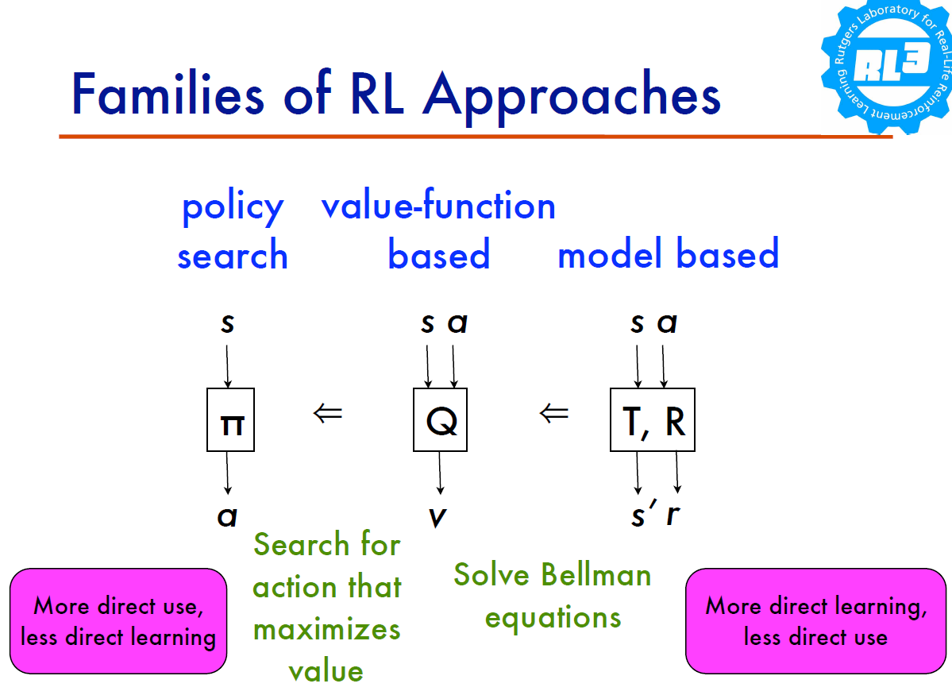

Slide 51
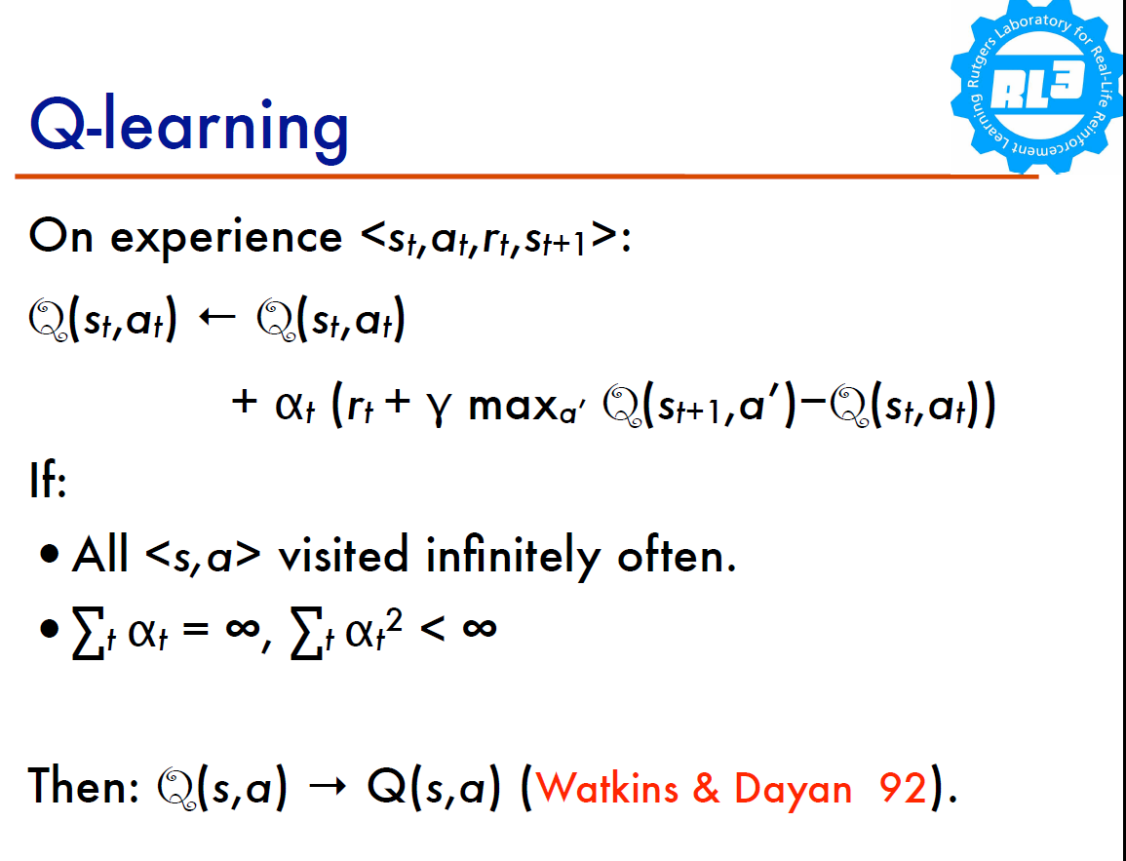

Slide 52
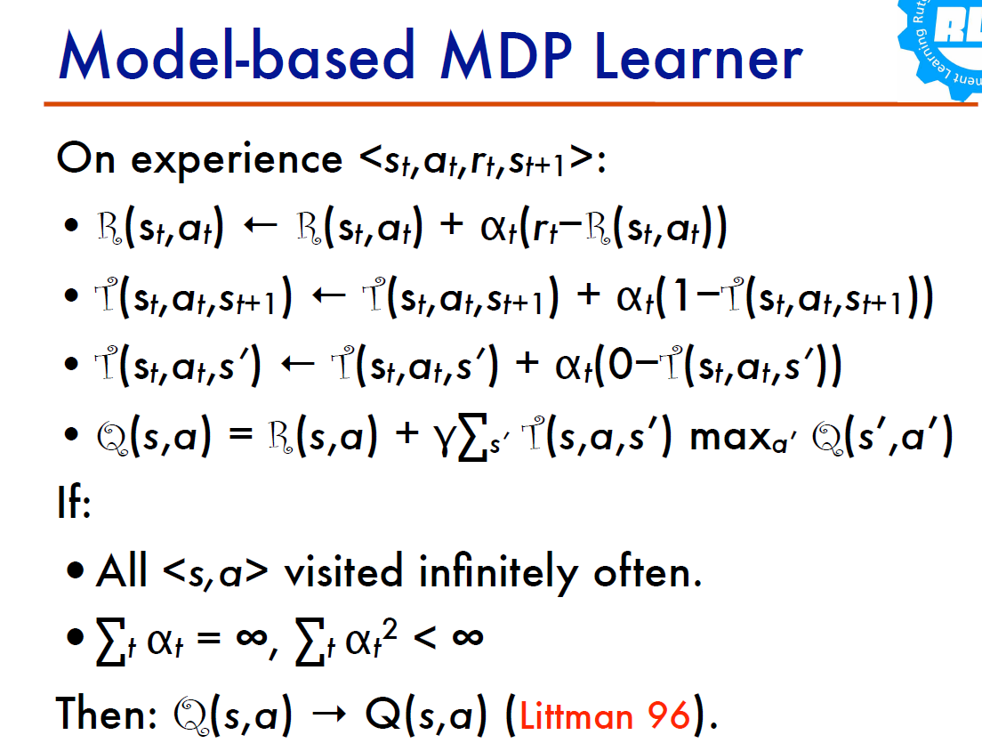

Slide 53
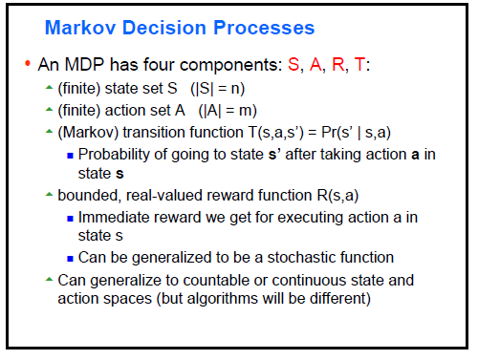

Slide 54
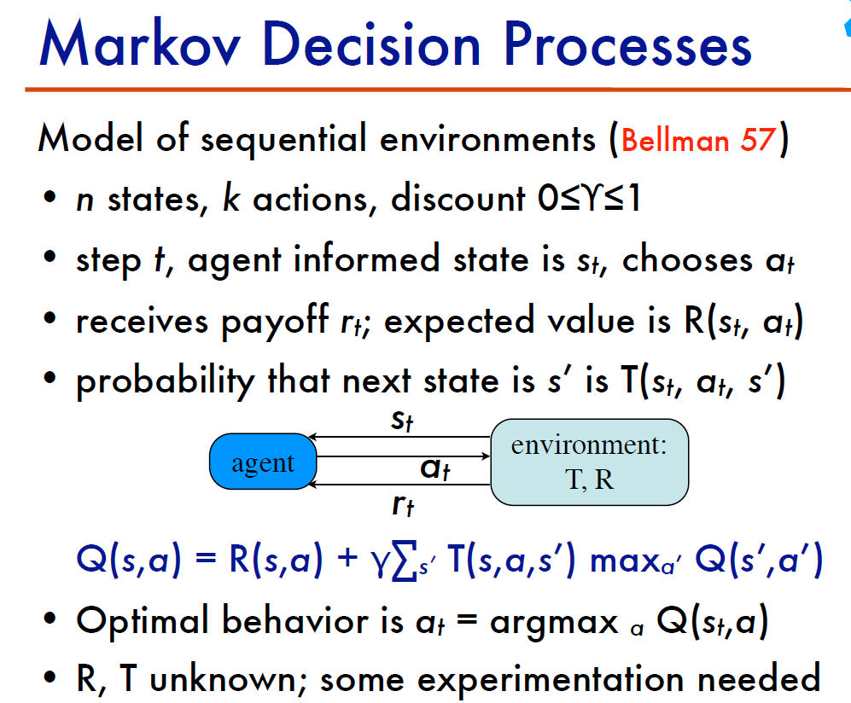

Slide 55
Thinking Big…
"... consider maze domains. Reinforcement learning researchers, including this author, have spent countless years of research solving a solved problem! Navigating in grid worlds, even with stochastic dynamics, has been far from rocket science since the advent of search techniques such as A*.” -- David Andre
Use planners, theorem provers, etc. as components in big hierarchical solver.

Slide 56
TODO: add theorem to show that it’s necessary to add all primitive subtasks

Slide 57
Pseudo-Reward
Hierarchically Optimal policy sounds great
But.... Useless
That’s why people uses MAXQ
High pseudo reward behaves like→MAXQ (need to introduce MAXQ)
Higer learning rate, suboptimal policy
Lower Pseudo reward -> like HORDQ
Low pseudo reward with Leaf cover hierarchy →Q learning
Lower learning rate, near optimal policy
How to choose pseudo-reward
Show with an experiment or motivating example
Boss asks you to make iRobot, but you make a terminator
Experiment -> hierarchically optimal is worse than Q-learning
But with Pseudo-Reward no more hierarchical optimal policy (nor optimal policy)
Pseudo-reward indicates how much we believe our model
But it’s the model-free one that learns the optimal policy
You can use large reward to encourage exporartion in the early stage
And decrease it overtime to learn the opitmal policy
But optimal policy is not important, I just want the agent
To finish the task
Show it with school bus domain
Model-based approach cannot finish the task

Slide 58
Root
Left
Left Speed
Right
Right Speed
Right Jump
Jump Speed
Jump
Right Speed Jump
Left Speed Jump

Slide 59
How I played video games:
Prediction (planning)
In a complex secenario (too many monsters)
Planning doesn’t work
Trial and error-> use experience and memory

Slide 60
Why Mario is important
A robot uses its sensor
Video camera
Computer vision, tracking
Build a model of it’s own dynamic through interaction
Other unknown object cannot be model
Use model-free instead
Learns how to destory koobma and save princess
Move around obstacles, avoid dangerous creature

Slide 61
Two Baseline Algorithm
Mario Competition 2009 Champion
RL Competition 2009 Champion

Slide 62
Mario Competition 2009
A*
Assume a perfect knowledge about the game
Have access to the simulator interface
My approach: A* with “learned model”
And static assumption

Slide 63
Static Assumption Planning
Learner
Regression Tree
Predict the future location of mario, and speed and reward
Heuristic to reduce the branch
Jump
From HORDQ

Slide 64
Mario:
Why model-based is neccessary->the pit
Model-based can model the terrain, but model-free cannot
Why model-free is neccessary ->
Not everything can be modeled –
We don’t know when
Moving monster
Turtle will be turned into shell Turtle->shell
Kick shell to the wall
Piraha flower
Monsters comes out from right edge of the screen
Fireball kills the monster
Mario is the only moving subject
No 100% accurary classifier
It will make a suboptimal decision at some point

Slide 65
A picture with moving path
No monster
To show how Model-based approach can work

Slide 66
No dynamic programming anymore
(x, y, dx, dy) is too huge to emeuerate
Use k-step look ahead planning
Similar to Robin’s idea
Search for N nodes

Slide 67
Model-free
Use xx’s idea
State abstraciton
Feature

Slide 68
Pavlov’s pet
SaeHoon Yi (USA)
• Paul Ringstad (USA)
• Fengming Wang (USA)

Slide 69
The Hierarchy for Mario
Pics here
9 actions
No temporal abstraction and spatial abstraction
No benefit from hierarchical representation
All subtasks finished in single step
The benefit from my appraoch
The combination of two complementary appraoch
Notes:
My work is not HRL

Slide 70
Why model-based approach can handle pit?
Why model-free approach can’t?

Slide 71
Model-based approach encodes our prior knowledge about the system dynamics. It is beneficial if the agent possess such knowledge. However, our dynamical model may be not perfect....

Slide 72
Infinite Mario
Observation Space
Mixed discrete continuous
Visible board, monster descriptions
Variable dimensionality
Compositional / object oriented
Action Space
3 integers, representing the buttons
on a Nintendo controller!
Rewards
Variable (!)
Parameterization
Speed, critter dynamics, reward function, action mappings

Slide 73
RL Competition
Input Features:
Screen features
No onGround, isSliding, isMonsterAhead, isPit
Unlike Mario competition
No fireflower
22x16 Tiles (not including monsters)
List of monsters (including speed and position)
Linear Sarsa
3 nearest monster or pit
How to represent the pit
Theirs-> hand-coded the pit feature
Mine-> work on 5x5 tiles

Slide 75
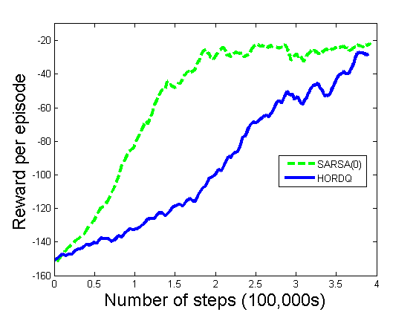

Slide 76
if it will converge

Slide 77
Will it converge?
Open problem (russel and david andre fail to prove it(

Slide 78
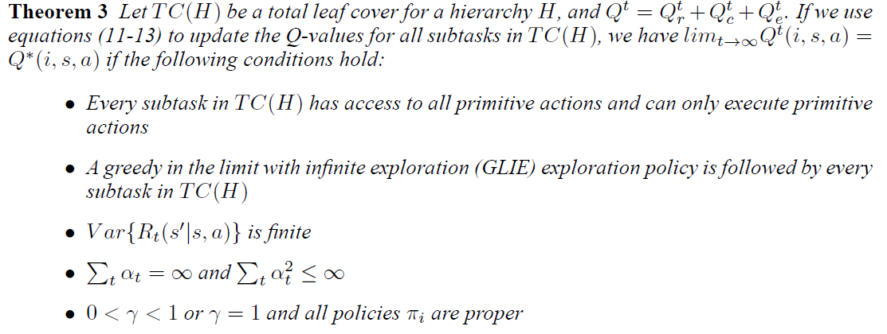

Slide 79
You can put
Anything here:
Model-free RL
Model-based RL
Include all
Classical planning algorithms
And still get an optimal
Policy!! for an MDP
Symbolic programming
A*
STRIPS
MAXQ
HORDQ

Slide 80
Experiment 2: Result
The number of times to pass the level:
SARSA: 1/1000
Model+HORDQ(10): 277/1000
Model+HORDQ(10): 64/1000
Model: 0/1000
Notes:
Model-free approaches fail to learn the
Model-based approaches
Build a model of it’s own dynamic through interaction
Other unknown object cannot

Slide 81
Conclusion
I combine two champion approaches and produce a better one
A* is still the state of the art for Mario
With a perfect model
without, my approach is better
Compare to RL competition
We include the terrain information
Move efficiently
Less sample
Easier to generalize to new level

Slide 82
