Slide 1
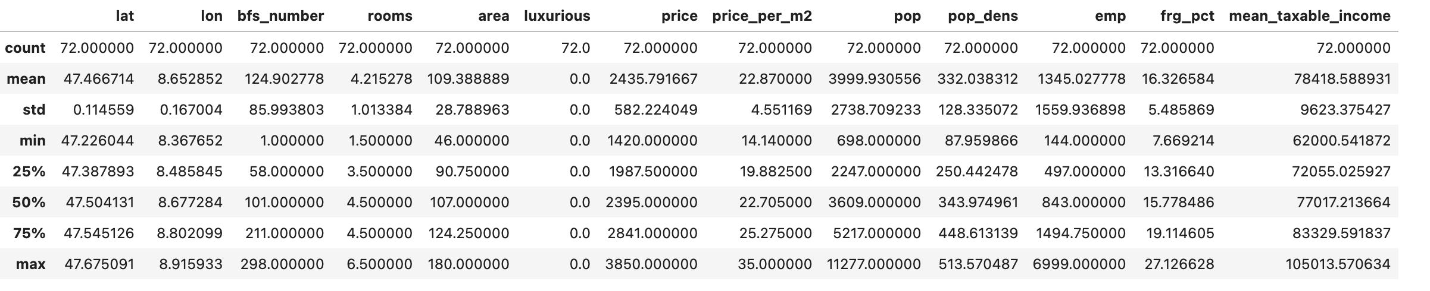
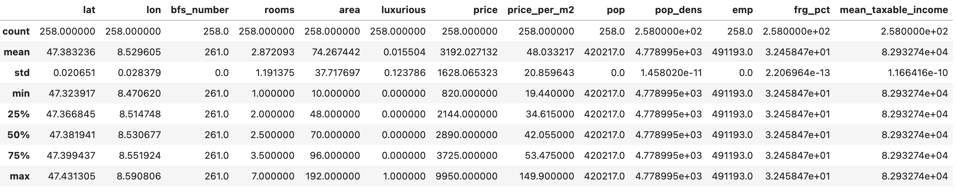
Rural- vs. city-apartments
Summary Statistics
Rural
City

Slide 2
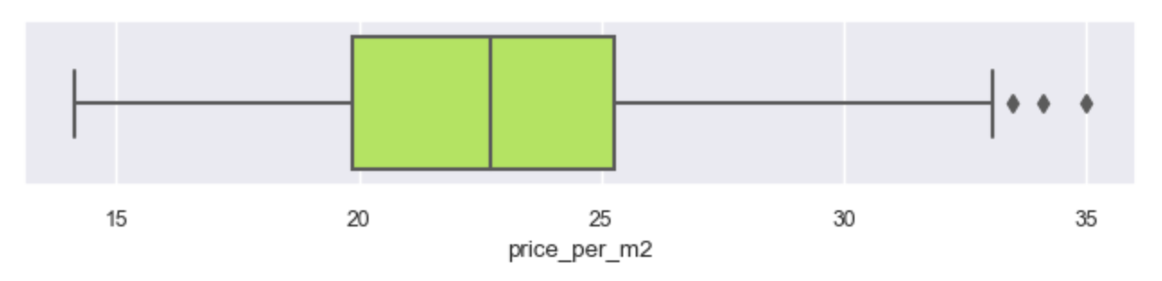
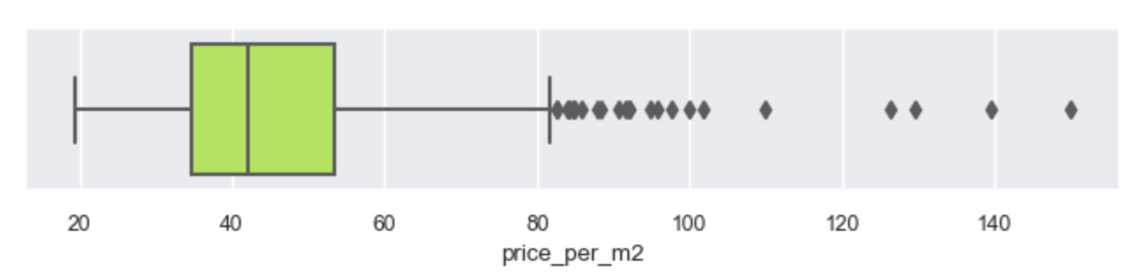
Rural- vs. city-apartments
Boxplot price_per_m2
Rural
City

Slide 3
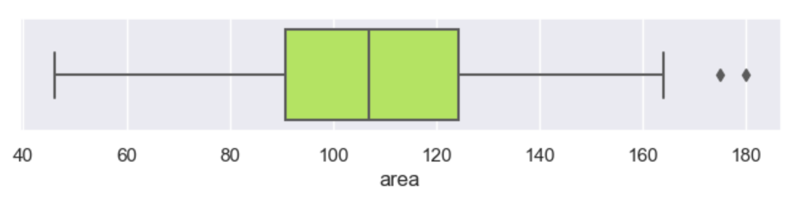
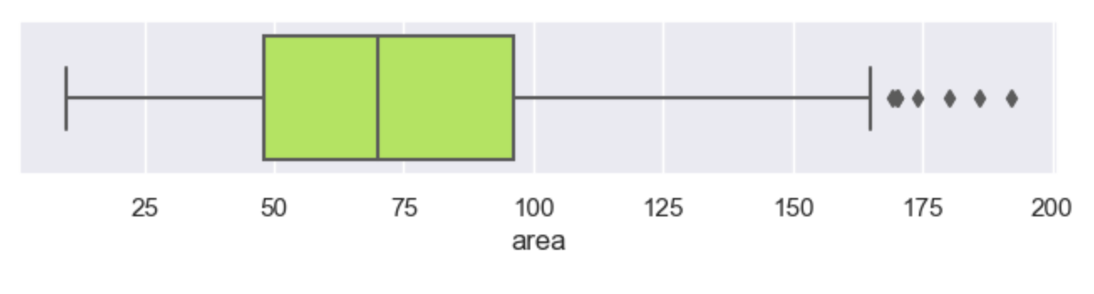
Rural- vs. city-apartments
Boxplot area
Rural
City

Slide 4
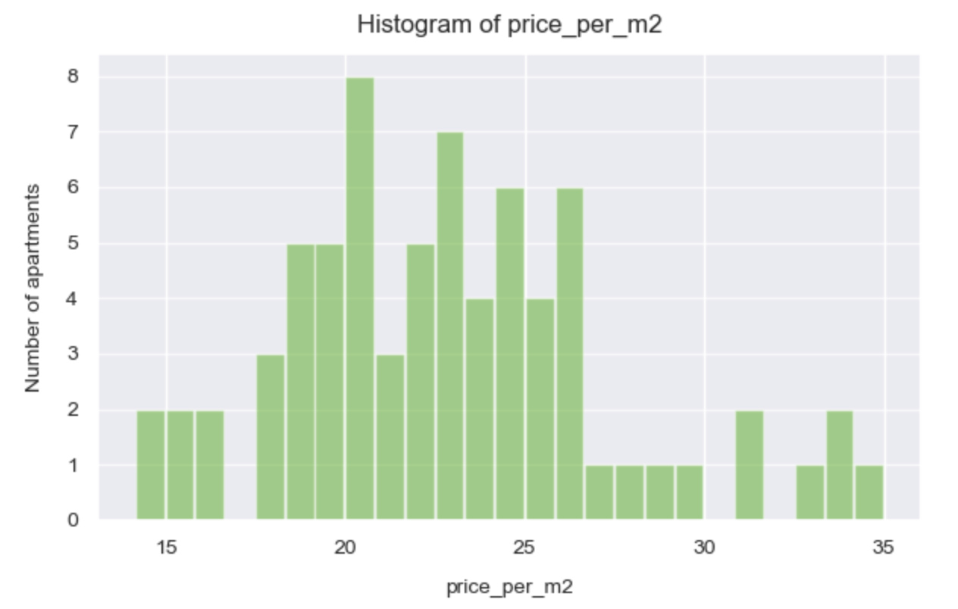
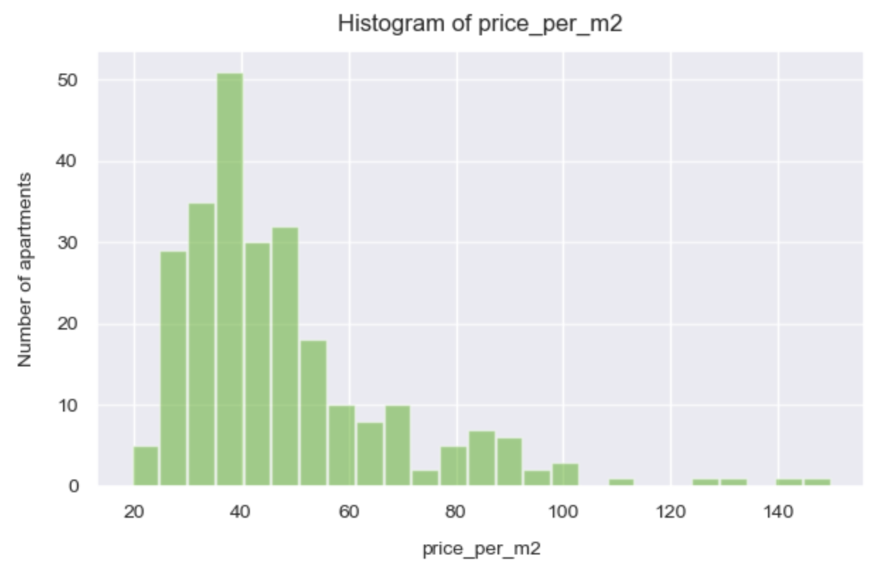
Rural- vs. city-apartments
Histogram price_per_m2
Rural
City

Slide 5
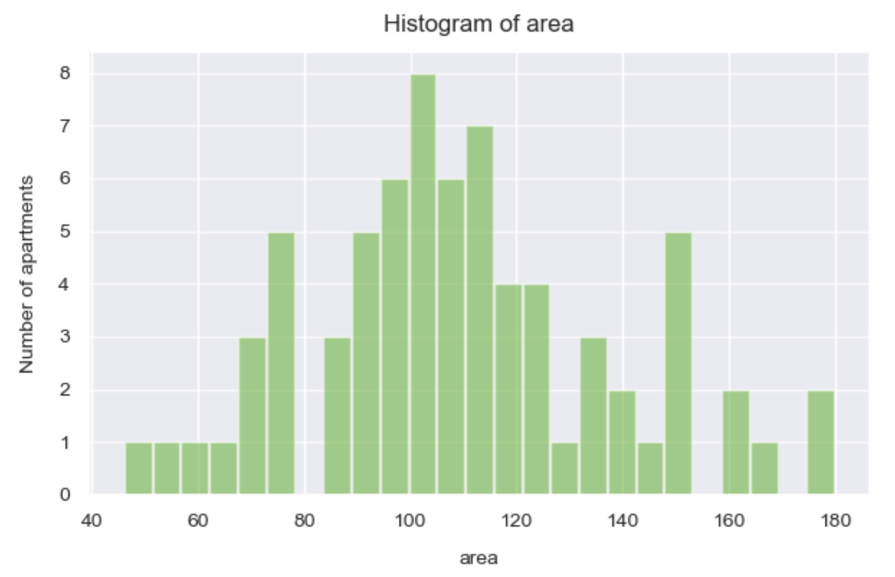
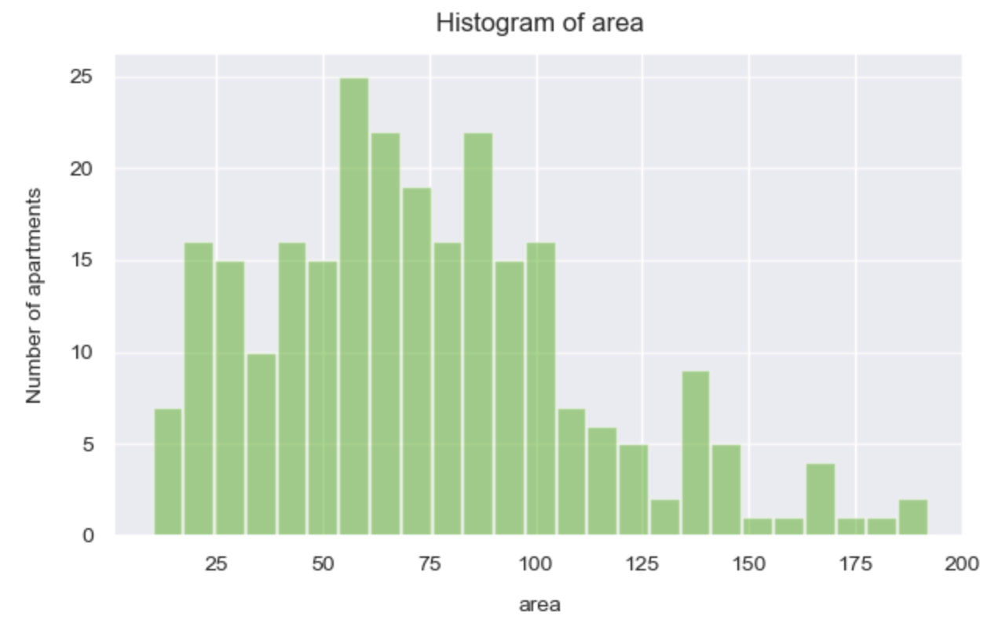
Rural- vs. city-apartments
Histogram area
Rural
City

