Slide 1

Do Pre-Trained Models have Storytelling Bias?
Luc De Nardi
Notes:
Do Pre-Trained Models have Storytelling Bias?

Slide 2
Background
Storytelling is an inherently human creation
  Brings communities together.
If we have models be trained on more languages
  there might be more representation on cultures which hopefully hopefully steer to less biased summarization/aid in better translation.

Slide 3
Background
Main research questions:
  How close are the topics of stories and spoken narratives from differing communities of low/medium resourced languages?
Main hypothesis:
  I believe that the topics will be similar by language families and will see pockets in the overall space.

Slide 4
Methodology - Models
Used 3 pre-trained multilingual models:
  XLM RoBerta Base
  DeBerta v3 Base
  Qwen2.5-7B-Instruct
    Did not have any instructions to keep it equivalent to the Bert-family of models
    Having instructions will switch what I would be looking into more how well instruction-tuned models can perform narrative categorization/alignment when prompted

Slide 5
Methodology - Languages
Had 24 languages from 3 different datasets on huggingface
  8 from google/WaxalNLP which “..is a large-scale multilingual speech corpus for African languages…”¹
  9 from Dxniz/TinyStories-Multilingual which “… is a high-fidelity synthetic dataset of short, child-safe fiction designed to stress-test literary consistency, emotional warmth, and multilingual fluency in small models…” ²
  7 from deeponh/multilingual-tinystories which “[a] collection of children's stories in multiple Indian languages, generated for language model training”³
¹ (Diack et al., 2026) ²(Afacan, 2026) ³(Halder & Mukherjee, 2026)

Slide 6
Methodology - Languages
Used the ASR training portion of google/WaxalNLP¹
  Participants say a story about an image shown to them
  Used transcription column
Dxniz/TinyStories-Multilingual² & deeponh/multilingual-tinystories³ are generated stories
¹ (Diack et al., 2026) ²(Afacan, 2026) ³(Halder & Mukherjee, 2026)

Slide 7
Methodology - Languages
Dataset | Languages
Google/WaxalNLP¹ | Acholi, Luganda, Masaaba, Nyankole, Soga, Akan, Ewe, Dagbani
Dxniz/TinyStories-Multilingual² | Norwegian, Slovak, Serbian, Bulgarian, Czech, Turkish, Persian, Vietnamese, Indonesia
Deeponh/multilingual-tinystories³ | Assamese, Dogri, GOM, Kannada, Nepali, Tamil, Sindhi
¹ (Diack et al., 2026) ²(Afacan, 2026) ³(Halder & Mukherjee, 2026)

Slide 8
Methodology - Models
Made embedding space for all languages for each model
Used an LDA model to find topics and see if the models can categorize the stories using the topics

Slide 9
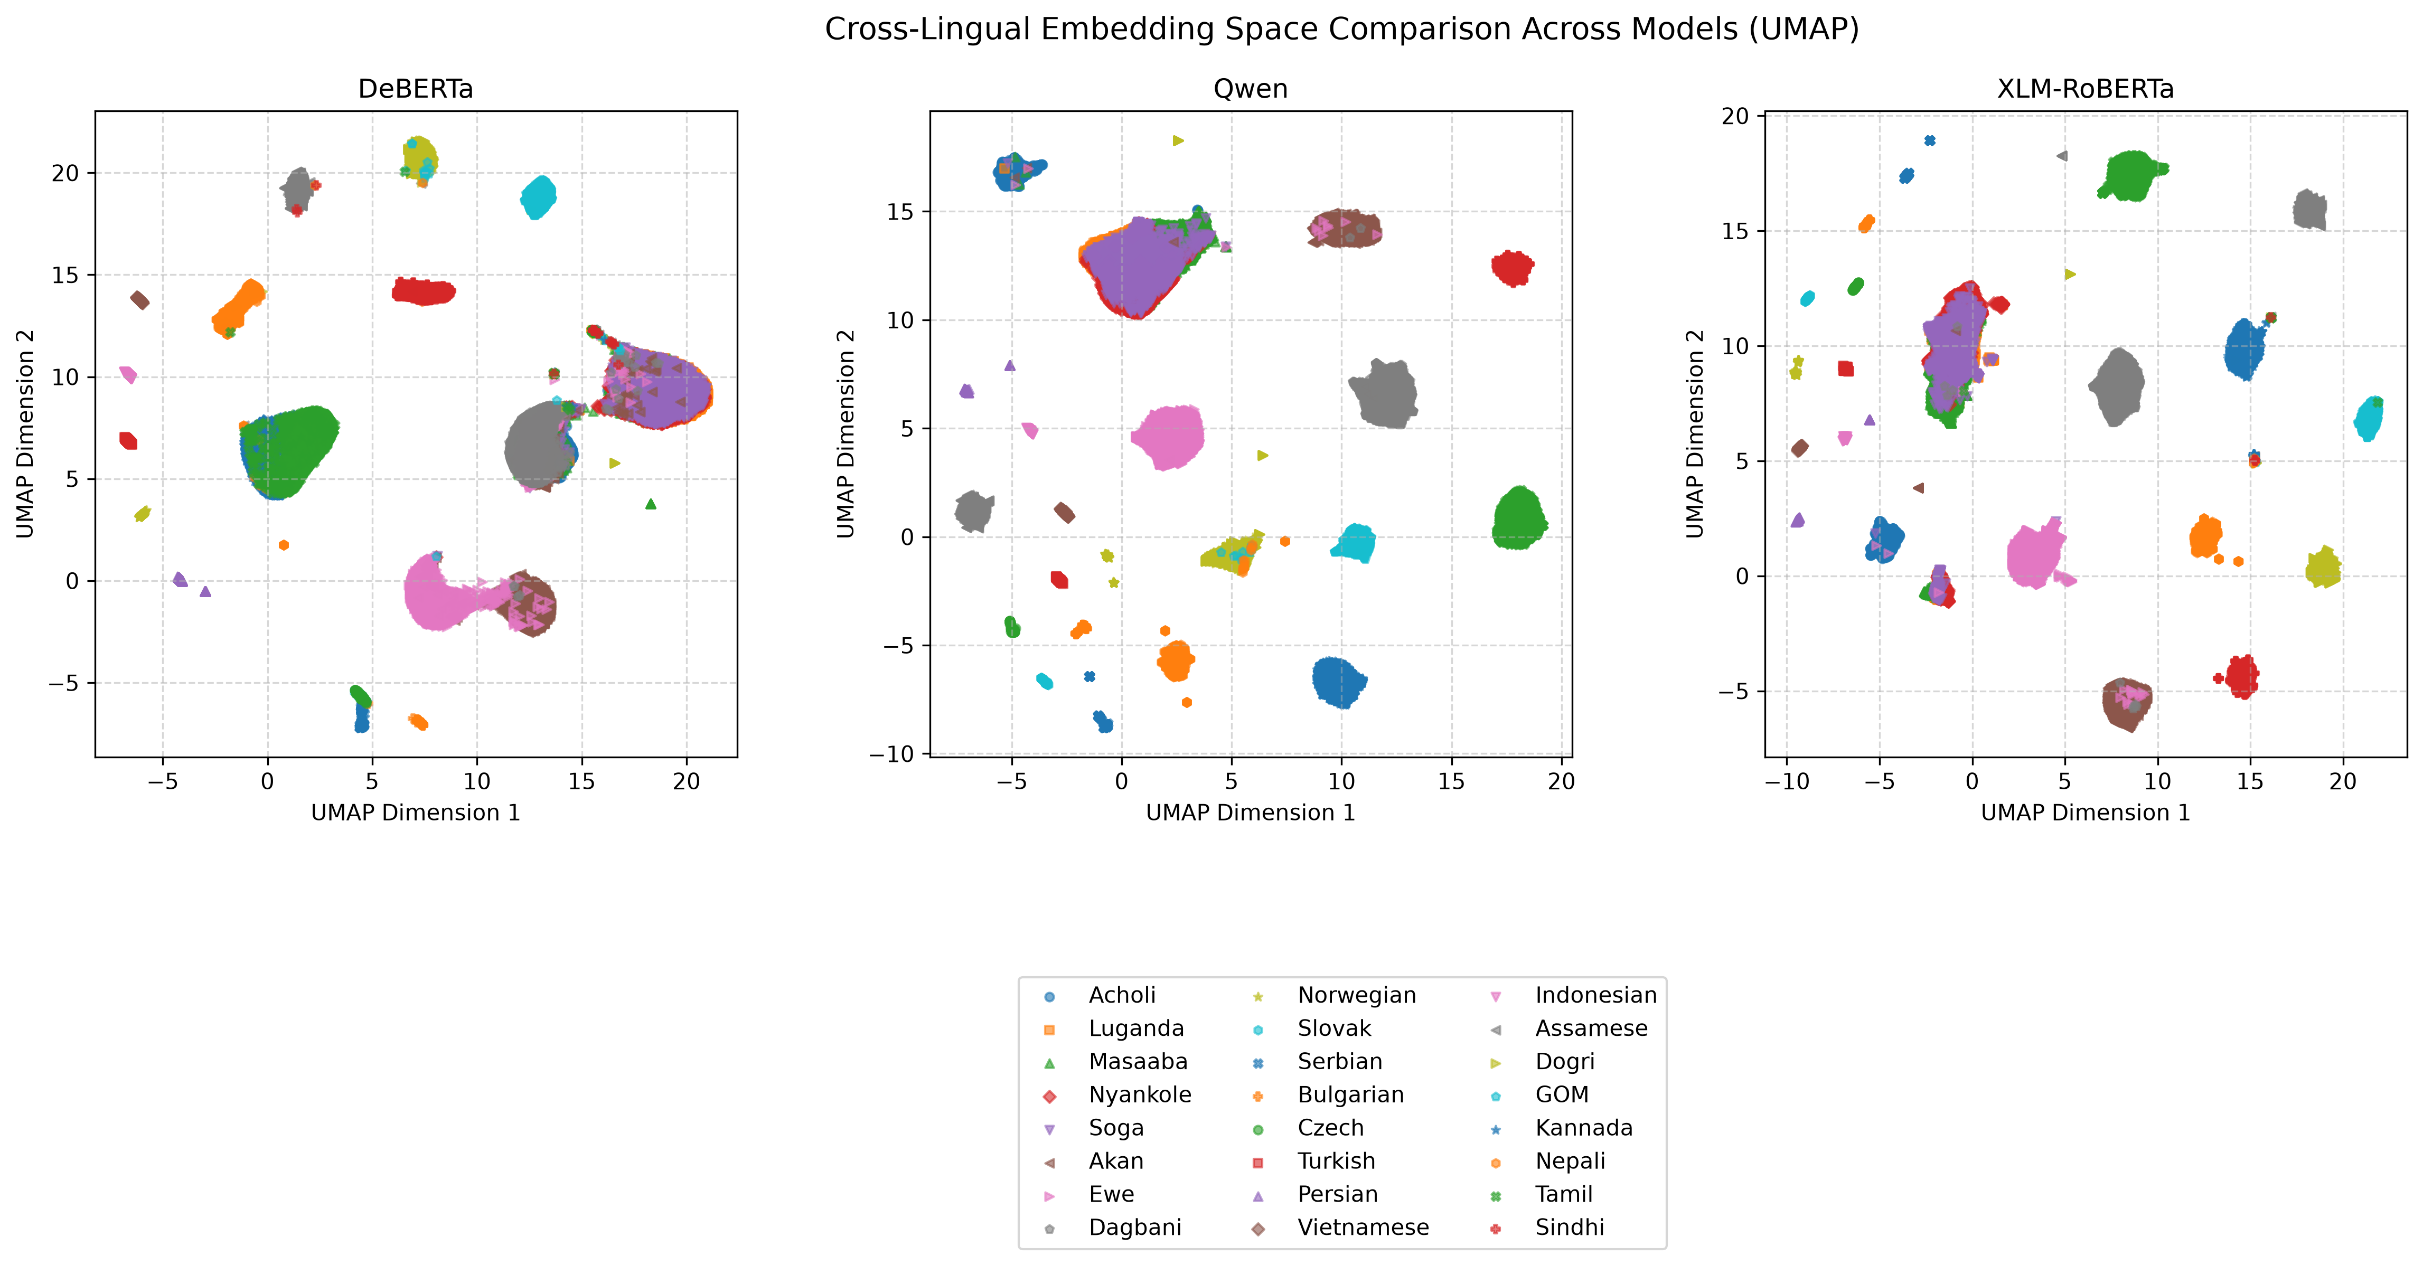
Results – Embedding space

Slide 10
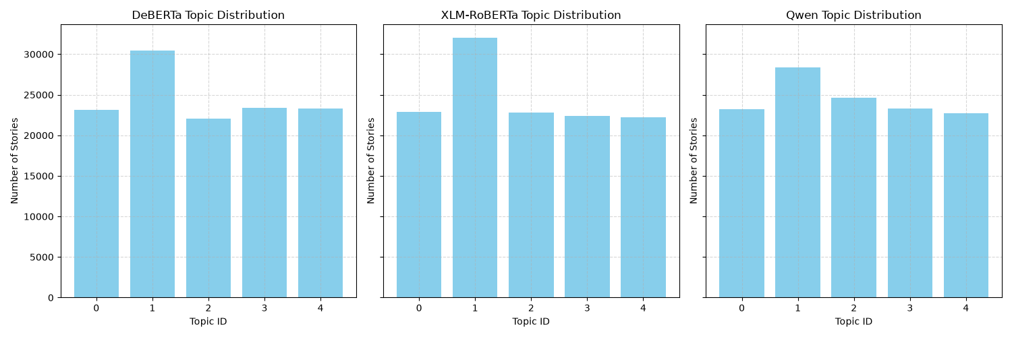
Results – LDA topic categorization

Slide 11
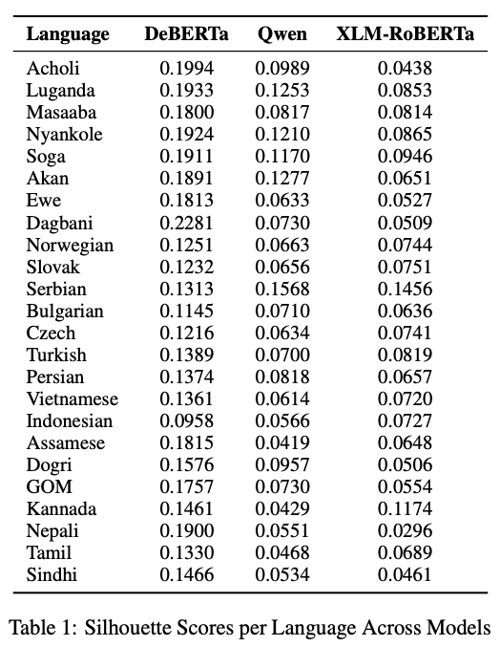

Results – Metrics (Silhouette scores)
A good score would be from 0.71 to 1.0
  Means that the clustering structure is strong and very well-defined
A reasonable score of 0.51 to 0.70
  Means that the clusters are reasonably well separated, which is common and acceptable for many real-world datasets
$≤$ 0.25 (No Substantial Structure):
  Likely does not have natural clusters or is poorly suited for the data shape.

Slide 12
Citations
Afacan, D. (2026). Dxniz/tinystories-multilingual · datasets at hugging face. Dxniz/TinyStories-Multilingual · Datasets at Hugging Face. https://huggingface.co/datasets/Dxniz/TinyStories-Multilingual
Diack, A., Nelson, P., Agbesi, K., Nakalembe, A., MohamedKhair, M., Dube, V., Siyavora, T., Venugopalan, S., Hickey, J., Okonkwo, U., Bapna, A., Wiafe, I., Helegah, R. D., Atsakpo, E. D., Nutrokpor, C., Winful, F. B. P., Solaga, K. K., Abdulai, J.-D., Ekpezu, A. O., ... Matias, Y. (2026). WAXAL: A large-scale multilingual African language speech corpus [Preprint]. arXiv. https://doi.org/10.48550/arXiv.2602.02734 [1, 2]
Halder, D., & Mukherjee, A. (2026). Multilingual TinyStories: A synthetic combinatorial corpus of Indic children's stories for training small language models [Preprint]. arXiv. doi.org

