Slide 1
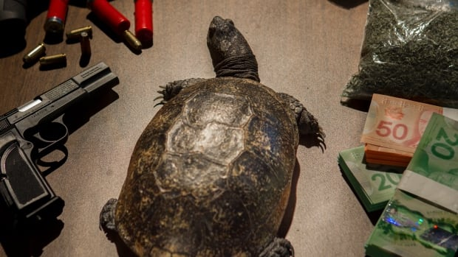
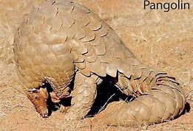
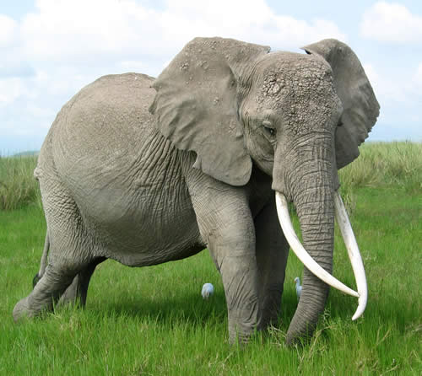
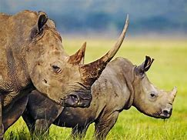
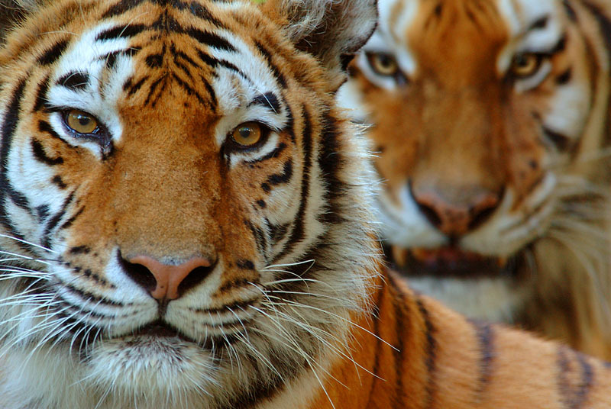
Zoohackathon 2019
<Coding to End Wildlife Trafficking>
Be My Voice

Slide 2
Global Problem Statement 10
Intelligence is needed to combat wildlife trafficking, the basis of which is information
The internet provides a rich vein of open-source information which is starting point for understanding the patterns, trends and dynamics of the billion-dollar transnational illegal wildlife trade
There is a huge effort required for NGOs to manually collate all the information from existing and subsequent news reports to build a incremental powerful intelligence picture.

Slide 3
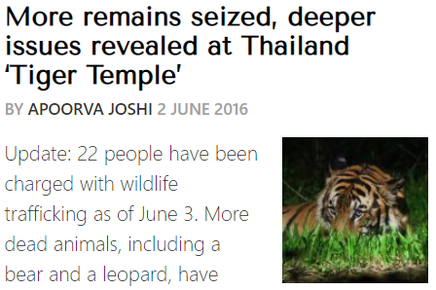
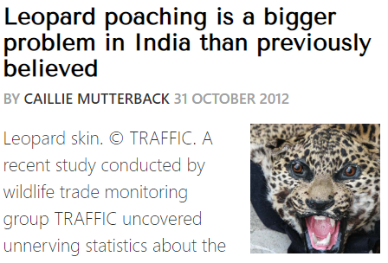
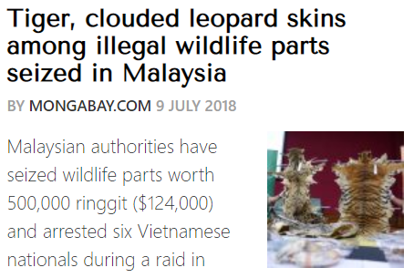
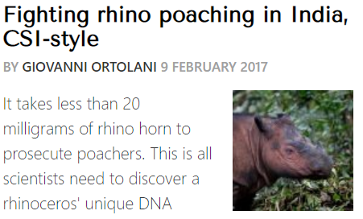
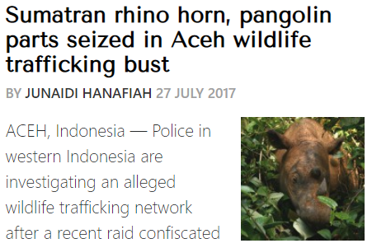
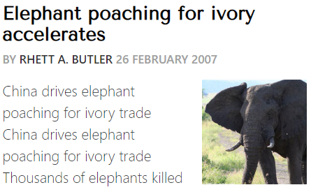
Source of Information
Source

Slide 4


Solution Approach
Search in News articles across the web and identify relevant news feeds.
1
Leverage the data to create reports in user friendly format
Transforming plain text articles to machine readable data
4
2
Natural Language Processing to convert to structured data
3

Slide 5
Technical Solution
Use news aggregator NewsAPI to search the articles with words such as ‘seize’, ‘poaching’, ‘ivory’, ‘tusk’, ‘horn’
Date, Author, URL, Summary, Article
These details will be refined over time using machine learning
Use Natural language processing
Use NLTK, Spacy, Gensim, Glove embedding
Find Location, Animal traded, Volume, Organizations
Present the data in structured format
Publish the data to Mobile App / Website

Slide 6
Output
Title | URL | Date | Article Header | Summary | Animal | Volume | Location | Money
Hong Kong Customs seizes suspected rhino horns (with photo)' | https://www.customs.gov.hk/en/publication_press/press/index_id_2736.html' | 19-Oct-19 | Hong Kong Customs seizes suspected rhino horns (with photo)' | Hong Kong Customs today (October 19) seized about 16 kilograms of suspected rhino horns with an estimated market value of about $3.2 million at Hong Kong International Airport. Members of the public may report any suspected smuggling activities to Customs' 24-hour hotline 2545 6182 or its dedicated crime-reporting email account (crimereport@customs.gov.hk). None | Rhino', 'rhino horn' | about 16 kilograms | Hong Kong International Airport Hong Kong Customs | about $3.2 million

Slide 7
Roadmap
Improve search to identify same report in different news articles and eliminate duplicate
More robust result set, to have all the necessary data – vehicles/vessels, trafficking routes etc.
Identify additional information on previously reported information
Multiple language support
Create more User Friendly interface, such as a simple UI with search functionality
Mobile APP to be used anywhere with ease of use

Slide 8
Thank You

