Slide 1
K Means Clustering
Mr. Pritam Prakash Shete
Computer Division, BARC
Centre for Excellence in Basic Sciences

Slide 2
Topics
Introduction
Unsupervised learning
Clustering applications
K means clustering
Optimization objective
Random initialization
Number of clusters
Advantages and disadvantages

Slide 3
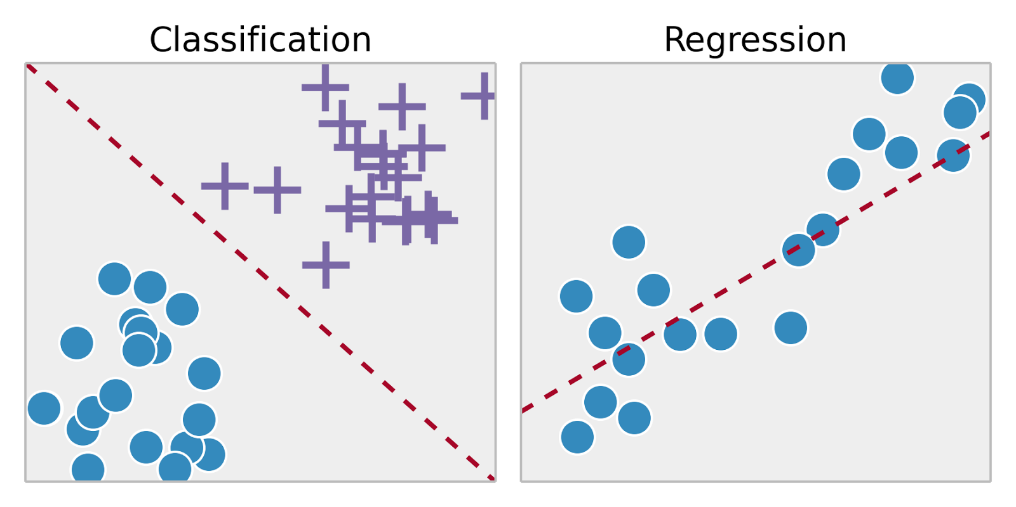
Supervised Learning
Training set – { (x⁽¹⁾,y⁽¹⁾), (x⁽²⁾,y⁽²⁾), …, (x^{(m)},y^{(m)})}
Labeled dataset
Image ack – Google

Slide 4
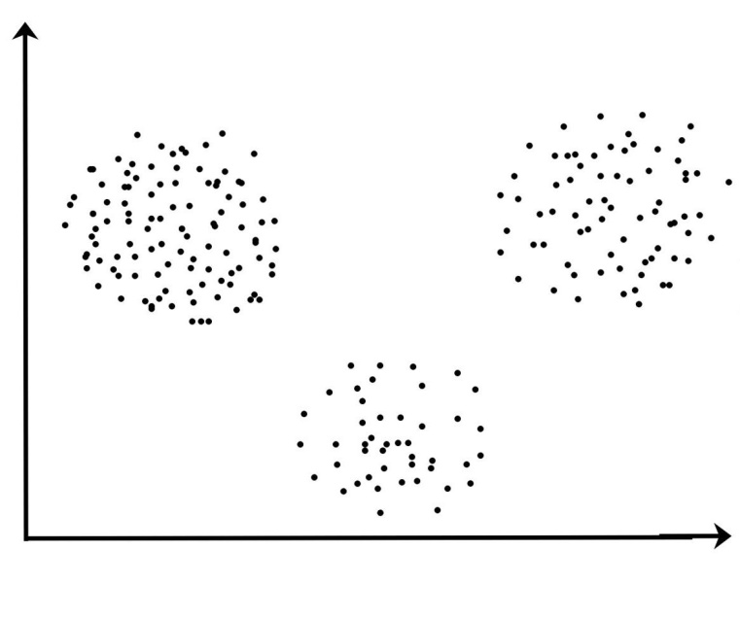
Unsupervised Learning – What?
Training set – { x⁽¹⁾, x⁽²⁾, …, x^{(m)}}
Unlabeled dataset
Image ack – Google
Notes:
All type + examples + GAN

Slide 5
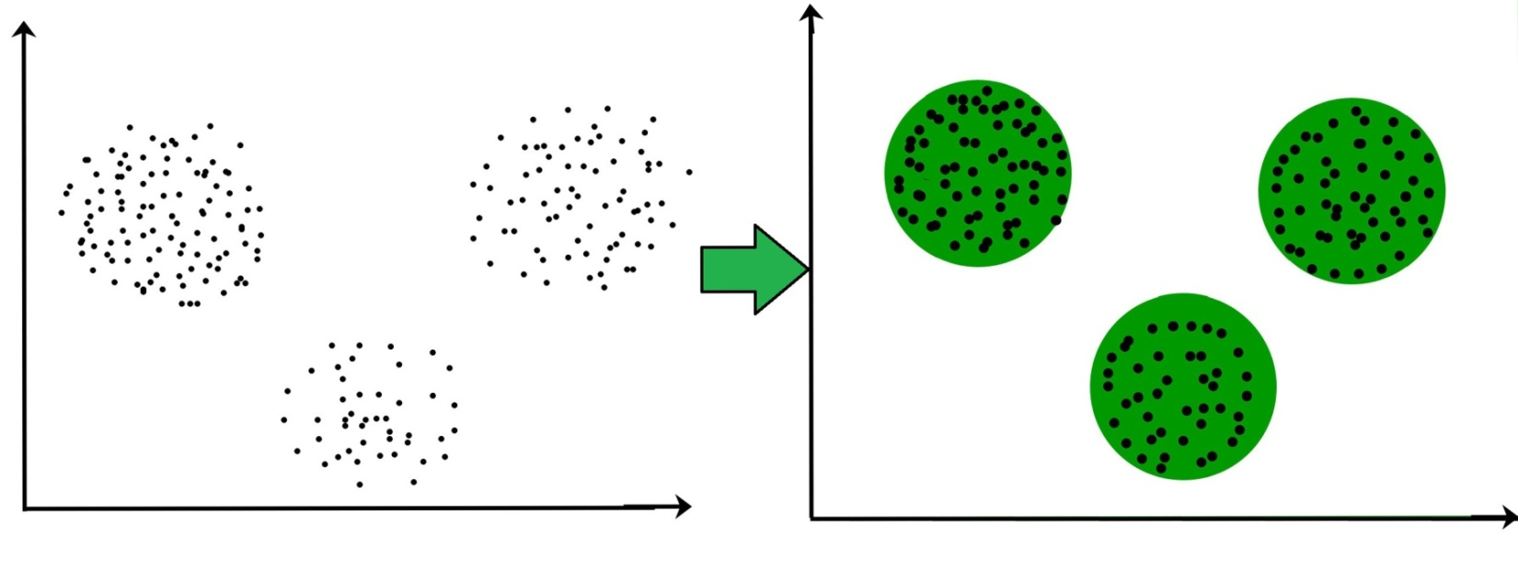
Unsupervised Learning – How?
Find structure of data
Group or cluster data
Extract useful information about data
Image ack – Google
Notes:
All type + examples + GAN

Slide 6



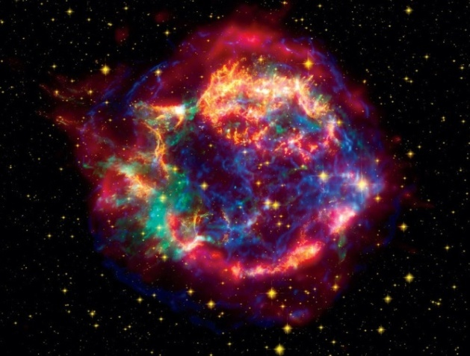
Applications
Market segmentation
Social network analysis
Computing cluster organization
Astronomical data analysis
Image ack – Google
Notes:
All type + examples + GAN

Slide 7
Market Segmentation
Customer database
Group into market segments
Serve market segments differently
Image ack – Google
Notes:
All type + examples + GAN

Slide 8
Social Network Analysis
Users send mails frequently
Users receive mails frequently
Coherence group of users
Image ack – Google
Notes:
All type + examples + GAN

Slide 9
Computing Cluster Organization
Compactness – Similarity within a cluster
Separation – Difference between clusters
Different nodes
Compute node
Data node
GPU vs CPU nodes
Different applications
Image ack – Google
Notes:
All type + examples + GAN

Slide 10
Astronomical Data Analysis
Identify
Star clusters
Cosmic structures
Anomaly detection
Brightness
Spectral characteristics
Image ack – Google
Notes:
All type + examples + GAN

Slide 11
K Means Clustering
Unsupervised learning – Unlabeled dataset
Centroid based algorithm
Iterative algorithm
K – Number of pre-defined clusters
Divide dataset into K different clusters
Decrease distance between samples from same cluster
Increase distance between samples from different clusters

Slide 12
Optimization Objective
WCSS – Within Cluster Sum of Squares
Variations within a cluster
Objective – Minimize WCSS

Slide 13
K Means Clustering Algorithm
Select number of clusters – K
Select random K points as centroids
Cluster assignment
Assign each data point to closest centroid
Centroid movement
Compute centroids for new clusters
Repeat Steps 3 to 5 until
Maximum number of iterations
Minimum variation in cluster centers
No change in cluster centers

Slide 14
Random Initialization
Select maximum number of iterations
For each iteration
Select random K points as centroids
Compute K clusters
Compute WCSS value
Keep cluster centroids with minimum WCSS
Use cluster centroids with minimum WCSS

Slide 15
Elbow Method – Number Of Clusters
Select range of values for K
For each value of K
Compute WCSS value
Plots curve between
Calculated WCSS values
Number of clusters K
Best value of K – Sharp reduction in WCSS

Slide 16
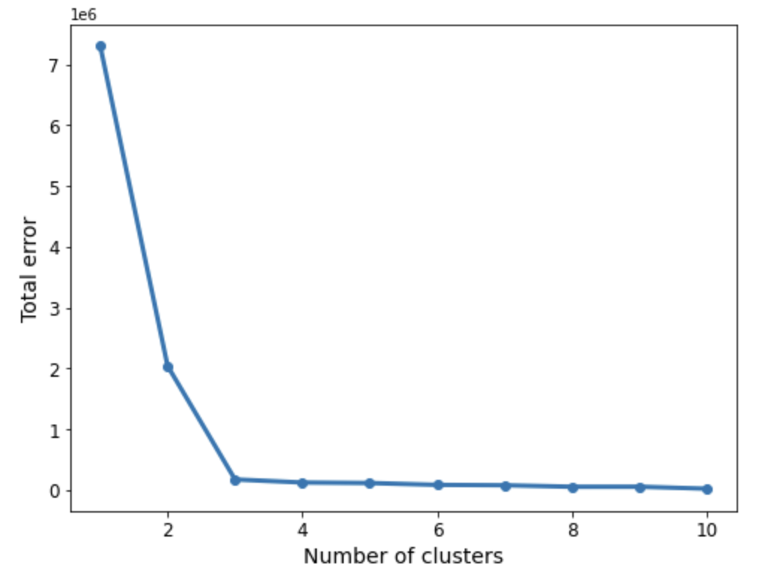
Elbow Method – Number Of Clusters

Slide 17
Advantages
Easy to implement
Computationally faster
Works well with spherical clusters

Slide 18
Disadvantages
Difficult to predict number of clusters K
Random initialization – Strong impact
Sensitive to outliers
Asymmetric clusters
Good for spherical clusters only

Slide 19
Questions?
Thank you

