Slide 1
Artificial Neural Network
Pritam Prakash Shete
Computer Division, BARC
Centre for Excellence in Basic Sciences

Slide 2
Topics
Linear regression
Logistic regression
Artificial neural network
Gradient descent
Back propagation
Activation functions

Slide 3
Linear Regression
Weights – W
Vector
W ε R
Dimension – n_{X}
Bias – b
Scalar
b ε R
y = W^{T}X + b

Slide 4
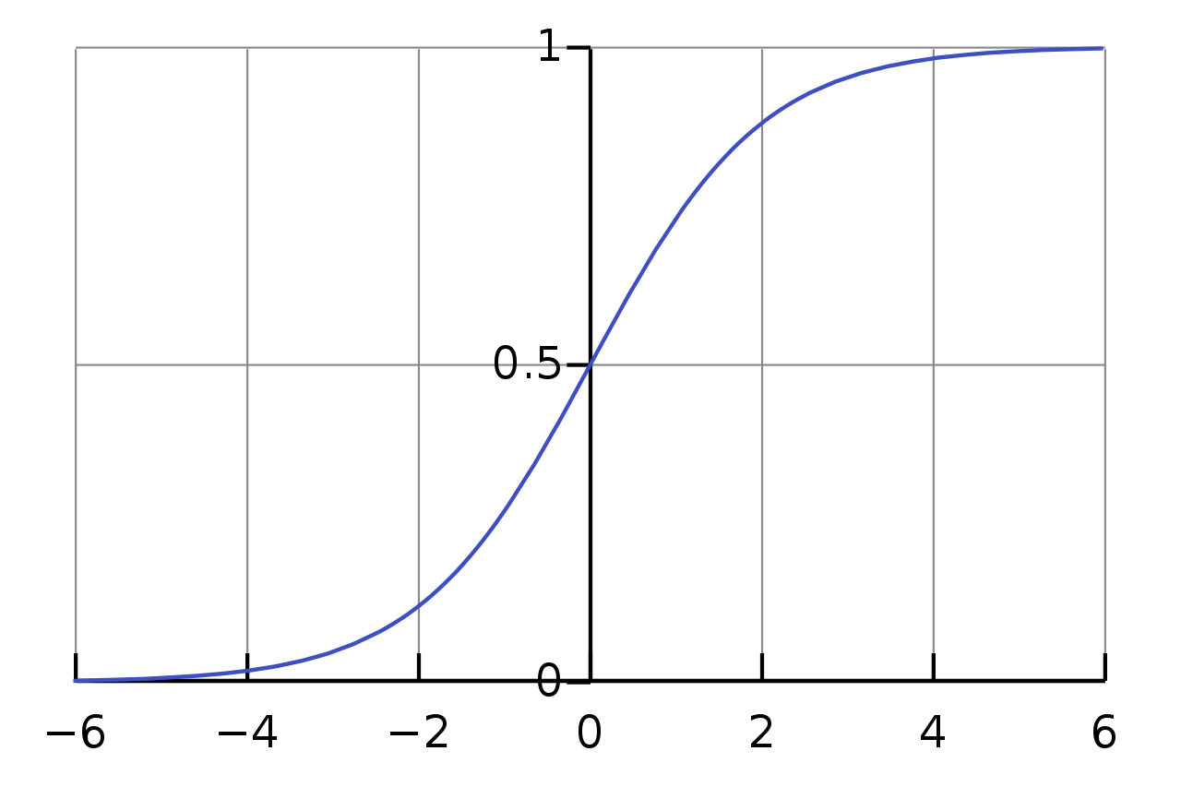
Sigmoid Function

Slide 5
Sigmoid Function
σ(Z) ~ 1 – For Z >> 0
σ(Z) ~ 0 – For Z << 0
σ(Z) = 0.5 – For Z = 0
Z | σ(Z)
-2 | 0.12
-1.5 | 0.18
-1 | 0.27
-0.5 | 0.38
0 | 0.50
0.5 | 0.62
1 | 0.73
1.5 | 0.82
2 | 0.88

Slide 6
Logistic Regression
Input – X
Vector
X ε R
Dimension – n_{X}
Output – ŷ
Scalar
0 <= ŷ <= 1.0

Slide 7
Linear Regression
Weights – W
Vector
W ε R
Dimension – n_{X}
Bias – b
Scalar
b ε R
y = W^{T}X + b

Slide 8
Logistic Regression
Weights – W
Vector
W ε R
Dimension – n_{X}
Bias – b
Scalar
b ε R
y = W^{T}X + b

Slide 9
Logistic Regression
Weights – W
Vector
W ε R
Dimension – n_{X}
Bias – b
Scalar
b ε R
Z = W^{T}X + b
ŷ = σ(Z) – Activation (sigmoid) function
x₁
W₁
+b
W₂
x₂
ŷ
activation
x₃
W₃

Slide 10
Logistic Regression
Weights – W
Vector
W ε R
Dimension – n_{X}
Bias – b
Scalar
b ε R
Z = W^{T}X + b
ŷ = P( y=1 | X)

Slide 11
Artificial Neural Network
Z = W^{T}X + b
Linear regression
x₁
W₁
+b
W₂
x₂
a = ŷ
activation
x₃
W₃

Slide 12
Artificial Neural Network
Z = W^{T}X + b
Linear regression
ŷ = σ(Z) = a
Activation function
e.g. sigmoid function
x₁
W₁
+b
W₂
x₂
a = ŷ
activation
x₃
W₃

Slide 13
Artificial Neural Network
Z = W^{T}X + b
Linear regression
ŷ = σ(Z) = a
Activation function
e.g. sigmoid function
Loss function
L(ŷ^{(i)}, y^{(i)}) – One i^{th} sample
x₁
W₁
+b
W₂
x₂
a = ŷ
activation
x₃
W₃

Slide 14
Artificial Neural Network
Z = W^{T}X + b
Linear regression
ŷ = σ(Z) = a
Activation function
e.g. sigmoid function
Loss function
L(ŷ^{(i)}, y^{(i)}) – One i^{th} sample
Cost function
J(W, b) – Average of loss function for all samples
x₁
W₁
+b
W₂
x₂
a = ŷ
activation
x₃
W₃

Slide 15
Two Layer Neural Network
Input layer
Hidden layer – Layer 1
Output layer – Layer 2
x₁
x₂
ŷ
x₃

Slide 16
Two Layer Neural Network
Layer 1
Z^{[1]} = W^{[1]}X + b^{[1]}
x₁
x₂
ŷ
x₃

Slide 17
Two Layer Neural Network
Layer 1
Z^{[1]} = W^{[1]}a^{[0]} + b^{[1]}
x₁
x₂
ŷ
x₃

Slide 18
Two Layer Neural Network
Layer 1
Z^{[1]} = W^{[1]}a^{[0]} + b^{[1]}
a^{[1]} = σ(Z^{[1]})
x₁
x₂
ŷ
x₃

Slide 19
Two Layer Neural Network
Layer 1
Z^{[1]} = W^{[1]}a^{[0]} + b^{[1]}
a^{[1]} = σ(Z^{[1]})
Layer 2
Z^{[2]} = W^{[2]}a^{[1]} + b^{[2]}
x₁
x₂
ŷ
x₃

Slide 20
Two Layer Neural Network
Layer 1
Z^{[1]} = W^{[1]}a^{[0]} + b^{[1]}
a^{[1]} = σ(Z^{[1]})
Layer 2
Z^{[2]} = W^{[2]}a^{[1]} + b^{[2]}
a^{[2]} = σ(Z^{[2]})
x₁
x₂
ŷ
x₃

Slide 21
Two Layer Neural Network
Layer 1
Z^{[1]} = W^{[1]}a^{[0]} + b^{[1]}
a^{[1]} = σ(Z^{[1]})
Layer 2
Z^{[2]} = W^{[2]}a^{[1]} + b^{[2]}
ŷ = a^{[2]} = σ(Z^{[2]})
Loss function
L(ŷ, y)
x₁
x₂
ŷ
x₃

Slide 22
Two Layer Neural Network
Layer 1
Z^{[1]} = W^{[1]}a^{[0]} + b^{[1]}
a^{[1]} = σ(Z^{[1]})
Layer 2
Z^{[2]} = W^{[2]}a^{[1]} + b^{[2]}
ŷ = a^{[2]} = σ(Z^{[2]})
Loss function
L(ŷ^{(i)}, y^{(i)})
x₁
x₂
ŷ
x₃

Slide 23
Two Layer Neural Network
Layer 1
Z^{[1]} = W^{[1]}a^{[0]} + b^{[1]}
a^{[1]} = σ(Z^{[1]})
Layer 2
Z^{[2]} = W^{[2]}a^{[1]} + b^{[2]}
ŷ = a^{[2]} = σ(Z^{[2]})
Cost function
J(W, b)
x₁
x₂
ŷ
x₃

Slide 24
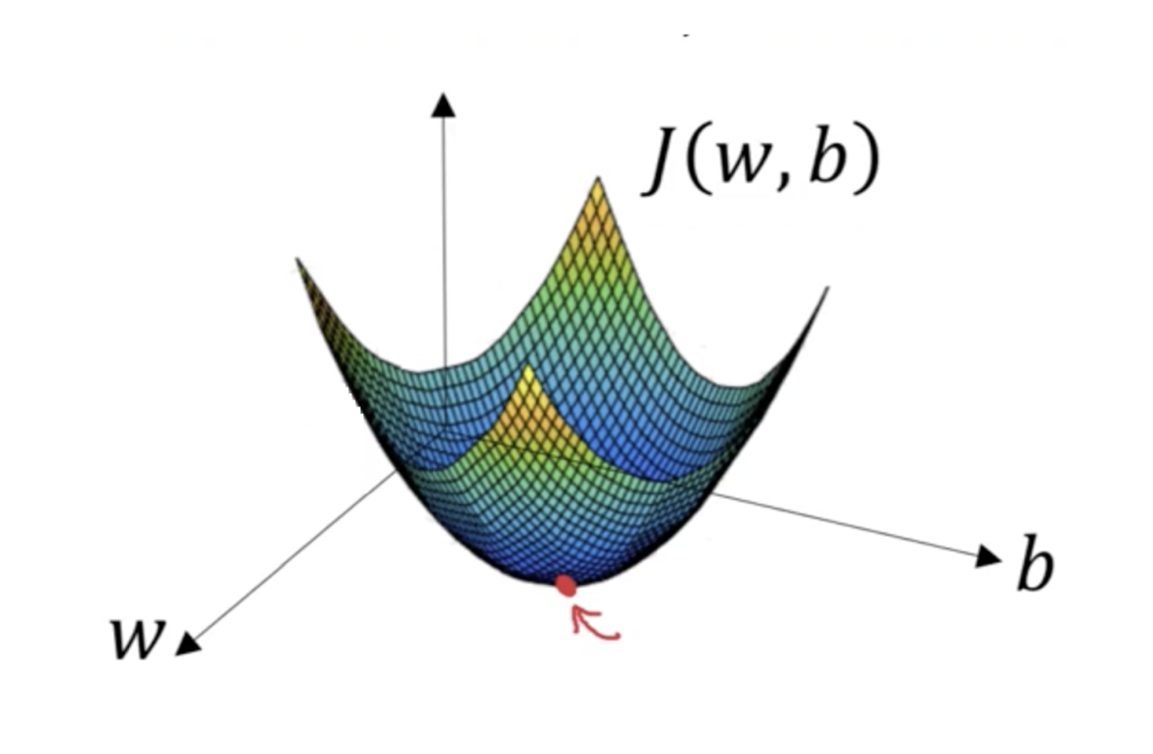
Gradient Descent
Convex function
Global optimum
Image ack – Google

Slide 25
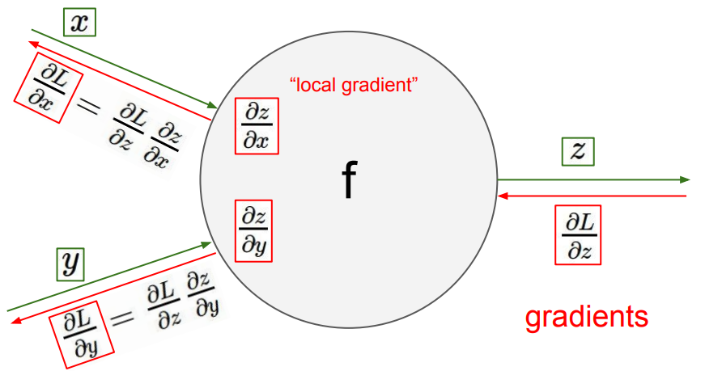
Back Propagation
Image ack – Google

Slide 26
Back Propagation
Parameters
W^{[1]}, b^{[1]}, W^{[2]}, b^{[2]}
Cost function
J(W^{[1]}, b^{[1]}, W^{[2]}, b^{[2]})
Forward pass
Z^{[1]}= W^{[1]}a^{[0]} + b^{[1]}
a^{[1]} = σ(Z^{[1]})

Slide 27
Back Propagation
Parameters
W^{[1]}, b^{[1]}, W^{[2]}, b^{[2]}
Cost function
J(W^{[1]}, b^{[1]}, W^{[2]}, b^{[2]})
Forward pass
Z^{[1]}= W^{[1]}a^{[0]} + b^{[1]}
a^{[1]} = σ(Z^{[1]})
Z^{[2]}= W^{[2]}a^{[1]} + b^{[2]}
ŷ = a^{[2]} = σ(Z^{[2]})

Slide 28
Back Propagation
Parameters
W^{[1]}, b^{[1]}, W^{[2]}, b^{[2]}
Cost function
J(W^{[1]}, b^{[1]}, W^{[2]}, b^{[2]})
Forward pass
Z^{[1]}= W^{[1]}a^{[0]} + b^{[1]}
a^{[1]} = σ(Z^{[1]})
Z^{[2]}= W^{[2]}a^{[1]} + b^{[2]}
ŷ = a^{[2]} = σ(Z^{[2]})
L(ŷ^{(i)}, y^{(i)})
J(W^{[1]}, b^{[1]}, W^{[2]}, b^{[2]})

Slide 29
Back Propagation
Parameters
W^{[1]}, b^{[1]}, W^{[2]}, b^{[2]}
Cost function
J(W^{[1]}, b^{[1]}, W^{[2]}, b^{[2]})
Backward pass

Slide 30
Back Propagation
Parameters
W^{[1]}, b^{[1]}, W^{[2]}, b^{[2]}
Cost function
J(W^{[1]}, b^{[1]}, W^{[2]}, b^{[2]})
Backward pass

Slide 31
Back Propagation
Parameters
W^{[1]}, b^{[1]}, W^{[2]}, b^{[2]}
Cost function
J(W^{[1]}, b^{[1]}, W^{[2]}, b^{[2]})
Backward pass

Slide 32
Back Propagation
Parameters
W^{[1]}, b^{[1]}, W^{[2]}, b^{[2]}
Cost function
J(W^{[1]}, b^{[1]}, W^{[2]}, b^{[2]})
Backward pass

Slide 33
Activation Functions
Sigmoid activation
tanh activation
ReLU – Rectified Linear Units
Leaky ReLU

Slide 34
Sigmoid Activation

Slide 35
Sigmoid Activation
0 <= ŷ <= 1.0
Binary classification

Slide 36
Sigmoid Activation

Slide 37
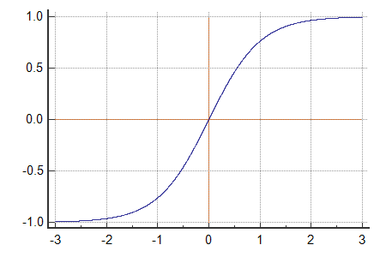
tanh Activation

Slide 38
tanh Activation
tanh(Z) ~ 1 – For Z >> 0
tanh(Z) ~ -1 – For Z << 0
tanh(Z) = 0 – For Z = 0

Slide 39
tanh Activation
Zero mean
Range – -1.0 to +1.0
Scaled and zero mean Sigmoid function
Better than Sigmoid activation function
Neural network
Recurrent neural network

Slide 40
tanh Activation

Slide 41
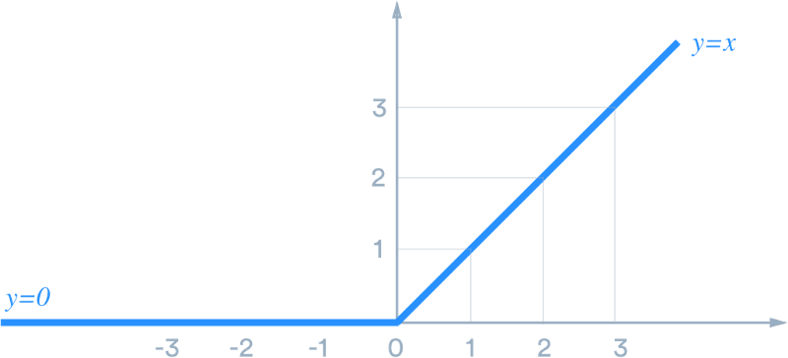
ReLU Activation

Slide 42
ReLU Activation
ReLU(Z) ~ Z – For Z > 0
ReLU(Z) ~ 0 – For Z < 0
ReLU(Z) = ? – For Z = 0

Slide 43
ReLU Activation
Neural network
Convolutional neural network

Slide 44
ReLU Activation

Slide 45
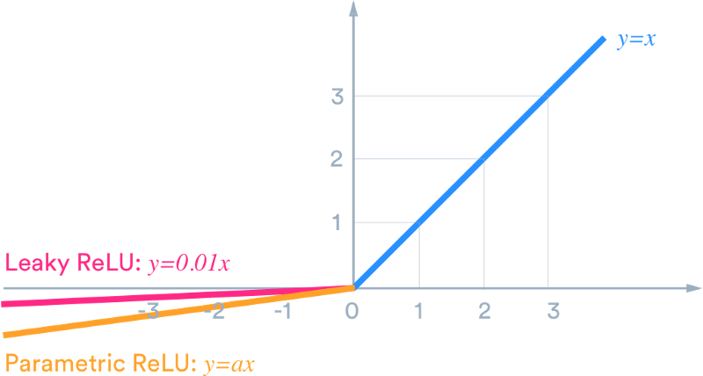
Leaky ReLU Activation

Slide 46
Leaky ReLU Activation
Leaky ReLU(Z) ~ Z – For Z > 0
Leaky ReLU(Z) ~ 0.01 * Z – For Z < 0
Leaky ReLU(Z) = ? – For Z = 0

Slide 47
Leaky ReLU Activation
Neural network
Convolutional neural network

Slide 48
Leaky ReLU Activation

Slide 49
Questions?
Thank you

