Slide 1
Artificial Neural Network
Computer Division, BARC
Centre for Excellence in Basic Sciences

Slide 2
Topics
Linear regression
Logistic regression
Artificial neural network
Activation functions
Loss Functions
Gradient descent
Back propagation

Slide 3
Linear Regression
Weights – W
Vector
W ε R
Dimension – n_{X}
Bias – b
Scalar
b ε R
y = W^{T}X + b

Slide 4
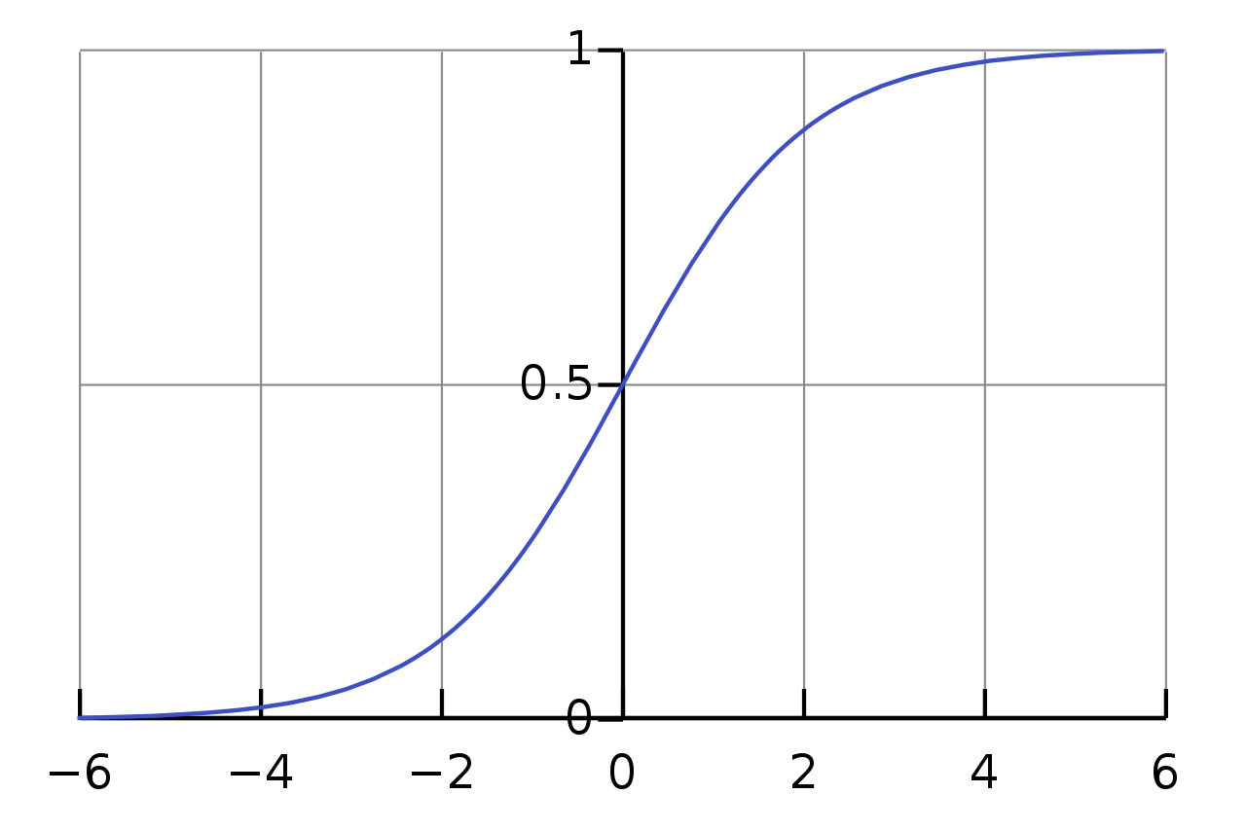
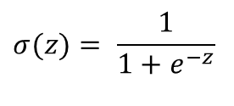
Sigmoid Function
$$σ(z)= \frac{1}{1+e^{−z}}$$

Slide 5
Sigmoid Function
σ(Z) ~ 1 – For Z >> 0
σ(Z) ~ 0 – For Z << 0
σ(Z) = 0.5 – For Z = 0
Z | σ(Z)
-2 | 0.12
-1.5 | 0.18
-1 | 0.27
-0.5 | 0.38
0 | 0.50
0.5 | 0.62
1 | 0.73
1.5 | 0.82
2 | 0.88

Slide 6
Logistic Regression
Input – X
Vector
X ε R
Dimension – n_{X}
Output – ŷ
Scalar
0 <= ŷ <= 1.0

Slide 7
Linear Regression
Weights – W
Vector
W ε R
Dimension – n_{X}
Bias – b
Scalar
b ε R
y = W^{T}X + b

Slide 8
Logistic Regression
Weights – W
Vector
W ε R
Dimension – n_{X}
Bias – b
Scalar
b ε R
y = W^{T}X + b

Slide 9
Logistic Regression
Weights – W
Vector
W ε R
Dimension – n_{X}
Bias – b
Scalar
b ε R
Z = W^{T}X + b
ŷ = σ(Z) – Activation (sigmoid) function
x₁
W₁
+b
W₂
x₂
ŷ
activation
x₃
W₃

Slide 10
Logistic Regression
Weights – W
Vector
W ε R
Dimension – n_{X}
Bias – b
Scalar
b ε R
Z = W^{T}X + b
ŷ = P( y=1 | X)

Slide 11
Artificial Neural Network
Z = W^{T}X + b= W₁*x₁ + W₂*x₂ + W₃*x₃+b
= W₁*x₁ + W₂*x₂ + W₃*x₃ + W₀*1
= W₀*1 +W₁*x₁ + W₂*x₂ + W₃*x₃
Linear regression
x₁
W₁
+b
W₂
x₂
a = ŷ
activation
x₃
W₃

Slide 12
Artificial Neural Network
Z = W^{T}X + b = W₁*x₁ + W₂*x₂ + W₃*x₃+b
Linear regression
ŷ = σ(Z) = a
Activation function
e.g. sigmoid function
x₁
W₁
+b
W₂
x₂
a = ŷ
activation
x₃
W₃

Slide 13
Artificial Neural Network
Z = W^{T}X + b = W₁*x₁ + W₂*x₂ + W₃*x₃+b
Linear regression
ŷ = σ(Z) = a
Activation function
e.g. sigmoid function
Loss function
L(ŷ^{(i)}, y^{(i)}) – One i^{th} sample
x₁
W₁
+b
W₂
x₂
a = ŷ
activation
x₃
W₃

Slide 14
Artificial Neural Network
Z = W^{T}X + b = W₁*x₁ + W₂*x₂ + W₃*x₃+b
Linear regression
ŷ = σ(Z) = a
Activation function
e.g. sigmoid function
Loss function
L(ŷ^{(i)}, y^{(i)}) – One i^{th} sample
Cost function
J(W, b) – Average of loss function for all samples
x₁
W₁
+b
W₂
x₂
a = ŷ
activation
x₃
W₃

Slide 15
Two Layer Neural Network
Input layer
Hidden layer – Layer 1
Output layer – Layer 2
x₁
x₂
ŷ
x₃

Slide 16
Two Layer Neural Network
Layer 1
Z^{[1]} = W^{[1]}X + b^{[1]}
x₁
x₂
ŷ
x₃

Slide 17
Two Layer Neural Network
Layer 1
Z^{[1]} = W^{[1]}a^{[0]} + b^{[1]}
x₁
x₂
ŷ
x₃

Slide 18
Two Layer Neural Network
Layer 1
Z^{[1]} = W^{[1]}a^{[0]} + b^{[1]}
a^{[1]} = σ(Z^{[1]})
x₁
x₂
ŷ
x₃

Slide 19
Two Layer Neural Network
Layer 1
Z^{[1]} = W^{[1]}a^{[0]} + b^{[1]}
a^{[1]} = σ(Z^{[1]})
Layer 2
Z^{[2]} = W^{[2]}a^{[1]} + b^{[2]}
x₁
x₂
ŷ
x₃

Slide 20
Two Layer Neural Network
Layer 1
Z^{[1]} = W^{[1]}a^{[0]} + b^{[1]}
a^{[1]} = σ(Z^{[1]})
Layer 2
Z^{[2]} = W^{[2]}a^{[1]} + b^{[2]}
a^{[2]} = σ(Z^{[2]})
x₁
x₂
ŷ
x₃

Slide 21
Two Layer Neural Network
Layer 1
Z^{[1]} = W^{[1]}a^{[0]} + b^{[1]}
a^{[1]} = σ(Z^{[1]})
Layer 2
Z^{[2]} = W^{[2]}a^{[1]} + b^{[2]}
ŷ = a^{[2]} = σ(Z^{[2]})
Loss function
L(ŷ, y)
x₁
x₂
ŷ
x₃

Slide 22
Two Layer Neural Network
Layer 1
Z^{[1]} = W^{[1]}a^{[0]} + b^{[1]}
a^{[1]} = σ(Z^{[1]})
Layer 2
Z^{[2]} = W^{[2]}a^{[1]} + b^{[2]}
ŷ = a^{[2]} = σ(Z^{[2]})
Loss function
L(ŷ^{(i)}, y^{(i)})
x₁
x₂
ŷ
x₃

Slide 23
Two Layer Neural Network
Layer 1
Z^{[1]} = W^{[1]}a^{[0]} + b^{[1]}
a^{[1]} = σ(Z^{[1]})
Layer 2
Z^{[2]} = W^{[2]}a^{[1]} + b^{[2]}
ŷ = a^{[2]} = σ(Z^{[2]})
Cost function
J(W, b)
x₁
x₂
ŷ
x₃

Slide 24
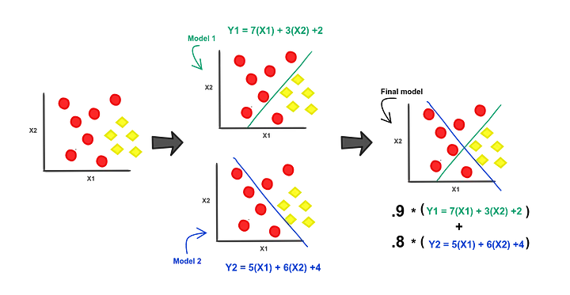
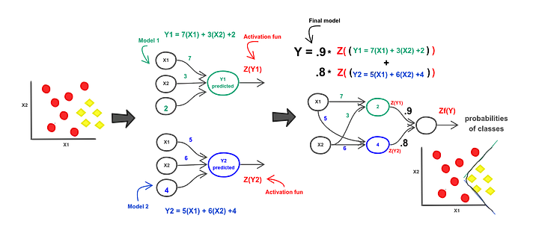
Logistic Regression
Artificial Neural Network/ Deep Learning

Slide 25
Artificial Neural Network
Each layer is called Fully Connected Layer or Dense Layer
Number of neurons in layer L (n_{L})
Number of neurons in layer L -1 (n_{L-1})
Number of Parameters= n_{w} + n_{b}
Number of Weights(n_{w})= n_{L-1} *n_{L}
Number of Biases(n_{b})= n_{L}
Neural network with 13 input neurons, two hidden layers of 5 and 4 neurons, and an output layer of 3 neurons.
The total number of weights is ( 13 * 5 ) + ( 5 * 4 ) + ( 4 * 3 ) = 97. The total number of biases is 5 + 4 + 3 = 12. Which makes the total number of parameters 97 + 12 = 109

Slide 26
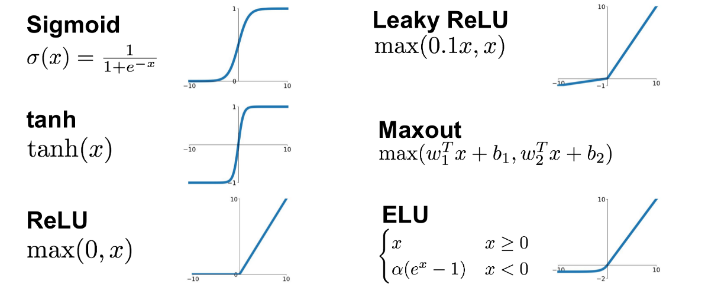
Activation Function

Slide 27
Sigmoid Activation
$$σ(z)= \frac{1}{1+e^{−z}}$$

Slide 28
Sigmoid Activation
0 <= ŷ <= 1.0
Binary classification

Slide 29
Sigmoid Activation

Slide 30
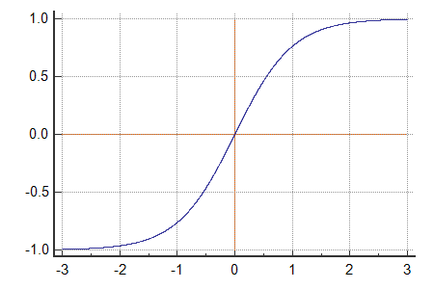
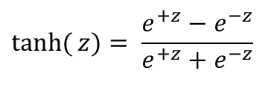
tanh Activation
$$\tanh{(}z)= \frac{e^{+z}−e^{−z}}{e^{+z}+e^{−z}}$$

Slide 31
tanh Activation
tanh(Z) ~ 1 – For Z >> 0
tanh(Z) ~ -1 – For Z << 0
tanh(Z) = 0 – For Z = 0

Slide 32
tanh Activation
Zero mean
Range – -1.0 to +1.0
Scaled and zero mean Sigmoid function
Better than Sigmoid activation function
Neural network
Recurrent neural network

Slide 33
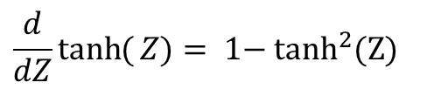
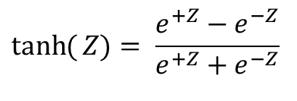
tanh Activation
$$\tanh{(}Z)= \frac{e^{+Z}−e^{−Z}}{e^{+Z}+e^{−Z}}$$
$$\frac{d}{dZ}\tanh{(}Z)=\text{ 1− }\text{tan}{\text{h}}^{2}(Z)$$

Slide 34
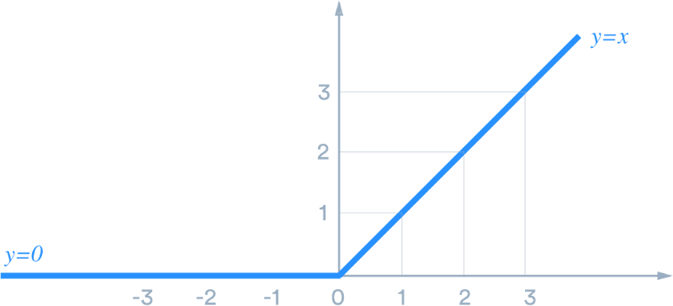

ReLU Activation
$$\operatorname{Re}{L}U(Z)= \text{max}(\text{0, }\text{Z})$$

Slide 35
ReLU Activation
Neural network
Convolutional neural network

Slide 36
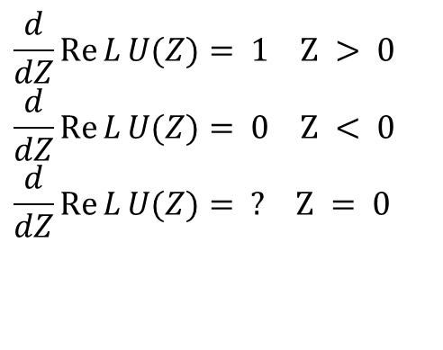

ReLU Activation
$$\operatorname{Re}{L}U(Z)= \text{max}(\text{0, }\text{Z})$$
$$\frac{d}{dZ}\operatorname{Re}{L}U(Z)=\text{ 1 }\text{Z} >\text{ 0} \\ \frac{d}{dZ}\operatorname{Re}{L}U(Z)=\text{ 0 }\text{Z} <\text{ 0} \\ \frac{d}{dZ}\operatorname{Re}{L}U(Z)=\text{ ? }\text{Z} =\text{ 0}$$

Slide 37
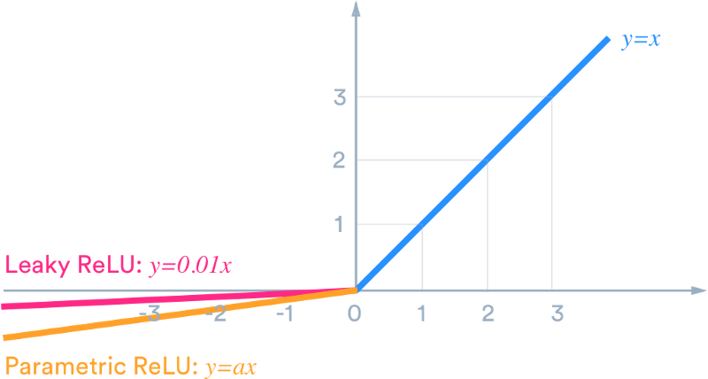
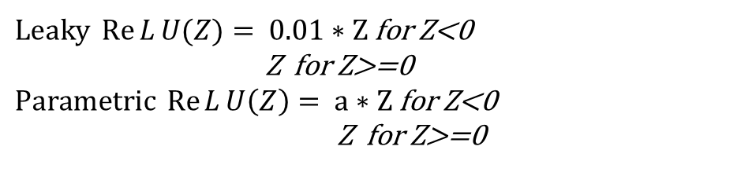
Leaky ReLU Activation
$\text{Leaky} \operatorname{Re}{L}U(Z)=\text{ 0.01 ∗ }\text{Z}$ for Z<0
Z for Z>=0 $\text{Parametric} \operatorname{Re}{L}U\left(Z\right)= \text{a}\text{ ∗ }\text{Z}$for Z<0
Z for Z>=0

Slide 38
Leaky ReLU Activation
Leaky ReLU(Z) ~ Z – For Z > 0
Leaky ReLU(Z) ~ 0.01 * Z – For Z < 0
Leaky ReLU(Z) = 0 – For Z = 0

Slide 39
Leaky ReLU Activation
Neural network
Convolutional neural network

Slide 40
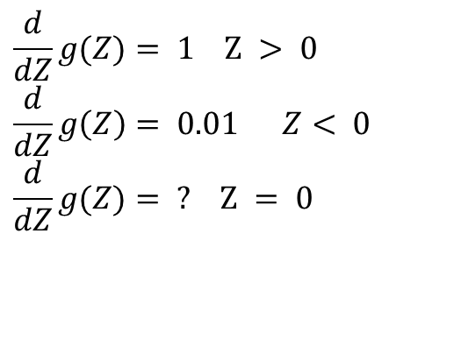
Leaky ReLU Activation
$$Leaky\operatorname{Re}{L}U(Z)= \text{max}(\text{0, 0.01 ∗}\text{Z}) =g(Z)$$
$$\frac{d}{dZ}g(Z)=\text{ 1 }\text{Z} >\text{ 0} \\ \frac{d}{dZ}g\left(Z\right)=\text{ 0.01 } Z<\text{ 0} \\ \frac{d}{dZ}g(Z)=\text{ ? }\text{Z} =\text{ 0}$$

Slide 41
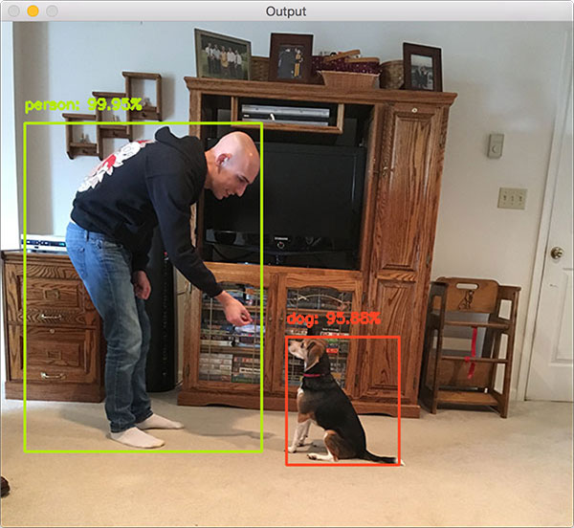
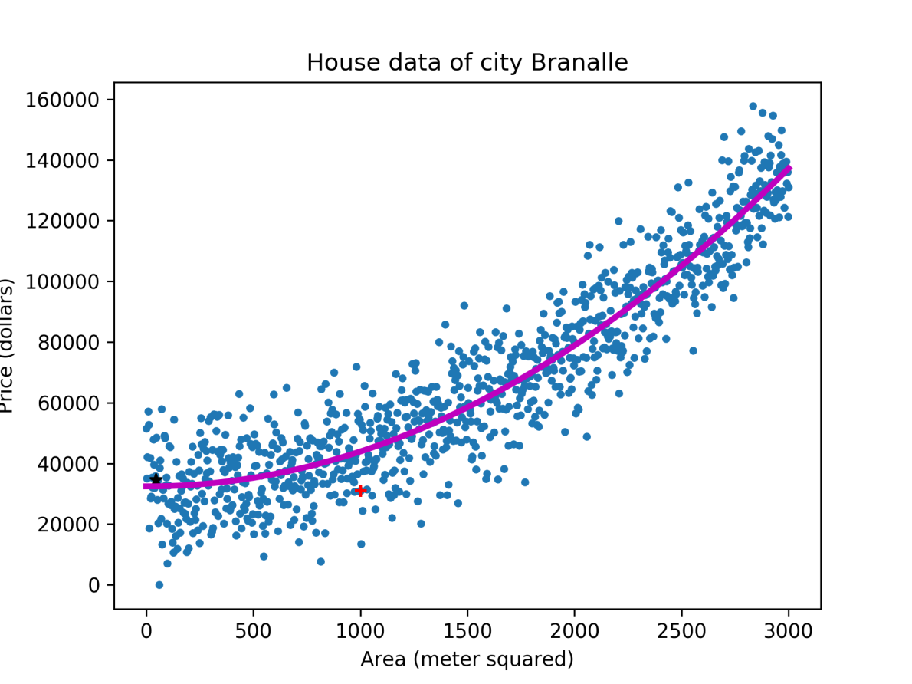
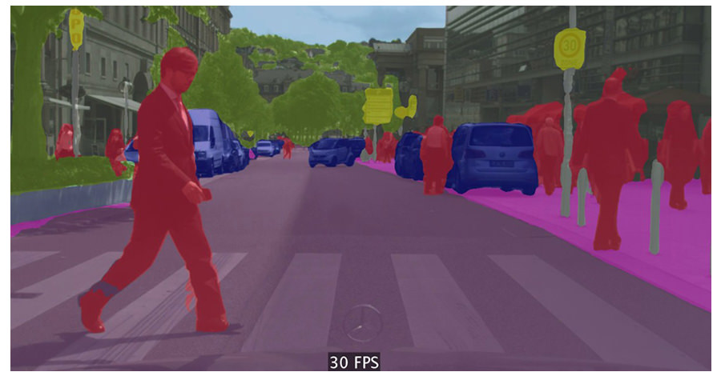
Supervised Learning
Classification
Logistic regression

Slide 42
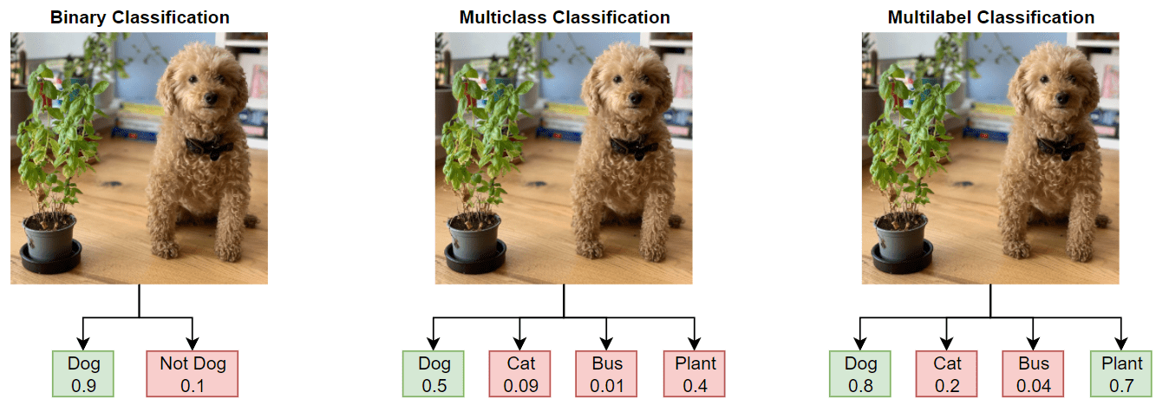

Loss/Cost Function
Binary Classification
Multiclass Classification
Regression

Slide 43
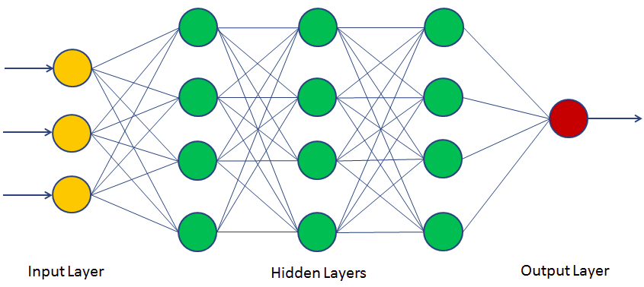
Binary classification

Slide 44
Binary Classification-Loss function
L(ŷ, y) = – y * log(ŷ) – (1 – y) * log(1 – ŷ)
y = 1
L(ŷ, y) = – log(ŷ)
– log(ŷ) – Minimize
log(ŷ) – Maximize
ŷ – Maximize
ŷ – 1.0

Slide 45
Binary Classification-Loss function
L(ŷ, y) = – y * log(ŷ) – (1 – y) * log(1 – ŷ)
y = 0
L(ŷ, y) = – log(1 – ŷ)
– log(1 – ŷ) – Minimize
log(1 – ŷ) – Maximize
1 – ŷ – Maximize
ŷ – Minimize
ŷ – 0.0

Slide 46
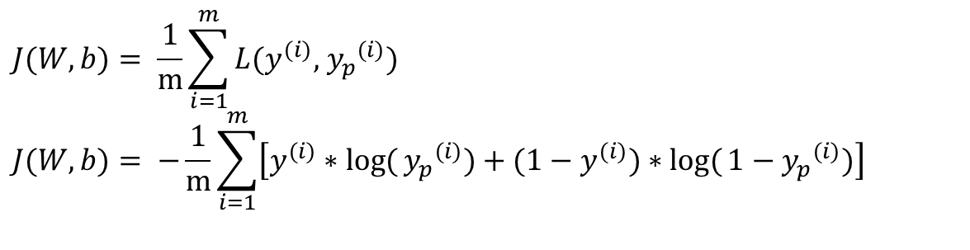
Binary Classification-Cost function
Loss function
One sample – i^{th} sample
L(ŷ^{(i)}, y^{(i)}) = – y^{(i)} * log(ŷ^{(i)}) – (1 – y^{(i)}) * log(1 – ŷ^{(i)})
Cost function
Average of loss function for all samples
$$J(W,b)= \frac{1}{m}\sum_{i=1}^{m}{L(y^{(i)}\text{, }{y_{p}}^{(i)})} \\ J(W,b)=\text{ −}\frac{1}{m}\sum_{i=1}^{m}{\left[y^{(i)}∗\log{(}{y_{p}}^{(i)})+(1−y^{(i)})∗\log{(}1−{y_{p}}^{(i)})\right]}$$

Slide 47
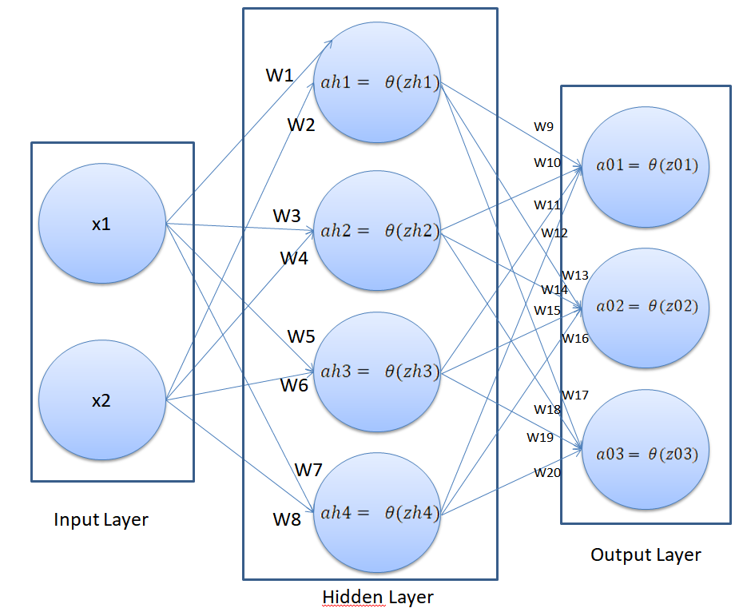
Multi Class Classification

Slide 48
Multi Class Classification One Hot Encoding
Each output is represented as a binary vector that is all zero values except the index of the integer, which is marked with a 1.
Example No | Output (Income) | ID | <500k | >=500k & <1000k | >=1000k
1 | >=500k & <1000k | 2 | 0 | 1 | 0
2 | <500k | 1 | 1 | 0 | 0
3 | >=500k & <1000k | 2 | 0 | 1 | 0
4 | >=1000k | 3 | 0 | 0 | 1
5 | >=1000k | 3 | 0 | 0 | 1

Slide 49
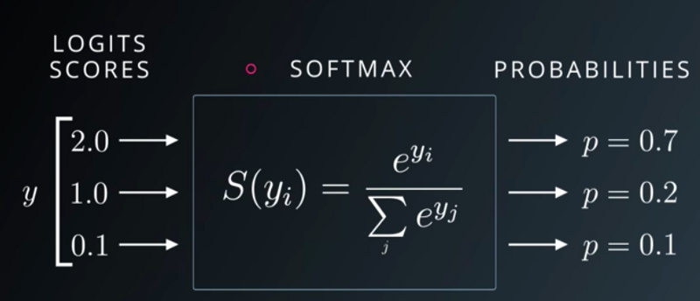
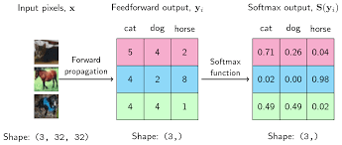

Multi Class Classification SOFTMAX
Linear Classifier for Multi class classification
Calculates a probability for every possible class
Uses Cross entropy Loss
L= - $\sum_{i}{ti log⁡(S(yi)}$)

Slide 50
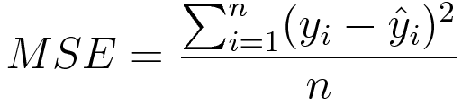
Regression Problem
Similar NN used for classification can be used with few changes
No activation function for the output layer
Predict numerical values directly without transform
Loss- Mean squared error

Slide 51
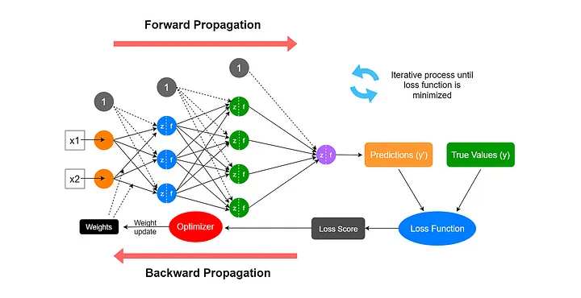
How Neural Network are Trained?

Slide 52
Gradient Descent
Optimization technique to minimize the cost function of a model by iteratively adjusting the model parameters to reduce the difference between predicted and actual values, improving the model’s performance
Convex function
Global optimum

Slide 53
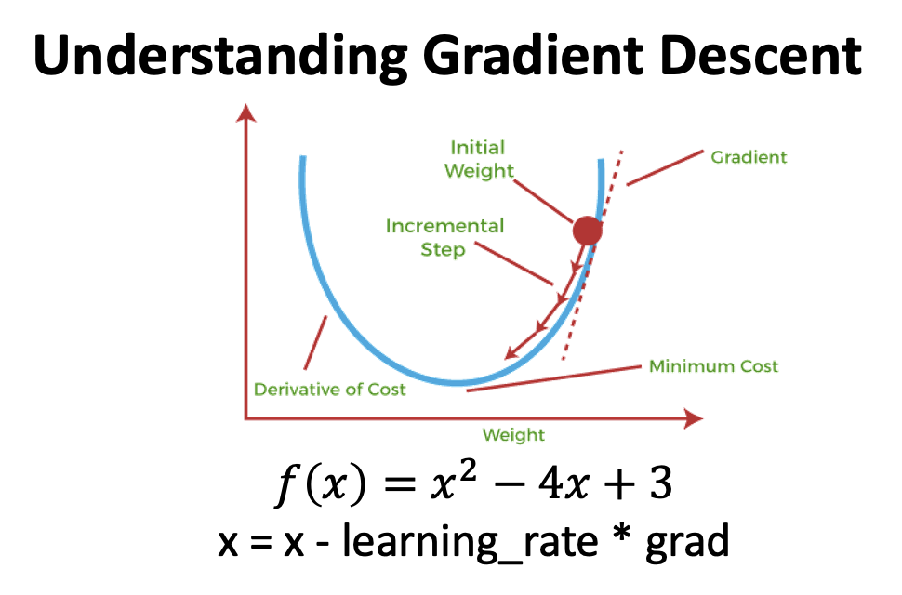

Slide 54
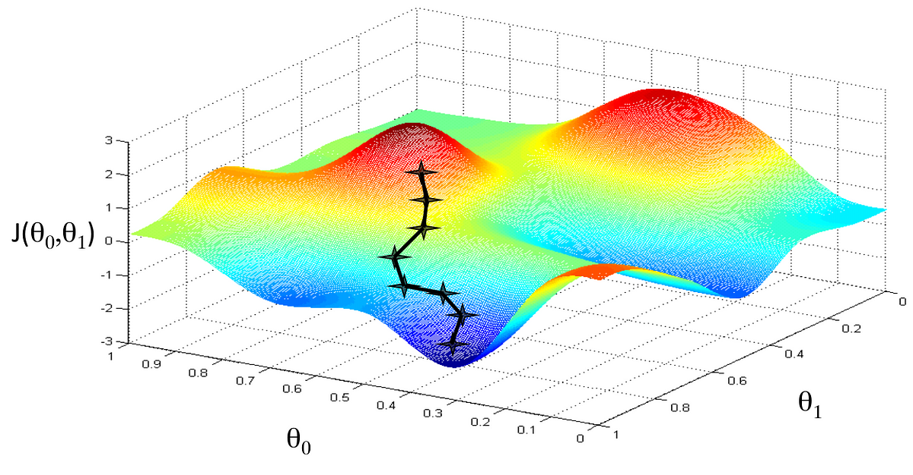

Slide 55
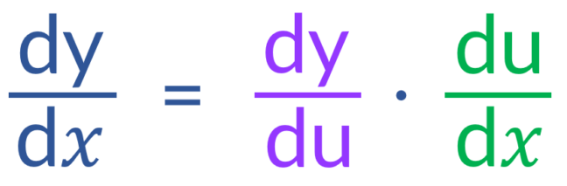
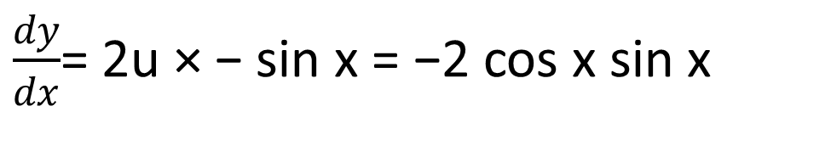
Chain Rule
Suppose, y = f (g(x))
f (x) = x² g(x) = cos x
Then f (g(x)) = f (cos x) = (cos x)²
To differentiate y = f (g(x)), let u = g(x). Then y = f (u)
$\frac{dy}{dx}$= 2u × − sin x = −2 cos x sin x

Slide 56
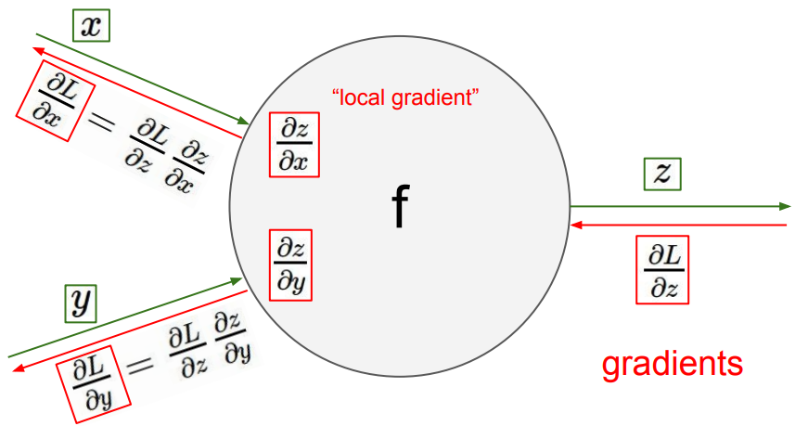
Back Propagation
Image ack – Google

Slide 57
Back Propagation
Parameters
W^{[1]}, b^{[1]}, W^{[2]}, b^{[2]}
Cost function
J(W^{[1]}, b^{[1]}, W^{[2]}, b^{[2]})
Forward pass
Z^{[1]}= W^{[1]}a^{[0]} + b^{[1]}
a^{[1]} = σ(Z^{[1]})

Slide 58
Back Propagation
Parameters
W^{[1]}, b^{[1]}, W^{[2]}, b^{[2]}
Cost function
J(W^{[1]}, b^{[1]}, W^{[2]}, b^{[2]})
Forward pass
Z^{[1]}= W^{[1]}a^{[0]} + b^{[1]}
a^{[1]} = σ(Z^{[1]})
Z^{[2]}= W^{[2]}a^{[1]} + b^{[2]}
ŷ = a^{[2]} = σ(Z^{[2]})

Slide 59
Back Propagation
Parameters
W^{[1]}, b^{[1]}, W^{[2]}, b^{[2]}
Cost function
J(W^{[1]}, b^{[1]}, W^{[2]}, b^{[2]})
Forward pass
Z^{[1]}= W^{[1]}a^{[0]} + b^{[1]}
a^{[1]} = σ(Z^{[1]})
Z^{[2]}= W^{[2]}a^{[1]} + b^{[2]}
ŷ = a^{[2]} = σ(Z^{[2]})
L(ŷ^{(i)}, y^{(i)})
J(W^{[1]}, b^{[1]}, W^{[2]}, b^{[2]})

Slide 60
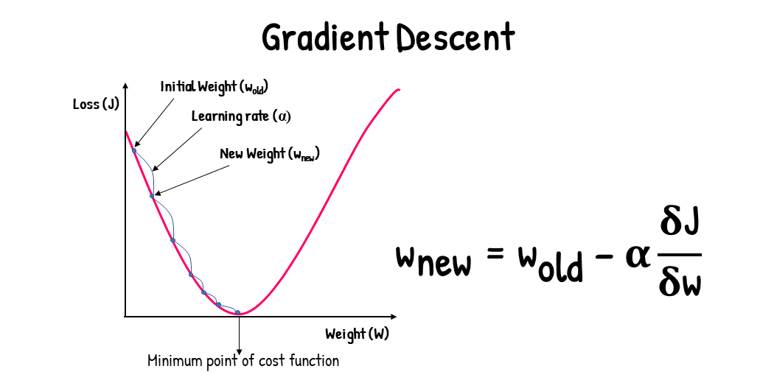

Slide 61

Back Propagation
Parameters
W^{[1]}, b^{[1]}, W^{[2]}, b^{[2]}
Cost function
J(W^{[1]}, b^{[1]}, W^{[2]}, b^{[2]})
Backward pass
$$dW^{[2]}=\frac{∂J}{∂W^{[2]}},db^{[2]}=\frac{∂J}{∂b^{[2]}}$$

Slide 62

Back Propagation
Parameters
W^{[1]}, b^{[1]}, W^{[2]}, b^{[2]}
Cost function
J(W^{[1]}, b^{[1]}, W^{[2]}, b^{[2]})
Backward pass
$$dW^{[2]}=\frac{∂J}{∂W^{[2]}},db^{[2]}=\frac{∂J}{∂b^{[2]}} \\ dW^{[1]}=\frac{∂J}{∂W^{[1]}},db^{[1]}=\frac{∂J}{∂b^{[1]}}$$

Slide 63

Back Propagation
Parameters
W^{[1]}, b^{[1]}, W^{[2]}, b^{[2]}
Cost function
J(W^{[1]}, b^{[1]}, W^{[2]}, b^{[2]})
Backward pass
$$dW^{[2]}=\frac{∂J}{∂W^{[2]}},db^{[2]}=\frac{∂J}{∂b^{[2]}} \\ dW^{[1]}=\frac{∂J}{∂W^{[1]}},db^{[1]}=\frac{∂J}{∂b^{[1]}} \\ W^{[2]}=W^{[2]}−α∗dW^{[2]} \\ b^{[2]}=b^{[2]}−α∗db^{[2]}$$

Slide 64

Back Propagation
Parameters
W^{[1]}, b^{[1]}, W^{[2]}, b^{[2]}
Cost function
J(W^{[1]}, b^{[1]}, W^{[2]}, b^{[2]})
Backward pass
$$dW^{[2]}=\frac{∂J}{∂W^{[2]}},db^{[2]}=\frac{∂J}{∂b^{[2]}} \\ dW^{[1]}=\frac{∂J}{∂W^{[1]}},db^{[1]}=\frac{∂J}{∂b^{[1]}} \\ W^{[2]}=W^{[2]}−α∗dW^{[2]} \\ b^{[2]}=b^{[2]}−α∗db^{[2]} \\ W^{[1]}=W^{[1]}−α∗dW^{[1]} \\ b^{[1]}=b^{[1]}−α∗db^{[1]}$$

Slide 65

EXAMPLE-Gradient descent
Forward pass
Z^{[1]}= W^{[1]}a^{[0]} + b^{[1]}
ŷ = a^{[1]} = σ(Z^{[1]})
L(ŷ^{(i)}, y^{(i)})= – y^{(i)} * log(ŷ^{(i)}) – (1 – y^{(i)}) * log(1 – ŷ^{(i)})
Backward pass
$$da^{[1]}=\frac{∂L}{∂a^{[1]}} \\ da^{[1]}=\frac{−y}{a}+\frac{1−y}{1−a}$$
*Derivative of log(x) is 1/x

Slide 66

EXAMPLE-Gradient descent
Forward pass
Z^{[1]}= W^{[1]}a^{[0]} + b^{[1]}
ŷ = a^{[1]} = σ(Z^{[1]})
L(ŷ^{(i)}, y^{(i)})= – y^{(i)} * log(ŷ^{(i)}) – (1 – y^{(i)}) * log(1 – ŷ^{(i)})
Backward pass
$$da^{[1]}=\frac{−y}{a}+\frac{1−y}{1−a}$$
$$dZ^{[1]}=\frac{∂L}{∂Z^{[1]}}=\frac{∂L}{∂a^{[1]}}\frac{∂a^{[1]}}{∂Z^{[1]}}$$ $$dZ^{[1]}=\left(\frac{−y}{\text{ŷ}}+\frac{1−y}{1−\text{ŷ}}\right)\left(a\left(1−a\right)\right)$$
*Derivative of sigmoid(x) is σ(x)(1- σ (x))

Slide 67

EXAMPLE-Gradient descent
Forward pass
Z^{[1]}= W^{[1]}a^{[0]} + b^{[1]}
ŷ = a^{[1]} = σ(Z^{[1]})
L(ŷ^{(i)}, y^{(i)})
Backward pass
$$da^{[1]}=\frac{−y}{a}+\frac{1−y}{1−a} \\ dZ^{[1]}=a−y \\ dW^{[1]}=\frac{∂L}{∂W^{[1]}}=\frac{∂L}{∂a^{[1]}}\frac{∂a^{[1]}}{∂Z^{[1]}}\frac{∂Z^{[1]}}{∂W^{[1]}}$$
$$dW^{[1]}=a\text{[0]}(a−y)$$

Slide 68

EXAMPLE-Gradient descent
Forward pass
Z^{[1]}= W^{[1]}a^{[0]} + b^{[1]}
ŷ = a^{[1]} = σ(Z^{[1]})
L(ŷ^{(i)}, y^{(i)})
Backward pass
$$da^{[1]}=\frac{−y}{a}+\frac{1−y}{1−a} \\ dZ^{[1]}=a−y \\ dW^{[1]}=a\text{[0]}(a−y) \\ db^{[1]}=\frac{∂L}{∂b^{[1]}}=\frac{∂L}{∂a^{[1]}}\frac{∂a^{[1]}}{∂Z^{[1]}}\frac{∂Z^{[1]}}{∂b^{[1]}}$$

Slide 69

EXAMPLE-Gradient descent
Forward pass
Z^{[1]}= W^{[1]}a^{[0]} + b^{[1]}
ŷ = a^{[1]} = σ(Z^{[1]})
L(ŷ^{(i)}, y^{(i)})
Backward pass
$$da^{[1]}=\frac{−y}{\text{ŷ}}+\frac{1−y}{1−a} \\ dZ^{[1]}=a−y \\ dW^{[1]}=a\text{[0]}(a−y) \\ db^{[1]}=a−y$$

Slide 70
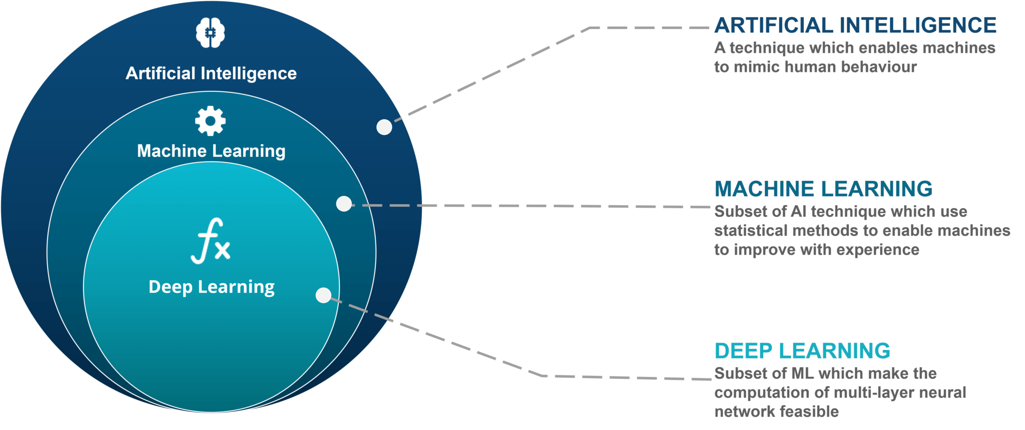
AI vs ML vs Deep Learning
Subset of ML based on specific set of algorithms that attempt to mimic the human brain in the form of multi-layered neural networks

Slide 71
Deep Learning Networks
Standard Neural Network(Dense Layers/Fully connected Layers) – Spatial Weather prediction
Convolution Neural Network – Image classification etc
Recurrent Neural Network – Temporal Weather prediction
Generative Adversarial Networks - image generation, image editing, and image enhancement
Transformers - understand DNA, drug design, NLP, image to text, text to image
Large Language Models – NLP( translation, summarization of text etc) (eg ChatGPT)

Slide 72
Questions?
Thank you

