Slide 1
Residual Network
Computer Division, BARC

Slide 2
Topics
Vanishing Gradient
Residual block
Residual network
Plain v/s residual network
Why residual network works?

Slide 3
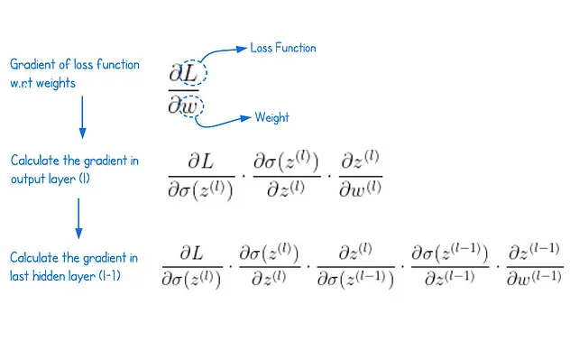

Vanishing/Exploding Gradients
Forward pass
Z^{[L-1]}= W^{[L-1]}a^{[L-2]} + b^{[L-1]}
a^{[L-1]} = σ(Z^{[L-1]})
Z^{[L]}= W^{[L]}a^{[L-1]} + b^{[L]}
ŷ = a^{[2]} = σ(Z^{[L]})
L(ŷ^{(i)}, y^{(i)})
$$W^{[M]}=W^{[M]}−α∗\frac{∂J}{∂W^{[M]}}$$

Slide 4
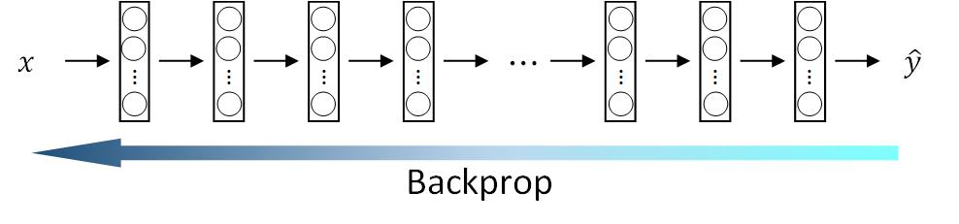
Vanishing/Exploding Gradients

Slide 5
Vanishing Gradient
During backpropagation, the error from the output layer is propagated back through the network.
As the algorithm moves through the layers, the gradients get smaller and smaller.
The gradients of earlier layers become exponentially smaller than the gradients of later layers.
Consequently earlier layers stop learning

Slide 6
Solution
Vanishing Gradient
Use the rectified linear unit (ReLU) activation function instead of sigmoid
Use RESNET
Exploding Gradient
Gradient Clipping: Set maximum threshold for the magnitude of gradients during backpropagation. Any gradient exceeding the threshold is clipped to the threshold value, preventing it from growing unbounded.
Batch Normalization

Slide 7
Plain network block
z^{[l+1]} = W^{[l+1]} a^{[l]} + b^{[l+1]} – Linear regression
a^{[l+1]} = g(z^{[l+1]}) – ReLU activation
a^{[l]}
a^{[l+1]}
a^{[l+2]}
…
…

Slide 8
Plain network block
z^{[l+1]} = W^{[l+1]} a^{[l]} + b^{[l+1]} – Linear regression
a^{[l+1]} = g(z^{[l+1]}) – ReLU activation
z^{[l+2]} = W^{[l+2]} a^{[l+1]} + b^{[l+2]} – Linear regression
a^{[l+2]} = g(z^{[l+2]}) – ReLU activation
a^{[l]}
a^{[l+1]}
a^{[l+2]}
…
…

Slide 9
Residual block
z^{[l+1]} = W^{[l+1]} a^{[l]} + b^{[l+1]} – Linear regression
a^{[l+1]} = g(z^{[l+1]}) – ReLU activation
a^{[l]}
a^{[l+1]}
a^{[l+2]}
…
…

Slide 10
Residual block
z^{[l+1]} = W^{[l+1]} a^{[l]} + b^{[l+1]} – Linear regression
a^{[l+1]} = g(z^{[l+1]}) – ReLU activation
z^{[l+2]} = W^{[l+2]} a^{[l+1]} + b^{[l+2]} – Linear regression
a^{[l+2]} = g(z^{[l+2]} + a^{[l]}) – ReLU activation
a^{[l]}
a^{[l+1]}
a^{[l+2]}
…
…

Slide 11
Residual block
a^{[l]}
a^{[l+1]}
a^{[l+2]}
…
…
Main path

Slide 12
Residual block
Shortcut or
Skip connection
a^{[l]}
a^{[l+1]}
a^{[l+2]}
…
…
Main path

Slide 13
Plain network
X
a^{[l]}
…
…
…
…
…
…

Slide 14
Residual network
Add shortcuts or skip connections
X
a^{[l]}
…
…
…
…
…
…

Slide 15
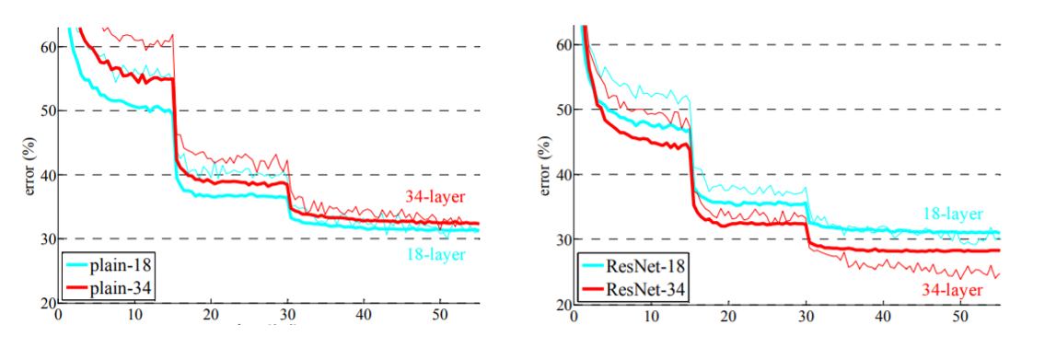
Plain v/s residual network
Plain network
More network layers – More training error
Image ack – ResNet paper

Slide 16
Plain v/s residual network
Plain network
More network layers – More training error
Residual network
More network layers – Less training error
Image ack – ResNet paper

Slide 17
Why residual network works?
z^{[l]} = W^{[l]} a^{[l-1]} + b^{[l]} – Linear regression
a^{[l]} = g(z^{[l]}) – ReLU activation
X
a^{[l]}
…
…
…
…

Slide 18
Why residual network works?
z^{[l+2]} = W^{[l+2]} a^{[l+1]} + b^{[l+2]} – Linear regression
a^{[l+2]} = g(z^{[l+2]} + a^{[l]}) – ReLU activation
X
a^{[l]}
a^{[l+2]}
…
…
…
…
…
…

Slide 19
Why residual network works?
z^{[l+2]} = W^{[l+2]} a^{[l+1]} + b^{[l+2]} – Linear regression
a^{[l+2]} = g(z^{[l+2]} + a^{[l]}) – ReLU activation
= g(W^{[l+2]} a^{[l+1]} + b^{[l+2]} + a^{[l]})
X
a^{[l]}
a^{[l+2]}
…
…
…
…
…
…

Slide 20
Why residual network works?
z^{[l+2]} = W^{[l+2]} a^{[l+1]} + b^{[l+2]} – Linear regression
a^{[l+2]} = g(z^{[l+2]} + a^{[l]}) – ReLU activation
= g(W^{[l+2]} a^{[l+1]} + b^{[l+2]} + a^{[l]})
W^{[l+2]}~ 0 and b^{[l+2]} ~0 then W^{[l+2]} a^{[l+1]} + b^{[l+2]} = 0
X
a^{[l]}
a^{[l+2]}
…
…
…
…
…
…

Slide 21
Why residual network works?
z^{[l+2]} = W^{[l+2]} a^{[l+1]} + b^{[l+2]} – Linear regression
a^{[l+2]} = g(z^{[l+2]} + a^{[l]}) – ReLU activation
= g(W^{[l+2]} a^{[l+1]} + b^{[l+2]} + a^{[l]})
= g(a^{[l]})
= a^{[l]} – ReLU activation
X
a^{[l]}
a^{[l+2]}
…
…
…
…
…
…

Slide 22
Why residual network works?
z^{[l+2]} = W^{[l+2]} a^{[l+1]} + b^{[l+2]} – Linear regression
a^{[l+2]} = g(z^{[l+2]} + a^{[l]}) – ReLU activation
= g(W^{[l+2]} a^{[l+1]} + b^{[l+2]} + a^{[l]})
= g(a^{[l]})
= a^{[l]} – Identity function
X
a^{[l]}
a^{[l+2]}
…
…
…
…
…
…

Slide 23
Why residual network works?
z^{[l+2]} = W^{[l+2]} a^{[l+1]} + b^{[l+2]} – Linear regression
a^{[l+2]} = g(z^{[l+2]} + a^{[l]}) – ReLU activation
= g(W^{[l+2]} a^{[l+1]} + b^{[l+2]} + a^{[l]})
= g(a^{[l]})
= a^{[l]} – Easy to learn
X
a^{[l]}
a^{[l+2]}
…
…
…
…
…
…

Slide 24
Why residual network works?
Residual block
Does NOT hurt training performance
X
a^{[l]}
a^{[l+2]}
…
…
…
…
…
…

Slide 25
Why residual network works?
Residual block
Does NOT hurt training performance
Solve vanishing gradients problem
X
a^{[l]}
a^{[l+2]}
…
…
…
…
…
…

Slide 26
Why residual network works?
Residual block
Does NOT hurt training performance
Solve vanishing gradients problem
Improve training performance
X
a^{[l]}
a^{[l+2]}
…
…
…
…
…
…

Slide 27
Why residual network works?
Residual block
Does NOT hurt training performance
Solve vanishing gradients problem
Improve training performance
Allow design of large neural network
X
a^{[l]}
a^{[l+2]}
…
…
…
…
…
…

Slide 28
Questions?
Thank you

