Slide 1
Convolutional Neural Network
Computer Division, BARC

Slide 2
Topics
Introduction
Applications
Convolution
Image convolution
Convolution layer
Pooling layer
Why convolutions?

Slide 3

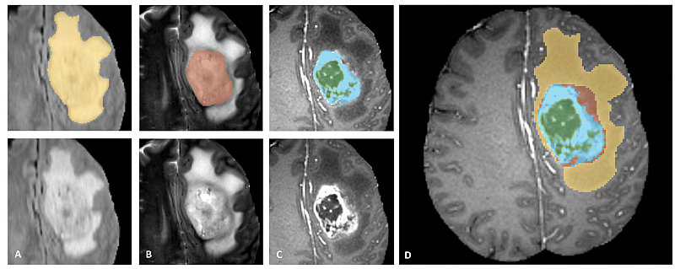
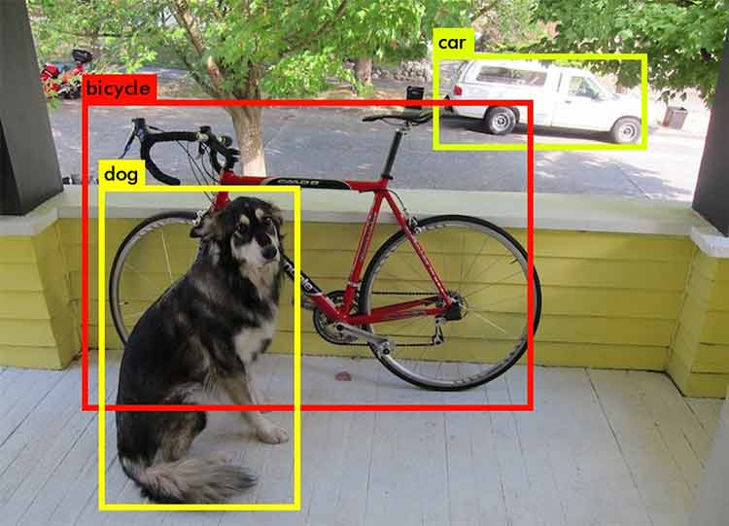
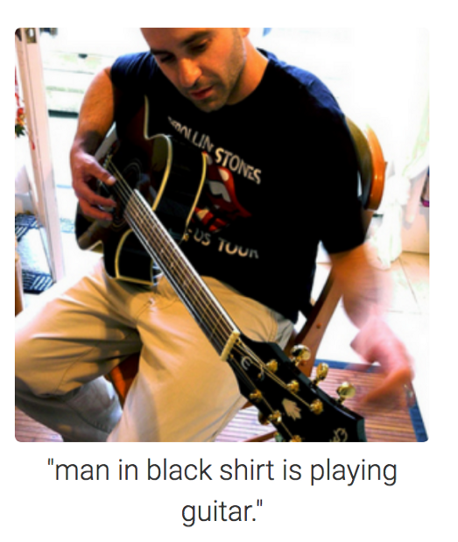
Introduction
Sachin Tendulkar
Image classification
Image segmentation
Object detection
Image captioning
Image ack – Google

Slide 4
Applications – Image classification
Classify input image for object type
Applications
Classify different objects using input image
ImageNet dataset – 20K objects – 14 Million images
State of art accuracy
Verify or recognize person using facial image
MS-Celeb-20K dataset – 20K celebrities – 1.2 Million images
State of art accuracy

Slide 5
Applications – Object detection
Detect and locate objects in input image
Applications
Self driving car
ImageNet dataset – 20K objects – 14 Million images

Slide 6
Applications – Image segmentation
Segment input image using object types
Applications
Self driving car
ImageNet dataset – 20K objects – 14 Million images
Brain tumor segmentation
MICCAI BraTS 2018 dataset
Brain tissues segmentation
MICCAI MRBrainS18 dataset

Slide 7
Applications – Image captioning
Caption input image
Applications
Optical character recognition
Synthetic image data
State of art accuracy
Vehicle number plate recognition
Synthetic + real image data
State of art accuracy

Slide 8
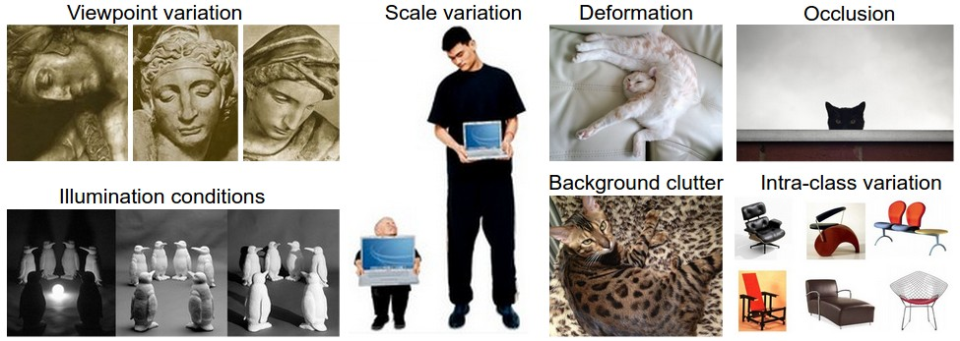
Applications

Slide 9
Convolution
Mathematical operation
Two functions – f and g
Convolving f with g – f*g
Expresses how the shape of one function is modified by the other function
One function – Time shifted and reversed
Notes:
Convolution is similar to cross-correlation.
For discrete, real-valued functions, they differ only in a time reversal in one of the functions.
For continuous functions, the cross-correlation operator is the adjoint of the convolution operator.

Slide 10
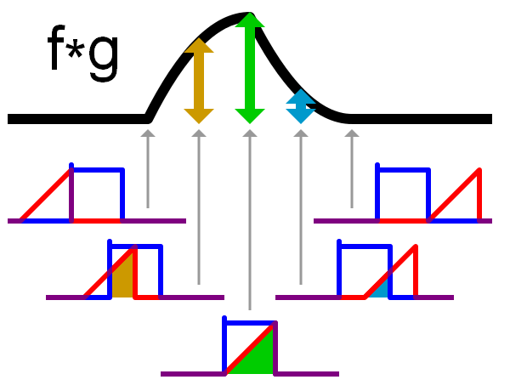
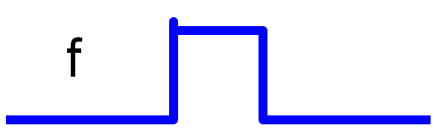
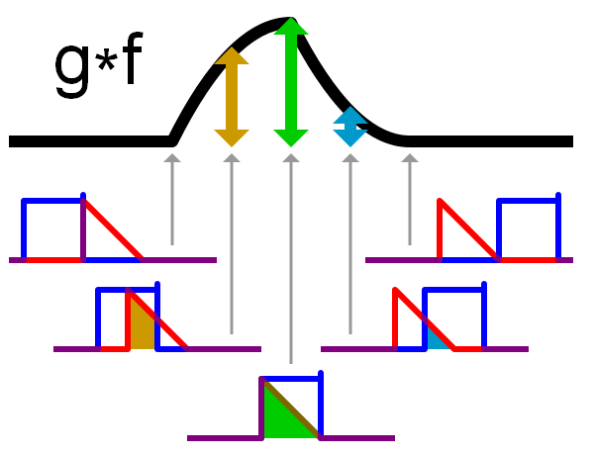
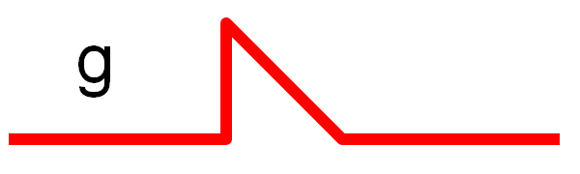
Convolution – Example
Image ack – Wikipedia

Slide 12
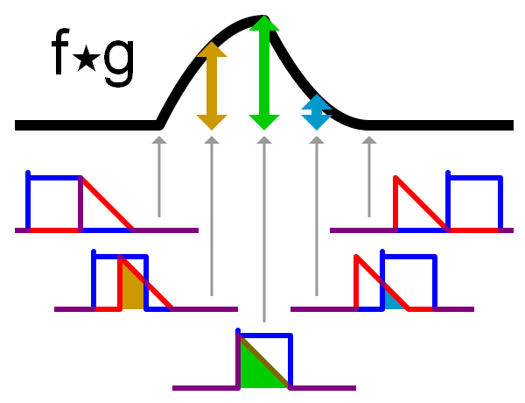
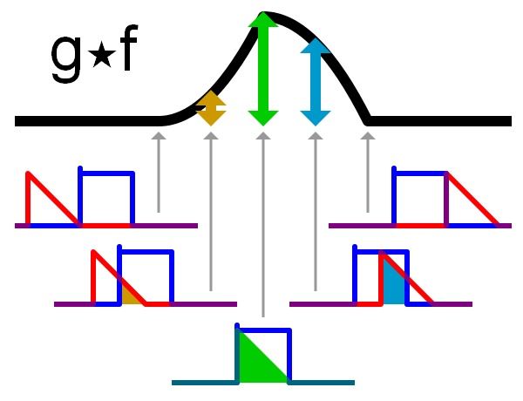
Cross correlation – Example
Image ack – Wikipedia

Slide 13
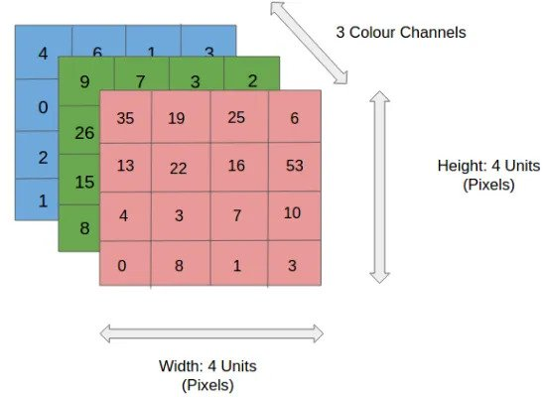

Slide 14
Image convolution – Definition
Source image – f
Kernel – g
Convolving image f with kernel g – f*g

Slide 15
Image convolution – Example
105 | 102 | 100 | 98 | 96
103 | 99 | 103 | 101 | 102
102 | 99 | 105 | 102 | 100
99 | 101 | 106 | 104 | 99
104 | 104 | 104 | 100 | 98
1/9 | 1/9 | 1/9
1/9 | 1/9 | 1/9
1/9 | 1/9 | 1/9
3x3 filter
Input image
Output image

Slide 16
Image convolution – Example
105 | 102 | 100 | 98 | 96
103 | 99 | 103 | 101 | 102
102 | 99 | 105 | 102 | 100
99 | 101 | 106 | 104 | 99
104 | 104 | 104 | 100 | 98
1/9 | 1/9 | 1/9
1/9 | 1/9 | 1/9
1/9 | 1/9 | 1/9
 | 102
3x3 filter
Input image
Output image
105*1/9 + 102*1/9 + 100*1/9
+ 103*1/9 + 99*1/9 + 103*1/9
+ 102*1/9 + 99*1/9 + 105*1/9
= 102

Slide 17
Image convolution – Example
105 | 102 | 100 | 98 | 96
103 | 99 | 103 | 101 | 102
102 | 99 | 105 | 102 | 100
99 | 101 | 106 | 104 | 99
104 | 104 | 104 | 100 | 98
1/9 | 1/9 | 1/9
1/9 | 1/9 | 1/9
1/9 | 1/9 | 1/9
 |  | 101
3x3 filter
Input image
Output image
102*1/9 + 100*1/9 + 98*1/9
+ 99*1/9 + 103*1/9 + 101*1/9
+ 99*1/9 + 105*1/9 + 102*1/9
= 101

Slide 18
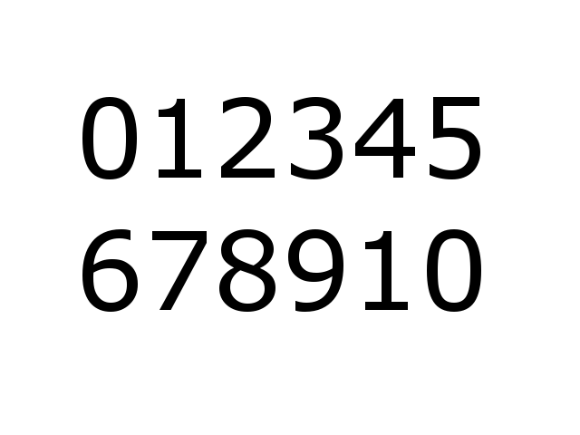
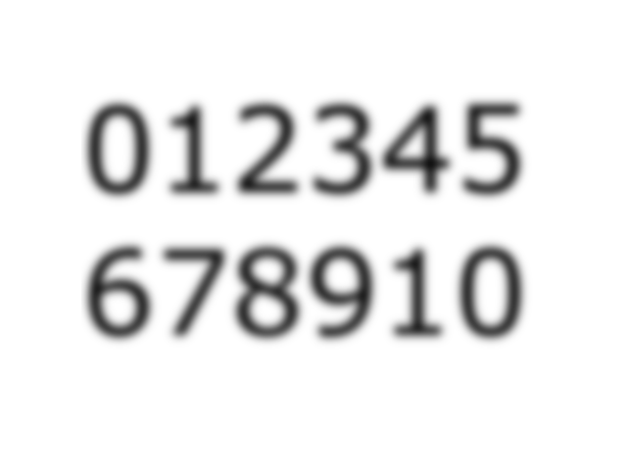
Image convolution – Example
1/9 | 1/9 | 1/9
1/9 | 1/9 | 1/9
1/9 | 1/9 | 1/9
3x3 filter
Input image
Output image

Slide 20
Image convolution – Algorithm
Flip the kernel both horizontally and vertically
Repeat for all pixels in input image
Put the center element of the kernel at every pixel of the image
Multiply each element of the kernel with its corresponding element of the image
Sum up all product outputs
Put the result in the output matrix at the same position

Slide 21
Edge detection – Example
10 | 10 | 10 | 0 | 0 | 0
10 | 10 | 10 | 0 | 0 | 0
10 | 10 | 10 | 0 | 0 | 0
10 | 10 | 10 | 0 | 0 | 0
10 | 10 | 10 | 0 | 0 | 0
10 | 10 | 10 | 0 | 0 | 0
1 | 0 | -1
1 | 0 | -1
1 | 0 | -1
*
3x3 filter
4x4 output
6x6 input

Slide 22
Edge detection – Vertical edge
10 | 10 | 10 | 0 | 0 | 0
10 | 10 | 10 | 0 | 0 | 0
10 | 10 | 10 | 0 | 0 | 0
10 | 10 | 10 | 0 | 0 | 0
10 | 10 | 10 | 0 | 0 | 0
10 | 10 | 10 | 0 | 0 | 0
0
1 | 0 | -1
1 | 0 | -1
1 | 0 | -1
*
3x3 filter
4x4 output
6x6 input

Slide 23
Edge detection – Vertical edge
10 | 10 | 10 | 0 | 0 | 0
10 | 10 | 10 | 0 | 0 | 0
10 | 10 | 10 | 0 | 0 | 0
10 | 10 | 10 | 0 | 0 | 0
10 | 10 | 10 | 0 | 0 | 0
10 | 10 | 10 | 0 | 0 | 0
0 | 30
1 | 0 | -1
1 | 0 | -1
1 | 0 | -1
*
3x3 filter
4x4 output
6x6 input

Slide 24
Edge detection – Vertical edge
10 | 10 | 10 | 0 | 0 | 0
10 | 10 | 10 | 0 | 0 | 0
10 | 10 | 10 | 0 | 0 | 0
10 | 10 | 10 | 0 | 0 | 0
10 | 10 | 10 | 0 | 0 | 0
10 | 10 | 10 | 0 | 0 | 0
0 | 30 | 30
1 | 0 | -1
1 | 0 | -1
1 | 0 | -1
*
3x3 filter
4x4 output
6x6 input

Slide 25
Edge detection – Vertical edge
10 | 10 | 10 | 0 | 0 | 0
10 | 10 | 10 | 0 | 0 | 0
10 | 10 | 10 | 0 | 0 | 0
10 | 10 | 10 | 0 | 0 | 0
10 | 10 | 10 | 0 | 0 | 0
10 | 10 | 10 | 0 | 0 | 0
0 | 30 | 30 | 0
1 | 0 | -1
1 | 0 | -1
1 | 0 | -1
*
3x3 filter
4x4 output
6x6 input

Slide 26
Edge detection – Vertical edge
10 | 10 | 10 | 0 | 0 | 0
10 | 10 | 10 | 0 | 0 | 0
10 | 10 | 10 | 0 | 0 | 0
10 | 10 | 10 | 0 | 0 | 0
10 | 10 | 10 | 0 | 0 | 0
10 | 10 | 10 | 0 | 0 | 0
0 | 30 | 30 | 0
0
1 | 0 | -1
1 | 0 | -1
1 | 0 | -1
*
3x3 filter
4x4 output
6x6 input

Slide 27

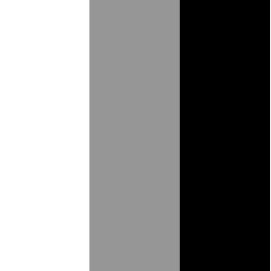

Edge detection – Vertical edge
10 | 10 | 10 | 0 | 0 | 0
10 | 10 | 10 | 0 | 0 | 0
10 | 10 | 10 | 0 | 0 | 0
10 | 10 | 10 | 0 | 0 | 0
10 | 10 | 10 | 0 | 0 | 0
10 | 10 | 10 | 0 | 0 | 0
0 | 30 | 30 | 0
0 | 30 | 30 | 0
0 | 30 | 30 | 0
0 | 30 | 30 | 0
1 | 0 | -1
1 | 0 | -1
1 | 0 | -1
*
3x3 filter
4x4 output
6x6 input

Slide 28


Edge detection – Vertical edge
0 | 0 | 0 | 10 | 10 | 10
0 | 0 | 0 | 10 | 10 | 10
0 | 0 | 0 | 10 | 10 | 10
0 | 0 | 0 | 10 | 10 | 10
0 | 0 | 0 | 10 | 10 | 10
0 | 0 | 0 | 10 | 10 | 10
0 | -30 | -30 | 0
0 | -30 | -30 | 0
0 | -30 | -30 | 0
0 | -30 | -30 | 0
1 | 0 | -1
1 | 0 | -1
1 | 0 | -1
*
3x3 filter
4x4 output
6x6 input
Vertical edge detection

Slide 29
Edge detection – Vertical & horizontal
0 | 30 | 30 | 0
0 | 10 | 10 | 0
0 | -10 | -10 | 0
0 | -30 | -30 | 0
1 | 0 | -1
1 | 0 | -1
1 | 0 | -1
10 | 10 | 10 | 0 | 0 | 0
10 | 10 | 10 | 0 | 0 | 0
10 | 10 | 10 | 0 | 0 | 0
0 | 0 | 0 | 10 | 10 | 10
0 | 0 | 0 | 10 | 10 | 10
0 | 0 | 0 | 10 | 10 | 10
*
3x3 filter
4x4 output
1 | 1 | 1
0 | 0 | 0
-1 | -1 | -1
0 | 0 | 0 | 0
30 | 10 | -10 | -30
30 | 10 | -10 | -30
0 | 0 | 0 | 0
*
6x6 input
3x3 filter
4x4 output

Slide 30
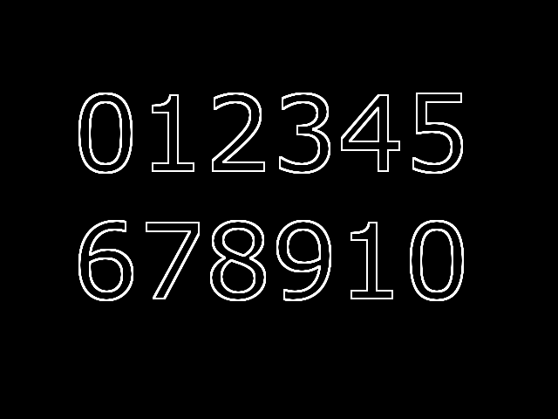
Edge detection – Learn filters
?
1 | 0 | -1
1 | 0 | -1
1 | 0 | -1
*
3x3 filter
?
1 | 1 | 1
0 | 0 | 0
-1 | -1 | -1
*
Input image
Output image
3x3 filter

Slide 31
Convolution layer – 2D input
*
3x3 filter
6x6 input
4x4 output

Slide 32
Convolution layer – Padding
Convolution operation – Reduce image size
Multilayer CNN – 1x1 or lesser output size
Less utilization of corner image pixels
Solution – Padding

Slide 33
Convolution layer – Valid padding
*
3x3 filter
6x6 input
4x4 output

Slide 34
Convolution layer – Same padding
*
3x3 filter
8x8 padded input
6x6 output

Slide 36
Convolution layer – Stride
2 | 3 | 7 | 4 | 6 | 2 | 9
6 | 6 | 9 | 8 | 7 | 4 | 3
3 | 4 | 8 | 3 | 8 | 9 | 7
7 | 8 | 3 | 6 | 6 | 3 | 4
4 | 2 | 1 | 8 | 3 | 4 | 6
3 | 2 | 4 | 1 | 9 | 8 | 3
0 | 1 | 3 | 9 | 2 | 1 | 4
3 | 1 | 2
1 | 0 | 2
1 | 2 | 3
*
3x3 filter stride = 2
3x3 output
7x7 input

Slide 37
Convolution layer – Stride
2 | 3 | 7 | 4 | 6 | 2 | 9
6 | 6 | 9 | 8 | 7 | 4 | 3
3 | 4 | 8 | 3 | 8 | 9 | 7
7 | 8 | 3 | 6 | 6 | 3 | 4
4 | 2 | 1 | 8 | 3 | 4 | 6
3 | 2 | 4 | 1 | 9 | 8 | 3
0 | 1 | 3 | 9 | 2 | 1 | 4
3 | 1 | 2
1 | 0 | 2
1 | 2 | 3
82
*
3x3 filter stride = 2
3x3 output
7x7 input

Slide 38
Convolution layer – Stride
2 | 3 | 7 | 4 | 6 | 2 | 9
6 | 6 | 9 | 8 | 7 | 4 | 3
3 | 4 | 8 | 3 | 8 | 9 | 7
7 | 8 | 3 | 6 | 6 | 3 | 4
4 | 2 | 1 | 8 | 3 | 4 | 6
3 | 2 | 4 | 1 | 9 | 8 | 3
0 | 1 | 3 | 9 | 2 | 1 | 4
3 | 1 | 2
1 | 0 | 2
1 | 2 | 3
82 | 98
*
3x3 filter stride = 2
3x3 output
7x7 input

Slide 39
Convolution layer – Stride
2 | 3 | 7 | 4 | 6 | 2 | 9
6 | 6 | 9 | 8 | 7 | 4 | 3
3 | 4 | 8 | 3 | 8 | 9 | 7
7 | 8 | 3 | 6 | 6 | 3 | 4
4 | 2 | 1 | 8 | 3 | 4 | 6
3 | 2 | 4 | 1 | 9 | 8 | 3
0 | 1 | 3 | 9 | 2 | 1 | 4
3 | 1 | 2
1 | 0 | 2
1 | 2 | 3
82 | 98 | 98
*
3x3 filter stride = 2
3x3 output
7x7 input

Slide 40
Convolution layer – Stride
2 | 3 | 7 | 4 | 6 | 2 | 9
6 | 6 | 9 | 8 | 7 | 4 | 3
3 | 4 | 8 | 3 | 8 | 9 | 7
7 | 8 | 3 | 6 | 6 | 3 | 4
4 | 2 | 1 | 8 | 3 | 4 | 6
3 | 2 | 4 | 1 | 9 | 8 | 3
0 | 1 | 3 | 9 | 2 | 1 | 4
3 | 1 | 2
1 | 0 | 2
1 | 2 | 3
82 | 98 | 98
53
*
3x3 filter stride = 2
3x3 output
7x7 input

Slide 42
Convolution layer – RGB input

Slide 43
Convolution layer – RGB input
*
3x3x3 filter
(HWC)
6x6x3 input
(HWC)
4x4 output
(HW)

Slide 44
Convolution layer – RGB input
*
3x3x3 filter
*
6x6x3 input
4x4x2 output
3x3x3 filter

Slide 45
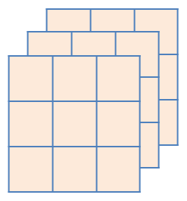
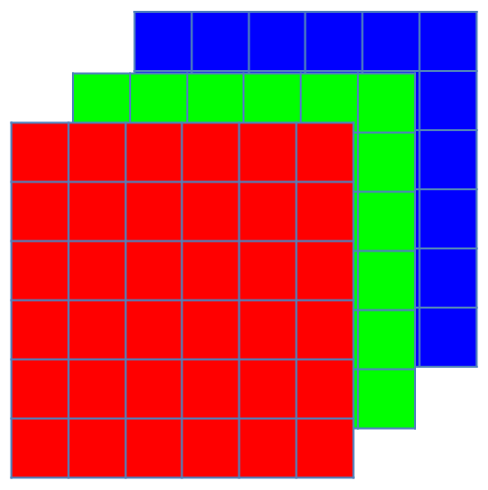
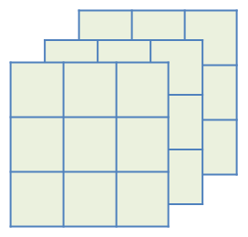
Convolution layer – Example
*
3x3x3 filter
6x6x3 input
*
3x3x3 filter
Notes:
Vs fully connected

Slide 46
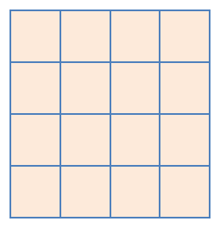

Convolution layer – Example
Relu( )
*
+ b
3x3x3 filter
Activation
Relu( )
+ b
6x6x3 input
*
3x3x3 filter
Activation
Notes:
Vs fully connected

Slide 47
Convolution layer – Example
Relu( )
*
+ b
3x3x3 filter
Activation
Relu( )
4x4x2 output
+ b
6x6x3 input
*
3x3x3 filter
Activation
Notes:
Vs fully connected

Slide 48
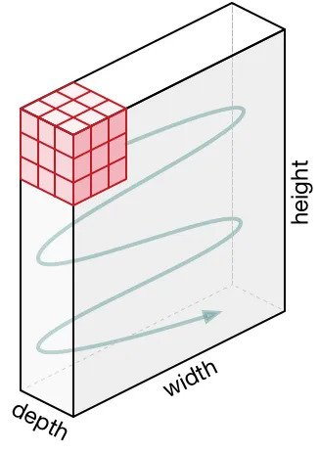

Slide 49
Pooling layer – What?
Reduce size of feature map
Reduces the number of parameters to learn and the amount of computation performed in the network.
Summarises the features present in a region of the feature map generated by a convolution layer
Different types
Max pooling layer
Average pooling layer

Slide 50
Pooling layer – Max pool
Max pool
with 2x2 filter
and stride=2
2 | 3 | 4 | 6
4 | 7 | 9 | 7
5 | 8 | 6 | 4
7 | 2 | 2 | 8
7 | 9
8 | 8
4x4 input
2x2 output

Slide 52
Pooling layer – Average pool
Average pool
with 2x2 filter
and stride=2
2 | 3 | 4 | 6
4 | 7 | 9 | 7
5 | 8 | 6 | 4
7 | 2 | 2 | 8
4 | 6.5
5.5 | 5
4x4 input
2x2 output

Slide 53
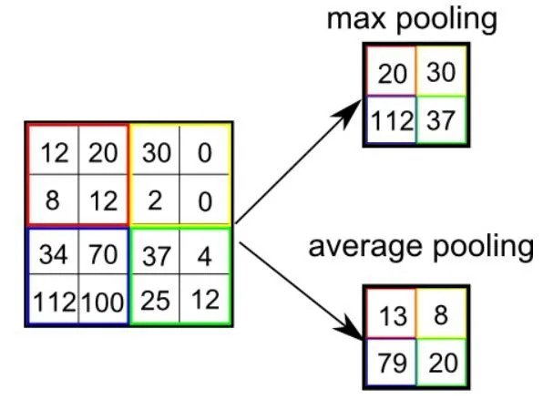

Slide 54
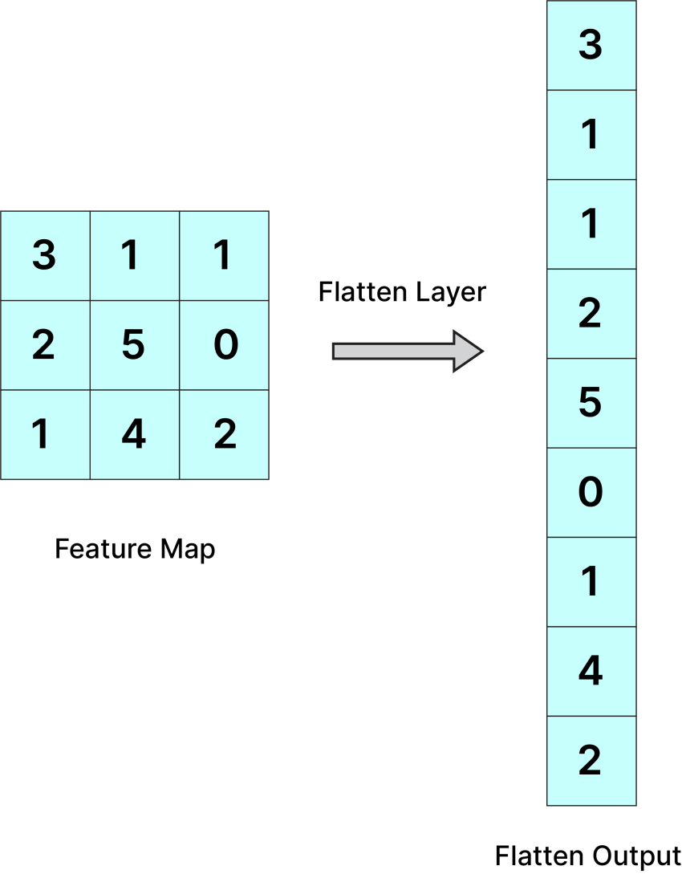
Flatten Layer

Slide 55
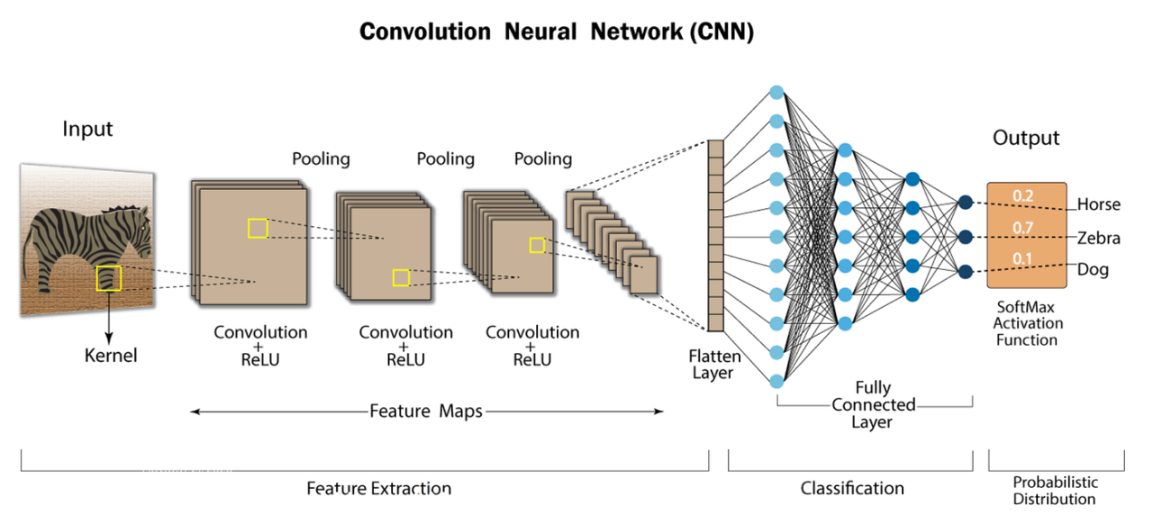

Slide 56
Pooling layer – Parameters
Parameters
Zero
Hyper parameters
Filter size
Stride size

Slide 57
Convolution layer – Parameters
Filter size – (f x f x n_{C})
Number of filters – n_{F}
Bias term – 1
Parameters - n_{F} x [ ( f x f x n_{C} ) + 1 ]
Hyper parameters
Filter size
Stride size
Padding size
Number of filters
Notes:
Vs fully connected

Slide 58
Convolution layer v/s FC layer
Input size – 32x32x3 – 3072
Filter size – 5x5x3 and 5 filters – 380
Output size – 28x28x5 – 3920
Fully connected layer parameters
Input size * Output size
3072 * 3920 – 12 Million
Convolutional layer parameters
380

Slide 59
Why convolutions?
Parameter sharing
Sharable feature detector
Feature detector useful in one part of the image is useful in another part of image
Sparsity of connection
Output value depends on a small number of inputs
Group of near-by pixels has better info than grouping distant pixels
Spatial Invariance

Slide 60
Convolutions – Parameter sharing
10 | 10 | 10 | 0 | 0 | 0
10 | 10 | 10 | 0 | 0 | 0
10 | 10 | 10 | 0 | 0 | 0
10 | 10 | 10 | 0 | 0 | 0
10 | 10 | 10 | 0 | 0 | 0
10 | 10 | 10 | 0 | 0 | 0
0 | 30 | 30 | 0
0 | 30 | 30 | 0
0 | 30 | 30 | 0
0 | 30 | 30 | 0
1 | 0 | -1
1 | 0 | -1
1 | 0 | -1
*
3x3 filter
6x6 input
4x4 output

Slide 61
Convolutions – Parameter sharing
10 | 10 | 10 | 0 | 0 | 0
10 | 10 | 10 | 0 | 0 | 0
10 | 10 | 10 | 0 | 0 | 0
10 | 10 | 10 | 0 | 0 | 0
10 | 10 | 10 | 0 | 0 | 0
10 | 10 | 10 | 0 | 0 | 0
0 | 30 | 30 | 0
0 | 30 | 30 | 0
0 | 30 | 30 | 0
0 | 30 | 30 | 0
1 | 0 | -1
1 | 0 | -1
1 | 0 | -1
*
3x3 filter
6x6 input
4x4 output

Slide 62
Convolutions – Parameter sharing
10 | 10 | 10 | 0 | 0 | 0
10 | 10 | 10 | 0 | 0 | 0
10 | 10 | 10 | 0 | 0 | 0
10 | 10 | 10 | 0 | 0 | 0
10 | 10 | 10 | 0 | 0 | 0
10 | 10 | 10 | 0 | 0 | 0
0 | 30 | 30 | 0
0 | 30 | 30 | 0
0 | 30 | 30 | 0
0 | 30 | 30 | 0
1 | 0 | -1
1 | 0 | -1
1 | 0 | -1
*
3x3 filter
6x6 input
4x4 output

Slide 63
Convolutions – Parameter sharing
10 | 10 | 10 | 0 | 0 | 0
10 | 10 | 10 | 0 | 0 | 0
10 | 10 | 10 | 0 | 0 | 0
10 | 10 | 10 | 0 | 0 | 0
10 | 10 | 10 | 0 | 0 | 0
10 | 10 | 10 | 0 | 0 | 0
0 | 30 | 30 | 0
0 | 30 | 30 | 0
0 | 30 | 30 | 0
0 | 30 | 30 | 0
1 | 0 | -1
1 | 0 | -1
1 | 0 | -1
*
3x3 filter
6x6 input
4x4 output

Slide 64
Convolutions – Parameter sharing
10 | 10 | 10 | 0 | 0 | 0
10 | 10 | 10 | 0 | 0 | 0
10 | 10 | 10 | 0 | 0 | 0
10 | 10 | 10 | 0 | 0 | 0
10 | 10 | 10 | 0 | 0 | 0
10 | 10 | 10 | 0 | 0 | 0
0 | 30 | 30 | 0
0 | 30 | 30 | 0
0 | 30 | 30 | 0
0 | 30 | 30 | 0
1 | 0 | -1
1 | 0 | -1
1 | 0 | -1
*
3x3 filter
6x6 input
4x4 output

Slide 65
Convolutions – Sparsity of connection
10 | 10 | 10 | 0 | 0 | 0
10 | 10 | 10 | 0 | 0 | 0
10 | 10 | 10 | 0 | 0 | 0
10 | 10 | 10 | 0 | 0 | 0
10 | 10 | 10 | 0 | 0 | 0
10 | 10 | 10 | 0 | 0 | 0
0 | 30 | 30 | 0
0 | 30 | 30 | 0
0 | 30 | 30 | 0
0 | 30 | 30 | 0
1 | 0 | -1
1 | 0 | -1
1 | 0 | -1
*
3x3 filter
6x6 input
4x4 output

Slide 66
Convolutions – Sparsity of connection
10 | 10 | 10 | 0 | 0 | 0
10 | 10 | 10 | 0 | 0 | 0
10 | 10 | 10 | 0 | 0 | 0
10 | 10 | 10 | 0 | 0 | 0
10 | 10 | 10 | 0 | 0 | 0
10 | 10 | 10 | 0 | 0 | 0
0 | 30 | 30 | 0
0 | 30 | 30 | 0
0 | 30 | 30 | 0
0 | 30 | 30 | 0
1 | 0 | -1
1 | 0 | -1
1 | 0 | -1
*
3x3 filter
6x6 input
4x4 output

Slide 67
Convolutions – Sparsity of connection
10 | 10 | 10 | 0 | 0 | 0
10 | 10 | 10 | 0 | 0 | 0
10 | 10 | 10 | 0 | 0 | 0
10 | 10 | 10 | 0 | 0 | 0
10 | 10 | 10 | 0 | 0 | 0
10 | 10 | 10 | 0 | 0 | 0
0 | 30 | 30 | 0
0 | 30 | 30 | 0
0 | 30 | 30 | 0
0 | 30 | 30 | 0
1 | 0 | -1
1 | 0 | -1
1 | 0 | -1
*
3x3 filter
6x6 input
4x4 output

Slide 68
Convolutions – Sparsity of connection
10 | 10 | 10 | 0 | 0 | 0
10 | 10 | 10 | 0 | 0 | 0
10 | 10 | 10 | 0 | 0 | 0
10 | 10 | 10 | 0 | 0 | 0
10 | 10 | 10 | 0 | 0 | 0
10 | 10 | 10 | 0 | 0 | 0
0 | 30 | 30 | 0
0 | 30 | 30 | 0
0 | 30 | 30 | 0
0 | 30 | 30 | 0
1 | 0 | -1
1 | 0 | -1
1 | 0 | -1
*
3x3 filter
6x6 input
4x4 output

Slide 69
Convolutions – Sparsity of connection
10 | 10 | 10 | 0 | 0 | 0
10 | 10 | 10 | 0 | 0 | 0
10 | 10 | 10 | 0 | 0 | 0
10 | 10 | 10 | 0 | 0 | 0
10 | 10 | 10 | 0 | 0 | 0
10 | 10 | 10 | 0 | 0 | 0
0 | 30 | 30 | 0
0 | 30 | 30 | 0
0 | 30 | 30 | 0
0 | 30 | 30 | 0
1 | 0 | -1
1 | 0 | -1
1 | 0 | -1
*
3x3 filter
6x6 input
4x4 output

Slide 70
Questions?
Thank you

