Slide 1
Hyperparameter Tuning
Vibhuti Duggal
Computer Division
BARC

Slide 2
Model Parameters | Hyperparameters
They are the features of training data that are learned during training | They are the parameters that determine the entire training process
Example: Weights and Biases Split point of Decision Tree | Example: Learning Rate Number/Type of Layers
They are internal to the model and their value can be estimated from data | They are external to the model and their value can’t be estimated from data

Slide 3
Hyperparameters in Neural Networks
Learning rate
Data
Augmentation/ Normalization(Batch Normalization)
Train-test split ratio
Epochs
Early-stopping
Architecture
Number of layers
Number of nodes per layer
Activation function
Mini Batch Size
Regularization

Slide 4
Gradient Descent
Stochastic Gradient Descent
Batch Gradient Descent
Mini Batch Gradient Descent

Slide 5
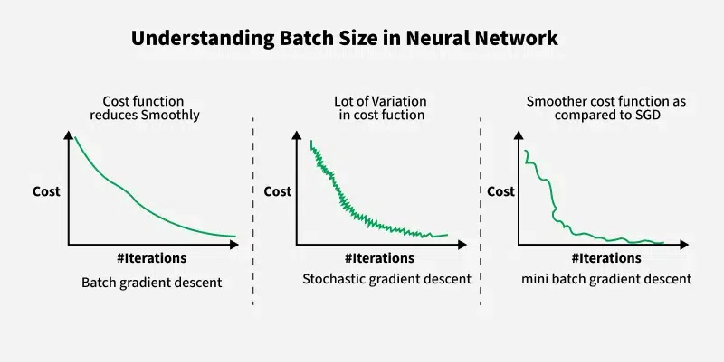
Batch Gradient Descent
Calculate the error for each example in the training dataset, but only updates the model after all training examples have been evaluated
Memory expensive
Slow - updates are done after whole data is processed

Slide 6
Stochastic Gradient Descent
Calculate the error and update parameters for each example in the training dataset
Simplest to implement
The increased model update frequency can result in faster learning on some problems
Updating the model so frequently is more computationally expensive
Noisy learning process

Slide 7
Mini Batch Gradient Descent
Split training dataset into small batches
Calculate model error and update model coefficients
Computationally more efficient process than stochastic gradient descent
All data can fit in memory
Notes:
Because mini-batch gradient descent makes a parameter update after seeing just a subset of examples, the direction of the update has some variance, and so the path taken by mini-batch gradient descent will "oscillate" toward convergence. Using momentum can reduce these oscillations.
Momentum takes into account the past gradients to smooth out the update. We will store the 'direction' of the previous gradients in the variable vv. Formally, this will be the exponentially weighted average of the gradient on previous steps. You can also think of vv as the "velocity" of a ball rolling downhill, building up speed (and momentum) according to the direction of the gradient/slope of the hill.

Slide 8
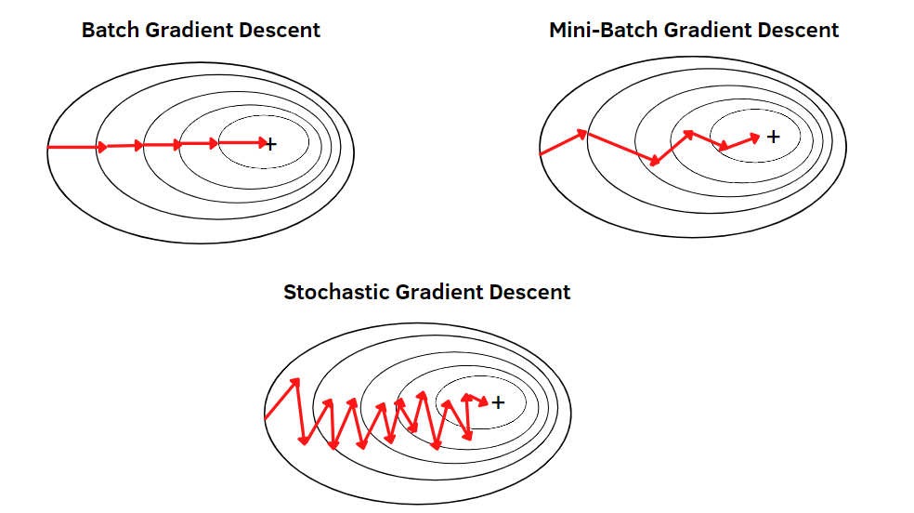

Slide 9
Mini Batch Size
Training time until convergence: If the batch size is very small (e.g. 8), this time goes up. If the batch size is huge, it is also higher than the minimum.
Training time per epoch: Bigger computes faster (is efficient)
Mini-batch sizes are often chosen as a power of 2, i.e., 16,32,64,128,256 etc.
Now, while choosing a proper size for mini-batch gradient descent, make sure that the minibatch fits in the CPU/GPU
Randomly shuffled data is take in each mini batch

Slide 10
Bias/Variance & Underfitting/Overfitting

Slide 11
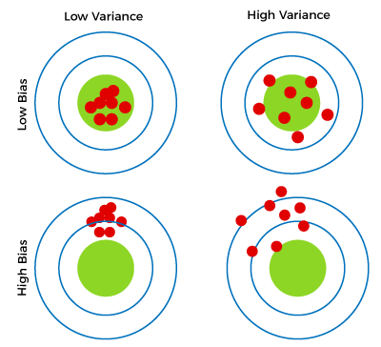
Bias/Variance
Bias- differences between actual or expected values and the predicted values
Variance implies the error value that occurs when we try to make predictions by using data that is not previously seen by the model

Slide 12
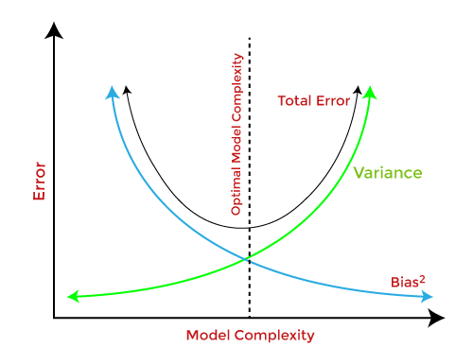
Bias Variance Tradeoff

Slide 13
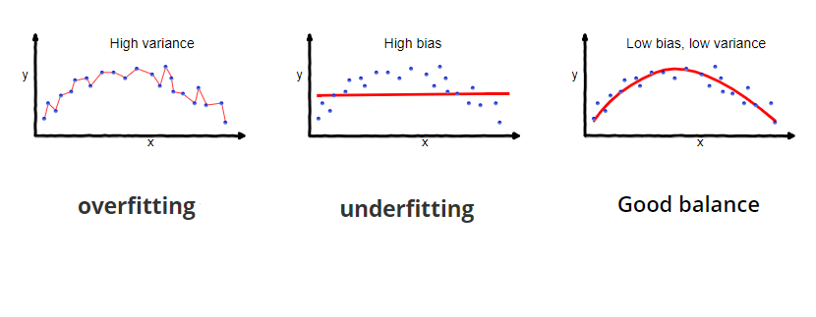
Underfitting
Model unable to capture the underlying pattern of the data
Simple network
Low Accuracy on Training Set
Solved by
Use a more complex model

Slide 14
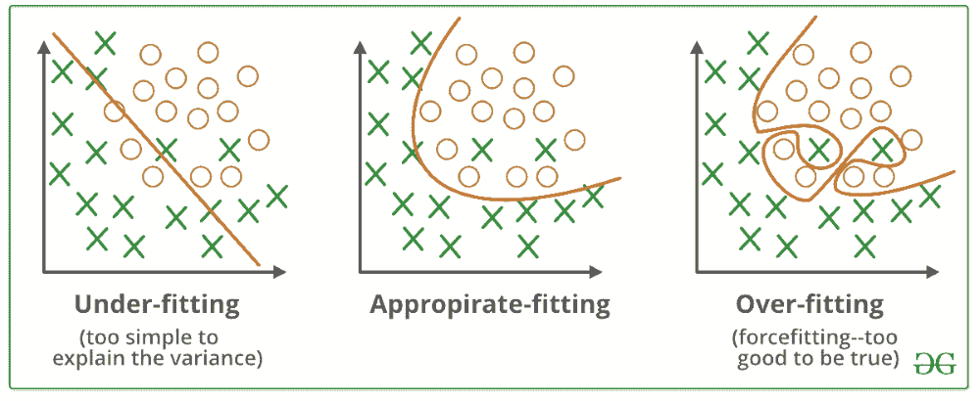
Overfitting
Model captures the noise along with the underlying pattern in data
Complex Network
Memorizes the Training set output
High Accuracy on Training Set
Low Accuracy on Validation Set
Solved by
Increase the training data
Regularization

Slide 15
Early Stopping

Slide 16
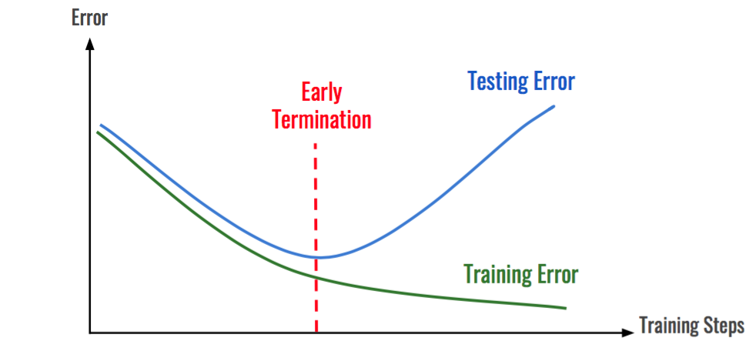
Early Stopping
Regularization technique
Avoid overfitting
Store and update the current best parameters during training, and when parameter updates no longer yield an improvement, training stops and the last best parameters are used

Slide 17
Batch Normalizationn

Slide 18

Batch Normalization
Internal covariate shift - As the input data propagates through the network, the distribution of each layer’s inputs changes.
Normalization of the mini-batch of activations by re-centering and re-scaling
Scale and shift the normalized activations
y_{i}​=γx’​+β
Gradients propagated during backpropagation are less likely to vanish or explode
Regularization: BN helps to prevent overfitting by reducing the model's dependence on specific activation patterns

Slide 19
Weight Decay

Slide 20
Regularization(Weight Decay)
Reduce overfitting and improve generalization
Ensures parameters(weights) of the model remains small
Less sensitive to statistical fluctuations of the input data
Total cost = Cost of the network + L1 or/and L2 Loss
L2 Loss = λ∑ w²
Encourages weights to be small and similar
L1 Loss = λ∑ |w|
Encourages less important weights to be 0 (Improves Interpretability)
Combination of L1 as well as L2 regularization
λ( α ∑ w²+ (1- α ) ∑ |w|)

Slide 21
Dropout

Slide 22
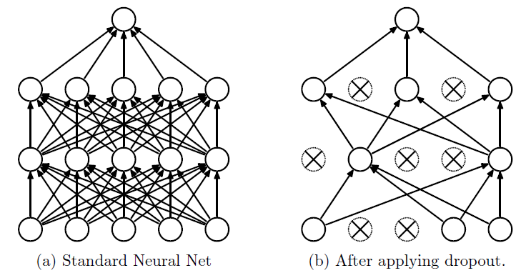
Dropout
Contribution to the activation of downstream neurons is temporally removed on the forward pass
Weight updates are not applied to the neuron on the backward pass
Reduce overfitting and improve generalization error

Slide 23
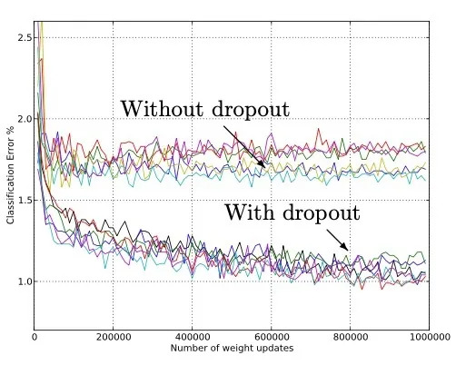
Dropout
Evaluation Mode: Dropout layer works as a scalar to multiply all input by a factor such that the next layer will see input similar in scale. Precisely, if the dropout rate is R , the input will be scaled by a factor of 1-R
Use a larger network
Small dropout value
of 20%-50% of neurons

Slide 24
Learning Rate

Slide 25
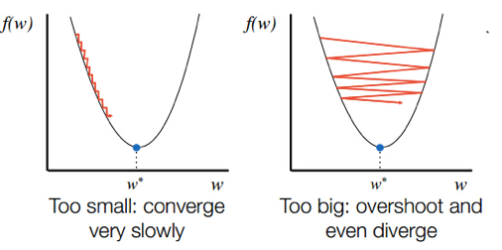
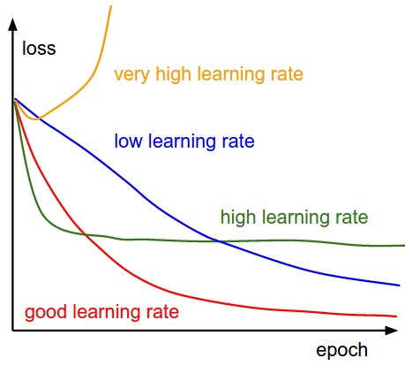
Learning rate

Slide 26
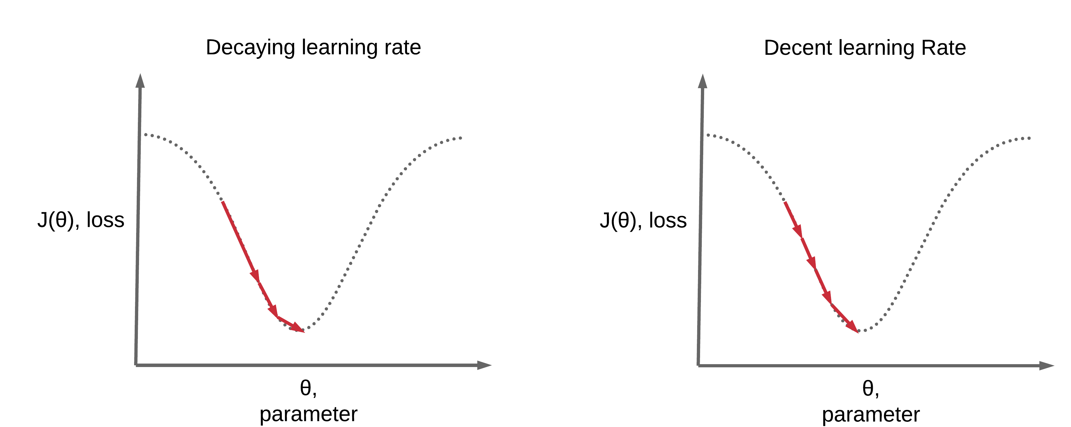
Learning Rate Schedules
Step Wise Decay
Reduce Learning Rate on Plateau
Adam
Converge faster
Higher accuracy

Slide 27
Step-wise Decay
At each epoch
η_{t}= η_{t-1} γ where γ=0.1

Slide 28
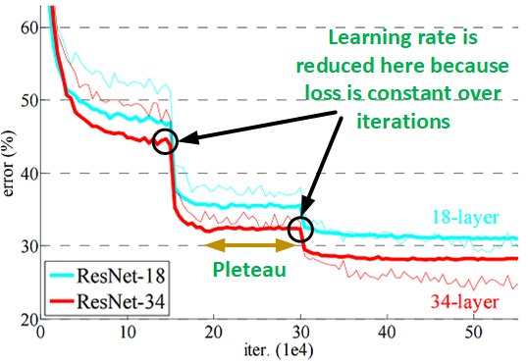
Reduce Learning Rate on Plateau
Reduce learning rate when a metric has stopped improving. Models often benefit from reducing the learning rate by a factor of 2-10 once learning stagnates. This scheduler reads a metrics quantity and if no improvement is seen for a specified number of epochs, the learning rate is reduced.

Slide 29
Hyperparameter Tuning

Slide 30
Hyperparameters in Neural Networks
Learning rate
Data
Augmentation/ Normalization
Train-test split ratio
Epochs
Early-stopping
Architecture
Number of layers
Number of nodes per layer
Activation function
Mini Batch Size
Regularization

Slide 31
Hyperparameter Tuning
Manual Search
Grid Search
Random Search
Adaptive Search(Hyperband)
Optimization Function
Bayesian optimization
Genetic algorithm
Hyperparameter ranges are selected based on experience and similar networks

Slide 32
Tuning Hyperparameters
Manual Search
Number of hyperparameters is relatively small and the model is simple
Data scientist or machine learning engineer manually selects and adjusts the hyperparameters of the model
Train all those combinations
Measure the performance of network by cross-validation on the training set
Select best combinations
Time-consuming and may require significant trial and error

Slide 33
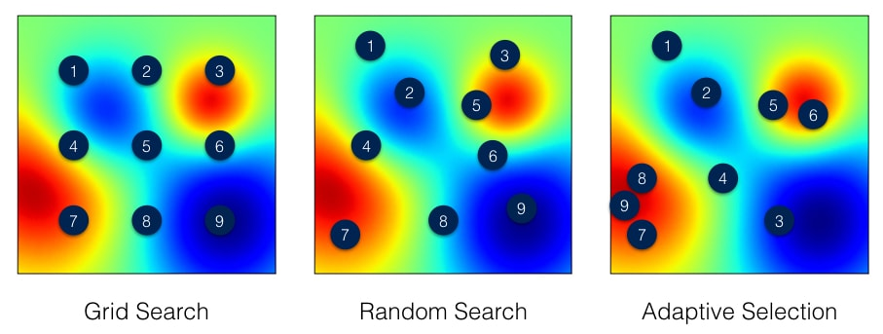
Tuning Hyperparameters
Grid Search
Select all possible combination of values of hyperparameters by in a predefined set
Train all those combinations
Measure the performance of network by cross-validation on the training set
Select best combinations
Computationally intensive
Smaller and less complex models

Slide 34
Tuning Hyperparameters
Random Search
Specify ranges of values of different hyperparameters
Select several combination of values of hyperparameters by selecting them randomly
Train all those combinations
Measure the performance of network by cross-validation on the training set
Select best combinations

Slide 35
Tuning Hyperparameters
Adaptive Search(Hyperband)
Specify ranges of values of different
hyperparameters
Select several combination of values of
hyperparameters by selecting them randomly
Train all those combinations
Measure the performance of network by cross-validation on the training set
The model with the best performance is selected, and the hyperparameter space is narrowed to focus on the most promising configurations
Eliminate unpromising configurations and focus on the most promising ones
Save time and computational resources

Slide 36
Limitations of Neural Network
Large amount of clean data
Hard and expensive
Susceptible to attacks
Not easily interpreted
Don’t give exact answer
Analytical equations available

