Slide 1
Data
Vibhuti Duggal
Computer Division
BARC

Slide 2
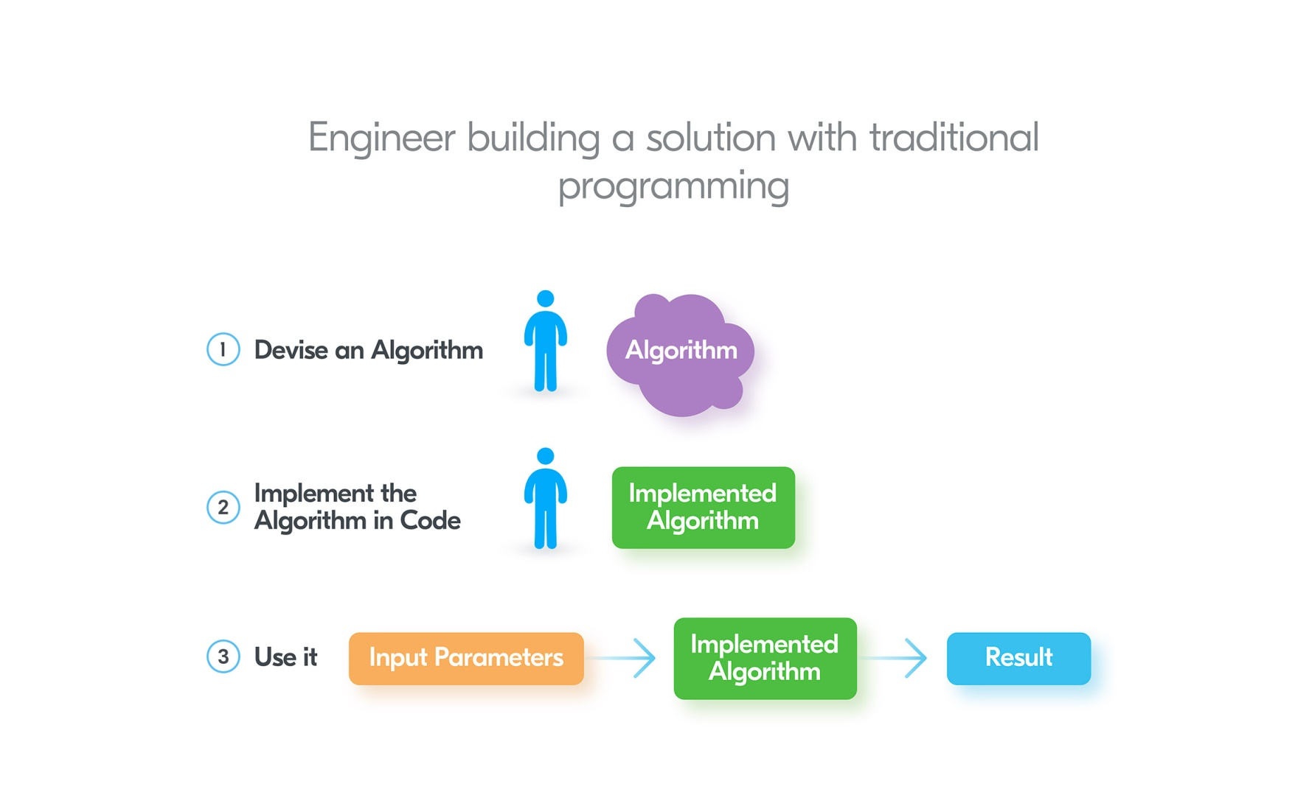
Traditional Programming

Slide 3
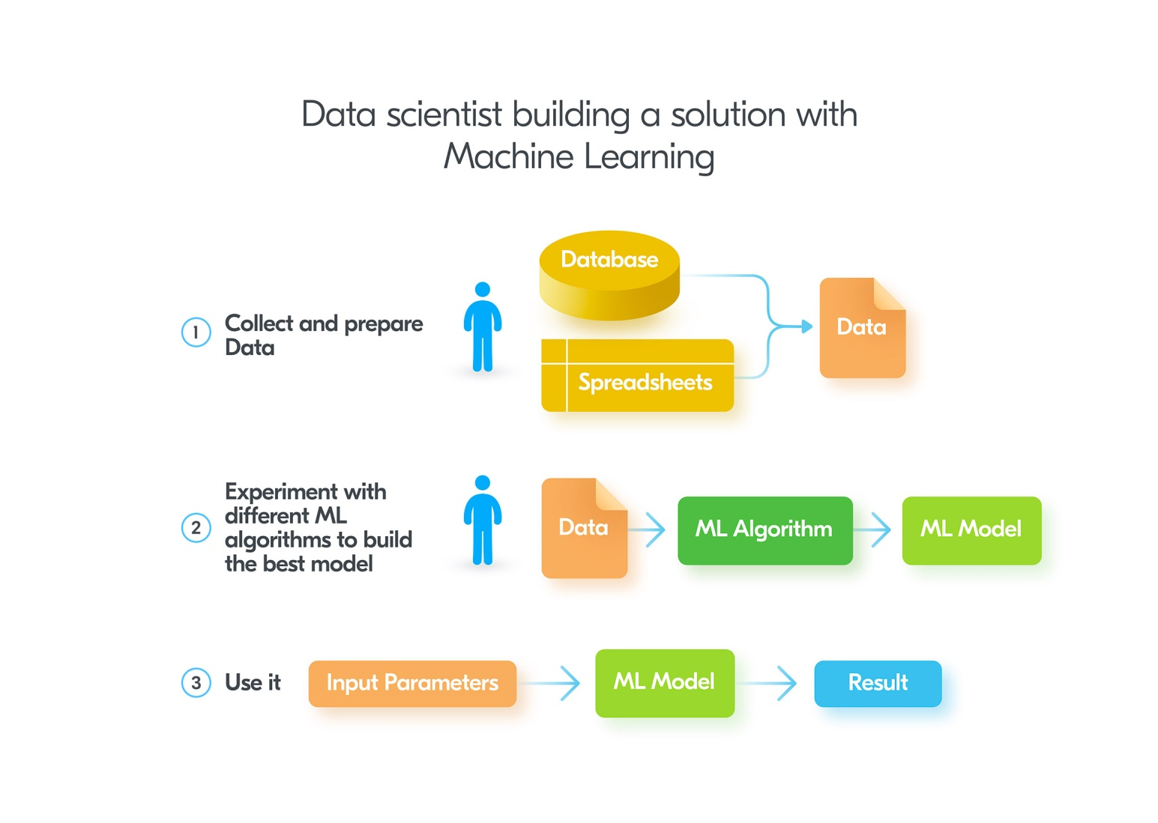
Machine Learning

Slide 4
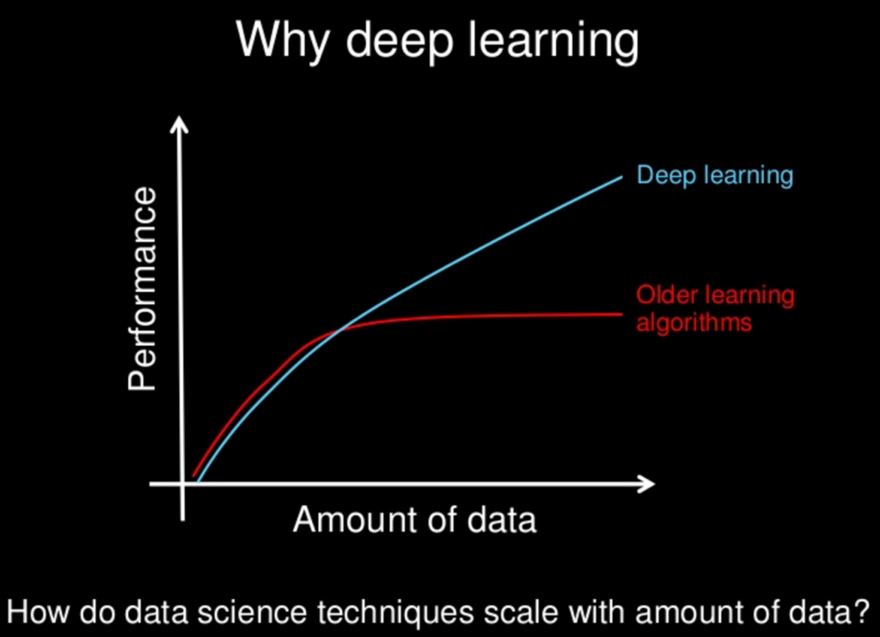
Data in ML
Supervised Learning requires large amount of clean data
Affects the quality, accuracy, and performance of your models
Cleaning data is challenging and time-consuming task

Slide 5
Issues in Data for ML
Missing data
Inconsistent data
Irrelevant data
Class Imbalance
Data bias
Lesser amount of data

Slide 6
Issues in Data for ML
Missing data
Inconsistent data
Irrelevant data
Class Imbalance
Data bias
Lesser amount of data

Slide 7
Handling Missing Data
Ignore the data row
Replace with some constant value outside fixed value range-999,-1 etc
Replace with mean, median value

Slide 8
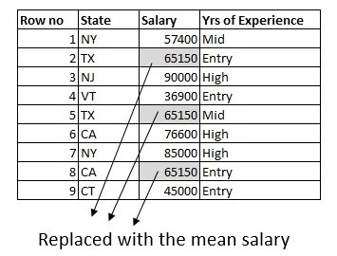
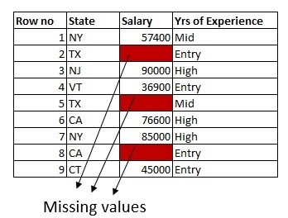
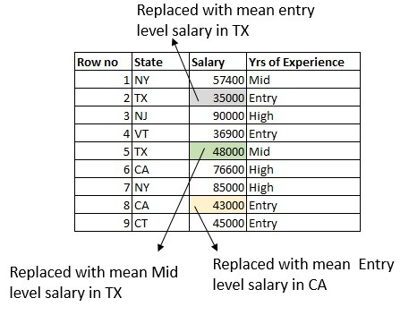
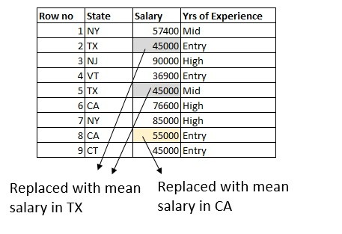

Slide 9
Issues in Data for ML
Missing data
Inconsistent data
Irrelevant data
Class Imbalance
Data bias
Lesser amount of data

Slide 10

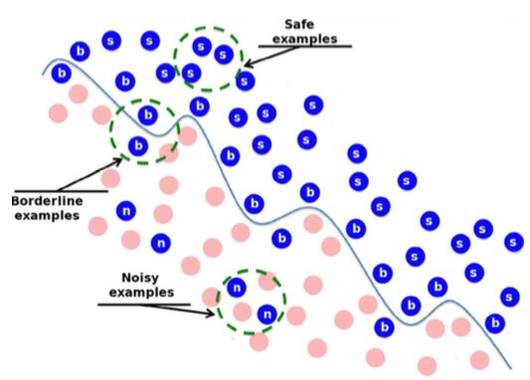
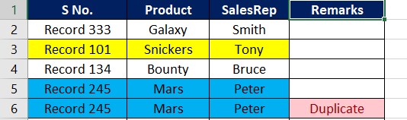
Inconsistent data
Wrongly labelled data
Noisy data
Outlier elimination
Autoencoder
Duplicate data
Drop duplicates
CAT

Slide 11
Issues in Data for ML
Missing data
Inconsistent data
Irrelevant data
Class Imbalance
Data bias
Lesser amount of data

Slide 12
Irrelevant data
Slow down and confuse analysis
Eg Predicting salary of the person, you don’t need to include their email addresses
Remove these columns while training
Decision Tree
L1 Regularization

Slide 13
Issues in Data for ML
Missing data
Inconsistent data
Irrelevant data
Class Imbalance
Data bias
Lesser amount of data

Slide 14
Class imbalance
Distribution of examples within a dataset is skewed
Eg credit card fraud detection dataset
Most of the credit card transactions are not fraud
Very few classes are fraud transactions
Solve Class Imbalance
Undersampling or oversampling
Penalize Algorithms
Synthetic data

Slide 15
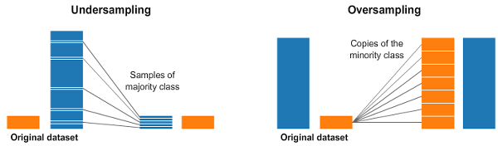
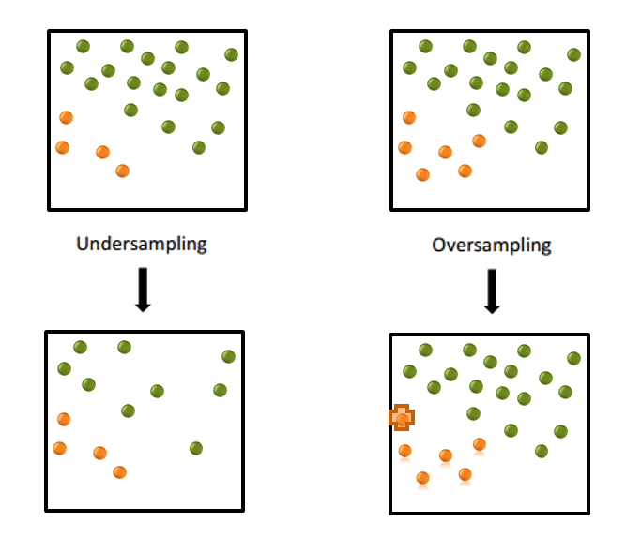
Handling Class Imbalance
Over-sampling-Duplicate random records from the minority class
Under-sampling- Removing random records from the majority class
loss of information

Slide 16
Handling Class Imbalance
Penalize Algorithm
Penalize mistakes on the minority class by an amount proportional to how under-represented it is
Eg A class : B class is 95:5
Divide Loss of A by 95
Divide Loss of B by 5

Slide 17
Issues in Data for ML
Missing data
Inconsistent data
Irrelevant data
Class Imbalance
Data bias
Lesser amount of data

Slide 18
Data Bias
Training data does not represent fully the diversity of a general population. A dataset can be bias toward, for instance, a certain gender, race, or class
eg selecting candidates for interviews at St George's Hospital Medical School in 1988
Discrimination against women and people with non-European sounding names
Leads to
Inaccurate model with skewed outcomes, systematic prejudice, and low accuracy
Handled
Data diversity

Slide 19
Issues in Data for ML
Missing data
Inconsistent data
Irrelevant data
Class Imbalance
Data bias
Lesser amount of data

Slide 20
Handling Lesser amount of data
Data Augmentation
Artificially Synthesised data
Generative Adversarial Network(GAN)
Image processing/Audio editing

Slide 21
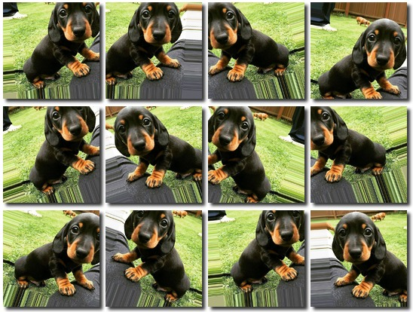
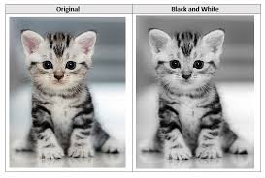
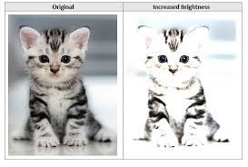
Data Augmentation
Images
Random Crop, Rotate etc
Change HSV, Brightness, Blur etc

Slide 22
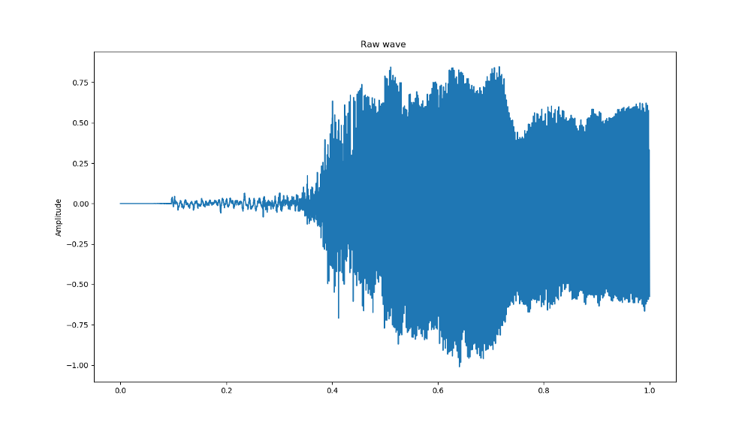
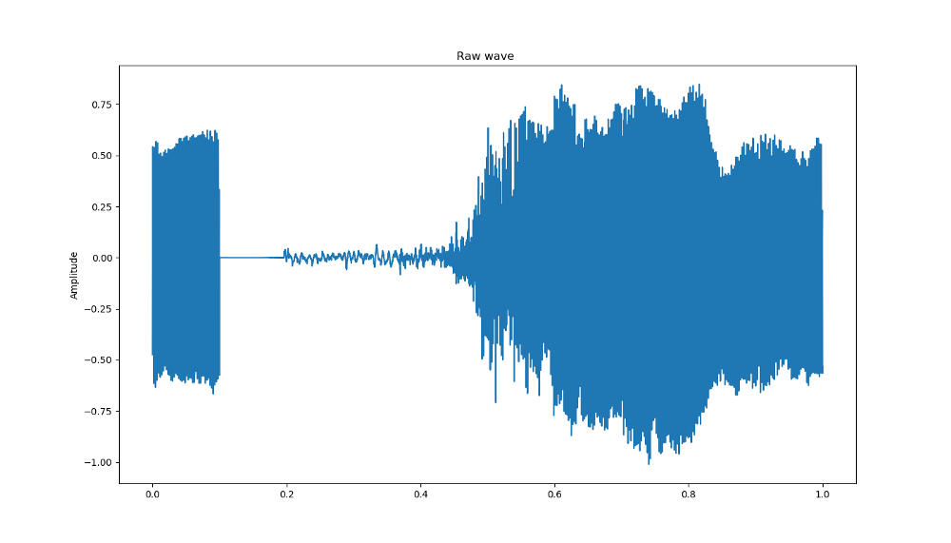
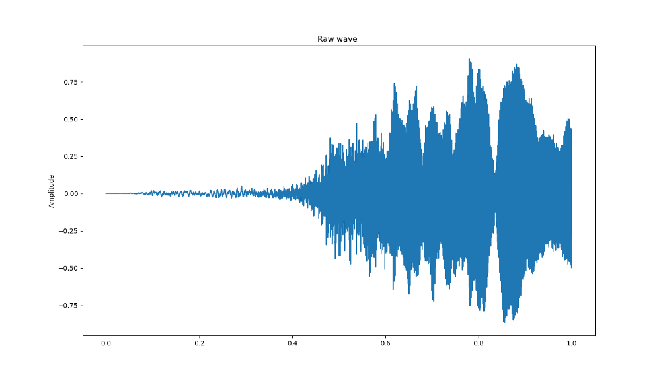
Data Augmentation
Voice
Add Noise
Increase/Decrease frequency
Shifting/Stretching audio

Slide 23

Artificially synthesized Data
Voice
Add background noise

