Slide 1
Transfer Learning
Vibhuti Duggal
Computer Division
BARC

Slide 2
Training from scratch
Lots of data, time, resources needed to train and tune a neural network from scratch
LLM can take weeks/months to train and fine-tune from scratch.
384 GPUs, possible to achieve in 3 months for Falcon network
Cheaper, faster way of adapting a neural network by exploiting their generalization properties

Slide 3
Neural Network Layers: General to Specific
Bottom/first/earlier layers: general learners
Low-level notions of edges, visual shapes
Top/last/later layers: specific learners
High-level features such as eyes, feathers

Slide 4
Multi Task Learning

Slide 5
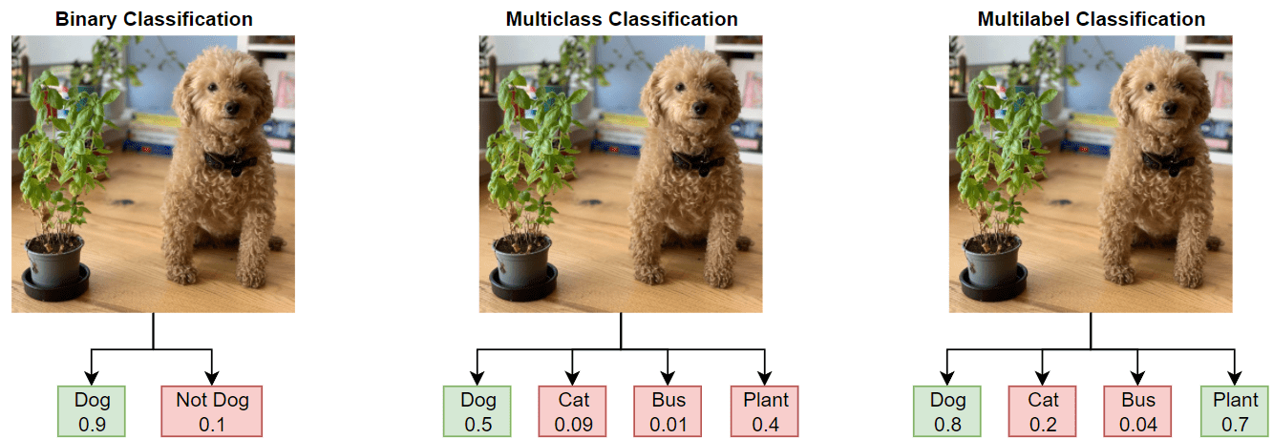

Slide 6
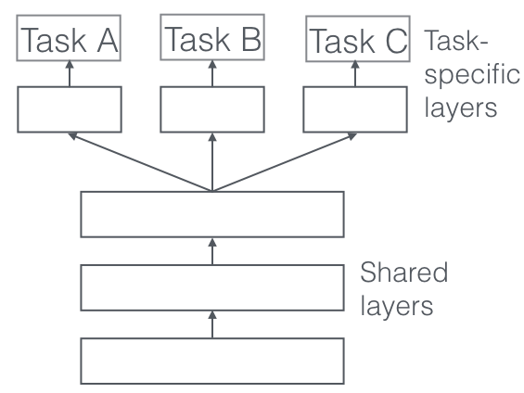
Multi Task Learning
One neural network do several things at the same time
Exploit similarities between tasks to enhance performance
Similar tasks tend to be grouped together.
Eg, tasks such as Object detection and segmentation are inherently similar and good candidates to be trained together

Slide 7
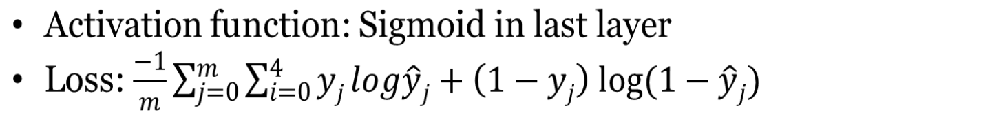
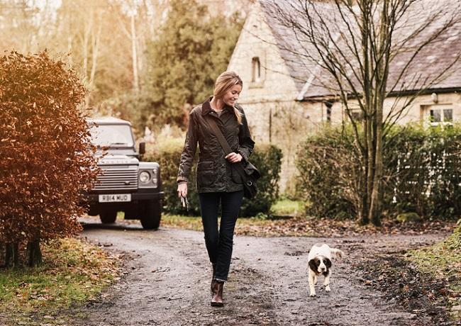
Multi Task Learning
Binary Classification Problem
Example No | Person | Dog | Cat | Car
1 | 1 | 1 | 0 | 1
2 | 1 | ? | ? | 1
3 | ? | ? | ? | 1
4 | 1 | 1 | 1 | ?
5 | 0 | 1 | 0 | 1

Slide 8
Multi Task Learning
Reduced overfitting through shared representations
Encode features in a more general manner rather than a way that caters to a single task
Increases sample size
When the tasks are very different or independent, MTL can lead to suboptimal performance compared to training a single-task mode

Slide 9
Transfer Learning

Slide 10
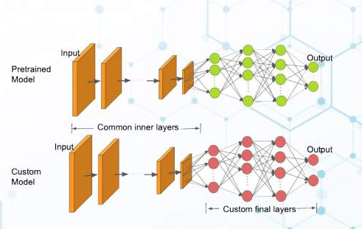
Transfer Learning
Knowledge gained while solving one problem and applying it to a different but related problem

Slide 11
Transfer Learning-Process
Pre-Training
Train the network on a large dataset
eg Pretrain a CNN on a very large dataset (e.g. ImageNet, which contains 1.2 million images with 1000 categories)
Partition network into:
Featurizers: identify which layers to keep
Classifiers: identify which layers to replace
Re-train classifier layers with new data
New dataset is almost similar to the original dataset used for pre-training
Same weights can be used for extracting the features from the new dataset

Slide 12
Fine Tuning-Process
Pre-Training
Train the network on a large dataset
eg Pretrain a CNN on a very large dataset (e.g. ImageNet, which contains 1.2 million images with 1000 categories)
Unfreeze weights and fine-tune whole network with smaller learning rate
New dataset is different and large
Performance is low for retraining only few layers

Slide 13
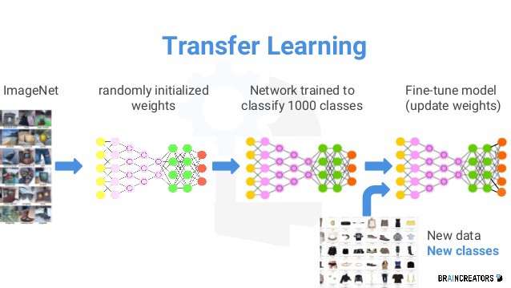

Slide 14
Transfer Learning-Process
Which layers to re-train?
Depends on the domain
Start by re-training the last layers (last full-connected and last convolutional)
Work backwards if performance is not satisfactory
Learning Rates
Training linear classifier: typical learning rate
Training all layers(Fine tuning): use smaller learning rate to avoid distorting the existing weights
Assumes weights are close to "good"

Slide 15
When and how to fine tune?
Dataset size | Dataset similarity | Recommendation
Large | Very different | Train model B from scratch, initialize weights from model A
Large | Similar | OK to fine-tune (less likely to overfit)
Small | Very different | Train classifier using the earlier layers (later layers won't help much)
Small | Similar | Don't fine-tune (overfitting). Train a linear classifier

Slide 16
Transfer Learning
Advantages
Speed up the training process
Better performance
Training on small datasets

